Slide 1
Golden Age of Algorithms
Prabhas Chongstitvatana
Chulalongkorn University

Slide 2
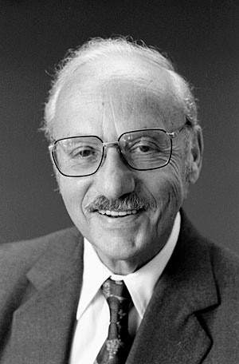
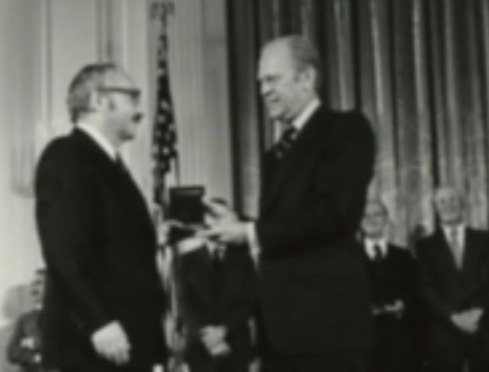
Simplex method
1947 George Dantzig

Slide 3
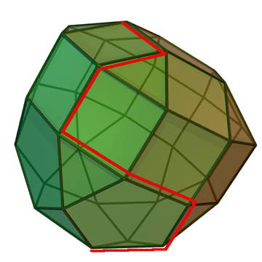
Simplex method

Slide 4
Fast Fourier Transform
1965 J. Cooley and J. Tukey
DFT direct implementation O(N^2)
FFT O(N log N)
Use in Picture, Audio, Video compression
MP3 audio lossy compression algorithm

Slide 5
PageRank
PageRank works by counting the number and quality of links to a page to determine a rough estimate of how important the website is. The underlying assumption is that more important websites are likely to receive more links from other websites.
$$PR\left(u\right)= \sum_{v∈B(u)}{\frac{PR(v)}{L(v)}}$$

Slide 6
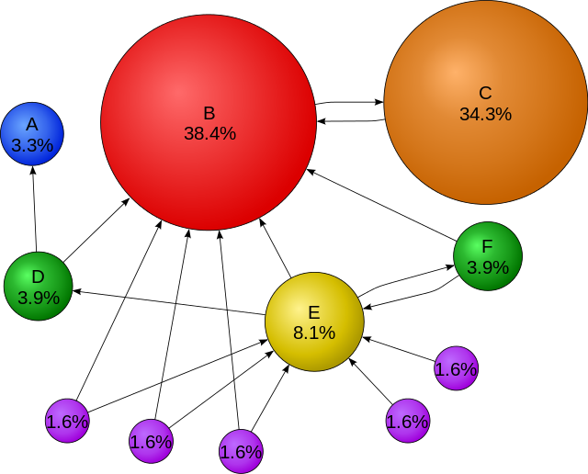
PageRank

Slide 7
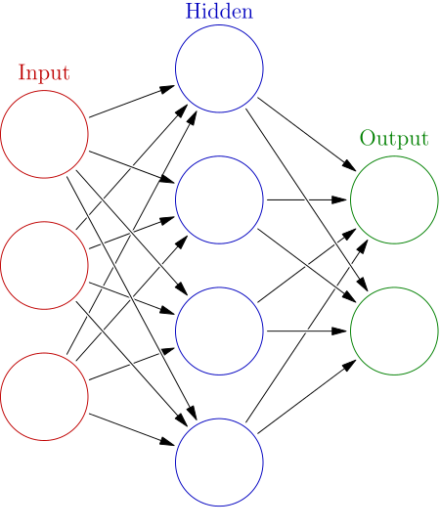
Deep Learning
1980 Kunihiko Fukushima
Based on Artificial Neuron Networks

Slide 8
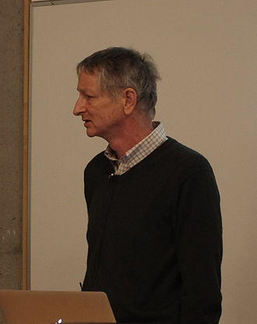
Deep Learning
2007 Geoffrey Hinton and Ruslan Salakhutdinov showed how a many-layered feedforward neural network could be effectively pre-trained one layer at a time.
Treating each layer in turn as an unsupervised restricted Boltzmann machine, then using supervised backpropagation for fine-tuning.

Slide 9
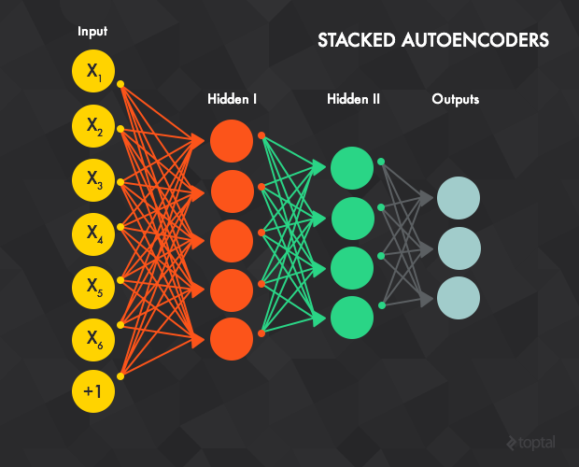
Deep Learning

Slide 10
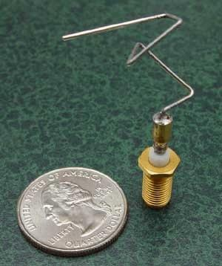
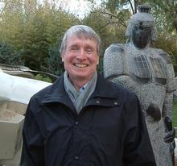
Genetic Algorithms
1975 John Holland
Adaptation in Natural and Artificial Systems
The X-Band Antenna of the ST5 Satellites

Slide 11
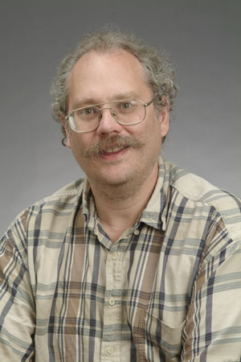
Quantum Algorithms
Algorithm that runs on a quantum computer
1994 Peter Shor -- a quantum algorithm for integer factorization formulated .
Given an integer N, find its prime factors

Slide 12
Shor’s algorithm
The factorization also needs huge amount of quantum gates. It increases with N as (log N)³. Thus factoring of a 4096-bit number requires 4,947,802,324,992 quantum gates.

Slide 13
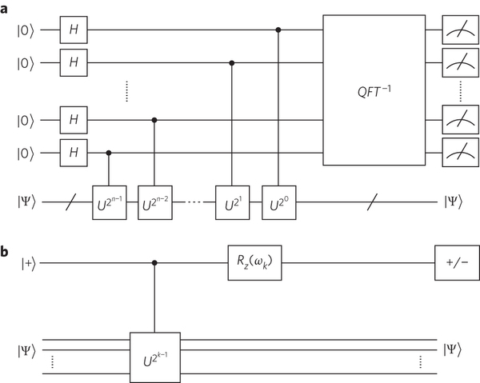
Quantum circuits

Slide 14
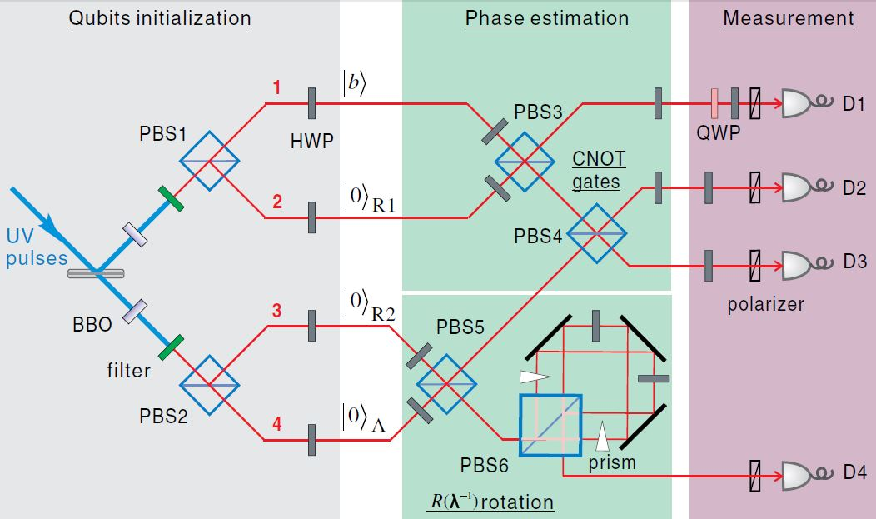
Quantum circuits

Slide 15
Other algorithms
Search engine indexing
Public key cryptography
Error correcting code
Pattern recognition
Digital signature

Slide 16
Further reading
J. Don-gara, Top Ten Algorithms of the Century, 2000.
J. MacCormick, Nine algorithms that changed the future, 2012.
http://www.technologyreview.com/featuredstory/513696/deep-learning/
http://math.nist.gov/quantum/zoo/
Yingchareonthawornchai, S., Aporntewan, C., and Chongstitvatana, P., "An Implementation of Compact Genetic Algorithm on a Quantum Computer," 2012.

Slide 17
