Slide 1
Quantum Computing
Prabhas Chongstitvatana
Chulalongkorn University

Slide 2
What is a quantum computer?
a computer that relies on special memory, "quantum bit", to perform massively parallel computing.

Slide 3
What is a quantum bit?
a basic unit of memory that uses superposition of "quantum" effect (entanglement) to store information.
a "qubit" stores the probability of information. It represents both "1" and "0" at the same time.

Slide 4
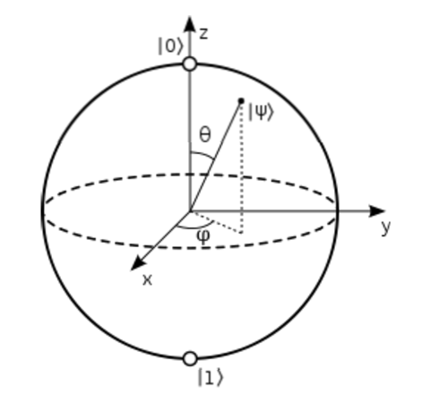

Slide 5
What is the advantage?
it is very very fast compared to conventional computers.

Slide 6
Analogy
We have multiple keys. We want to find out what key fits a given keyhole.

Slide 7
Serial computers
try each key, until we find the one that fits.
this is resource efficient but take a long time.

Slide 8
Parallel computers
duplicate keyholes, try all keys at once.
this is very fast but take a lot of resource.

Slide 9
Quantum computers
all keyholes are stored in
"quantum bits", try all keys at once.
this is resource efficient and very fast.

Slide 10
How to make a quantum bit?
"quantum effect"
photon entanglement
cold atom
electron spin

Slide 11
Components
Quantum circuit
Quantum gates
components of quantum computers that manipulate state of quantum bits.

Slide 12
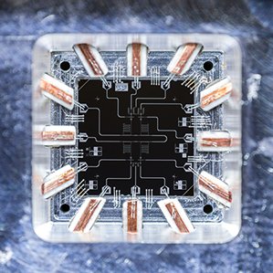
Quantum Gates

Slide 13
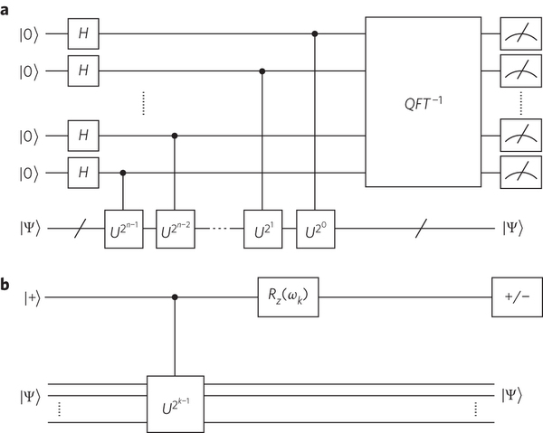
Quantum circuits

Slide 14
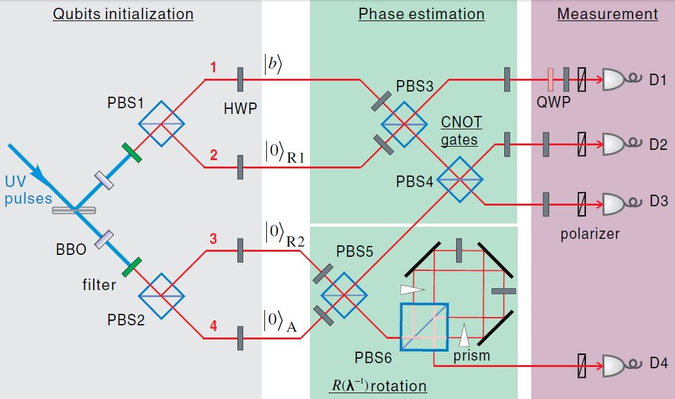
Quantum circuits

Slide 15
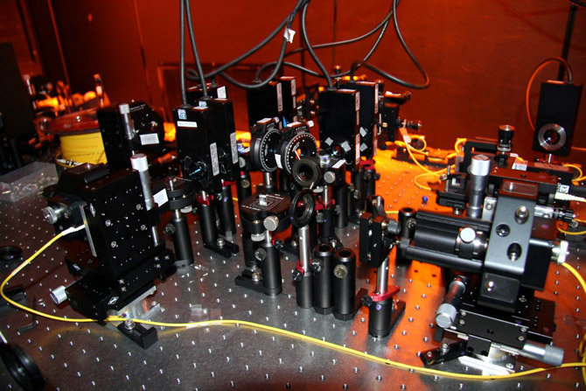

Slide 16
Quantum algorithms
computer programs that work on quantum computers

Slide 17
Famous algorithms
Shor's integer factorization
Given an integer N, find its prime factors

Slide 18
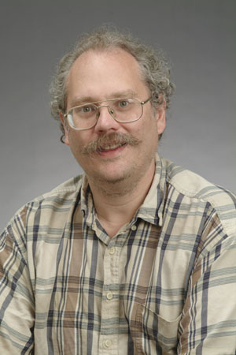
Quantum Algorithms
Peter Shor
a quantum algorithm for integer factorization formulated .

Slide 19
Shor’s algorithm
The factorization also needs huge amount of quantum gates. It increases with N as (log N)³. Thus factoring of a 4096-bit number requires 4,947,802,324,992 quantum gates.

Slide 20
Example of quantum computers
ibm 5 qubits
D-wave two, quantum annealing

Slide 21
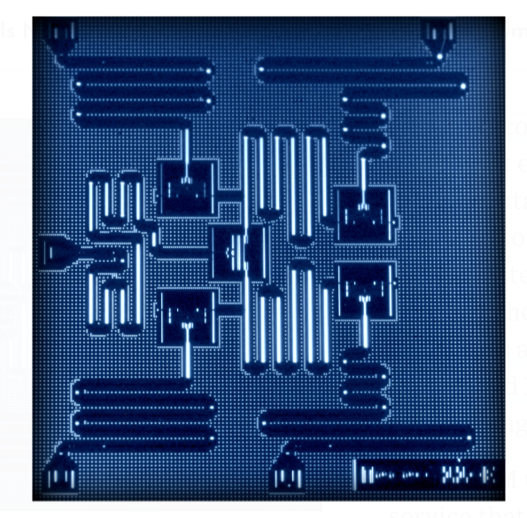
IBM 5 qubits processor

Slide 22
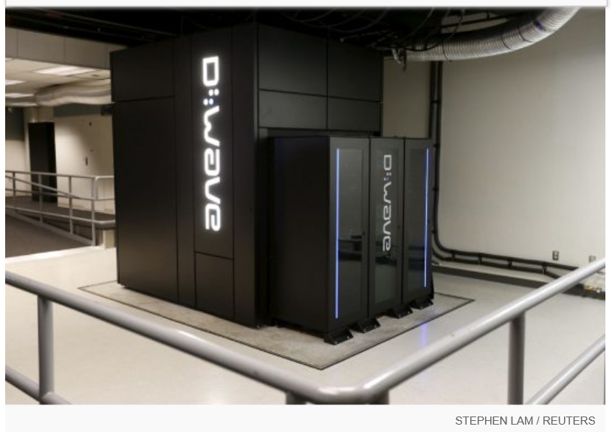
Google Nasa, D-Wave 2x machine

Slide 23
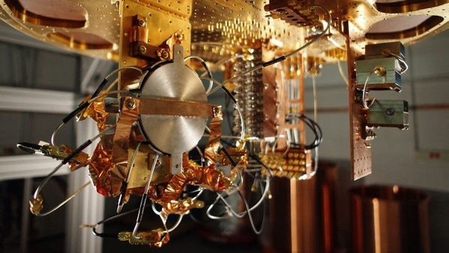
Quantum bit in D-wave machine

Slide 24
Recent work
google quantum lab's paper
claim of 100,000,000x speed up

Slide 25
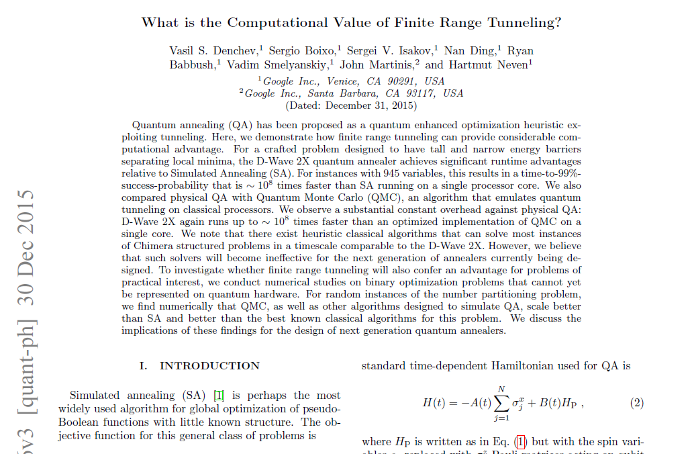

Slide 26
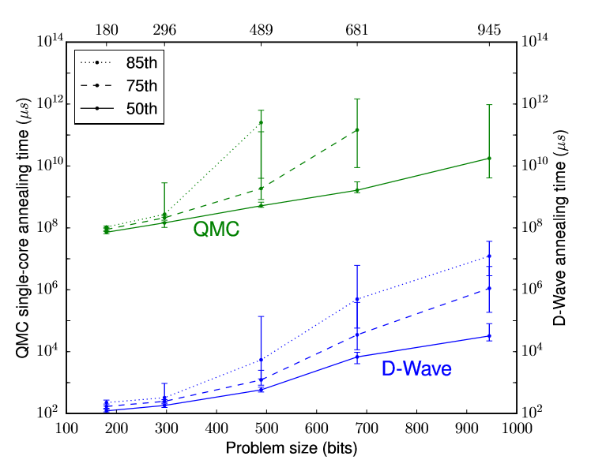

Slide 27
My own example of quantum computation
compact genetic algorithm by quantum computers
exponential speedup

Slide 28
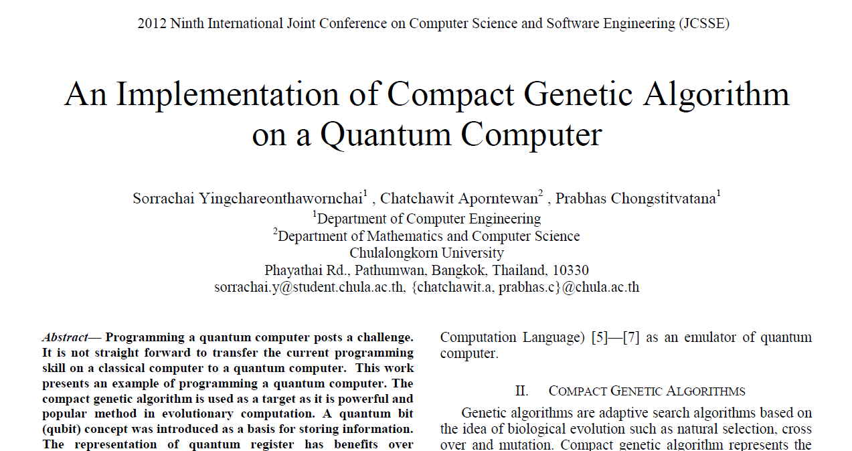

Slide 29
Example of Quantum Algorithm
Yingchareonthawornchai, S., Aporntewan, C., and Chongstitvatana, P., "An Implementation of Compact Genetic Algorithm on a Quantum Computer," Int. Joint Conf. on Computer Science and Software Engineering (JCSSE), 30 May - 1 June 2012, pp.131-135.
http://www.cp.eng.chula.ac.th/~piak/paper/2012/jcsse-quantum-cga.pdf

Slide 30
Normal
1) initialze qureg x
2) generate two individuals from qureg
3) let them compete
4) update qureg x with the winner
5) repeat step 2..4 for k times
6) generate the final result

Slide 31
quantum speedup
1) initialze qureg x
2) generate the first individual from qureg x
3) generate the second individual with condition that fitness is greater than the first
4) let them compete
5) update qureg x with the winner
6) repeat step 2..5 for k times
7) generate the final result

Slide 32
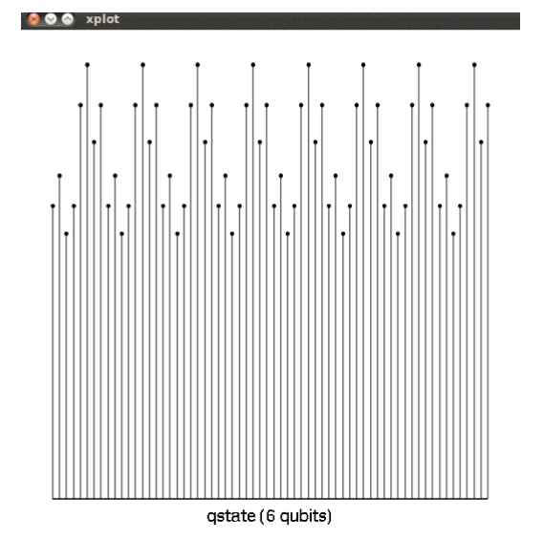
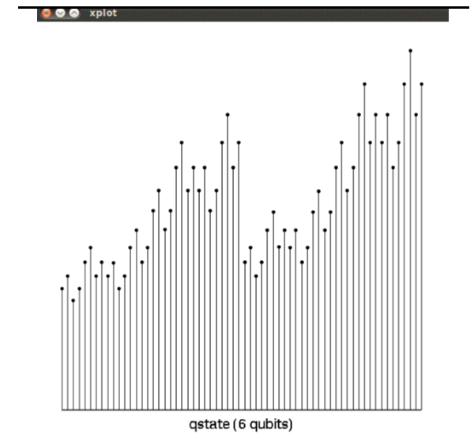
output

Slide 33
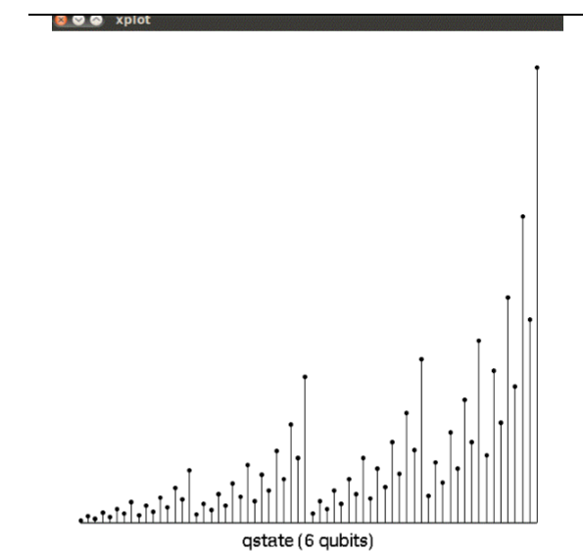
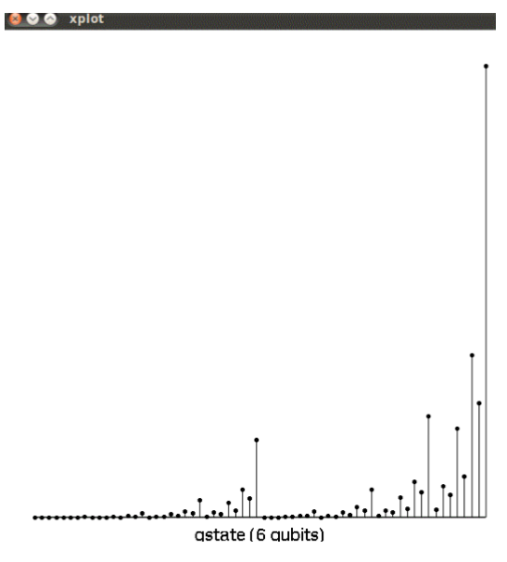
output

Slide 34
Future
qubits
quantum annealing computers
scaling up

Slide 35
Predicting future
uncertain of success
special purpose quantum computers
quantum style will motivate a new class of computation

Slide 36

More Information
Search “Prabhas Chongstitvatana”
Get to me homepage

