Slide 1
Everything as a service
Prabhas Chongstitvatana
Chulalongkorn University

Slide 2
Everything as a service
enable by
Internet of everything

Slide 3

Download this slides
Search “Prabhas Chongstitvatana”
Go to me homepage

Slide 4
Internet of Things = IoT
Machines to Machines
Next information revolution

Slide 5
1% of physical world is connected to Internet
Huge potential
Potentials
Innovative business process
Operational efficiency
New customer services

Slide 6
What is IoT
Network of Physical Objects
Embedded systems with electronics, software, sensors
Enable objects to exchange data with manufacturer, operator, other devices through network infrastructure

Slide 7
Allow remote control
Direct integration = computer + physical world
Result: Automation in all fields

Slide 8
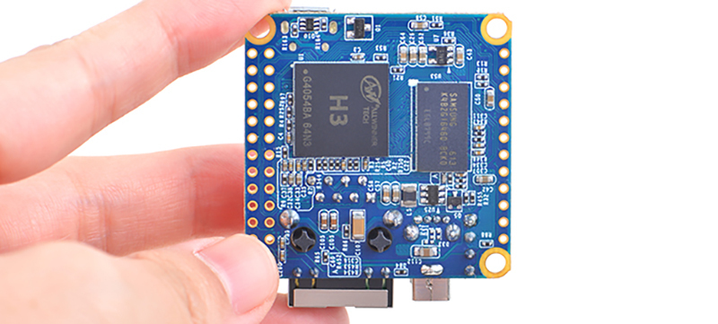

Slide 9
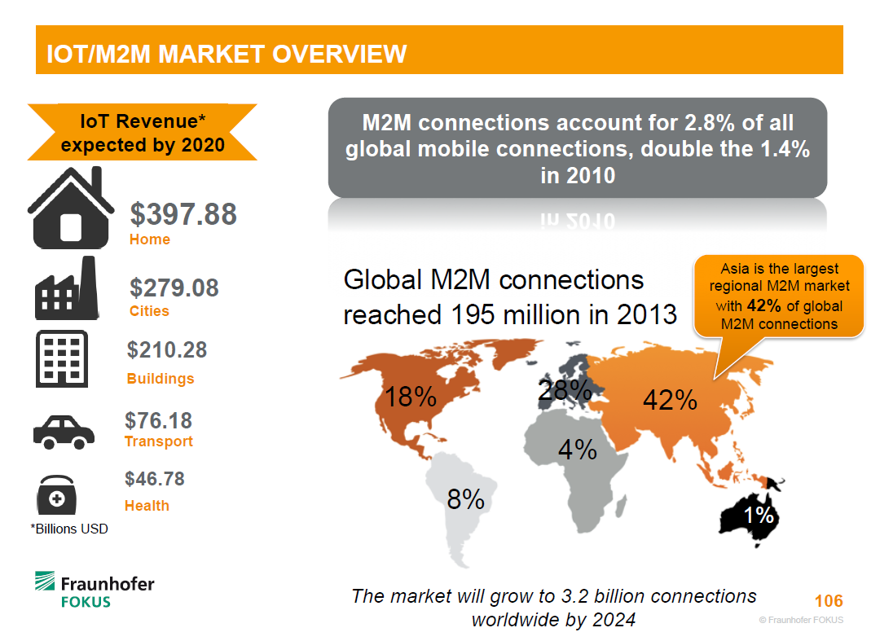

Slide 10
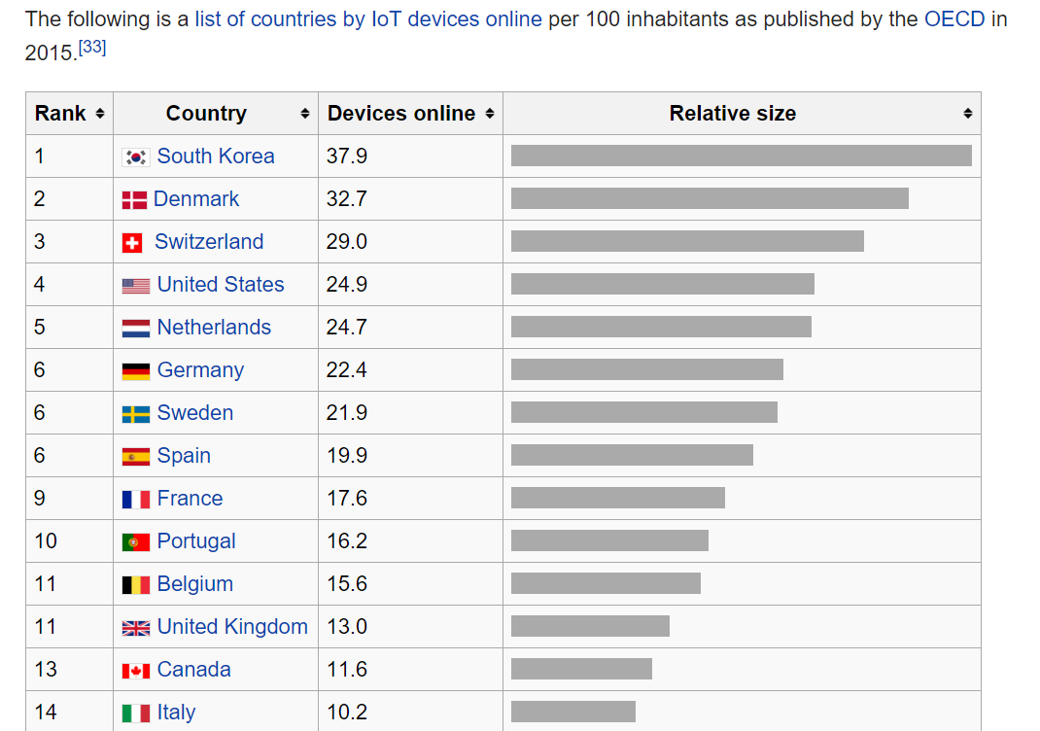

Slide 11
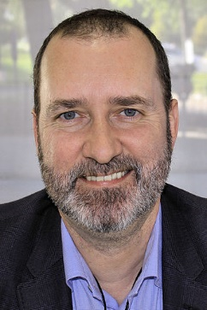
A bit of history
The term "Internet of Things" is coined by Kevin Ashton 1999.
Early example, 1982, Coke machine at Carnegie Mellon University was connected to internet: report its inventory and temperature
Notes:
Kevin Ashton (born 1968) is a British technology pioneer who cofounded the Auto-ID Centerat the Massachusetts Institute of Technology (MIT), which created a global standard system for RFID and other sensors.

Slide 12
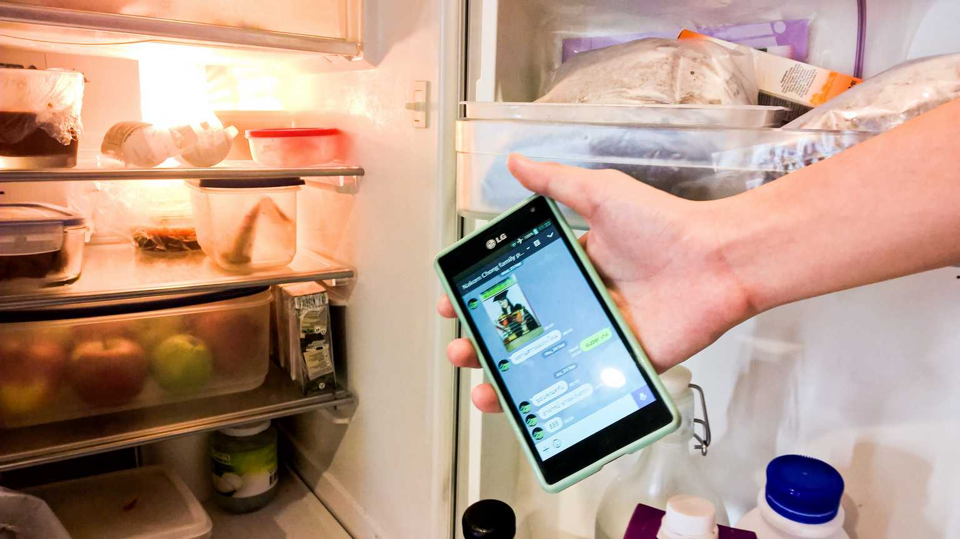

Slide 13
Applications
Environmental monitoring
Infrastructure management
Manufacturing
Energy management
Medical and health care systems
Building and home automation
Transportation

Slide 14
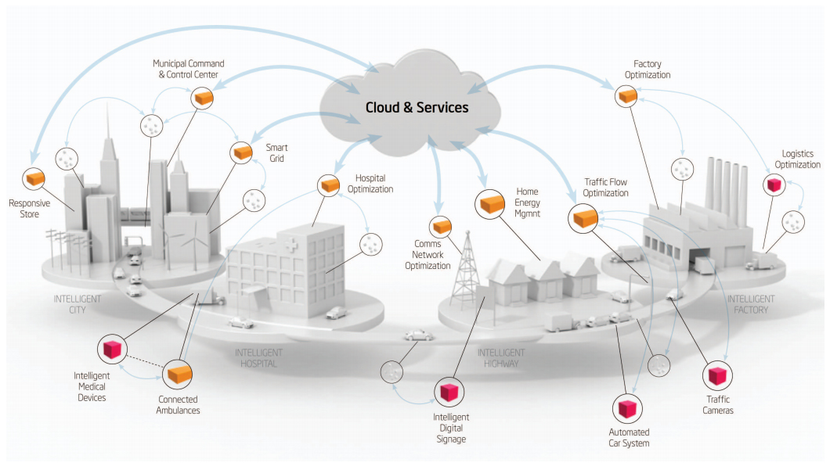
Smart Cities

Slide 15
Large Scale examples: Smart City
Songdo, South Korea
Santander, Spain
10,000 sensors: parking search, environ. monitoring
San Francisco Bay area
wireless sensors data network
New York waterways
Padova Smart City Project, Italy

Slide 16
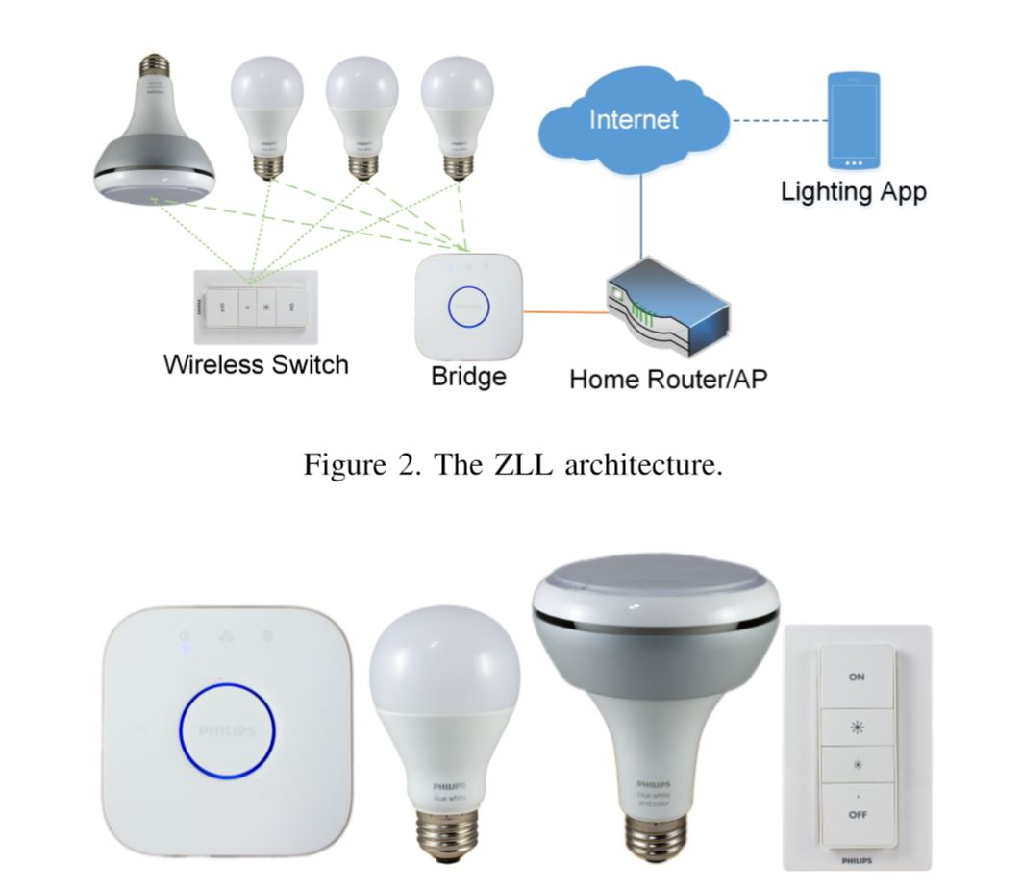
IoT security

Slide 17
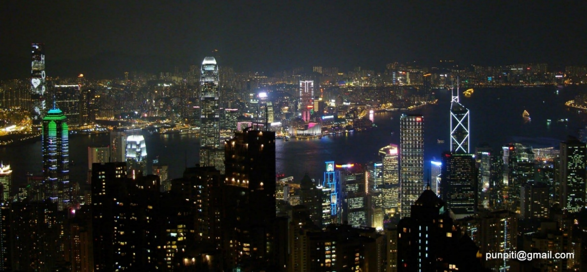

Slide 18
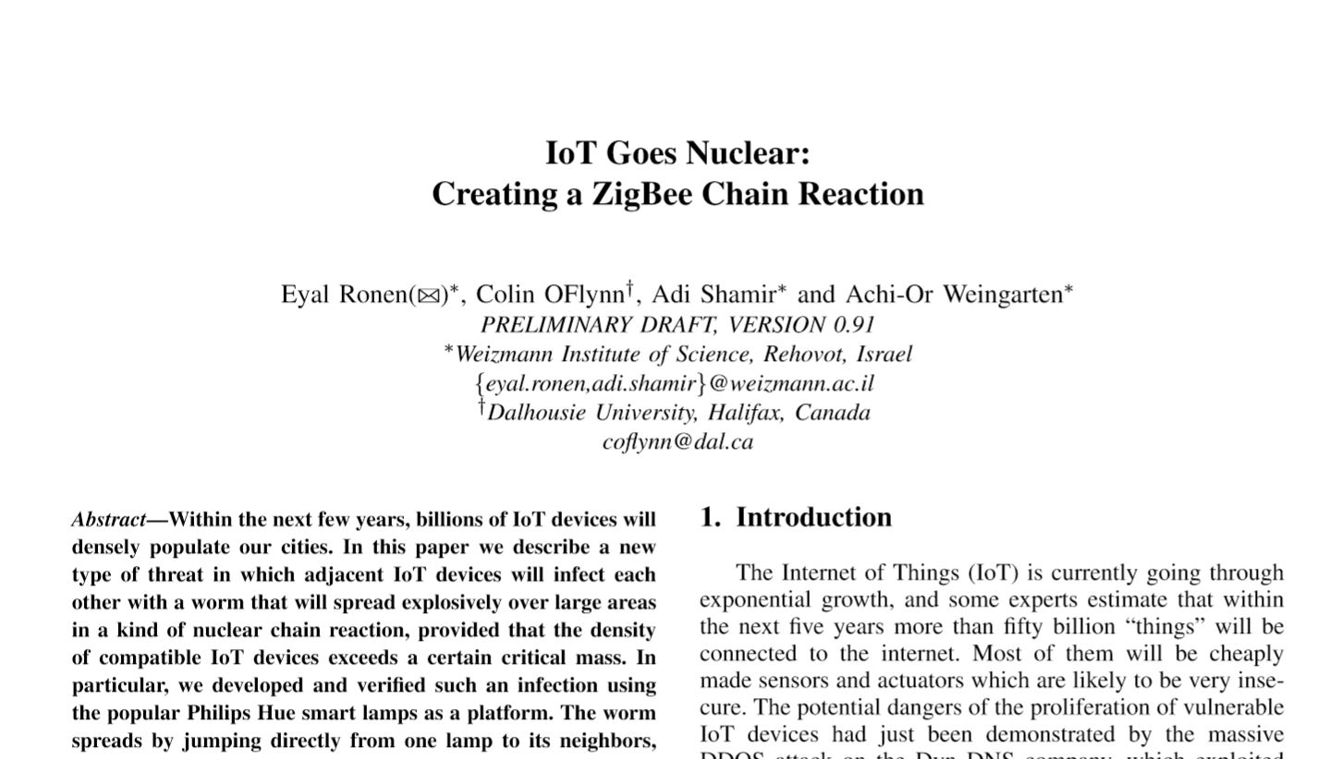
Notes:
2017 IEEE Symposium on Security and Privacy, 22-26 May 2017, San Jose, California, USA

Slide 19
Impact
Civic engagement
Privacy, autonomy and control
technology <> just tools
technology = active agent
IoT = Human augmentation (Tim O Reilly)
data-driven decision making

Slide 20
concern
Security
  cyber attack in Physical world
  spy on people in their own homes
Increase in electronics waste 10x

Slide 21
Technology roadmap
50-100 Trillion objects,
each person carries 1000-5000 trackable objects
computer manage and inventory objects and people
transform daily life

Slide 22
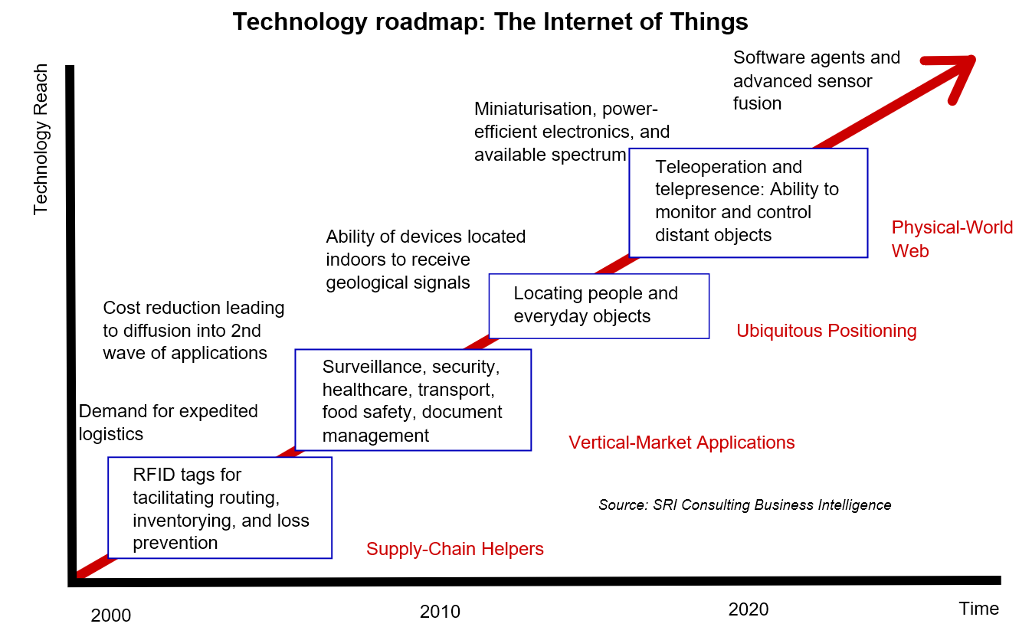

Slide 23
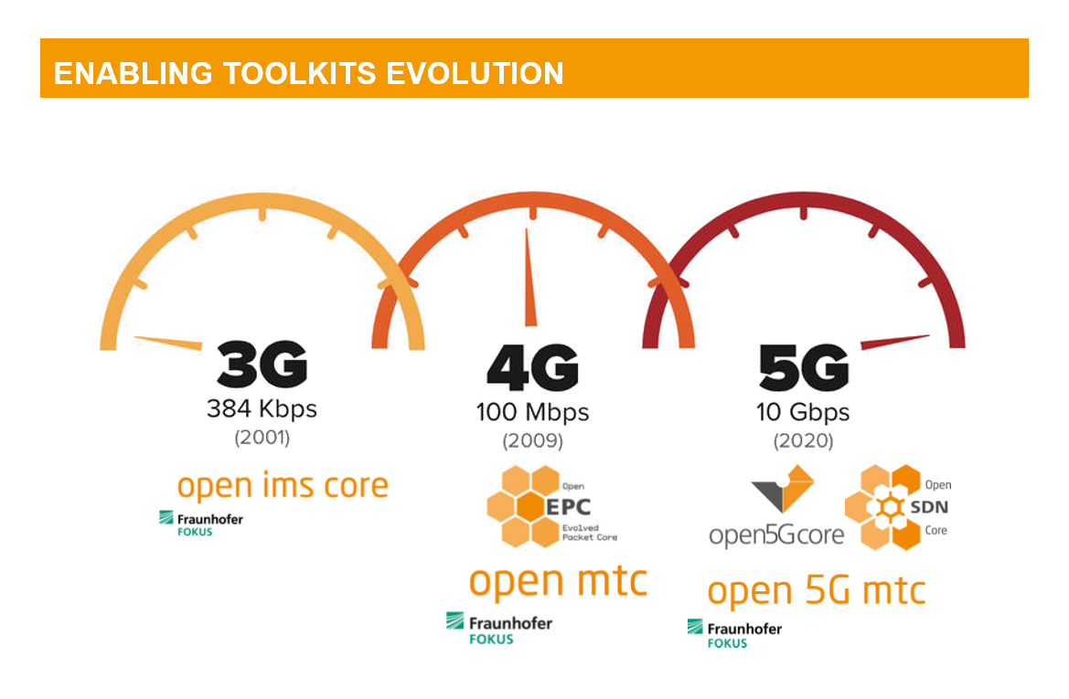

Slide 24
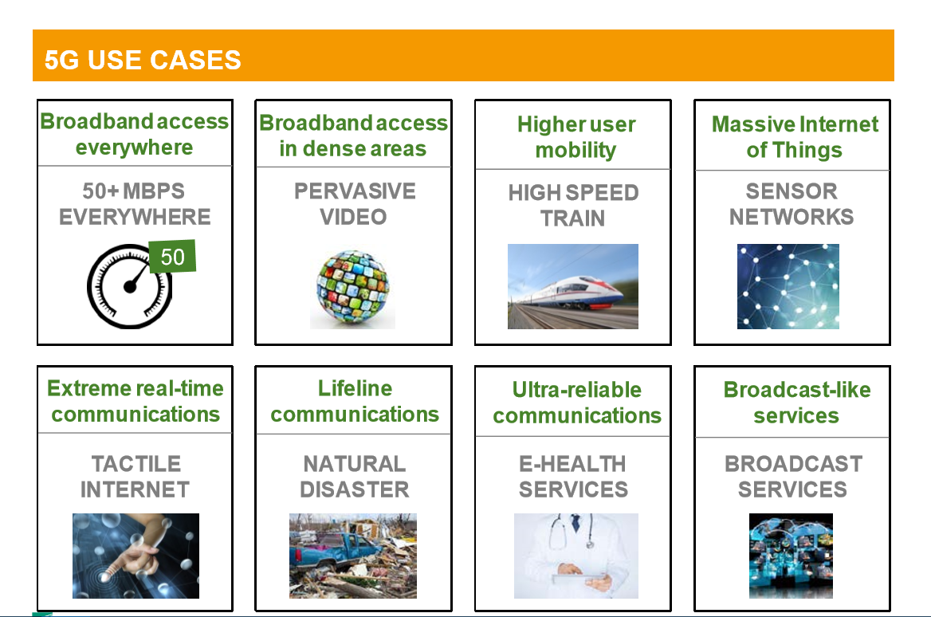

Slide 25
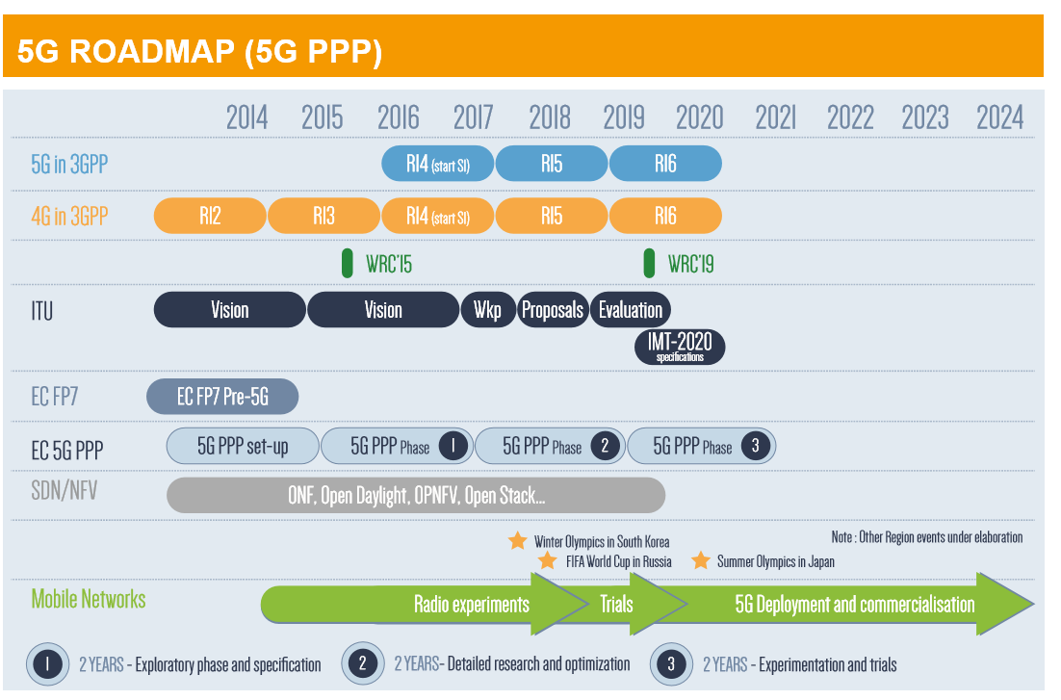

Slide 26
More Information
Search “Prabhas Chongstitvatana”

