Slide 1
From Research To Innovation
Prabhas Chongstitvatana
Faculty of Engineering
Chulalongkorn University

Slide 2
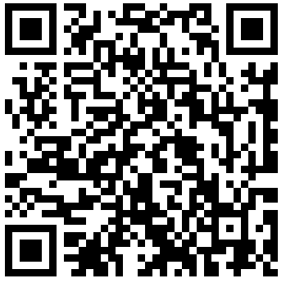
More Information
Search “Prabhas Chongstitvatana”
Get to my homepage

Slide 3
Research
Definition
Motivation
How to do research
Pitfalls
Conclusion

Slide 4
Definition
Careful or diligent search
Studious inquiry or examination; especially investigation or experimentation aimed at the discovery and interpretation of facts, revision of accepted theories or laws in the light of new facts, or practical application of such new or revised theories or laws
The collecting of information about a particular subject

Slide 5
Motivation
It is very important to appreciate the value of research. If you value it, you will motivation yourself to do it.
I view research along the time axis:
short term 1 year
medium term 2-5 years
long term > 5 years

Slide 6
There is no doubt about the correlation between scientific development and wealth of a nation. Scientific development is mostly driven by research. Most everyday products are the result of some fundamental discovery in science. Technology is the fruit of scientific discovery.

Slide 7
The value of short term research is the immediate application of knowledge to real-world problems.
The value of medium term research is the development and improvement of new methods.
The value of long term research is the discovery of new knowledge.

Slide 8
Method
What should be the topic of research?
How can we "create" a suitable topic?
The important things are
1 the "newness" of the subject.
2 the "value" of the subject.

Slide 9
Create a topic
There are many ways to create a topic:
1 from the real-world problems
2 from the boundary of current knowledge
3 from imagination

Slide 10
Step-by-step of doing research
What is your interest?
Asking the right research question
Doable in a reasonable time
Do small project (or initial Design)
Experiment with your project/design
Write paper

Slide 11
If you are new
Find a good mentor
Expectation is the most important element in successful collaboration.
Work out what will be the result of your research.
You must convince yourself of the "value" of your proposed research.
The job of your mentor is the guide you through the jungle of difficulty. (and not to tell you really how to do it, I believe!)

Slide 12
Your to do list
read a lot, to know what is the current state of the art
talk a lot, to synthesis your idea
write a lot, to make your idea concrete and to communicate your idea formally.

Slide 13
My own observation
research is very much social activities [but a lot of time you need quite time and place to think hard.]
motivation is very important [find the topic that suite your interest]
publication always takes more time than you expect. start writing a paper is difficult.

Slide 14
Conclusion
It is very important to appreciate the value of research work. Your imagination can create a good research topic.
The usefulness of research work for the industry in three categories are:
  short term research -- to improve the process
  medium term research -- to enhance competitiveness
  long term research -- to create new market

Slide 15
Avoid Pitfalls
Don't choose the topic that requires new skill. For example, if you are proficient C programmer, use C. Don't try to learn a new language for your work. The time is too short.
Get the scope of your work right. Most often, you underestimate the amount of work required and overestimate your ability. The time is too short.
The time is always too short. Don't postpone any work, do it now.

Slide 16
Enjoy doing research!

Slide 17
Innovation Examples
Learning finite state machine
Genetic algorithm in hardware
Building Blocks
Scheduling in manufacturing
Search for Lead-free Solder Alloys
2D DNA sequence search

Slide 18
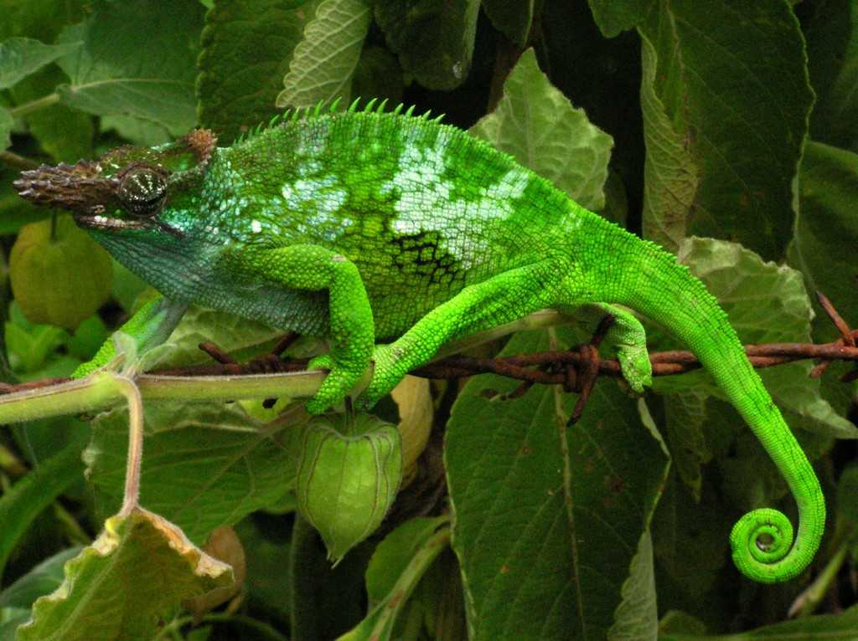
1998 Synthesis of Synchronous Sequential Logic Circuits from Partial Input/Output Sequences
.
Two-Horn Chameleon (Bradypodion fischeri ssp.) in the Usambara mountains, Tanzania

Slide 20
2001 A Hardware Implementation of the Compact Genetic Algorithm
Fabricate on FPGA, runs about 1,000 times faster than the software executing on a workstation.

Slide 21
Pseudocode of Compact GA

Slide 24
2004 Building block identification by simulateneity matrix
Building Blocks concept
Identify Building Blocks
Improve performance of GA

Slide 25
x = 11100 f(x) = 28
x = 11011 f(x) = 27
x = 10111 f(x) = 23
x = 10100 f(x) = 20
---------------------------
x = 01011 f(x) = 11
x = 01010 f(x) = 10
x = 00111 f(x) = 7
x = 00000 f(x) = 0
Induction
1 * * * *
(Building Block)

Slide 26
x = 11111 f(x) = 31
x = 11110 f(x) = 30
x = 11101 f(x) = 29
x = 10110 f(x) = 22
---------------------------
x = 10101 f(x) = 21
x = 10100 f(x) = 20
x = 10010 f(x) = 18
x = 01101 f(x) = 13
Reproduction
1 * * * *
(Building Block)

Slide 27
x = 11111 f(x) = 31
x = 11110 f(x) = 30
x = 11101 f(x) = 29
x = 10110 f(x) = 22
---------------------------
x = 10101 f(x) = 21
x = 10100 f(x) = 20
x = 10010 f(x) = 18
x = 01101 f(x) = 13
Induction
1 * 1 * *
1 1 * * *
(Building Blocks)

Slide 28
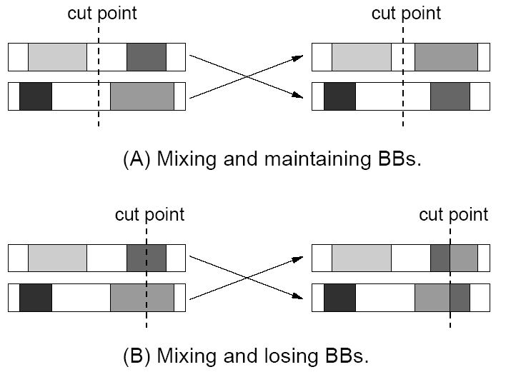

Slide 29
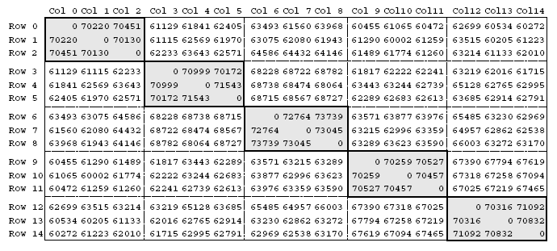
{{0,1,2},{3,4,5},{6,7,8},{9,10,11},{12,13,14}}

Slide 31
2009 Combinatorial Optimization with Coincidence (COIN)
Use both good and not-good solutions.
A Generator represents a probabilistic model of the required solution.
Reward and punishment schemes are incorporated in updating the generator.

Slide 32
Pseudo code for COIN
Initialize the generator.
Generate the population using the generator.
Evaluate the population.
Select the candidates.
  Adaptive selection: select the above and below the average ±2σ
For each joint probability h(xi|xj), update the generator according to the reward and punishment
Repeat Step 2. Until the terminate condition is met.

Slide 33

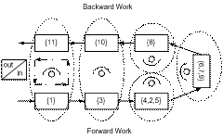
Complete line assignment for straight assembly line.
Complete line assignment for U-shaped assembly line

Slide 34



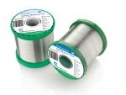
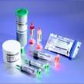
Lead-free Solder Alloys
Lead-based Solder
Low cost and abundant supply
Forms a reliable metallurgical joint
Good manufacturability
Excellent history of reliable use
Toxicity
Lead-free Solder
No toxicity
Meet Government legislations
(WEEE & RoHS)
Marketing Advantage (green product)
Increased Cost of Non-compliant parts
Variation of properties (Bad or Good)

Slide 35
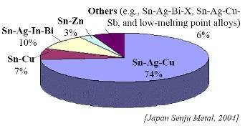
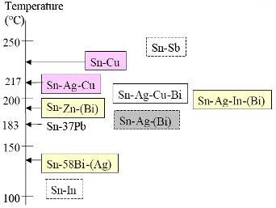
Sn-Ag-Cu (SAC) Solder
Advantage
Sufficient Supply
Good Wetting Characteristics
Good Fatigue Resistance
Good overall joint strength
Limitation
Moderate High Melting Temp
Long Term Reliability Data

Slide 37
Beauty leads Science
Science leads Education

Slide 38
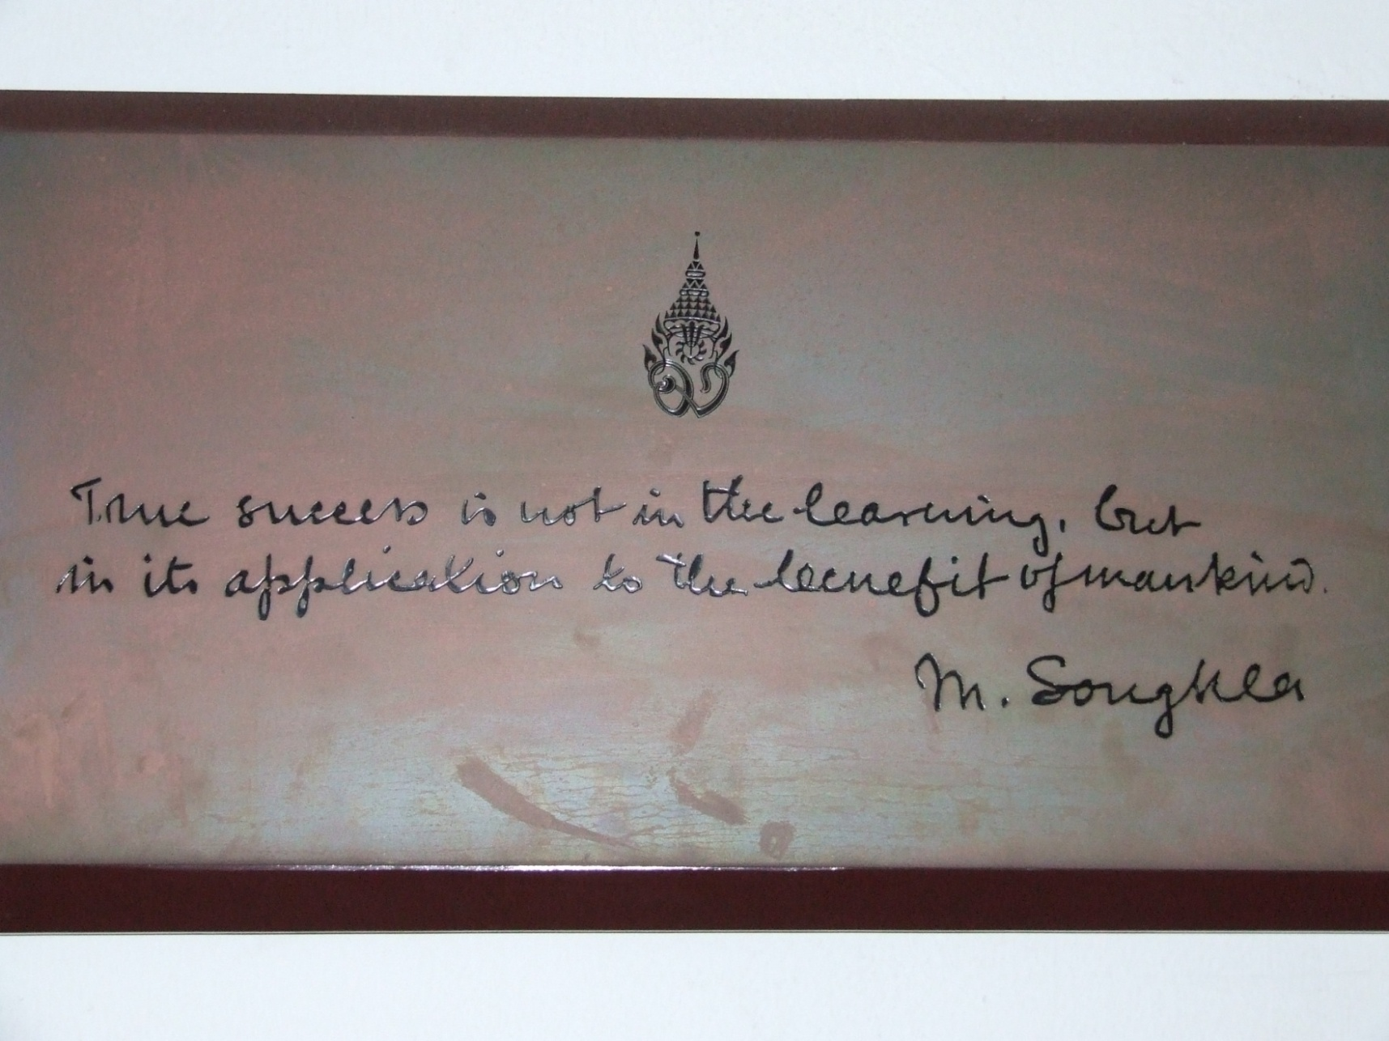
Notes:
"สงขลานครินทร์"เป็นพระยศของ สมเด็จพระมหิตลาธิเบศร อดุลยเดชวิกรม พระบรมราชชนกส่วน"มหิดล"เป็นพระนามของพระองค์ท่าน

Slide 39
More Information
Search “Prabhas Chongstitvatana”
Get to my homepage

