Slide 1
Introduction to Quantum Computing
by
Kamonluk Suksen

Slide 2
Overview
From bits to qubits: Dirac notation, density matrices, measurement, Bloch sphere
Quantum circuits: basic single-qubit & two-qubit gates, multipartite quantum states
Entanglement: Bell states, Teleportation

Slide 3
From bits to qubits
Superpositions allow to perform calculations on many states at the same time.
Quantum algorithms with exponential speed-up.
But: Once we measure the superposition state, it collapse to one of its states.
We can use interference effects to keep the right answer.
Photo courtesy of : https://medium.com/qntm/qntm-entering-the-era-of-quantum-computing

Slide 4
Dirac notation & density matrices
It used to describe quantum states: Let a, b are 2-dimensional vector with complex entries.
ket: $\left.\left|a\right.\right\rangle =\left({a_{0} \atop a_{1}}\right)$
bra: $\left\langle \left.b\right|\right.={\left.\left|b\right.\right\rangle }^{+}={\left({b_{0} \atop b_{1}}\right)}^{+}=(b_{0}^{∗} b_{1}^{∗})$
bra-ket: $\left\langle b | a\right\rangle ={a_{0}b_{0}}^{∗}+{a_{1}b_{1}}^{∗}={\left\langle a | b\right\rangle }^{∗}∈∁$ (inner product)
ket-bra: $\left|\left.a\right\rangle \right.\left\langle \left.b\right|\right.=\left(\begin{matrix}{a_{0}b_{0}}^{∗} & {a_{0}b_{1}}^{∗} \\ {a_{1}b_{0}}^{∗} & {a_{1}b_{1}}^{∗}\end{matrix}\right)$ (2x2 matrix)

Slide 5
Dirac notation & density matrices
The pure states are $\left.\left|0\right.\right\rangle =\left({1 \atop 0}\right),\left.\left|1\right.\right\rangle =\left({0 \atop 1}\right)$, which are orthogonal: $\left\langle 0 | 1\right\rangle =1.0+0.1=0$
$\left|\left.0\right\rangle \right.\left\langle \left.0\right|=\right.\left({1 \atop 0}\right)\left(1\right. \left.0\right)=\left(\begin{matrix}1 & 0 \\ 0 & 0\end{matrix}\right)$, $\left|\left.1\right\rangle \right.\left\langle \left.1\right|=\right.\left({0 \atop 1}\right)\left(0\right. \left.1\right)=\left(\begin{matrix}0 & 0 \\ 0 & 1\end{matrix}\right)$
$\text{}=\left(\begin{matrix}{\text{}}_{00} & {\text{}}_{01} \\ {\text{}}_{10} & {\text{}}_{11}\end{matrix}\right)={\text{}}_{00}\left|\left.0\right\rangle \right.\left\langle \left.0\right|\right.+{\text{}}_{01}\left|\left.0\right\rangle \right.\left\langle \left.1\right|\right.+{\text{}}_{10}\left|\left.1\right\rangle \right.\left\langle \left.0\right|\right.+{\text{}}_{11}\left|\left.1\right\rangle \right.\left\langle \left.1\right|\right.$
All quantum states can be described by density matrices.
All quantum states are normalized, i.e., $\left\langle  | \right\rangle =1$, e.g., $\left|\left.\right\rangle \right.=\frac{1}{\sqrt{2}}\left(\left|\left.0\right\rangle \right.+\left|\left.1\right\rangle \right.\right)=\left({\frac{1}{\sqrt{2}} \atop \frac{1}{\sqrt{2}}}\right)$
A density matrix is pure, if $\text{}=\left|\left.ψ\right\rangle \right.\left\langle \left.ψ\right|\right.$, otherwise it is mixed.
$\text{}=\left(\begin{matrix}1 & 0 \\ 0 & 0\end{matrix}\right)=\left|\left.0\right\rangle \right.\left\langle \left.0\right|\right.→Pure$, $\text{}=\left(\begin{matrix}0 & 0 \\ 0 & 1\end{matrix}\right)=\left|\left.1\right\rangle \right.\left\langle \left.1\right|\right.→Pure$
$\text{}=\frac{1}{2}\left(\begin{matrix}1 & 0 \\ 0 & 1\end{matrix}\right)=\frac{1}{2}(\left|\left.0\right\rangle \right.\left\langle \left.0\right|\right.+\left|\left.1\right\rangle \right.\left\langle \left.1\right|\right.)→Mixed$
$\text{}=\frac{1}{2}\left(\begin{matrix}1 & −1 \\ −1 & 1\end{matrix}\right)=\frac{1}{2}\left(\left|\left.0\right\rangle \right.\left\langle \left.0\right|\right.−\left|\left.0\right\rangle \right.\left\langle \left.1\right|\right.−\left|\left.1\right\rangle \right.\left\langle \left.0\right|\right.+\left|\left.1\right\rangle \right.\left\langle \left.1\right|\right.\right)=\frac{1}{2}(\left.\left|0\right.\right\rangle −\left.\left|1\right.\right\rangle )(\left.\left|0\right.\right\rangle −\left.\left|1\right.\right\rangle )→Pure$

Slide 6
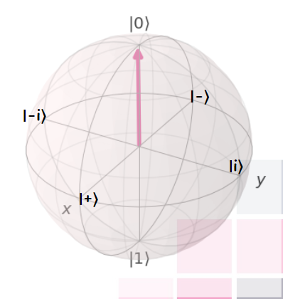
Measurement
We choose orthogonal base to describe and measure quantum states (projective measurement).
During a measurement onto the basis $\left\{\left.\left|0\right.\right\rangle ,\left.\left|1\right.\right\rangle \right\}$, the states will collapse into either state $\left.\left|0\right.\right\rangle$ or $\left.\left|1\right.\right\rangle$, as those are the eigenstates of $σ_{Z}$, we call this a Z-measurement.
Other different bases are:
$\left.\left|+\right.\right\rangle =\frac{1}{\sqrt{2}}(\left.\left|0\right.\right\rangle +\left.\left|1\right.\right\rangle )$, $\left.\left|−\right.\right\rangle =\frac{1}{\sqrt{2}}(\left.\left|0\right.\right\rangle −\left.\left|1\right.\right\rangle )$, corresponding to the eigenstates of $σ_{x}$,
$\left.\left|+i\right.\right\rangle =\frac{1}{\sqrt{2}}(\left.\left|0\right.\right\rangle +\left.i\left|1\right.\right\rangle )$, $\left.\left|−i\right.\right\rangle =\frac{1}{\sqrt{2}}(\left.\left|0\right.\right\rangle −\left.i\left|1\right.\right\rangle )$, corresponding to the eigenstates of $σ_{y}$.

Slide 7
Measurement
Born rule: the probability that a state $\left.\left|\right.\right\rangle$ collapses during a project measurement onto the basis $\left\{\left.\left|X\right.\right\rangle , \left|\left.X^{⊥}\right\rangle \right. \right\}$ to the state $\left.\left|X\right.\right\rangle$ is given by $P\left(X\right)={\left|\left\langle X | \right\rangle \right|}^{2}$, $\sum_{i}{P}\left(X_{i}\right)=1$
Examples:
$\left.\left|\right.\right\rangle =\frac{1}{\sqrt{3}}\left(\left.\left|0\right.\right\rangle +\sqrt{2}\left.\left|1\right.\right\rangle \right)$ is measured in the basis $\left\{\left.\left|0\right.\right\rangle ,\left.\left|1\right.\right\rangle \right\}$:
$P\left(0\right)={\left\langle 0 | \frac{1}{\sqrt{3}}\left.(\left|0\right.\right\rangle +\sqrt{2} | 1\right\rangle )}^{2}={\left|\frac{1}{\sqrt{3}}\left\langle 0 | 0\right\rangle +\frac{\sqrt{2}}{\sqrt{3}}\left\langle 0 | 1\right\rangle \right|}^{2}=\frac{1}{3} → P\left(1\right)=\frac{2}{3}$
$\left.\left|\right.\right\rangle =\frac{1}{\sqrt{2}}\left(\left.\left|0\right.\right\rangle −\left.\left|1\right.\right\rangle \right)$ is measured in the basis $\left\{\left.\left|+\right.\right\rangle ,\left.\left|−\right.\right\rangle \right\}$:
$P\left(+\right)={\left|\left\langle + | \right\rangle \right|}^{2}={\left|\frac{1}{\sqrt{2}}\left.(\left|0\right.\right\rangle +\left.\left|1\right.\right\rangle )\frac{1}{\sqrt{2}}\left.(\left|0\right.\right\rangle −\left.\left|1\right.\right\rangle )\right|}^{2}=\frac{1}{4}{\left|\left(\left\langle 0 | 0\right\rangle −\left\langle 0 | 1\right\rangle +\left\langle 1 | 0\right\rangle −\left\langle 1 | 1\right\rangle \right)\right|}^{2}=0→expected as$ $\left\langle + | −\right\rangle =0$,
$P\left(−\right)=$ ${\left|\left\langle − | −\right\rangle \right|}^{2}=1$

Slide 8
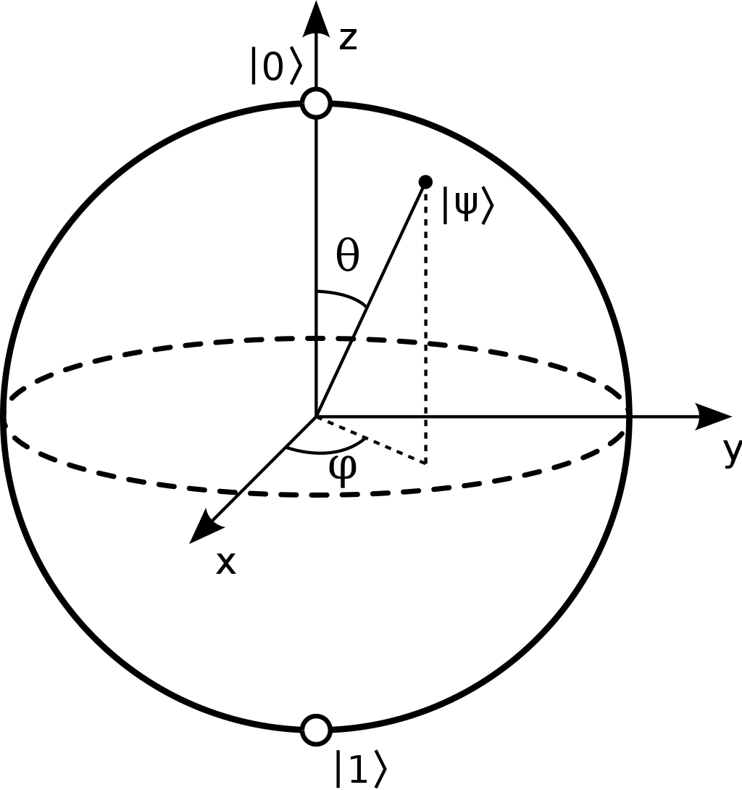
Bloch sphere
We can write any normalized pure state as $\left.\left|\right.\right\rangle =\cos{\frac{θ}{2}\left.\left|0\right.\right\rangle +e^{iφ}\sin{\frac{θ}{2}}}\left.\left|1\right.\right\rangle$, where $φ∈\left[0, 2π\right]$ describes the relative phase and $θ∈\left[0, π\right]$ determines the probability to measure $\left.\left|0\right.\right\rangle$, $\left.\left|1\right.\right\rangle$: $P\left(\left.\left|0\right.\right\rangle \right)=\cos^{2}{\frac{θ}{2}}$, $P\left(\left.\left|1\right.\right\rangle \right)=\sin^{2}{\frac{θ}{2}}$.
All normalized pure states can be illustrated on the surface of a sphere with radius $\left|\overset{⃑}{r}\right|=1$, which we call the Bloch sphere.
The coordinates of such a state are given by the Bloch vector: $\overset{⃑}{r}=\left(\begin{matrix}\sin{θ\cos{φ}} \\ \sin{θ}\sin{φ} \\ \cos{θ}\end{matrix}\right)$

Slide 9
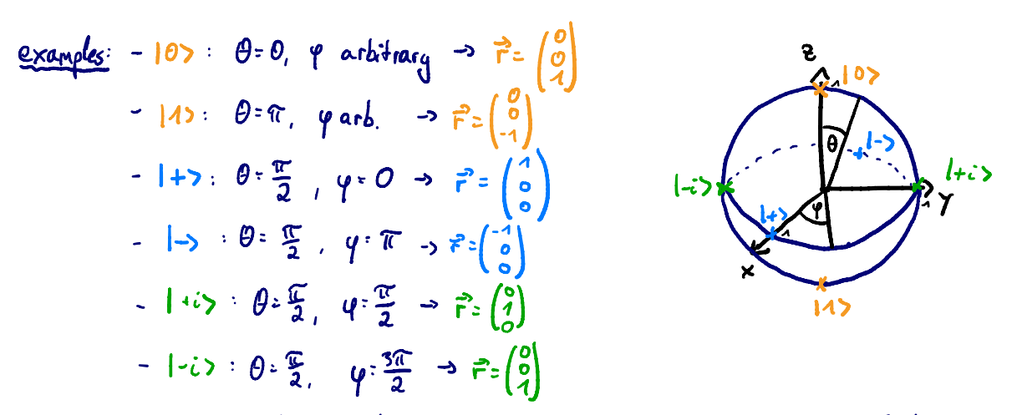
Bloch sphere
Be careful: On the Bloch sphere, angles are twice as big as in Hilbert space:
e.g., $\left.\left|0\right.\right\rangle$ & $\left.\left|1\right.\right\rangle$ are orthogonal, but on the Bloch sphere their angle is ${180}^{o}$.
For a general state, $\left.\left|\right.\right\rangle =\cos{\frac{θ}{2}\left.\left|0\right.\right\rangle +…}→θ$is the angle on the Bloch sphere, while $\frac{θ}{2}$ is the actual angle in Hilbert space!
Photo courtesy of : IBM quantum summer school 2019

Slide 10
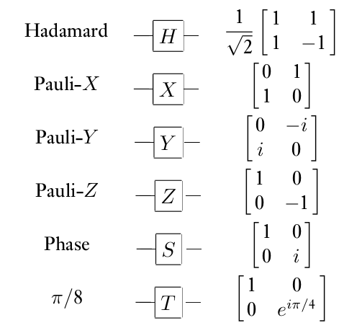
Quantum circuits: single qubit gates
Circuit model: sequence of building block that carry out computations, called gates.
Quantum gates are represented by unitary matrices, A unitary matrix is a square matrix of complex numbers, whose inverse is equal to its conjugate transpose.
Single qubit gates:
input
algorithm
output
creates superposition
rotation around X-axis by $π$
bit flip
rotation around Y-axis by $π$
bit & phase flip
rotation around Z-axis by $π$
phase flip
used to change from Z to Y-basis

Slide 11
Quantum circuits: single qubit gates
Photo courtesy of : IBM quantum summer school 2019

Slide 12
Quantum circuits: multipartite quantum states
We use tensor product to describe multiple states:
$\left.\left|a\right.\right\rangle ⊗\left.\left|b\right.\right\rangle =\left({a_{1} \atop a_{2}}\right)⊗\left({b_{1} \atop b_{2}}\right)=\left({a_{1}b_{1} \atop \begin{matrix}a_{1}b_{2} \\ \begin{matrix}a_{2}b_{1} \\ a_{2}b_{2}\end{matrix}\end{matrix}}\right)$
Example: system A is in state ${\left.\left|1\right.\right\rangle }_{A}$ and system B is in state ${\left.\left|0\right.\right\rangle }_{B}=\left({0 \atop 1}\right)⊗\left({1 \atop 0}\right)=\left({0 \atop \begin{matrix}0 \\ \begin{matrix}1 \\ 0\end{matrix}\end{matrix}}\right)$, states of this form are called uncorrelated.
But there are also bipartite states that cannot be written as ${\left.\left|\right.\right\rangle }_{a}⊗{\left.\left|ψ\right.\right\rangle }_{b}$. These states are correlated and sometimes even entangled (very strong correlation), e.g. ${\left.\left|\right.\right\rangle }_{AB}^{(00)}=\frac{1}{\sqrt{2}}({\left.\left|00\right.\right\rangle }_{AB}+{\left.\left|11\right.\right\rangle }_{AB})=\frac{1}{\sqrt{2}}$ $\left({1 \atop \begin{matrix}0 \\ \begin{matrix}0 \\ 1\end{matrix}\end{matrix}}\right)$, it so called Bell state, used for teleportation, cryptography, Bell tests, etc.

Slide 13
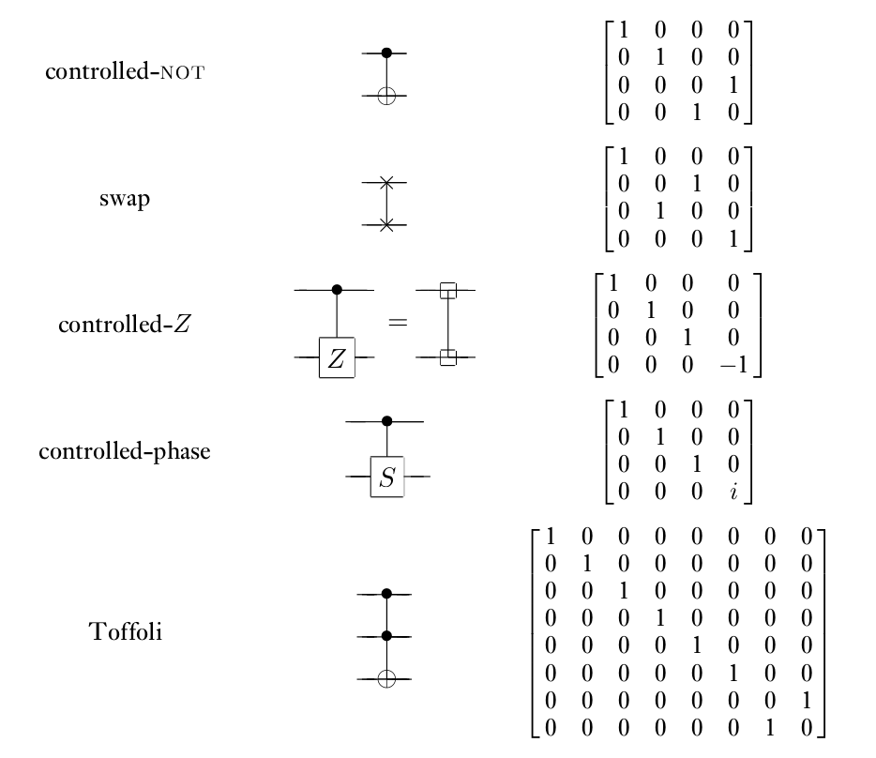
Quantum circuits: multiple-qubit gates

Slide 14
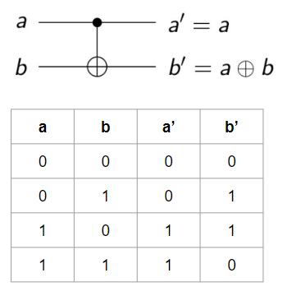
Quantum circuits: two-qubit gates
Classical example: XOR
But as quantum theory is unitary, we only consider unitary and therefore reversible gates
Quantum example: CNOT gate
X
XOR
X⊕Y
irreversible: given the output, we cannot recover the input.
Y
Quantum circuits can perform all function
that can be calculated classically.

Slide 15
Entanglement
If a pure state${\left.\left|\right.\right\rangle }_{AB}$on system A,B cannot be written as ${\left.\left|\right.\right\rangle }_{a}⊗{\left.\left|φ\right.\right\rangle }_{b}$, it is entangled.
These are four so called Bell states that are maximally entangled and build on orthonormal basis:
$\left|\left.^{00}\right\rangle \right.≔\frac{1}{\sqrt{2}}\left(\left.\left|00\right.\right\rangle +\left.\left|11\right.\right\rangle \right)$,
$\left|\left.^{01}\right\rangle \right.≔\frac{1}{\sqrt{2}}\left(\left.\left|01\right.\right\rangle +\left.\left|10\right.\right\rangle \right)$,
$\left|\left.^{10}\right\rangle \right.≔\frac{1}{\sqrt{2}}\left(\left.\left|00\right.\right\rangle −\left.\left|11\right.\right\rangle \right)$,
$\left|\left.^{11}\right\rangle \right.≔\frac{1}{\sqrt{2}}\left(\left.\left|01\right.\right\rangle −\left.\left|10\right.\right\rangle \right).$

Slide 16
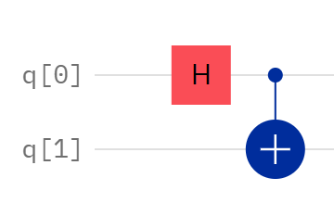
Entanglement
Creation of Bell states:
$${\left.\left|q_{0}q_{1}\right.\right\rangle }_{00} H_{0}→\frac{1}{\sqrt{2}}\left(\left.\left|00\right.\right\rangle +\left.\left|10\right.\right\rangle \right) {CNOT}_{01}→\frac{1}{\sqrt{2}}\left(\left.\left|00\right.\right\rangle +\left.\left|11\right.\right\rangle \right)=\left|\left.ψ^{00}\right\rangle \right.,$$
$${\left.\left|q_{0}q_{1}\right.\right\rangle }_{01} H_{0}→\frac{1}{\sqrt{2}}\left(\left.\left|01\right.\right\rangle +\left.\left|11\right.\right\rangle \right){ CNOT}_{01}→\frac{1}{\sqrt{2}}\left(\left.\left|01\right.\right\rangle +\left.\left|10\right.\right\rangle \right)=\left|\left.ψ^{01}\right\rangle \right.,$$
$${\left.\left|q_{0}q_{1}\right.\right\rangle }_{10} H_{0}→\frac{1}{\sqrt{2}}\left(\left.\left|00\right.\right\rangle −\left.\left|10\right.\right\rangle \right){ CNOT}_{01}→\frac{1}{\sqrt{2}}\left(\left.\left|00\right.\right\rangle −\left.\left|11\right.\right\rangle \right)=\left|\left.ψ^{10}\right\rangle \right.,$$
$${\left.\left|q_{0}q_{1}\right.\right\rangle }_{11} H_{0}→\frac{1}{\sqrt{2}}\left(\left.\left|01\right.\right\rangle −\left.\left|11\right.\right\rangle \right){ CNOT}_{01}→\frac{1}{\sqrt{2}}\left(\left.\left|01\right.\right\rangle −\left.\left|10\right.\right\rangle \right)=\left|\left.ψ^{11}\right\rangle \right..$$

Slide 17
Teleportation
Goal:
Alice want to send her (unknown) state ${\left.\left|\right.\right\rangle }_{s}≔α{\left.\left|0\right.\right\rangle }_{s}+β{\left.\left|1\right.\right\rangle }_{s}$ to Bob.
She can only send him two classical bits though.
They both share the maximally entangled state ${\left.\left|\right.\right\rangle }_{AB}^{(00)}=\frac{1}{\sqrt{2}}({\left.\left|00\right.\right\rangle }_{AB}+{\left.\left|11\right.\right\rangle }_{AB})$.
Initial states of the total system:
Photo courtesy of : IBM quantum summer school 2019

Slide 18
Teleportation
Protocol:
Alice’s state collapsed during the measurement, so she doesn’t have the initial state ${\left.\left|\right.\right\rangle }_{s}$ anymore. This is expected due to the no-cloning theorem, as she cannot copy her state, but just send her state to Bob when destroying her own.
Photo courtesy of : IBM quantum summer school 2019

Slide 19
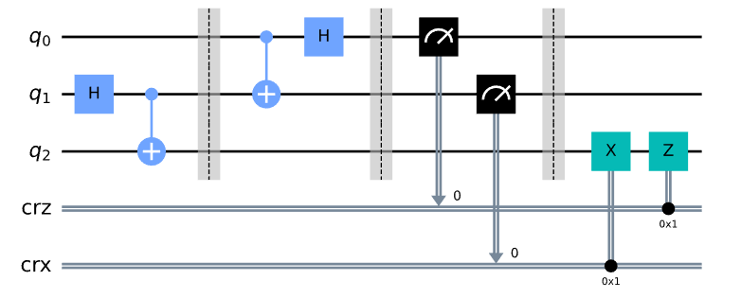
Teleportation
Quantum circuit:
two classical bits
The qubit she is trying to send Bob.
Alice’s qubit
Bob’s qubit
00 → Do nothing
01 → Apply X gate
10 → Apply Z gate
11 → Apply ZX gate

Slide 20
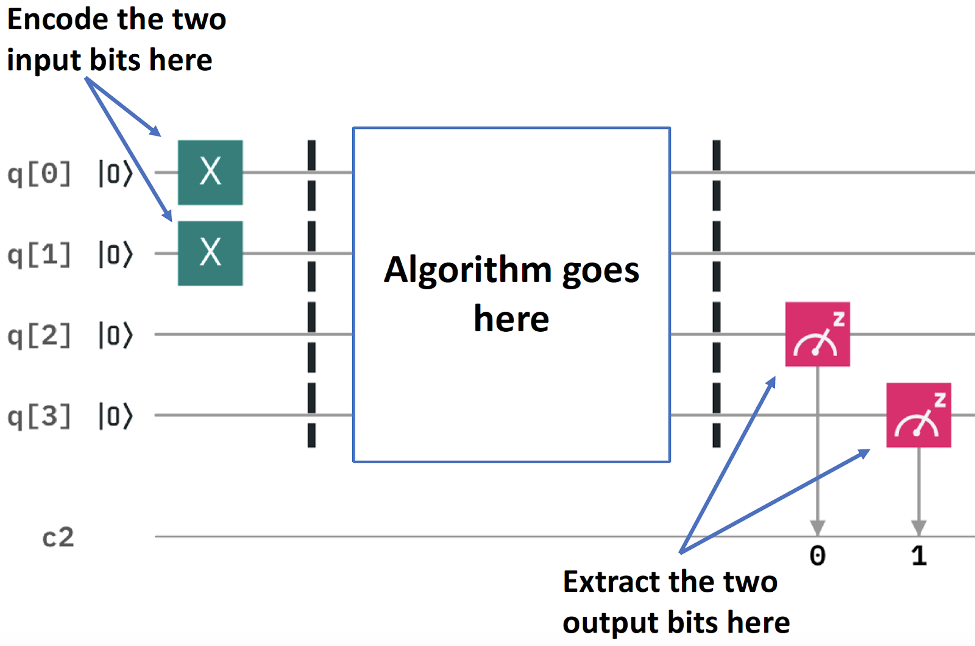
Quantum programming using Qiskit
Half adder circuit for input 11
0+0 = 00 (in decimal, this is 0+0 = 0)
0+1 = 01 (in decimal, this is 0+1 = 1)
1+0 = 01 (in decimal, this is 1+0 = 1)
1+1 = 10 (in decimal, this is 1+1 = 2)

Slide 21
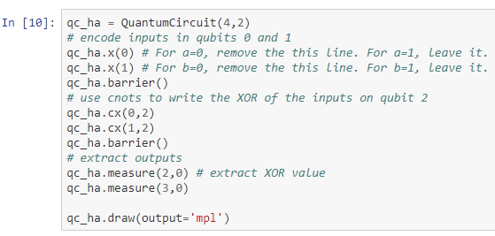
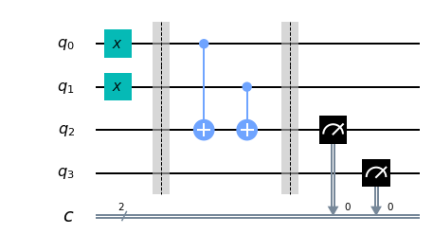
Quantum programming using Qiskit
Half adder circuit for input 11

Slide 22
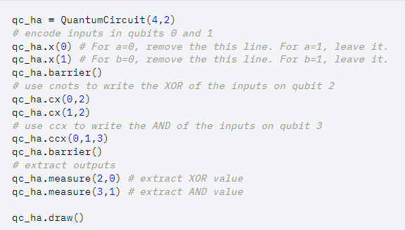
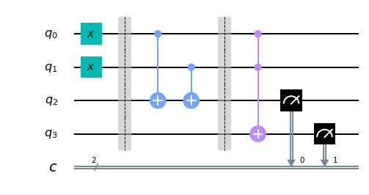
Quantum programming using Qiskit
Half adder circuit for input 11
Add toffoli gate

Slide 23
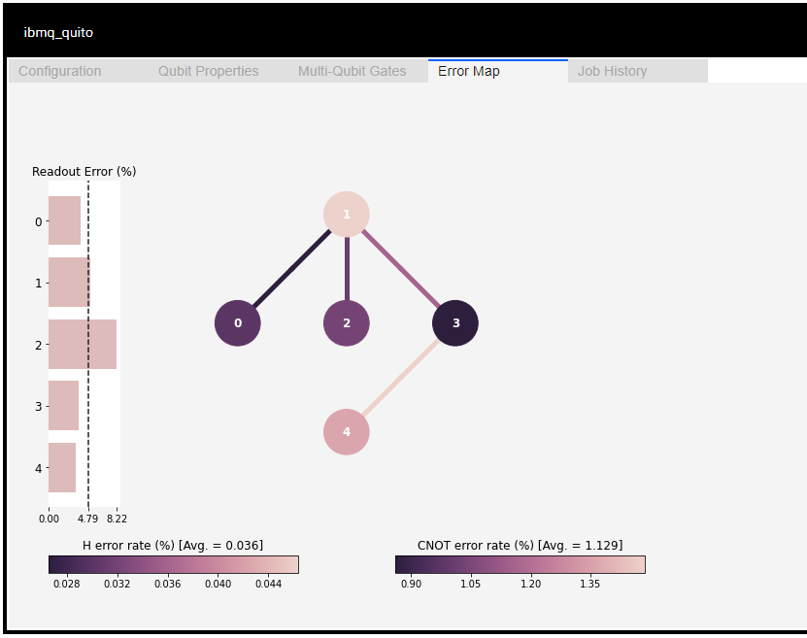
How the noise properties affect the result
There are often optimizations that the transpiler can perform that reduce the overall gate count, and thus total length of the input circuits.
Qiskit library has a command “backend” to show the chosen backend information graphically such as “Error Map”.
We can select a good initial layout considering connectivity and error information that you can find from the map to initial layout onto the physical qubits with at least noise.
Notes:
การสูญเสียความเป็นคลื่นของสถานะทางควอนตัมที่เกิดจากสัญญาณรบกวนโดยธรรมชาติ และความไม่สมบูรณ์ของระบบที่ใช้ควบคุม สามารถแก้ไขได้โดยการทำ error correction หรือง่ายกว่านั้นคือ ถ้าเรารู้ topology ของเครื่องที่เราใช้งานอยู่ เราสามารถเลือกที่จะใช้งาน qubit ที่มี error ต่ำได้

Slide 24
Assignment I: quantum circuits
Required:
Go to https://quantum-computing.ibm.com/
Register IBMid account or sign in with Google, Github, LinkedIn, and Twitter.
Download source codes at t.ly/M8Qg and upload files “Lab-1.ipynb” and “Lab-2.ipynb” into IBM Quantum Lab.

Slide 25
Quantum algorithms
Deutsch-Jozsa algorithm
We are given a hidden Boolean function 𝑓 , which takes as input a string of bits, and returns either 0 or 1 , that is:
The property of the given Boolean function is that it is guaranteed to either be balanced (returns 1 for half of the input domain and 0 for the other half) or constant (0 on all inputs or 1 on all inputs).
Our task is to determine whether the given function is balanced or constant.

Slide 26
Quantum algorithms
Deutsch-Jozsa algorithm
For classical solution, we need to ask the oracle at least twice, but if we get twice the same output, we need to ask again. At most to query is (N/2)+1, where N is number of state.
For quantum solution, need only one query. If the output is the zero bit string, we know that the oracle is constant. If it is any other bit string, we know that it is balanced.
We have the function 𝑓 implemented as a quantum oracle, which maps the state |𝑥⟩|𝑦⟩ to |𝑥⟩|𝑦⊕𝑓(𝑥)⟩ , where ⊕ is addition modulo 2.

Slide 27
Quantum algorithms
Deutsch-Jozsa algorithm
The initial state of which can be expressed:
which is then put into superposition, which can conveniently be expressed:

Slide 28
Quantum algorithms
Deutsch-Jozsa algorithm
Apply the quantum oracle |𝑥⟩|𝑦⟩ to |𝑥⟩|𝑦⊕𝑓(𝑥)⟩:
We now address the interference $H^{n}$on the first n wires, for which we use the expression:
which allows us to express:
where $x.z=x_{0}z_{0}x_{1}z_{1}…{x}_{n−1}z_{n−1}$ is the sum of the bitwise product.

Slide 29
Quantum algorithms
Deutsch-Jozsa algorithm
We can now determine whether the function is constant or balanced by measuring the first n qubits of the final state.
Specifically, we consider the probability of measuring zero on every qubit, which corresponds to the term in the superposition where |𝑥⟩ is
So it follows that measuring the first n qubits allows us to determine with certainty whether the function is constant (measure all zeros) or balanced (measure at least one 1).

Slide 30
Quantum algorithms
Deutsch-Jozsa algorithm
We can encode any mathematical function as a unitary matrix.
Deutsch’s algorithm was the first algorithm that demonstrated a quantum advantage: specifically, a reduction in query complexity compared to the classical case.
The Deutsch-Jozsa algorithm generalises Deutsch’s algorithm and reveals the possibility of exponential speed-ups using quantum computers.

Slide 31
Assignment II: quantum algorithms
Required:
Go to https://quantum-computing.ibm.com/
Download source codes at t.ly/M8Qg and upload files “Lab-3.ipynb” into IBM Quantum Lab.

Slide 32
Quantum algorithms
Grover’s algorithm
It can be used to solve unstructured search problems.
This algorithm can speed up an unstructured search problem quadratically using the amplitude amplification trick.

Slide 33
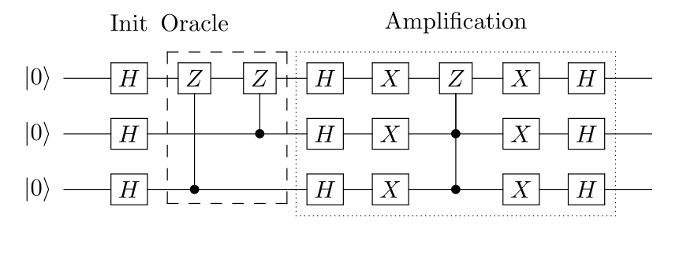
Quantum algorithms
Grover’s algorithm
The example of Grover's algorithm for 3 qubits with two marked states |101⟩ and |110⟩.
Grover iterations ~ $\frac{π}{4}\sqrt{\frac{N}{t}}$
Photo courtesy of https://qiskit.org/textbook/ch-algorithms/grover.html

Slide 34
Quantum algorithms
The implemented stages of the Grover’s search algorithm:
Initialization: In the first stage of the algorithm all qubits are set to be in superposition by applying the Hadamard gate to each qubit. After this operation the amplitude of each state is 1/sqrt(n).
Oracle: The oracle function performs a phase flip on the marked state. If the marked state is |0110〉, the phase flip inverts the amplitude ⍺0110 of the state.
Amplification: The amplification stage performs an inversion of the average of the amplitudes.
Measurement: The qubits are measured in finally.
Grover iterations ~ $\frac{π}{4}\sqrt{\frac{N}{t}}$
Photo courtesy of https://qiskit.org/textbook/ch-algorithms/grover.html

Slide 35
Quantum algorithms
Grover’s algorithm
Invert amplitude of the optimum and re-compute the average of amplitude
Grover iteration maximum at
Initialize the system to the superposition state
Apply oracle
New amplitude:
$$l_{i_new}=m−\left(l_{i}−m\right)$$
$=2m −$ $l_{i}$
$m$ is new average of amplitude.
No
$$\frac{π}{4}\sqrt{\frac{N}{t}}$$
Optimum? success prob max?
0 | 1 | 2 | 3 | 4 | … | N-1
Yes
The optimum is at index “a”,
Define Tagging Function :
f(x) = 0, x ≠ a
f(x) = 1, x = a
Perform the measurement

Slide 36
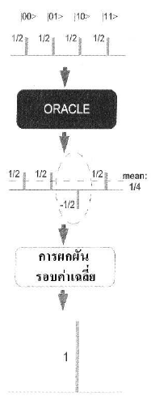
Quantum algorithms
Operation of searching data by Grover’s algorithm for 2 qubits:
Oracle
$$m=\frac{\left(\frac{1}{2}+\frac{1}{2}−\frac{1}{2}+\frac{1}{2}\right)}{4}= \frac{1}{4}$$
Invert iteration
$$l_{i}|00⟩,|01⟩,|11⟩= \frac{1}{4} −\left(\frac{1}{2} − \frac{1}{4}\right)=0$$
$$l_{i}|10⟩ = \frac{1}{4} −\left(−\frac{1}{2} − \frac{1}{4}\right)=1$$

Slide 37
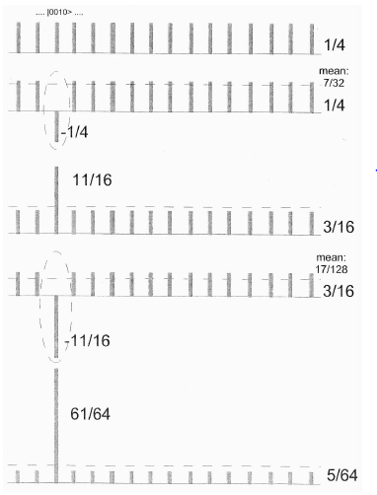
Quantum algorithms
Operation of searching data by Grover’s algorithm for 4 qubits:
Grover iteration = $\frac{π}{4} x \sqrt{\frac{N}{t}}$times,
N is the number of data (states) and
t is the number of target solutions.
Try it out at t.ly/M8Qg and upload files “Grover's algorithm.ipynb” into IBM Quantum Lab.

Slide 38
Superdense coding
Superdense coding is a procedure that allows someone to send two classical bits to another party using just a single qubit of communication.
Take advantage of quantum mechanics to more efficiently transmit classical information.
Word “coding” means there are 2 essential processes, encoding and decoding:
encoding: classical state → quantum state,
decoding: quantum state → classical state.
Teleportation | Superdense Coding
Transmit one qubit using two classical bits. | Transmit two classical bits using one qubit.

Slide 39
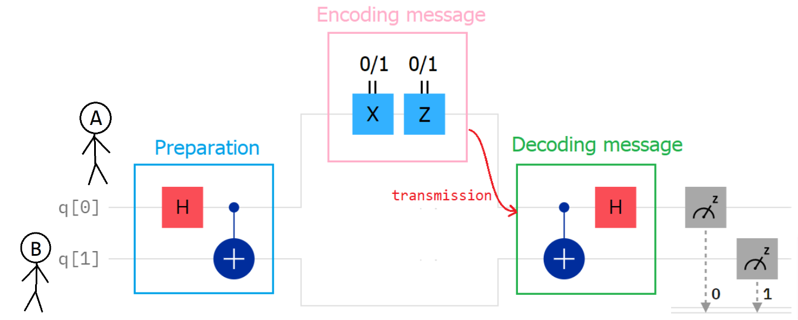
Superdense coding
Superdense coding includes 4 steps:
preparation,
encoding message,
transmission,
decoding message.

Slide 40
Superdense coding
Step 1: preparation
Start with 2 qubits in the basis state |0⟩.
Applying Hadamard gate to the first qubit and CNOT gate (the first qubit as control, another qubit as target) accordingly.

Slide 41
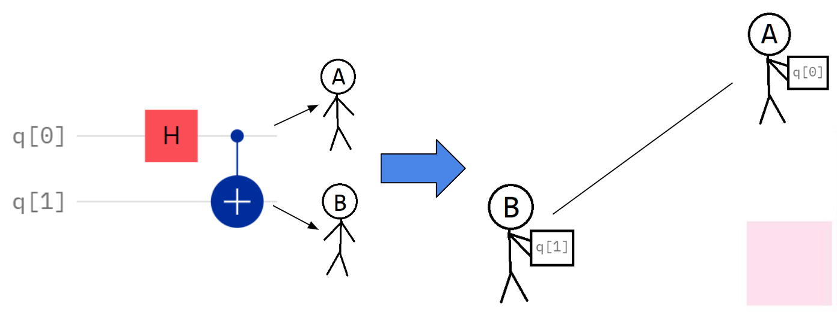
Superdense coding
Step 1: preparation
Give the first qubit to A and the second qubit to B.
A and B travel far away.

Slide 42
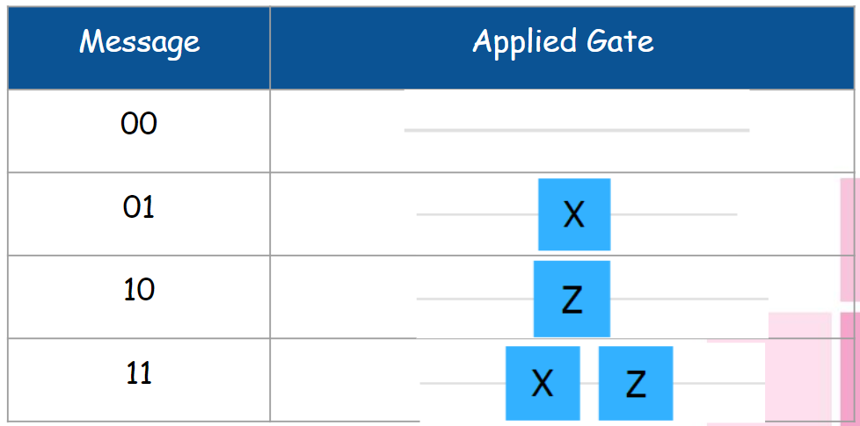
Superdense coding
Step 2: encoding message
A encodes the classical state in the qubit by applying gate(s).

Slide 43
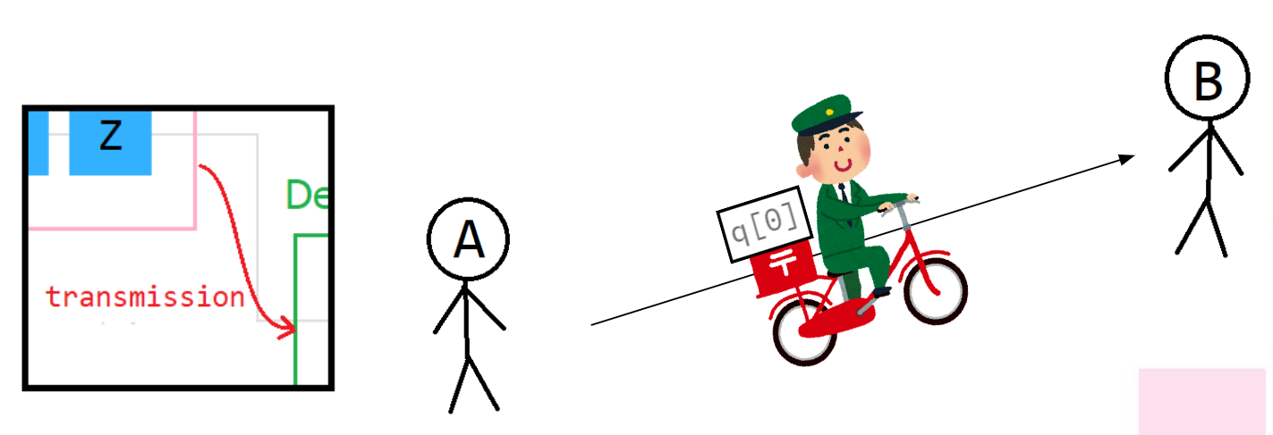
Superdense coding
Step 3: transmission
A sends the first qubit to B.

Slide 44
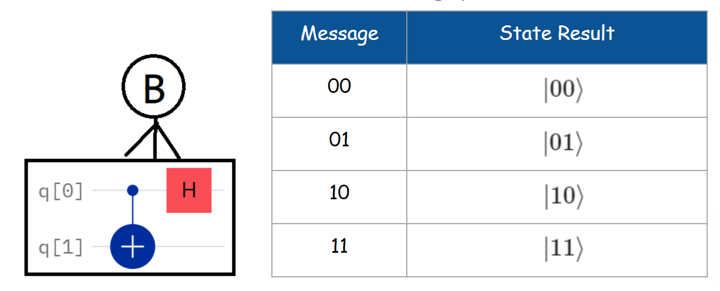
Superdense coding
Step 4: decoding message
Applying CNOT gate (the first qubit as control, another qubit as target) and Hadamard gate to the first qubit accordingly.

Slide 45
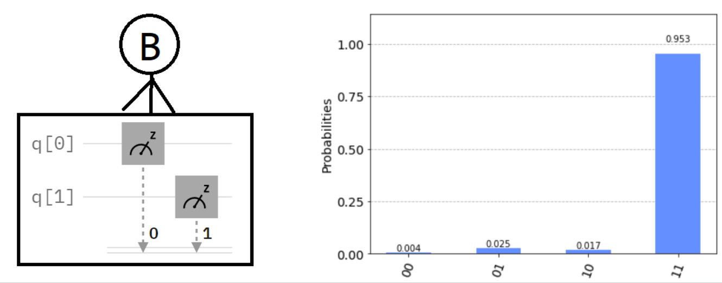
Superdense coding
Test the circuit which encodes message “11” and run on “ibm_oslo”.
Step 4: decoding message
Finally, measure both qubits.

Slide 46
Assignment II: superdense coding
Required:
Go to https://quantum-computing.ibm.com/
Download source codes at t.ly/M8Qg and upload files “Lab-4.ipynb” into IBM Quantum Lab.

