Slide 1
Instructions
Prabhas Chongstitvatana
Faculty of Engineering
Chulalongkorn University

Slide 8
literals

Slide 9
Binary number

Slide 10
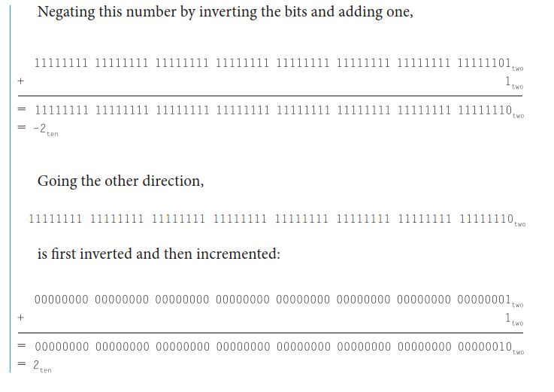

Slide 11
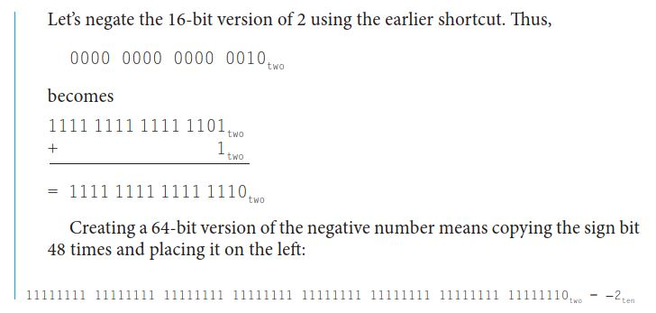

Slide 12
Instruction encoding

Slide 14
Stored-program concept

Slide 15
Logic operations

Slide 16
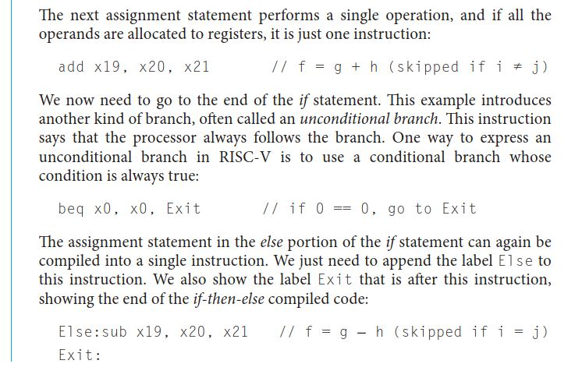
Branch operations

Slide 18
Compile and run

