Slide 1
Learning from negative examples: application in combinatorial optimization
Prabhas Chongstitvatana
Faculty of Engineering
Chulalongkorn University

Slide 2
Learning from negative examples: application in combinatorial optimization
Prabhas Chongstitvatana
Faculty of Engineering
Chulalongkorn University

Slide 3
Outline
Evolutionary Algorithms
Simple Genetic Algorithm
Second Generation GA
Using models: Simultaneous Matrix
Combinatorial optimisation
Coincidence Algorithm
Applications

Slide 4
What is Evolutionary Computation
EC is a probabilistic search procedure to obtain solutions starting from a set of candidate solutions, using improving operators to “evolve” solutions.
Improving operators are inspired by natural evolution.

Slide 5
Survival of the fittest.
The objective function depends on the problem.
EC is not a random search.

Slide 6
Genetic Algorithm Pseudo Code
Initialise population P
While not terminate
  evaluate P by fitness function
  P’ = selection.recombination.mutation of P
  P = P’
terminating conditions:
  1 found satisfactory solutions
  2 waiting too long

Slide 7
Simple Genetic Algorithm
Represent a solution by a binary string {0,1}*
Selection: chance to be selected is proportional to its fitness
Recombination: single point crossover
Mutation: single bit flip

Slide 8
Recombination
Select a cut point, cut two parents, exchange parts
AAAAAA 111111
cut at bit 2
AA AAAA 11 1111
exchange parts
AA1111 11AAAA

Slide 9
Mutation
single bit flip
111111 --> 111011
flip at bit 4

Slide 10
Building Block Hypothesis
BBs are sampled, recombined, form higher fitness individual.
“construct better individual from the best partial solution of past samples.”
Goldberg 1989

Slide 11
Second generation genetic algorithms
GA + Machine learning
current population -> selection -> model-building -> next generation
replace crossover + mutation with learning and sampling
probabilistic model

Slide 12
Building block identification by simulateneity matrix
Building Blocks concept
Identify Building Blocks
Improve performance of GA

Slide 13
x = 11100 f(x) = 28
x = 11011 f(x) = 27
x = 10111 f(x) = 23
x = 10100 f(x) = 20
---------------------------
x = 01011 f(x) = 11
x = 01010 f(x) = 10
x = 00111 f(x) = 7
x = 00000 f(x) = 0
Induction
1 * * * *
(Building Block)

Slide 14
x = 11111 f(x) = 31
x = 11110 f(x) = 30
x = 11101 f(x) = 29
x = 10110 f(x) = 22
---------------------------
x = 10101 f(x) = 21
x = 10100 f(x) = 20
x = 10010 f(x) = 18
x = 01101 f(x) = 13
Reproduction
1 * * * *
(Building Block)

Slide 15
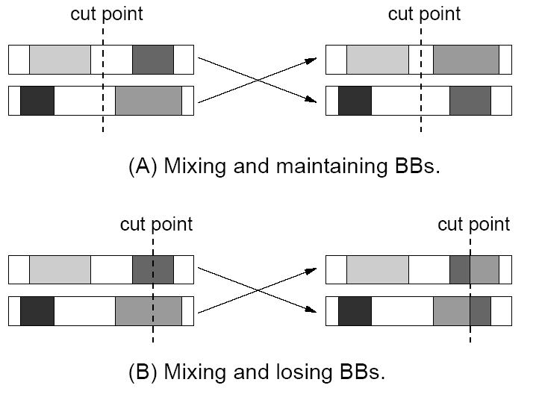

Slide 16
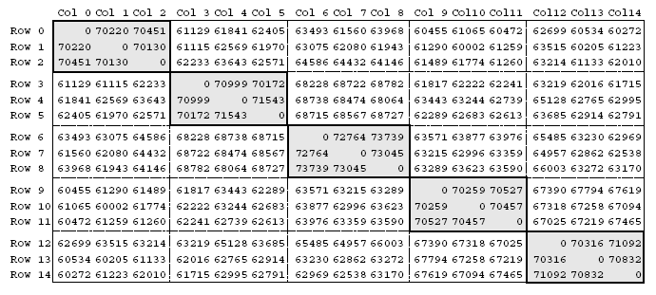
{{0,1,2},{3,4,5},{6,7,8},{9,10,11},{12,13,14}}

Slide 17
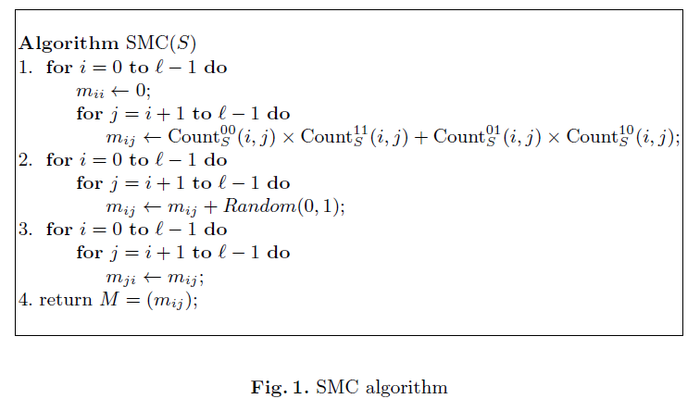
Simultaneous Matrix

Slide 20
Applications

Slide 21
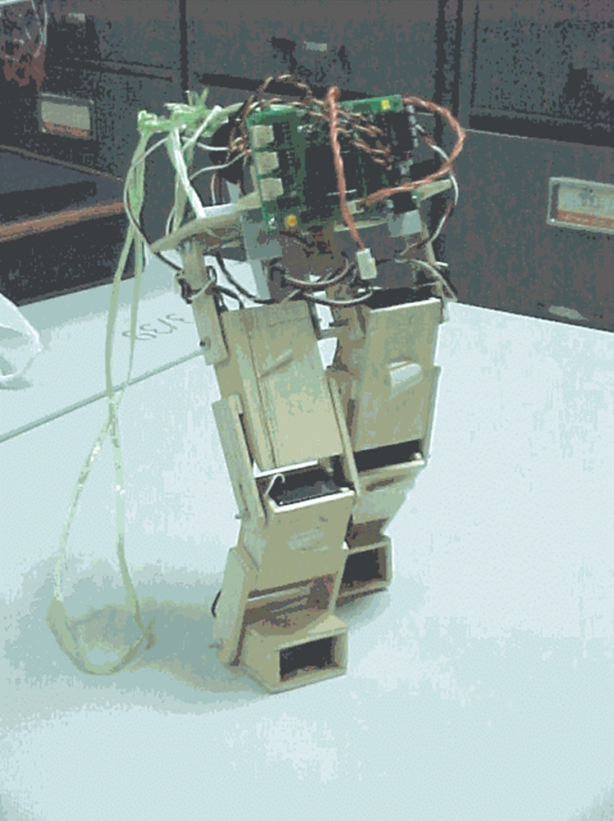
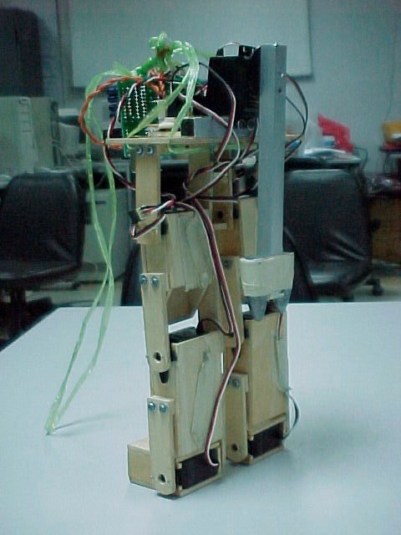
Generate Program for Walking

Slide 22
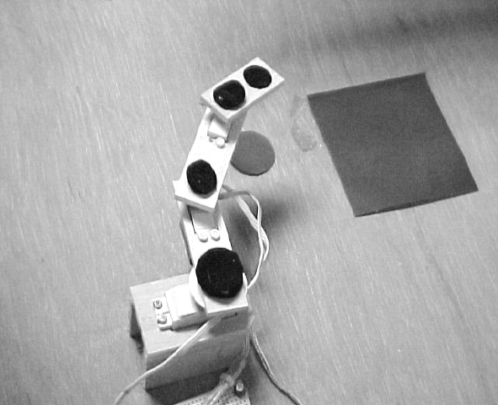
Control robot arms

Slide 23
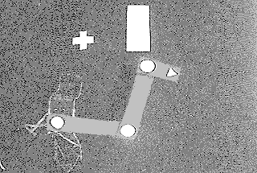
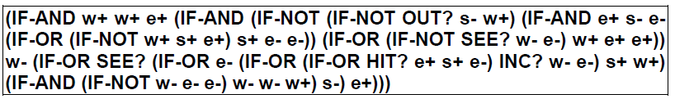

Slide 24
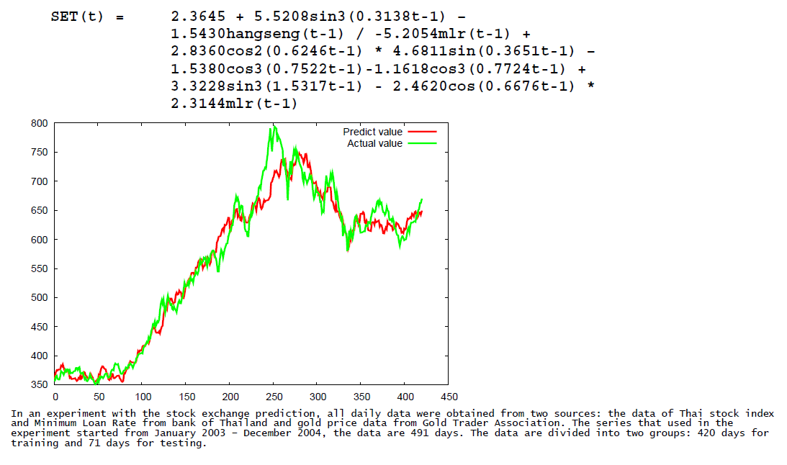

Slide 25
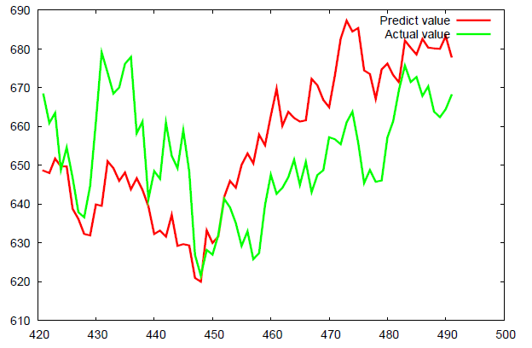

Slide 26





Lead-free Solder Alloys
Lead-based Solder
Low cost and abundant supply
Forms a reliable metallurgical joint
Good manufacturability
Excellent history of reliable use
Toxicity
Lead-free Solder
No toxicity
Meet Government legislations
(WEEE & RoHS)
Marketing Advantage (green product)
Increased Cost of Non-compliant parts
Variation of properties (Bad or Good)

Slide 27
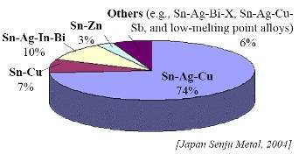
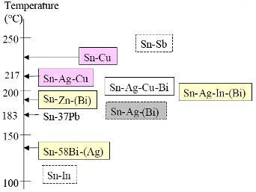
Sn-Ag-Cu (SAC) Solder
Advantage
Sufficient Supply
Good Wetting Characteristics
Good Fatigue Resistance
Good overall joint strength
Limitation
Moderate High Melting Temp
Long Term Reliability Data

Slide 28
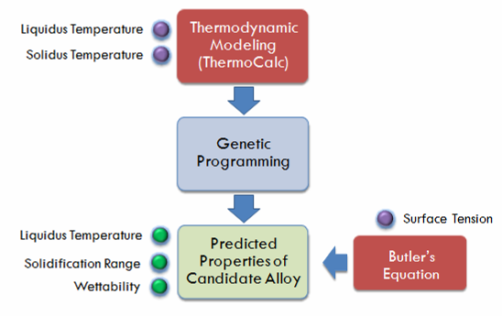

Slide 29
Experiments
10 Solder
Compositions
Thermal Properties Testing (DSC)
Liquidus Temperature
Solidus Temperature
Solidification Range
Wettability Testing
(Wetting Balance;
Globule Method)
Wetting Time
Wetting Force

Slide 30
Coincidence Algorithm (COIN)
Belong to second generation GA
Use both positive and negative examples to learn the model.
Solve Combinatorial optimisation problems

Slide 31
Combinatorial optimisation
The domains of feasible solutions are discrete.
Examples
  Traveling salesman problem
  Minimum spanning tree problem
  Set-covering problem
  Knapsack problem
  Bin packing

Slide 32
Model in COIN
A joint probability matrix, H.
Markov Chain.
An entry in H_{xy} is a probability of transition from a state x to a state y.
xy a coincidence of the event x and event y.

Slide 33
Steps of the algorithm
Initialise H to a uniform distribution.
Sample a population from H.
Evaluate the population.
Select two groups of candidates: better, and worse.
Use these two groups to update H.
Repeate the steps 2-3-4-5 until satisfactory solutions are found.

Slide 34
Updating of H
k denotes the step size, n the length of a candidate, r_{xy} the number of occurrence of xy in the better-group candidates, p_{xy} the number of occurrence of xy in the worse-group candidates. H_{xx} are always zero.

Slide 35
Coincidence Algorithm
Combinatorial Optimisation with Coincidence
  Coincidences found in the good solution are good
  Coincidences found in the not good solutions are not good
  How about the Coincidences found in both good and not good solutions!
Notes:
If we believe in the building block hypothesis, that the good candidates are composed with the good building blocks,
In contrast the bad candidates must also contain the bad building blocks as well.
So we are going to extract some information from the bad candidates in order to prevent the undesired results
Obviously, Coincidences found in the good solution are good and Coincidences found in the not good solutions are not good
How about the Coincidences found in both good and not good solutions!
We are considering them as the false positive. And keep questioning them to be explored.

Slide 36
Coincidence Algorithm
Next Incidence
Initialize H
 | X₁ | X₂ | X₃ | X₄ | X₅
X₁ | 0 | 0.25 | 0.25 | 0.25 | 0.25
X₂ | 0.25 | 0 | 0.25 | 0.25 | 0.25
X₃ | 0.25 | 0.25 | 0 | 0.25 | 0.25
X₄ | 0.25 | 0.25 | 0.25 | 0 | 0.25
X₅ | 0.25 | 0.25 | 0.25 | 0.25 | 0
Generate the Population
Prior Incidence
Evaluate the Population
Selection
Joint Probability Matrix
Update H
Notes:
Our algorithm use the Markov chain matrix of order 1 in order to construct a generator
This generator represent the joint probability of all the possible search space.
For example the probabilities of the incidence in which x1 can be followed by x2 x3 x4 and x5
Since x1 can not be followed by it self due to the encoding represent the permutation of numbers

Slide 37
Coincidence Algorithm
Initialize H
 | X₁ | X₂ | X₃ | X₄ | X₅
X₁ | 0 | 0.25 | 0.25 | 0.25 | 0.25
X₂ | 0.25 | 0 | 0.25 | 0.25 | 0.25
X₃ | 0.25 | 0.25 | 0 | 0.25 | 0.25
X₄ | 0.25 | 0.25 | 0.25 | 0 | 0.25
X₅ | 0.25 | 0.25 | 0.25 | 0.25 | 0
P(X₁|X₂) = P(X₁|X₃) = P(X₁|X₄) = P(X₁|X₅)
= 1/(n -1)
= 1/(5-1)
= 0.25
Notes:
The algorithm starts by initializing the generator so that all of the joint probabilities are equal
In this case the problem size is 5 so the joint probability for each xi followed by xj is equal to 0.25

Slide 38
Coincidence Algorithm
Initialize H
 | X₁ | X₂ | X₃ | X₄ | X₅
X₁ | 0 | 0.25 | 0.25 | 0.25 | 0.25
X₂ | 0.25 | 0 | 0.25 | 0.25 | 0.25
X₃ | 0.25 | 0.25 | 0 | 0.25 | 0.25
X₄ | 0.25 | 0.25 | 0.25 | 0 | 0.25
X₅ | 0.25 | 0.25 | 0.25 | 0.25 | 0
Generate the Population
Begin at any node X_{i}
For each X_{i}, choose its value according to the empirical probability h(X_{i}|X_{j}).
X2
X3
X1
X4
X5
Notes:
After the generator is initiated, we will start generating the population from the condition probability
Firstly we random a starting point X2, Since the joint probability Xj after x2 are equal so we can select any Xj
Then the conditional probability in which Xk can be follow by X2 and X3 are selected until each of the string is completed.

Slide 39
Coincidence Algorithm
Initialize H
 | X₁ | X₂ | X₃ | X₄ | X₅
X₁ | 0 | 0.25 | 0.25 | 0.25 | 0.25
X₂ | 0.25 | 0 | 0.25 | 0.25 | 0.25
X₃ | 0.25 | 0.25 | 0 | 0.25 | 0.25
X₄ | 0.25 | 0.25 | 0.25 | 0 | 0.25
X₅ | 0.25 | 0.25 | 0.25 | 0.25 | 0
Generate the Population
Evaluate the Population
Population |  |  |  |  | Fit
X₂ | X₃ | X₁ | X₄ | X₅ | 7
X₁ | X₂ | X₃ | X₅ | X₄ | 6
X₄ | X₃ | X₁ | X₂ | X₅ | 3
X₁ | X₃ | X₂ | X₄ | X₅ | 2
Notes:
After we finish generating the population they are evaluated and sorted

Slide 40
Coincidence Algorithm
Initialize H
 | X₁ | X₂ | X₃ | X₄ | X₅
X₁ | 0 | 0.25 | 0.25 | 0.25 | 0.25
X₂ | 0.25 | 0 | 0.25 | 0.25 | 0.25
X₃ | 0.25 | 0.25 | 0 | 0.25 | 0.25
X₄ | 0.25 | 0.25 | 0.25 | 0 | 0.25
X₅ | 0.25 | 0.25 | 0.25 | 0.25 | 0
Uniform Selection :
selects from the top and bottom c percent of the population
Generate the Population
Evaluate the Population
Population
Top c%
Population |  |  |  |  | Fit
X₂ | X₃ | X₁ | X₄ | X₅ | 7
X₁ | X₂ | X₃ | X₅ | X₄ | 6
X₄ | X₃ | X₁ | X₂ | X₅ | 3
X₁ | X₃ | X₂ | X₄ | X₅ | 2
Selection
Good
Discard
Bottom c%
Not Good
Notes:
Unlike the other evolutionary algorithm that we normally use the good candidate to evolve to the better candidate
In our work we also use the undesired solution as well.
Just to find out why they are not able to survive.
If we can extract the information why they are not good we would be able to generate the better solution
Our selection method can be uniform which select both good and not good equally
And it can also be the adaptive method due to how many candidates appear to be above and below the band of two standard deviations
In order to maintain the diversity

Slide 41
Coincidence Algorithm
Update H
Note:
Reward:
If an incidence X_{i},X_{j} is found in the good string, the joint probability P(X_{i},X_{j}) is rewarded by gathering the probability d from other P(X_{i}|X_{else})
d = k/(n-1) = 0.05
 | X₁ | X₂ | X₃ | X₄ | X₅
X₁ | 0 | 0.25 | 0.25 | 0.25 | 0.25
X₂ | 0.25 | 0 | 0.25 | 0.25 | 0.25
X₃ | 0.25 | 0.25 | 0 | 0.25 | 0.25
X₄ | 0.25 | 0.25 | 0.25 | 0 | 0.25
X₅ | 0.25 | 0.25 | 0.25 | 0.25 | 0
 | X₁ | X₂ | X₃ | X₄ | X₅
X₁ | 0 | 0.25 | 0.25 | 0.25 | 0.25
X₂ | 0.20 | 0 | 0.40 | 0.20 | 0.20
X₃ | 0.25 | 0.25 | 0 | 0.25 | 0.25
X₄ | 0.25 | 0.25 | 0.25 | 0 | 0.25
X₅ | 0.25 | 0.25 | 0.25 | 0.25 | 0
 | X₁ | X₂ | X₃ | X₄ | X₅
X₁ | 0 | 0.25 | 0.25 | 0.25 | 0.25
X₂ | 0.20 | 0 | 0.40 | 0.20 | 0.20
X₃ | 0.40 | 0.20 | 0 | 0.20 | 0.20
X₄ | 0.25 | 0.25 | 0.25 | 0 | 0.25
X₅ | 0.25 | 0.25 | 0.25 | 0.25 | 0
 | X₁ | X₂ | X₃ | X₄ | X₅
X₁ | 0 | 0.20 | 0.20 | 0.40 | 0.20
X₂ | 0.20 | 0 | 0.40 | 0.20 | 0.20
X₃ | 0.40 | 0.20 | 0 | 0.20 | 0.20
X₄ | 0.25 | 0.25 | 0.25 | 0 | 0.25
X₅ | 0.25 | 0.25 | 0.25 | 0.25 | 0
Initialize H
 | X₁ | X₂ | X₃ | X₄ | X₅
X₁ | 0 | 0.20 | 0.20 | 0.40 | 0.20
X₂ | 0.20 | 0 | 0.40 | 0.20 | 0.20
X₃ | 0.40 | 0.20 | 0 | 0.20 | 0.20
X₄ | 0.20 | 0.20 | 0.20 | 0 | 0.40
X₅ | 0.25 | 0.25 | 0.25 | 0.25 | 0
k=0.2
Generate the Population
Evaluate the Population
Population |  |  |  |  | Fit
X₂ | X₃ | X₁ | X₄ | X₅ | 7
X₁ | X₂ | X₃ | X₅ | X₄ | 6
X₄ | X₃ | X₁ | X₂ | X₅ | 3
X₁ | X₃ | X₂ | X₄ | X₅ | 2
Selection
Discard
Update H
Notes:
Our algorithm is different from the mimic algorithm in which we are not generating the whole generator in each generation
But we learn in an incremental or detrimental method
As we can see that the incidence X2 followed by x3 is found in the good candidate
Each of the joint probability then give the reward to the Joint prob by 0.5 according to the equation
The more complex update equation can be seen in the literature
In this presentation we rather show you the effect of the equation in animation
And we are going to train the generator this way until end of the string is met.
In case the representation of the string can be circulated we also need to give the reward to the the tail followed by the head.

Slide 42
Coincidence Algorithm
Initialize H
 | X₁ | X₂ | X₃ | X₄ | X₅
X₁ | 0 | 0.25 | 0.05 | 0.45 | 0.25
X₂ | 0.25 | 0 | 0.45 | 0.05 | 0.25
X₃ | 0.45 | 0.05 | 0 | 0.25 | 0.25
X₄ | 0.25 | 0.25 | 0.25 | 0 | 0.25
X₅ | 0.25 | 0.25 | 0.25 | 0.25 | 0
Generate the Population
Evaluate the Population
Selection
X1
X4
X3
X5
X2
Update H
Notes:
Finally we continue to repeat the process until the terminate conditions are met
You can see that if we perform greedy search according to the joint probability
The candidate would rather look like this

Slide 43
Computational Cost and Space
Generating the population requires time O(mn²) and space O(mn)
Sorting the population requires time O(m log m)
The generator require space O(n²)
Updating the joint probability matrix requires time O(mn²)

Slide 44
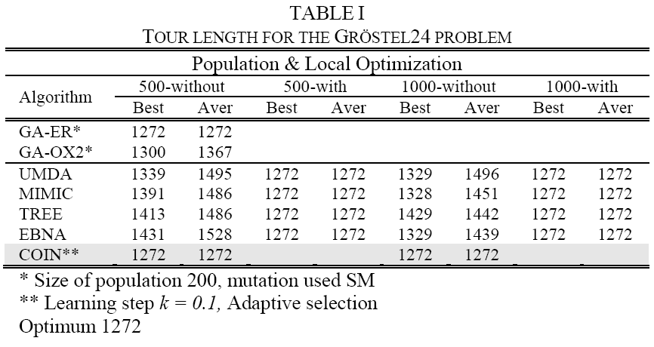
TSP

Slide 45
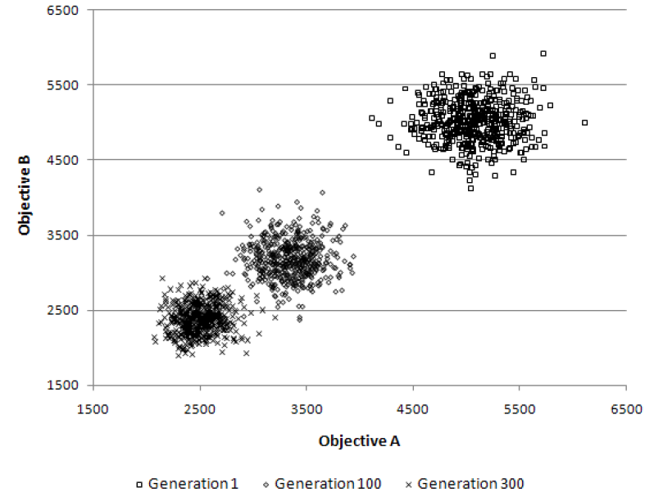
Multi-objective TSP
The population clouds in a random 100-city 2-obj TSP

Slide 46
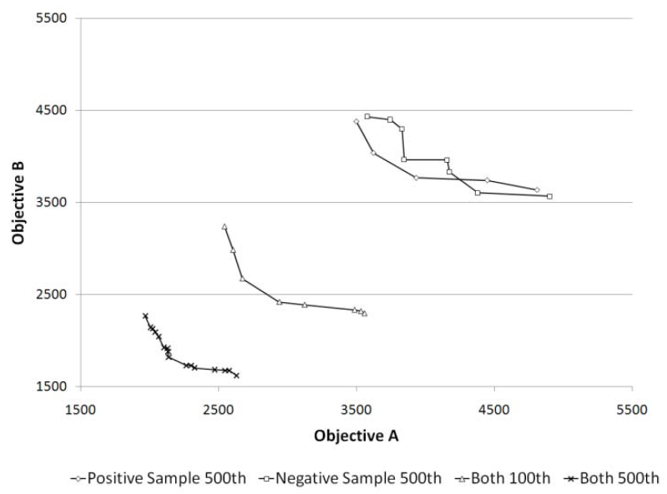
Role of Negative Correlation

Slide 47
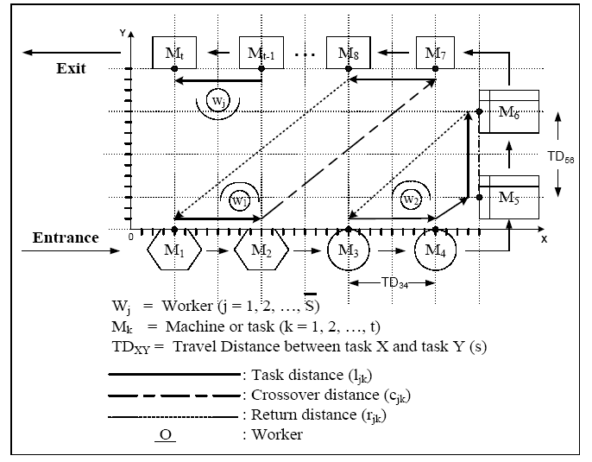
U-shaped assembly line for j workers and k machines

Slide 48
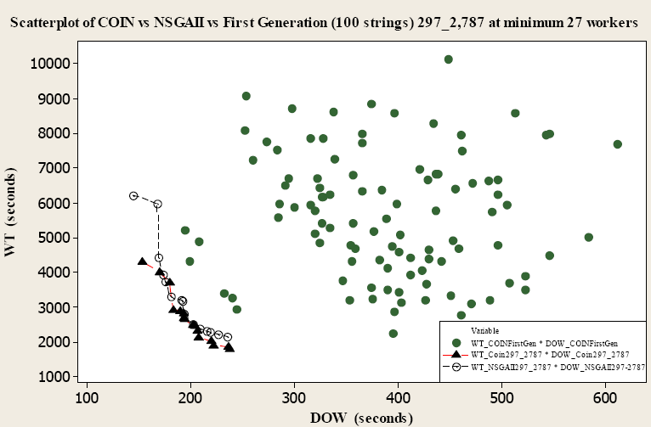
Comparison for Scholl and Klein’s 297 tasks at the cycle time of 2,787 time units

Slide 49
n-queens (b) n-rooks (c) n-bishops
(d) n-knights
Available moves and sample solutions
to combination problems on a 4x4 board

Slide 51


Slide 52
More Information
COIN homepage
http://www.cp.eng.chula.ac.th/~piak/project
/coin/index-coin.htm

