Slide 1
Digital Civilization: Future of Digital Society
Prabhas Chongstitvatana
Chulalongkorn University

Slide 2
Civilization
A civilization is any complex society characterized by urban development, social stratification, symbolic communication forms (typically, writing systems), and a perceived separation from and domination over the natural environment.
Wikipedia
Notes:
Civilization also refers to the process of a society developing into a centralized, urbanized, stratified structure.
Civilizations are organized in densely populated settlements divided into hierarchical
social classes with a ruling elite and subordinate urban and rural populations, which
engage in intensive agriculture, mining, small-scale manufacture and trade. Civilization
concentrates power, extending human control over the rest of nature, including over
other human beings.

Slide 3
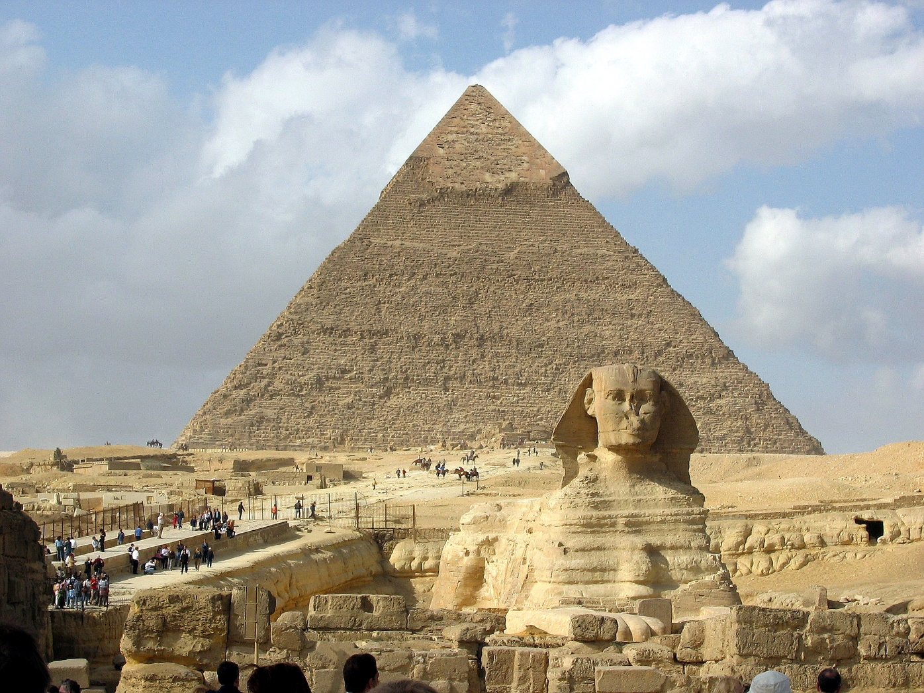

Slide 4
Civilization can also refer to the culture of a complex society.
Civilizations tend to develop intricate cultures, including a state-based decision making apparatus, a literature, professional art, architecture, organized religion, and complex customs of education, coercion and control associated with maintaining the elite.
Notes:
Every society, civilization or not, has a specific set of ideas and customs, and a certain set of manufactures and arts that make it unique.

Slide 5
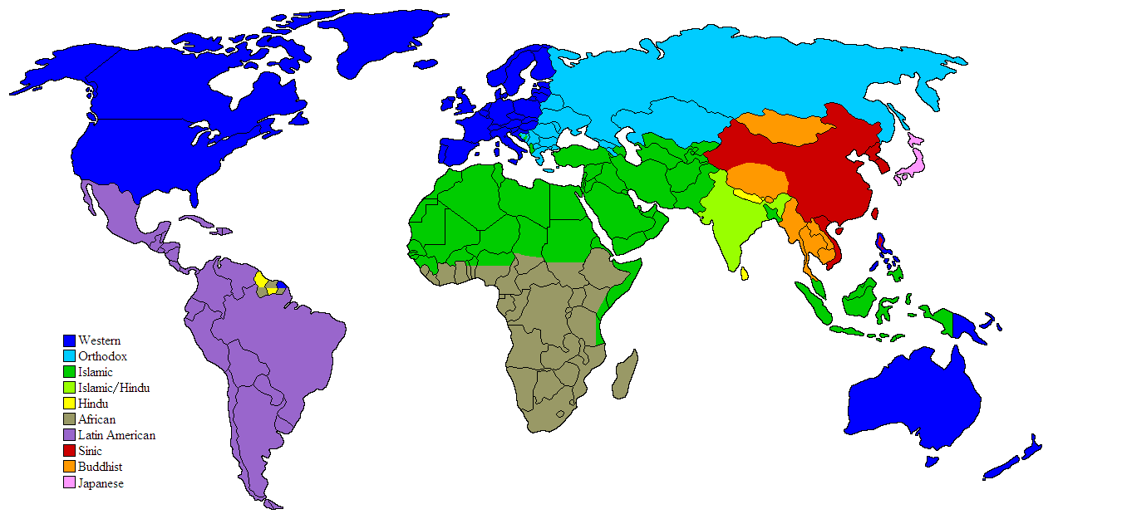
"Clash of Civilizations mapn2" by en:en:User:Kyle Cronan and en:en:User:Olahus - imported from enwiki. Licensed under GFDL via Commons - https://commons.wikimedia.org/wiki/File:Clash_of_Civilizations_mapn2.png#/media/File:Clash_of_Civilizations_mapn2.png

Slide 6
Digital Society
People engage in digital space
Value creation
Shift in power toward citizen, consumer
Social media penetration daily life
Difficult to control information flow

Slide 7
Old classic value creation vs Open Innovation
Open Government: increase interaction with public
Open Access: dissemination of scientific information
Spreading knowledge efficiently, economically
Open culture: free knowledge leads to innovation
Collaborative digital society
source: Deutsche Bank https://www.dbresearch.com

Slide 8
The Digital Economy and Society Index
The Digital Economy and Society Index (DESI) is a composite index that summarises relevant indicators on Europe’s digital performance and tracks the evolution of EU member states in digital competitiveness.

Slide 9
DESI
1 Connectivity
2 Human Capital
3 Use of Internet
4 Integration of Digital Technology
5 Digital Public Services
Notes:
1 Connectivity
The Connectivity dimension measures the deployment of broadband infrastructure and its quality. Access to fast broadband-enabled services is a necessary condition for competitiveness.
2 Human Capital
The Human Capital dimension measures the skills needed to take advantage of the possibilities offered by a digital society. Such skills go from basic user skills that enable individuals to interact online and consume digital goods and services, to advanced skills that empower the workforce to take advantage of technology for enhanced productivity and economic growth.
3 Use of Internet
The Use of Internet dimension accounts for the variety of activities performed by citizens already online. Such activities range from consumption of online content (videos, music, games, etc.) to modern communication activities or online shopping and banking.
4 Integration of Digital Technology
The Integration of Digital Technology dimension measures the digitisation of businesses and their exploitation of the online sales channel. By adopting digital technology businesses can enhance efficiency, reduce costs and better engage customers, collaborators and business partners. Furthermore, the Internet as a sales outlet offers access to wider markets and potential for growth
5 Digital Public Services
The Digital Public Services dimension measures the digitisation of public services, and focuses in particular on eGovernment and eHealth. Modernisation and digitisation of public services, including eHealth, can lead to efficiency gains for the public administration, citizens and businesses alike as well as to the delivery of better services for the citizen.

Slide 10
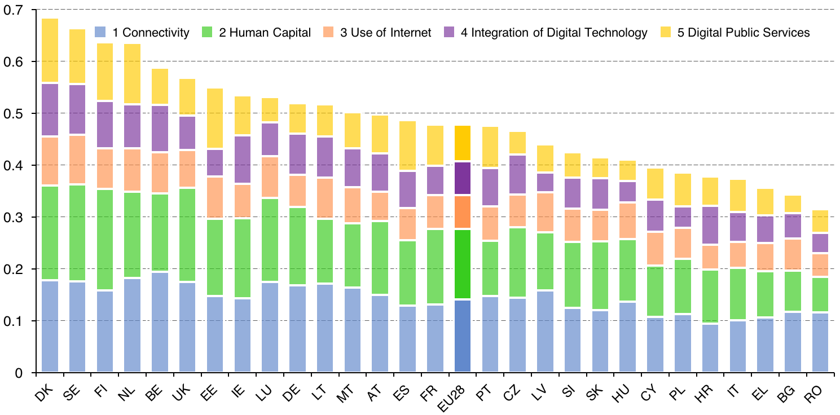

Slide 11
Thailand Digital Economy Plan

Slide 12
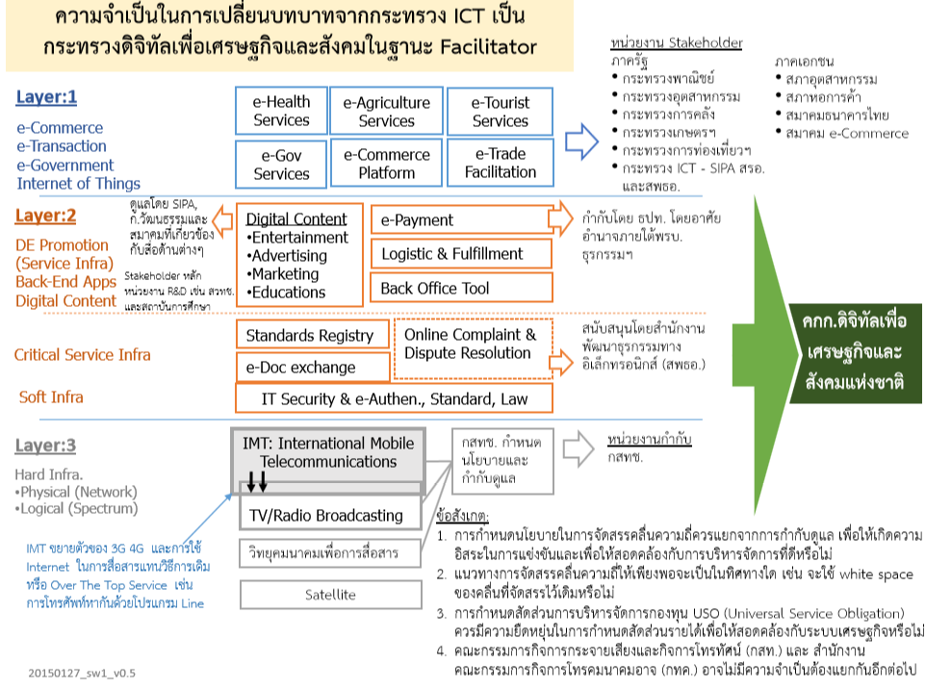

Slide 13
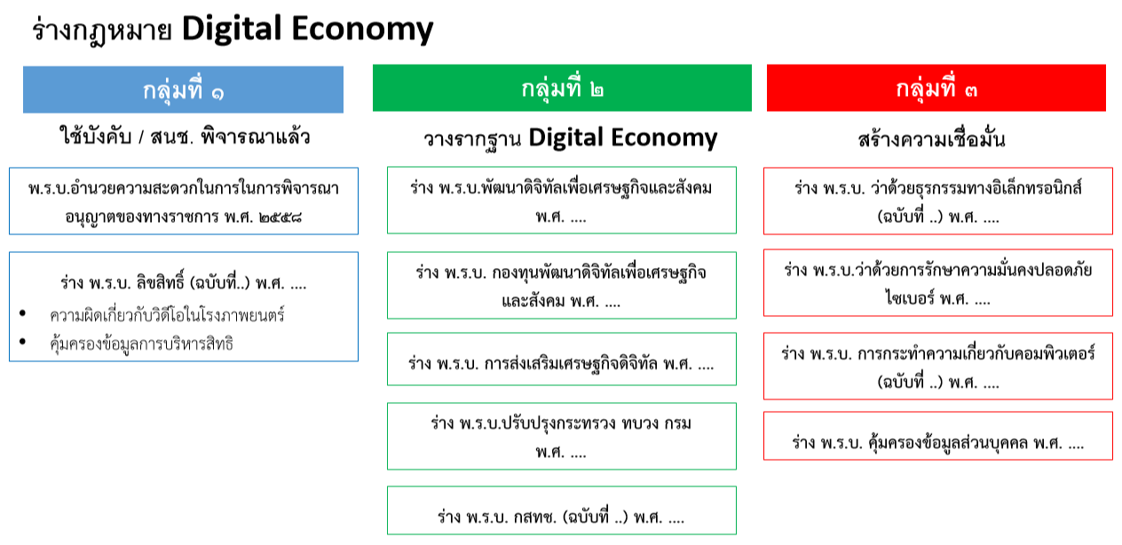
Notes:
12 issues of law

Slide 14
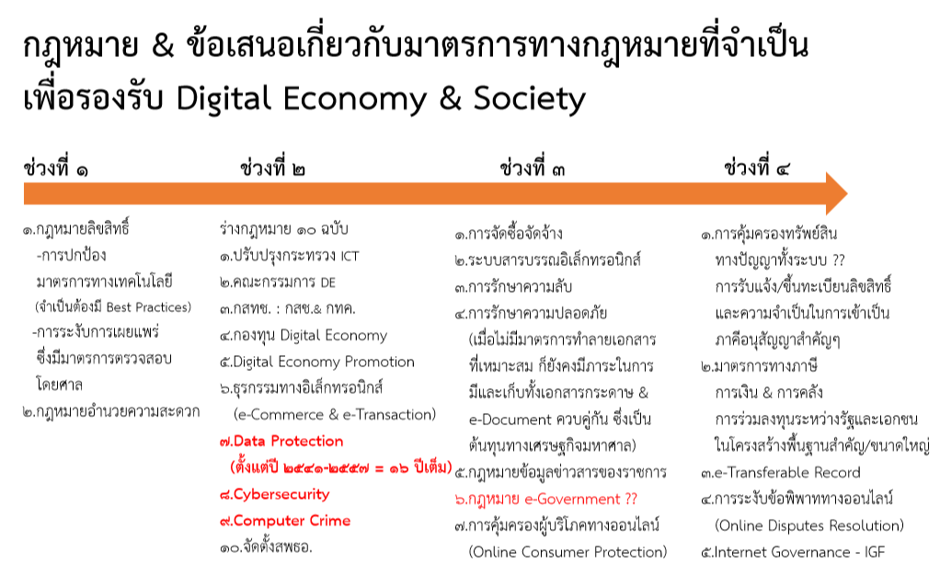

Slide 15
Digital Civilization
We are becoming more digital society.
Individual becomes more empowered.
Nation becomes borderless.

Slide 16

The end of nation state, by Kenichi Ohmae, 1996
Notes:
Nations are becoming obsolete from an economic standpoint, declares Tokyo-based business
consultant Ohmae (The Borderless World). He argues that the traditional nation-state,
now beholden to domestic special interests, its government "an enemy of the public at
large," has become an inefficient, even impossible, business unit in the new global
economy. Instead of a world order based on discrete, independent nations, Ohmae
envisions autonomous networks of what he calls "region states"? geographically linked
economic zones that forge productive ties with the global marketplace by putting the
right policies, information technology and infrastructure in place.

Slide 17
My Scenario
Citizenship is not only qualified by race, birthplace, religious belief, but people can applied for it.
Citizenship offers benefits for its citizen.
At the same time, citizen creates wealth for "nation".
A person can have many citizenship.
A nation must "acquire" her valuable citizen.

Slide 18
Future
Human society will accelerate to overcome "difference" in culture, belief, race.
Society will "share" more common wealth.
Society will be truly "globalise" and yet "localise".

Slide 19
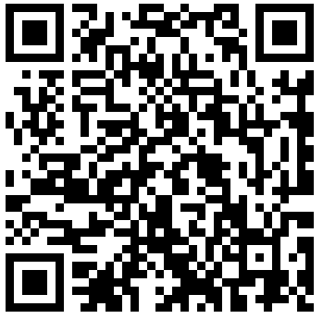
More Information
Search “Prabhas Chongstitvatana”

