Slide 1
Problem Identification
Prabhas Chongstitvatana
Faculty of Engineering
Chulalongkorn University

Slide 2
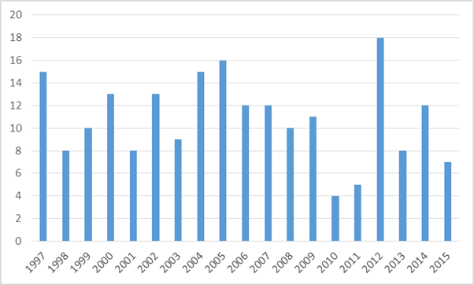
The speaker
Department of Computer Engineering

Slide 3
This perhaps is one of the most difficult question every researchers must confront.
It sounds hard but it is not.
There are several approaches to tackle this question.
I will show you a few of my tricks.

Slide 4
Outline
Make a right aim
Execute the right steps
Examples from real-life

Slide 5
Make a right aim
Level
  domestic
  regional
  international

Slide 6
Make a right aim
Perspective
  self-centred
  present market
  future

Slide 7
Make a right aim
Objective
  to complete a degree requirement
  to meet an academic promotion
  to solve problems
  to satisfy one's curiosity

Slide 8
Method
What should be the topic of research?
How can we "create" a suitable topic?
The important things are
  the "newness" of the subject.
  the "value" of the subject.

Slide 9
Value
The value of short term research is the immediate application of knowledge to real-world problems.
The value of medium term research is the development and improvement of new methods.
The value of long term research is the discovery of new knowledge.

Slide 10
Evaluation
In research, we control the quality by "peer review". That is, we believe that the best person to "valuate" our work is the person who is knowledgable in the field, our "peer".

Slide 11
Exercise in "valuating" research work
What is the value of theses done in Thailand. In most library, there are a lot of theses in the shelves. How can we say these theses are useful? Who use it?
During postgraduate study, we are reading a lot of other people work. What is the value of the material we are reading? Why are we reading it?

Slide 12
Method
Lecturer
  find academic companion
  use strength, advantage of environment
Student
  choose by topics
  choose by advisors
  choose by skill set

Slide 13
Create a topic
1 from the real-world problems
2 from the boundary of current knowledge
3 from imagination

Slide 14
Tips
Lecturer
  aim for long term
  must rejuvenate motivation and curiosity
Student
  don't do what you are not good at
  don't do things that take too much time than you have

Slide 15
Step of doing research
1 Post a problem statement
2 Design a method to solve the problem
3 Negotiate the expectation of the result
4 Do it

Slide 16
Success Factors in Research
Computing Knowledge
Determination
Funding
Motivation
Maturity
Research
Perseverance
Luck
Independence
English
Scientific Method
Analytical Skill
Reading & Writing Skills

Slide 17
Real Examples
Read other works then make it better (sudoku)
Do what you are interested in then compare with others (cpu)
Invent and find its advantage (coin)
Solve a problem then differentiate (solder)

Slide 18
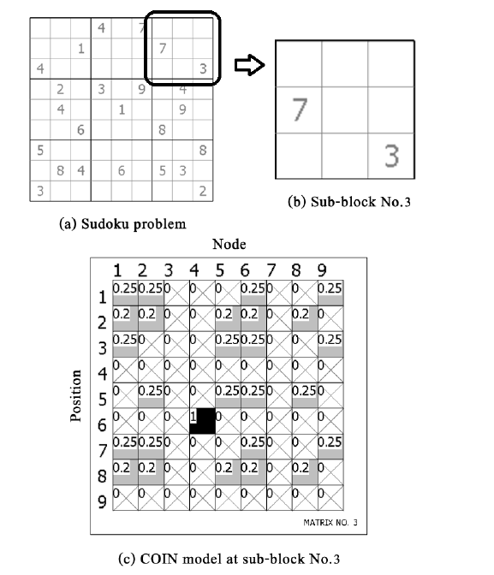
Solving Sudoku Puzzles with Node Based Coincidence Algorithm

Slide 19
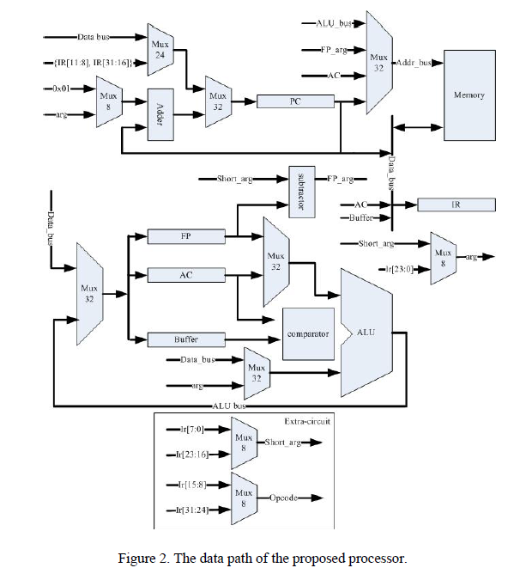
An Embedded Processor with Instruction Packing

Slide 20
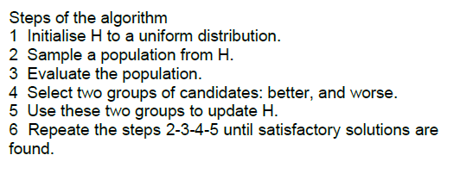
Coincidence Algorithm

Slide 21
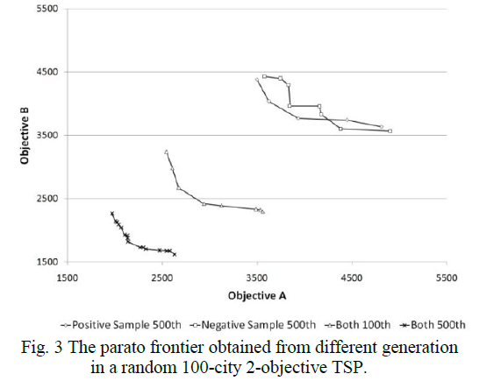
Coincidence Algorithm

Slide 22



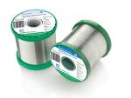

Lead-free Solder Alloys
Lead-based Solder
Low cost and abundant supply
Forms a reliable metallurgical joint
Good manufacturability
Excellent history of reliable use
Toxicity
Lead-free Solder
No toxicity
Meet Government legislations
(WEEE & RoHS)
Marketing Advantage (green product)
Increased Cost of Non-compliant parts
Variation of properties (Bad or Good)

Slide 23
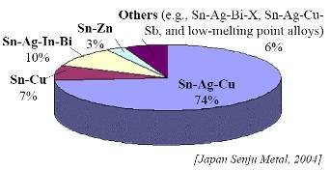
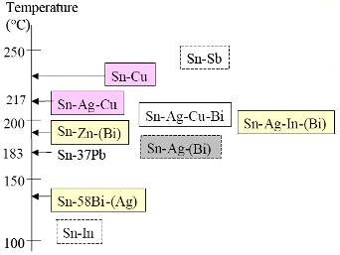
Sn-Ag-Cu (SAC) Solder
Advantage
Sufficient Supply
Good Wetting Characteristics
Good Fatigue Resistance
Good overall joint strength
Limitation
Moderate High Melting Temp
Long Term Reliability Data

Slide 24
You will
Read a lot, to know what is the current state of the art
Talk a lot, to synthesis your idea
Write a lot, to make your idea concrete and to communicate your idea formally.

Slide 25
Supervised Research
Good communication between you and your advisor
Work out what will be the result of your reseach. Discuss it with your advisor
Convince yourself of the "value" of your proposed research. Also convince your advisor.
Your advisor will guide you through the jungle of difficulty. (and not really tell you how to do it)

Slide 26
Pit falls of Grad Students
Don't choose the topic that requires new skill. For example, if you are proficient C programmer, use C. Don't try to learn a new language for your thesis. The time is too short.
Get the scope of your work right. Most oftenly, you underestimate the amount of work required and overestimate your ability. The time is too short.
The time is always too short. Don't postpone any work, do it now.

Slide 27
My own observation
Research is very much social activities
but a lot of time you need quiet time and place to think hard.
Motivation is very important
find the topic that suite your interest and work with your advisor to make it doable.
Publication always takes more time than you expect.
Start writing a thesis is difficult but finishing one is easy.

Slide 28
Tips
Read is NOT Do
Know is NOT Understand

Slide 29


Slide 30
Enjoy doing research!

Slide 31
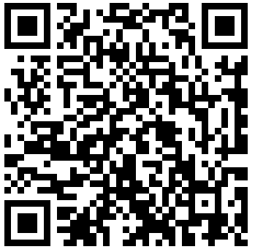
More Information
Search “Prabhas Chongstitvatana”
Get to me homepage

