Slide 1
Artificial Intelligence
Prabhas Chongstitvatana
Chulalongkorn University
prabhas.c@chula.ac.th

Slide 2
AI : Past, Present, Future

Slide 3
Why AI is popular today?

Slide 4
Performance in "human task"
Tagging Faces
Search Music
Personal assistance
Play Go

Slide 5
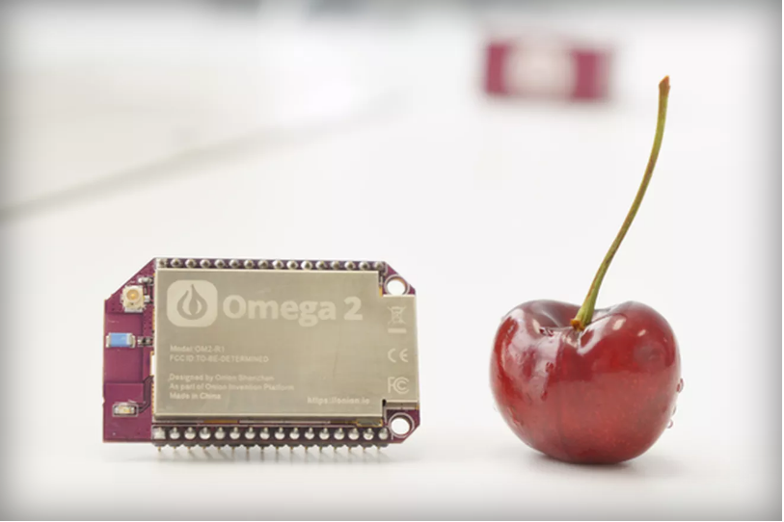
Tiny computer for 5 dollars
Notes:
For 5 bucks, you get a 580 MHz CPU, 64MB of memory, and 16MB of storage. built-in Wi-Fi. Onion has a cloud-based feature called Onion Cloud that allows you to control the Omega2 via the web browser

Slide 6
Past
Symbolic AI
based on Predicate logic
Physical Symbol Hypothesis
Connectionist

Slide 7
Physical Symbol Hypothesis
"A physical symbol system has the necessary and sufficient means for general intelligent action."
— Allen Newell and Herbert A. Simon
General Problem Solver

Slide 8
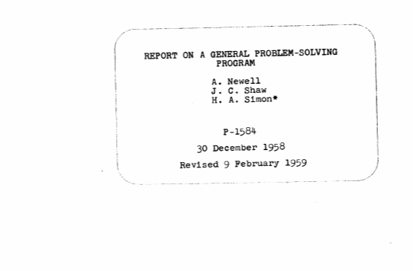
General Problem Solver

Slide 9
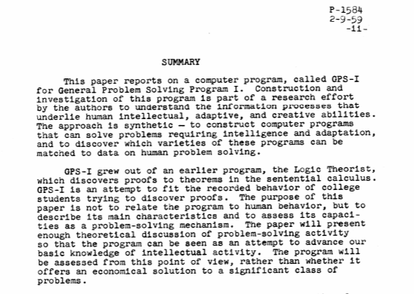

Slide 10
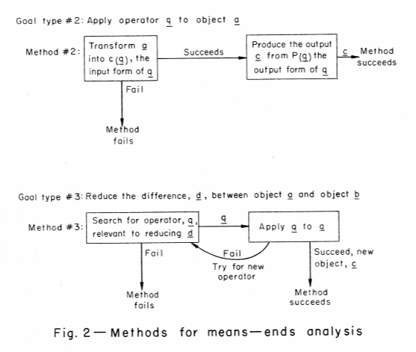
Means – Ends Analysis

Slide 11
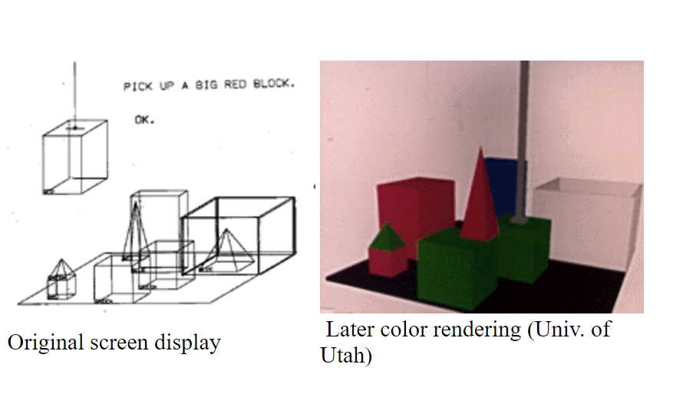
SHDRLU

Slide 12
SHDRLU
Here is a famous demonstration of SHRDLU:
Person: Pick up a big red block.
Computer: OK.
Person: Grasp the pyramid.
Computer: I DON'T UNDERSTAND WHICH PYRAMID YOU MEAN.
Person (changing their mind): Find a block which is taller than the one you are holding and put it into the box.
Computer: BY "IT", I ASSUME YOU MEAN THE BLOCK WHICH IS TALLER THAN THE ONE I AM HOLDING.
Computer: OK.
Person: What does the box contain?
Computer: THE BLUE PYRAMID AND THE BLUE BLOCK.
Person: What is the pyramid supported by?
Computer: THE BOX.
Person: How many blocks are not in the box?
Computer: FOUR OF THEM.

Slide 13
Example of logic system
Cyc
started in 1984 by Dough Lenat (ID3)
encyclopedia + everyday knowledge
(such as people will die)
in June 2012 the knowledge base contains 239,000 concepts and 2,039,000 facts
can be browsed on OpenCyc website

Slide 14
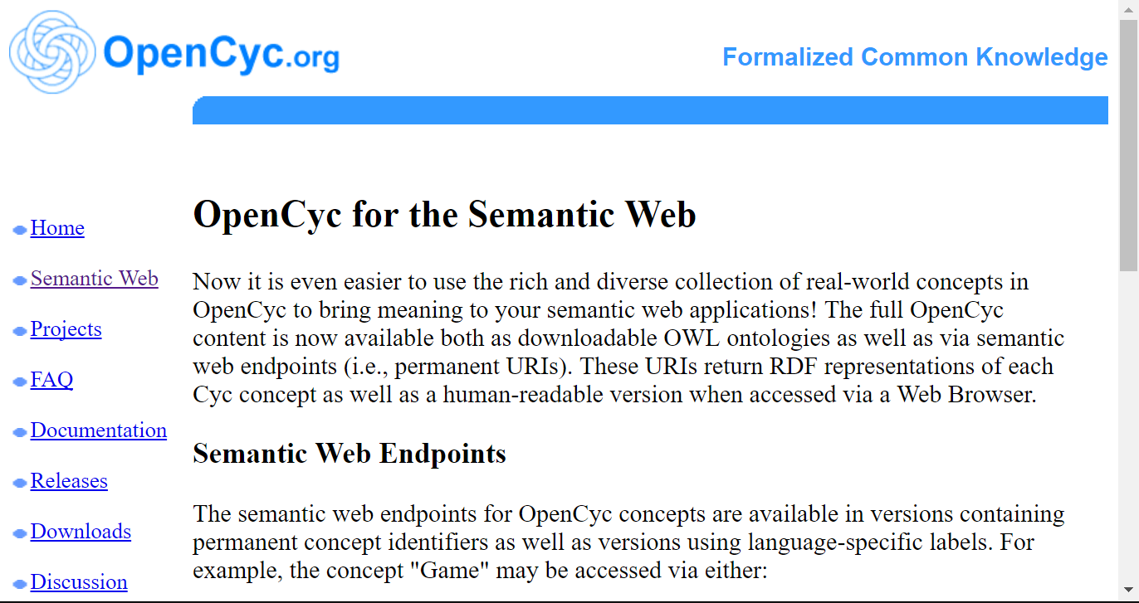
OpenCyc

Slide 15
Special Machines for Logic Systems
Japan Fifth Generation Computer System
Knowledge Information Processing systems" (applied Artificial Intelligence)
10 years project, start 1982, $400 millions
Logic system

Slide 16
Connectionist
Artificial Neural Networks
Deep learning

Slide 17
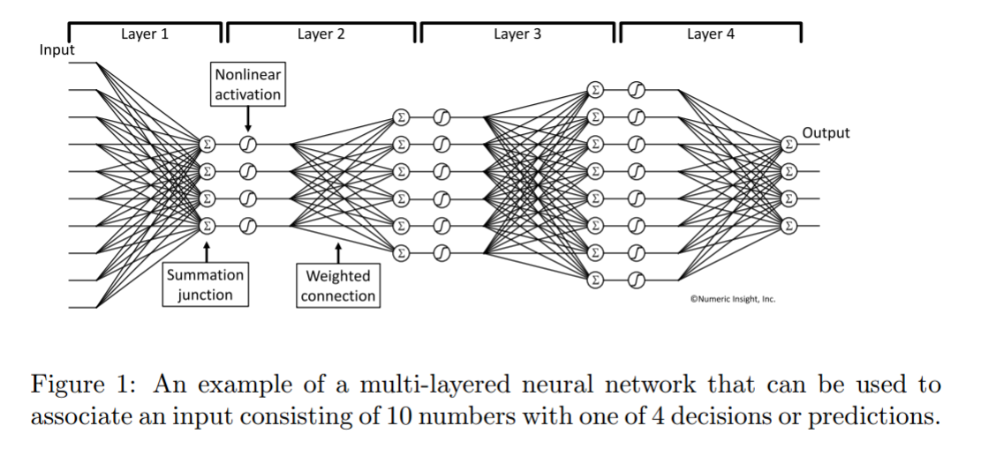
Artificial Neural Networks

Slide 18
Machine learning
Machines with common sense

Slide 19
Generate Music with GA
GenJam

Slide 20
Present
machine learning in computer vision
Alpha Go

Slide 21
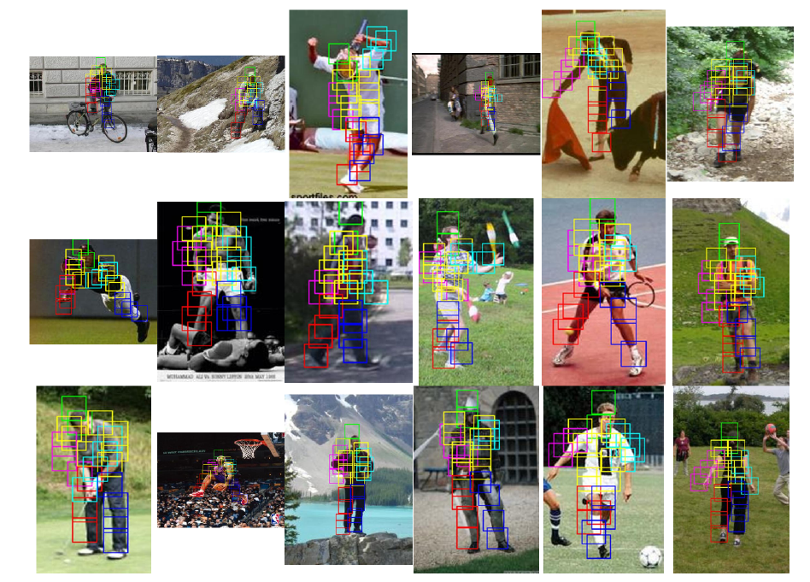
Object Recognition

Slide 22
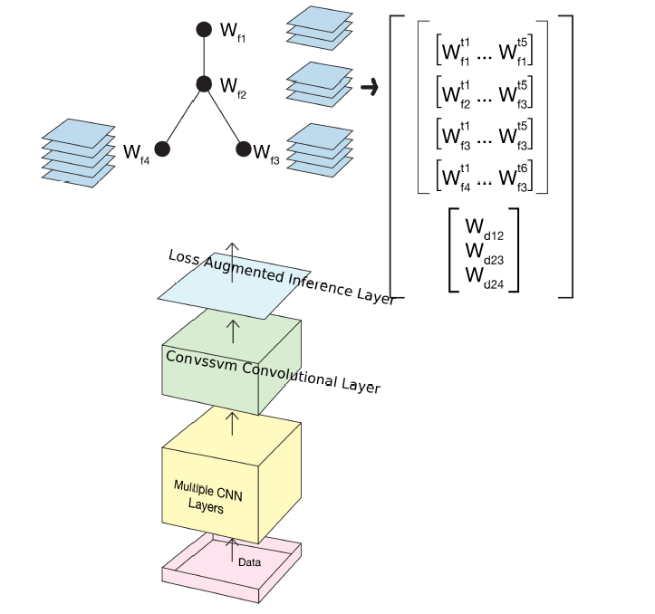
Deep Learning

Slide 23
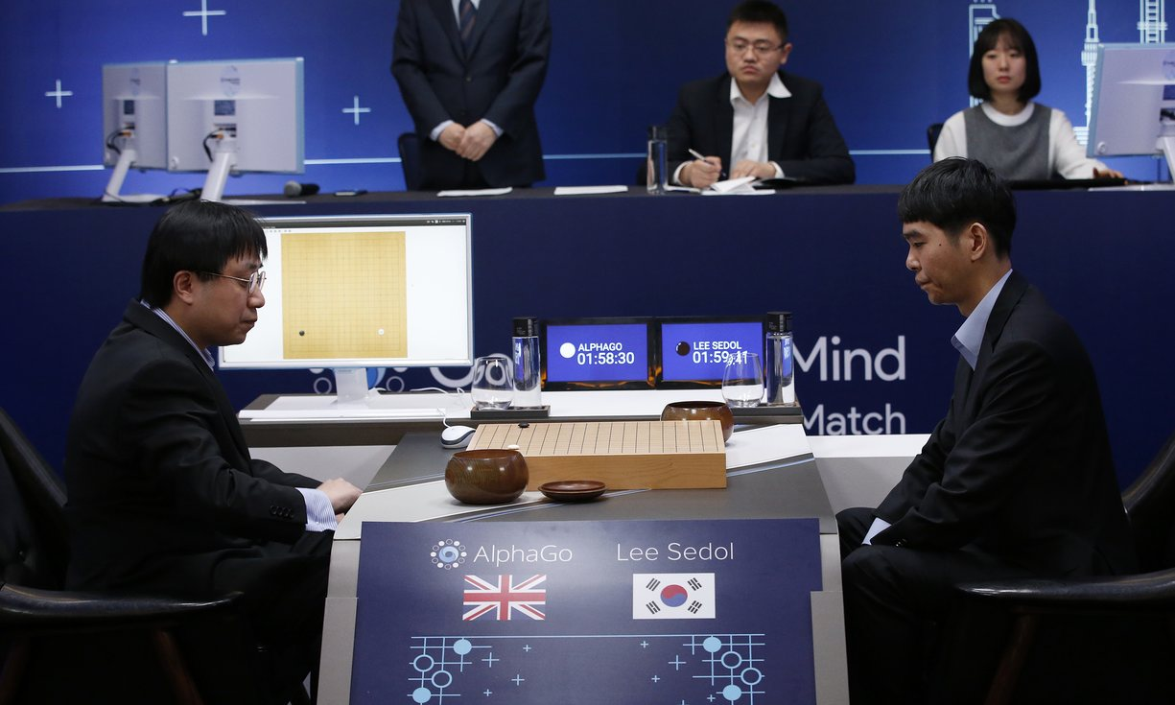
AlphaGo vs Lee Seidol, March 2016

Slide 24
Alpha Go
"Mastering the game of Go with deep neural networks and tree search". Nature. 529 (7587): 484–489.
Deep learning
Monte Carlo Tree search

Slide 25
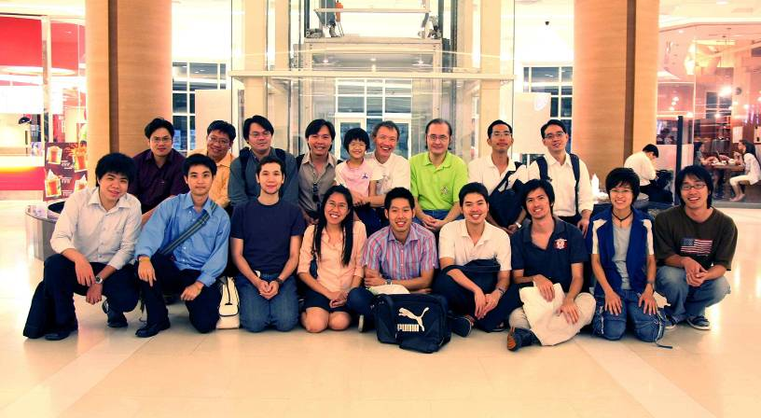
Team work

Slide 26

More Information
Search “Prabhas Chongstitvatana”
Get to me homepage

