Slide 1
Quantum Computing: an introduction
Prabhas Chongstitvatana
Computer Engineering
Chulalongkorn University

Slide 2
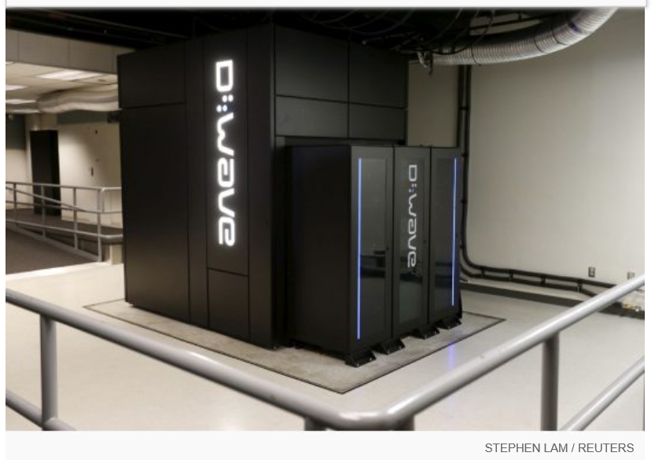
Google Nasa, D-Wave 2x machine

Slide 3
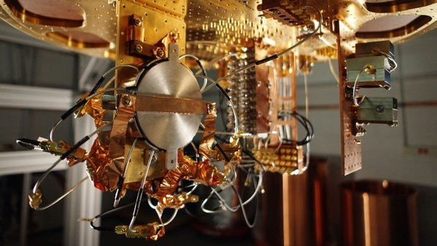
Quantum bit in D-wave machine

Slide 4
What is a quantum computer?
a computer that relies on special memory, "quantum bit", to perform massively parallel computing.

Slide 5
What is a quantum computer?
a computer that relies on special memory, "quantum bit", to perform massively parallel computing.

Slide 6
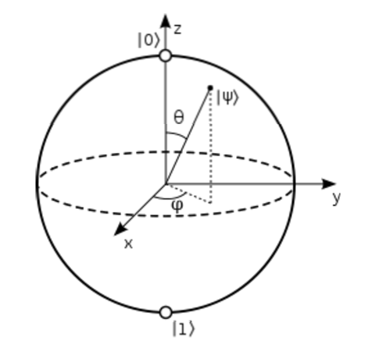

Slide 7
What is the advantage?
it is very very fast compared to conventional computers.

Slide 8
Analogy
We have multiple keys. We want to find out what key fits a given keyhole.

Slide 9
Serial computers
try each key, until we find the one that fits.
this is resource efficient but take a long time.

Slide 10
Parallel computers
duplicate keyholes, try all keys at once.
this is very fast but take a lot of resource.

Slide 11
Quantum computers
all keyholes are stored in
"quantum bits", try all keys at once.
this is resource efficient and very fast.

Slide 12
How to make a quantum bit?
"quantum effect"
photon entanglement
cold atom
electron spin

Slide 13
Components
Quantum circuit
Quantum gates
components of quantum computers that manipulate state of quantum bits.

Slide 14
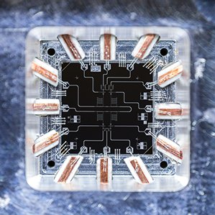
Quantum Gates

Slide 15
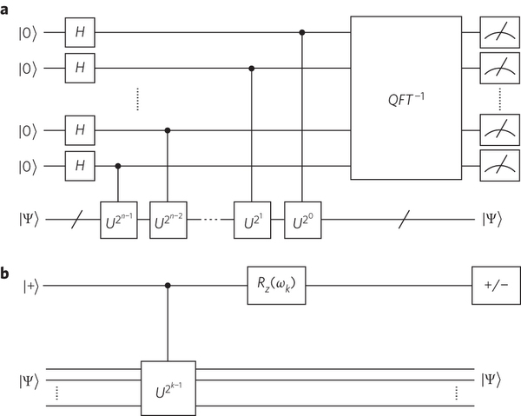
Quantum circuits

Slide 16
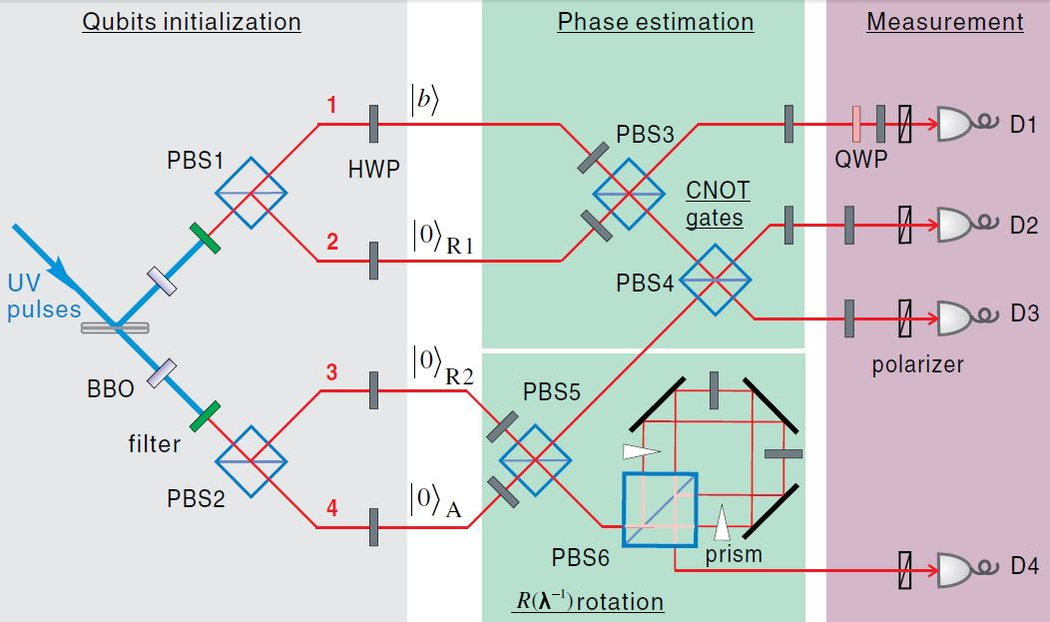
Quantum circuits

Slide 17
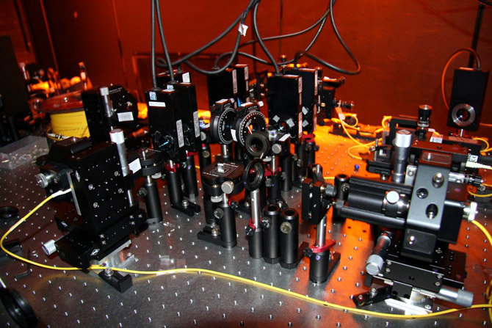

Slide 18
Quantum algorithms
computer programs that work on quantum computers

Slide 19
Famous algorithms
Shor's integer factorization
Given an integer N, find its prime factors

Slide 20
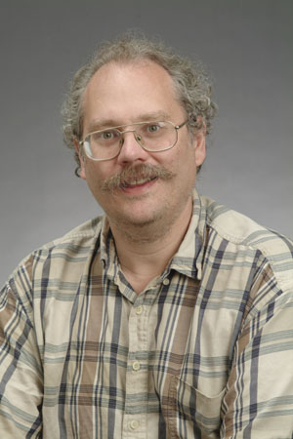
Quantum Algorithms
Peter Shor
a quantum algorithm for integer factorization formulated .

Slide 21
Shor’s algorithm
The factorization also needs huge amount of quantum gates. It increases with N as (log N)³. Thus factoring of a 4096-bit number requires 4,947,802,324,992 quantum gates.

Slide 22
Example of quantum computers
ibm 5 qubits
D-wave two, quantum annealing

Slide 23
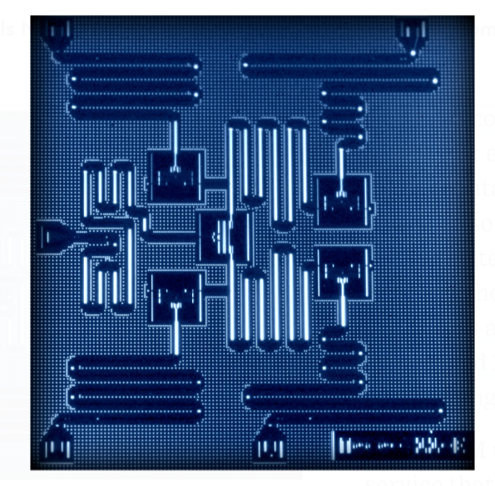
IBM 5 qubits processor

Slide 24
Google Nasa, D-Wave 2x machine

Slide 25
Recent work
google quantum lab's paper
claim of 100,000,000x speed up

Slide 26
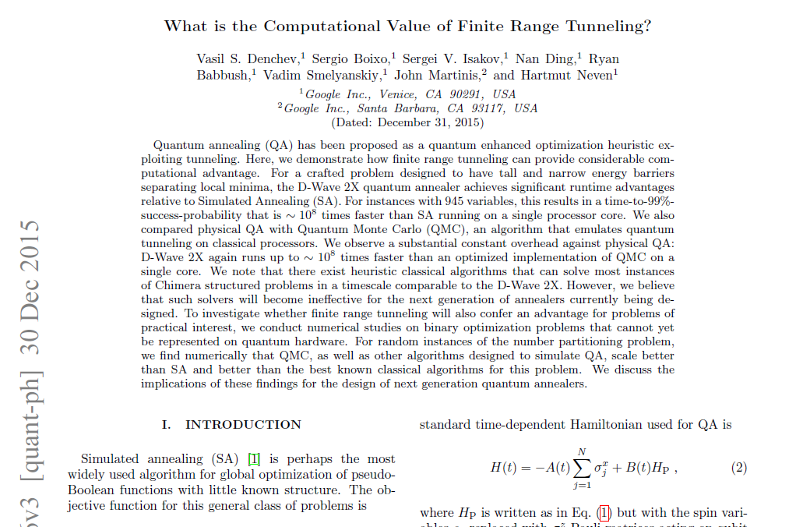

Slide 27
My own example of quantum computation
compact genetic algorithm by quantum computers
exponential speedup

Slide 28
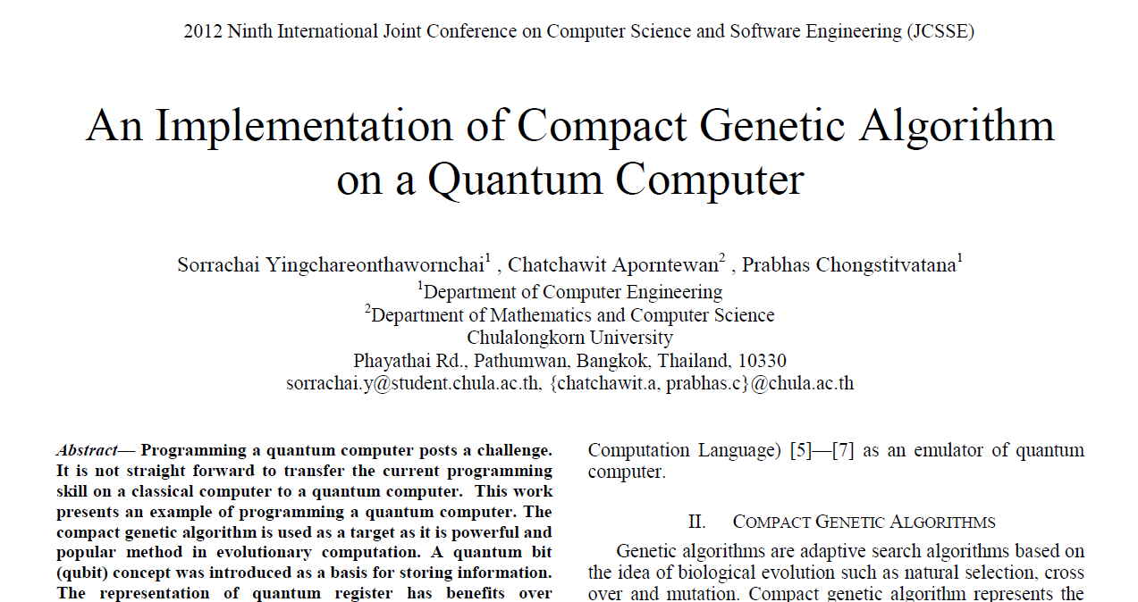

Slide 29
Example of Quantum Algorithm
Yingchareonthawornchai, S., Aporntewan, C., and Chongstitvatana, P., "An Implementation of Compact Genetic Algorithm on a Quantum Computer," Int. Joint Conf. on Computer Science and Software Engineering (JCSSE), 30 May - 1 June 2012, pp.131-135.
http://www.cp.eng.chula.ac.th/~piak/paper/2012/jcsse-quantum-cga.pdf

Slide 30
Future
qubits
quantum annealing computers
scaling up

Slide 31
Predicting future
uncertain of success
special purpose quantum computers
quantum style will motivate a new class of computation

Slide 32
Current issues in Quantum computing
You can read more information on the current issues in Quantum computing from this page. I gave a talk to graduate students in computer engineering in January 2016.
http://www.cp.eng.chula.ac.th/~piak/talk/2016/issues-in-quantum-computing.htm

Slide 33

More Information
Search “Prabhas Chongstitvatana”
Get to me homepage

