Slide 1
Quantum Computing: an introduction
Prabhas Chongstitvatana
Computer Engineering
Chulalongkorn University

Slide 2
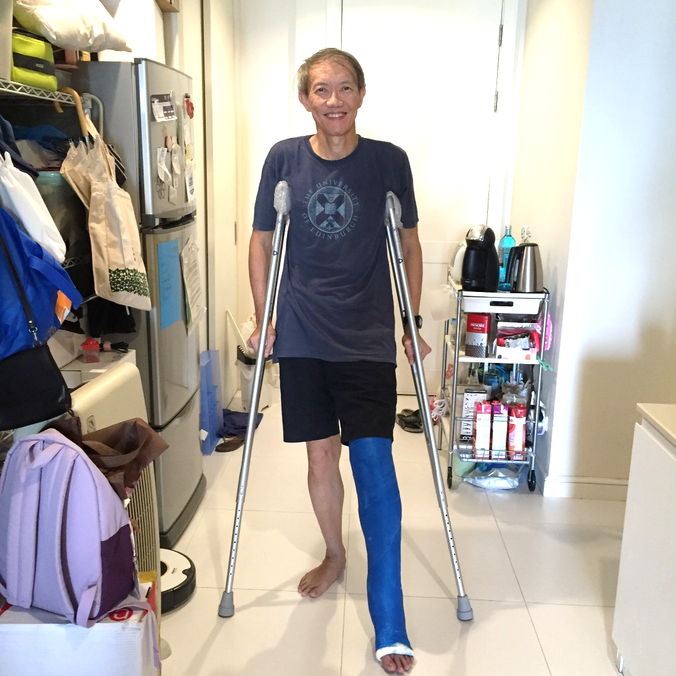
Greeting

Slide 3
What is a quantum computer
First, please watch a short video explaining what is a quantum computer.
https://www.youtube.com/watch?v=w_-_H9eBte8

Slide 4
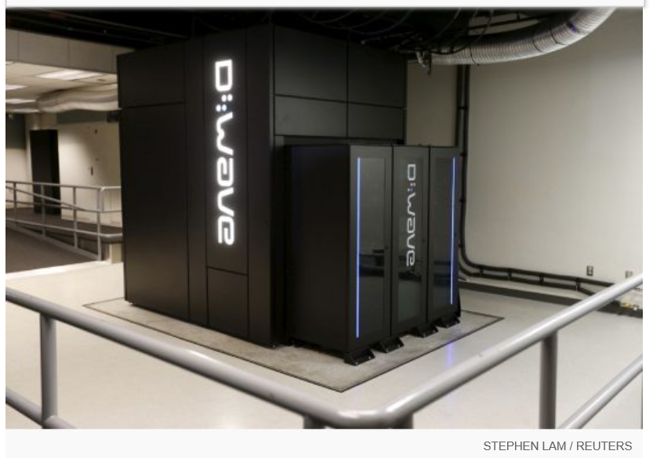
Google Nasa, D-Wave 2x machine

Slide 5
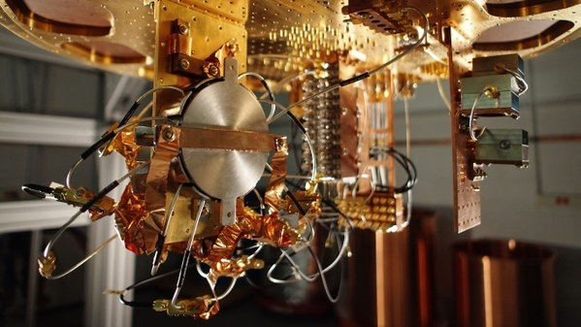
Quantum bit in D-wave machine

Slide 6
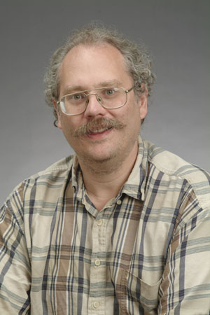
Quantum Algorithms
Algorithm that runs on a quantum computer
1994 Peter Shor -- a quantum algorithm for integer factorization formulated .
Given an integer N, find its prime factors

Slide 7
Shor’s algorithm
The factorization also needs huge amount of quantum gates. It increases with N as (log N)³. Thus factoring of a 4096-bit number requires 4,947,802,324,992 quantum gates.

Slide 8
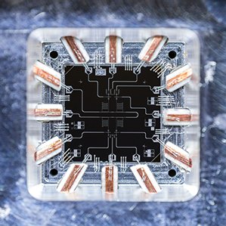
Quantum Gates

Slide 9
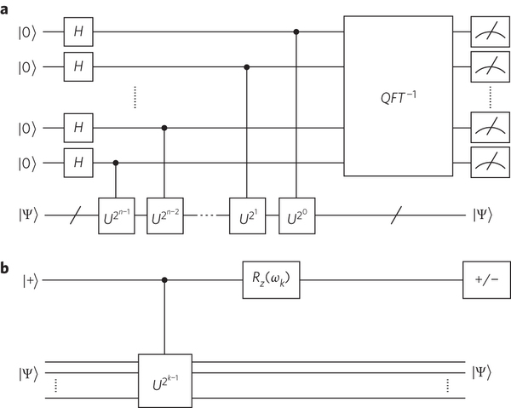
Quantum circuits

Slide 10
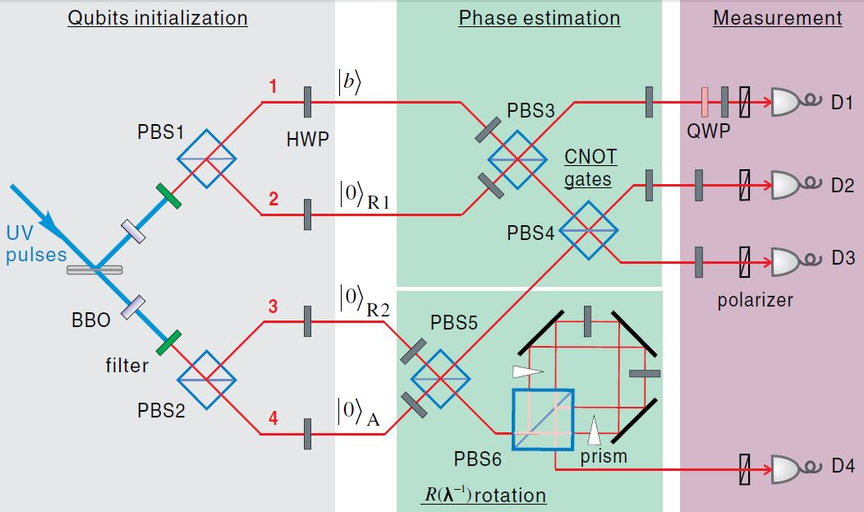
Quantum circuits

Slide 11
Example of Quantum Algorithm
I have one paper published in 2012. My result achieved an exponential speed up.
Yingchareonthawornchai, S., Aporntewan, C., and Chongstitvatana, P., "An Implementation of Compact Genetic Algorithm on a Quantum Computer," Int. Joint Conf. on Computer Science and Software Engineering (JCSSE), 30 May - 1 June 2012, pp.131-135.
http://www.cp.eng.chula.ac.th/~piak/paper/2012/jcsse-quantum-cga.pdf

Slide 12
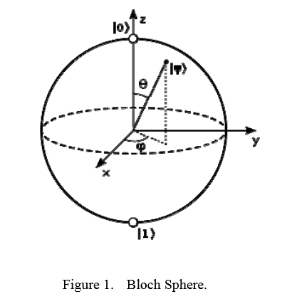
Representation of a qubit

Slide 13
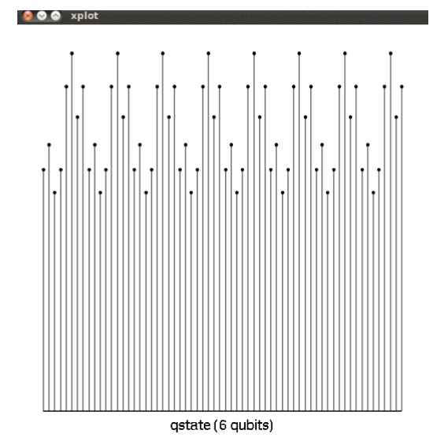
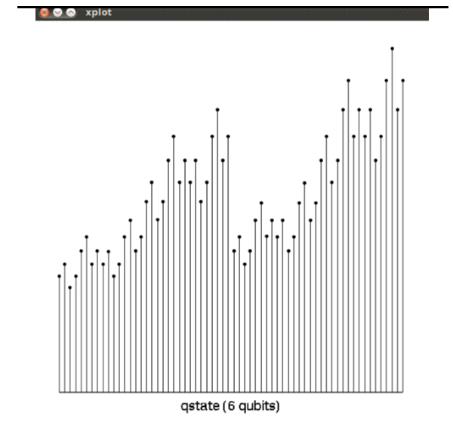
output

Slide 14
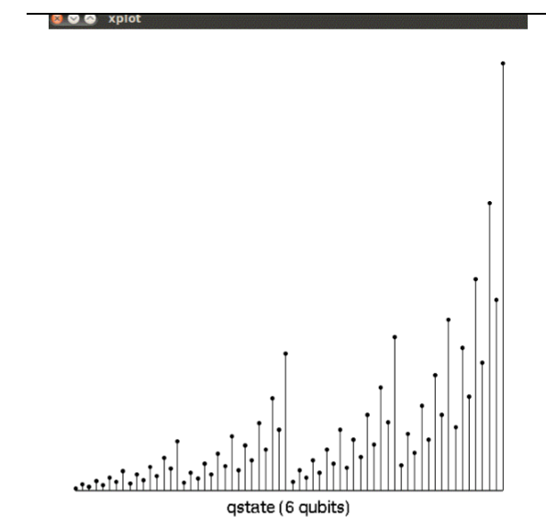
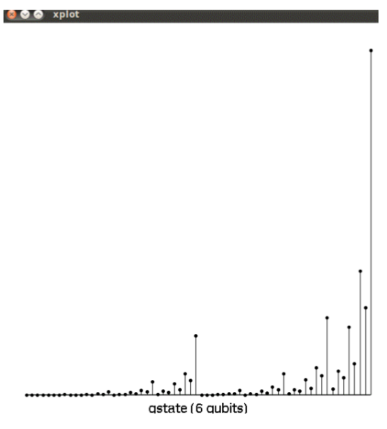
output

Slide 15
Current issues in Quantum computing
You can read more information on the current issues in Quantum computing from this page. I gave a talk to graduate students in computer engineering in January 2016.
http://www.cp.eng.chula.ac.th/~piak/talk/2016/issues-in-quantum-computing.htm

Slide 16

More Information
Search “Prabhas Chongstitvatana”
Get to me homepage

