Slide 1
Artificial Intelligence and Society
Prabhas Chongstitvatana
Chulalongkorn University

Slide 2
What is AI?
What is its impact on society?
Future of AI

Slide 3

More Information
Search “Prabhas Chongstitvatana”
Go to me homepage

Slide 4
What is AI?
an intelligent agent that acts like human.
this includes software services (aka Apps) and automated machines (think smart robot vacuum, automated factory etc.).

Slide 5
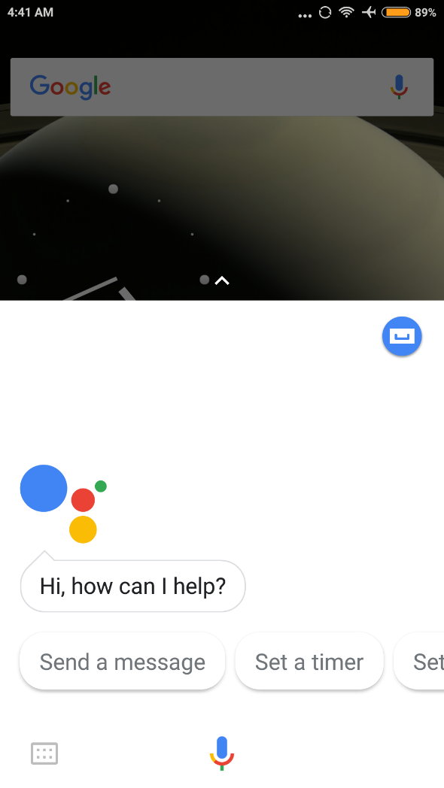
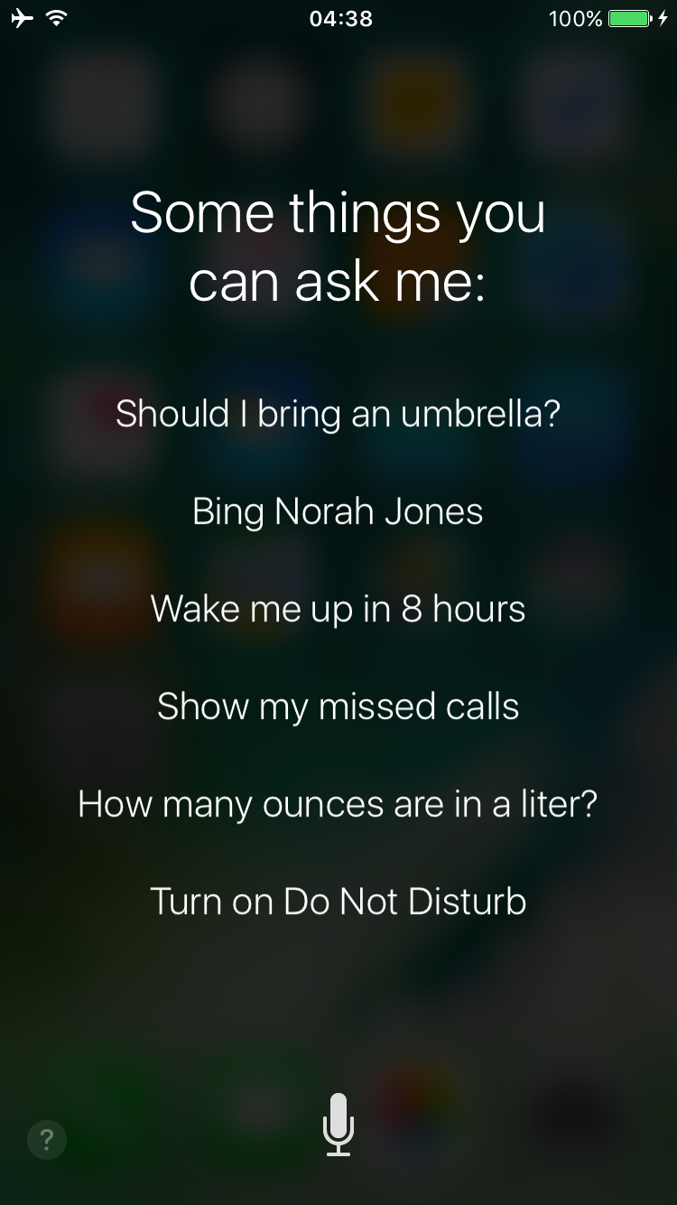

Slide 6
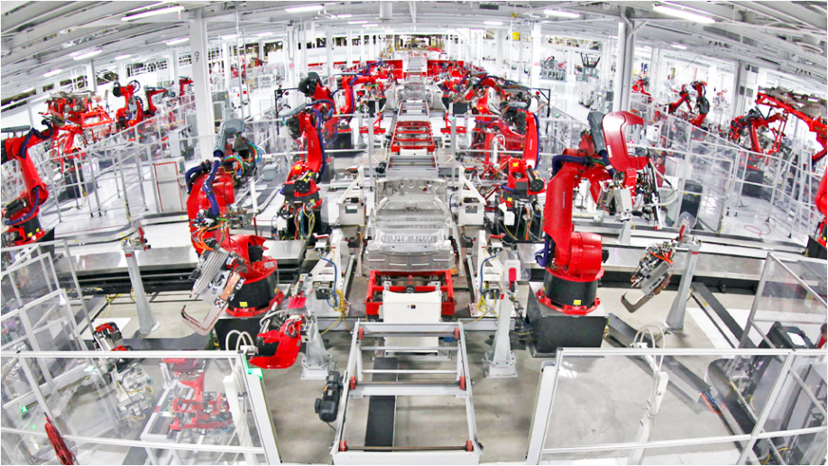

Slide 7
What can AI do?
understand human speech
identify objects from pictures
play games
analyse big financial data
drive cars
control robots
automate many jobs

Slide 8
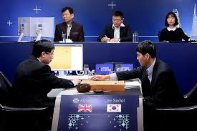

Slide 9
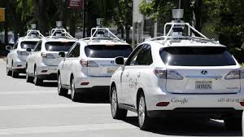

Slide 10
How a computer program be intelligent?
There are two approaches in the development of AI.
Logic
Memory an learning

Slide 11
First, using logical reasoning.
Computer program can perform deductive reasoning such as
socrates is a human
human are motal
therefore socrates is mortal
We can use logic to encode situation in the real world
when it rains, you cannot play tennis outdoor.

Slide 12
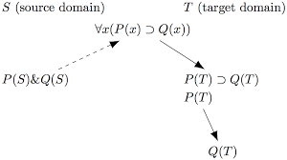

Slide 13
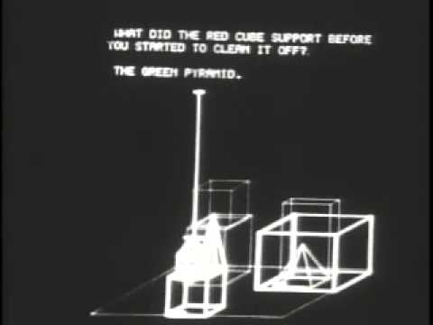
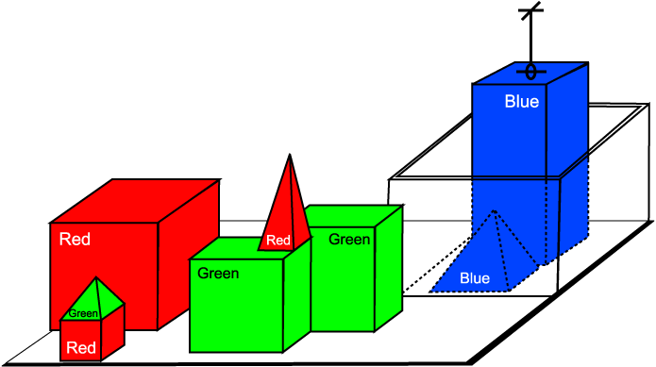

Slide 14
Using large amount of rules and facts, computer programs can deduce a lot of things.
Hence, it behaves intelligently.

Slide 15
Second, use memory and learning
We can imitate human brain by encoding information and memory into a large connected network.
This network responses to input with a correct output. The relationship of this input/output can be learn from large amount of data without human intervention.
This type of approch is called Artificial Neural Networks.

Slide 16
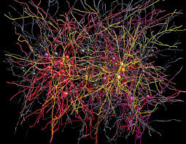

Slide 17
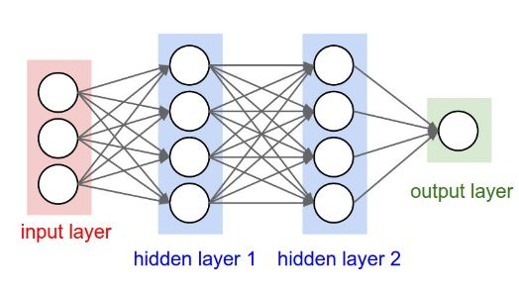
Artificial Neural Network 3-layer

Slide 18
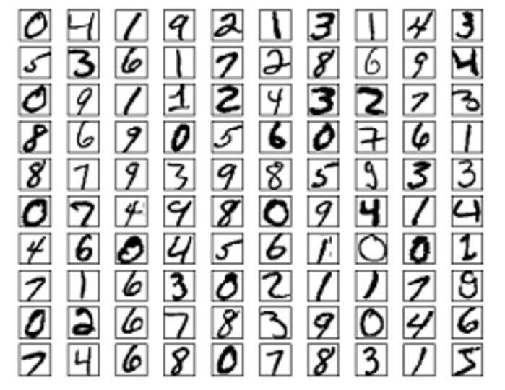

Slide 19
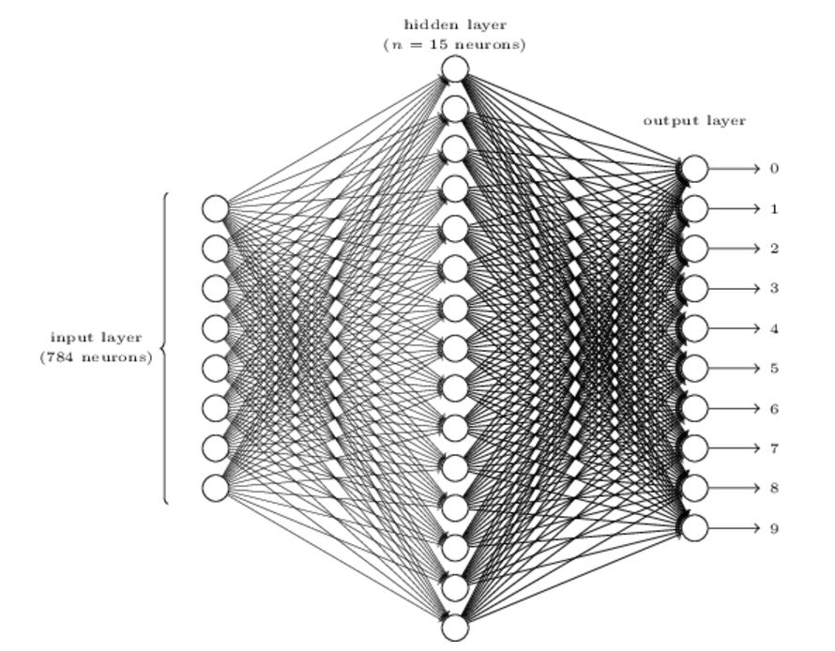
Digit recognition NN
Input 24x24 = 784
0.0 white 1.0 black

Slide 20
Example, recognise the picture of my wife
I can show a lot of pictures of my wife from many angles. Then I can train a kind of network to remember this face. I also train a lot of pictures of not-my-wife face. So, now the network can distinguish between my-wife and not-my-wife faces.

Slide 21
This is the most popular method today.
Multiple layers (update few hundreds) of this Network can be constructed
It is called Deep learning

Slide 22
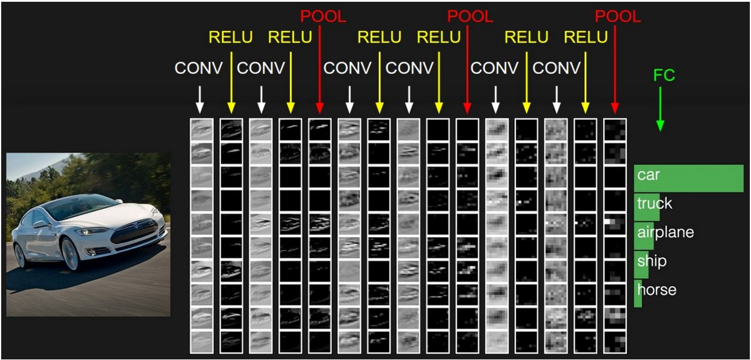
Example of NN layer

Slide 23
Most AI programs are written using "heuristic", i.e. the program behaves by some rule that is encoded "human" tactic.
For example, a program to play chess evaluate the board position according to rule created by human expert.

Slide 24
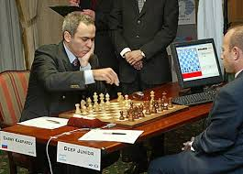

Slide 25
Another way to create AI program is by using "search".
The problem is encoded as many alternative way to solve it, and AI program looks at these alternatives (which can be enormously large in number) and choose a path carefully until a good solution is found.
For example, the sequence of chess moves can be "search" to maximise the possibility to win the game.

Slide 26
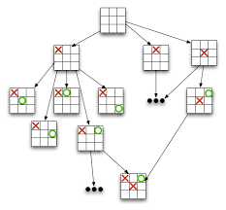

Slide 27
AI program can use evolution to find good solutions.
In this way, initial candidate solutions are created and then evaluate. The good solutions are selected and improve upon.
This step are repeated until solutions are found.
One of the popular method in this class is called Genetic Algorithm.

Slide 28
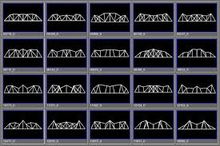

Slide 29
What is the impact of AI in the society?
Now that AI programs can do many work that human do that required intelligence.
A lot of work that nowadays are performed by human will be done by these AI programs.
There is economic benefit in doing so.

Slide 30
This is similar to the change in the last decade that many human jobs are replaced computers.
For example, you don't need typist as speech recognition allow you to create text message using voice.

Slide 31
Many manual labor job in the factory will be replaced by robots.
A case of Chinese t-shirt factory.
Human drivers are not necessary and replaced by robot drivers (in driverless car).
Finance traders on the trading floor are being replaced by automated trading.
Department store becomes more self-serving and e-buying, using less and less store workers.

Slide 32
However, there are plenty of jobs that are for humans.
Rearing your children
Education
Arts, music
Sports
Service for elderly people

Slide 33
As the shift of technology bring about the change in the way we work, we need to change the way we prepare our next generation.

Slide 34
Human creates
Human consumes
So, our next generation must be ready for "creativity", "caring for people"

Slide 35
Future of AI
As computers become faster, cheaper, there will be more and more powerful AI program.
Software that provide services will be driven by AI in almost every aspect imaginable.

Slide 36
The strength of AI are in logic and memory.
This advantage will be even greater as technology progress.

Slide 37
Summary
The strength of human is compassion, creativity.
People will serve other people better.
Technology can divide rich/poor but also it can empower and democratise.

Slide 38
More Information
Search “Prabhas Chongstitvatana”
Go to me homepage

