Slide 1
Knowledge & Innovation
Prabhas Chongstitvatana
Chulalongkorn University

Slide 2
innovation

Slide 3
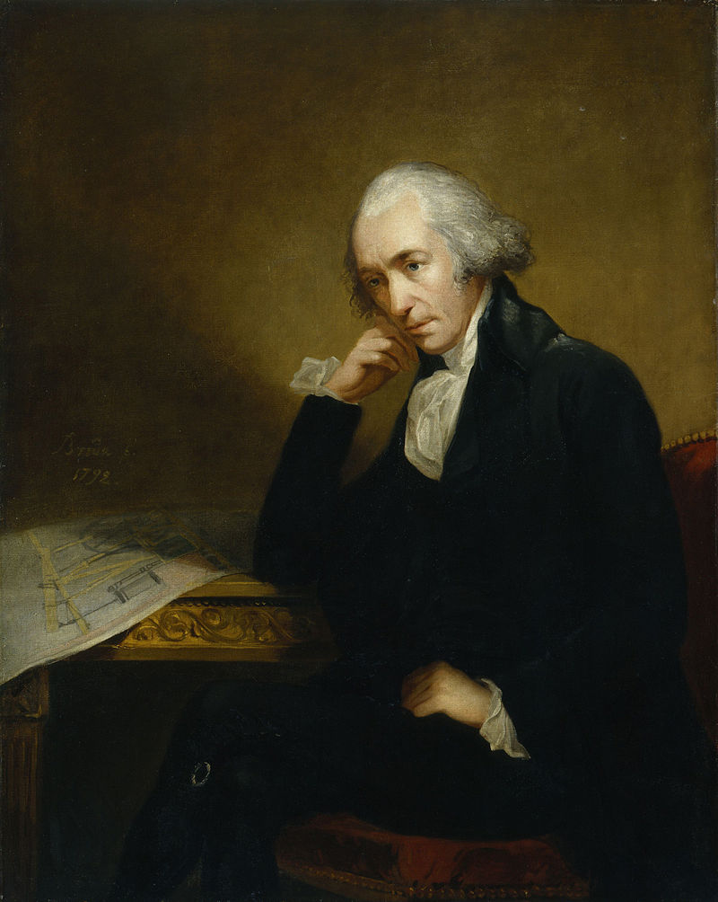
James Watt
30 January 1736 – 25 August 1819

Slide 4
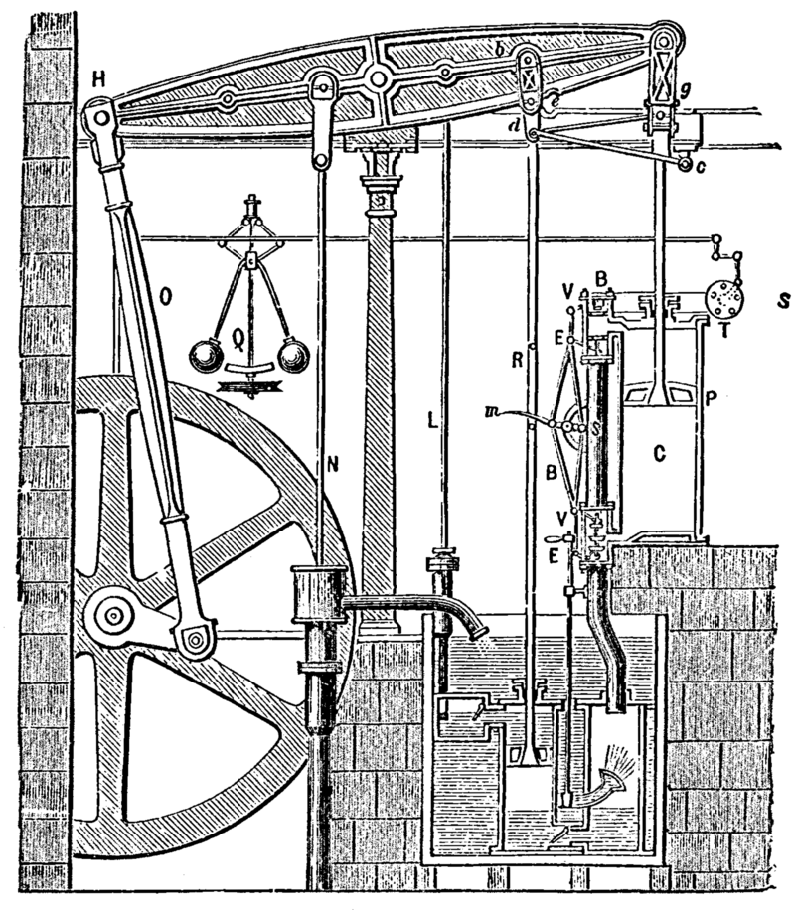
1784 Steam engine by Boulton and Watt

Slide 5
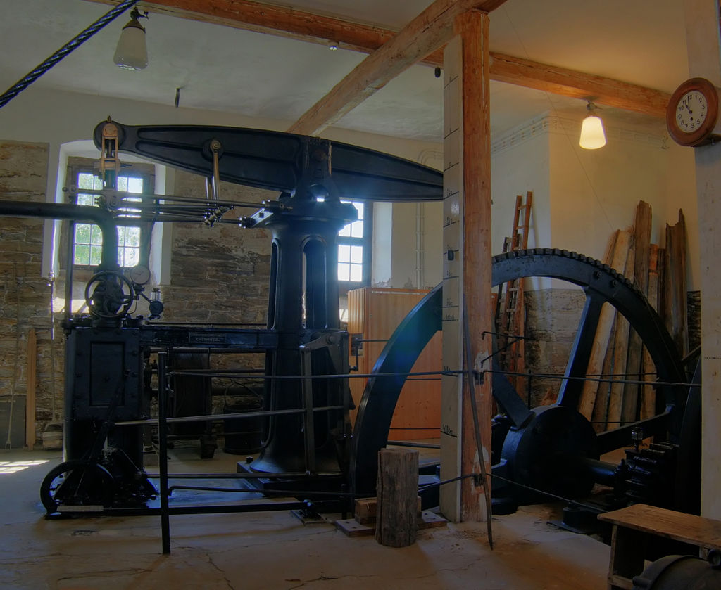
A steam engine built to James Watt's patent in 1848 at Freiberg in Germany

Slide 6
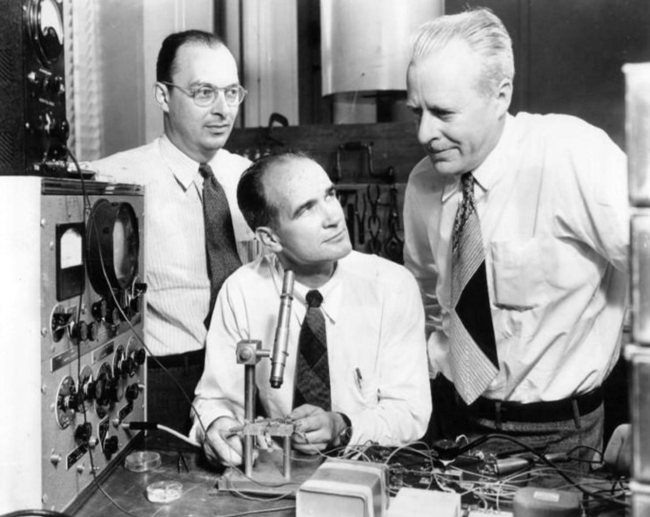
Transistor
John Bardeen, William Shockley and Walter Brattain at Bell Labs, 1948.

Slide 7
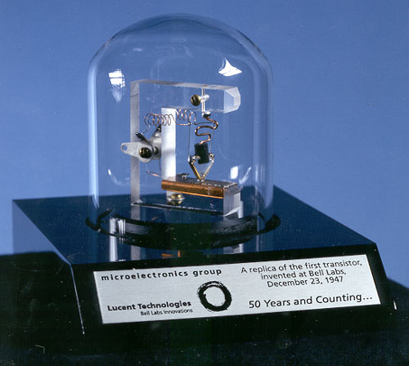

Slide 8
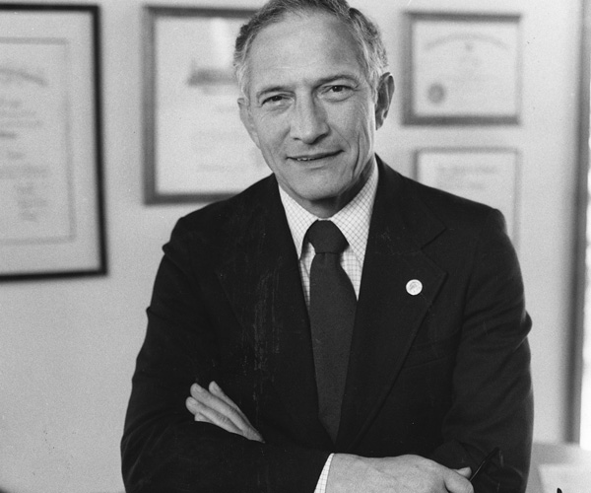
Robert Noyce
December 12, 1927 – June 3, 1990

Slide 9
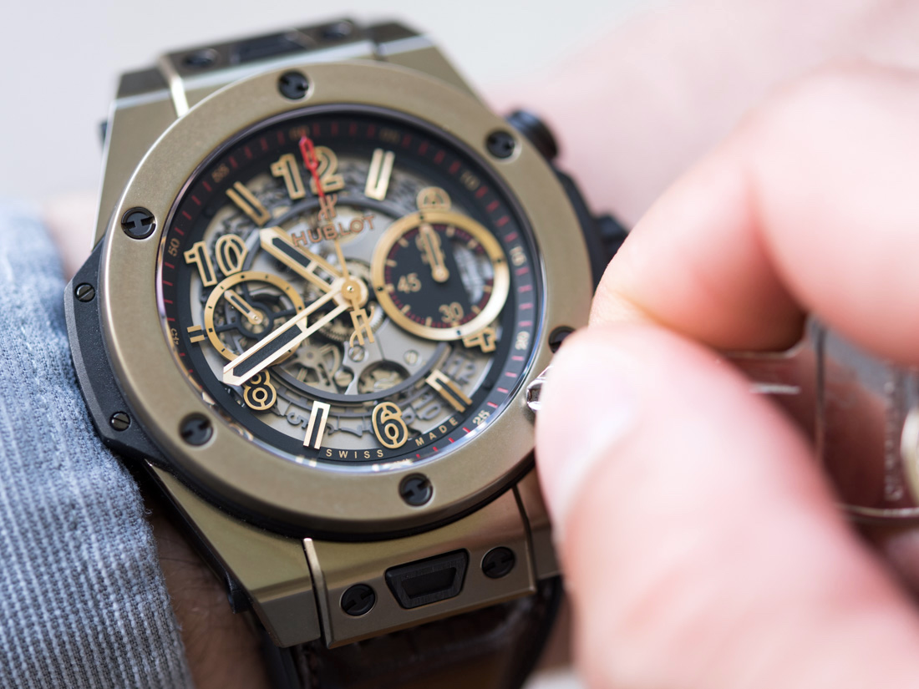
Hublot magic gold
Notes:
2011 Magic gold, scratch-resistant gold 18K, hardness 1,000 Vickers, 18k gold is 400. hardened steel 600. with EPFL Swiss polytechnique school of Lausanne, Prof Andreas Mortensen, 2014 production. Alloy 24k gold + ceramic (boron carbide , third hardest thing: diamond, cubic boron nitride). Compress 2000 bars sintered at 2200 c (24k gold melted at 1100 c).

Slide 10
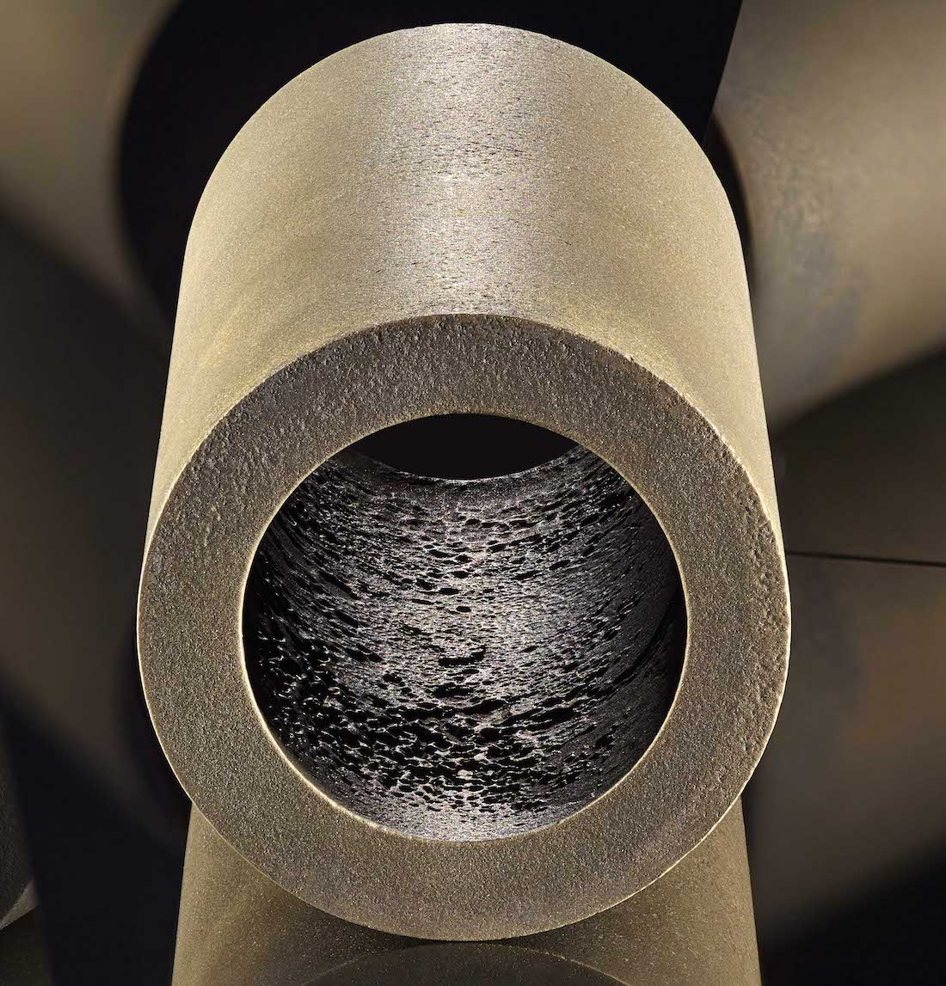

Slide 11
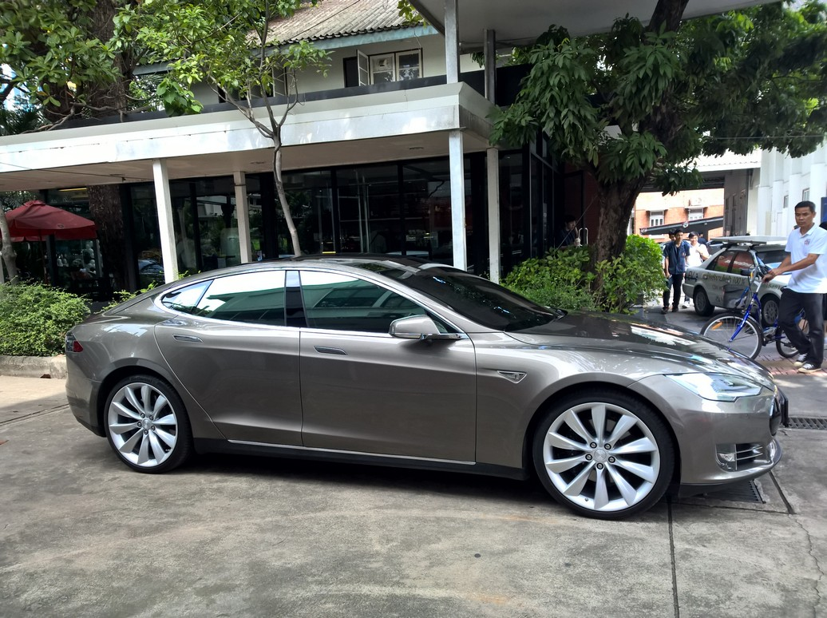
Tesla model s

Slide 12



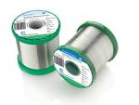
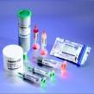
Lead-free Solder Alloys
Lead-based Solder
Low cost and abundant supply
Forms a reliable metallurgical joint
Good manufacturability
Excellent history of reliable use
Toxicity
Lead-free Solder
No toxicity
Meet Government legislations
(WEEE & RoHS)
Marketing Advantage (green product)
Increased Cost of Non-compliant parts
Variation of properties (Bad or Good)

Slide 13
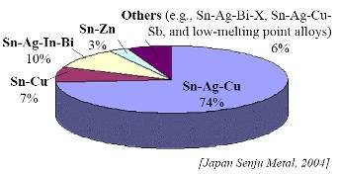
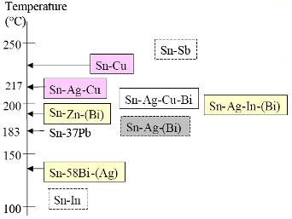
Sn-Ag-Cu (SAC) Solder
Advantage
Sufficient Supply
Good Wetting Characteristics
Good Fatigue Resistance
Good overall joint strength
Limitation
Moderate High Melting Temp
Long Term Reliability Data

Slide 14
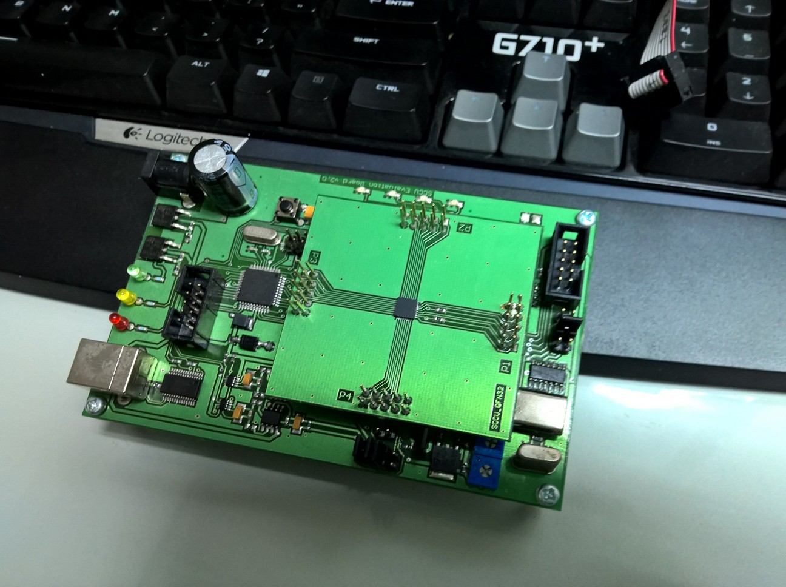
Low powered embedded processor

Slide 15
technology

Slide 16
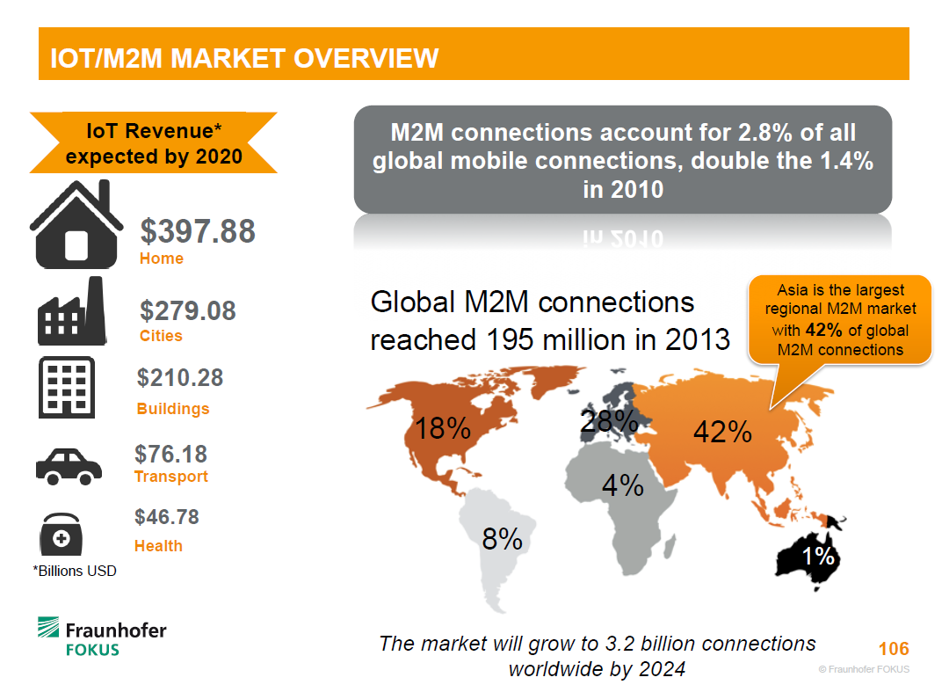

Slide 17
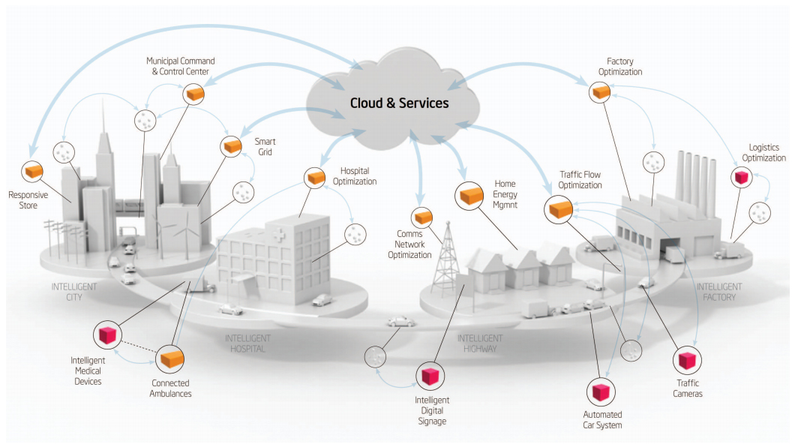
Smart Cities

Slide 18
Recommendation

Slide 19


Slide 20

More Information
Search “Prabhas Chongstitvatana”
Get to my homepage

