Slide 1
Recent topics in Smart City
Prabhas Chongstitvatana
Faculty of Engineering
Chulalongkorn University

Slide 2
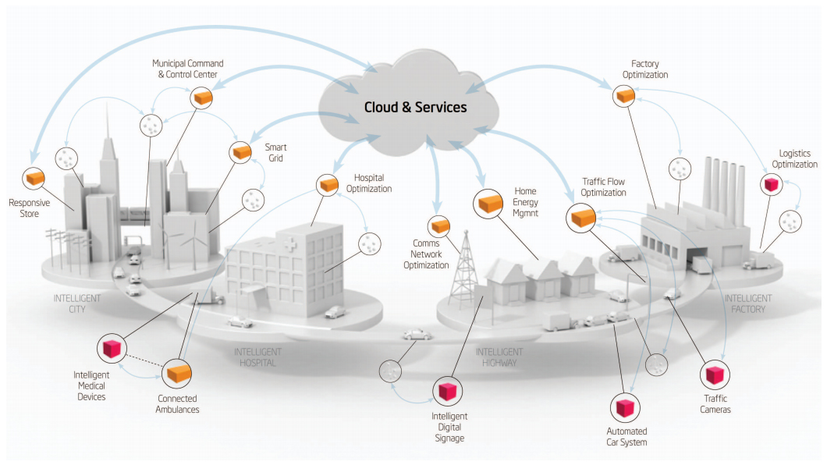
Smart Cities

Slide 3
What is IoT
Network of Physical Objects
Embedded systems with electronics, software, sensors
Enable objects to exchange data with manufacturer, operator, other devices through network infrastructure

Slide 4
Allow remote control
Direct integration = computer + physical world
Result: Automation in all fields

Slide 5
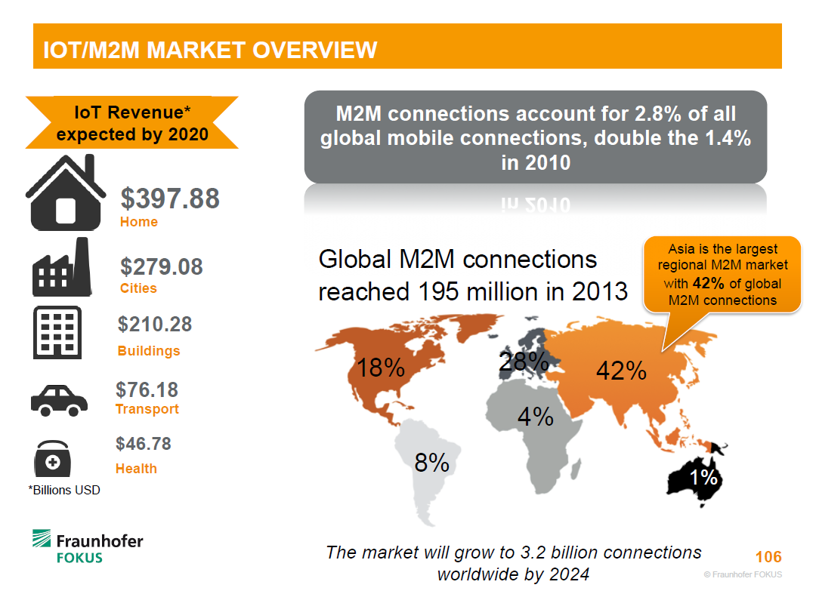

Slide 6
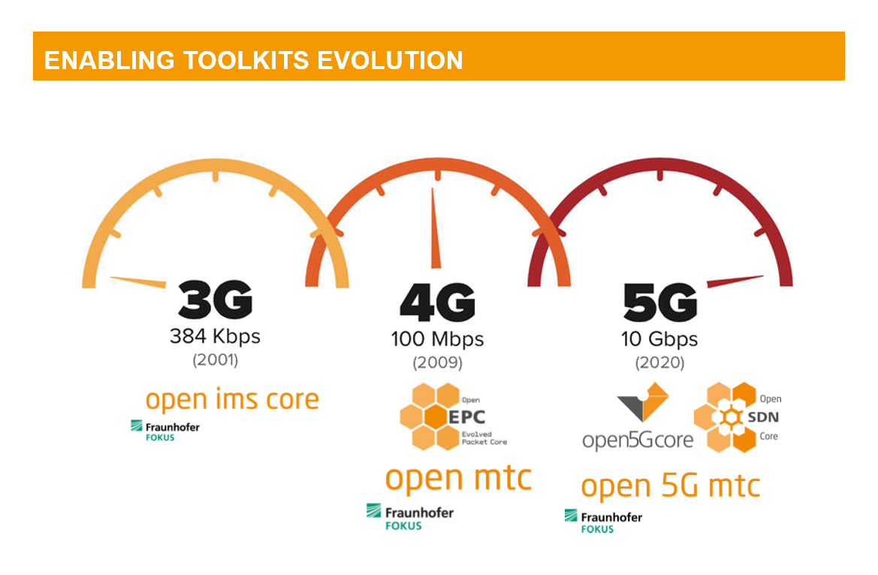

Slide 7
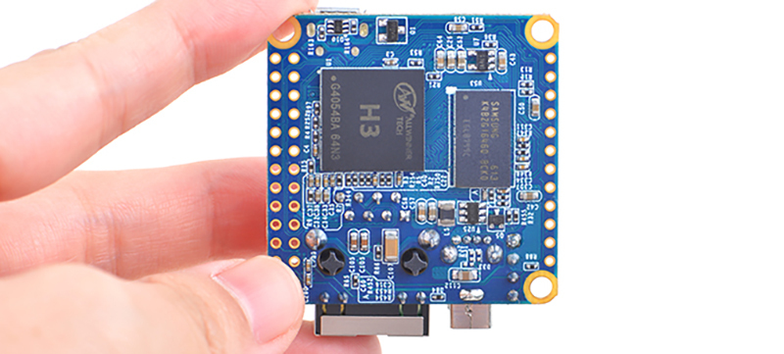

Slide 8
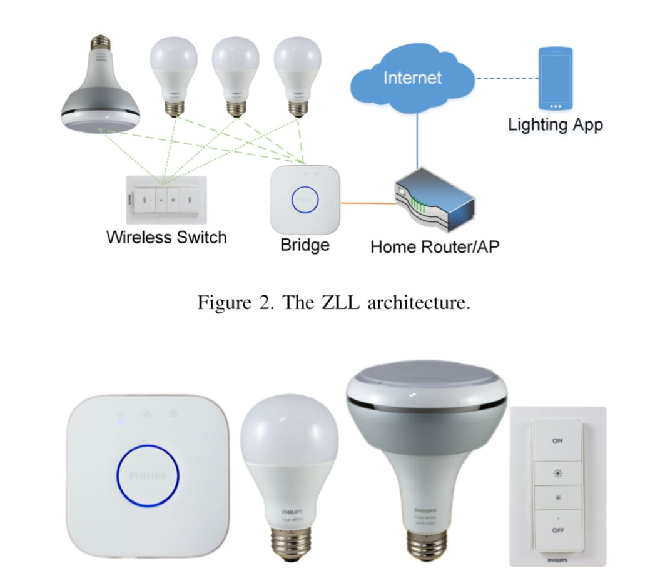

Slide 9
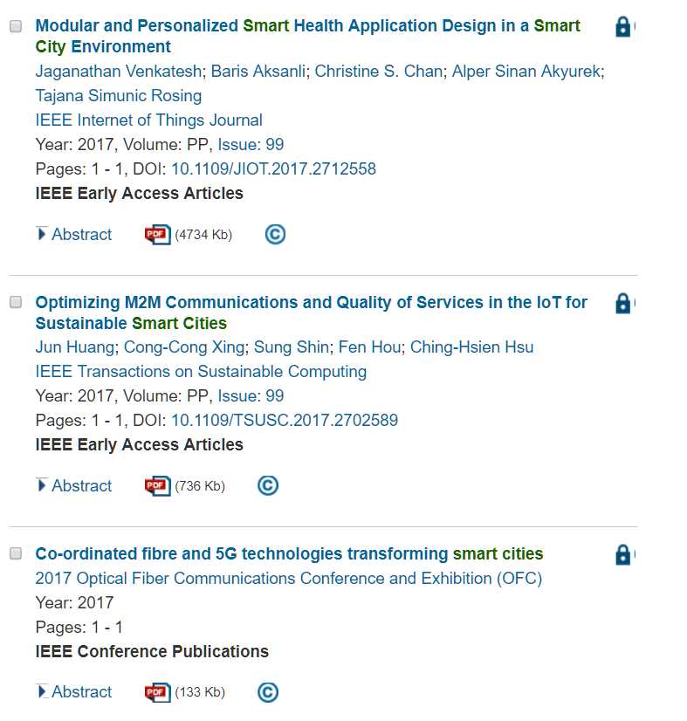
IEEE Explore

Slide 10
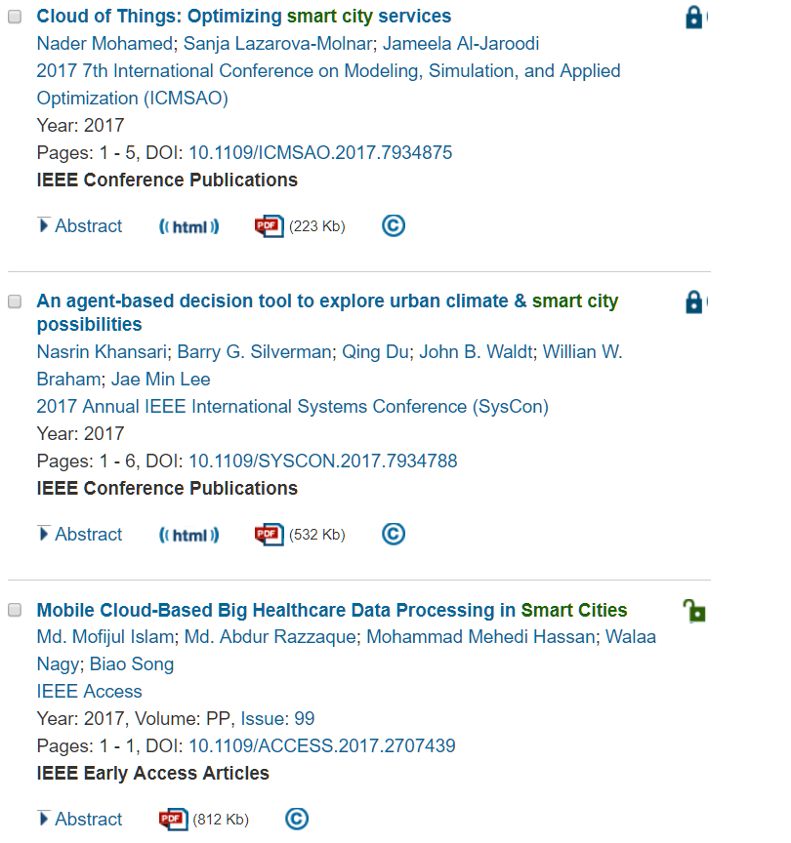

Slide 11
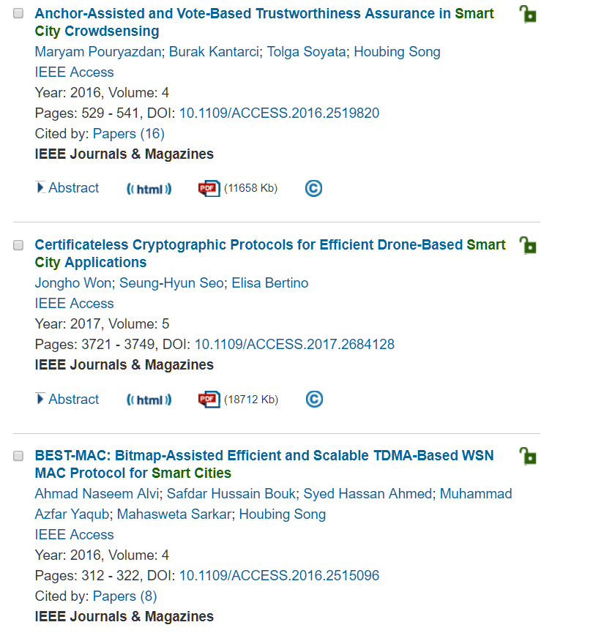

Slide 12
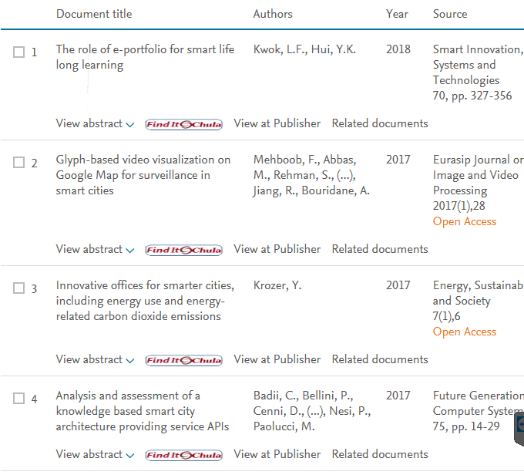
SCOPUS

Slide 13
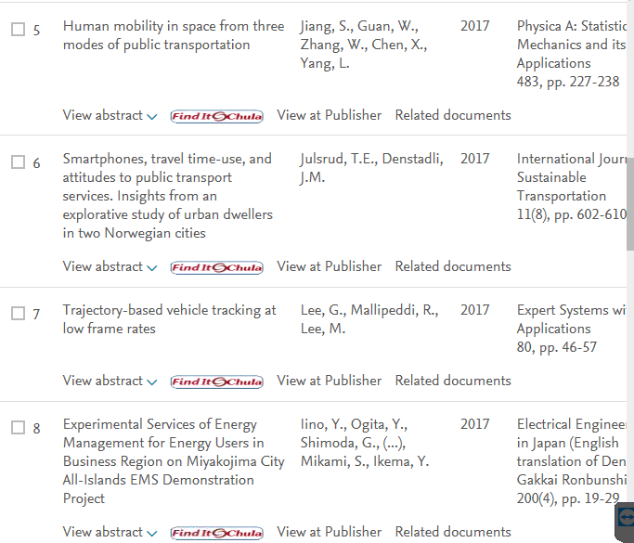

Slide 14
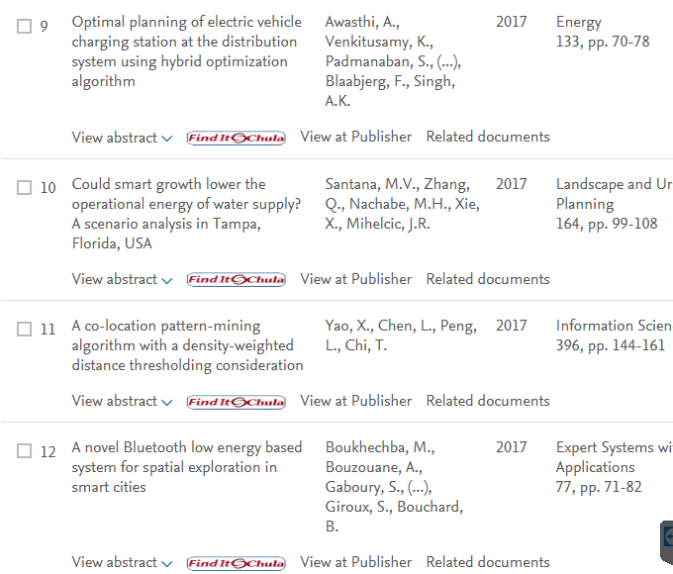

Slide 15
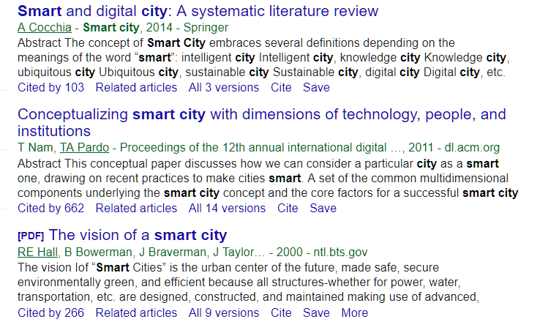
scholar.google.com

Slide 16
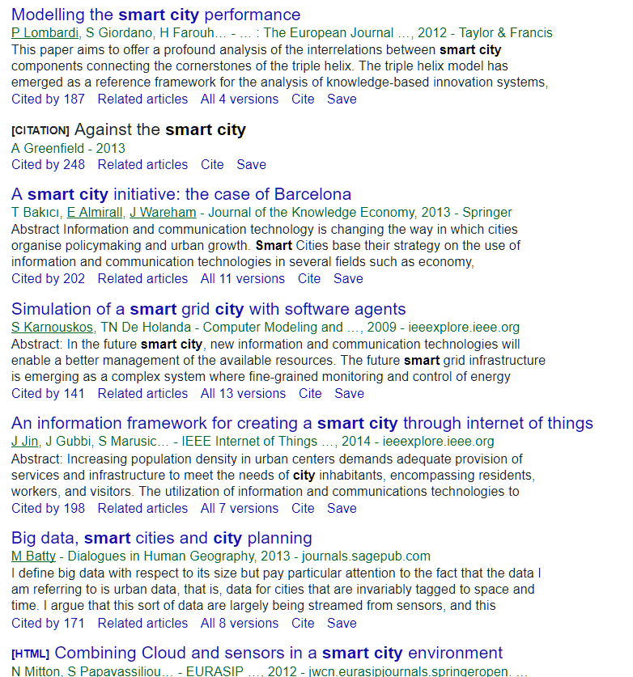

Slide 17
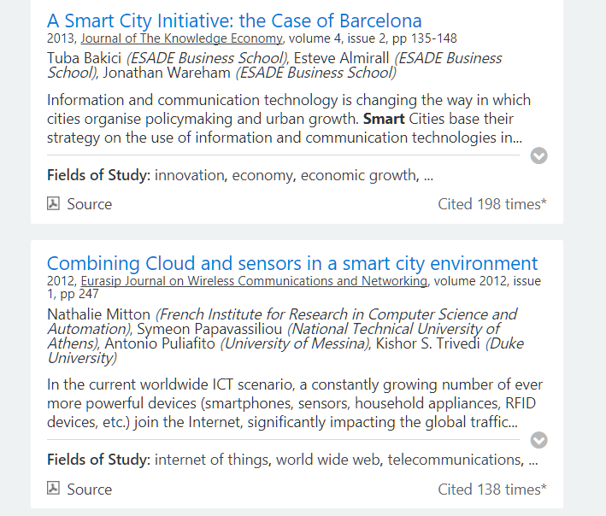
academic.microsoft.com

Slide 18
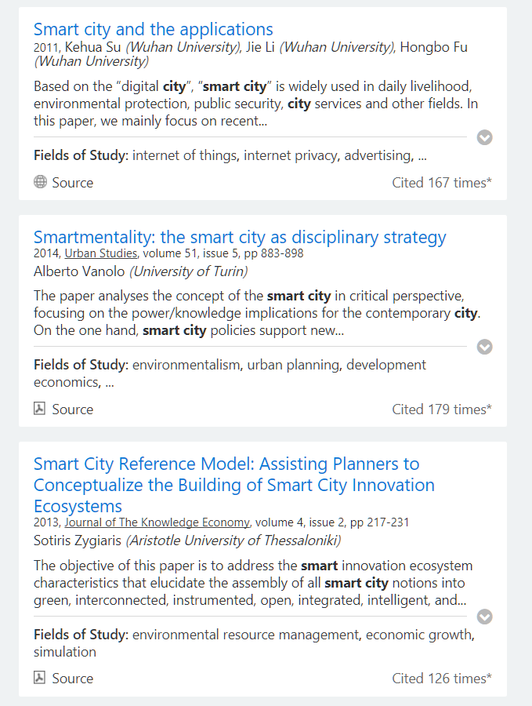

Slide 19

More Information
Search “Prabhas Chongstitvatana”
Get to me homepage

