Slide 1
From Research to Product
Prabhas Chongstitvatana
Faculty of Engineering
Chulalongkorn University

Slide 2
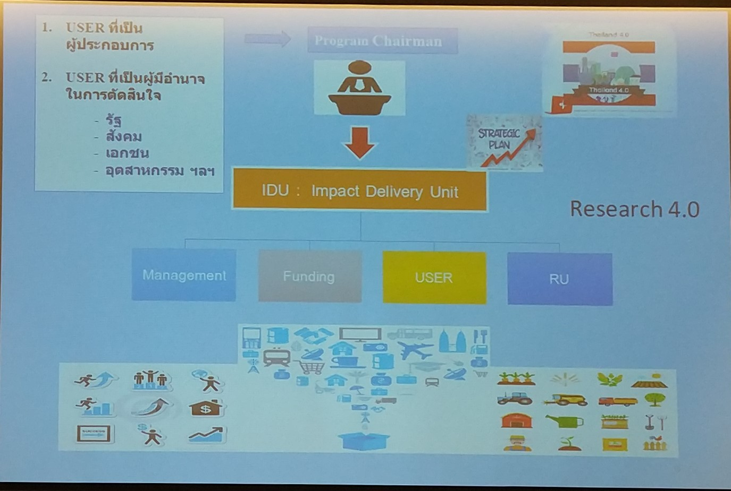

Slide 3
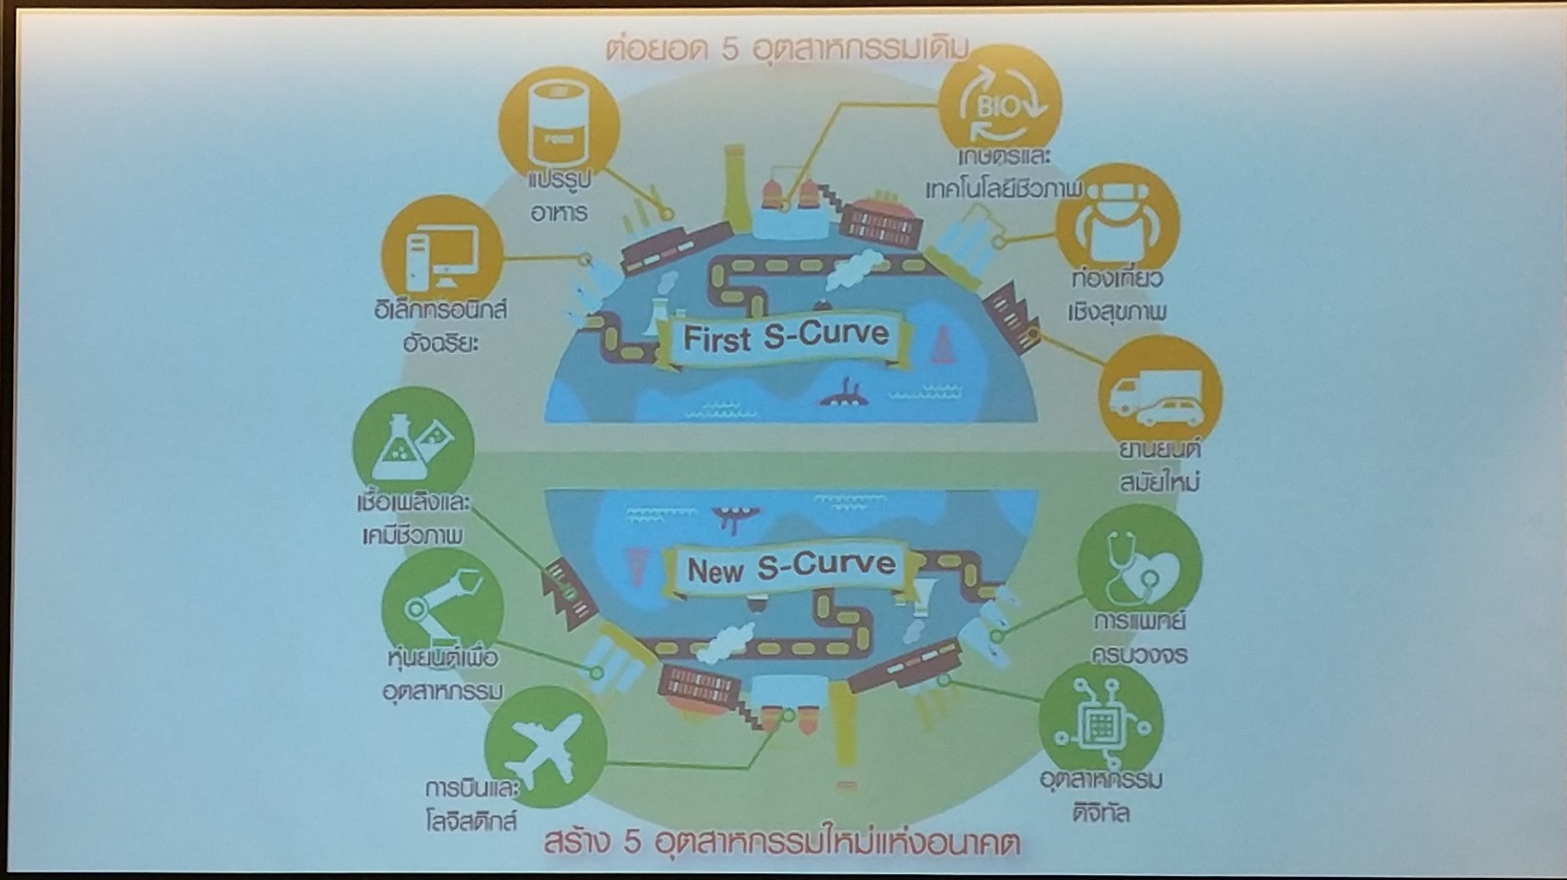

Slide 4
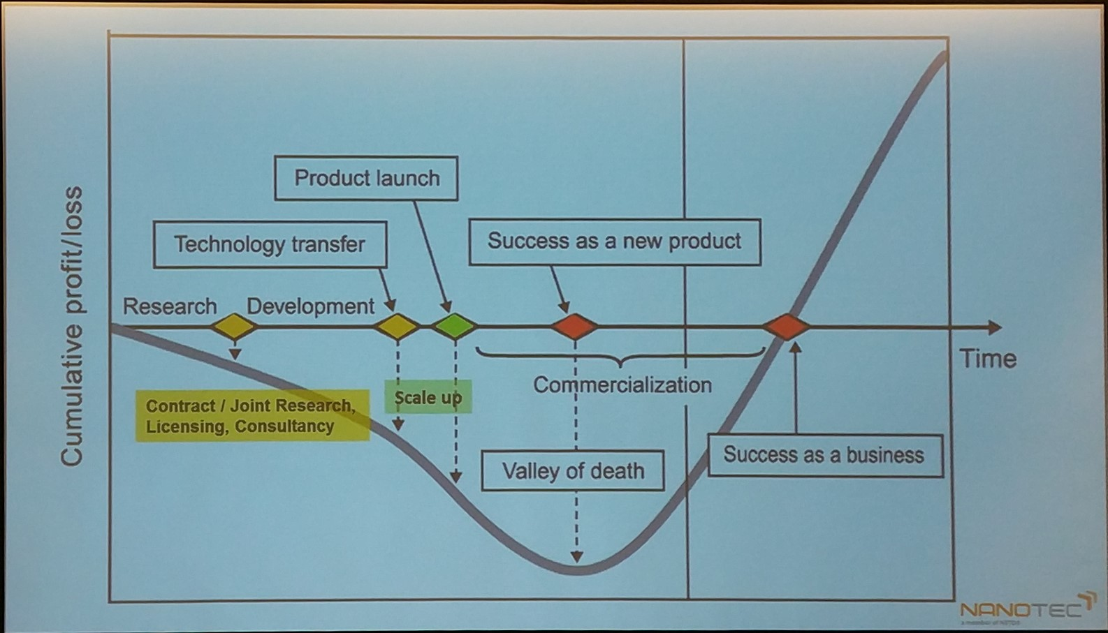

Slide 5
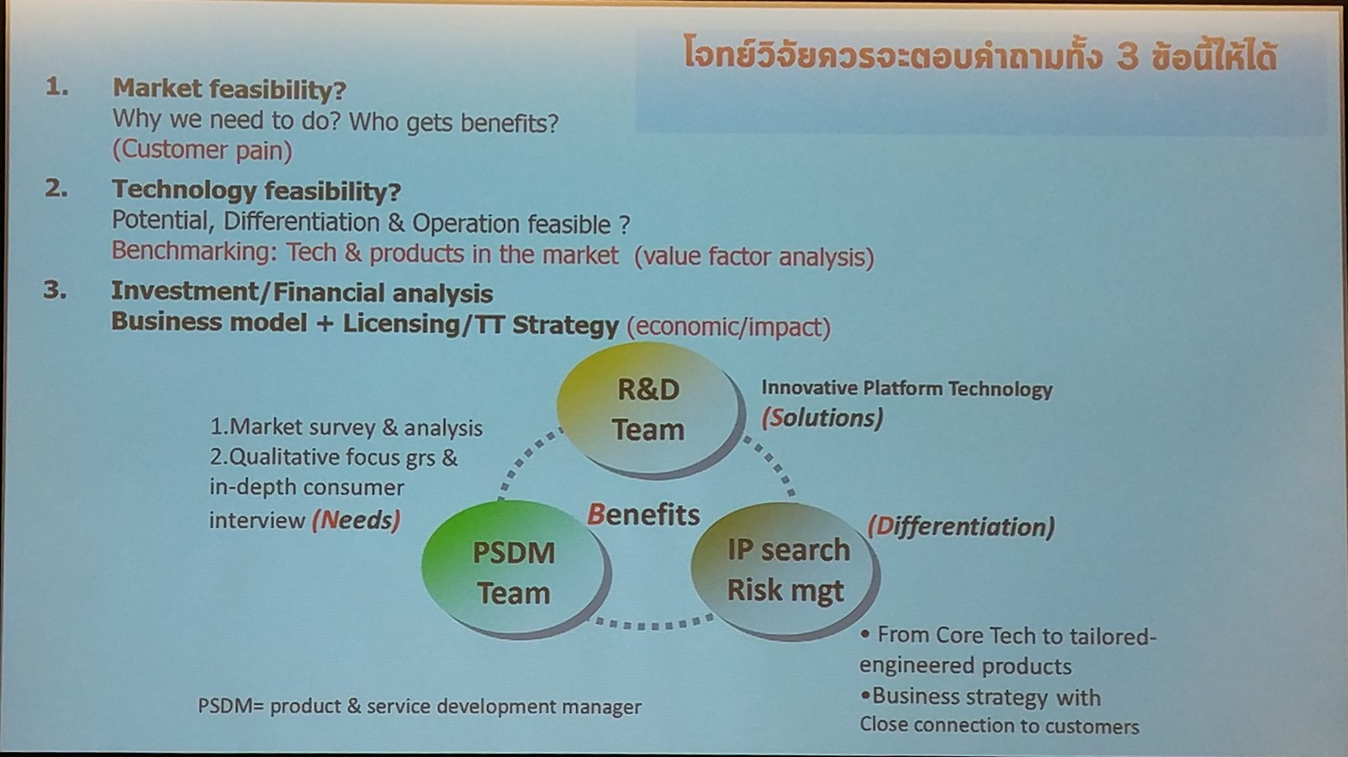

Slide 6
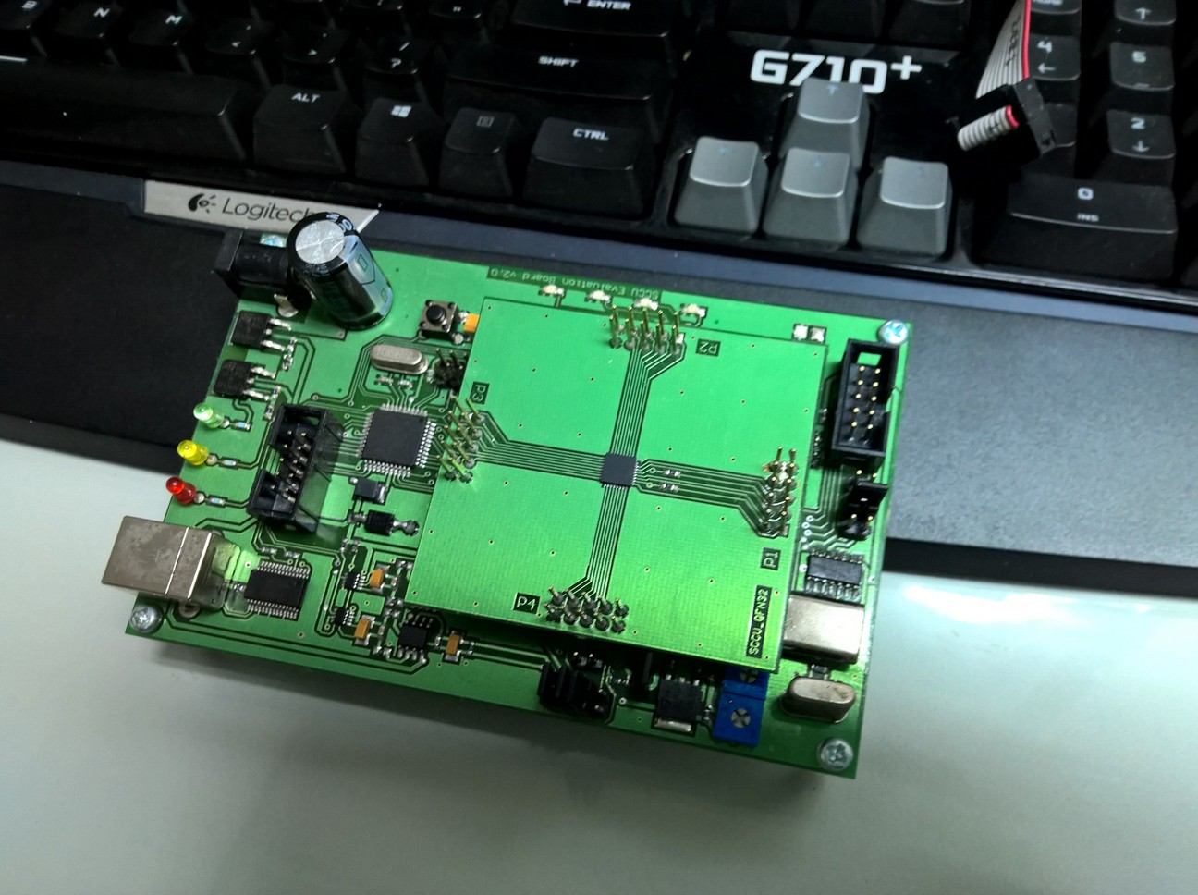

Slide 7
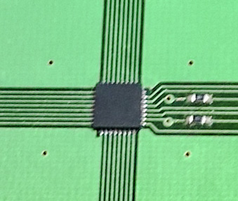

Slide 8
User Requirement
To increase product portfolio
To reduce time to market

Slide 9
Specification
Small size
Low power
Cover a set of applications
With specific performance

Slide 10
How we collaborate
Chief Architect
Company engineer
Weekly meeting
Detailed design
Site visit

Slide 11
Intellectual property
Company owned all IP
Consultation fee
But
There is always future project

Slide 12
Lesson learn
Academic can collaborate with commercial
Can be highly successful
Based on strength of company
With flexibility of university

Slide 13
Success Factor
Demand driven
Company has resource
Trust
Understanding

Slide 14

More Information
Search “Prabhas Chongstitvatana”
Get to my homepage

Slide 15
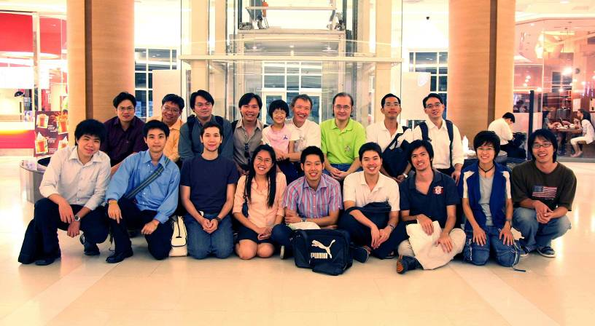
Team work

