Slide 1
Internet of Things: Cybersecurity
Prabhas Chongstitvatana
Faculty of Engineering
Chulalongkorn University

Slide 2
What is IoT
Network of Physical Objects
Embedded systems with electronics, software, sensors
Enable objects to exchange data with manufacturer, operator, other devices through network infrastructure

Slide 3
Allow remote control
Direct integration = computer + physical world
Result: Automation in all fields

Slide 4
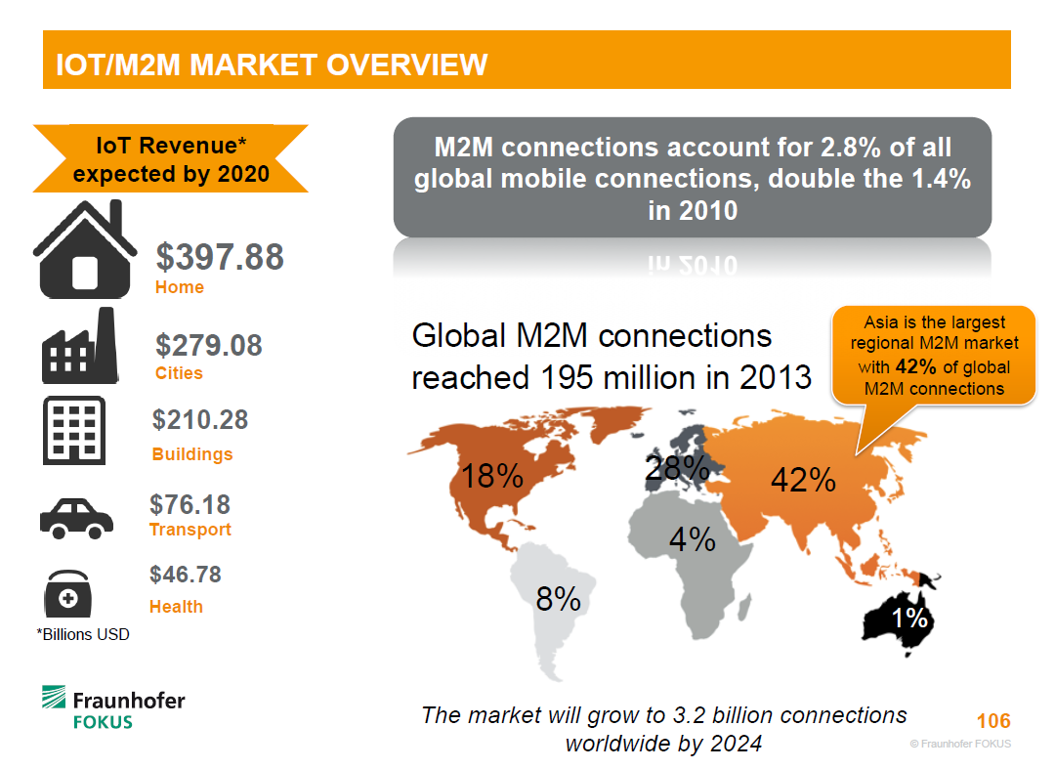

Slide 5
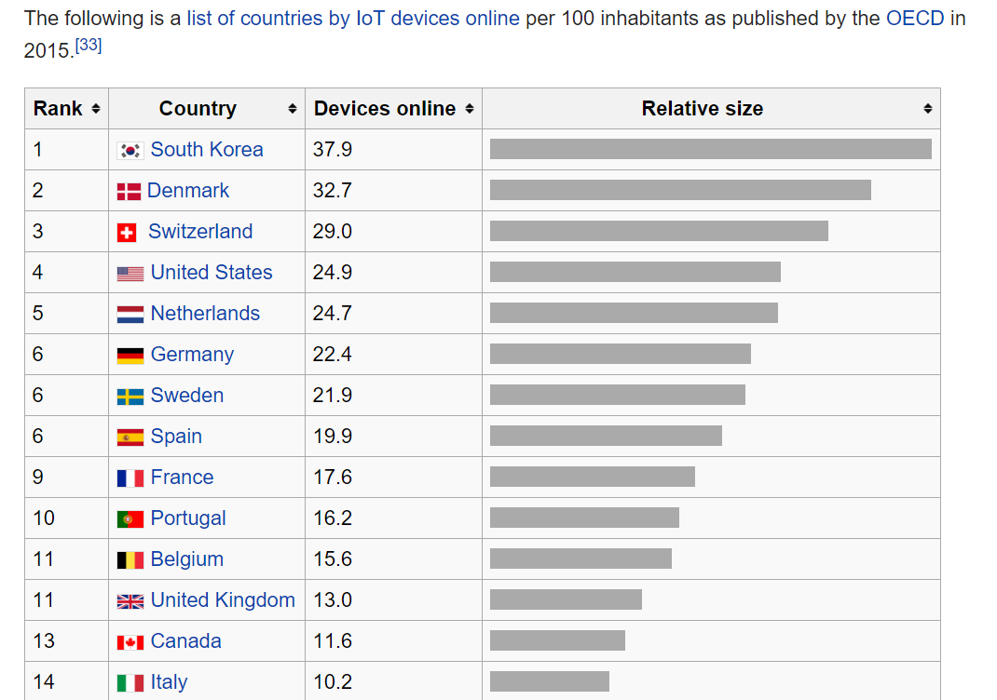

Slide 6
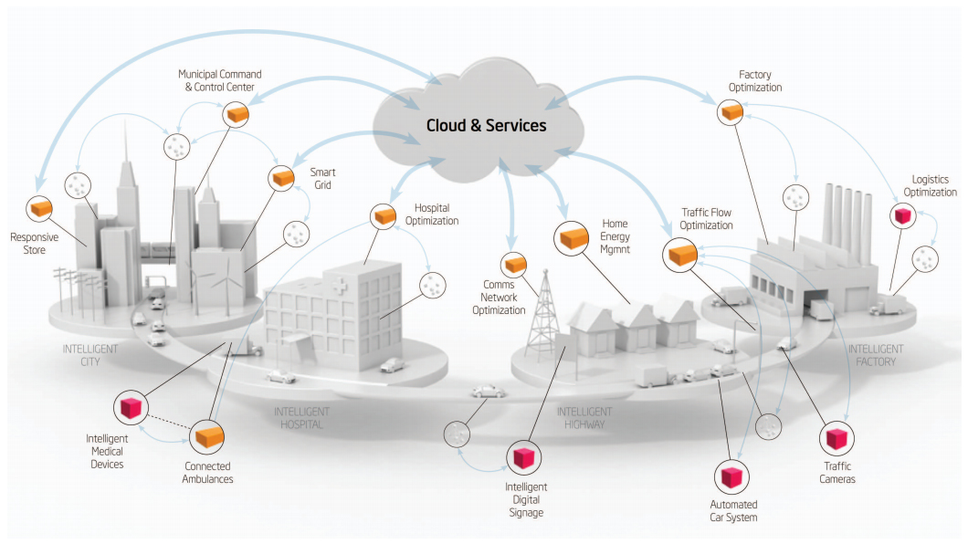
Smart Cities

Slide 7
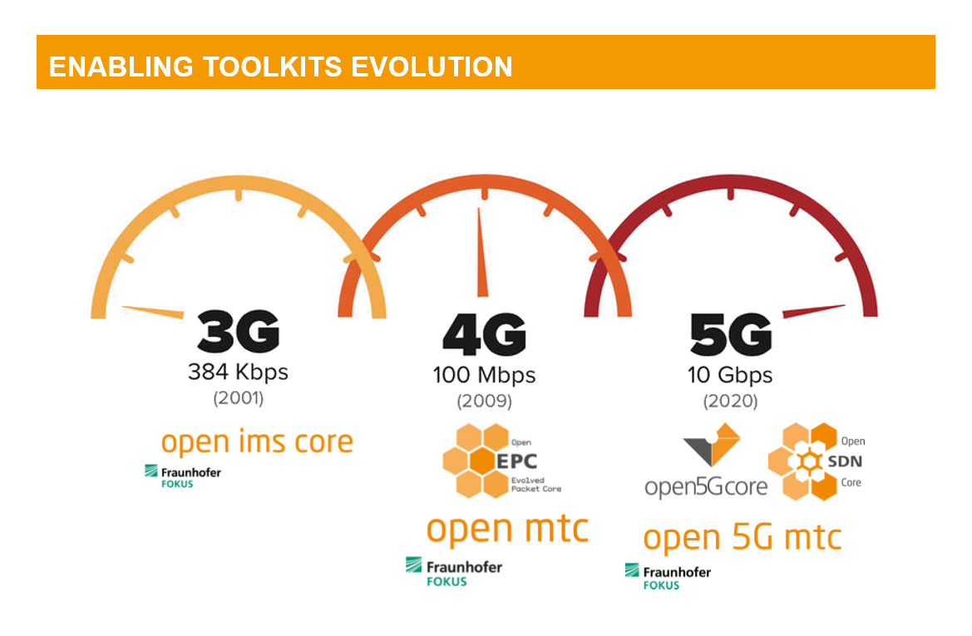

Slide 8
Cybersecurity

Slide 9
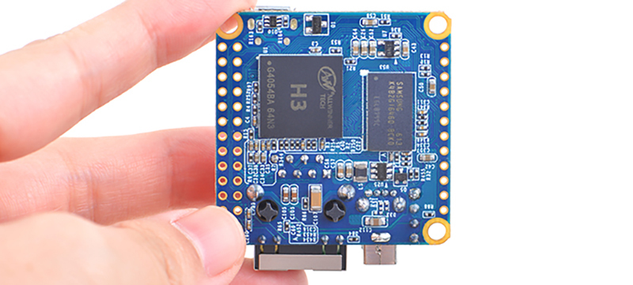

Slide 10
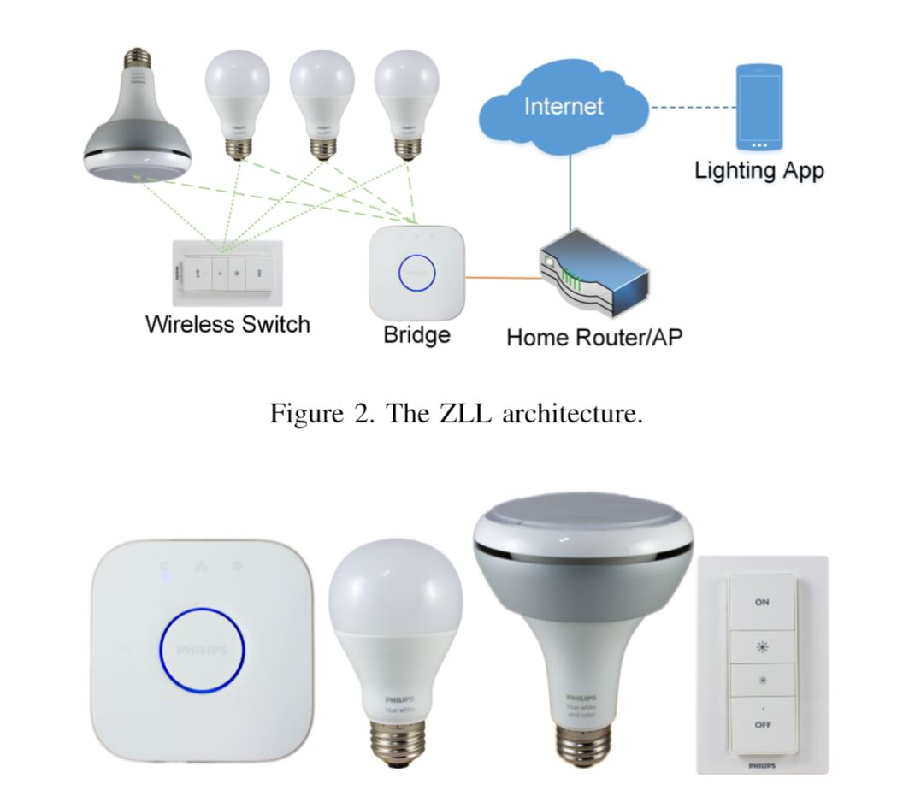

Slide 11


Slide 12
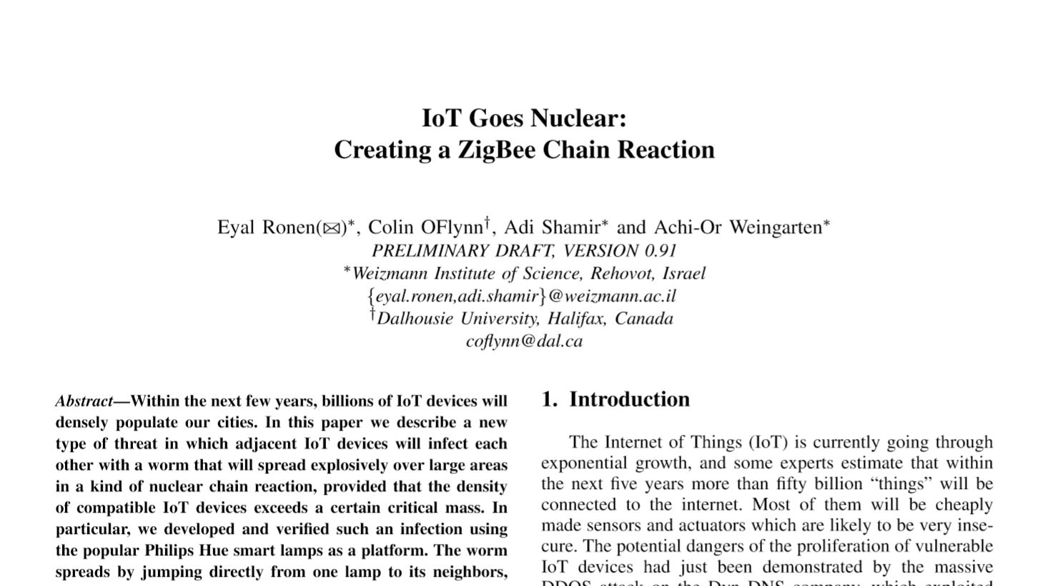

Slide 13
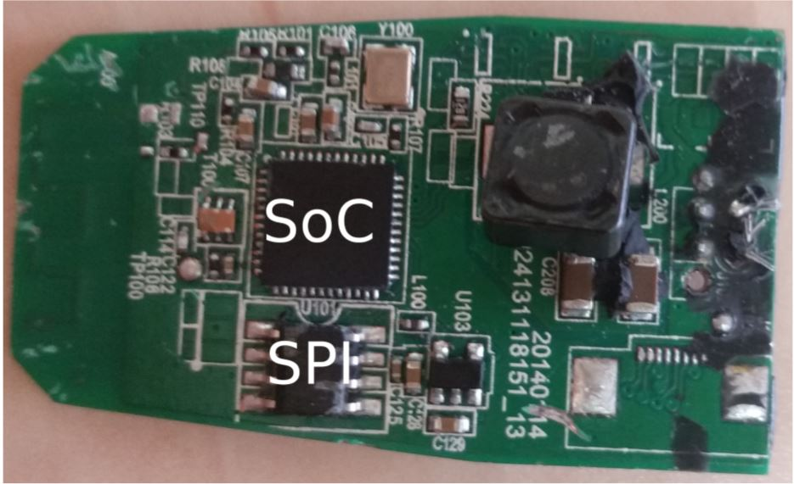

Slide 14
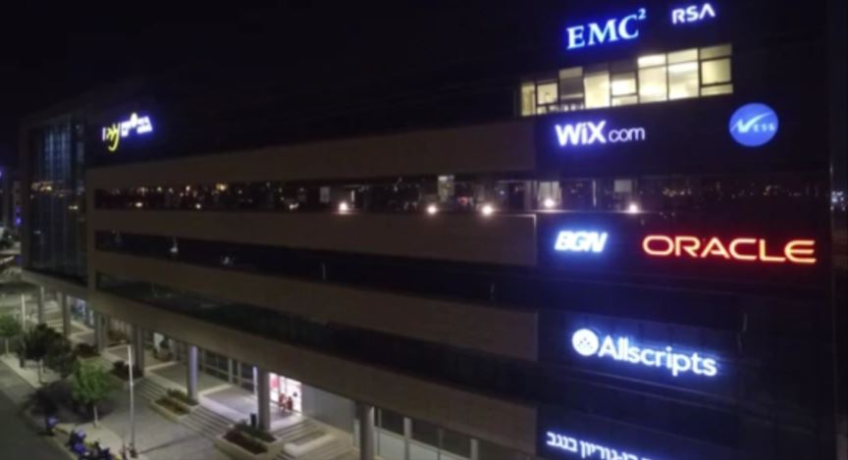

Slide 15
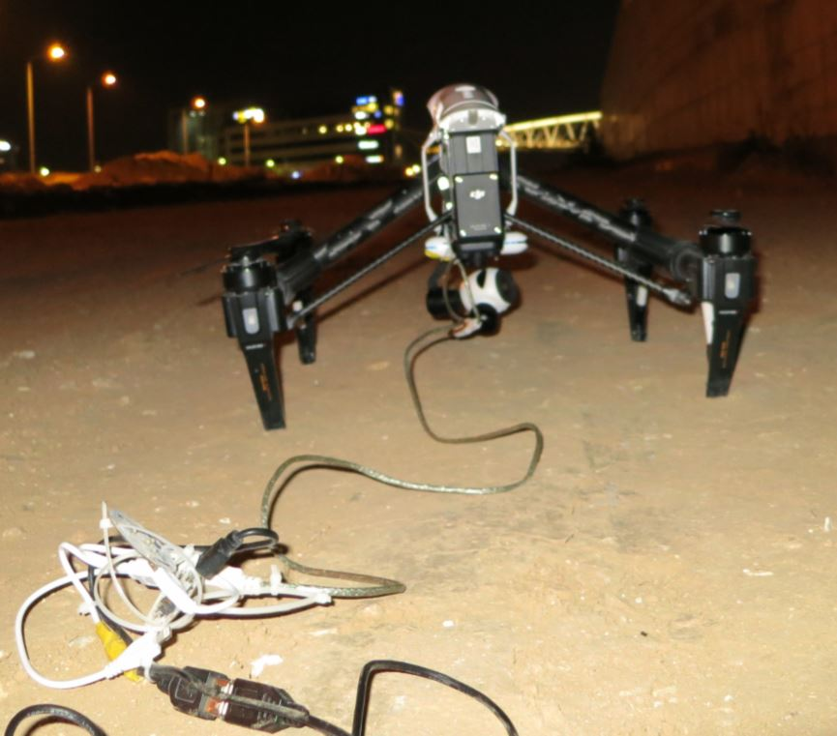

Slide 16
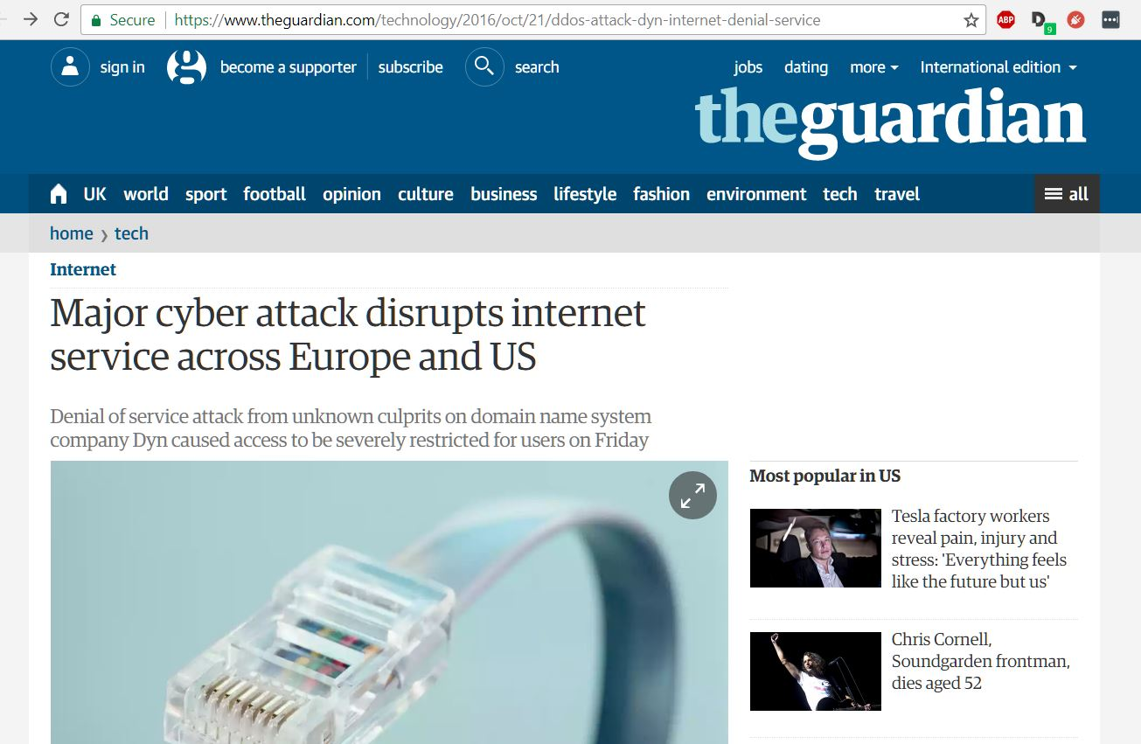
Friday 21 October 2016

Slide 17
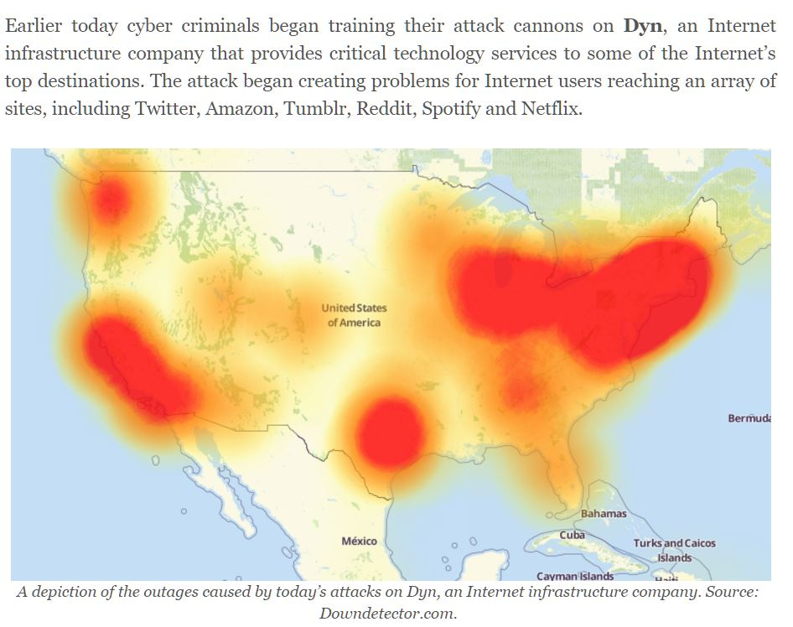
Mirai

Slide 18
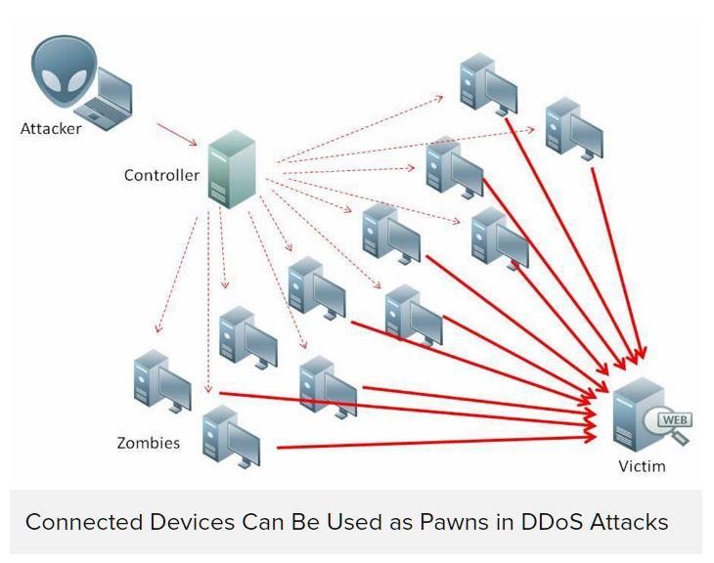

Slide 19
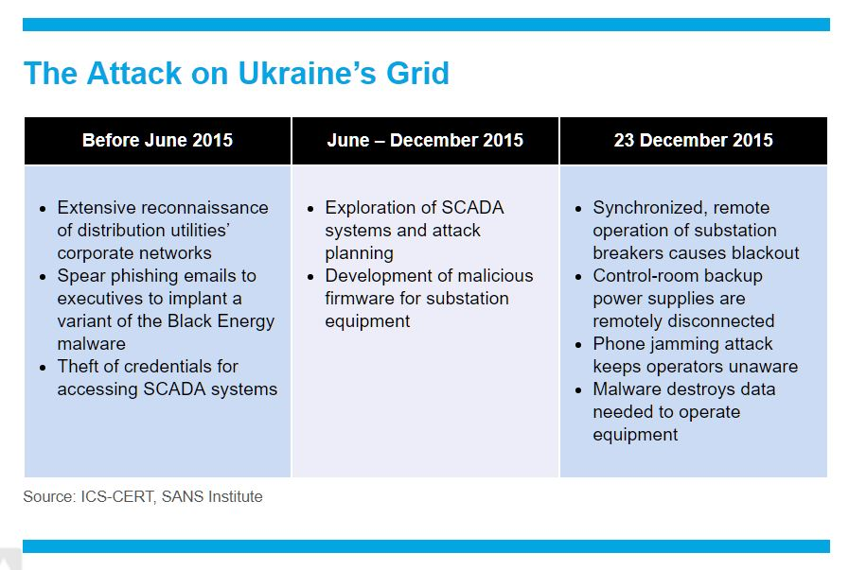
23 December 2015
Most affected were consumers of «Prykarpattyaoblenergo» (Ukrainian: Прикарпаттяобленерго; servicing Ivano-Frankivsk Oblast): 30 substations were switched off, about 230 thousands people were left without electricity for a period from 1 to 6 hours.

Slide 20

More Information
Search “Prabhas Chongstitvatana”
Get to me homepage

