Slide 1

Internet of Things and Smart Cities
Prabhas Chongstitvatana
Chulalongkorn University

Slide 2

Download this slides
Search “Prabhas Chongstitvatana”
Go to me homepage

Slide 3
Internet of Things = IoT
Machines to Machines
Next information revolution

Slide 4
1% of physical world is connected to Internet
Huge potential
Potentials
Innovative business process
Operational efficiency
New customer services

Slide 5
What is IoT
Network of Physical Objects
Embedded systems with electronics, software, sensors
Enable objects to exchange data with manufacturer, operator, other devices through network infrastructure

Slide 6
Allow remote control
Direct integration = computer + physical world
Result: Automation in all fields

Slide 7
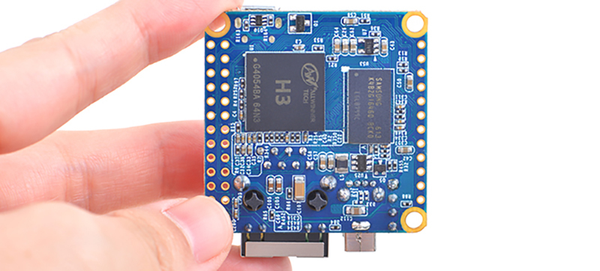

Slide 8
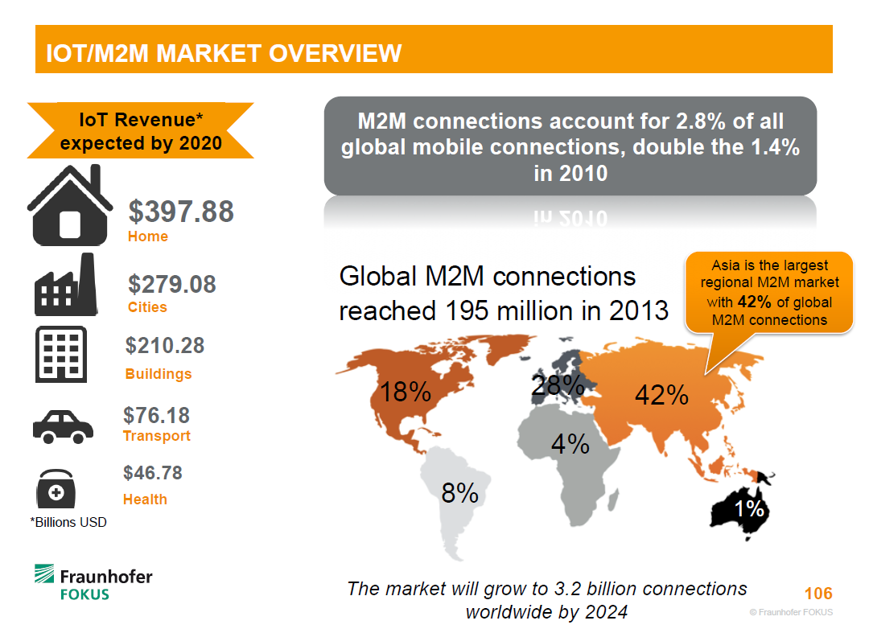

Slide 9
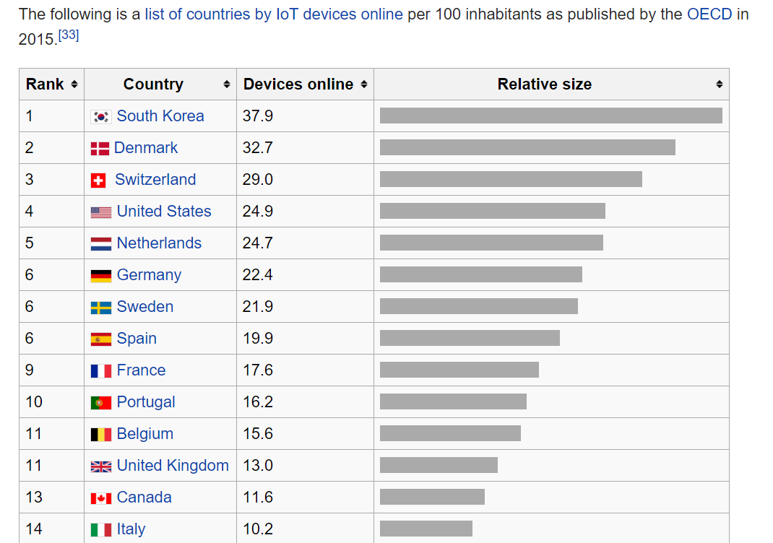

Slide 10
A bit of history
The term "Internet of Things" is coined by Kevin Ashton 1999.
Early example, 1982, Coke machine at Carnegie Mellon University was connected to internet: report its inventory and temperature

Slide 11
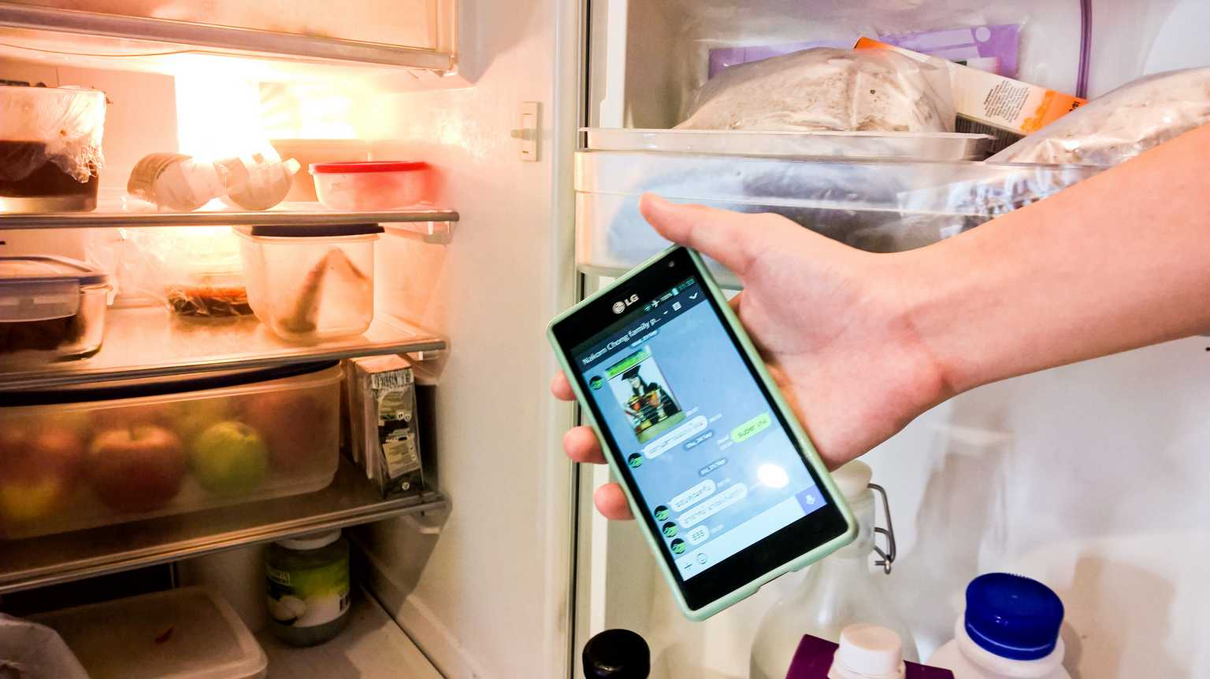

Slide 12
Applications
Environmental monitoring
Infrastructure management
Manufacturing
Energy management
Medical and health care systems
Building and home automation
Transportation

Slide 13
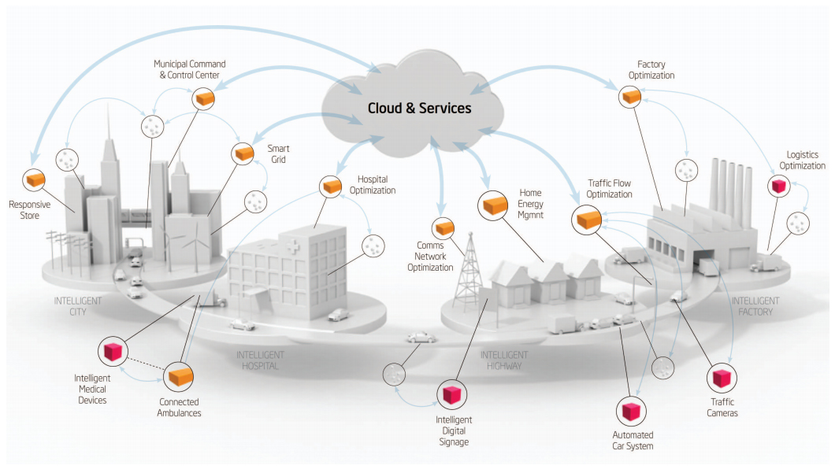
Smart Cities

Slide 14
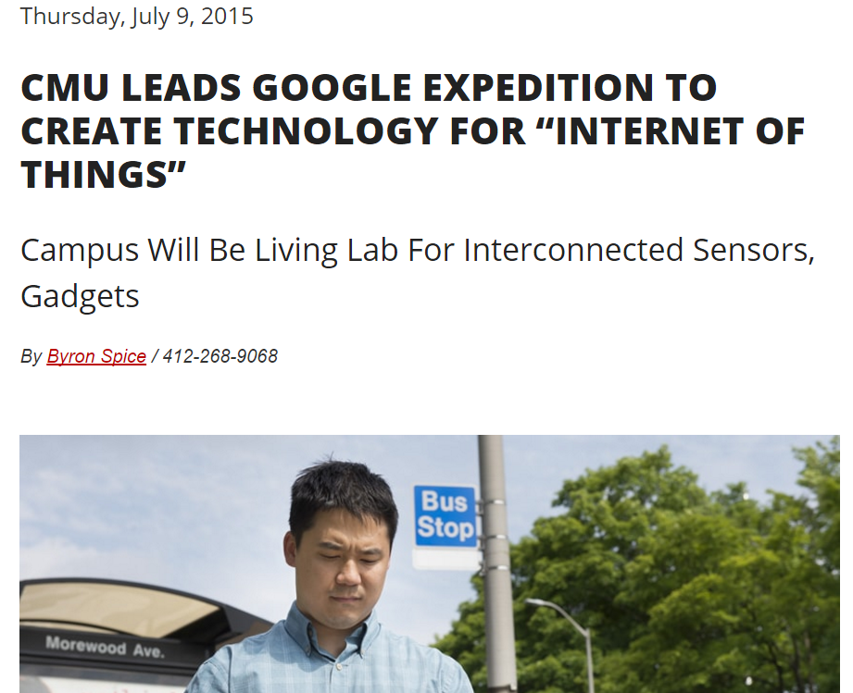

Slide 15
“The goal of our project will be nothing less than to radically enhance human-to-human and human-to­-computer interaction through a large-scale deployment of the Internet of Things (IoT) that ensures privacy, accommodates new features over time and enables people to readily design applications for their own use,” said Anind K. Dey, lead investigator of the expedition and director of CMU’s Human-Computer Interaction Institute.
“We will demonstrate the use of personalized privacy assistants that help users configure the many privacy settings necessary to ensure that they retain adequate control over their data,”

Slide 16
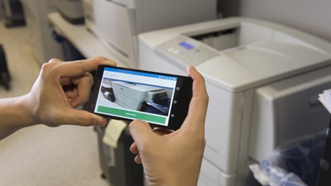
"Snap2It" lets users link to a printer or projector simply by taking a smartphone photo of it.

Slide 17
Large Scale examples: Smart City
Songdo, South Korea
Santander, Spain
10,000 sensors: parking search, environ. monitoring
San Francisco Bay area
wireless sensors data network
New York waterways
Padova Smart City Project, Italy

Slide 18
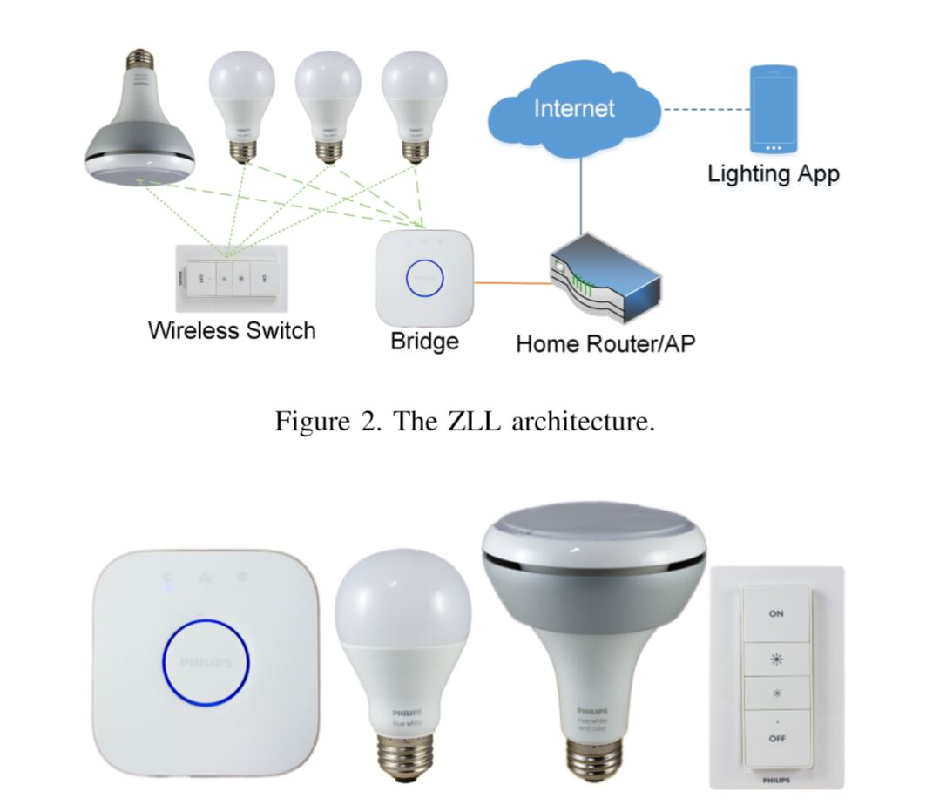
IoT security

Slide 19
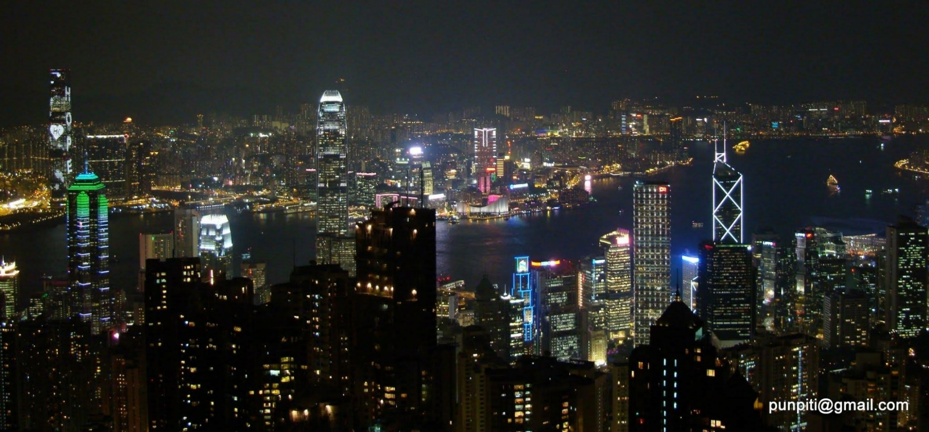

Slide 20
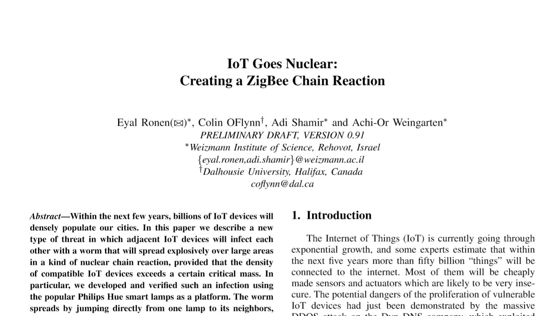

Slide 21
Impact
Civic engagement
Privacy, autonomy and control
technology <> just tools
technology = active agent
IoT = Human augmentation (Tim O Reilly)
data-driven decision making

Slide 22
Impact (cont.)
Security
cyber attack in Physical world
spy on people in their own homes
Increase in electronics waste 10x

Slide 23
Technology roadmap
50-100 Trillion objects,
each person carries 1000-5000 trackable objects
computer manage and inventory objects and people
transform daily life

Slide 24
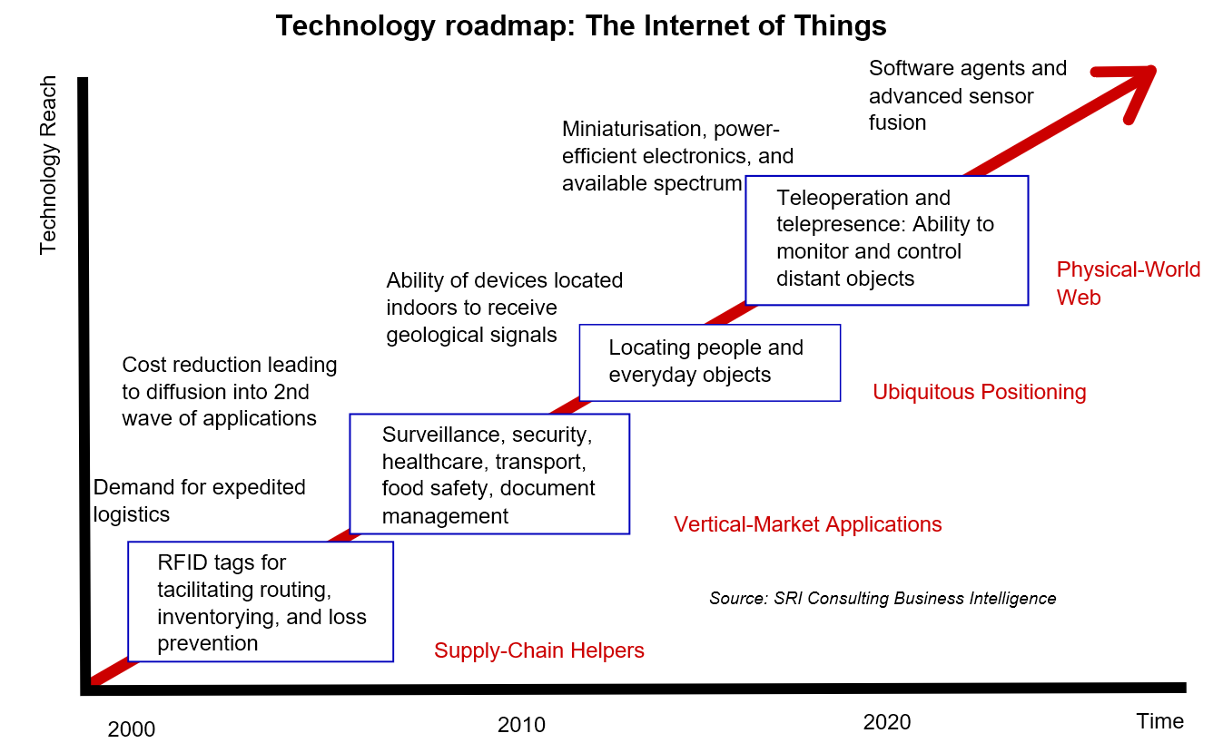

Slide 25
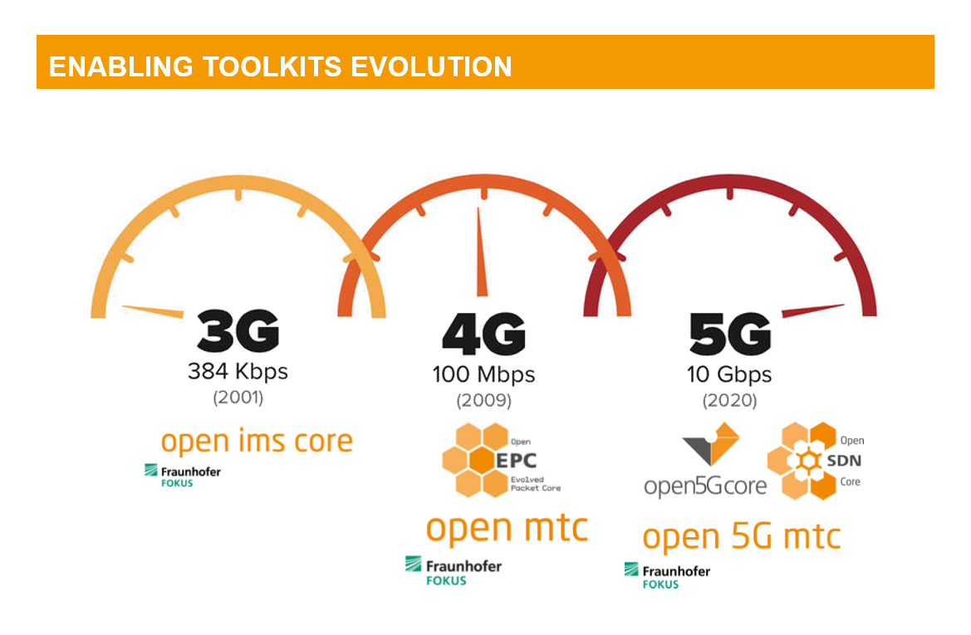

Slide 26
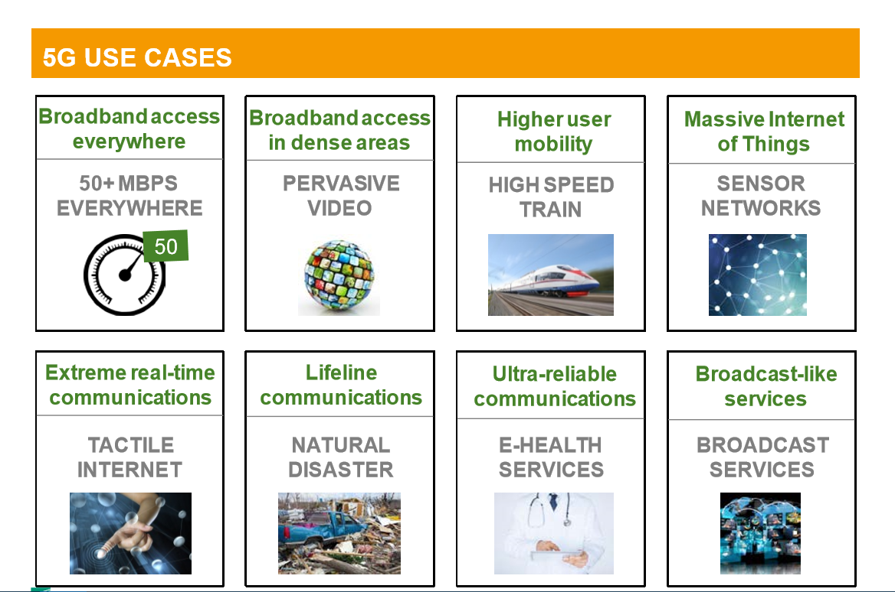

Slide 27
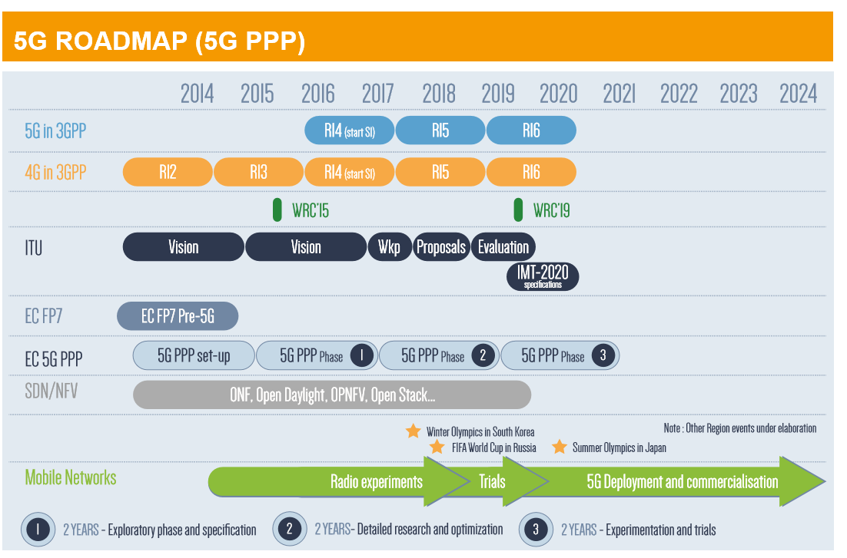

Slide 28
More Information
Search “Prabhas Chongstitvatana”

