Slide 1

Quantum Computing and Artificial Intelligence
Prabhas Chongstitvatana
With collaboration from Chatchawit Aporntewan, Department of Mathematics and Computer Science, Chulalongkorn University and Suwit Kiravittaya, Department of Electrical Engineering, Naresuan University

Slide 2

To get this presentation
Search “Prabhas Chongstitvatana”
Go to me homepage

Slide 3
Introduction to Quantum computing
Quantum Computers
Optimization
Artificial Intelligence

Slide 4
Technology advancement
Electricity
Electronics
Microelectronics
Nanotechnology
… ?

Slide 5
What is a quantum computer?
a computer that relies on special memory, "quantum bit", to perform massively parallel computing.

Slide 6
What is a quantum bit?
a basic unit of memory that uses superposition of "quantum" effect (entanglement) to store information.
a "qubit" stores the probability of information. It represents both "1" and "0" at the same time.

Slide 7
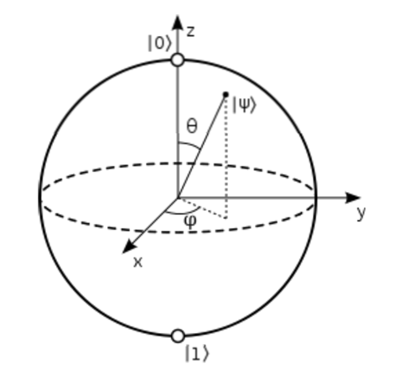

Slide 8
What is the advantage?
it is very very fast compared to conventional computers.

Slide 9
How to make a quantum bit?
"quantum effect"
photon entanglement
cold atom
electron spin

Slide 10
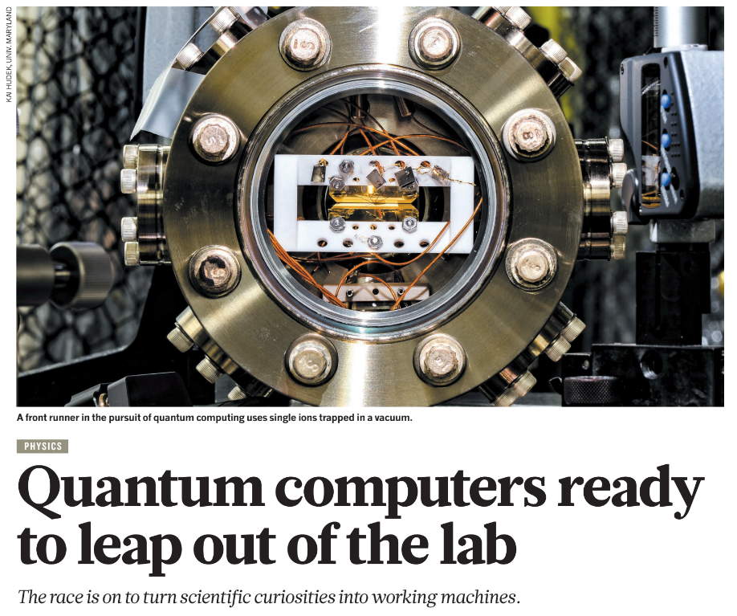
Quantum Computing
D. Castelvecchi, “Quantum computers ready to leap out of the lab”, Nature 541 (2017) 9.

Slide 11
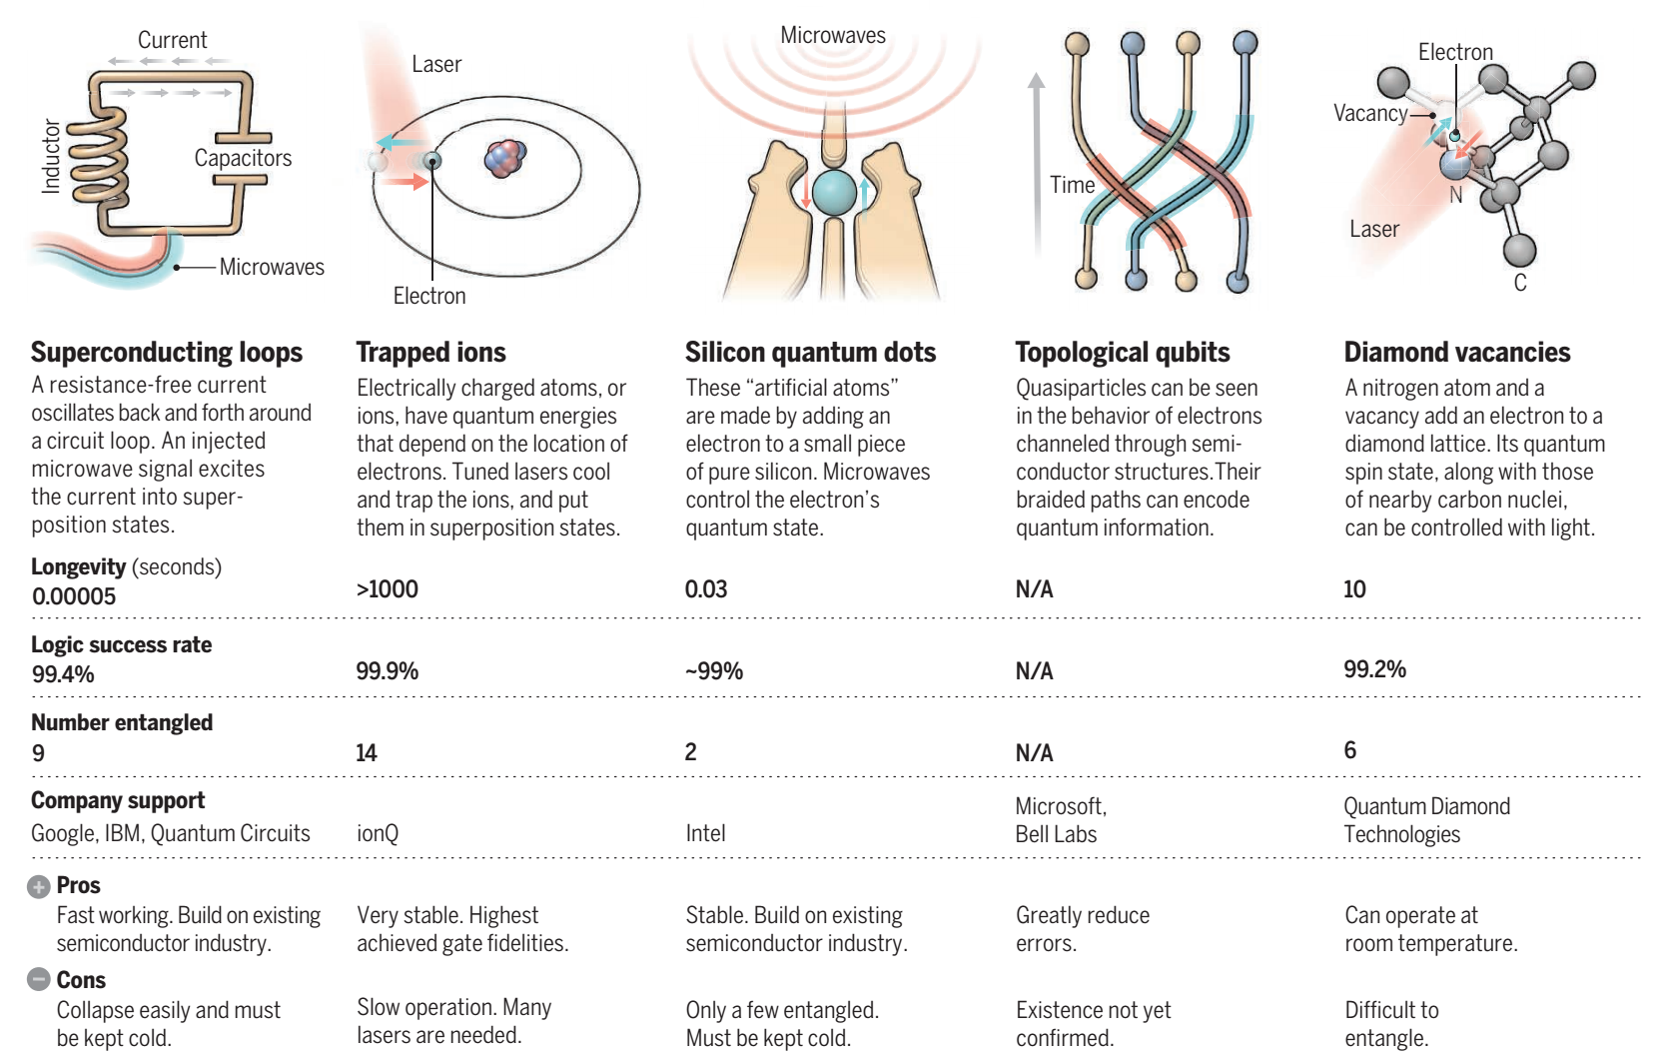
Systems for Quantum Bit (qubit)*
+ some more systems from other university research labs
D-Wave is exceptional & Scalability is the key issue.
* G. Popkin, “Quest for qubits”, Science 354 (2016) 1091.

Slide 12
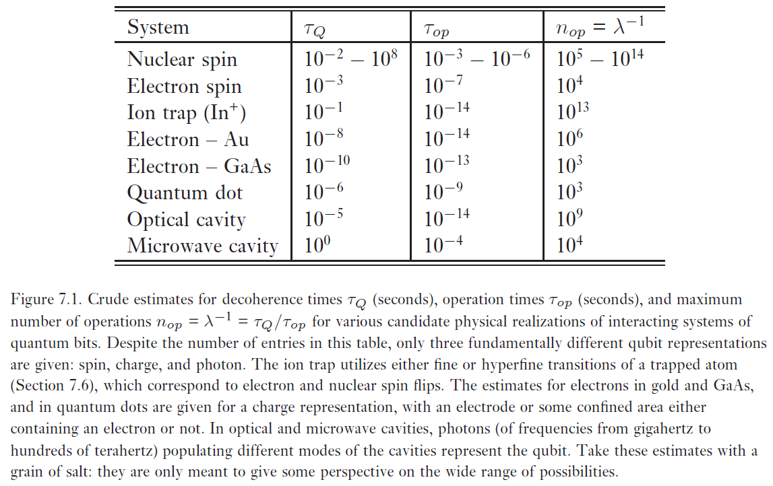
Quantum computers: physical realization

Slide 13
Components
Quantum circuit
Quantum gates
components of quantum computers that manipulate state of quantum bits.

Slide 14
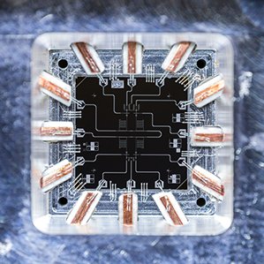
Quantum Gates

Slide 15





Single Qubit Gates
NOT
Unitary matrix

Slide 16
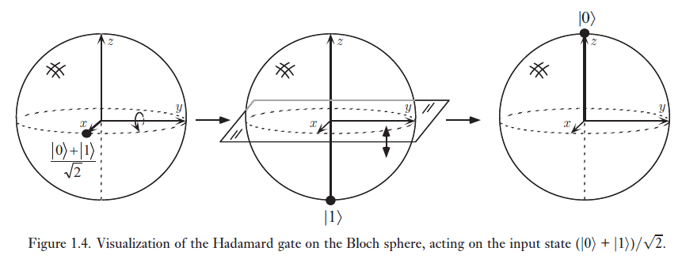


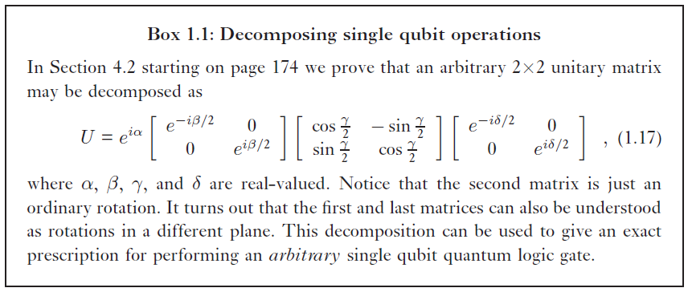


Single Qubit Gates
Z gate:
H gate (Hadamard):

Slide 17
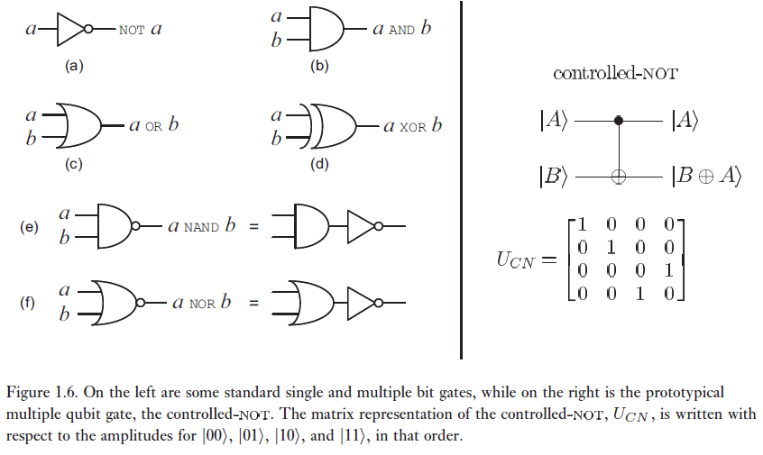
Multiple Qubit Gates

Slide 18
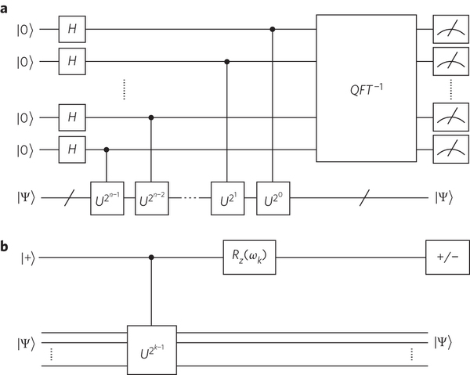
Quantum circuits

Slide 19
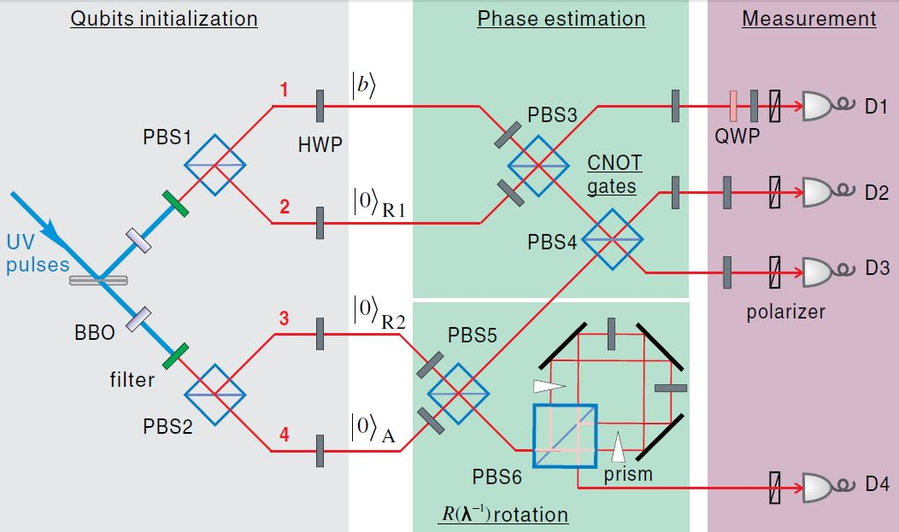
Quantum circuits

Slide 20
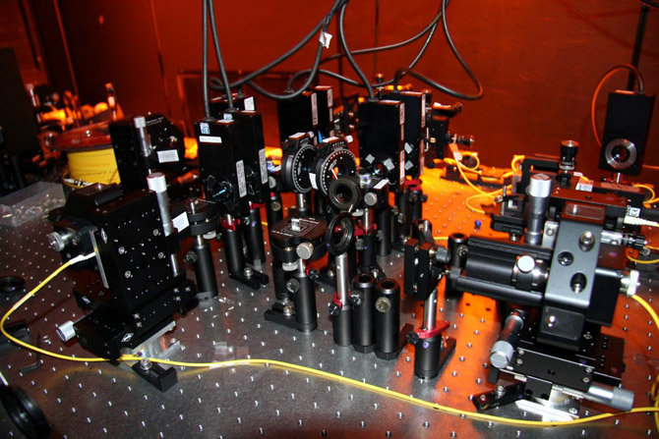

Slide 21
Quantum algorithms
computer programs that work on quantum computers

Slide 22
Famous algorithms
Shor's integer factorization
Given an integer N, find its prime factors

Slide 23
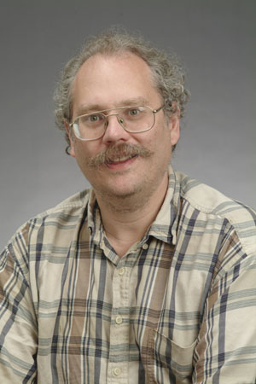
Quantum Algorithms
Peter Shor
a quantum algorithm for integer factorization formulated .

Slide 24
Shor’s algorithm
The factorization also needs huge amount of quantum gates. It increases with N as (log N)³. Thus factoring of a 4096-bit number requires 4,947,802,324,992 quantum gates.

Slide 25
Example of quantum computers
ibm 5 qubits
D-wave two, quantum annealing

Slide 26
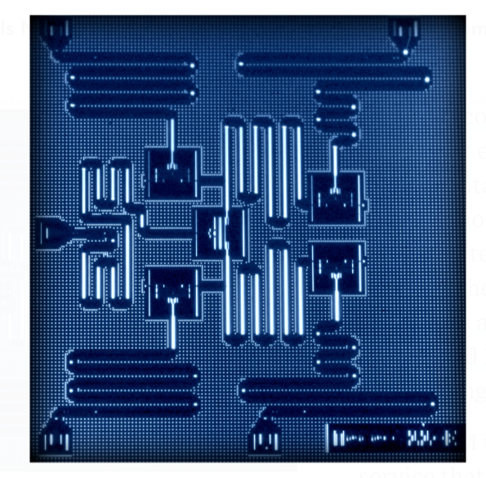
IBM 5 qubits processor

Slide 27
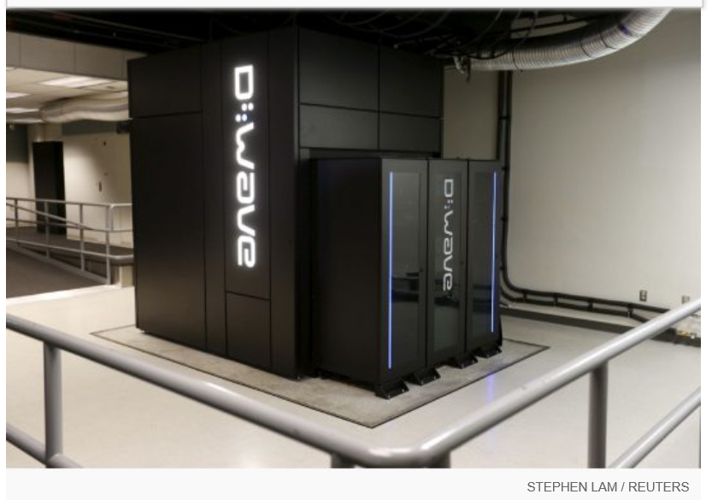
Google Nasa, D-Wave 2x machine

Slide 28
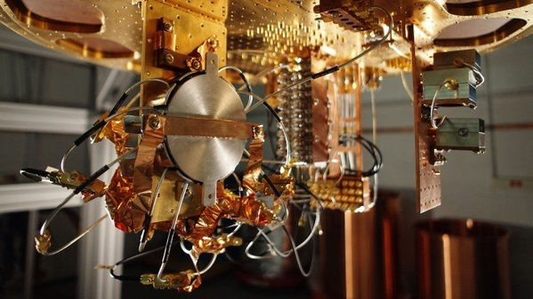
Quantum bit in D-wave machine

Slide 29
Optimization

Slide 30
Evolutionary Computation
Survival of the fittest.
The objective function depends on the problem.
EC is not a random search.

Slide 31
Simple Genetic Algorithm
Represent a solution by a binary string {0,1}*
Selection: chance to be selected is proportional to its fitness
Recombination: single point crossover
Mutation: single bit flip

Slide 32
Recombination
Select a cut point, cut two parents, exchange parts
AAAAAA 111111
cut at bit 2
AA AAAA 11 1111
exchange parts
AA1111 11AAAA

Slide 33
Mutation
single bit flip
111111 --> 111011
flip at bit 4

Slide 34
Estimation of Distribution Algorithms
GA + Machine learning
current population -> selection ->
model-building -> next generation
replace crossover + mutation with learning and sampling
probabilistic model

Slide 35
x = 11100 f(x) = 28 x = 11011 f(x) = 27 x = 10111 f(x) = 23 x = 10100 f(x) = 20 --------------------------- x = 01011 f(x) = 11 x = 01010 f(x) = 10 x = 00111 f(x) = 7 x = 00000 f(x) = 0
Induction
1 * * * *
(Building Block)

Slide 36
x = 11111 f(x) = 31 x = 11110 f(x) = 30 x = 11101 f(x) = 29 x = 10110 f(x) = 22 --------------------------- x = 10101 f(x) = 21 x = 10100 f(x) = 20 x = 10010 f(x) = 18 x = 01101 f(x) = 13
Reproduction
1 * * * *
(Building Block)

Slide 37
Combinatorial optimisation
The domains of feasible solutions are discrete.
Examples
Traveling salesman problem
Minimum spanning tree problem
Set-covering problem
Knapsack problem

Slide 38
Model in COIN
A joint probability matrix, H.
Markov Chain.
An entry in H_{xy} is a probability of transition from a state x to a state y.
xy a coincidence of the event x and event y.

Slide 39
Coincidence Algorithm steps
Initialize the Generator
 | X₁ | X₂ | X₃ | X₄ | X₅
X₁ | 0 | 0.25 | 0.25 | 0.25 | 0.25
X₂ | 0.25 | 0 | 0.25 | 0.25 | 0.25
X₃ | 0.25 | 0.25 | 0 | 0.25 | 0.25
X₄ | 0.25 | 0.25 | 0.25 | 0 | 0.25
X₅ | 0.25 | 0.25 | 0.25 | 0.25 | 0
Generate the Population
Evaluate the Population
The Generator
Selection
Update the Generator
Notes:
Our algorithm use the Markov chain matrix of order 1 in order to construct a generator
This generator represent the joint probability of all the possible search space.
For example the probabilities of the incidence in which x1 can be followed by x2 x3 x4 and x5
Since x1 can not be followed by it self due to the encoding represent the permutation of numbers

Slide 40
Steps of the algorithm
Initialise H to a uniform distribution.
Sample a population from H.
Evaluate the population.
Select two groups of candidates: better, and worse.
Use these two groups to update H.
Repeate the steps 2-3-4-5 until satisfactory solutions are found.

Slide 41
Updating of H
k denotes the step size, n the length of a candidate, r_{xy} the number of occurrence of xy in the better-group candidates, p_{xy} the number of occurrence of xy in the worse-group candidates. H_{xx} are always zero.

Slide 42
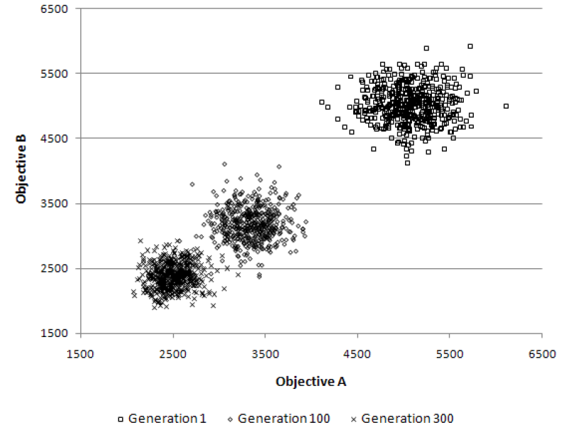
Multi-objective TSP
The population clouds in a random 100-city 2-obj TSP

Slide 44

More Information
COIN homepage
https://www.cp.eng.chula.ac.th/~piak/project/coin/index-coin.htm

Slide 45
Recent work in quantum computing
google quantum lab's paper
claim of 100,000,000x speed up

Slide 46
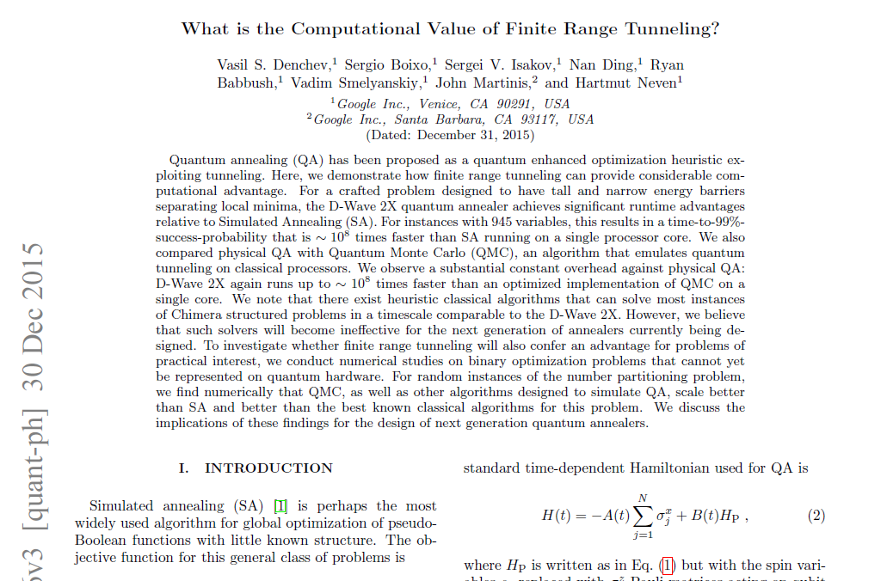

Slide 47
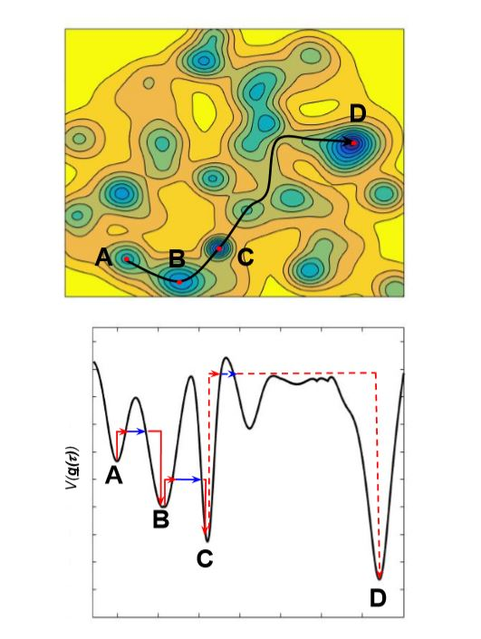

Slide 48
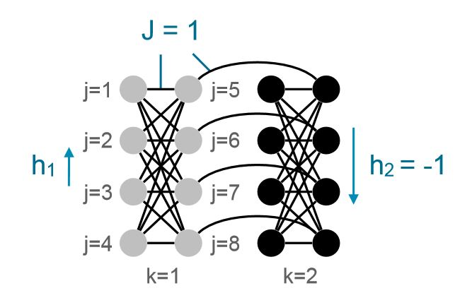

Slide 49
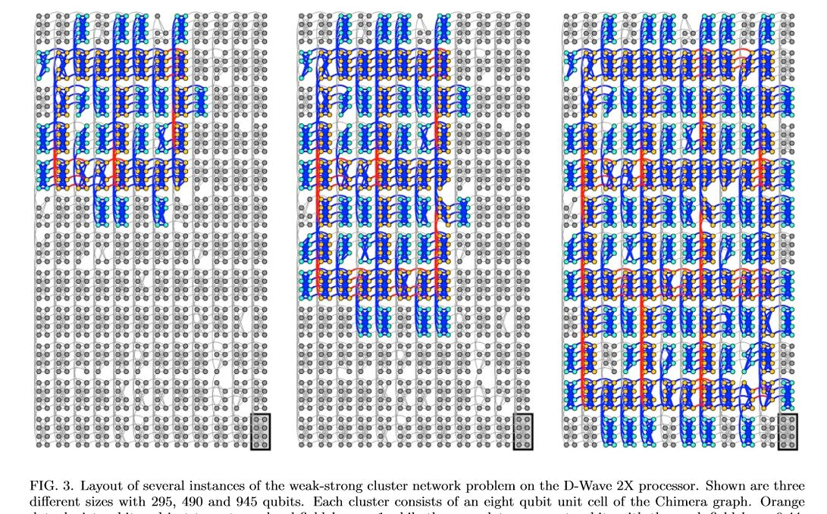

Slide 50
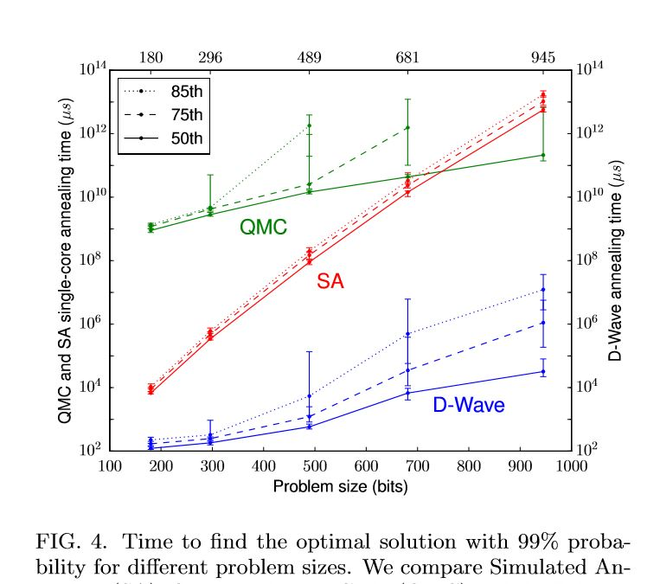

Slide 51
My own example of quantum computation
compact genetic algorithm by quantum computers
exponential speedup compared to conventional computers

Slide 52
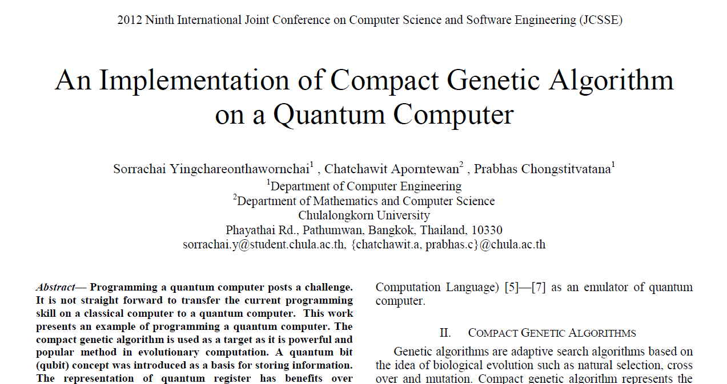
Example of Quantum Algorithm

Slide 53

Yingchareonthawornchai, S., Aporntewan, C., and Chongstitvatana, P., "An Implementation of Compact Genetic Algorithm on a Quantum Computer," Int. Joint Conf. on Computer Science and Software Engineering (JCSSE), 30 May - 1 June 2012, pp.131-135. http://www.cp.eng.chula.ac.th/~piak/paper/2012/jcsse-quantum-cga.pdf

Slide 54
Normal
1) initialze qureg x
2) generate two individuals from qureg
3) let them compete
4) update qureg x with the winner
5) repeat step 2..4 for k times
6) generate the final result

Slide 55
quantum speedup
1) initialze qureg x
2) generate the first individual from qureg x
3) generate the second individual with condition that fitness is greater than the first
4) let them compete
5) update qureg x with the winner
6) repeat step 2..5 for k times
7) generate the final result

Slide 56
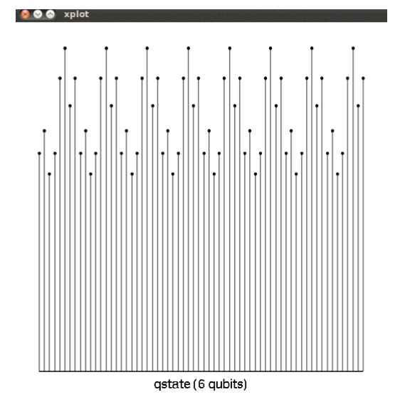
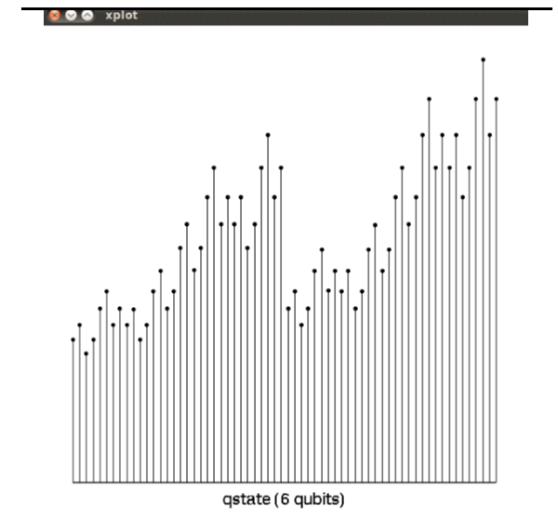
output

Slide 57
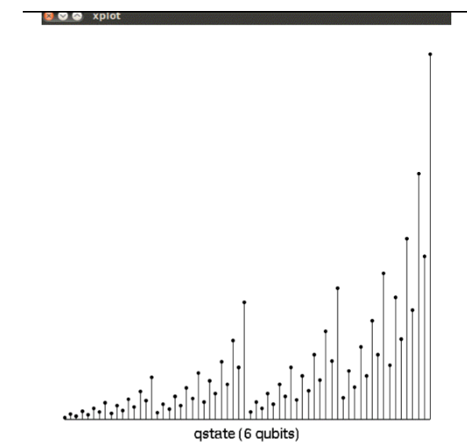
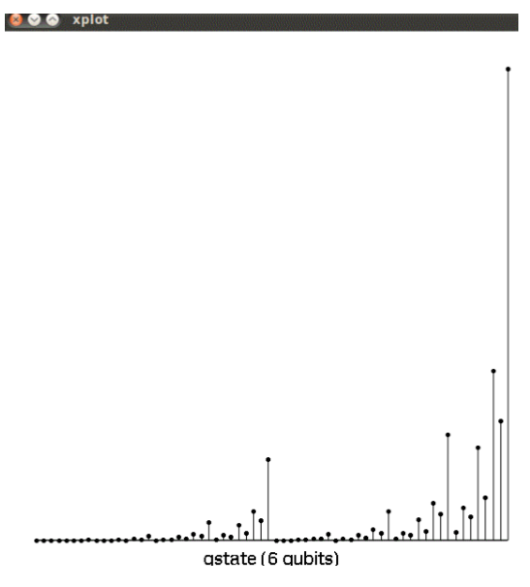
output

Slide 58
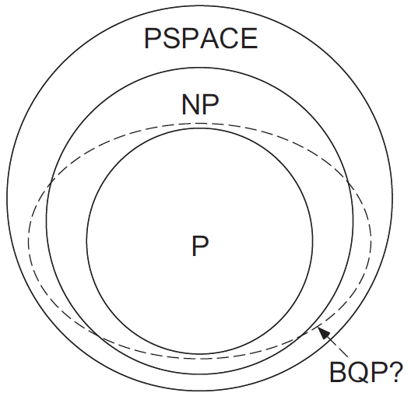
The Power of Quantum Computation
P = solved in polynomial time
NP = verified in polynomial time
PSPACE = solved in polynomial space
We do not know whether
P != NP
PSPACE is bigger than NP
NP-complete
Graph isomorphism Integer Factorization
BQP (bounded error quantum polynomial time) is the class of decision problems solvable by a quantum computer in polynomial time, with an error probability of at most 1/3 for all instances.

Slide 59
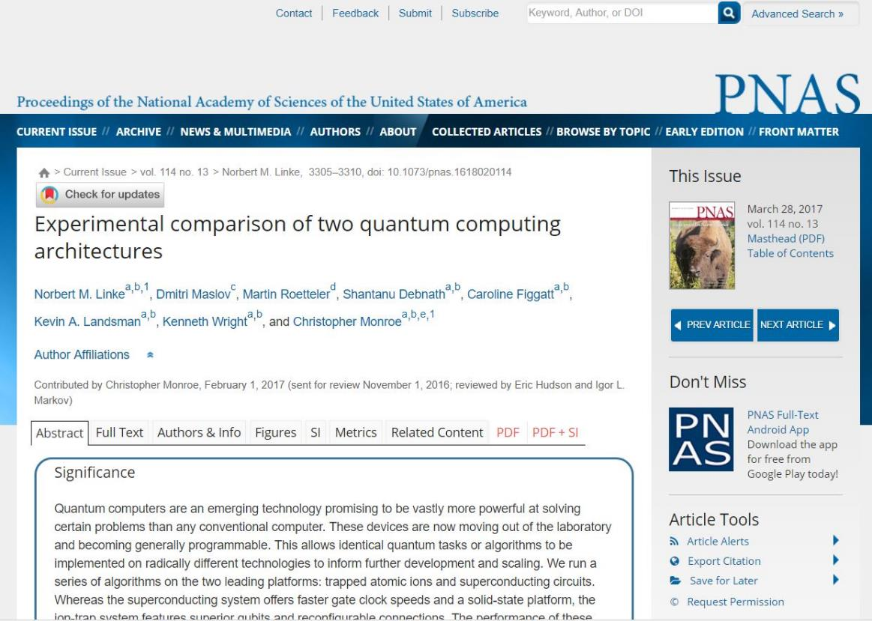
Recent advance in hardware

Slide 60
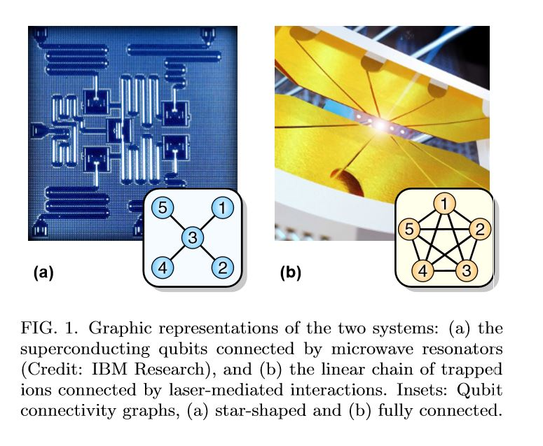

Slide 61
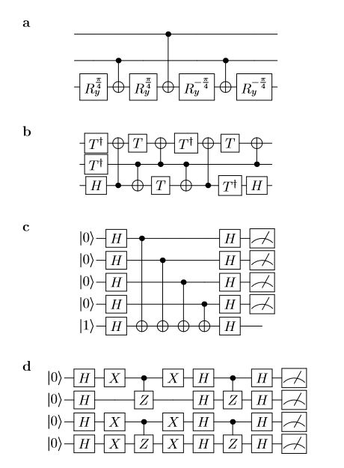

Slide 62
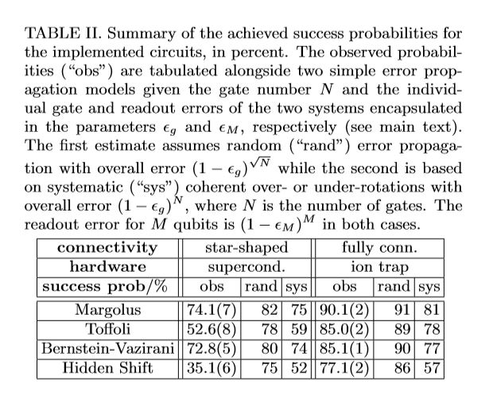

Slide 63
Future
qubits
quantum annealing computers
scaling up

Slide 64
Predicting future
uncertain of success
special purpose quantum computers
quantum style will motivate a new class of computation

Slide 65
More Information
Search “Prabhas Chongstitvatana”
Go to me homepage

