Slide 1

Quantum Computers: an introduction
Prabhas Chongstitvatana
Chulalongkorn University

Slide 2

More Information
Search “Prabhas Chongstitvatana”
Get to me homepage

Slide 3
What is a quantum computer?
a computer that relies on special memory, "quantum bit", to perform massively parallel computing.

Slide 4
What is a quantum bit?
a basic unit of memory that uses superposition of "quantum" effect (entanglement) to store information.
a "qubit" stores the probability of information. It represents both "1" and "0" at the same time.

Slide 5
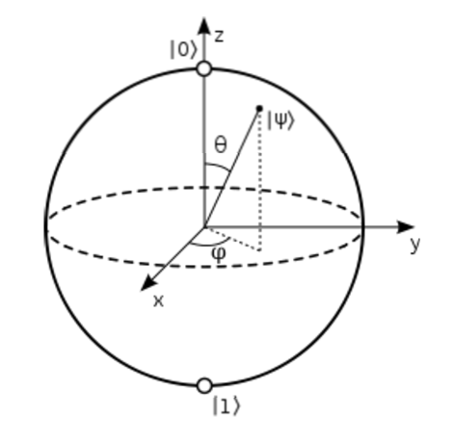

Slide 6
What is the advantage?
it is very very fast compared to conventional computers.

Slide 7
How to make a quantum bit?
"quantum effect"
photon entanglement
cold atom
electron spin

Slide 8
Components
Quantum circuit
Quantum gates
components of quantum computers that manipulate state of quantum bits.

Slide 9
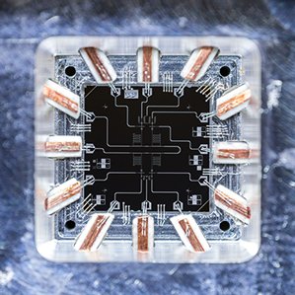
Quantum Gates

Slide 10
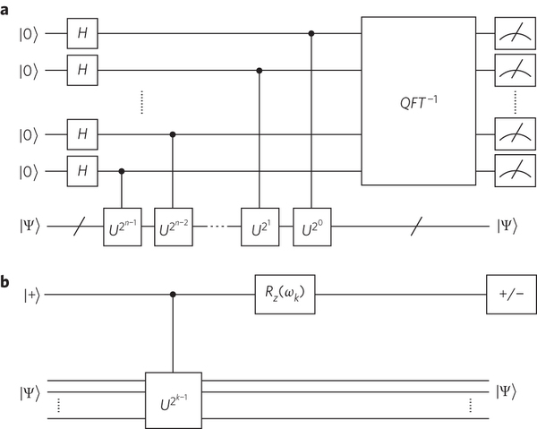
Quantum circuits

Slide 11
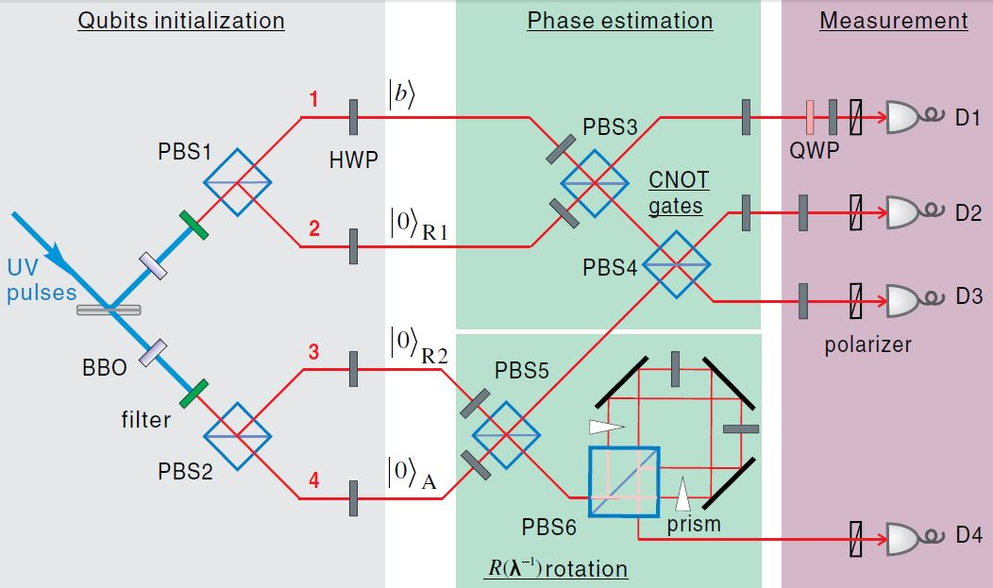
Quantum circuits

Slide 12
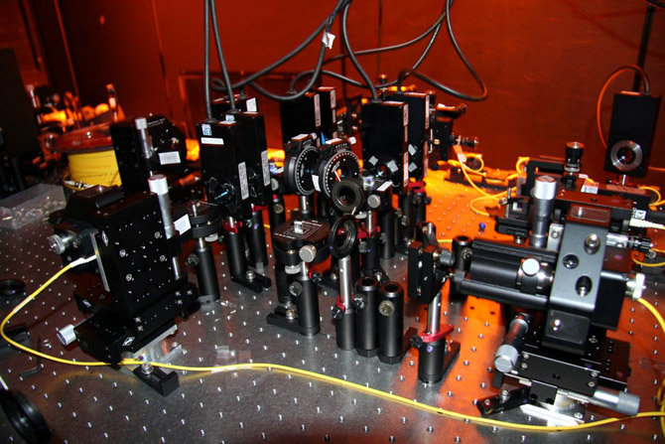

Slide 13
Quantum algorithms
computer programs that work on quantum computers

Slide 14
Famous algorithms
Shor's integer factorization
Given an integer N, find its prime factors

Slide 15
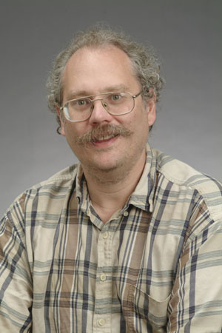
Quantum Algorithms
Peter Shor
a quantum algorithm for integer factorization formulated .

Slide 16
Shor’s algorithm
The factorization also needs huge amount of quantum gates. It increases with N as (log N)³. Thus factoring of a 4096-bit number requires 4,947,802,324,992 quantum gates.

Slide 17
Example of quantum computers
ibm 5 qubits
D-wave two, quantum annealing

Slide 18
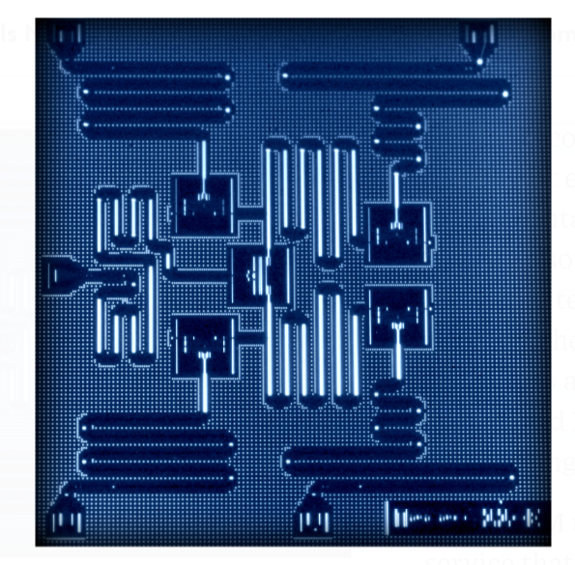
IBM 5 qubits processor

Slide 19
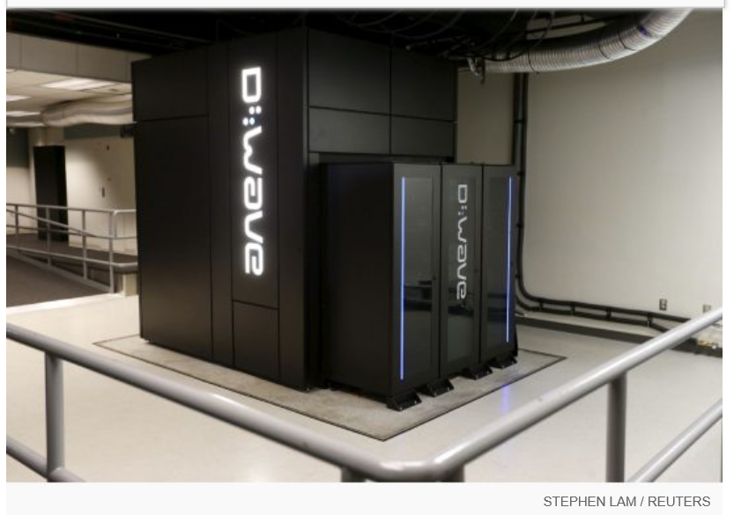
Google Nasa, D-Wave 2x machine

Slide 20
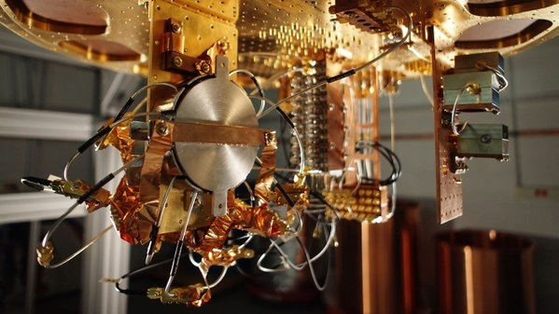
Quantum bit in D-wave machine

Slide 21
Optimization

Slide 23
More Information
COIN homepage
http://www.cp.eng.chula.ac.th/faculty/pjw/project/coin/index-coin.htm
My homepage
http://www.cp.eng.chula.ac.th/faculty/pjw

Slide 24
Recent work
google quantum lab's paper
claim of 100,000,000x speed up

Slide 25
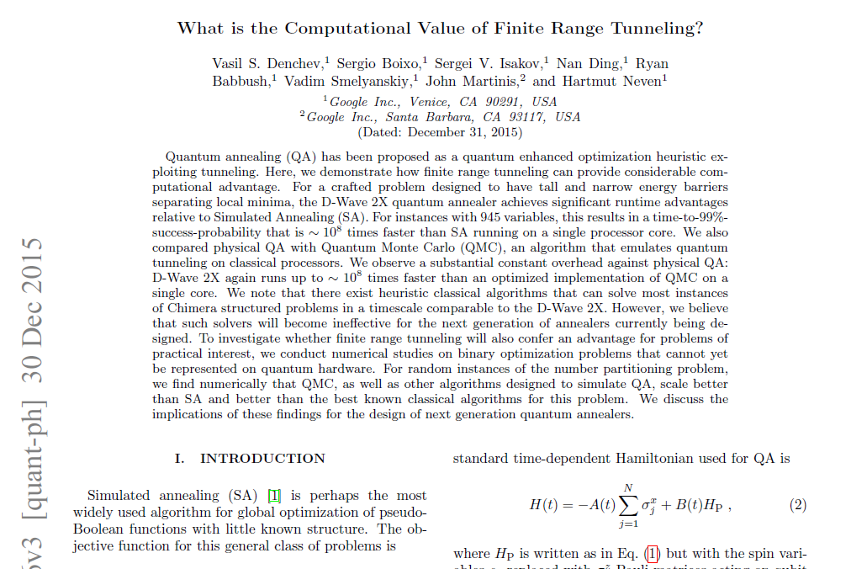

Slide 26
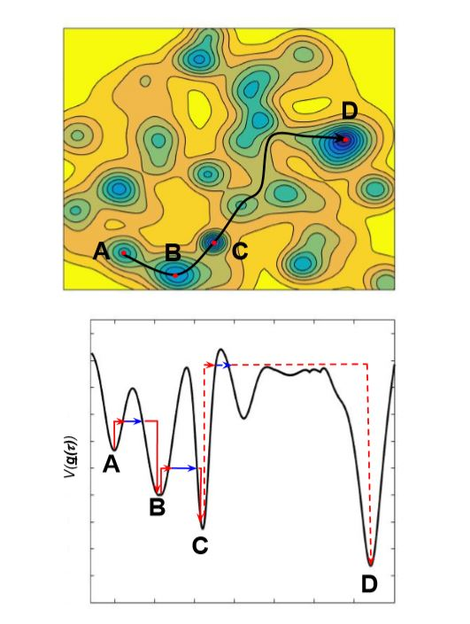

Slide 27
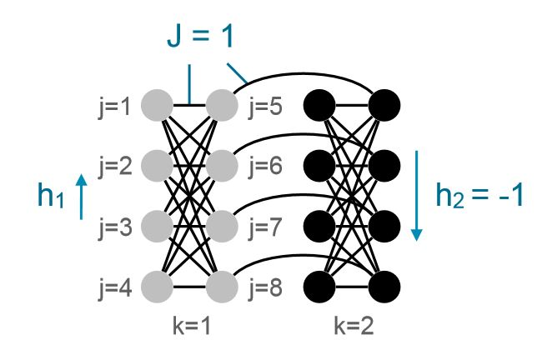

Slide 28
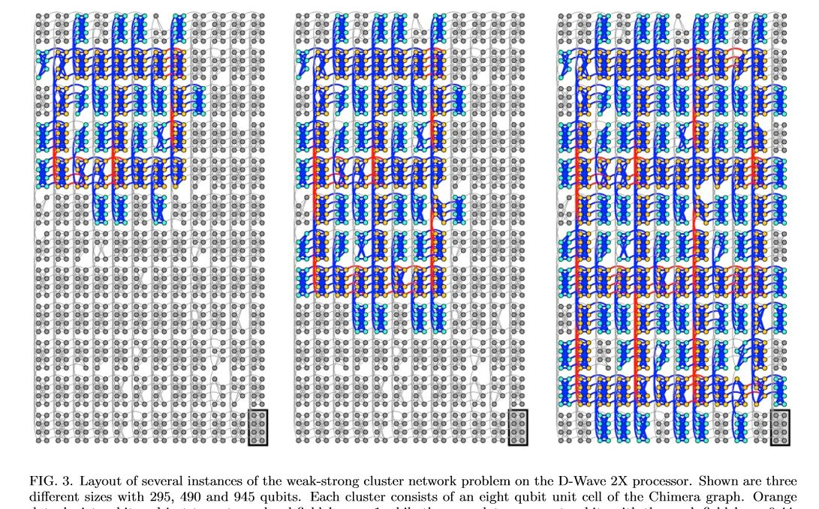

Slide 29
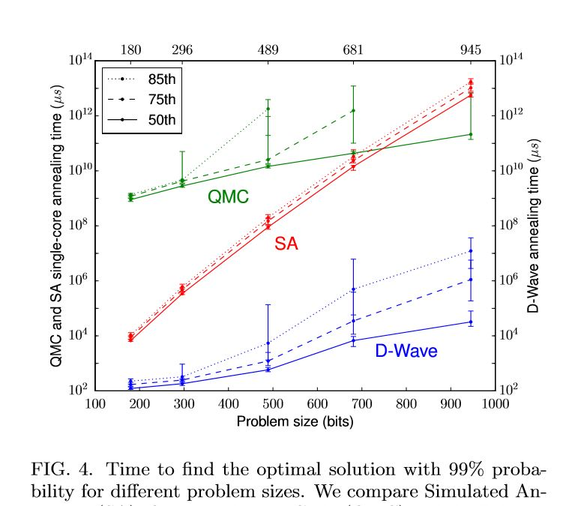

Slide 30
My own example of quantum computation
compact genetic algorithm by quantum computers
exponential speedup

Slide 31
Example of Quantum Algorithm
Yingchareonthawornchai, S., Aporntewan, C., and Chongstitvatana, P., "An Implementation of Compact Genetic Algorithm on a Quantum Computer," Int. Joint Conf. on Computer Science and Software Engineering (JCSSE), 30 May - 1 June 2012, pp.131-135. http://www.cp.eng.chula.ac.th/~piak/paper/2012/jcsse-quantum-cga.pdf

Slide 32
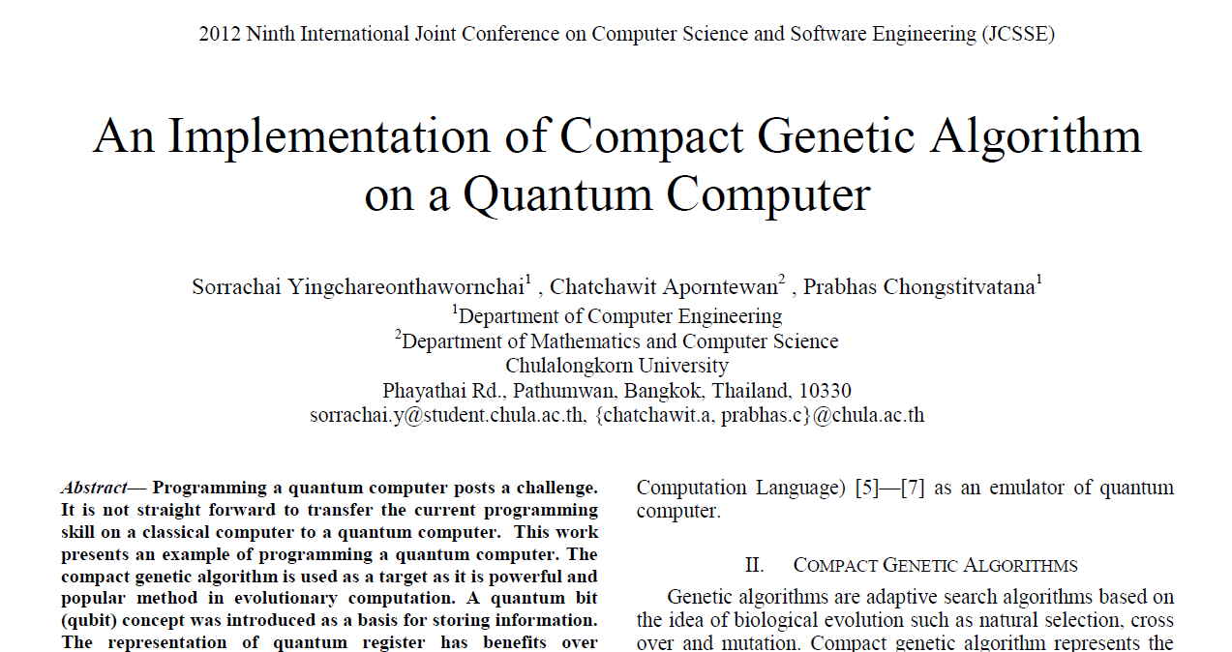

Slide 33
Normal
1) initialze qureg x
2) generate two individuals from qureg
3) let them compete
4) update qureg x with the winner
5) repeat step 2..4 for k times
6) generate the final result

Slide 34
quantum speedup
1) initialze qureg x
2) generate the first individual from qureg x
3) generate the second individual with condition that fitness is greater than the first
4) let them compete
5) update qureg x with the winner
6) repeat step 2..5 for k times
7) generate the final result

Slide 35
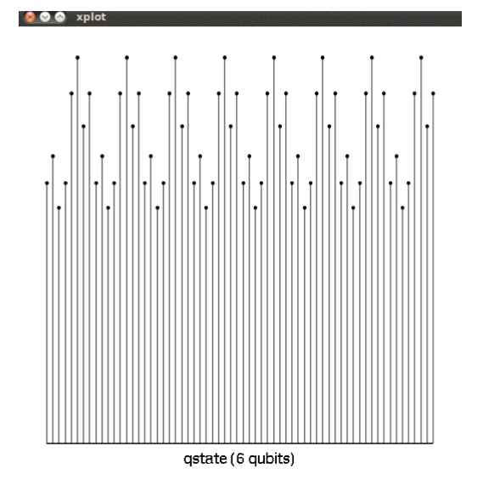
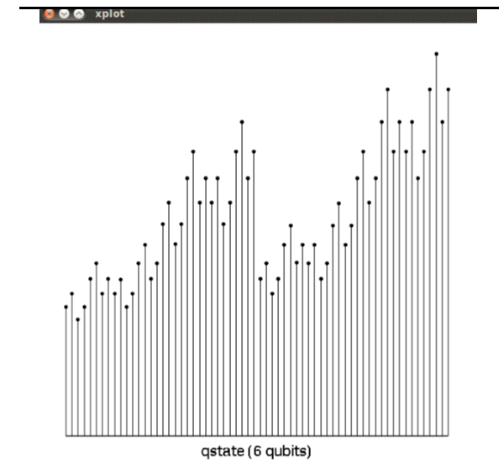
output

Slide 36
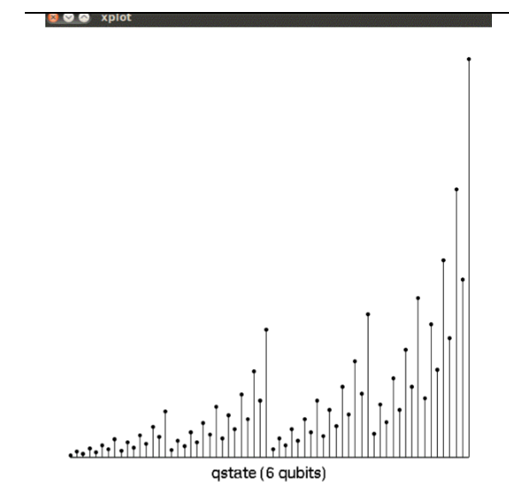
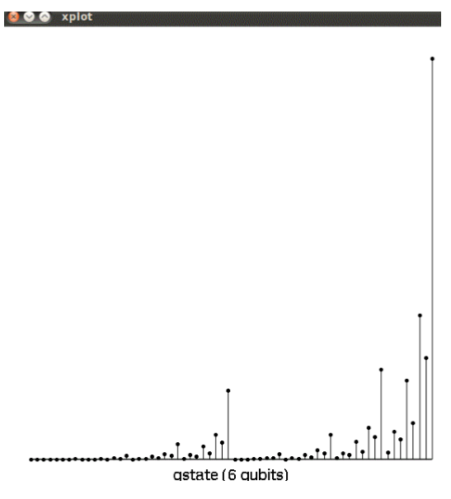
output

Slide 37
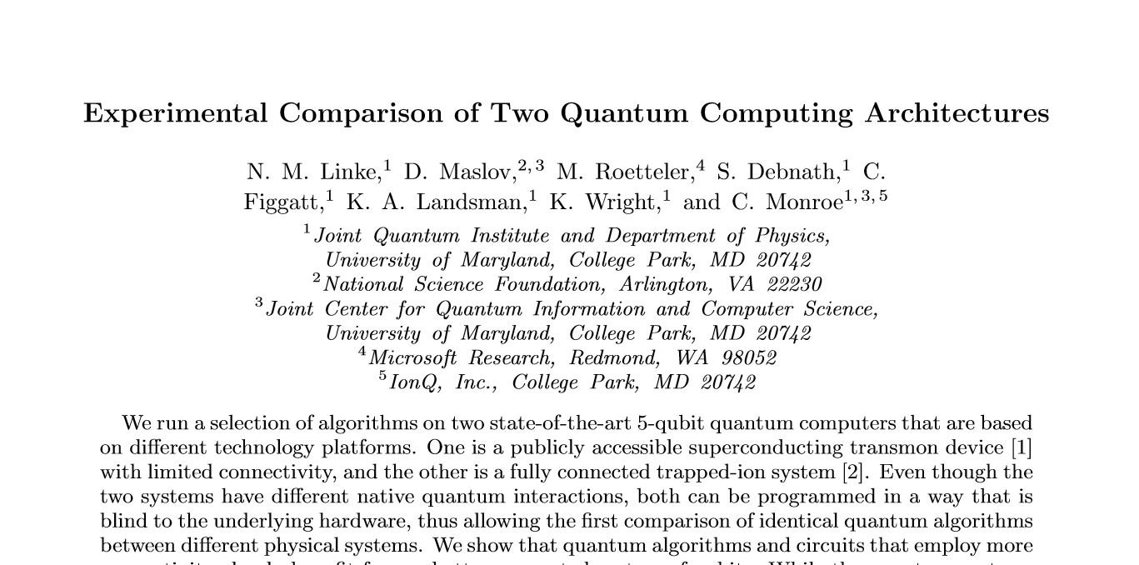
Recent advance in hardware

Slide 38
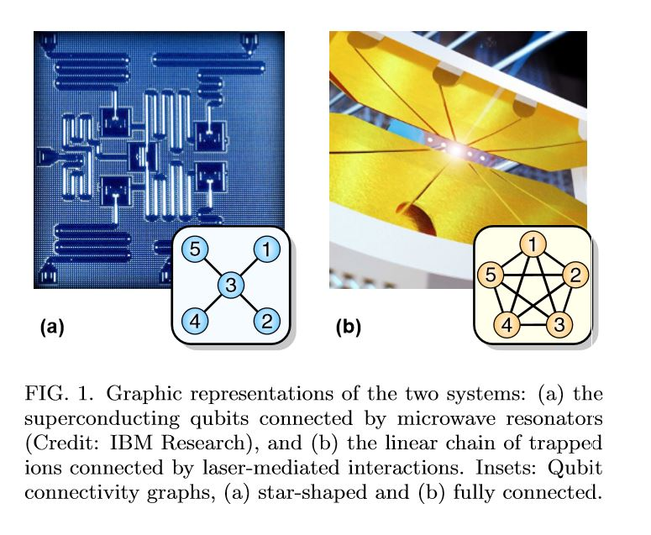

Slide 39
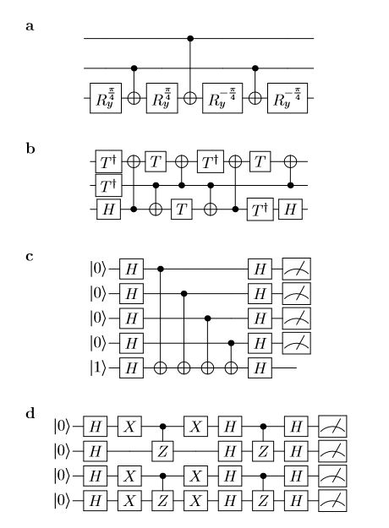

Slide 40
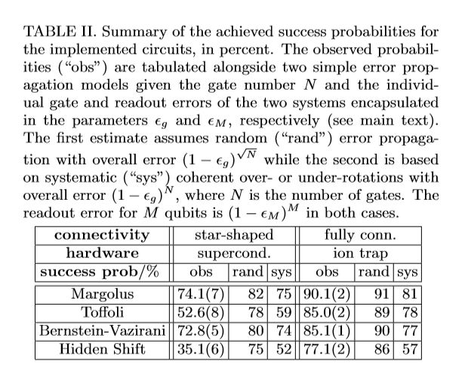

Slide 41
Future
qubits
quantum annealing computers
scaling up

Slide 42
Predicting future
uncertain of success
special purpose quantum computers
quantum style will motivate a new class of computation

Slide 43
More Information
Search “Prabhas Chongstitvatana”
Get to me homepage

