Slide 1

Optimization by Quantum Computers
Prabhas Chongstitvatana
Chulalongkorn University

Slide 2
What is a quantum computer?
a computer that relies on special memory, "quantum bit", to perform massively parallel computing.

Slide 3
What is a quantum bit?
a basic unit of memory that uses superposition of "quantum" effect (entanglement) to store information.
a "qubit" stores the probability of information. It represents both "1" and "0" at the same time.

Slide 4
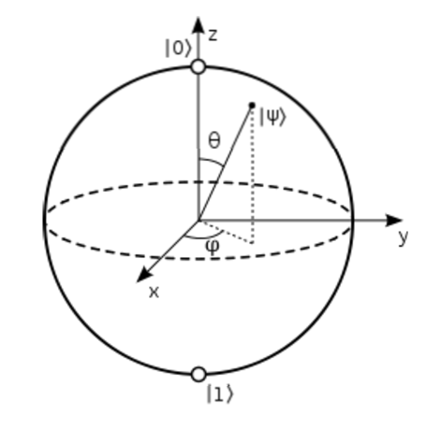

Slide 5
What is the advantage?
it is very very fast compared to conventional computers.

Slide 6
How to make a quantum bit?
"quantum effect"
photon entanglement
cold atom
electron spin

Slide 7
Components
Quantum circuit
Quantum gates
components of quantum computers that manipulate state of quantum bits.

Slide 8
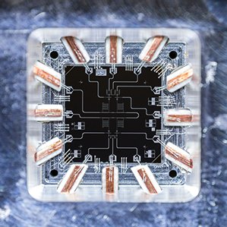
Quantum Gates

Slide 9
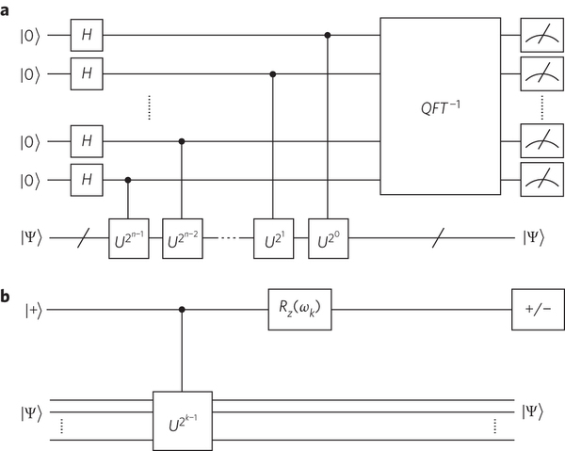
Quantum circuits

Slide 10
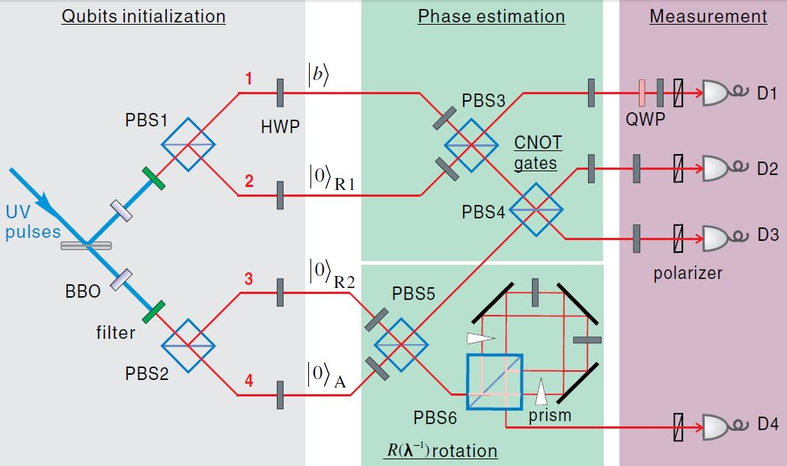
Quantum circuits

Slide 11
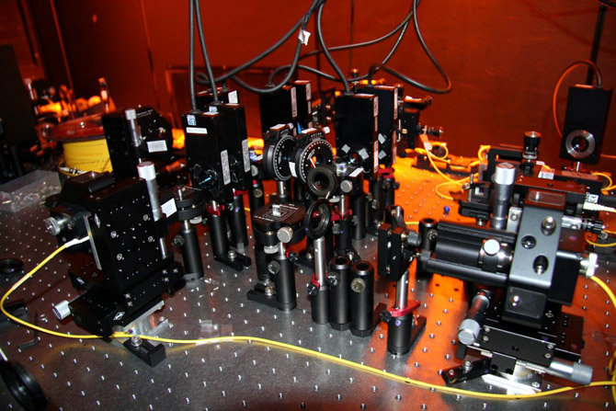

Slide 12
Quantum algorithms
computer programs that work on quantum computers

Slide 13
Famous algorithms
Shor's integer factorization
Given an integer N, find its prime factors

Slide 14
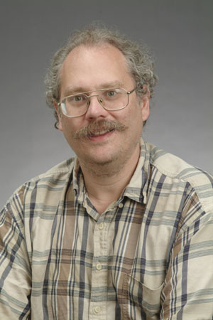
Quantum Algorithms
Peter Shor
a quantum algorithm for integer factorization formulated .

Slide 15
Shor’s algorithm
The factorization also needs huge amount of quantum gates. It increases with N as (log N)³. Thus factoring of a 4096-bit number requires 4,947,802,324,992 quantum gates.

Slide 16
Example of quantum computers
ibm 5 qubits
D-wave two, quantum annealing

Slide 17
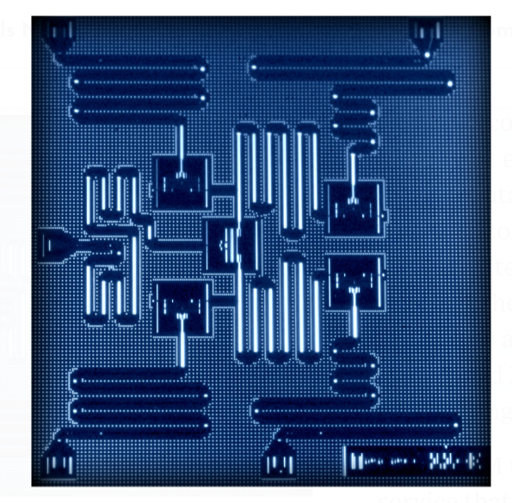
IBM 5 qubits processor

Slide 18
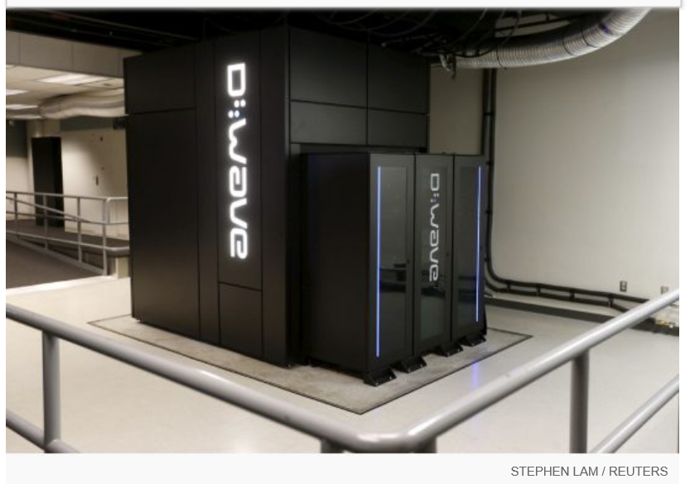
Google Nasa, D-Wave 2x machine

Slide 19
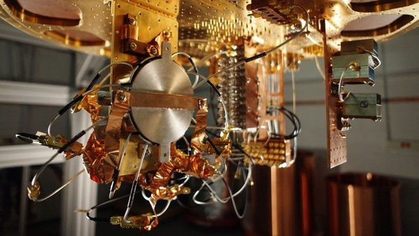
Quantum bit in D-wave machine

Slide 20
Optimization

Slide 21
Evolutionary Computation
Survival of the fittest.
The objective function depends on the problem.
EC is not a random search.

Slide 22
Genetic Algorithm Pseudo Code
initialise population P
while not terminate
evaluate P by fitness function
P’ = selection.recombination.mutation of P
P = P’
terminating conditions:
found satisfactory solutions
waiting too long

Slide 23
Simple Genetic Algorithm
Represent a solution by a binary string {0,1}*
Selection: chance to be selected is proportional to its fitness
Recombination: single point crossover
Mutation: single bit flip

Slide 24
Recombination
Select a cut point, cut two parents, exchange parts
AAAAAA 111111
cut at bit 2
AA AAAA 11 1111
exchange parts
AA1111 11AAAA

Slide 25
Mutation
single bit flip
111111 --> 111011
flip at bit 4

Slide 26
Estimation of Distribution Algorithms
GA + Machine learning
current population -> selection ->
model-building -> next generation
replace crossover + mutation with learning and sampling
probabilistic model

Slide 27
x = 11100 f(x) = 28 x = 11011 f(x) = 27 x = 10111 f(x) = 23 x = 10100 f(x) = 20 --------------------------- x = 01011 f(x) = 11 x = 01010 f(x) = 10 x = 00111 f(x) = 7 x = 00000 f(x) = 0
Induction
1 * * * *
(Building Block)

Slide 28
x = 11111 f(x) = 31 x = 11110 f(x) = 30 x = 11101 f(x) = 29 x = 10110 f(x) = 22 --------------------------- x = 10101 f(x) = 21 x = 10100 f(x) = 20 x = 10010 f(x) = 18 x = 01101 f(x) = 13
Reproduction
1 * * * *
(Building Block)

Slide 29
Combinatorial optimisation
The domains of feasible solutions are discrete.
Examples
Traveling salesman problem
Minimum spanning tree problem
Set-covering problem
Knapsack problem

Slide 30
Model in COIN
A joint probability matrix, H.
Markov Chain.
An entry in H_{xy} is a probability of transition from a state x to a state y.
xy a coincidence of the event x and event y.

Slide 31
Coincidence Algorithm steps
Initialize the Generator
 | X₁ | X₂ | X₃ | X₄ | X₅
X₁ | 0 | 0.25 | 0.25 | 0.25 | 0.25
X₂ | 0.25 | 0 | 0.25 | 0.25 | 0.25
X₃ | 0.25 | 0.25 | 0 | 0.25 | 0.25
X₄ | 0.25 | 0.25 | 0.25 | 0 | 0.25
X₅ | 0.25 | 0.25 | 0.25 | 0.25 | 0
Generate the Population
Evaluate the Population
The Generator
Selection
Update the Generator
Notes:
Our algorithm use the Markov chain matrix of order 1 in order to construct a generator
This generator represent the joint probability of all the possible search space.
For example the probabilities of the incidence in which x1 can be followed by x2 x3 x4 and x5
Since x1 can not be followed by it self due to the encoding represent the permutation of numbers

Slide 32
Steps of the algorithm
Initialise H to a uniform distribution.
Sample a population from H.
Evaluate the population.
Select two groups of candidates: better, and worse.
Use these two groups to update H.
Repeate the steps 2-3-4-5 until satisfactory solutions are found.

Slide 33
Updating of H
k denotes the step size, n the length of a candidate, r_{xy} the number of occurrence of xy in the better-group candidates, p_{xy} the number of occurrence of xy in the worse-group candidates. H_{xx} are always zero.

Slide 34
Computational Cost and Space
Generating the population requires time O(mn²) and space O(mn)
Sorting the population requires time O(m log m)
The generator require space O(n²)
Updating the joint probability matrix requires time O(mn²)

Slide 35
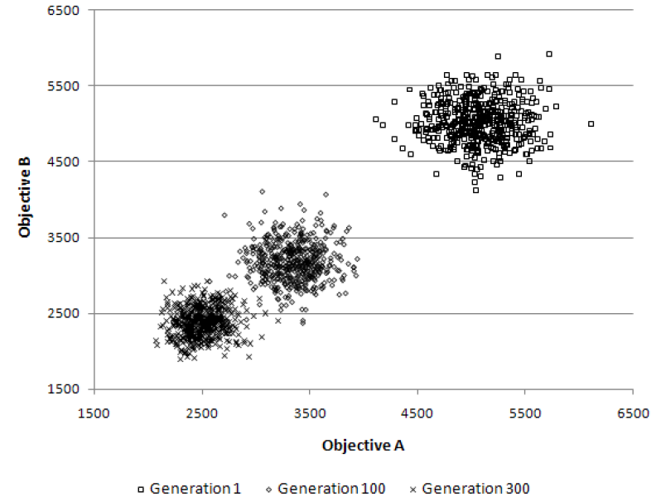
Multi-objective TSP
The population clouds in a random 100-city 2-obj TSP

Slide 37
More Information
COIN homepage
http://www.cp.eng.chula.ac.th/faculty/pjw/project/coin/index-coin.htm
My homepage
http://www.cp.eng.chula.ac.th/faculty/pjw

Slide 38
Recent work
google quantum lab's paper
claim of 100,000,000x speed up

Slide 39
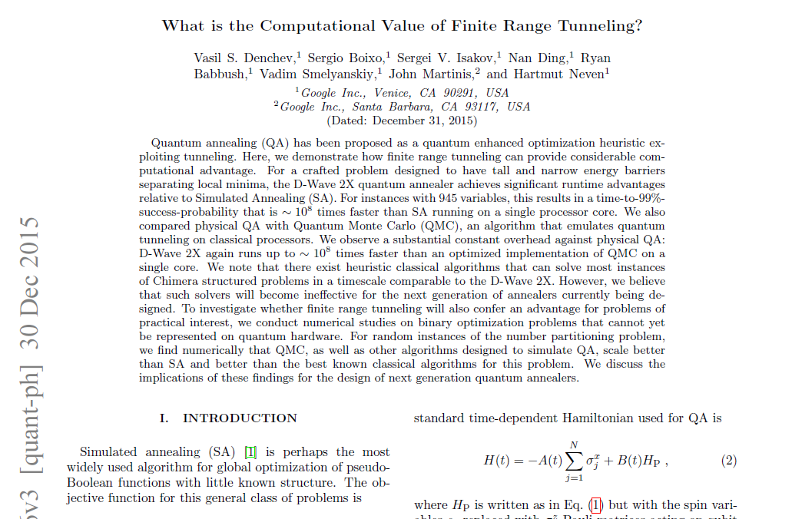

Slide 40
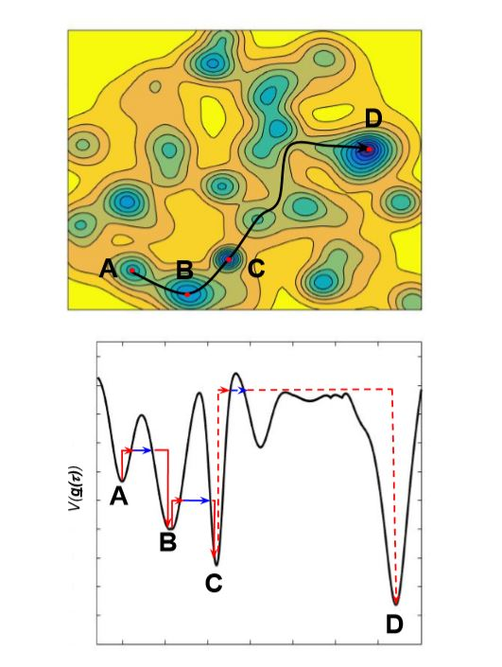

Slide 41
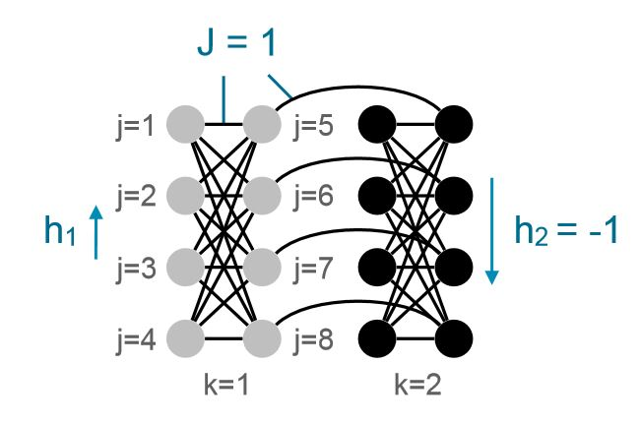

Slide 42
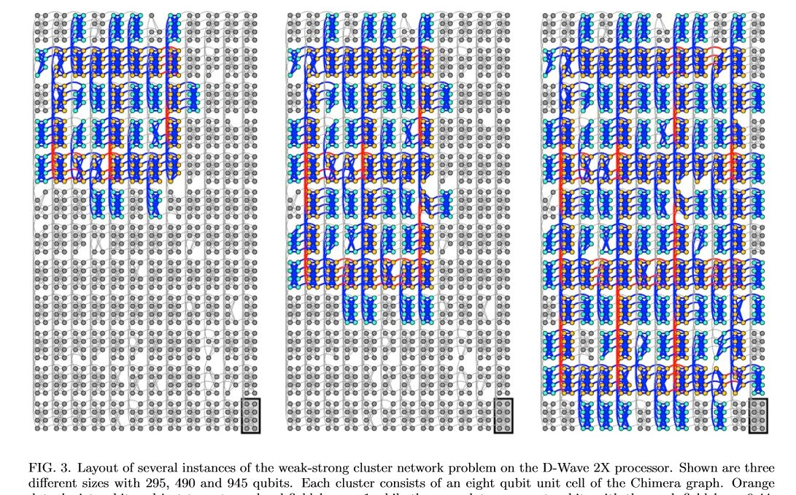

Slide 43
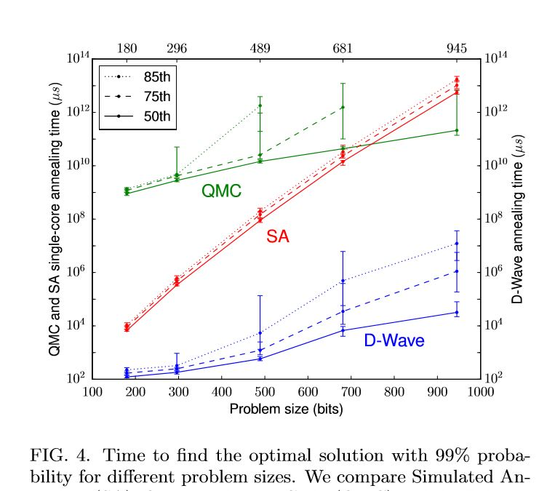

Slide 44
My own example of quantum computation
compact genetic algorithm by quantum computers
exponential speedup

Slide 45
Example of Quantum Algorithm
Yingchareonthawornchai, S., Aporntewan, C., and Chongstitvatana, P., "An Implementation of Compact Genetic Algorithm on a Quantum Computer," Int. Joint Conf. on Computer Science and Software Engineering (JCSSE), 30 May - 1 June 2012, pp.131-135. http://www.cp.eng.chula.ac.th/~piak/paper/2012/jcsse-quantum-cga.pdf

Slide 46
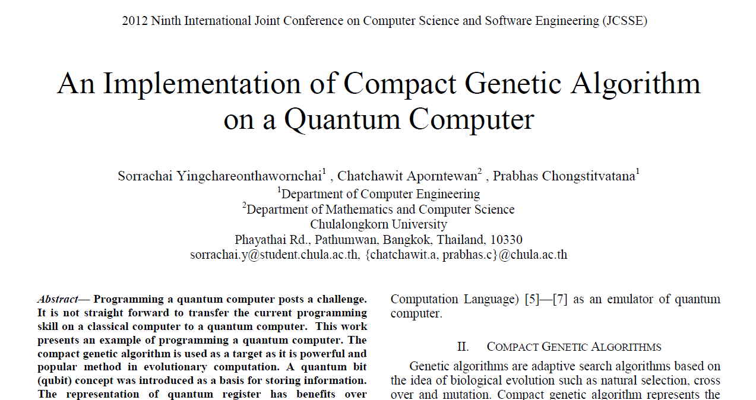

Slide 47
Normal
1) initialze qureg x
2) generate two individuals from qureg
3) let them compete
4) update qureg x with the winner
5) repeat step 2..4 for k times
6) generate the final result

Slide 48
quantum speedup
1) initialze qureg x
2) generate the first individual from qureg x
3) generate the second individual with condition that fitness is greater than the first
4) let them compete
5) update qureg x with the winner
6) repeat step 2..5 for k times
7) generate the final result

Slide 49
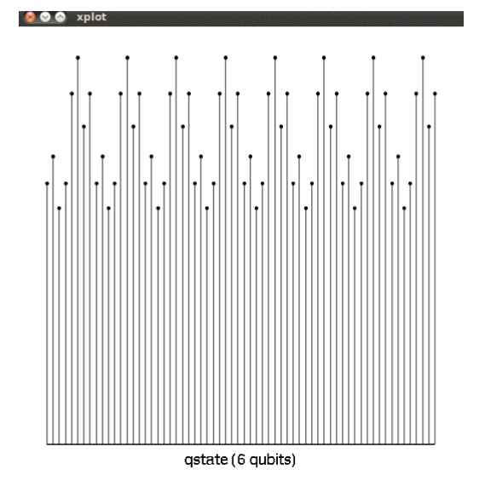
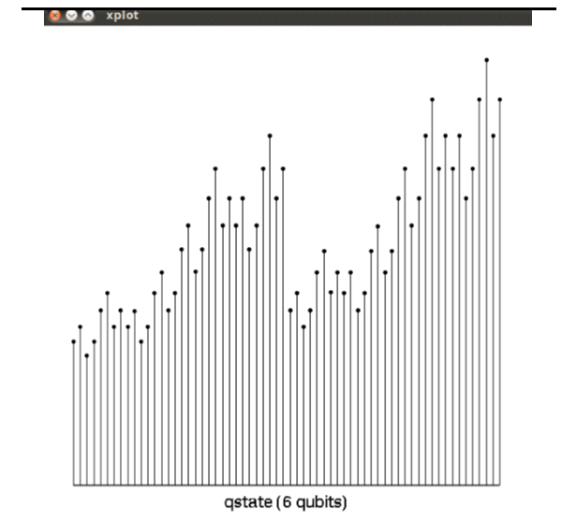
output

Slide 50
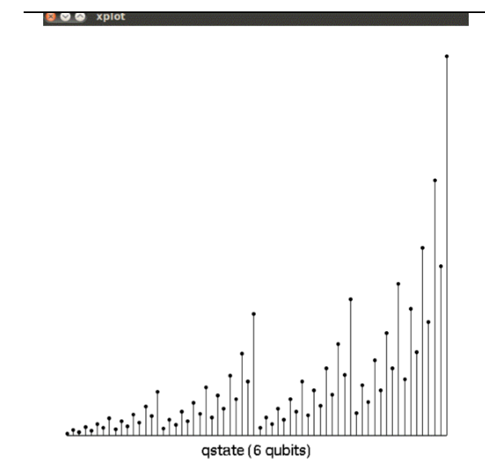
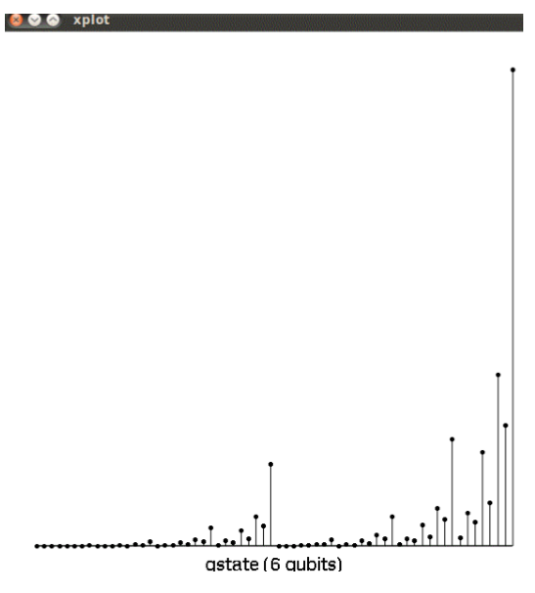
output

Slide 51
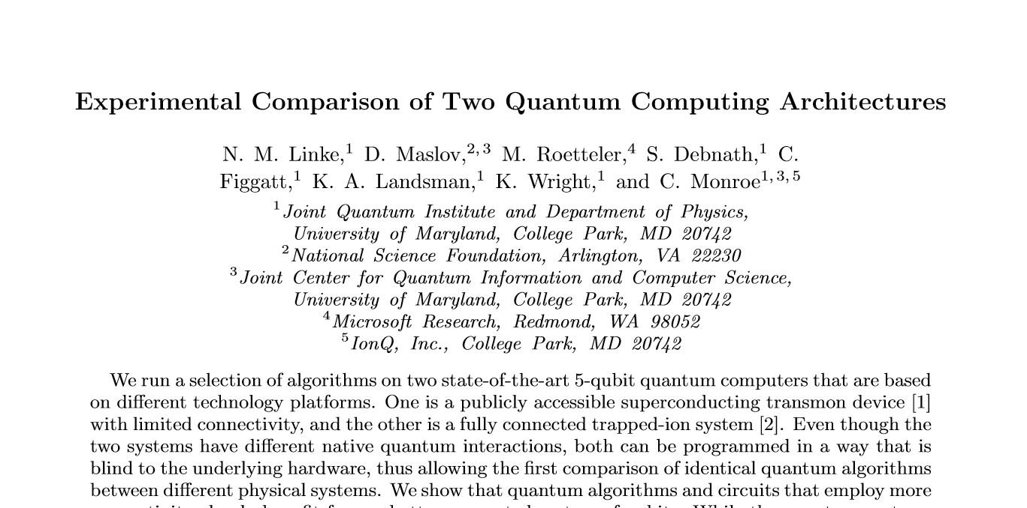
Recent advance in hardware

Slide 52
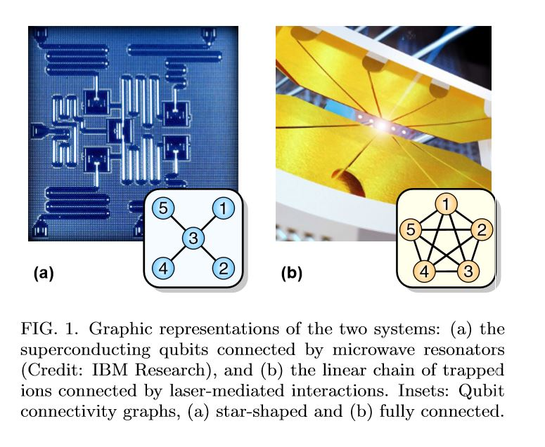

Slide 53
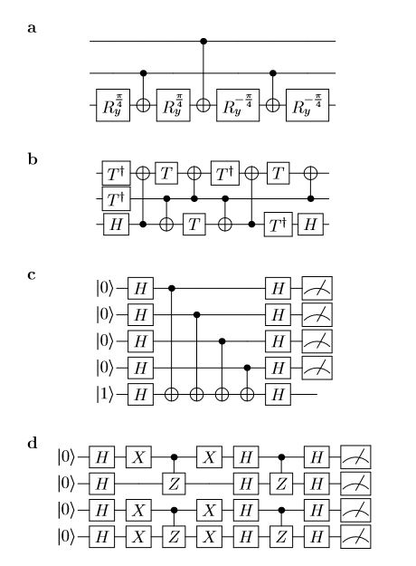

Slide 54
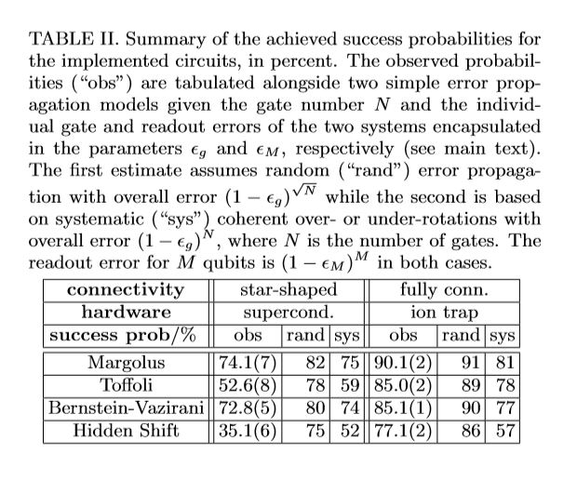

Slide 55
Future
qubits
quantum annealing computers
scaling up

Slide 56
Predicting future
uncertain of success
special purpose quantum computers
quantum style will motivate a new class of computation

Slide 57

More Information
Search “Prabhas Chongstitvatana”
Get to me homepage

