Slide 1
Benchmarking Quantum Computer
Prabhas Chongstitvatana
Faculty of Engineering
Chulalongkorn University

Slide 2
Hello World Program
quantum random circuit sampling (RCS) , that is, to approximately sample bitstrings from the output distribution generated by a random quantum circuit.

Slide 3
Simulation of Quantum Computation
a simulation of the quantum computation, and the computational cost increases exponentially in the number of qubits for quantum circuits of sufficient depth.
Storing the wave function from the output of a random quantum circuit with 40 qubits requires 8.8 TB at single precision (240 × 8 bytes), and 50qubits require 9 PB.

Slide 4
RCS benchmark
1) Generate random circuits fitted to a given NISQ architecture,
2) Execute random circuits, collecting bitstrings, time to solution, and energy consumption of the quantum computer,
3) Calculate probabilities of collected bitstrings using a classical simulation (qFlex) to measure the NISQ performance or fidelity,
4) Perform a classical noisy simulation (qFlex) based on calculated fidelity to collect equivalent classical computational metrics of relevance – total floating point operations/time-to-solution/power consumption.

Slide 5
Examples of Quantum Computer
Examples of NISQ devices are
the 50-qubit IBM QPU [32],
the 72-qubit Google Bristlecone QPU

Slide 6
Quantum Computer Energy Requirement
the main sources of energy consumption are:
- Dilution Refrigerator - because quantum computers operate at around the 15 mK range, a large dilution refrigerator that typically consumes ∼10 kW is necessary.
- Electronic racks - these typically consume around 5 kW of power. They consist of oscilloscopes, microwave electronics, Analog-Digital converters, and clocks.
Therefore a typical quantum computer will consume approximately ∼15 kW of energy for a single QPU of 72 qubits

Slide 7
Speed of Quantum Computer
the rate at which quantum computers can execute a circuit. In the case of superconducting qubits, the circuit execution rate is approximately 10 kHz to 100 kHz.

Slide 8
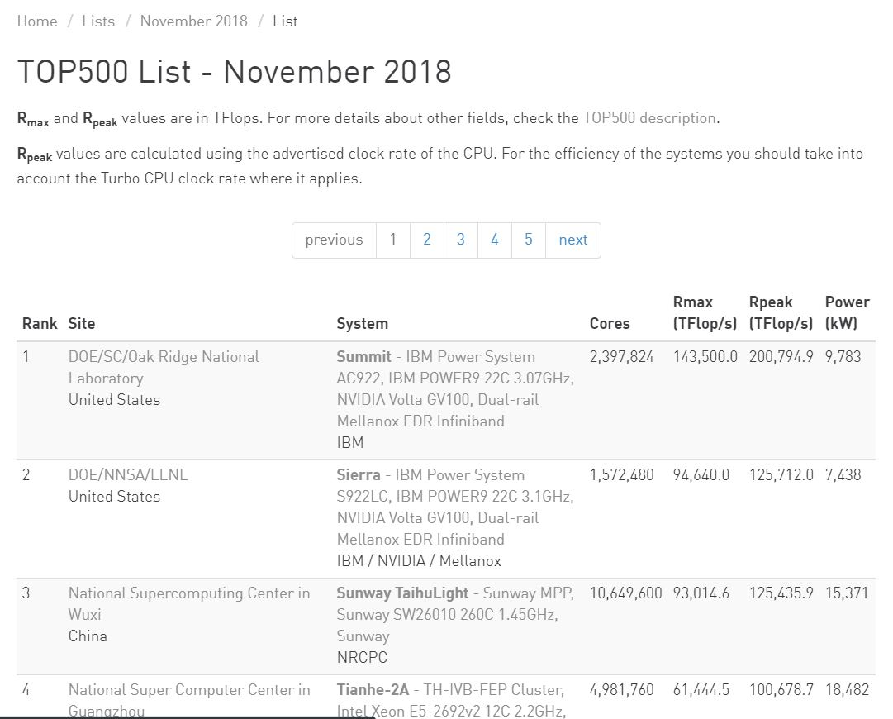
The Big Iron

Slide 9
Summit
Each node consumes around 2.4 kW of energy
and consists of 2 IBM Power9 CPUs and 6 NVIDIA V100 GPUs,
with a total of 4608 nodes
(1.8 kW per node is consumed by 6 NVIDIA Volta GPUs)

Slide 10
Performance
qFlex makes use of efficient single-precision matrix-matrix multiplications and an optimized tensor transpose kernel on NVIDIA GPUs
GPU implementation of qFlex reaches a peak performance of 92% and delivers a sustained absolute performance of 68% in simulations spanning the entire Summit supercomputer (281 Pflop/s single precision without mixed-precision acceleration).

Slide 11
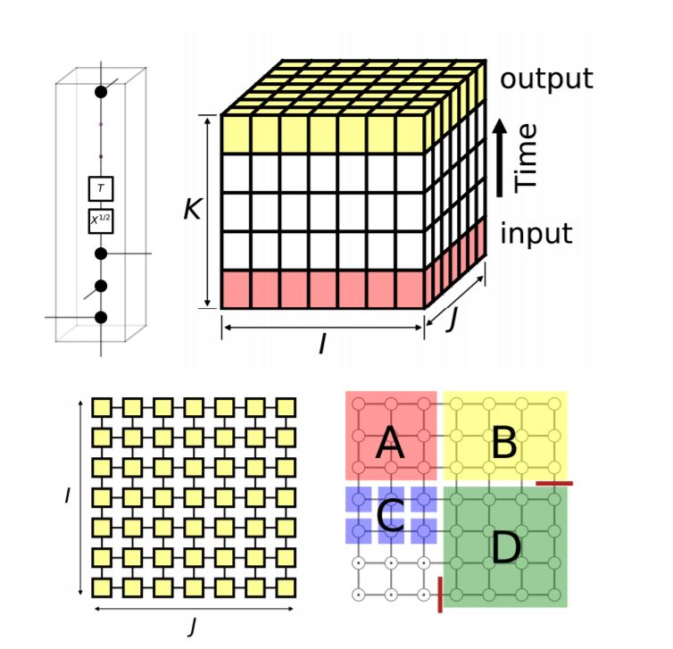
Benchmark

Slide 12
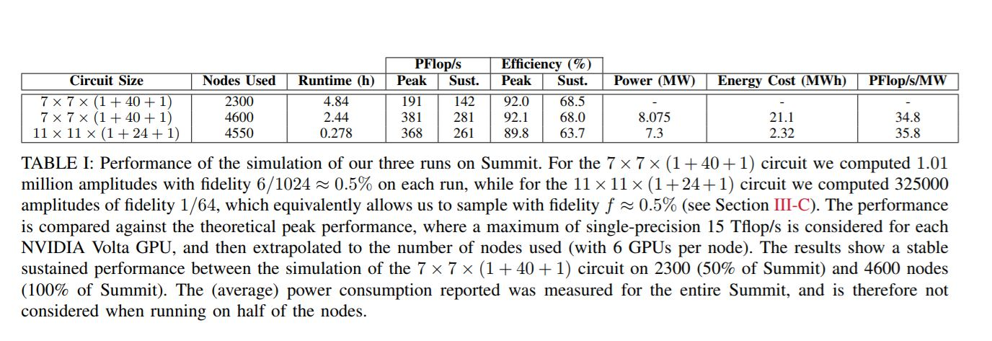
Result

Slide 13
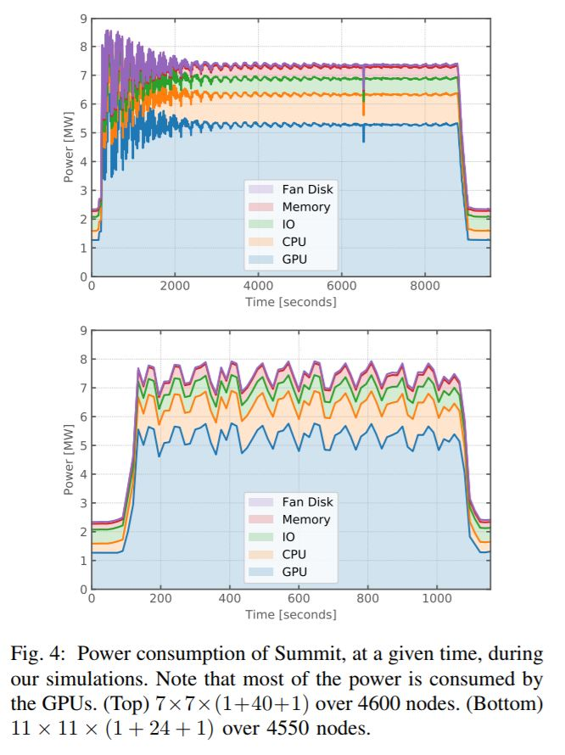
Energy

Slide 14
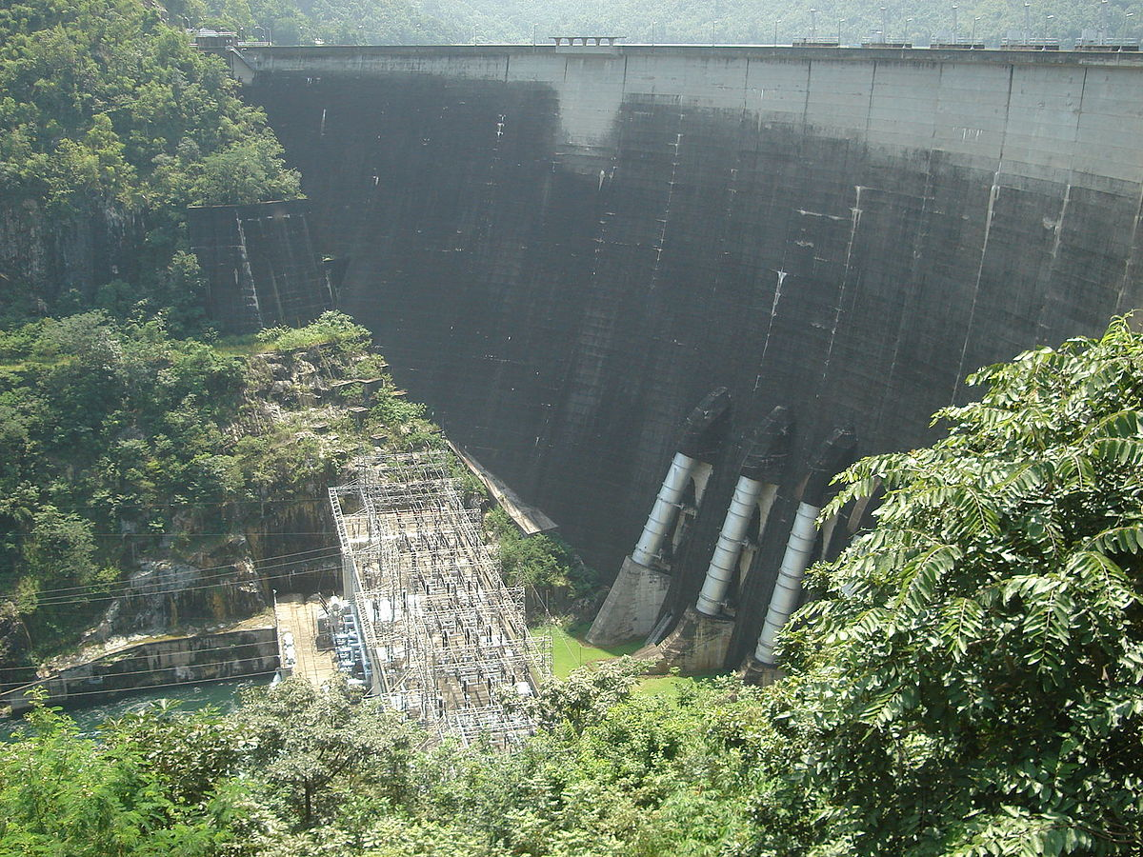
Bhumipol Dam
ชื่อทางการ เขื่อนภูมิพล
ที่ตั้ง เขาแก้ว อำเภอสามเงา จังหวัดตาก
พิกัดภูมิศาสตร์ 17.265°N 98.9°E
เริ่มต้นการก่อสร้าง พ.ศ. 2500
วันที่เปิด 17 พฤษภาคม พ.ศ. 2507
Dam and spillways
ความสูง 154 เมตร
ความยาว 486 เมตร
ความกว้าง (ที่ฐาน) 56 เมตร
กั้น แม่น้ำปิง
เขื่อนภูมิพลมีกำลังการผลิตติดตั้งทั้งสิ้น ๗๗๙.๒ เมกกะวัตต์ เมื่อวันที่ ๑๗ พฤษภาคม ๒๕๔๕

Slide 15

More Information
Search “Prabhas Chongstitvatana”
Go to me homepage

