Slide 1
Artificial Intelligence in Medicine
Prabhas Chongstitvatana
Chulalongkorn University
March 2019

Slide 2
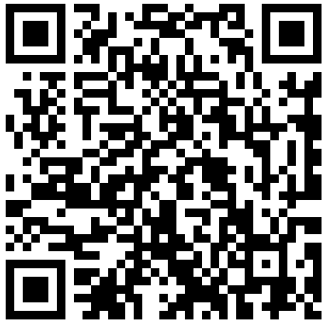
More Information
Search “Prabhas Chongstitvatana”
Go to me homepage

Slide 3
Outline
AI fundamentals
Machine learning
AI in Medicine

Slide 4
AI Fundamentals

Slide 5
What is AI?
an intelligent agent that acts like human.
this includes software services (aka Apps) and automated machines (think smart robot vacuum, automated factory etc.).

Slide 6
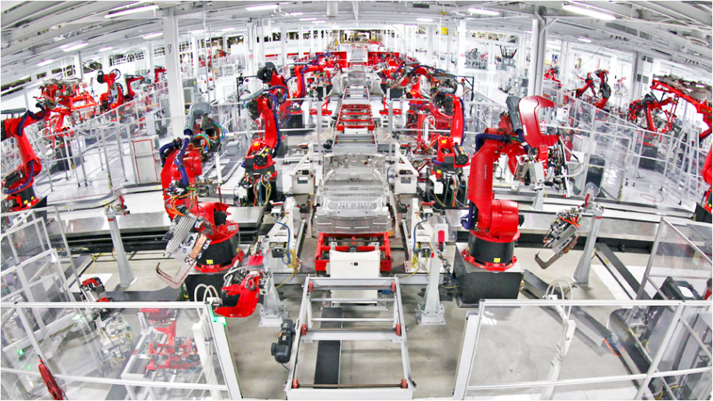

Slide 7
What can AI do?
understand human speech
identify objects from pictures
play games
analyse big financial data
drive cars
control robots
automate many jobs

Slide 8
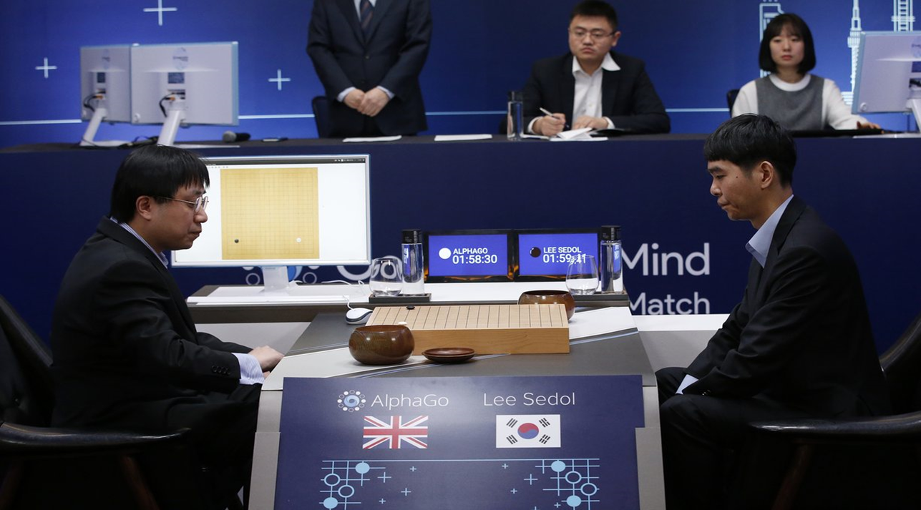

Slide 9
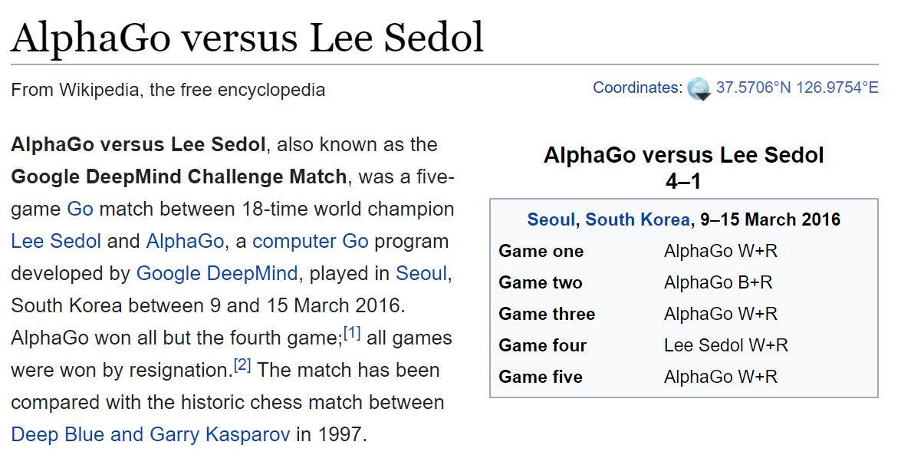
Source: Wikipedia “AlphaGo versus Lee Sedol”

Slide 10
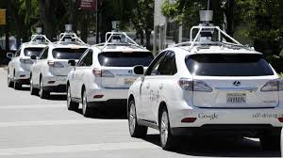

Slide 11
How a computer program be intelligent?
There are two approaches in the development of AI.
Logic
Memory an learning

Slide 12
First, using logical reasoning.
Computer program can perform deductive reasoning such as
socrates is a human
human are motal
therefore socrates is mortal
We can use logic to encode situation in the real world
when it rains, you cannot play tennis outdoor.

Slide 13
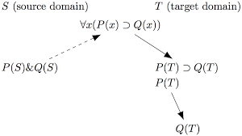

Slide 14
Using large amount of rules and facts, computer programs can deduce a lot of things.
Hence, it behaves intelligently.

Slide 15
Second, use memory and learning
We can imitate human brain by encoding information and memory into a large connected network.
This network responses to input with a correct output. The relationship of this input/output can be learn from large amount of data without human intervention.
This type of approch is called Artificial Neural Networks.

Slide 16
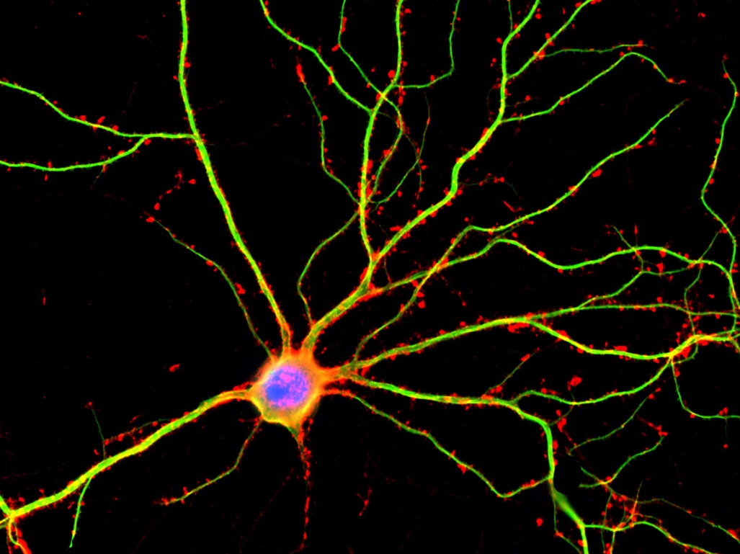
A hippocampal neuron seen in culture. Dendrites are green, dendritic spines are red and DNA is blue.
Science Source/Getty Images

Slide 17
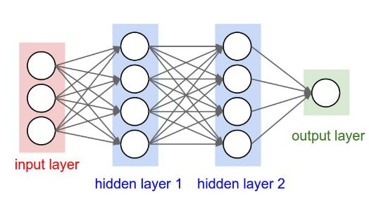
Artificial Neural Network 3-layer

Slide 18
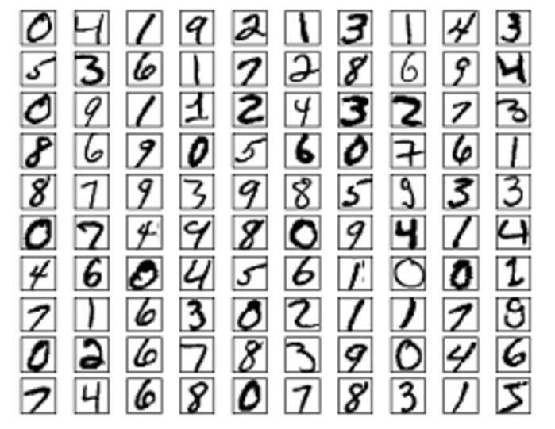

Slide 19
Example, recognise the picture of my wife
I can show a lot of pictures of my wife from many angles. Then I can train a kind of network to remember this face. I also train a lot of pictures of not-my-wife face. So, now the network can distinguish between my-wife and not-my-wife faces.

Slide 20
This is the most popular method today.
Multiple layers (update few hundreds) of this Network can be constructed
It is called Deep learning

Slide 21
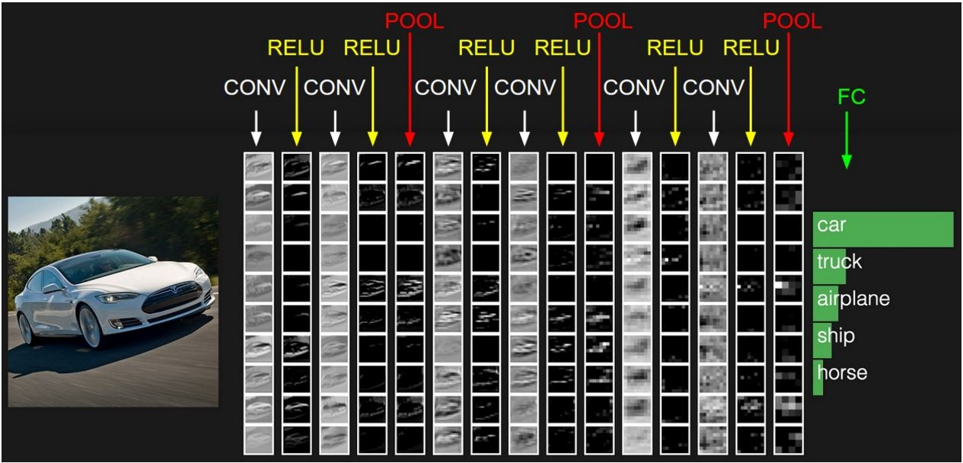
Example of NN layer
Source: Webpage of http://cs231n.stanford.edu/

Slide 22
Another way to create AI program is by using "search".
The problem is encoded as many alternative way to solve it, and AI program looks at these alternatives (which can be enormously large in number) and choose a path carefully until a good solution is found.
For example, the sequence of chess moves can be "search" to maximise the possibility to win the game.

Slide 23
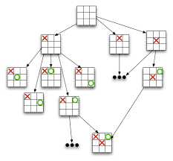

Slide 24
AI in Medicine (Rule-based)
So called Expert System
Famous example: E-MYCIN
E-Mycin in Artificial Intelligence Program is used for Respiratory tract infections, Bacterial infections, Pertussis, Listeriosis, Skin and skin structure infections, Diphtheria and other conditions.

Slide 25
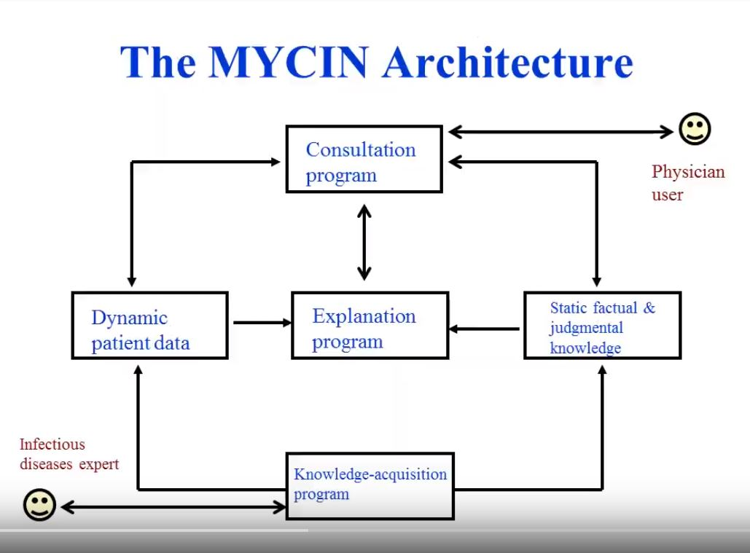
Source: Rule Based Expert Systems and the MYCIN Project
https://www.youtube.com/watch?v=fcp-XeOQSFA

Slide 26
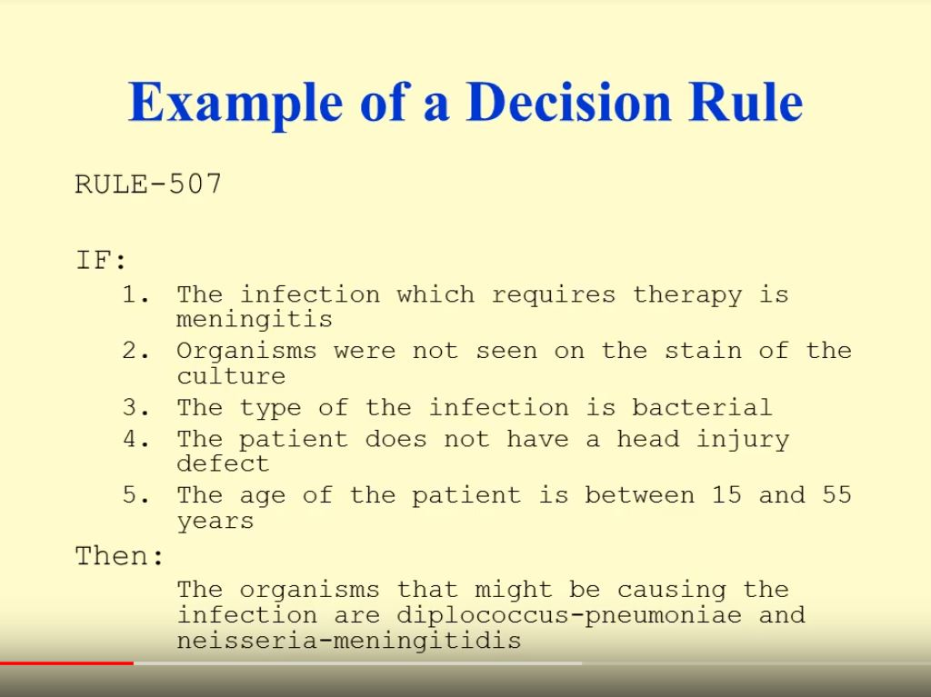
Source: Rule Based Expert Systems and the MYCIN Project
https://www.youtube.com/watch?v=fcp-XeOQSFA
Notes:
Research conducted at the Stanford Medical School found MYCIN received an acceptability rating of 65% on treatment plan from a panel of eight independent specialists, which was comparable to the 42.5% to 62.5% rating of five faculty members.

Slide 27
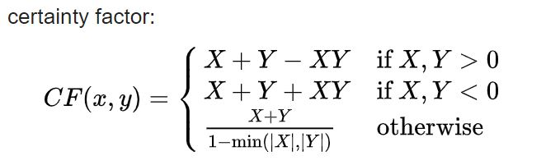
Combining evidences
Notes:
Research conducted at the Stanford Medical School found MYCIN received an acceptability rating of 65% on treatment plan from a panel of eight independent specialists, which was comparable to the 42.5% to 62.5% rating of five faculty members.

Slide 28
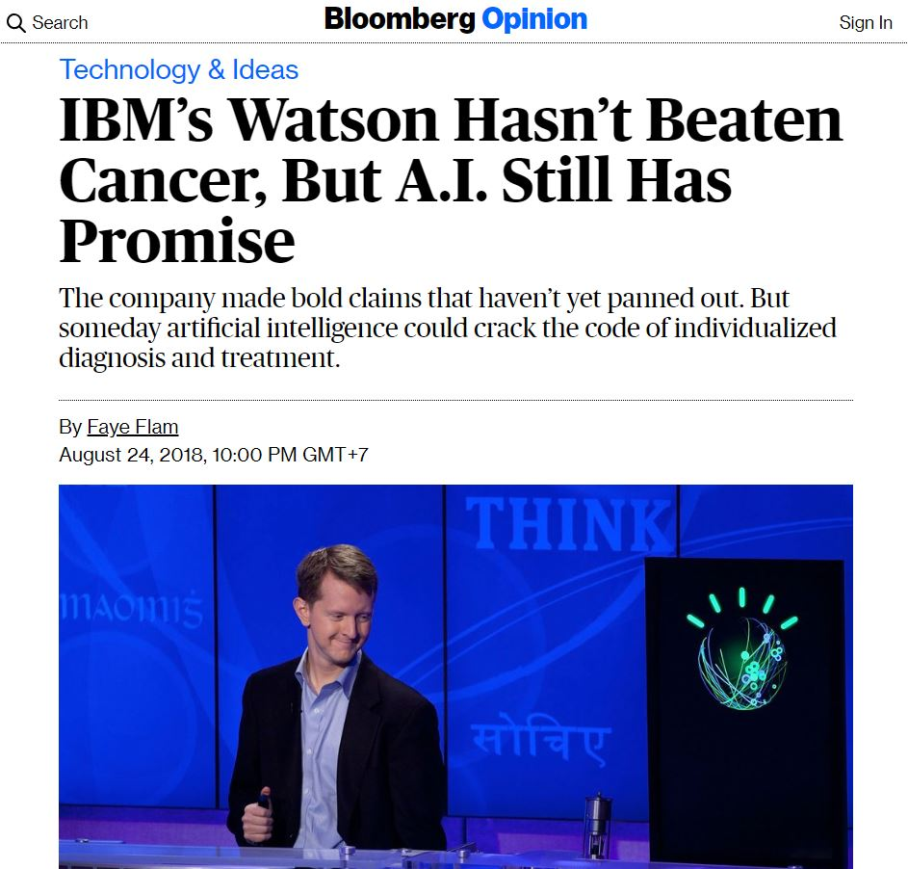
Source: https://www.bloomberg.com/opinion/articles/2018-08-24/ibm-s-watson-failed-against-cancer-but-a-i-still-has-promise
Notes:
Watson wins jeopardy against humans in Jan 2011
Watson gave unsafe treatment plan.

Slide 29
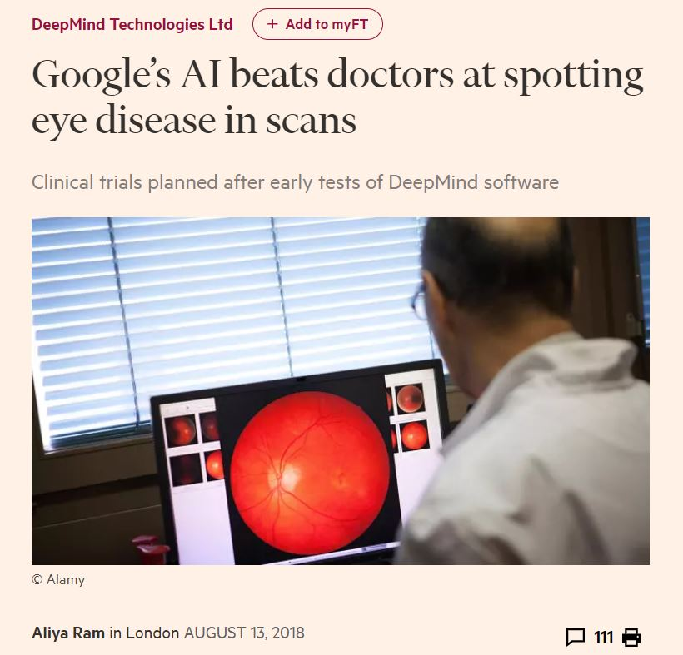
Source: https://www.ft.com/content/3de44984-9ef0-11e8-85da-eeb7a9ce36e4
Notes:
DeepMind analyse 3D retinal scans for signs of major eye diseases, such as glaucoma or diabetic retinopathy
algorithm was better than eight retinal specialists when tested on 997 patient scans.
DeepMind’s algorithm had an error rate of 5.5 per cent compared with between 6.7 per cent and 24.1 per cent for the eight doctors

Slide 30
Summary
Artificial Intelligence is an attempt to mimic the way human think.
It has been widely successful in many applications.
One of the most successful technique is “Machine Learning.”
ML exhibits some performance that surpass human.
But we have to be cautious in developing and deploying these systems.
AI needs to avoid “Bias” and needs to be “Transparent.”

Slide 31
More Information
Search “Prabhas Chongstitvatana”
Go to me homepage

