Slide 1

Quantum computer and its impact to industry
Prabhas Chongstitvatana
Faculty of Engineering
Chulalongkorn University
National Conference on Science and Technology, Bangkok, 2022

Slide 2
Outline
What is Quantum Computer
How does it work
Impact on industry

Slide 3

More Information
Search “Prabhas Chongstitvatana”
Go to me homepage

Slide 4
What is a quantum computer?
a computer that relies on special memory, "quantum bit", to perform massively parallel computing.

Slide 5
What is a quantum bit?
a basic unit of memory that uses superposition of "quantum" effect (entanglement) to store information.
a "qubit" stores the probability of information. It represents both "1" and "0" at the same time.

Slide 6
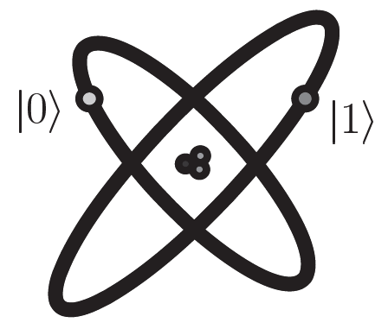


Quantum Bits (Qubits)
Classical bits vs. Quantum bits
Qubits are mathematical objects (similarly to 0/1 in classical bits)
Prob.
Prob.

Slide 7
What is the advantage?
It is very very fast compared to conventional computers
It has very large memory

Slide 8

Linear optics quantum computing (LOQC)
Experimental setup to generate up to four entangled photons. These photons are typically entangled in polarization and can be further manipulated by simple optical devices. Recently a four-photon cluster state was realized with this setup. http://homepage.univie.ac.at/robert.prevedel/test_research_LOQC.html

Slide 9
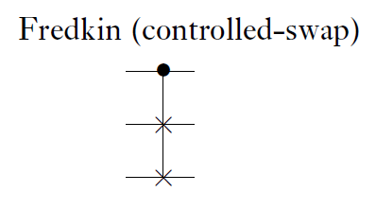
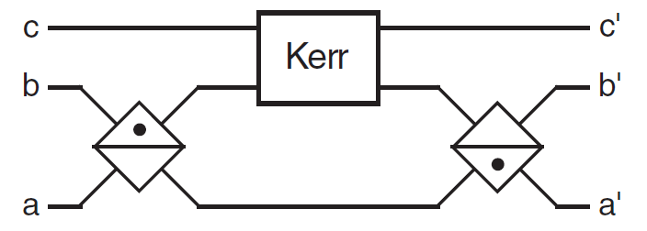
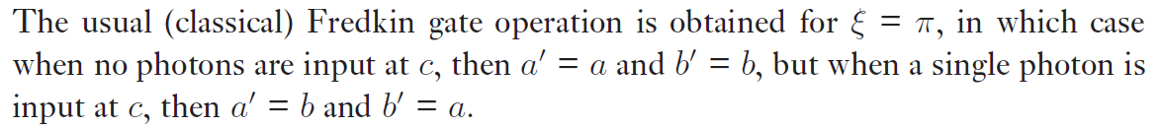
Quantum Optical Fredkin Gate

Slide 10
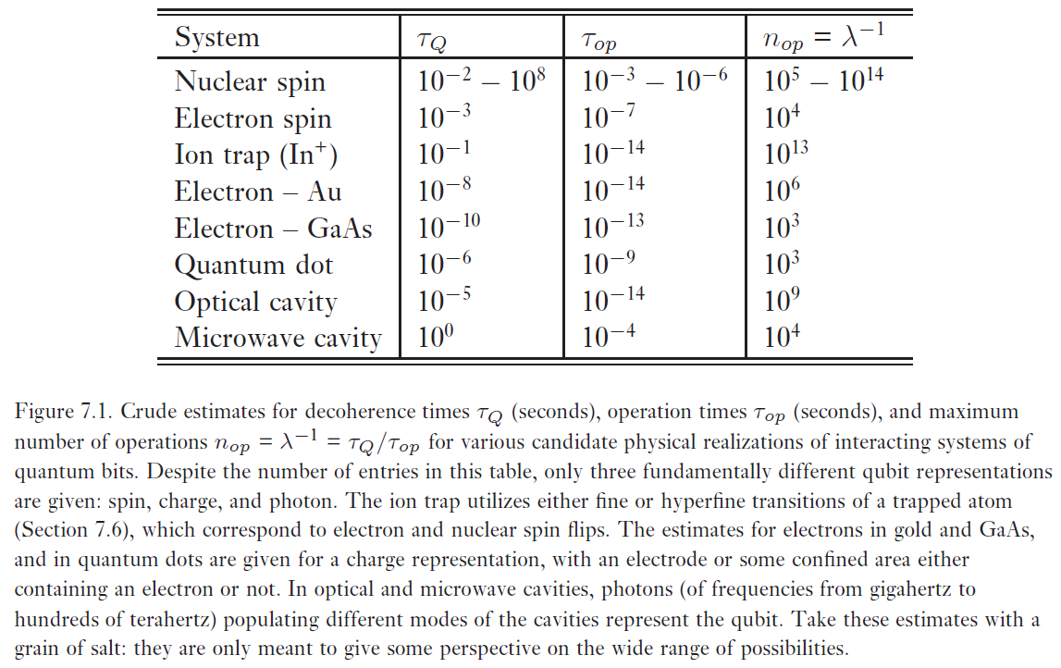
Quantum computers: physical realization

Slide 11
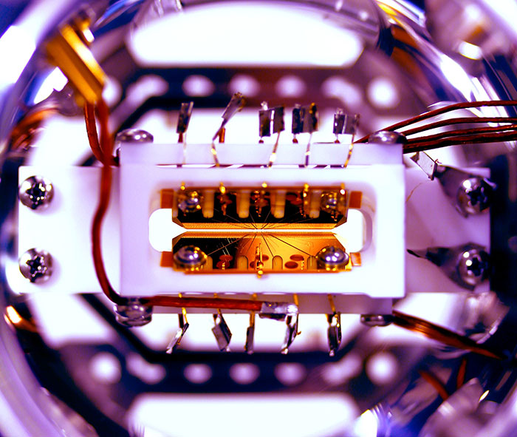

Slide 12
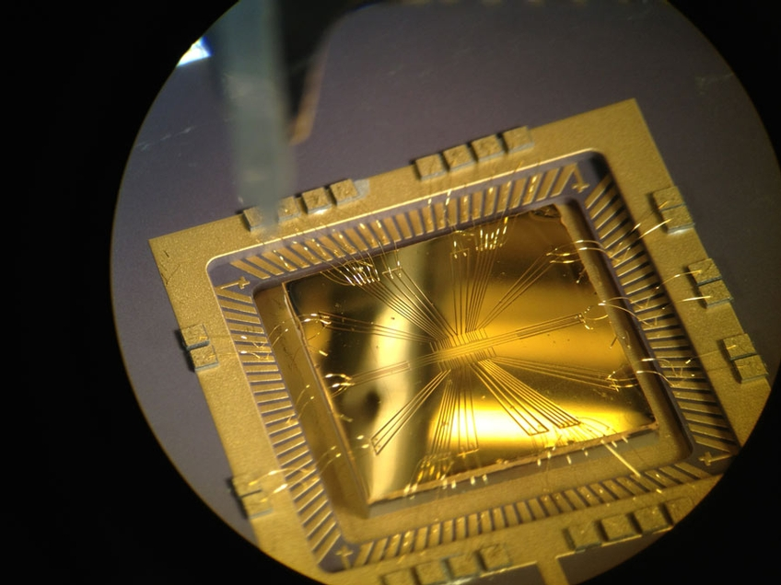

Slide 13
Example of quantum computers
IBM 5 and 50 qubits
D-wave two, quantum annealing

Slide 14
Recent work
google quantum lab's paper
claim of 100,000,000x speed up

Slide 15
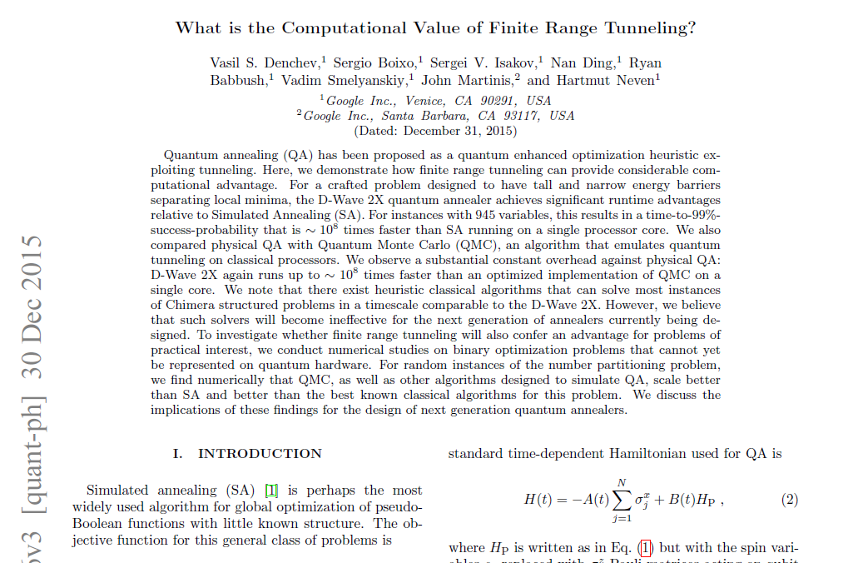

Slide 16
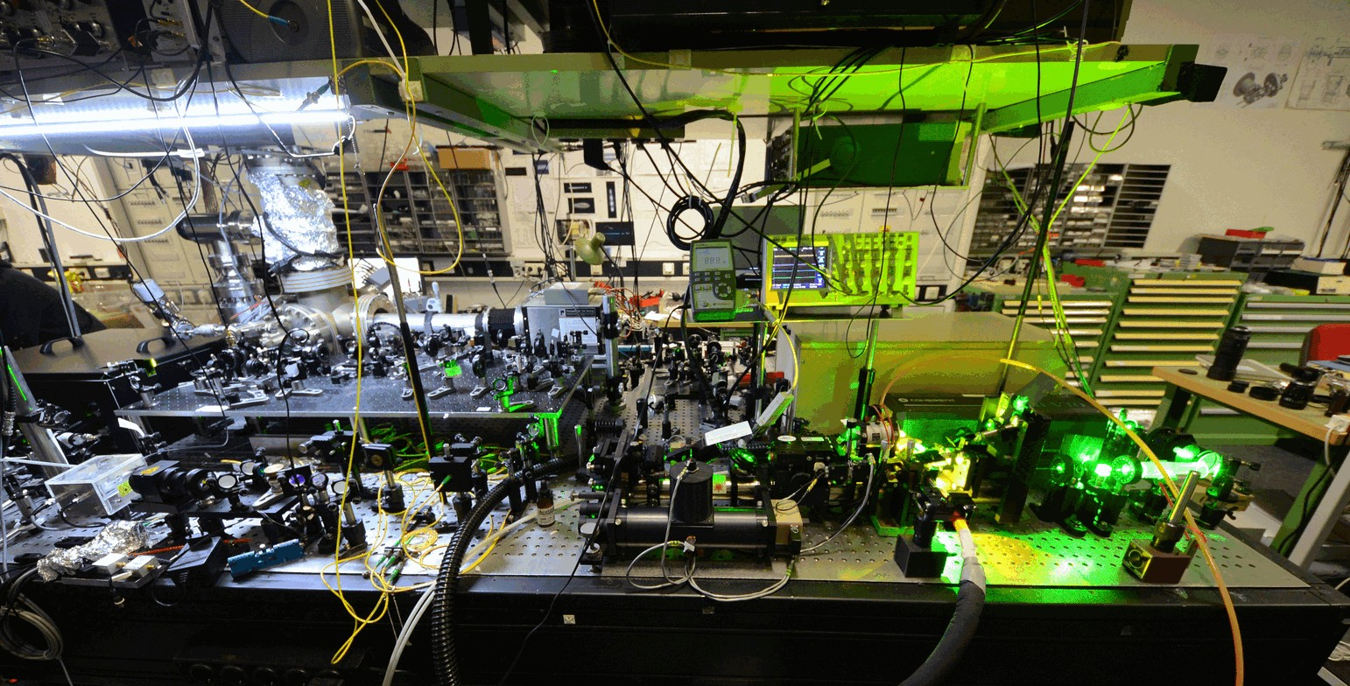

Slide 17
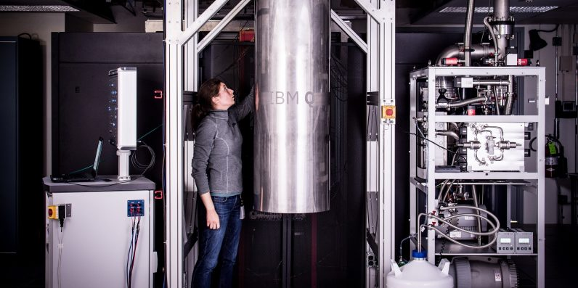
IBM 50 qubits quantum computer

Slide 18
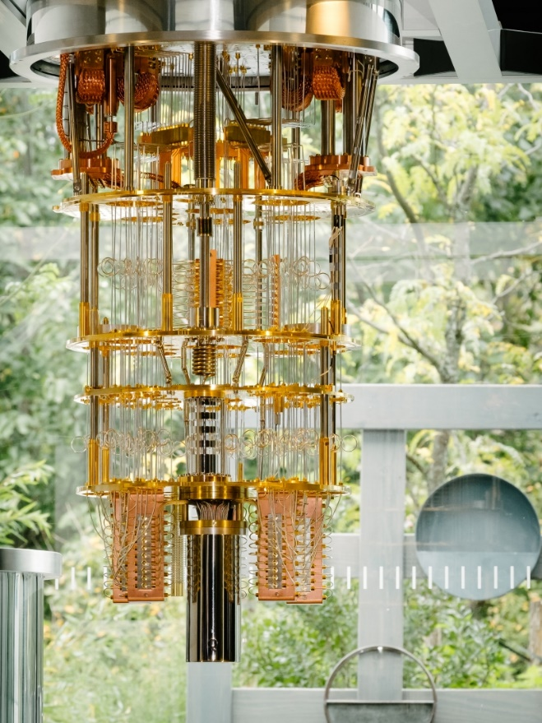

Slide 19
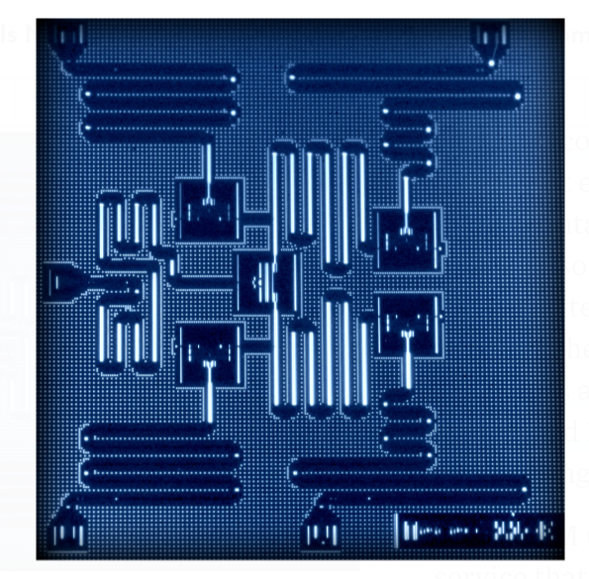
IBM 5 qubits processor

Slide 20
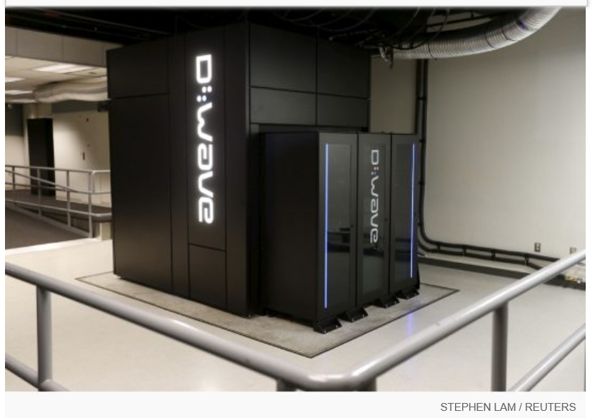
Google Nasa, D-Wave 2x machine

Slide 21
Programming Quantum Computers

Slide 22
Quantum algorithms
computer programs that work on quantum computers

Slide 23
Famous algorithms
Shor's integer factorization
Given an integer N, find its prime factors

Slide 24
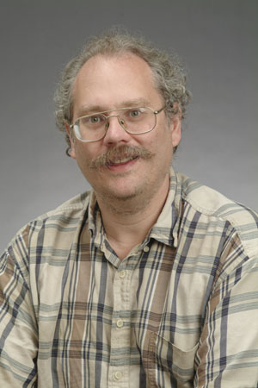
Quantum Algorithms
Peter Shor
a quantum algorithm for integer factorization formulated .

Slide 25
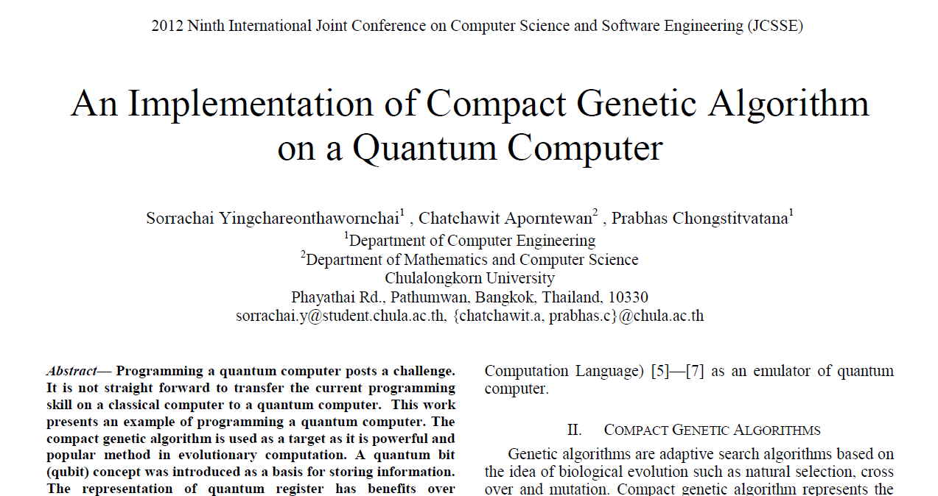

Slide 26


Quantum Circuits for Compact Genetic Algorithm
By Kamonluk Suksen, Naphan Benchasattabuse, and Prabhas Chongstitvatana

Slide 27
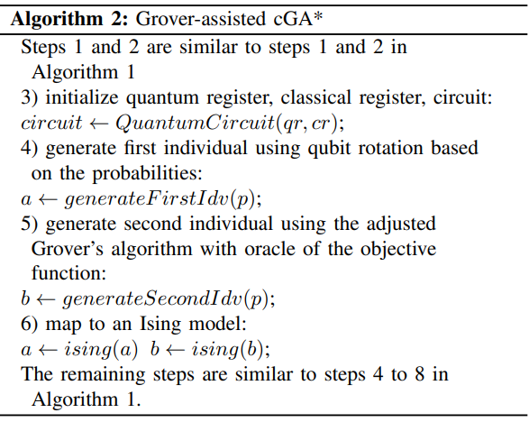



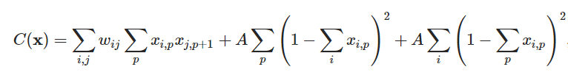
SECTION 5 Proposed Method
Grover-assisted Compact Genetic Algorithm
An arbitrary single-qubit state is defined:
The qubit rotation for angle(θ) is defined:
Mapping to Ising model for TSP:
System energy for TSP:
Total distance
The constraints to check a feasible path

Slide 28
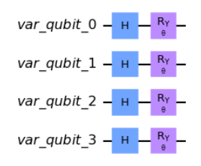
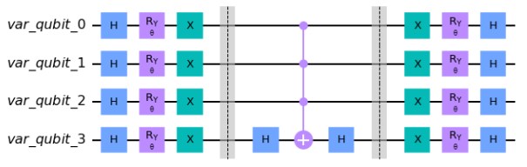
SECTION 5 Proposed Method
Grover-assisted Compact Genetic Algorithm
An arbitrary single-qubit state is defined:
The qubit rotation for angle(θ) is defined:
A circuit to initial the state based on the probability which encoding problem with 4 qubits.
A diffuser circuit which encoding problem with 4 qubits.

Slide 29
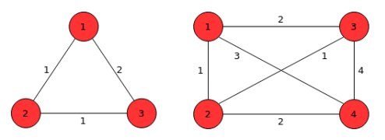

SECTION 6 Testing Problem
Travelling Salesman Problem
Demonstrate small size TSP (limit by the number of qubits supported by the simulator)
Minimize the number of required bits to address the problem on the classical cGA by adapting the path representation model which represents a feasible tour as possible permutations of the N cities.
Total number of feasible edges is a set of l-bit binary string.
TSP 3-city and 4-city.

Slide 30
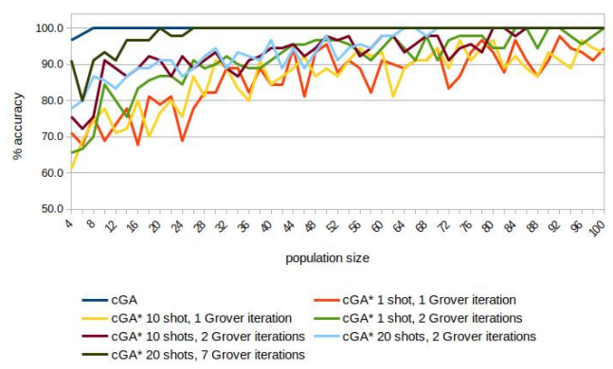
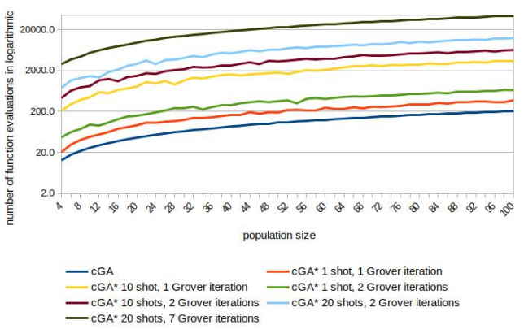
SECTION 7 Experimental Results & Analysis
Experimental Results
Comparison of the solution quality (number of correct bits in percentage at the end of the run) achieved by the classical cGA and the cGA* on TSP 4-city.
Comparison of the classical cGA and the cGA* in the number of function evaluations needed to achieve convergence on TSP 4-city.

Slide 31
Impact of quantum computer on industry
Four industry (near future)
  Pharmaceuticals
  Chemicals
  Automotive
  Finance
Four use cases
  Quantum Simulation
  Quantum AI and Machine learning
  Quantum Optimization
  Quantum Factorization

Slide 32
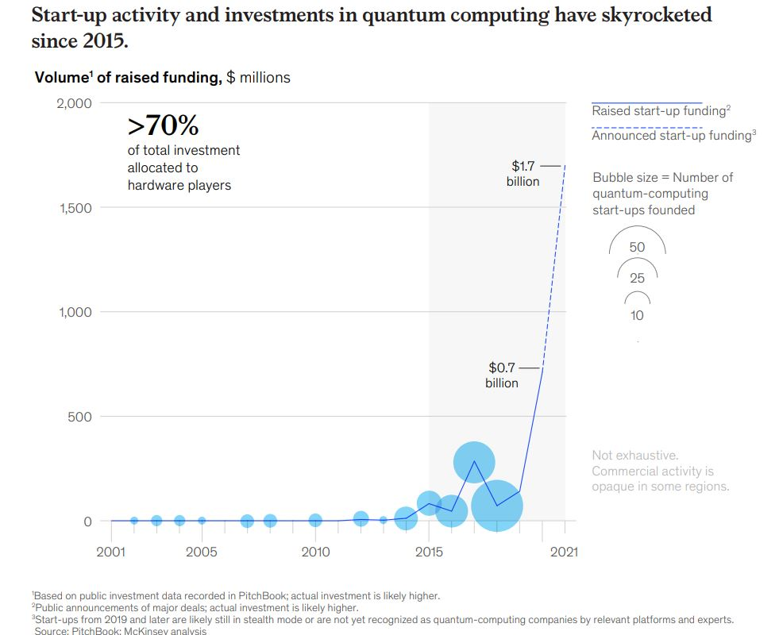

Slide 33
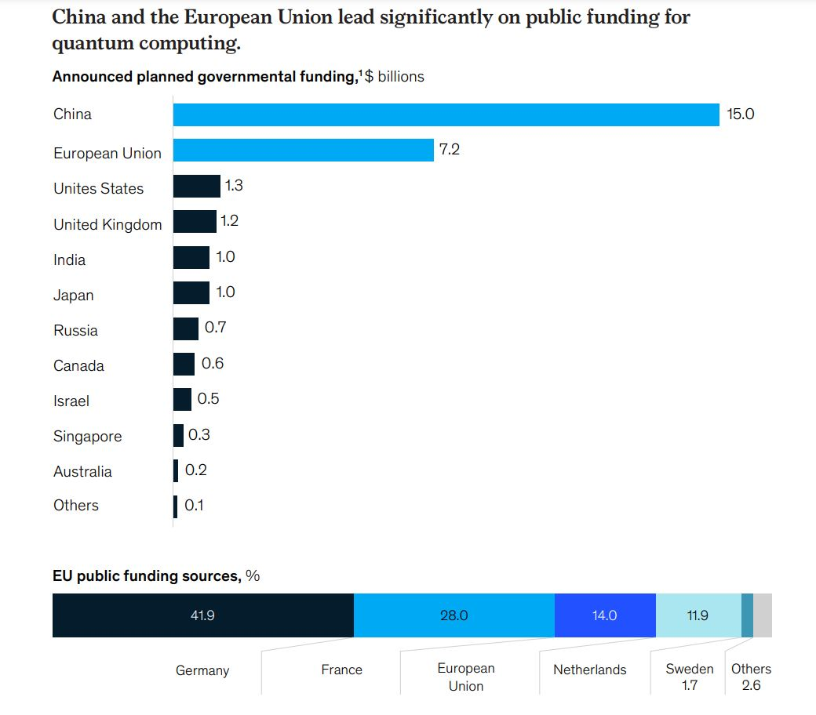

Slide 34
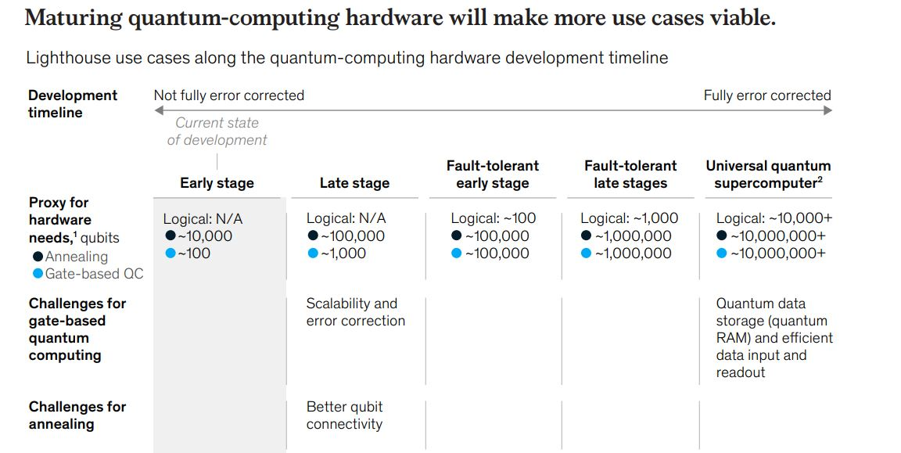

Slide 35
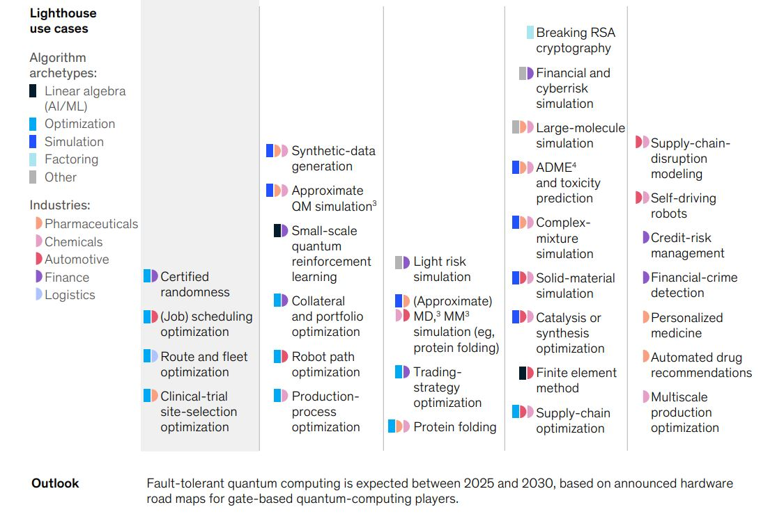

Slide 36
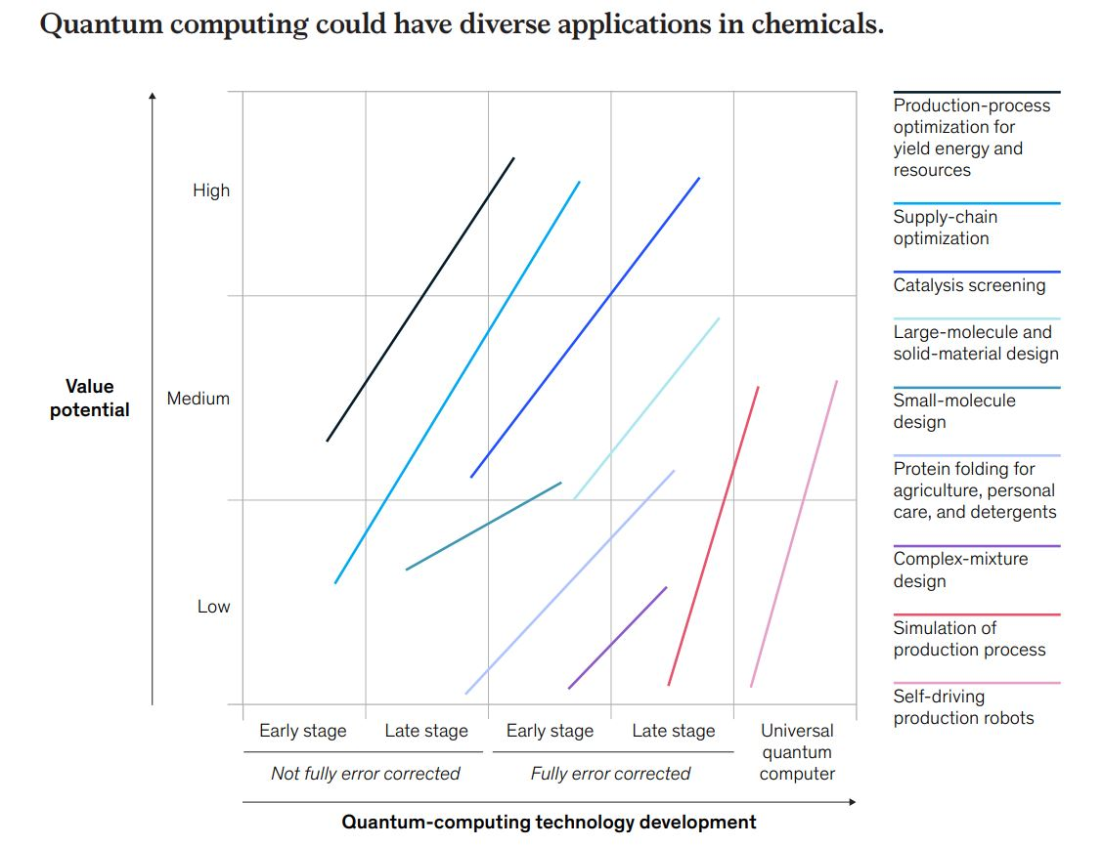

Slide 37
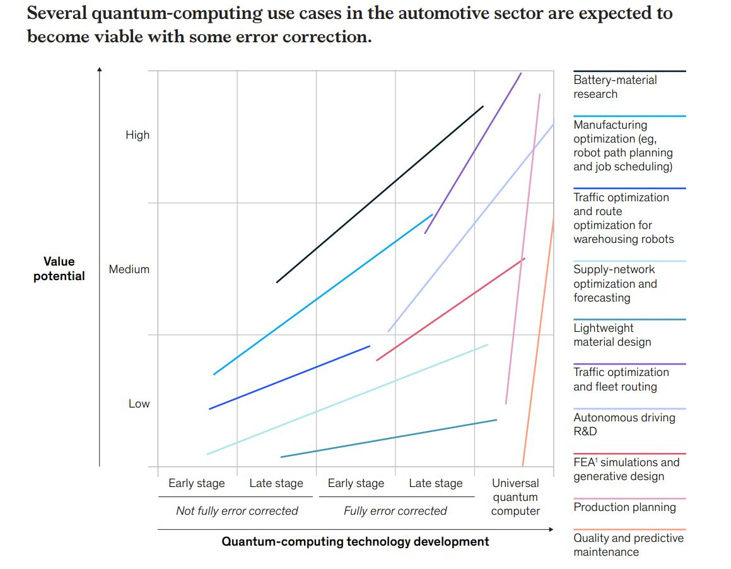

Slide 38
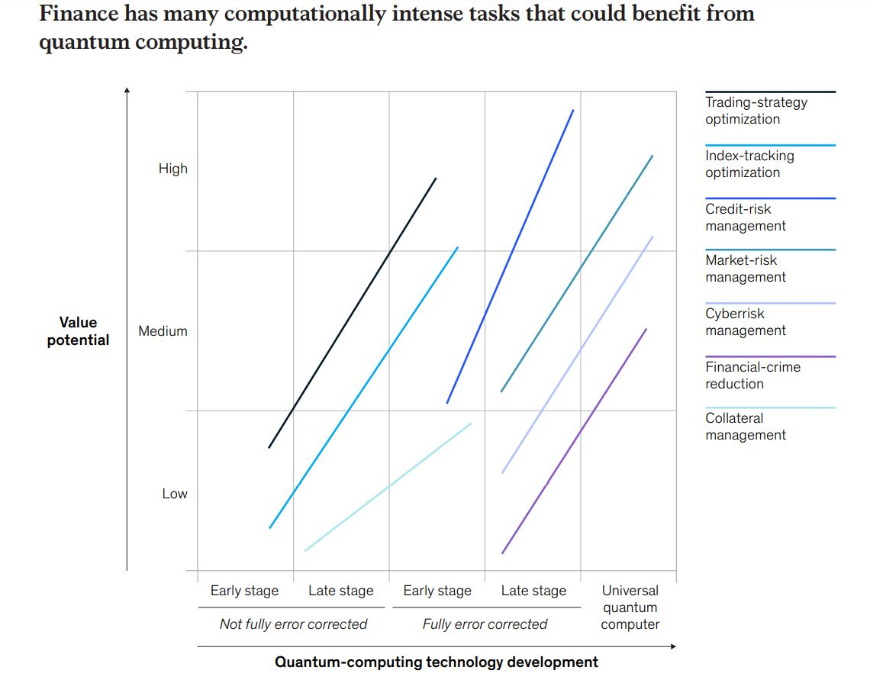

Slide 39
References
Yingchareonthawornchai, S., Aporntewan, C., and Chongstitvatana, P., "An Implementation of Compact Genetic Algorithm on a Quantum Computer," Int. Joint Conf. on Computer Science and Software Engineering (JCSSE), 30 May - 1 June 2012, pp.131-135.
http://www.cp.eng.chula.ac.th/~piak/paper/2012/jcsse-quantum-cga.pdf
Suksen, K. and Chongstitvatana, P., "Experiments on Quantum Circuits for Compact Genetic Algorithm," Int. Computer Science and Engineering Conference, 18-20 Nov, 2021, Thailand.
McKinsey & Company, Quantum computing: an emerging ecosystem and industry use cases, December 2021

Slide 40
More Information
Search “Prabhas Chongstitvatana”
Go to me homepage

