Slide 1


Solving Hard Optimization Problems With Quantum Computer
Kamonluk Suksen, Naphan Benchasattabuse and Prabhas Chongstitvatana

Slide 2

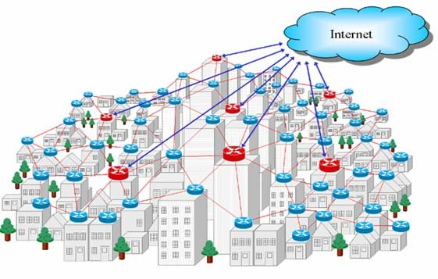
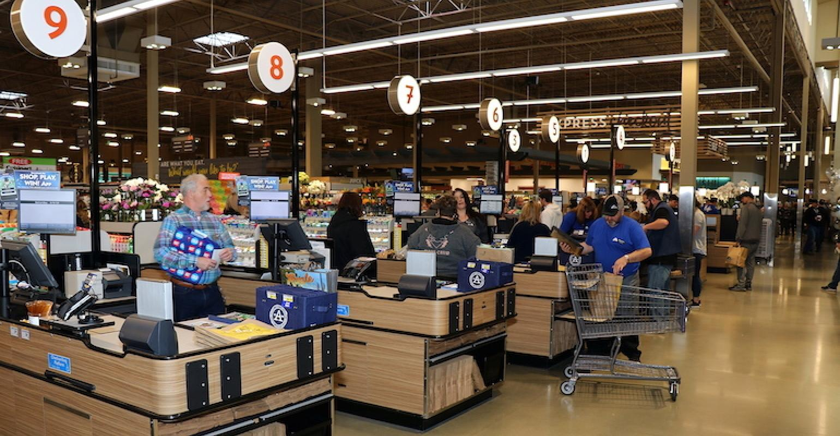

SECTION 1 Optimization problems
Toward solving optimization problems with a quantum computer
Optimization problems

Slide 3
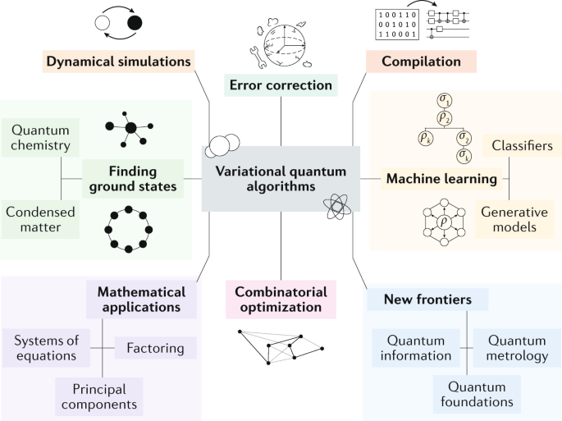
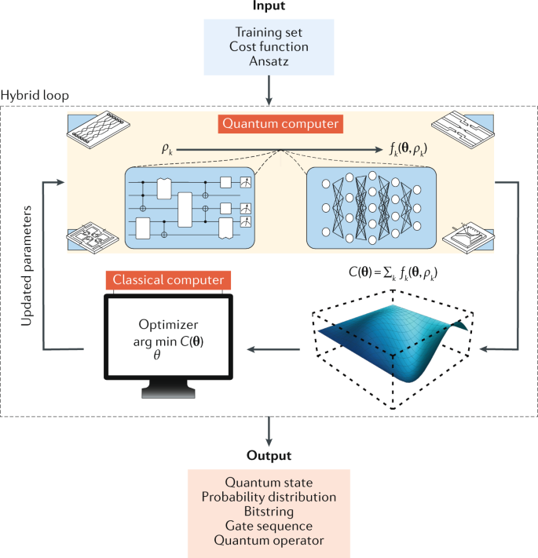
SECTION 2 Variational quantum algorithms
Variational quantum algorithms
Photo https://media.springernature.com/m685/springer-static/image/art%3A10.1038%2Fs42254-021-00348-9/MediaObjects/42254_2021_348_Fig1_HTML.png and https://media.springernature.com/lw685/springer-static/image/art%3A10.1038%2Fs42254-021-00348-9/MediaObjects/42254_2021_348_Fig2_HTML.png

Slide 4
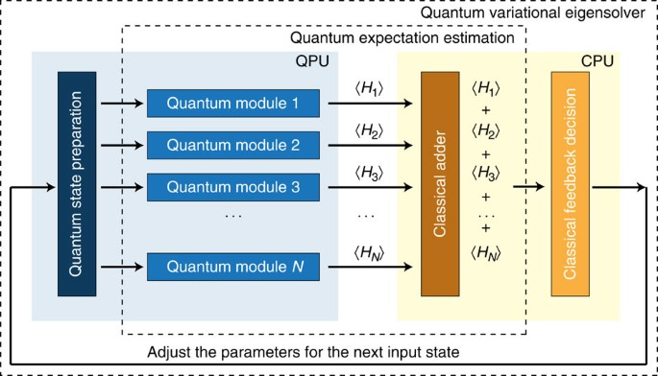
SECTION 3 Quantum variational eigensolver
Quantum variational eigensolver
Photo https://media.springernature.com/m685/springer-static/image/art%3A10.1038%2Fncomms5213/MediaObjects/41467_2014_Article_BFncomms5213_Fig1_HTML.jpg

Slide 5
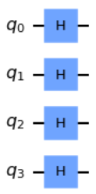
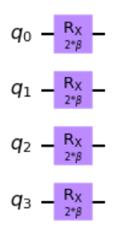
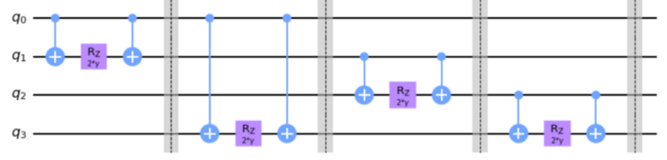

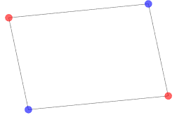


SECTION 4 Quantum approximate optimization algorithm
Quantum approximate optimization algorithm (QAOA)
Preparing an initial state
The mixing unitary
The problem unitary
where H_{B} is the mixing Hamiltonian and H_{P} is the problem Hamiltonian.
Goal: find to get
The max-cut problem
Photo https://qiskit.org/textbook/ch-applications/qaoa.html

Slide 6
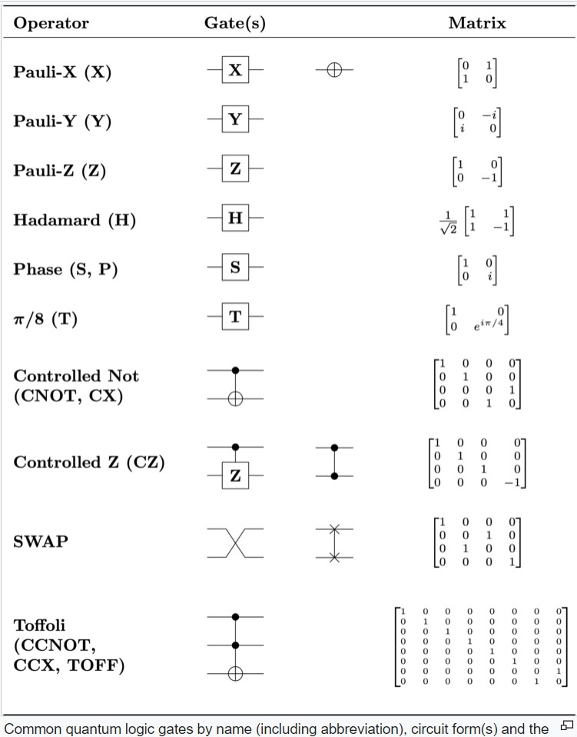
Quantum gates

Slide 7
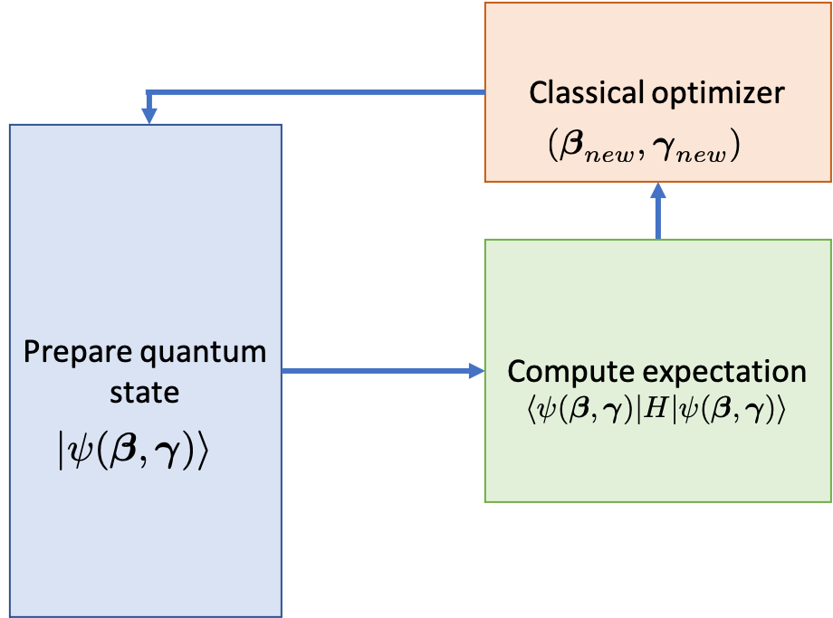
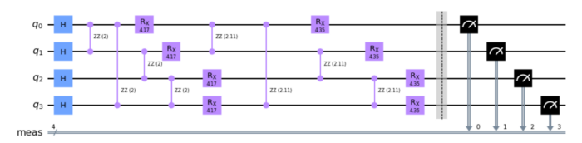
SECTION 4 Quantum approximate optimization algorithm
Quantum approximate optimization algorithm (QAOA)
P = 2 times
Photo https://qiskit.org/textbook/ch-applications/qaoa.html

Slide 8
SECTION 5 Quantum-inspired evolutionary algorithm
Quantum-inspired evolutionary algorithm
One approach to tackle the optimization problem is to use evolutionary algorithms such as Genetic algorithms (GAs) and Compact genetic algorithm (cGA).
Quantum-inspired genetic algorithms: the algorithms are still executed in the classical computers but took some of the ideas of quantum phenomena and translate them into classical analogue.

Slide 9
SECTION 6 Quantum-assisted genetic algorithms
Quantum-assisted genetic algorithms
Quantum-assisted genetic algorithms perform mutation operator while crossover and population update are on the classical side.
Compact genetic algorithm represents the population as a a probability distribution in a quantum register. The quantum variable is then updated toward the winner via qubit rotation
Redefining the GA in the context of quantum computation by creating a population with superposition of all states.

Slide 10
SECTION 7 Grover-asisted compact genetic algorithm
Grover-assisted Compact Genetic Algorithm (cGA*)
Initial Probability Vector and current best individual
Initial quantum register, classical register, and circuit
complete the second individual’s fitness and the current best individual’s fitness and select the winner to be the second individual
Generate the first individual using qubit rotation only
Generate the second individual using qubit rotation and Grover’s algorithm
complete the first and the second individual to find the winner
update the probability vector towards the winner
update the current best individual
Is vector converged?
no
yes
end
CPU
QPU
The schematic of Grover-assisted compact genetic algorithm.

Slide 11
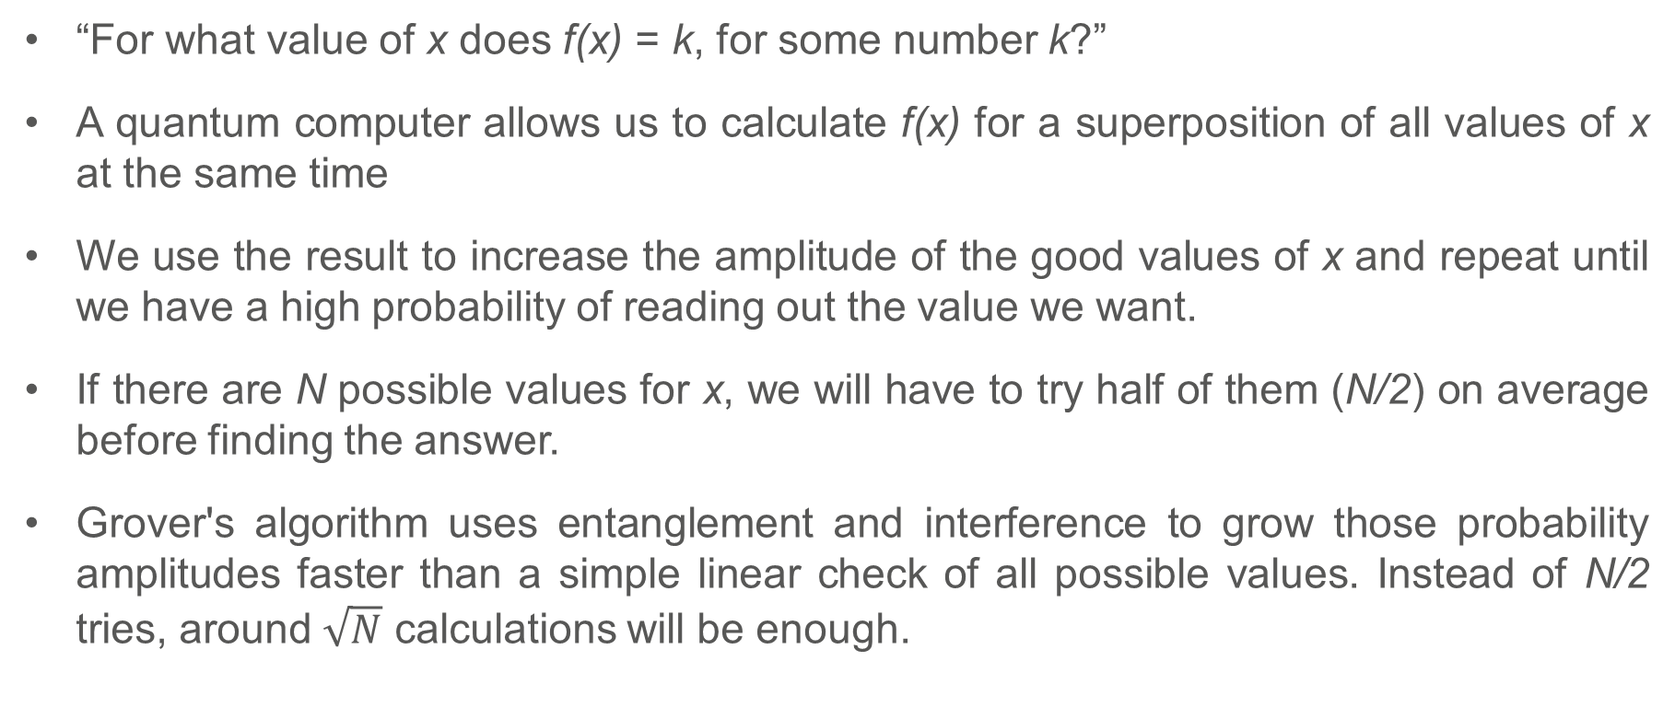
SECTION 7 Grover-asisted compact genetic algorithm
Grover’s Search Algorithm
“For what value of x does f(x) = k, for some number k?”
A quantum computer allows us to calculate f(x) for a superposition of all values of x at the same time
We use the result to increase the amplitude of the good values of x and repeat until we have a high probability of reading out the value we want.
If there are N possible values for x, we will have to try half of them (N/2) on average before finding the answer.
Grover's algorithm uses entanglement and interference to grow those probability amplitudes faster than a simple linear check of all possible values. Instead of N/2 tries, around $\sqrt{N}$ calculations will be enough.

Slide 12
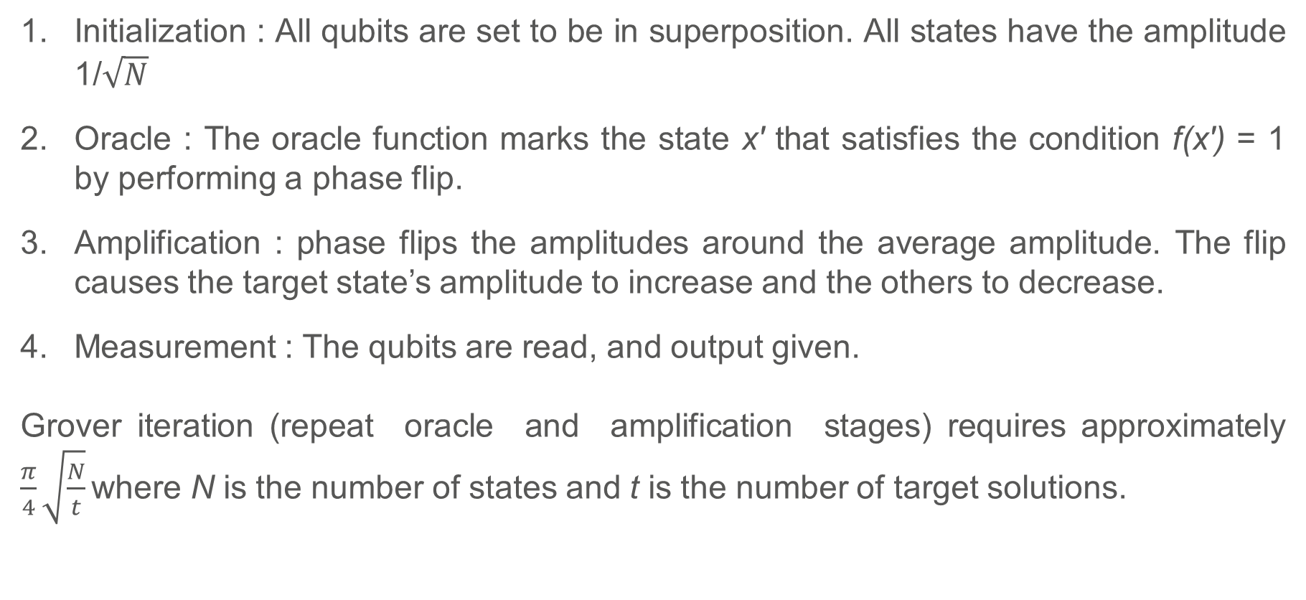
SECTION 7 Grover-asisted compact genetic algorithm
The Stages of Grover’s Search Algorithm
Initialization : All qubits are set to be in superposition. All states have the amplitude 1/$\sqrt{N}$
Oracle : The oracle function marks the state x′ that satisfies the condition f(x′) = 1 by performing a phase flip.
Amplification : phase flips the amplitudes around the average amplitude. The flip causes the target state’s amplitude to increase and the others to decrease.
Measurement : The qubits are read, and output given.
Grover iteration (repeat oracle and amplification stages) requires approximately $\frac{π}{4}\sqrt{\frac{N}{t}}$ where N is the number of states and t is the number of target solutions.

Slide 13
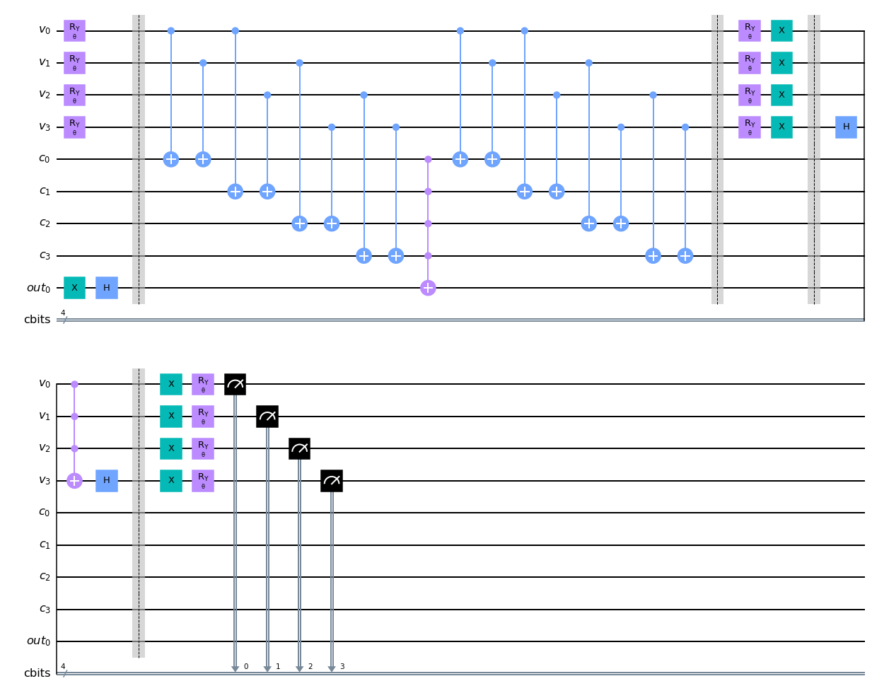
SECTION 7 Grover-asisted compact genetic algorithm
Grover-assisted Compact Genetic Algorithm (cGA*)
Initialization
1 Grover iteration
Measurement
Oracle
Diffusor
The quantum circuit of Grover’s search algorithm.

Slide 14


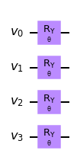
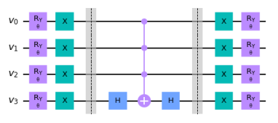
SECTION 7 Grover-asisted compact genetic algorithm
Grover-assisted Compact Genetic Algorithm (cGA*)
An arbitrary single-qubit state
The qubit rotation for angle(θ)
A circuit to initial the state based on the probability which encoding problem with 4 qubits.
A diffuser circuit which encoding problem with 4 qubits.

Slide 15
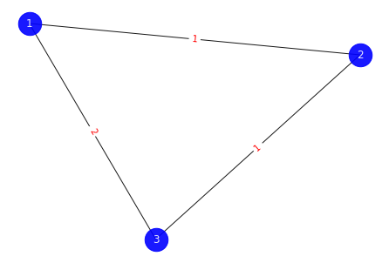
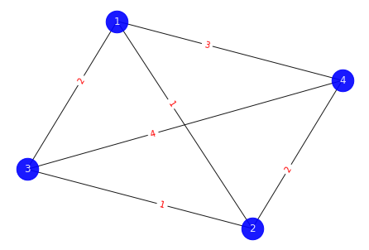

SECTION 7 Grover-asisted compact genetic algorithm
Travelling Salesman Problem
Find a shortest route that a salesman visits every city exactly once and returns to the starting point.
Define an oracle to recognize all feasible solutions.
TSP is mapped to an Ising model with scales ${(N−1)}^{2}$ spins are required, where N is the number of cities, and we designate city 1 to appear first in the route.
 | 1 | 2 | 3
1 | 1 | 0 | 0
2 | 0 | 1 | 0
3 | 0 | 0 | 1
The TSP 3 cities and 4 cities.
Matrix represents the route 1→ 2 → 3 → 1.

Slide 16
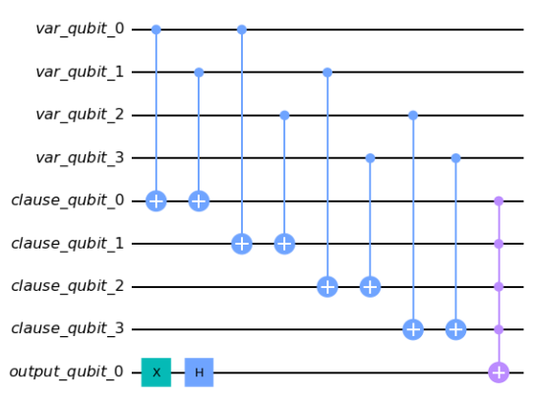
SECTION 7 Grover-asisted compact genetic algorithm
Travelling Salesman Problem
The oracle to check a feasible solution on the quantum state:
the oracle to verify a solution of TSP 3-city,
we need to check all 4 clauses include:
(𝑋_{2,2}, 𝑋_{2,3}), (𝑋_{2,2} , 𝑋_{3,2}), (𝑋_{2,3} , 𝑋_{3,3}), and (𝑋_{3,2} , 𝑋_{3,3}).
An example of oracle circuit for TSP 3 cities.

Slide 17
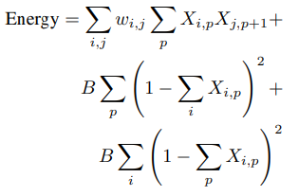
SECTION 7 Grover-asisted compact genetic algorithm
Travelling Salesman Problem
Classical optimizer:
the graph is fully connected.
three components in a single objective function to be minimized, and we get the following:
where B is the weight of the penalty term, it has a large enough weight to avoid an infeasible solution.
Total distance
The constraints to check a feasible path

Slide 18
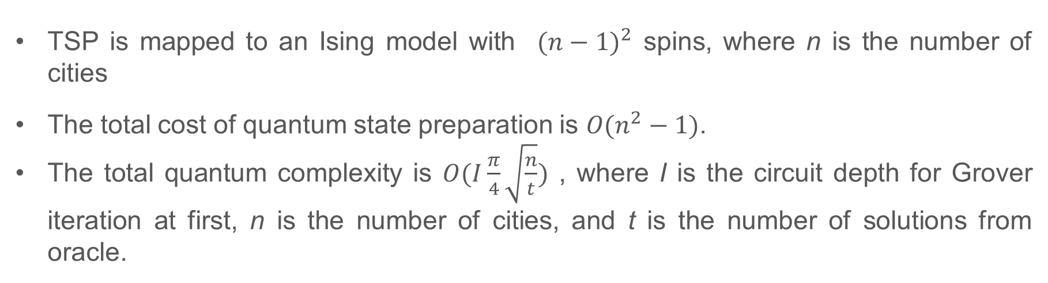
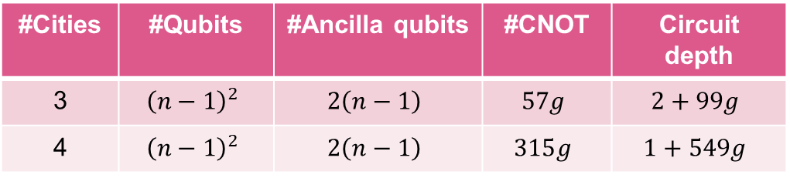
SECTION 7 Grover-asisted compact genetic algorithm
Experiment results
TSP is mapped to an Ising model with ${(n−1)}^{2}$ spins, where n is the number of cities
The total cost of quantum state preparation is 𝑂$(n^{2}−1)$.
The total quantum complexity is $O(I\frac{π}{4}\sqrt{\frac{n}{t}})$ , where I is the circuit depth for Grover iteration at first, n is the number of cities, and t is the number of solutions from oracle.
#Cities | #Qubits | #Ancilla qubits | #CNOT | Circuit depth
3 | $${\left(n−1\right)}^{2}$$ | $$2\left(n−1\right)$$ | $$57g$$ | $$2+99g$$
4 | $${\left(n−1\right)}^{2}$$ | $$2\left(n−1\right)$$ | $$315g$$ | $$1+549g$$
n is the number of cities, and g is the number of Grover iterations.

Slide 19
SECTION 8 Observation
Observation
Increasing the number of shots aids in obtaining a probability distribution of results, mitigating stochastic errors.
Quantum algorithms we have today only offer modest speed-ups over their classical counterparts.
Quantum algorithms don’t seem to offer exponential speedups for black box optimization problem. However, it’s possible that there may be some exponential speedup in cases where you know a bit more about the problem.

Slide 20
Reference
K. Suksen, N. Benchasattabuse and P. Chongstitvatana, "Compact Genetic Algorithm with Quantum-Assisted Feasibility Enforcement," ECTI TRANSACTIONS ON COMPUTER AND INFORMATION TECHNOLOGY, Vol.16, No.4, December 2022, pp.422-435.
DOI: 10.37936/ecti-cit.2022164.247821

Slide 21

More Information
Search “Prabhas Chongstitvatana”
Go to me homepage

Slide 22
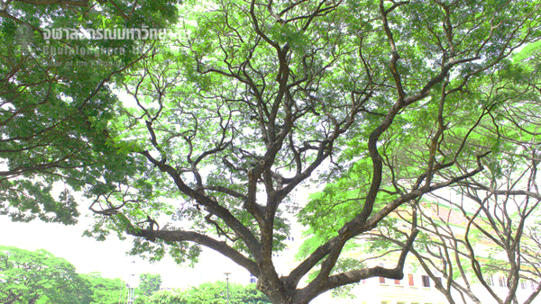
Q & A

