Slide 1
Impact of Generative AI on Education
Prabhas Chongstitvata
Chulalongkorn University

Slide 2

More Information
Search “Prabhas Chongstitvatana”
Go to me homepage

Slide 3
AI Fundamentals

Slide 4
What is AI?
an intelligent agent that acts like human.
this includes software services (aka Apps) and automated machines (think smart robot vacuum, automated factory etc.).

Slide 5
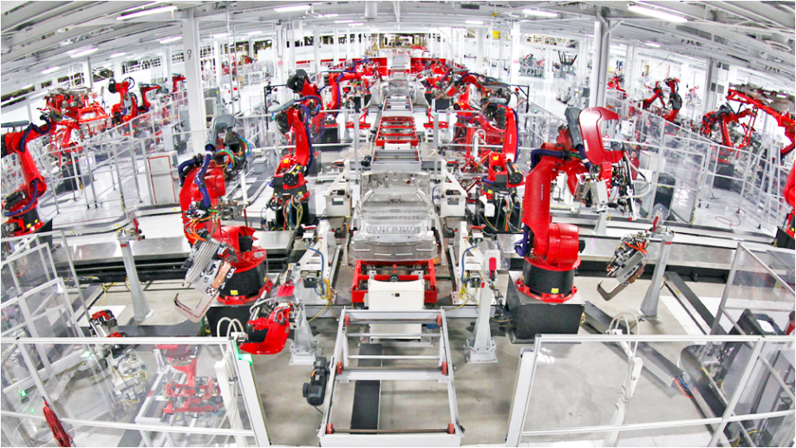

Slide 6
What can AI do?
understand human speech
identify objects from pictures
play games
analyse big financial data
drive cars
control robots
automate many jobs

Slide 7
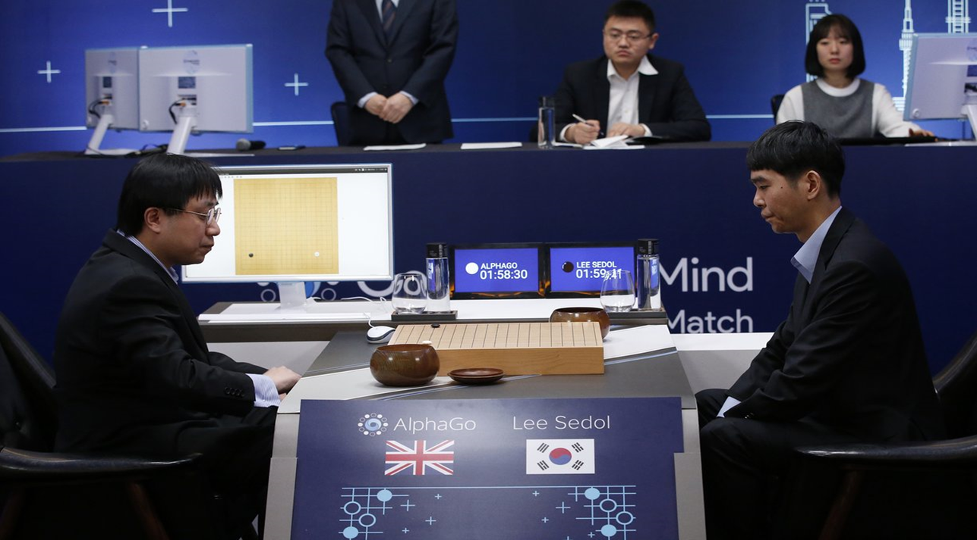
AlphaGo vs Lee Seidol, March 2016

Slide 8
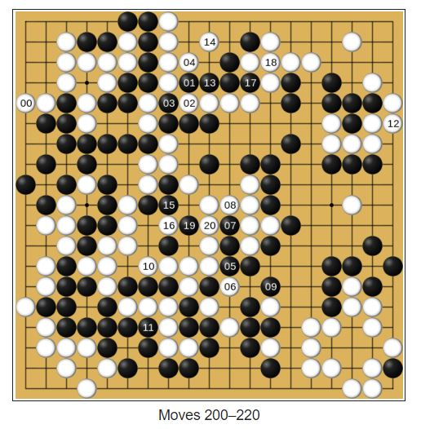
Future of Go Summit 2017

Slide 9
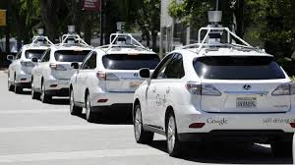

Slide 10
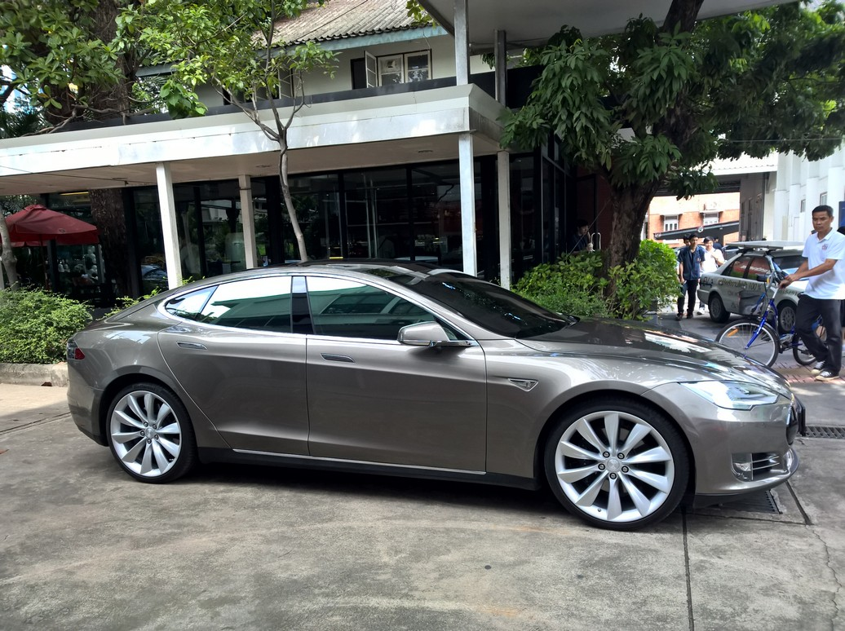
DriverLess car

Slide 11
How a computer program be intelligent?
There are two approaches in the development of AI.
Logic
Memory and learning

Slide 12
Logical reasoning.
Computer program can perform deductive reasoning such as
socrates is a human
human are motal
therefore socrates is mortal
We can use logic to encode situation in the real world
when it rains, you cannot play tennis outdoor.

Slide 13
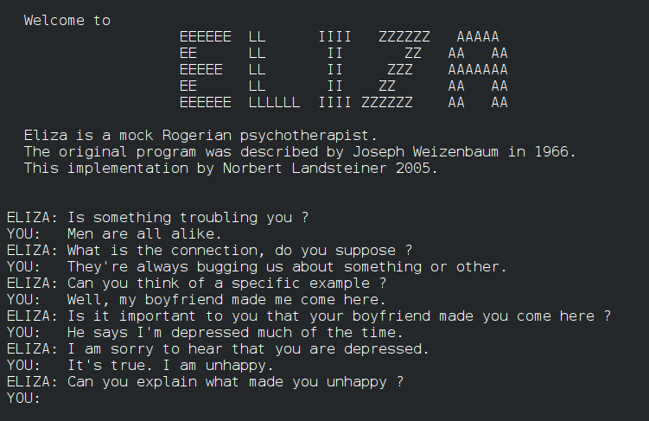
ELIZA, Weizenbaum 1964-1967

Slide 14
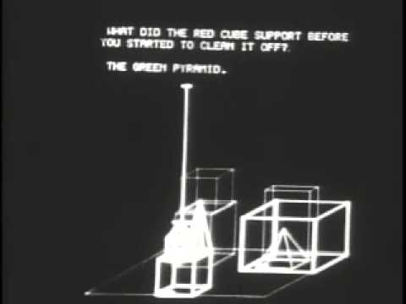
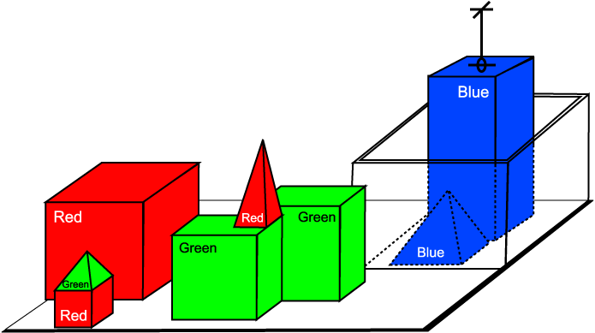
SHRDLU, Winograd MIT 1968-1970

Slide 15
First method: Logic
Using large amount of rules and facts, computer programs can deduce a lot of things.
Hence, it behaves intelligently.

Slide 16
Second method: use memory and learning
We can imitate human brain by encoding information and memory into a large connected network.
This network responses to input with a correct output. The relationship of this input/output can be learn from large amount of data without human intervention.
This type of approach is called Artificial Neural Networks.

Slide 17
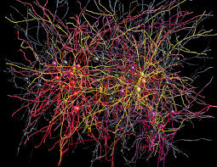

Slide 18
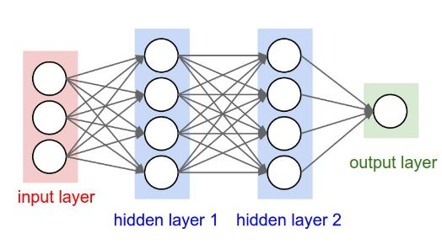
Artificial Neural Network 3-layer

Slide 19
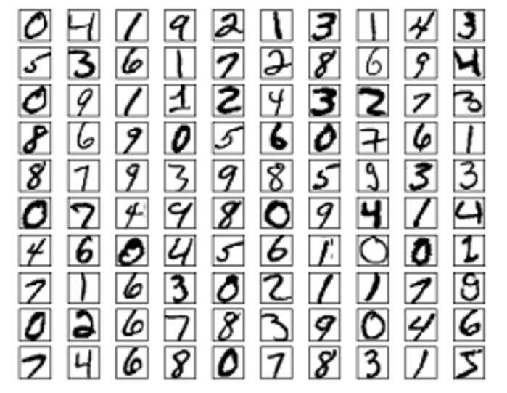

Slide 20
Example, recognise the picture of my wife
I can show a lot of pictures of my wife from many angles. Then I can train a kind of network to remember this face. I also train a lot of pictures of not-my-wife face. So, now the network can distinguish between my-wife and not-my-wife faces.

Slide 21
This is the most popular method today.
Multiple layers (update few hundreds) of this Network can be constructed
It is called Deep learning

Slide 22
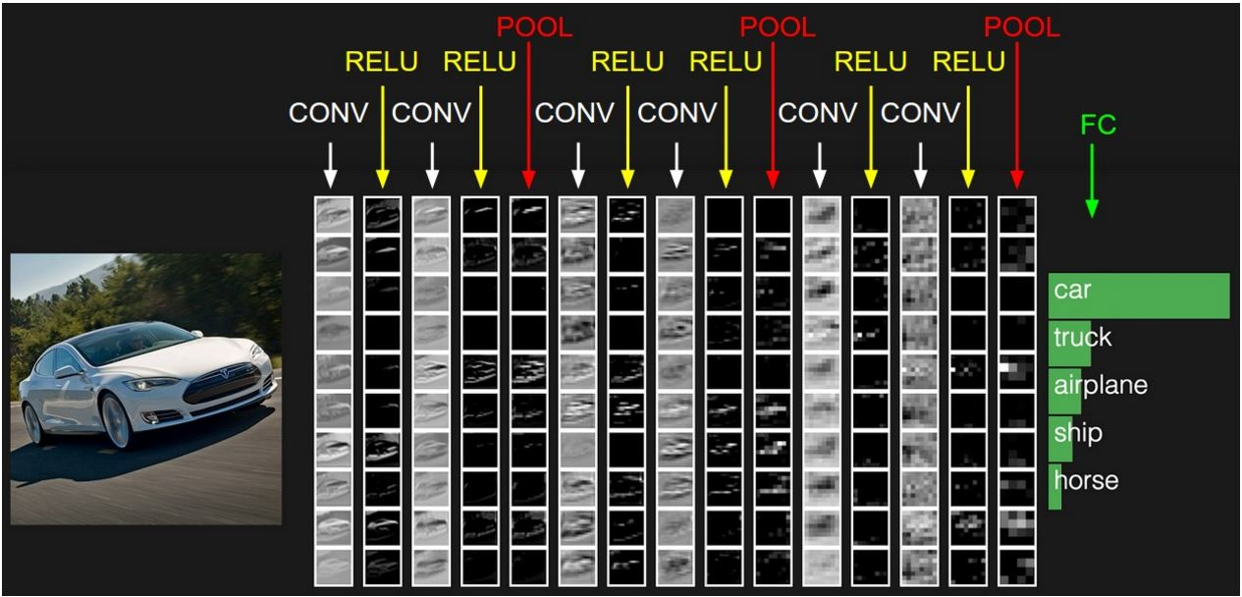
Example of NN layer

Slide 23
Most AI programs are written using "heuristic", i.e. the program behaves by some rule that is encoded "human" tactic.
For example, a program to play chess evaluate the board position according to rule created by human expert.

Slide 24
Another way to create AI program is by using "search".
The problem is encoded as many alternative way to solve it
AI program looks at these alternatives and choose a path carefully until a good solution is found.
For example, the sequence of chess moves can be "search" to maximise the possibility to win the game.

Slide 25
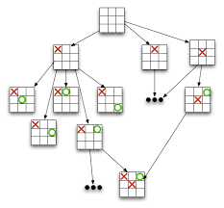

Slide 26
AI program can use evolution to find good solutions.
In this way, initial candidate solutions are created and then evaluate. The good solutions are selected and improve upon.
This step are repeated until solutions are found.
One of the popular method in this class is called Genetic Algorithm.

Slide 27
Machine Learning
Learning from data
Task : classification
Learn:
Association rule
Decision tree
Self improvement (reinforcement learning)

Slide 28
Artificial Neural Networks
Deep learning

Slide 30
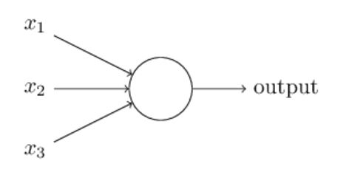
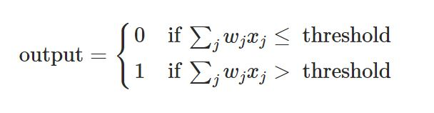
Perceptron
Rosenblatt, 1950

Slide 31
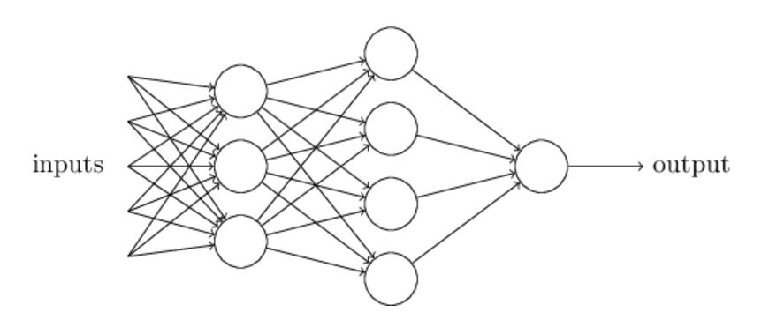
Multi-layer perceptron
Michael Nielsen, 2016

Slide 32
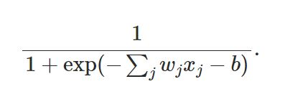
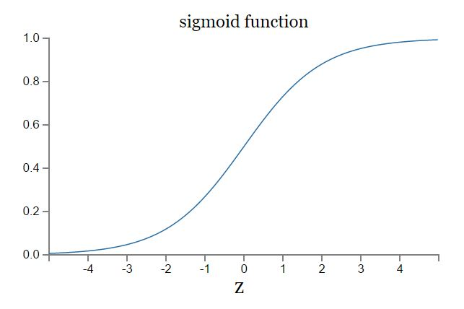
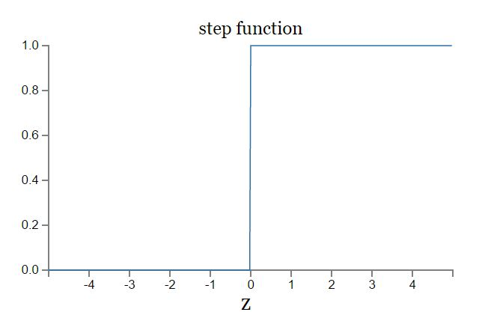
Sigmoid function

Slide 33
Artificial Neural Network 3-layer

Slide 34
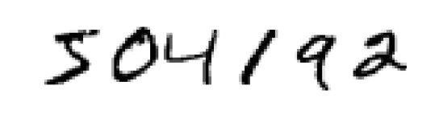
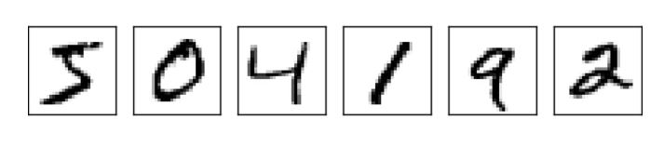

Slide 35
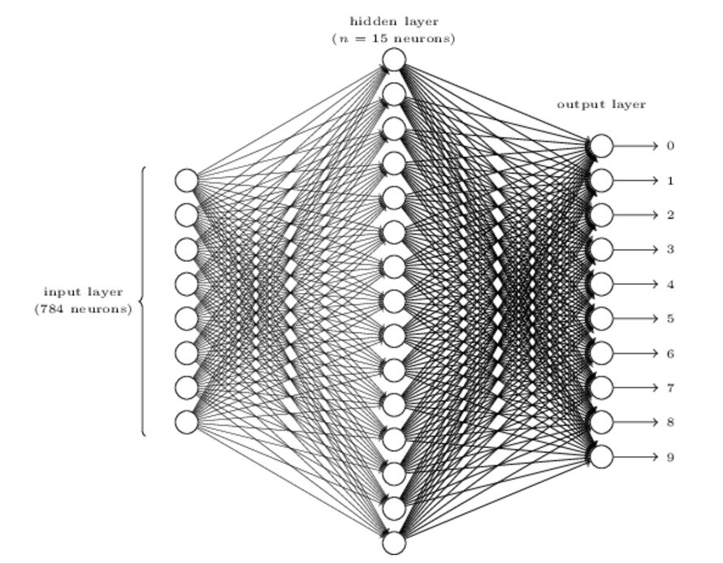
Digit recognition NN
24x24 = 784
0.0 white 1.0 black

Slide 36
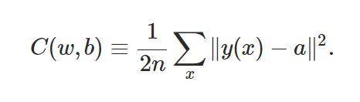
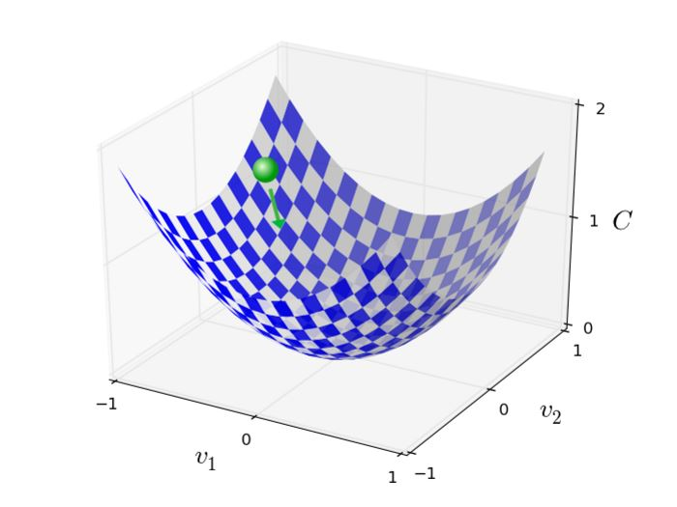
Training NN
Backpropagation is a fast way to compute this, 1986

Slide 37
Convolutional Neural Network
3 main types of layers
Convolutional layer
Pooling layer
Fully Connected layer

Slide 38
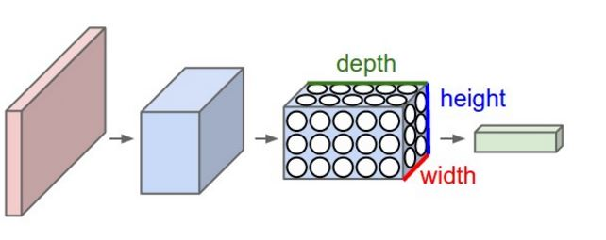
Convolutional Neural Network

Slide 39
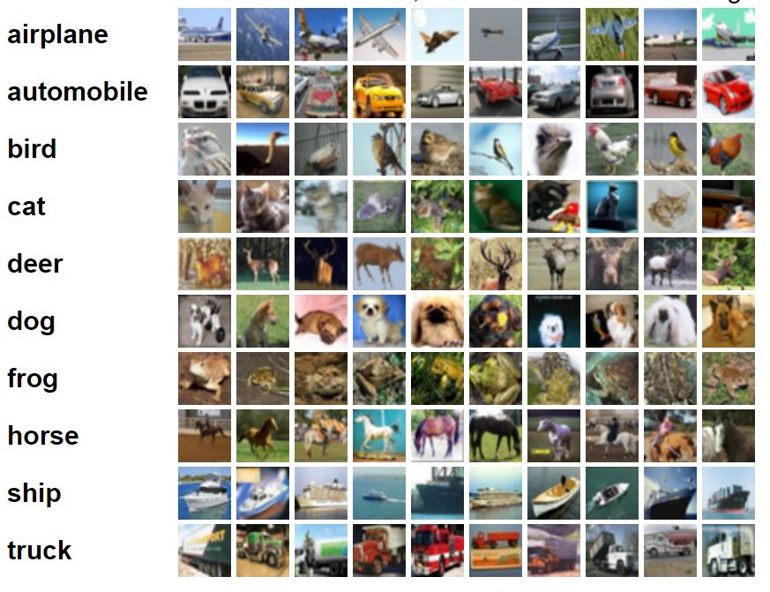
CIFA-10 image dataset

Slide 40
Example of CNN layer

Slide 41
Parameters
ImageNet challenge in 2012
images 227x227x3
convolutional layer
receptive field F = 11, S = 4, with 96 filters
55x55x96 = 290,400 neurons
each neuron connects to 11x11x3 = 363+1 bias weights
total 290400*364 = 105,705,600 parameters

Slide 42
Generative AI
Generative artificial intelligence (AI) describes algorithms (such as ChatGPT) that can be used to create new content, including audio, code, images, text, simulations, and videos. Recent breakthroughs in the field have the potential to drastically change the way we approach content creation.
https://www.mckinsey.com/featured-insights/mckinsey-explainers/what-is-generative-ai

Slide 43
Generative adversarial network
One of the pillar of Generative AI is Generative adversarial network
" A generative adversarial network (GAN) is a class of machine learning framework and a prominent framework for approaching generative AI. The concept was initially developed by Ian Goodfellow and his colleagues in June 2014. In a GAN, two neural networks contest with each other in the form of a zero-sum game, where one agent's gain is another agent's loss. “ (Wikipedia)

Slide 44
Given a training set, this technique learns to generate new data with the same statistics as the training set. For example, a GAN trained on photographs can generate new photographs that look at least superficially authentic to human observers, having many realistic characteristics. Though originally proposed as a form of generative model for unsupervised learning, GANs have also proved useful for semi-supervised learning, fully supervised learning, and reinforcement learning. "

Slide 45
Key concept: Generate more data from existing data

Slide 46
State of the art
Learn everything
No user program
Self improvement

Slide 47
Generative AI examples
Dall-E. Trained on a large data set of images and their associated text descriptions, Dall-E is an example of a multimodal AI application that identifies connections across multiple media, such as vision, text and audio.
ChatGPT. The AI-powered chatbot that took the world by storm in November 2022 was built on OpenAI's GPT-3.5 implementation. OpenAI has provided a way to interact and fine-tune text responses via a chat interface with interactive feedback.
Bard. Bard is a user interface to many tools that Google developed, such as transformer AI techniques for processing language, proteins and other types of content.

Slide 48
Use cases for generative AI
Implementing chatbots for customer service and technical support.
Improving dubbing for movies and educational content in different languages.
Writing email responses, dating profiles, resumes and term papers.
Creating photorealistic art in a particular style.
Improving product demonstration videos.
Designing physical products and buildings.
Optimizing new chip designs.
Writing music in a specific style or tone.

Slide 49
AI content generators
Text generation: GPT, Jasper, AI-Writer and Lex.
Image generation: Dall-E 2, Midjourney and Stable Diffusion.
Music generation: Amper, Dadabots and MuseNet.
Code generation: CodeStarter, Codex, GitHub Copilot and Tabnine.
Voice synthesis: Descript, Listnr and Podcast.ai.

Slide 50
Impact on Education
Students can generate contents
Factual knowledge can be search
Reading and Summarisation can be automated
Test and Evaluation are becoming difficult to manage
Deliver content to students becomes diverse

Slide 51
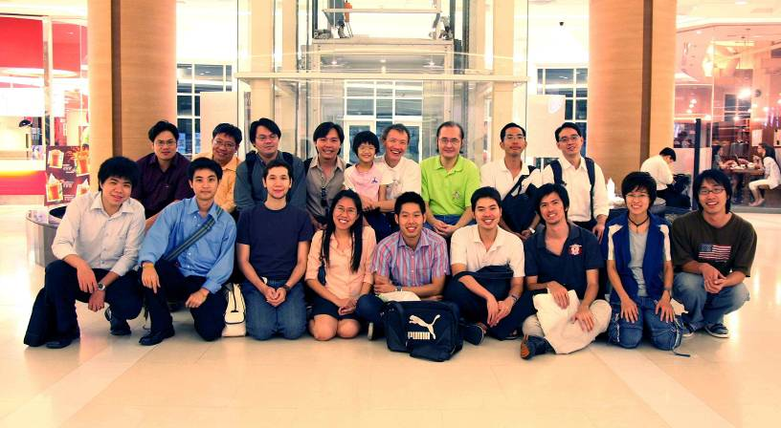
Team work 2010

Slide 52
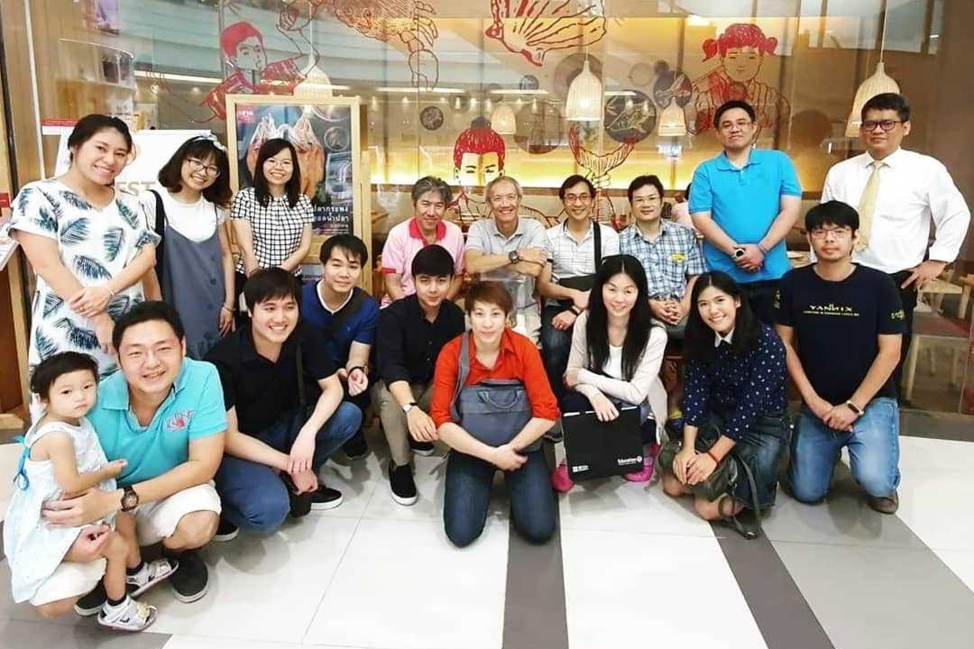
Students 2019

Slide 53
More Information
Search “Prabhas Chongstitvatana”
Get to my homepage

