Slide 1
ENGINEERING Optimization by Quantum Computers
Prabhas Chongstitvatana
Chulalongkorn University

Slide 2

More Information
Search “Prabhas Chongstitvatana”
Get to me homepage

Slide 3
What is a quantum computer?
a computer that relies on special memory, "quantum bit", to perform massively parallel computing.

Slide 4
What is a quantum bit?
a basic unit of memory that uses “quantum state” to store information.
a "qubit" stores the probability of information.

Slide 5
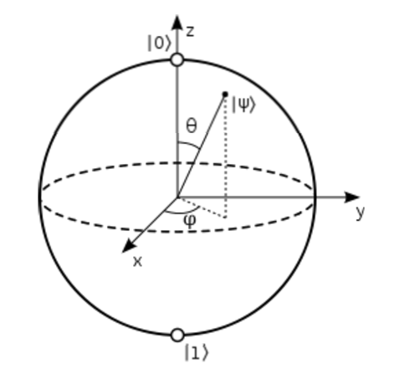

Slide 6
What is the advantage?
it is very very fast compared to conventional computers.

Slide 7
google quantum lab's paper Dec 2015
claim of 100,000,000x speed up

Slide 8
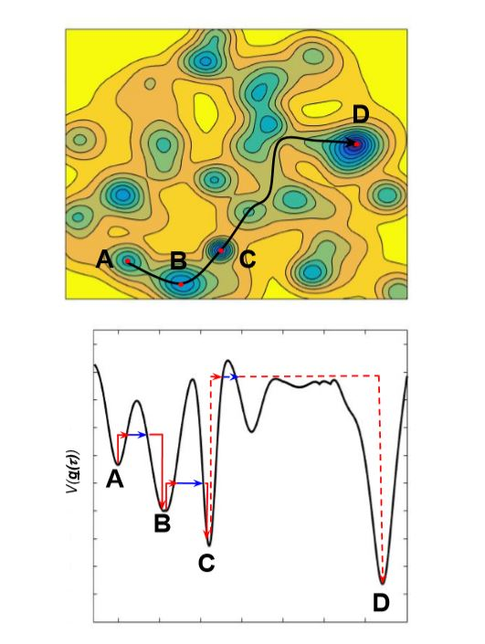

Slide 9
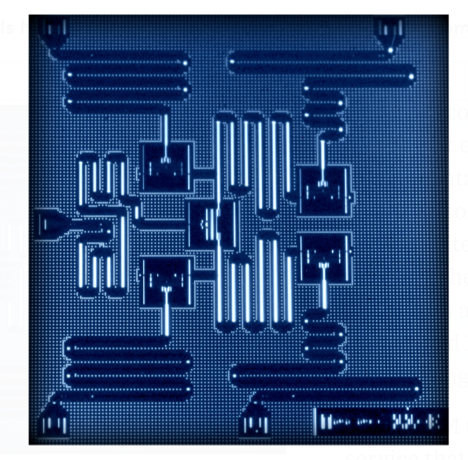
IBM 5 qubits processor

Slide 10
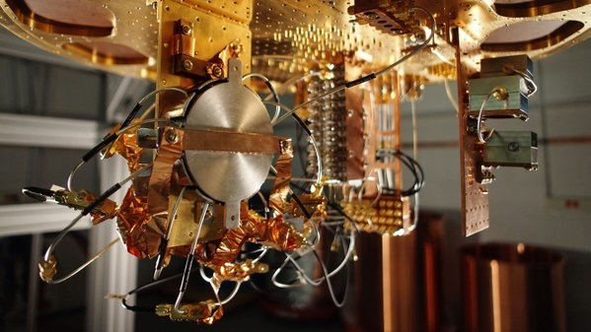
Quantum bit in D-wave machine

Slide 11
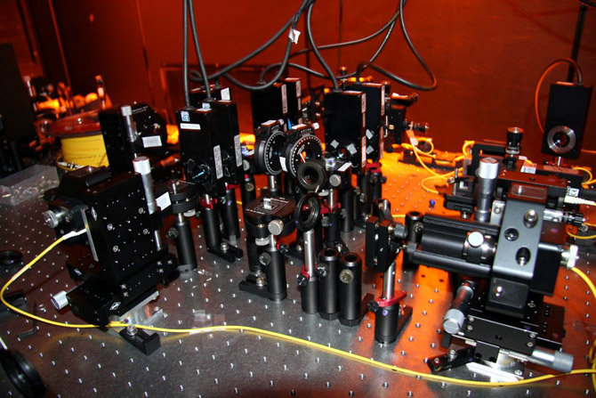

Slide 12
Quantum algorithms
computer programs that work on quantum computers

Slide 13
Famous algorithms
Shor's integer factorization
Given an integer N, find its prime factors

Slide 14
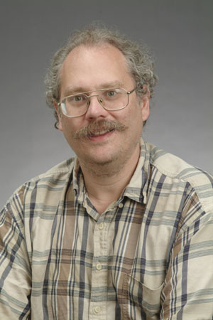
Quantum Algorithms
Peter Shor
a quantum algorithm for integer factorization formulated .

Slide 15
Optimization

Slide 16
Evolutionary Computation
Survival of the fittest.
The objective function depends on the problem.
EC is not a random search.

Slide 17
Combinatorial optimisation
The domains of feasible solutions are discrete.
Examples
Traveling salesman problem
Minimum spanning tree problem
Set-covering problem
Knapsack problem

Slide 18
My own example of quantum computation
compact genetic algorithm by quantum computers 2012, 2021
exponential speedup

Slide 19
Normal
1) initialze qureg x
2) generate two individuals from qureg
3) let them compete
4) update qureg x with the winner
5) repeat step 2..4 for k times
6) generate the final result

Slide 20
quantum speedup
1) initialze qureg x
2) generate the first individual from qureg x
3) generate the second individual with condition that fitness is greater than the first
4) let them compete
5) update qureg x with the winner
6) repeat step 2..5 for k times
7) generate the final result

Slide 21
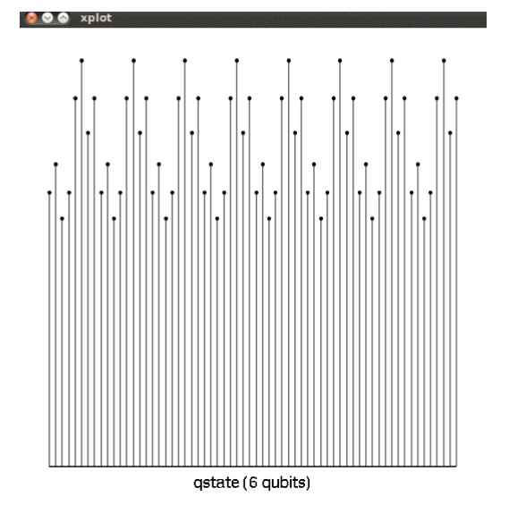
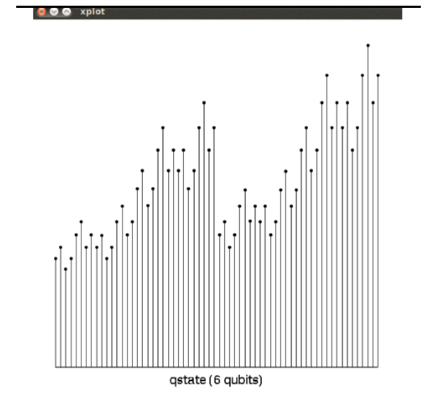
output

Slide 22
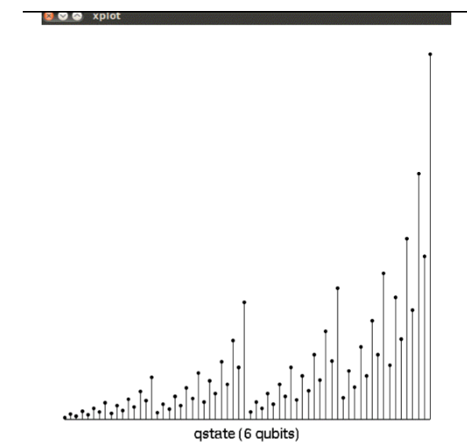
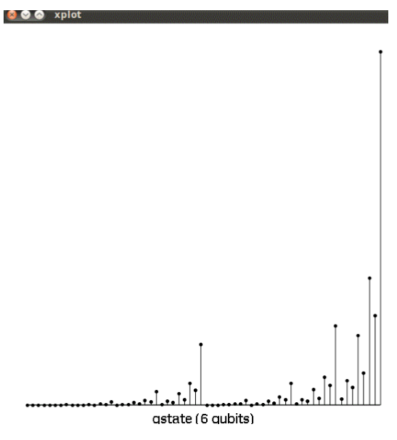
output

Slide 23
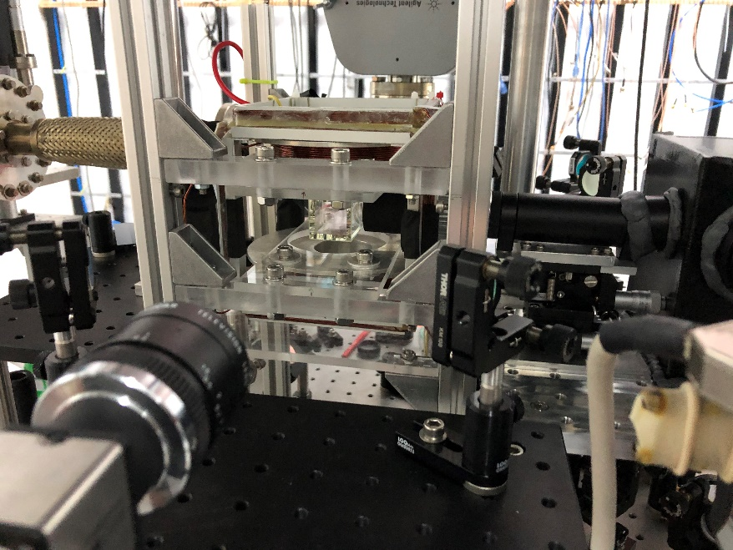
Cold Atom Trap experiment at Physics, Chiengmai University, 2020 (5 Rubidium atoms)

Slide 24
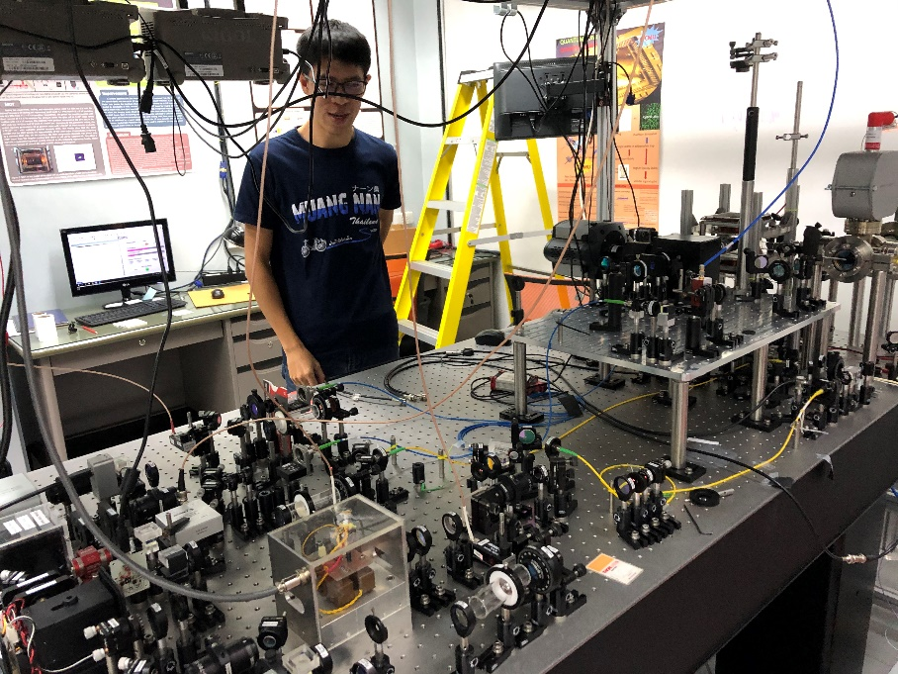
Experiment setup

Slide 25
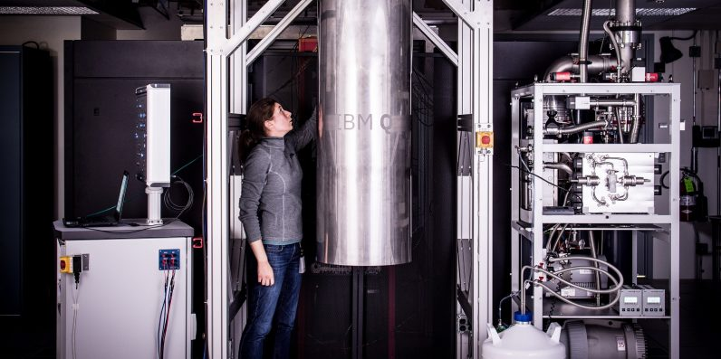
IBM 50 qubits quantum computer

Slide 26
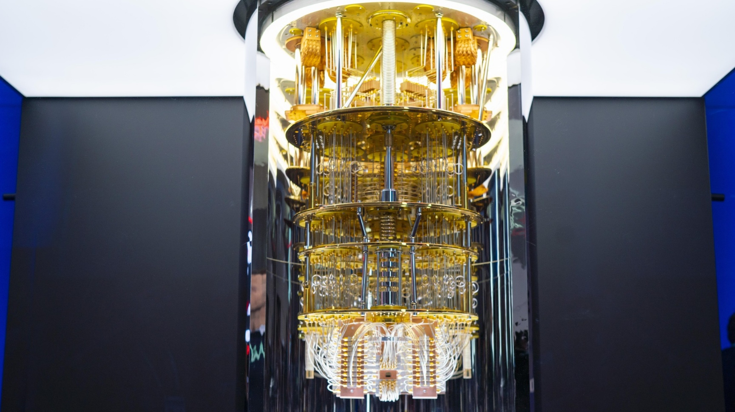

Slide 27
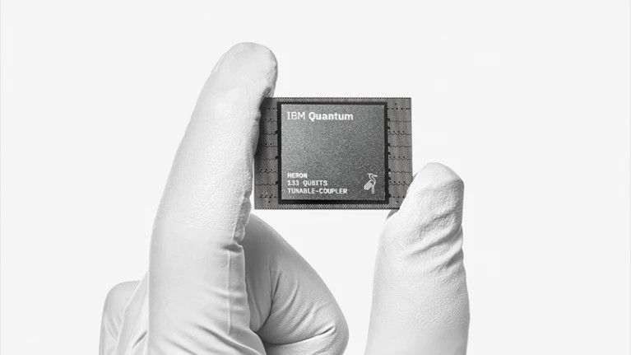
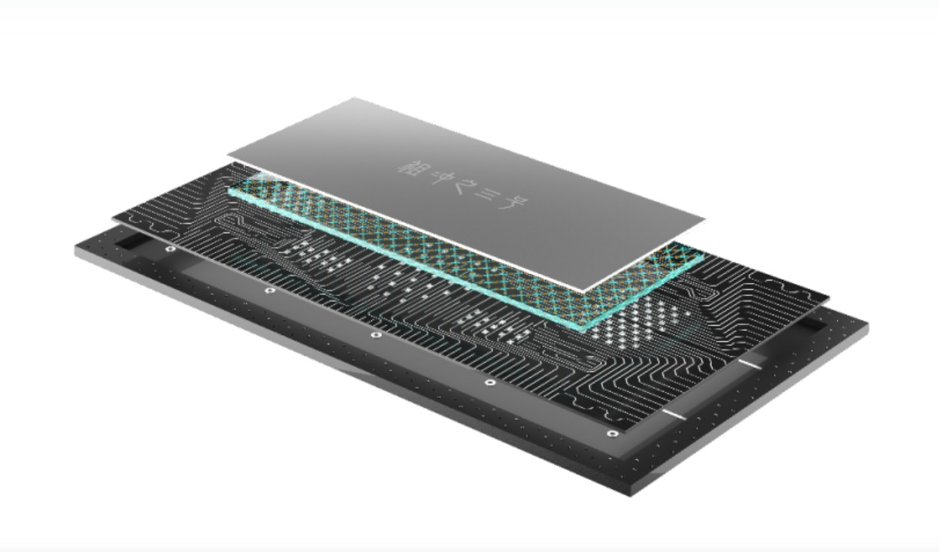

Slide 28
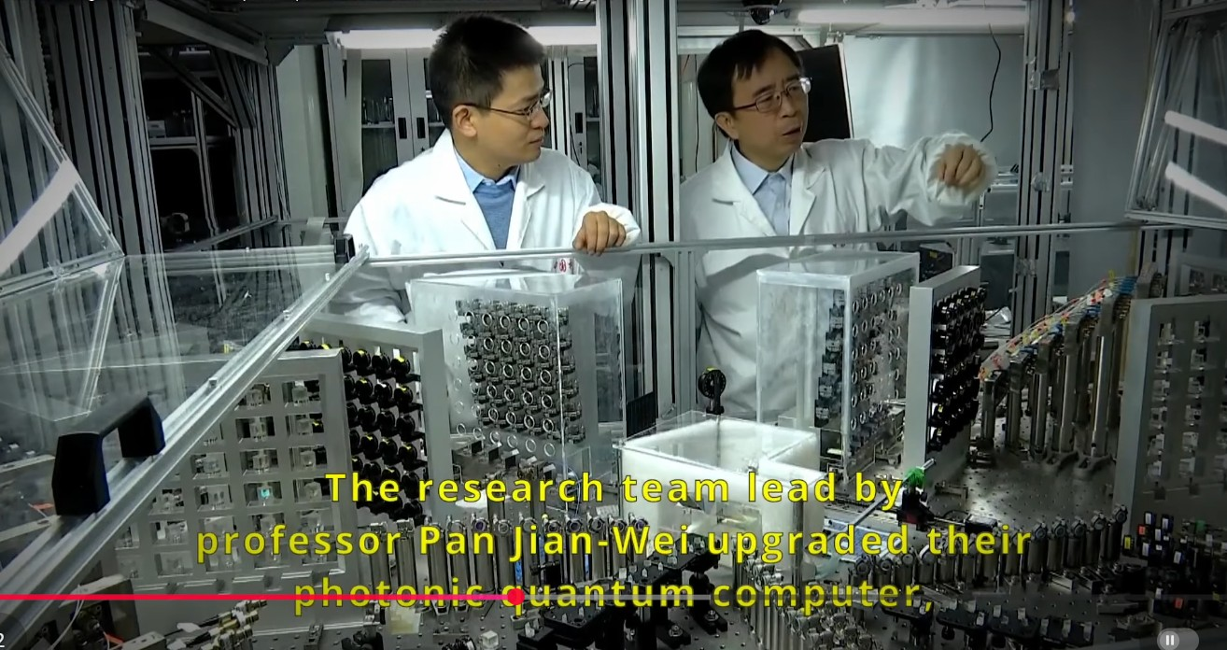

Slide 29
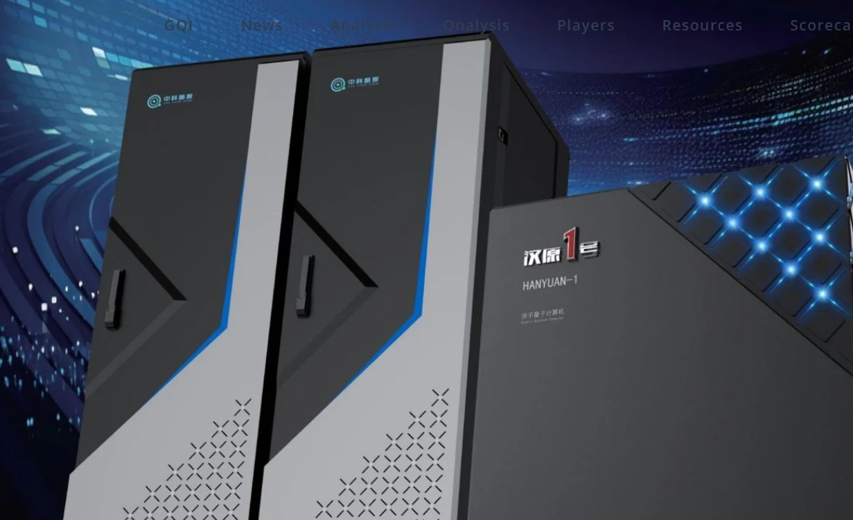

Slide 30
Future
Better qubits (live long, less error)
quantum annealing computers
scaling up

Slide 31
References
S. Yingchareonthawornchai, C. Aporntewan, and P. Chongstitvatana, "An Implementation of Compact Genetic Algorithm on a Quantum Computer," Int. Joint Conf. on Computer Science and Software Engineering (JCSSE), 30 May - 1 June 2012, pp.131-135.
http://www.cp.eng.chula.ac.th/~piak/paper/2012/jcsse-quantum-cga.pdf
K. Suksen, N. Benchasattabuse and P. Chongstitvatana, "Experiments on Quantum Circuits for Compact Genetic Algorithm," 2021 25th International Computer Science and Engineering Conference (ICSEC), Chiang Rai, Thailand, 2021, pp. 185-190, doi: 10.1109/ICSEC53205.2021.9684643.

Slide 32
More Information
Search “Prabhas Chongstitvatana”
Get to me homepage

