Slide 1
Cyber Security and Quantum Technology
Prabhas Chongstitvatana
Faculty of Engineering
Chulalongkorn University

Slide 2
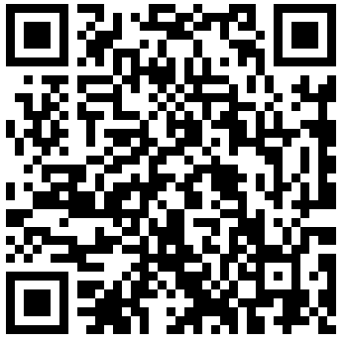
More Information
Search “Prabhas Chongstitvatana”
Get to me homepage

Slide 3
Outline
Cyber security
Quantum computer
principle
state of the art hardware
Quantum communication
QKD
Post quantum cryptography
NIST recommendation
Some approaches
international policies
Thai government current work

Slide 4
Cyber Security

Slide 5
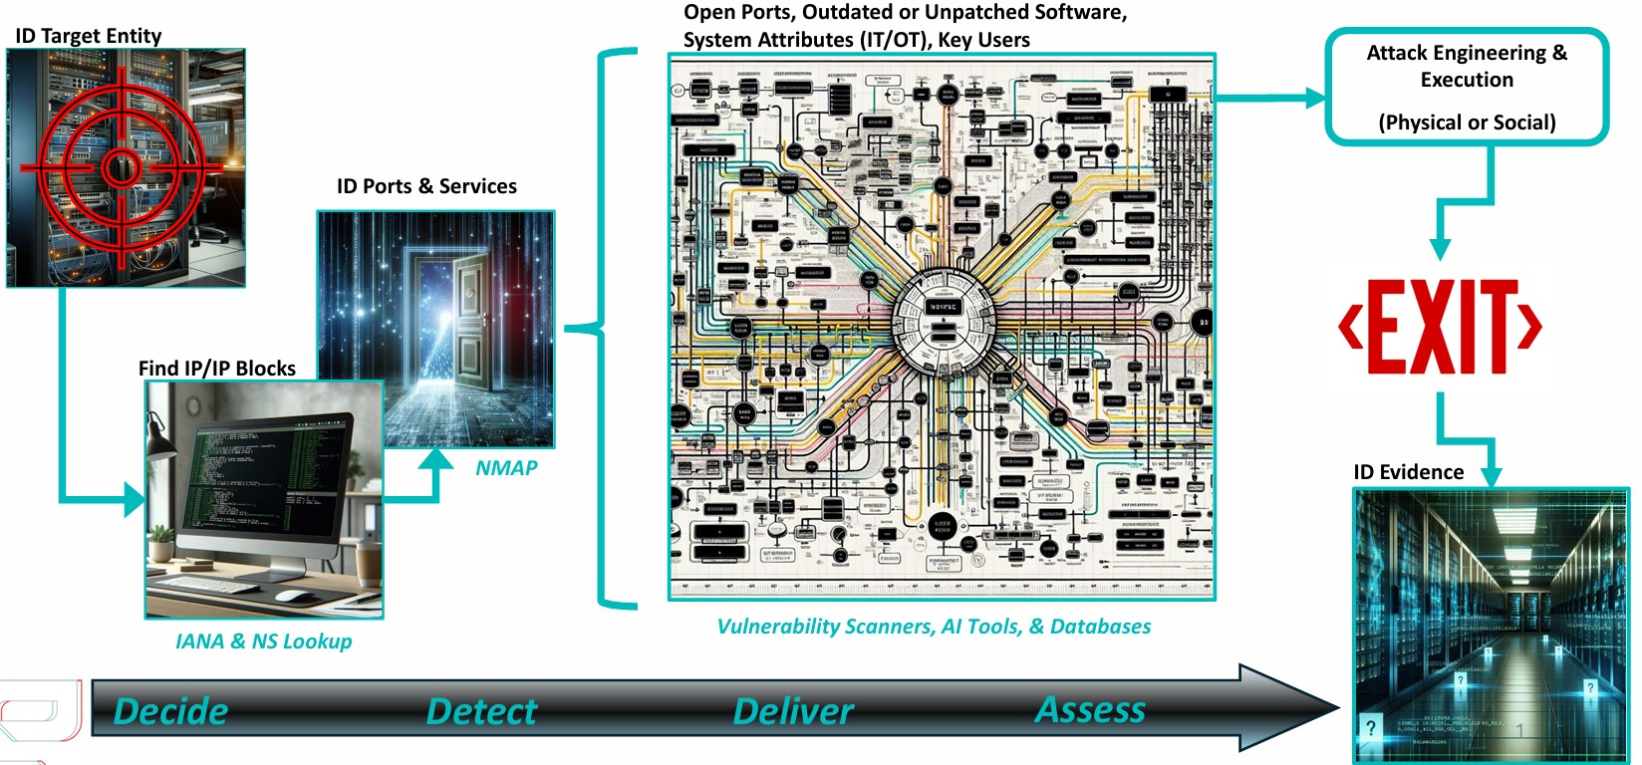
Anatomy of an attack

Slide 6
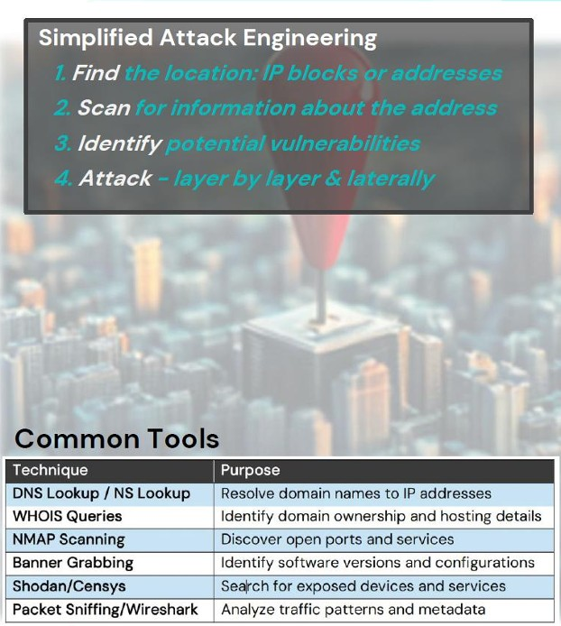
Discovery and exploitation

Slide 7
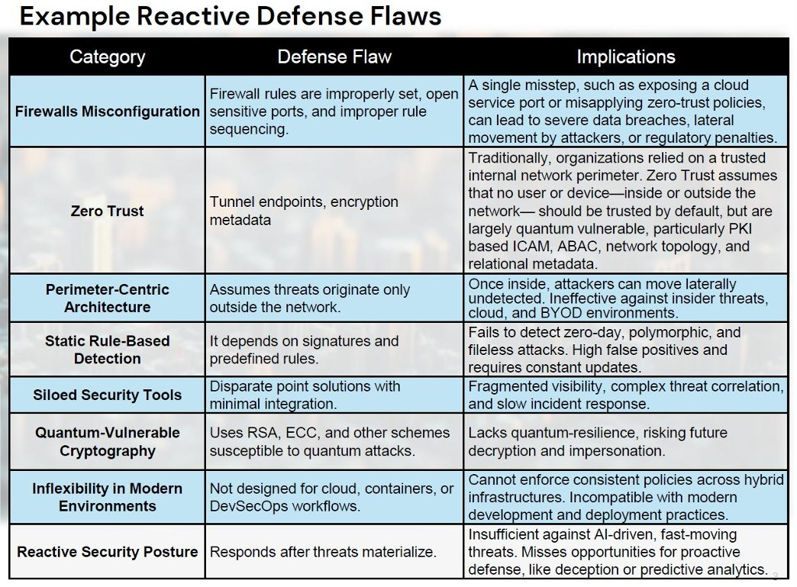
Defense Flaws

Slide 8
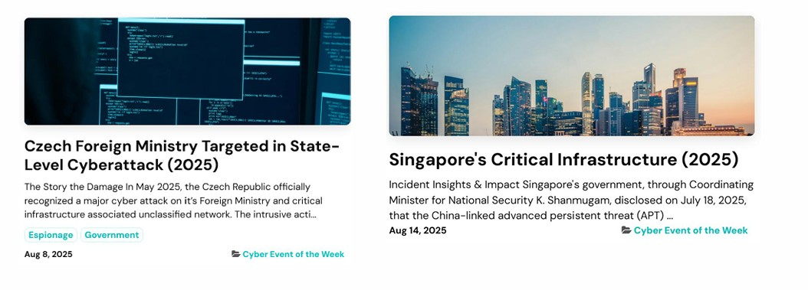
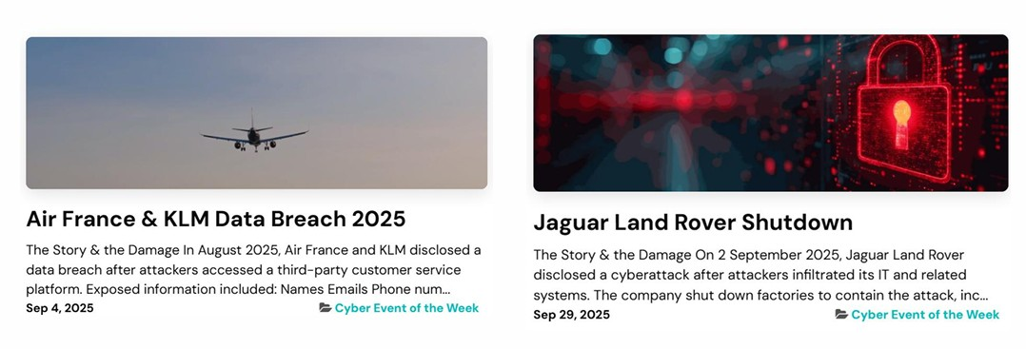
Cyber Crime

Slide 9
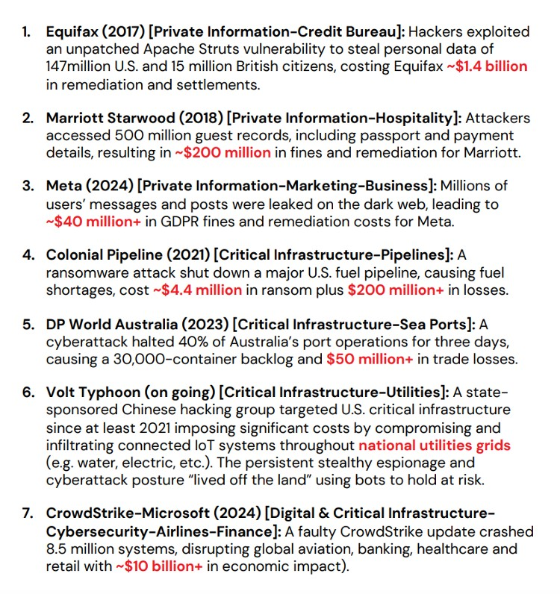

Slide 10
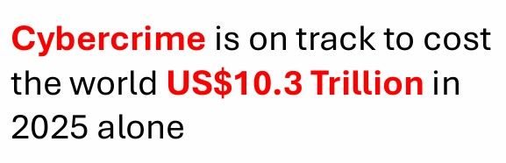

Slide 11
Example of attack: Stuknet
The Stuxnet incident (discovered in 2010) it was the world's first true digital weapon.
Stuxnet was a highly complex, nation-state-backed computer worm explicitly built to cross the line from the digital world into the physical world to sabotage Iran's nuclear program.
The primary target was the Natanz uranium enrichment plant. Because this facility housed highly sensitive, top-secret infrastructure, it was completely air-gapped—meaning its computers were entirely disconnected from the public internet.

Slide 12
How the attack work
The Infiltration: The worm was loaded onto USB flash drives. It is widely believed that compromised insiders or contractors unknowingly plugged these USB drives into the facility's computers.
The Exploit: Stuxnet utilized an unprecedented four "zero-day" vulnerabilities (previously unknown flaws in the Windows operating system) to automatically spread from the USB drive to the facility's computers without requiring any user interaction.
The Hunt: Once inside, the worm ignored 99% of the computers it encountered. It was specifically looking for a very precise configuration: PCs running a specific German software called Siemens STEP7, which was used to program Programmable Logic Controllers (PLCs). These PLCs were the tiny industrial computers controlling the physical machinery.
[Infected USB Drive] ➔ [Windows Engineering PC] ➔ [Siemens STEP7 Software] ➔ [Centrifuge PLCs]

Slide 13
Physical Destruction: It commanded the fast-spinning centrifuges to suddenly spin dangerously fast, then drastically slow down, and then speed up again. This intense, erratic physical stress caused the delicate aluminum rotors to warp, fly apart, and physically destroy themselves.
The Digital Mirage (Rootkit): While it was tearing the hardware apart, Stuxnet played a "pre-recorded loop" of normal operating data back to the control room monitors. To the Iranian scientists watching the screens, everything looked perfectly healthy.
In June 2010, a small cybersecurity firm in Belarus named VirusBlokAda was hired to look at a malfunctioning computer in Iran and discovered the wildly complex code. Security firms worldwide (like Symantec and Kaspersky) spent months dissecting it, realizing it had successfully ruined roughly one-fifth (about 1,000) of Iran’s nuclear centrifuges.

Slide 14
Classic cryptography
one-way function
integer factorization
quantum computer attack
Shor algorithm

Slide 15
Famous algorithms
Shor's integer factorization
Given an integer N, find its prime factors

Slide 16
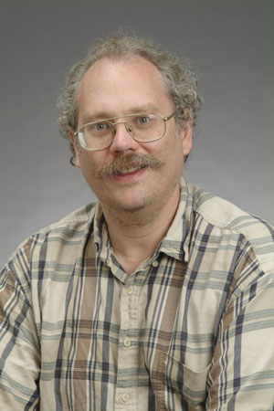
Quantum Algorithms
Peter Shor
a quantum algorithm for integer factorization formulated

Slide 17
Quantum Computer

Slide 18
What is a quantum computer?
a computer that relies on special memory, "quantum bit", to perform massively parallel computing.

Slide 19
What is a quantum bit?
a basic unit of memory that uses “quantum state” to store information.
a "qubit" stores the probability of many states of information.

Slide 20
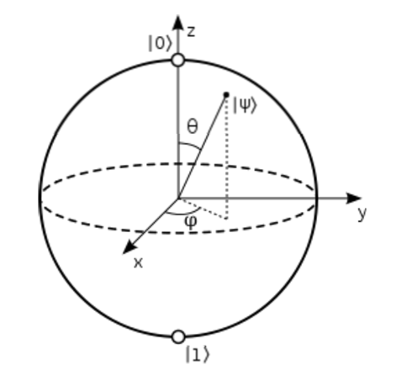

Slide 21
What is the advantage?
it is very very fast compared to conventional computers.

Slide 22
google quantum lab's paper Dec 2015
claim of 100,000,000x speed up

Slide 23
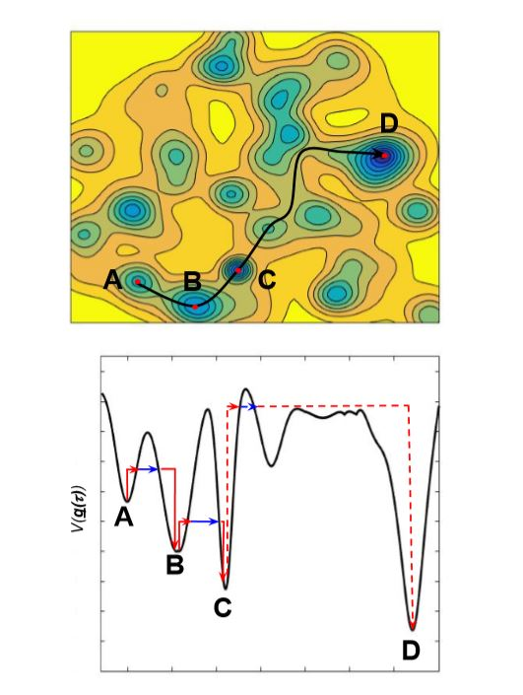

Slide 24
Quantum algorithms
computer programs that work on quantum computers

Slide 25
Combinatorial optimisation
The domains of feasible solutions are discrete.
Examples
  Traveling salesman problem
  Minimum spanning tree problem
  Set-covering problem
  Knapsack problem

Slide 26
Technology to build qubits
Super conducting qubit
Trapped Ion qubit
Photonic qubit
Semiconductor quantum dots

Slide 27
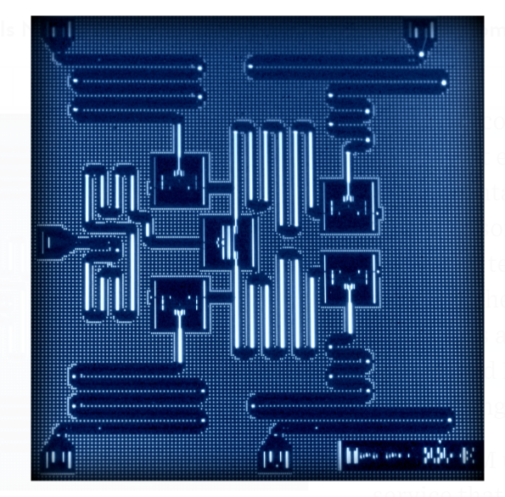
IBM 5 qubits processor

Slide 28
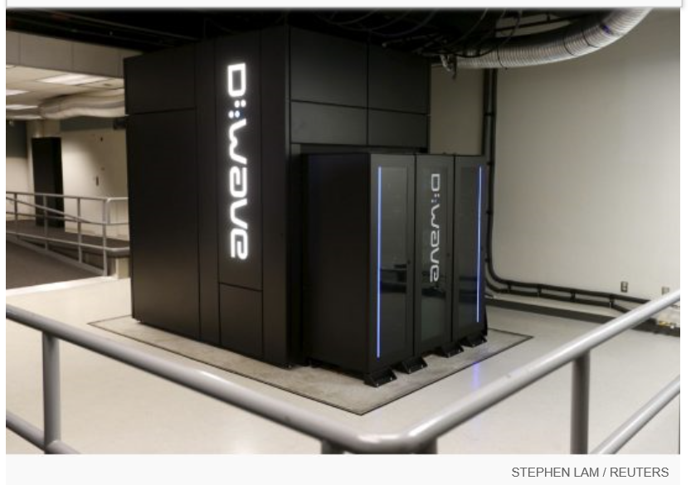
Google Nasa, D-Wave 2x machine

Slide 29
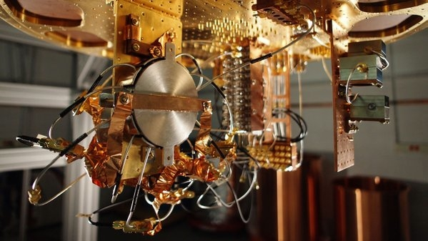
Quantum bit in D-wave machine

Slide 30
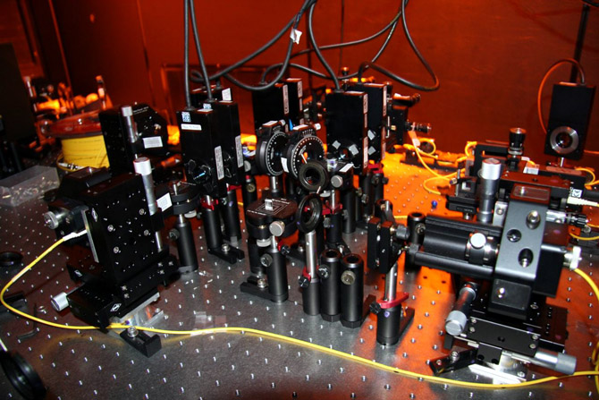

Slide 31
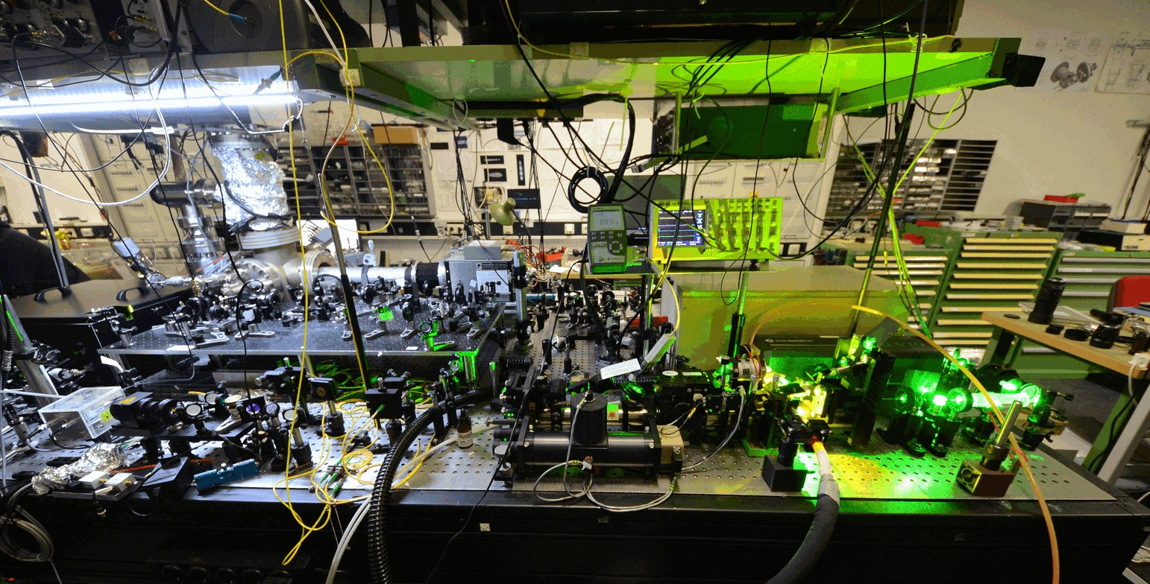
ION trapped system: with laser cooling

Slide 32
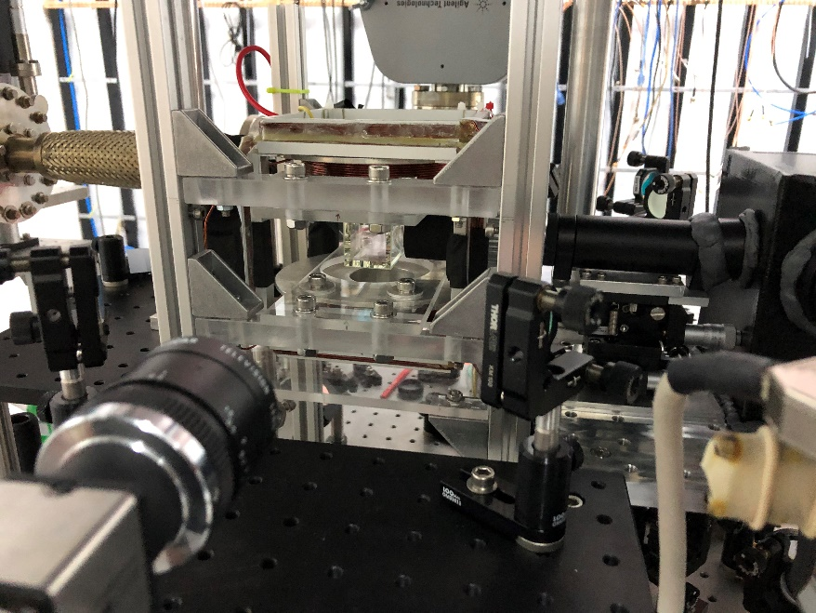
Cold Atom Trap experiment at Physics, Chiengmai University, 2020 (5 Rubidium atoms)

Slide 33
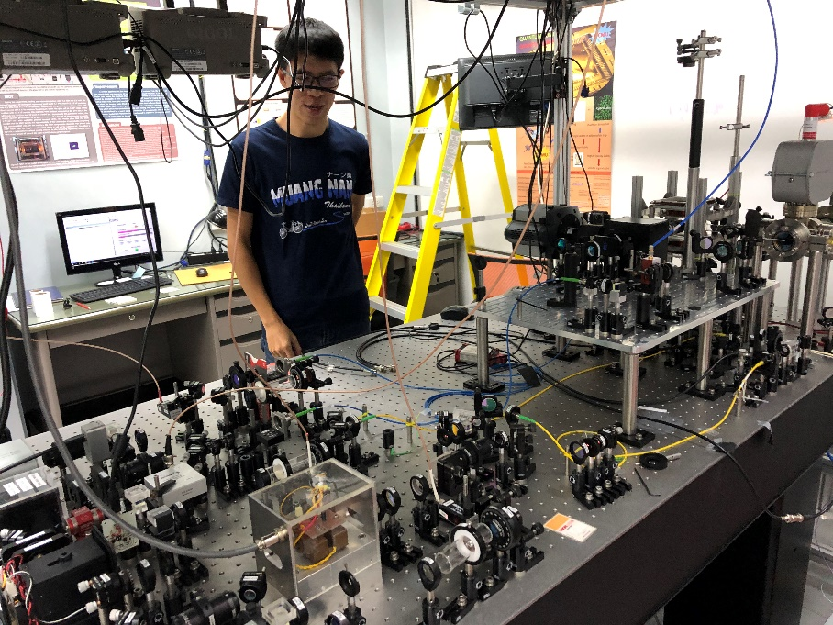
Experiment setup

Slide 34
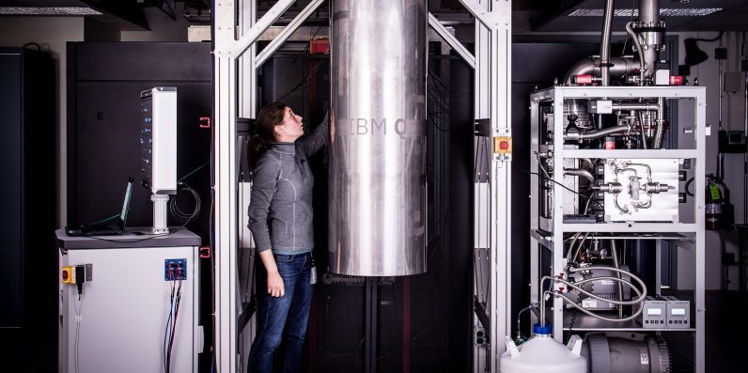
IBM 50 qubits quantum computer

Slide 35
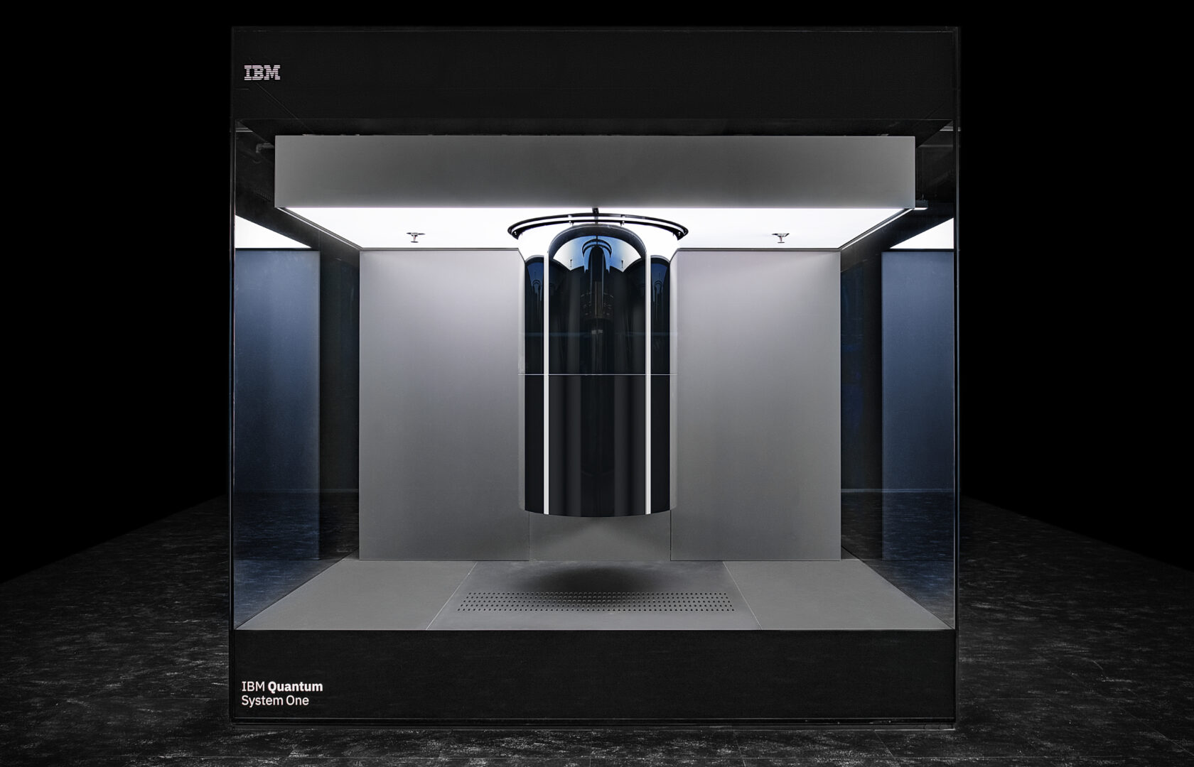

Slide 36
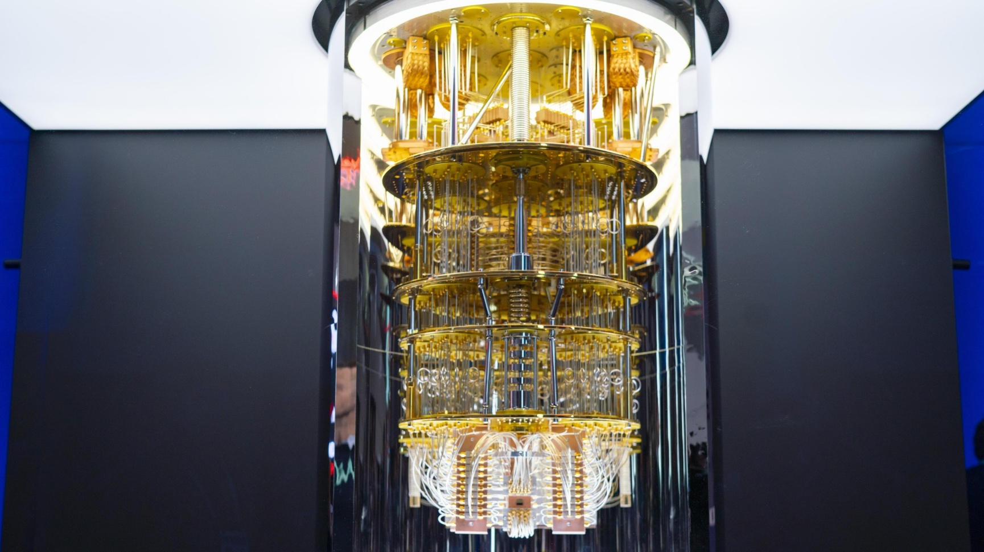

Slide 37
Recent developments
from scientific demonstrations to commercial utility and fault-tolerant scaling
Google:
Willow processor (105 qubits) successfully reduces errors exponentially as more qubits are added.
New algorithmic framework: Quantum Advantage

Slide 38
IBM:
Kookaburra Processor, By linking three chips together, they have achieved a 4,158-qubit system
Heron family processors can now perform 5,000 two-qubit gate operations
Microsoft:
The Magne System: January 2026, Microsoft (in collaboration with Atom Computing) unveiled Magne, a high-performance quantum computer using neutral-atom qubits.

Slide 39
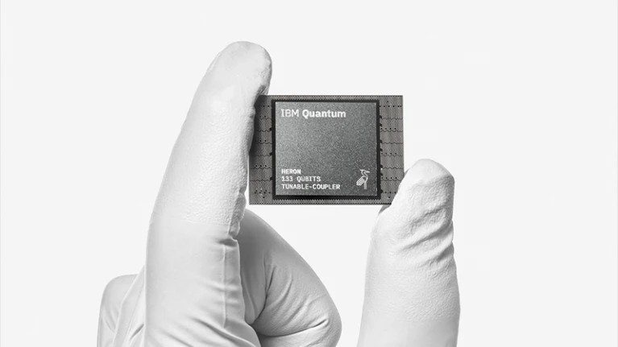
Willow chip is titled "Quantum error correction below the surface code threshold," published in the journal Nature on December 9, 2024.
The Willow processor is a 105-qubit superconducting system. It is the first quantum hardware to demonstrate that logical qubits can achieve lower error rates as the number of physical qubits they are built on

Slide 40
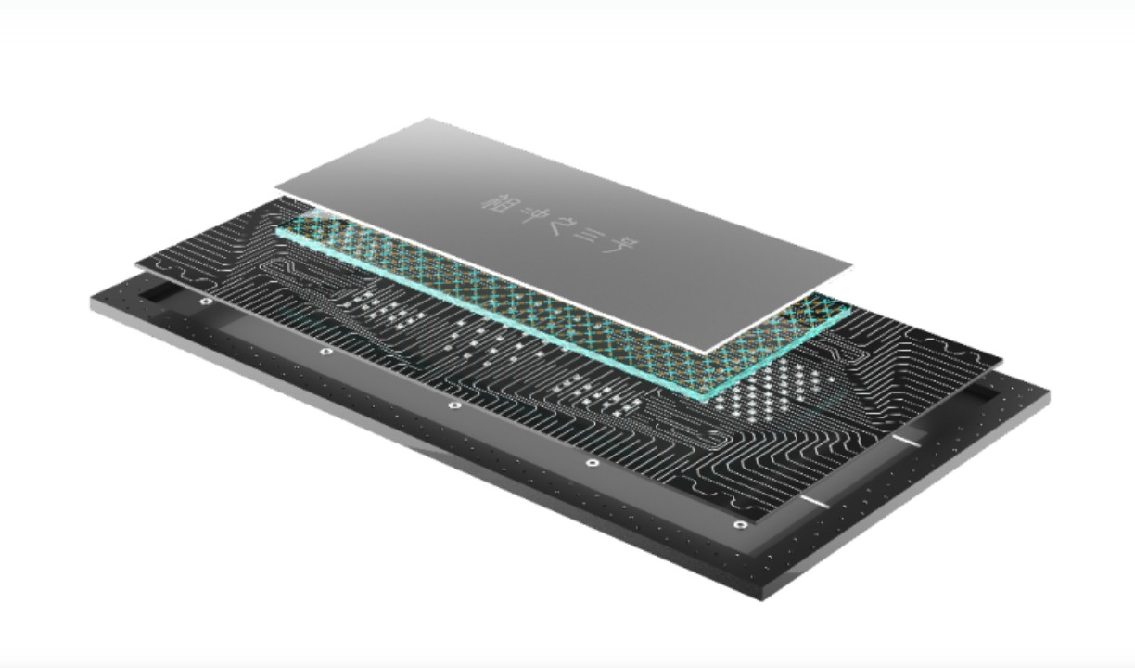
Zuchongzhi Series
Developed by the University of Science and Technology of China (USTC) 105-qubit processor

Slide 41
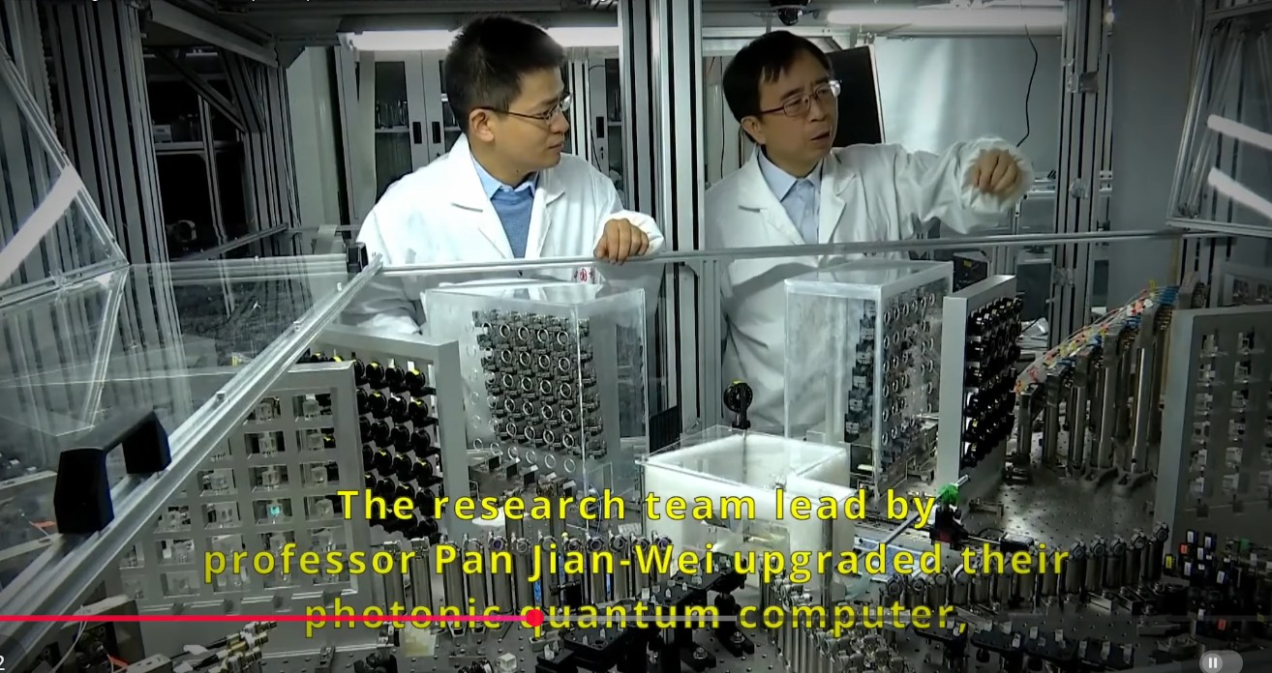

Slide 42
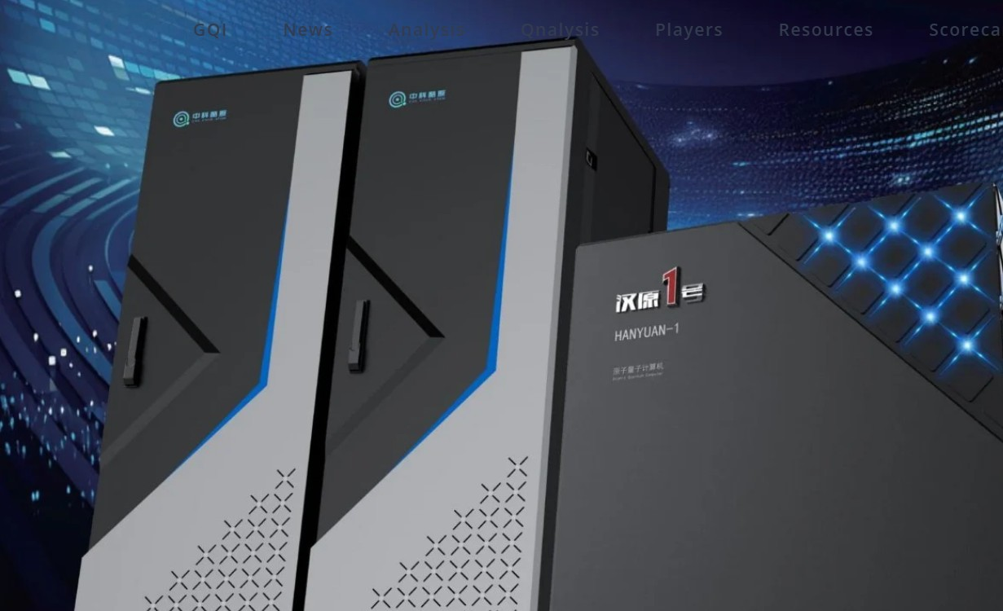
The Hanyuan-1 Quantum System
late 2025, China secured export order for a commercial-grade quantum computer, which was sold to Pakistan.
The Hanyuan-1 Quantum System, a neutral-atom (cold atom) quantum computing system, 100 qubits

Slide 43
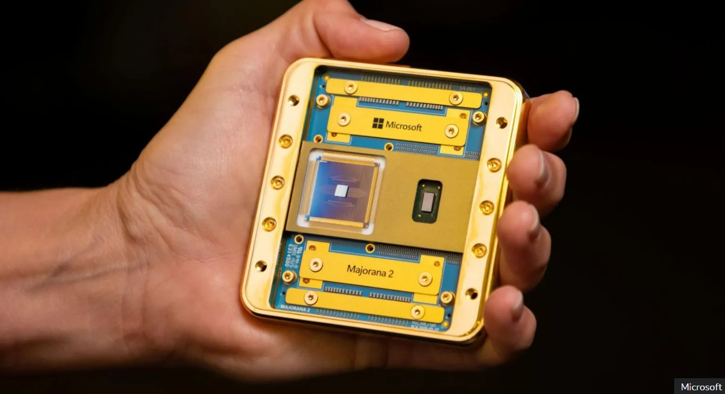
Microsoft Majorana 2 chip

Slide 44
Quantum Communications

Slide 45
Quantum communication transmits information using quantum states—usually encoded onto individual particles of light called photons.
Quantum Key Distribution QKD
data transmission fundamentally unhackable by using the laws of physics

Slide 46
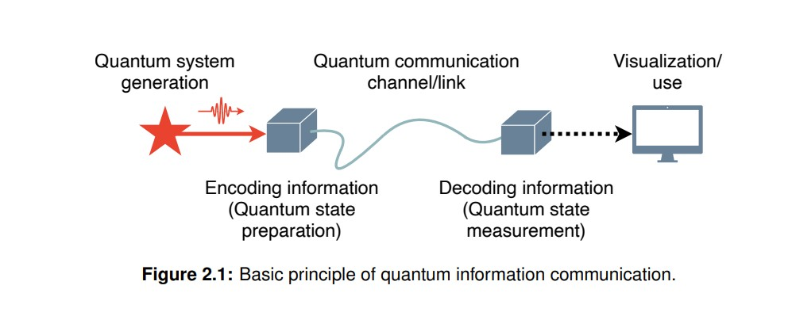

Slide 47
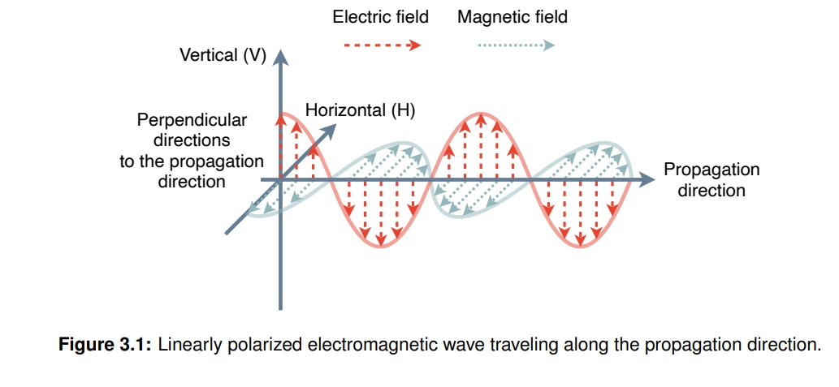

Slide 48
No-Cloning Theorem
The Quantum Trapping Effect: In quantum mechanics, the mere act of measuring or looking at a quantum system alters it.
If a hacker tries to intercept or eavesdrop on a quantum key transmission, their attempt instantly alters the photons.
This introduces errors into the data, immediately alerting the sender and receiver that the line is compromised, and rendering the stolen key useless.

Slide 49
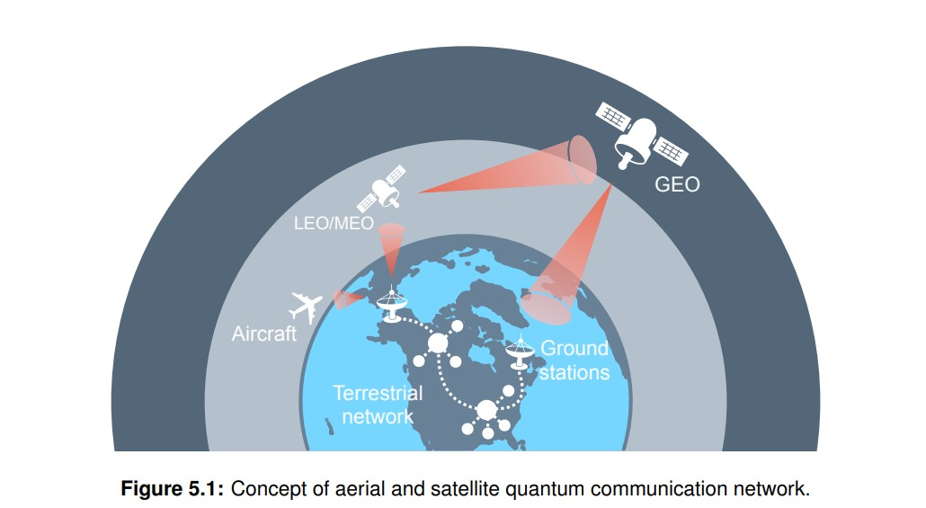

Slide 50
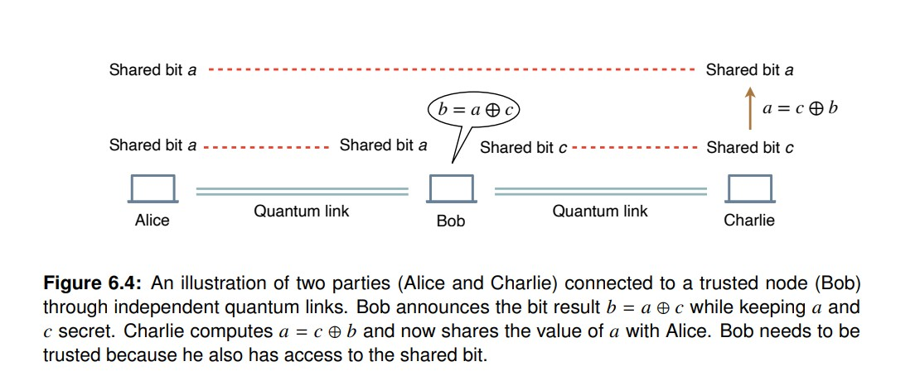
Quantum repeaters

Slide 51
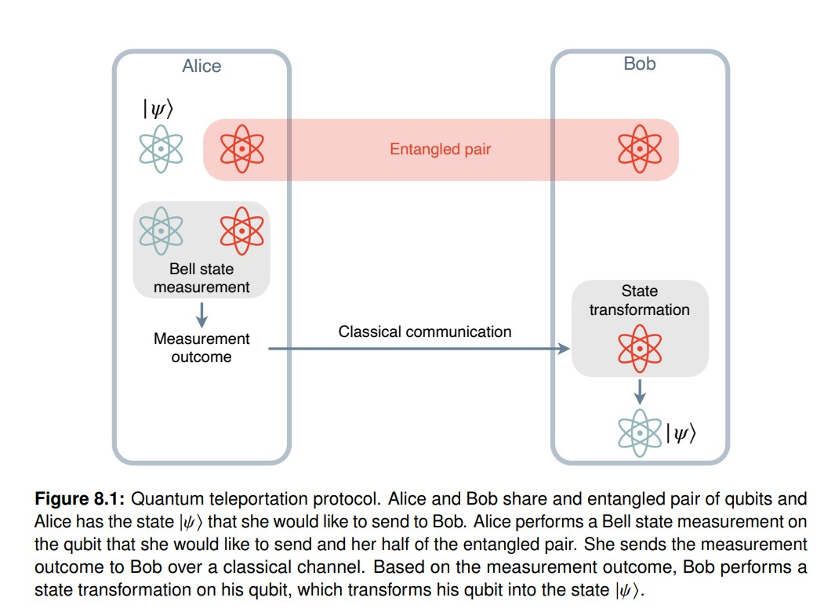

Slide 52
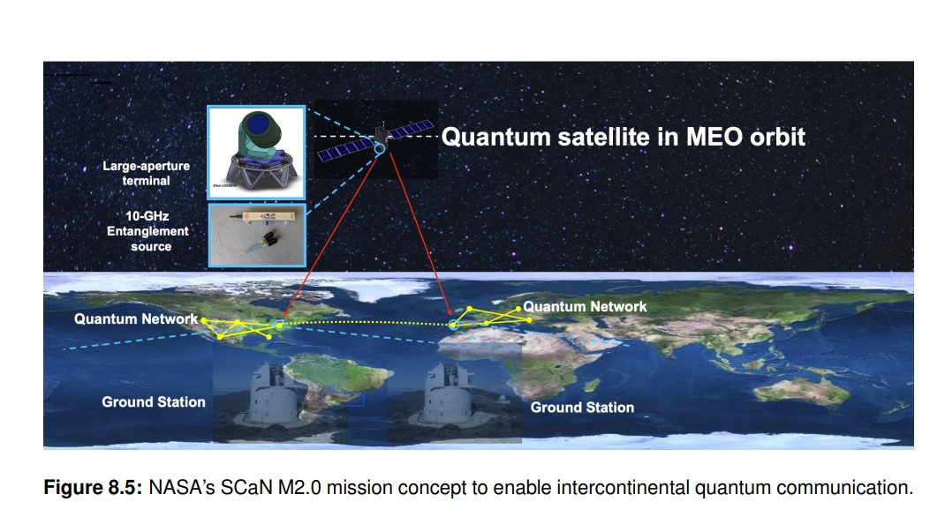

Slide 53
Limitation of QKD
QKD systems today are very limited both in the distance as well as their real-world security capability.
Sending and receiving of quantum states over large distances are very difficult.
QKD for now is limited to transmission over a few hundreds of kilometers at most.

Slide 54
Current development
Onboard the satellite are advanced optical components for generating pairs of photons entangled in polarization and sending these to ground stations.
The project has achieved long-distance entanglement distribution over 1200 km, prepare-and-measure QKD between satellite and ground station.
Generating keys used to secure a video-conference between China and Austria. (6-bit key)

Slide 55
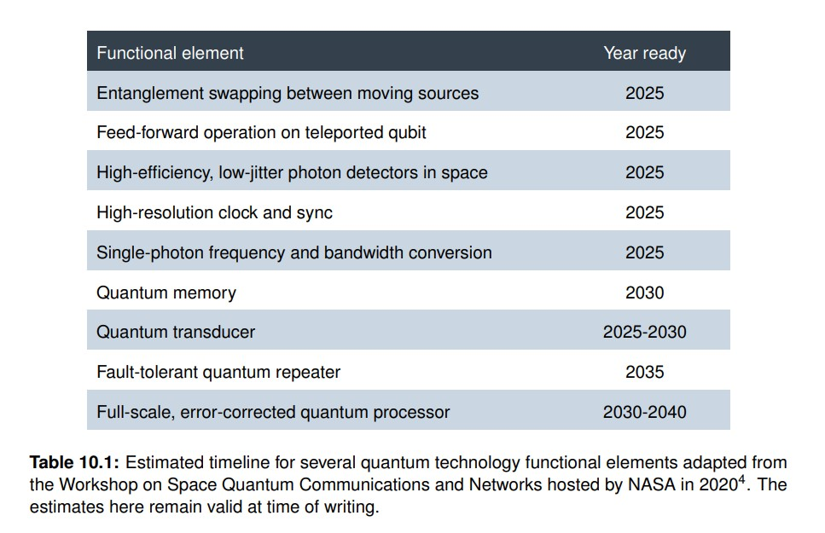
Timeline of quantum technologies

Slide 56
Reference
Quantum Communication101, Henry Semenenko, Sherilyn Wright, Michelle Lollie, Jefferson Flórez, Matty Hoban, Florian Curchod
https://www.nasa.gov/wp-content/uploads/2024/07/quantum-communication-101-final.pdf

Slide 57
Post Quantum Cryptography

Slide 58
Post-Quantum Cryptography (PQC) refers to a new generation of mathematical algorithms designed to be secure against both traditional computers and the future threat of a "Cryptographically Relevant Quantum Computer" (CRQC).

Slide 59
NIST Recommendation (FIPS Standards)
In 2024, the National Institute of Standards and Technology (NIST) finalized the world's first set of PQC standards.
Most current encryption (RSA and ECC) relies on factoring large numbers. Quantum computers are exceptionally good at that. The new NIST standards primarily use Lattice-based cryptography, which involves hiding data in complex multidimensional grids.

Slide 60
Federal Information Processing Standards
Standard | Name (Original Code Name) | Purpose | Best Used For
FIPS 203 | ML-KEM (CRYSTALS-Kyber) | Key Establishment | Securing web traffic
FIPS 204 | ML-DSA (CRYSTALS-Dilithium) | Digital Signatures | General-purpose identity verification and code signing.
FIPS 205 | SLH-DSA (SPHINCS+) | Digital Signatures | backup "hash-based" method if lattice math is ever broken.

Slide 61
"Harvest Now, Decrypt Later"
The Attack: Adversaries are currently capturing and storing massive amounts of encrypted sensitive data (government secrets, medical records, bank info).
The Goal: They are waiting for a quantum computer to be built in 5 or 10 years to decrypt that "old" data.
The Solution: By switching to PQC today, we ensure that the data being sent now remains unreadable even in a quantum future.

Slide 62
Timeline
Globally, governments have carved up the transition timeline into two major phases: 2030 (the "High-Risk & Legacy" cut-off) and 2035 (the "Full Implementation" deadline)
Heavily regulated sector and industries
Defense & National Security
Government & Public Sector
Banking & Financial Services
Critical Infrastructure & Telecom

Slide 63
The 2030 Mandates
Phase-Outs & High-Risk Targets
Deprecation of 112-bit Security (NIST) deprecated after December 31, 2030.
The EU High-Risk Target December 31, 2030, is the hard deadline for migrating high-risk use cases. After this date, EU critical infrastructure and high-impact industries must use quantum-safe algorithms by default.
U.S. Federal Hardware Cut-off by December 31, 2030. support the new CNSA 2.0 PQC
Elimination of Pre-Shared & Symmetric Exceptions such as certain symmetric and pre-shared keys—must be replaced by native, asymmetric PQC algorithms (like ML-KEM) by the end of 2030

Slide 64
The 2035 Mandates
Total Disallowance
Total Disallowance of Classical Algorithms: NIST and the NSA will completely disallow standard public-key algorithms (even those with higher 128-bit classical security strengths like RSA-3078 or ECDSA P-256) across federal and national systems.
100% NSA CNSA 2.0 Compliance: Under the NSM-10 framework, all National Security Systems (NSS) must be fully migrated to purely post-quantum algorithms by 2035.
Global Alignment (UK, Canada, EU): Both the UK's National Cyber Security Centre (NCSC) and Canada's CSE PQC Roadmaps align on 2035 as the definitive target for full adoption across all remaining non-classified public sectors, enterprise systems, and commercial products.

Slide 65
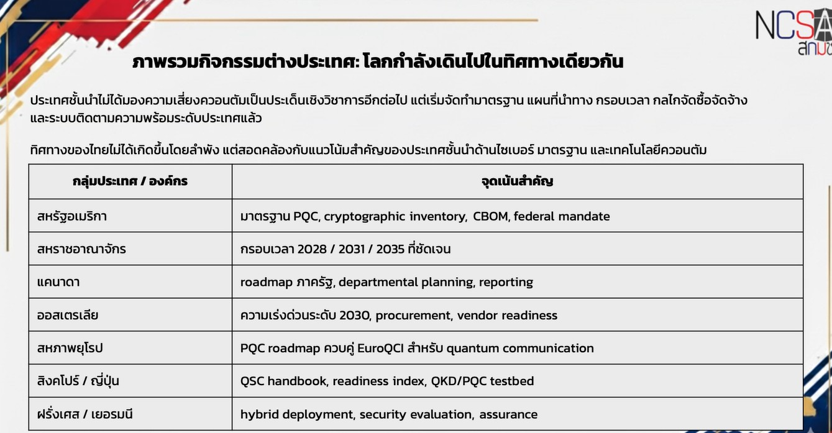

Slide 66
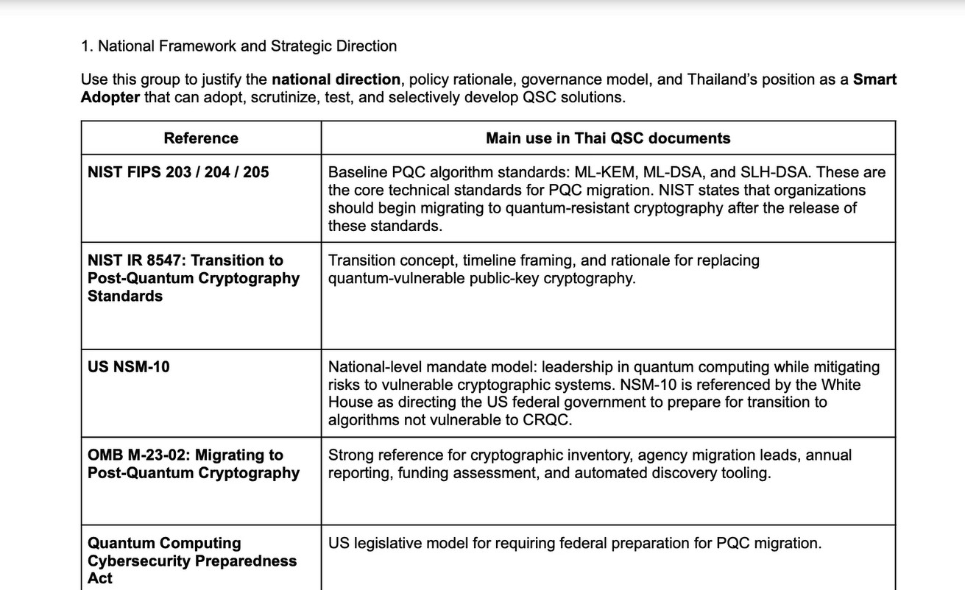
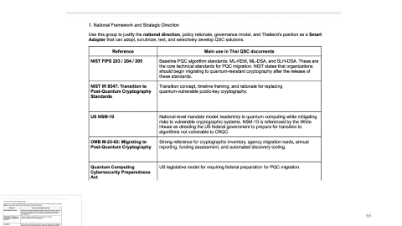


Slide 67
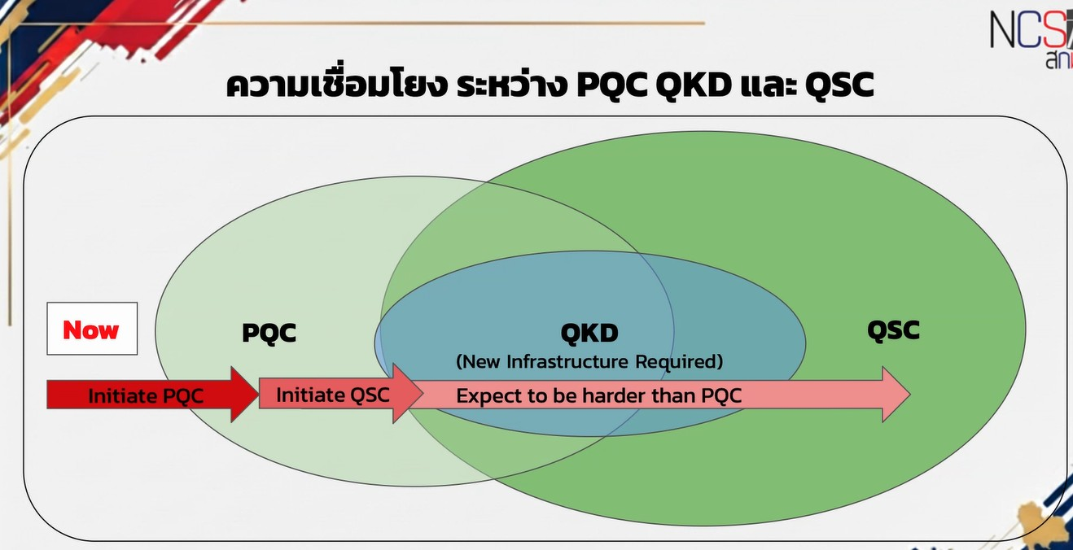

Slide 68
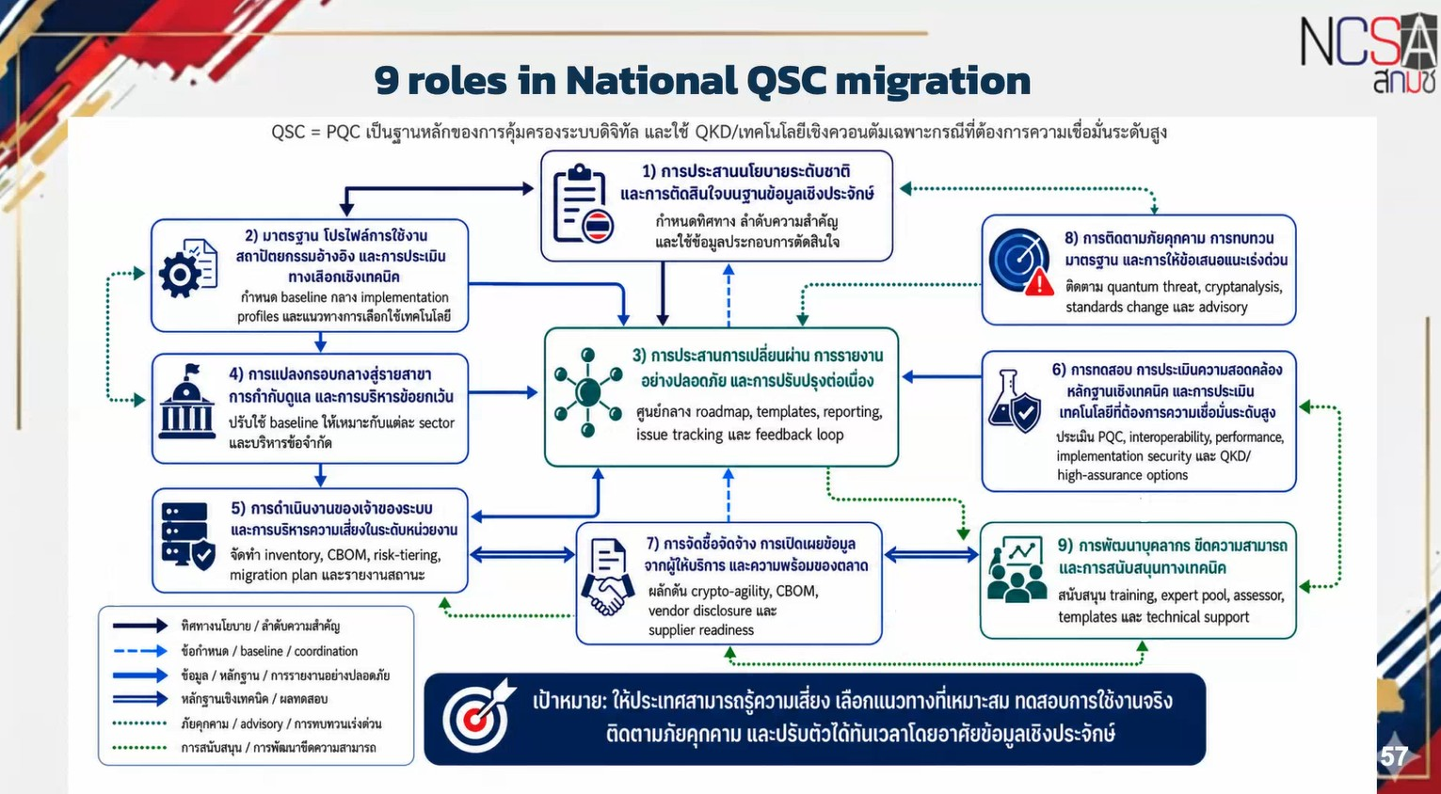

Slide 69
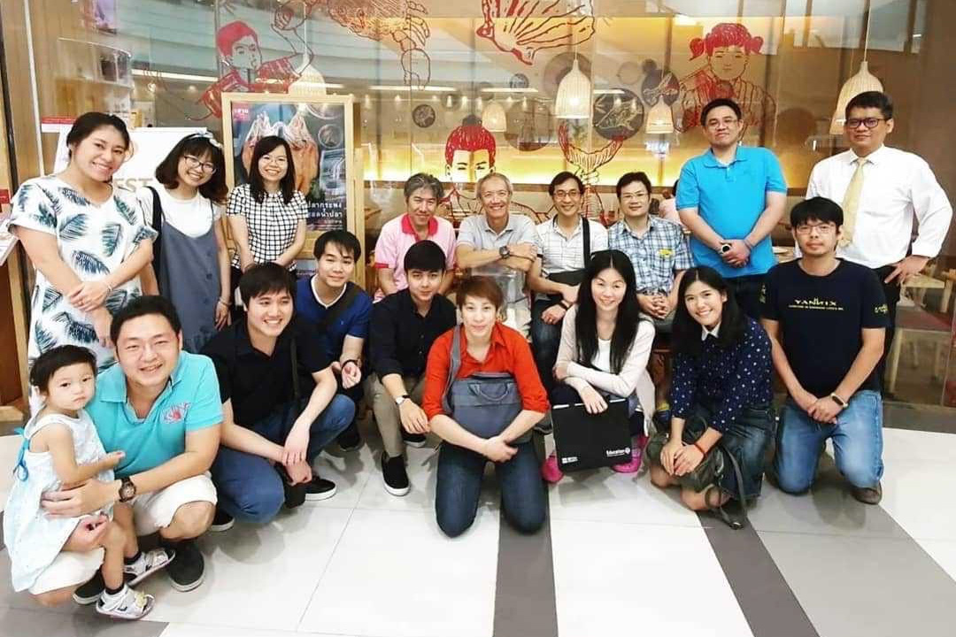
Contributors (student team 2019)

Slide 70
More Information
Search “Prabhas Chongstitvatana”
Get to me homepage

