Slide 1
Quantum Computing: Theory and Practices
Prabhas Chongstitvatana
Kamonluk Suksen
Chulalongkorn University

Slide 2

More Information
Search “Prabhas Chongstitvatana”
Get to me homepage

Slide 3
What is a quantum computer?
a computer that relies on special memory, "quantum bit", to perform massively parallel computing.

Slide 4
What is a quantum bit?
a basic unit of memory that uses “quantum state” to store information.
a "qubit" stores the probability of many states of information.

Slide 5
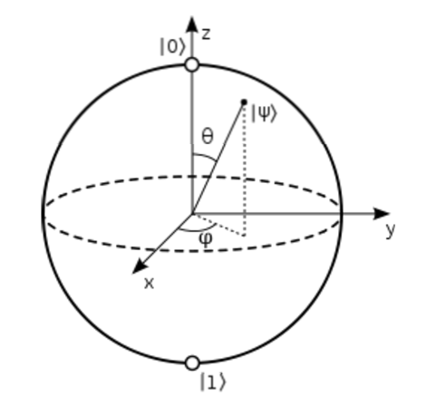

Slide 6
What is the advantage?
it is very very fast compared to conventional computers.

Slide 7
google quantum lab's paper Dec 2015
claim of 100,000,000x speed up

Slide 8
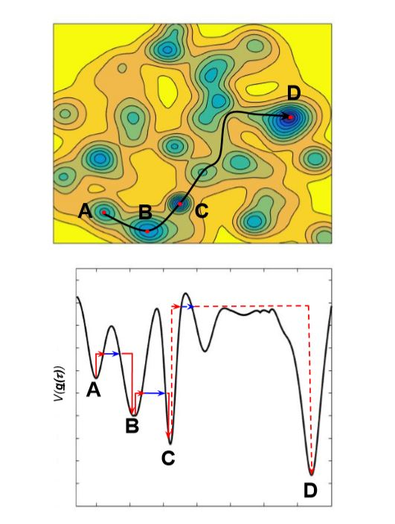

Slide 9
Quantum algorithms
computer programs that work on quantum computers

Slide 10
Famous algorithms
Shor's integer factorization
Given an integer N, find its prime factors

Slide 11
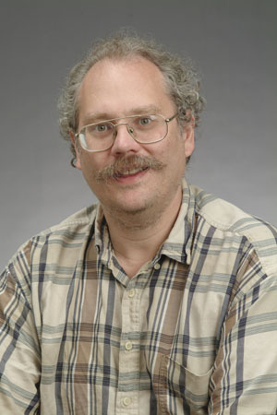
Quantum Algorithms
Peter Shor
a quantum algorithm for integer factorization formulated

Slide 12
Combinatorial optimisation
The domains of feasible solutions are discrete.
Examples
Traveling salesman problem
Minimum spanning tree problem
Set-covering problem
Knapsack problem

Slide 13
My own example of quantum computation
compact genetic algorithm by quantum computers 2012, 2021
exponential speedup

Slide 14
Normal
1) initialze qureg x
2) generate two individuals from qureg
3) let them compete
4) update qureg x with the winner
5) repeat step 2..4 for k times
6) generate the final result

Slide 15
quantum speedup
1) initialze qureg x
2) generate the first individual from qureg x
3) generate the second individual with condition that fitness is greater than the first
4) let them compete
5) update qureg x with the winner
6) repeat step 2..5 for k times
7) generate the final result

Slide 16
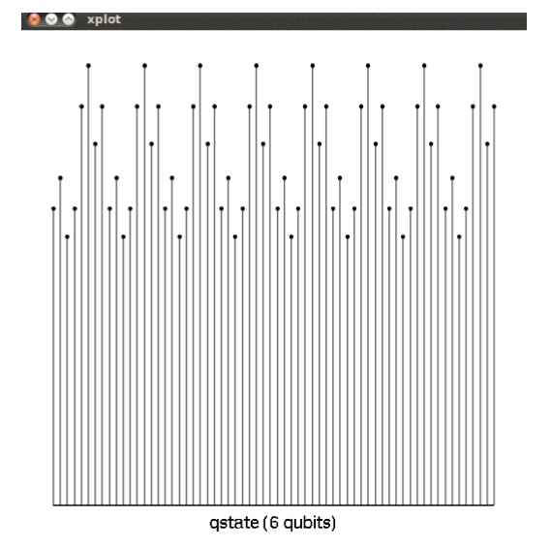
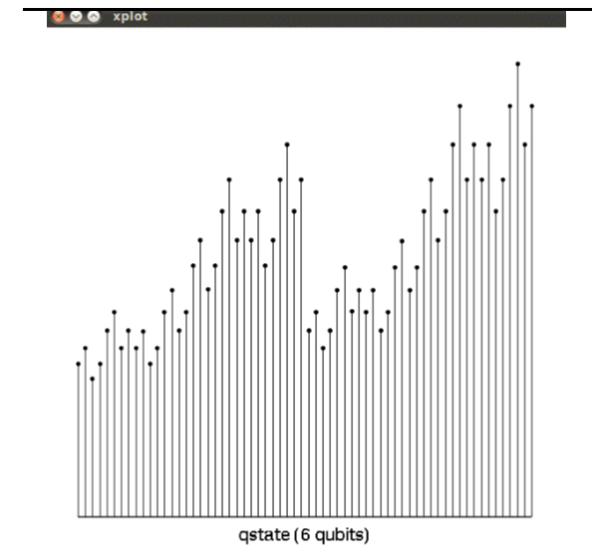
output

Slide 17
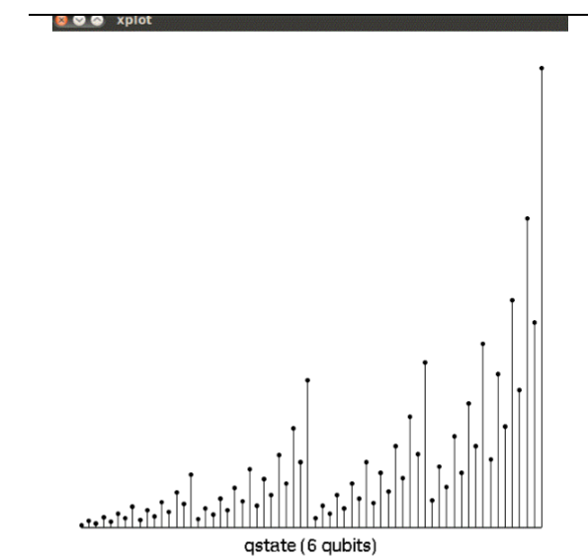
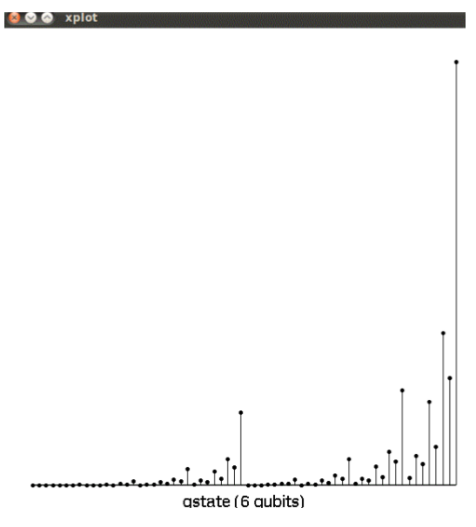
output

Slide 18
Technology to build qubits
Super conducting qubit
Trapped Ion qubit
Photonic qubit
Semiconductor quantum dots

Slide 19
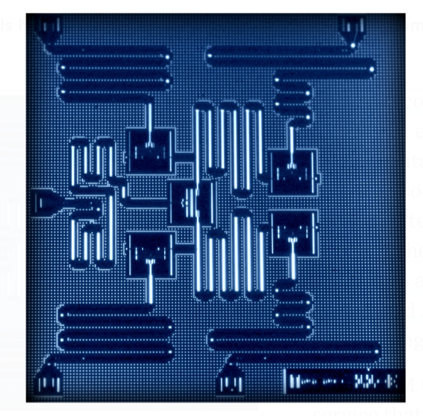
IBM 5 qubits processor

Slide 20
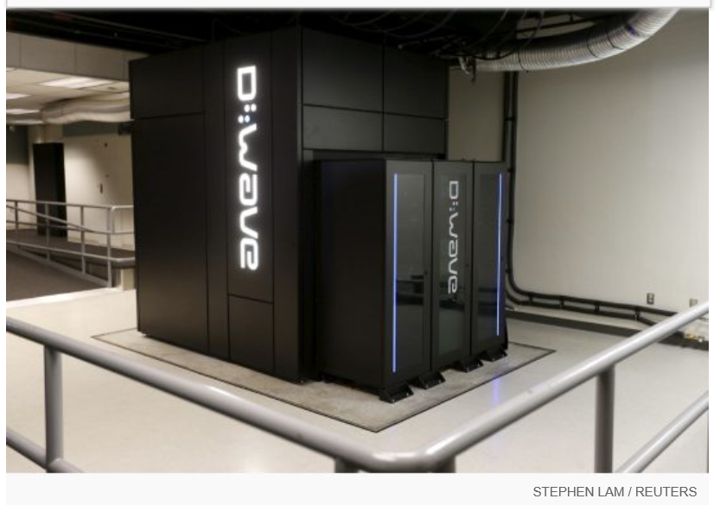
Google Nasa, D-Wave 2x machine

Slide 21
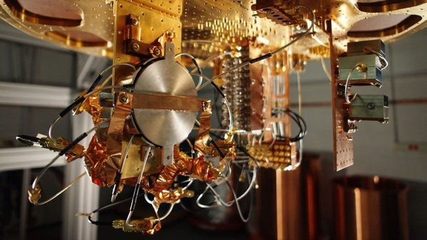
Quantum bit in D-wave machine

Slide 22
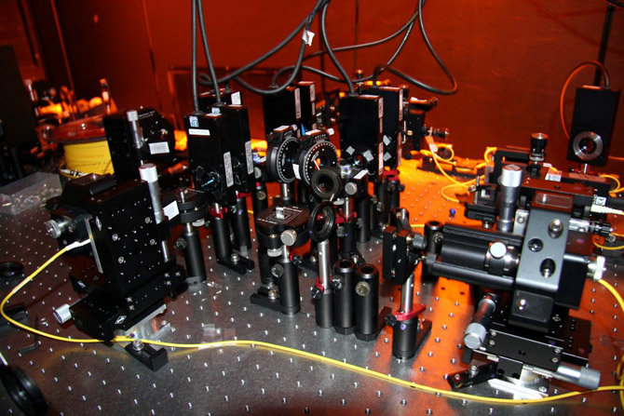

Slide 23
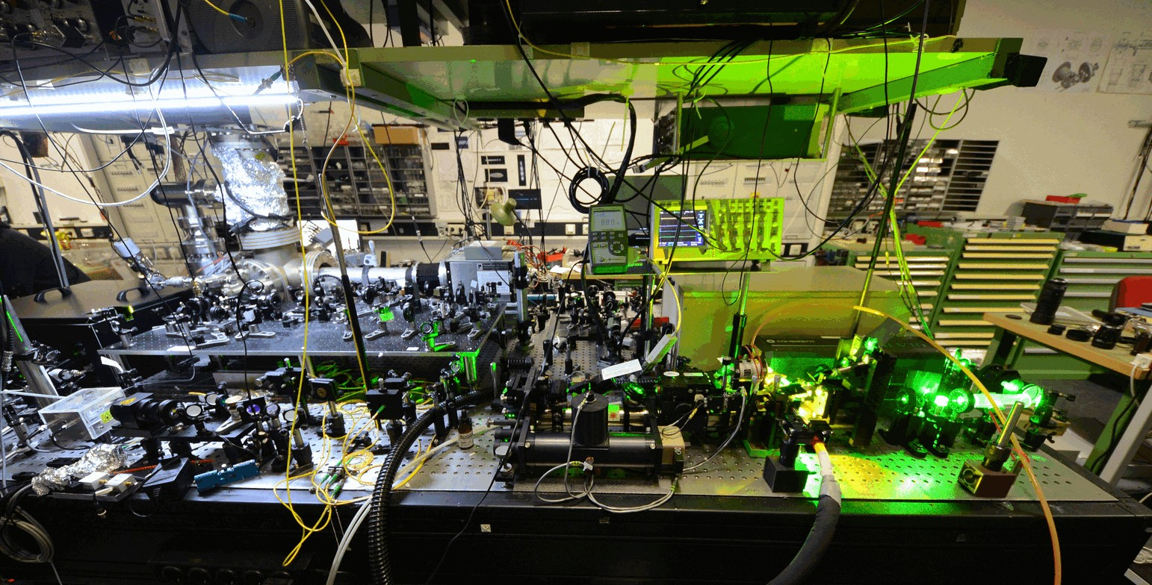
ION trapped system: with laser cooling

Slide 24
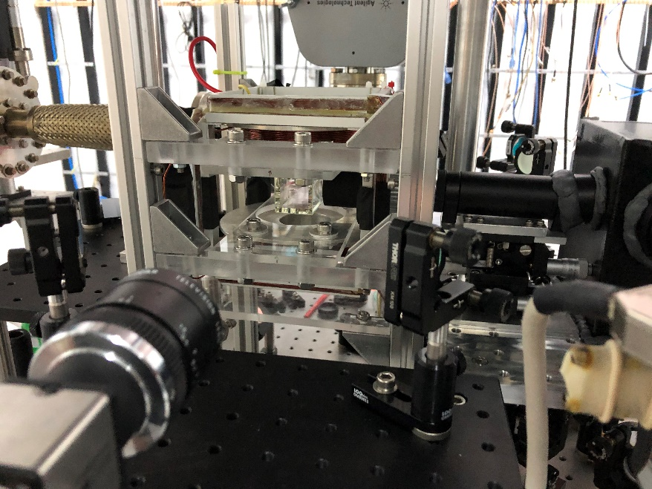
Cold Atom Trap experiment at Physics, Chiengmai University, 2020 (5 Rubidium atoms)

Slide 25
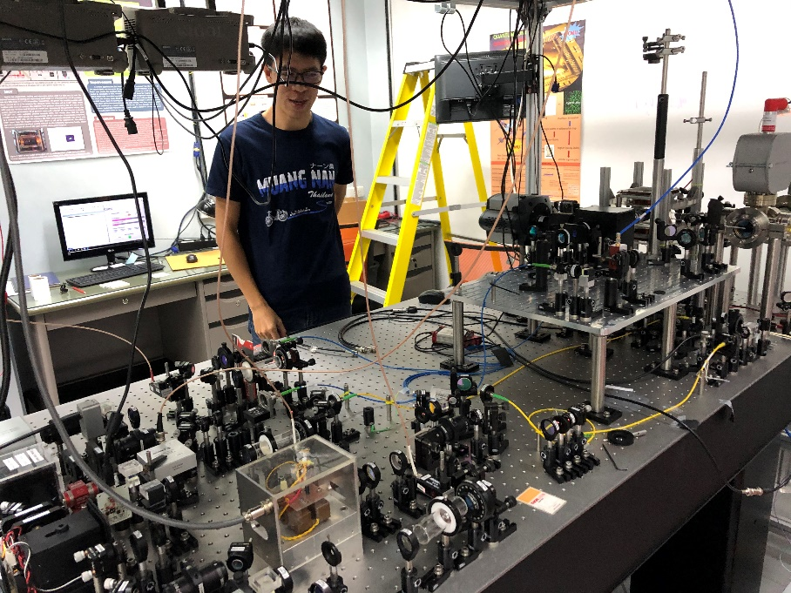
Experiment setup

Slide 26
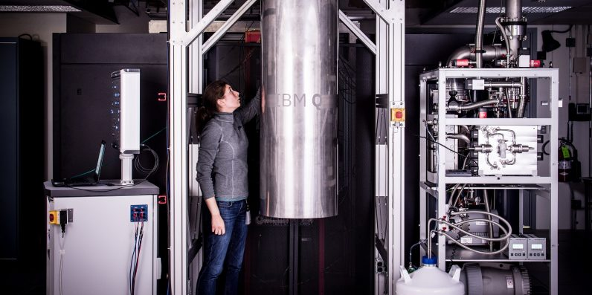
IBM 50 qubits quantum computer

Slide 27
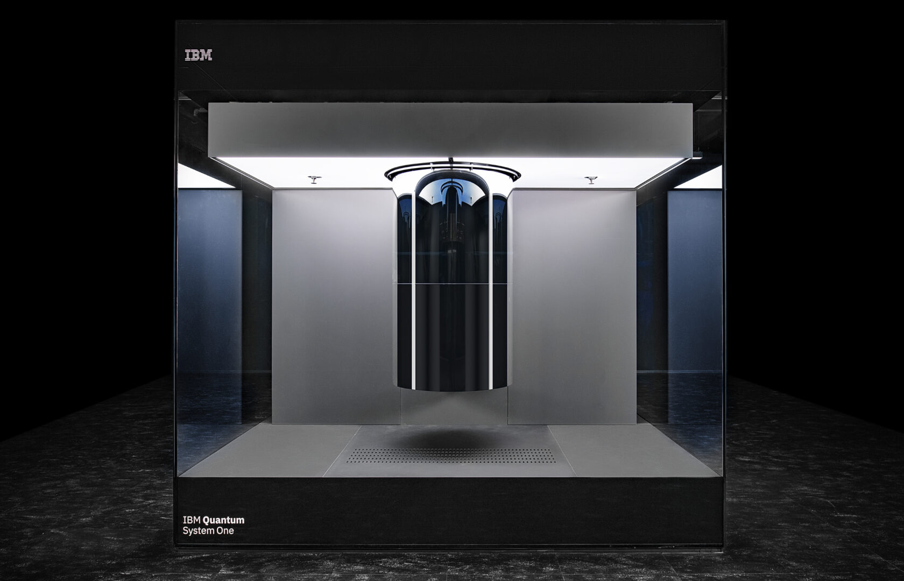

Slide 28
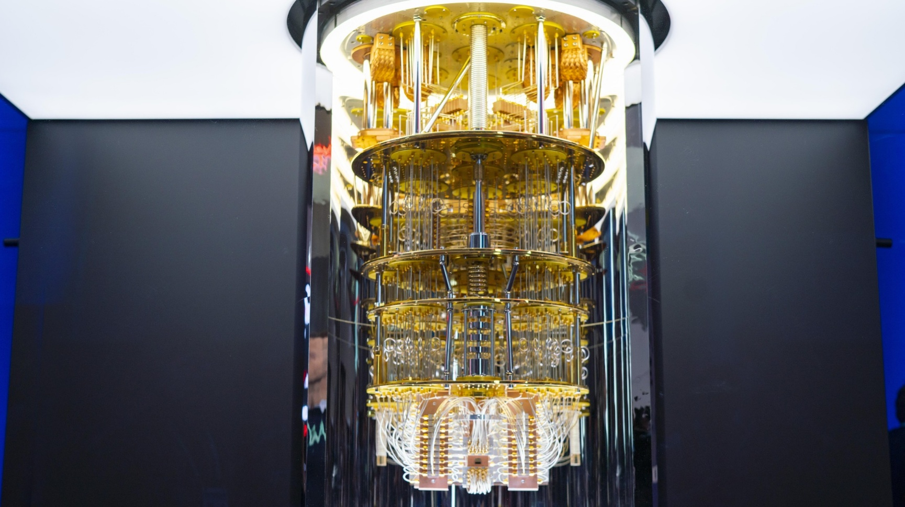

Slide 29
Recent developments
from scientific demonstrations to commercial utility and fault-tolerant scaling
Google:
Willow processor (105 qubits) successfully reduces errors exponentially as more qubits are added.
New algorithmic framework: Quantum Advantage

Slide 30
IBM:
Kookaburra Processor, By linking three chips together, they have achieved a 4,158-qubit system
Heron family processors can now perform 5,000 two-qubit gate operations
Microsoft:
The Magne System: January 2026, Microsoft (in collaboration with Atom Computing) unveiled Magne, a high-performance quantum computer using neutral-atom qubits.

Slide 31
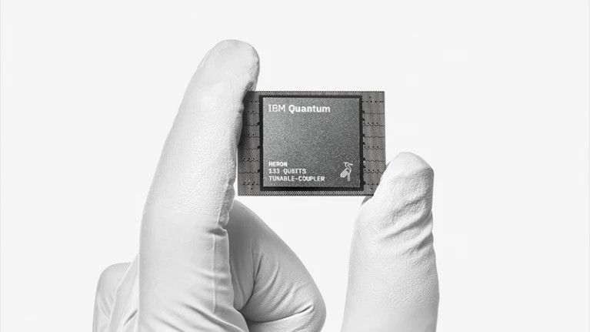
Willow chip is titled "Quantum error correction below the surface code threshold," published in the journal Nature on December 9, 2024.
The Willow processor is a 105-qubit superconducting system. It is the first quantum hardware to demonstrate that logical qubits can achieve lower error rates as the number of physical qubits they are built on

Slide 32
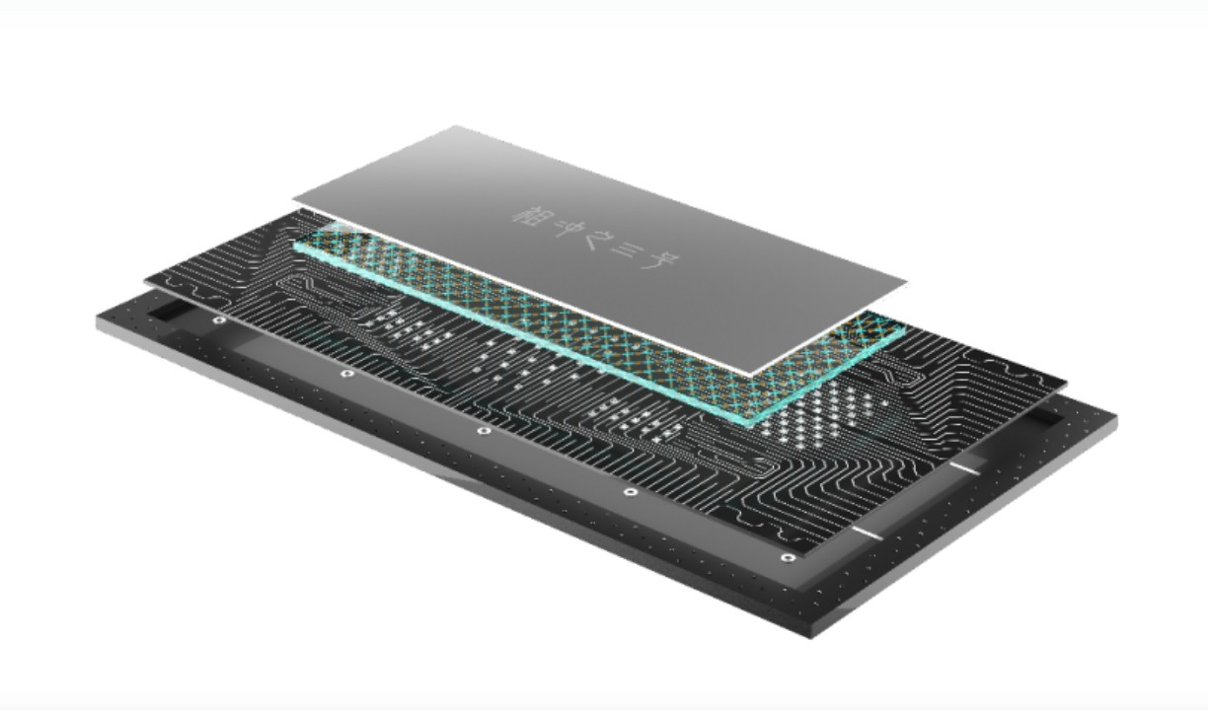
Zuchongzhi Series
Developed by the University of Science and Technology of China (USTC) 105-qubit processor

Slide 33
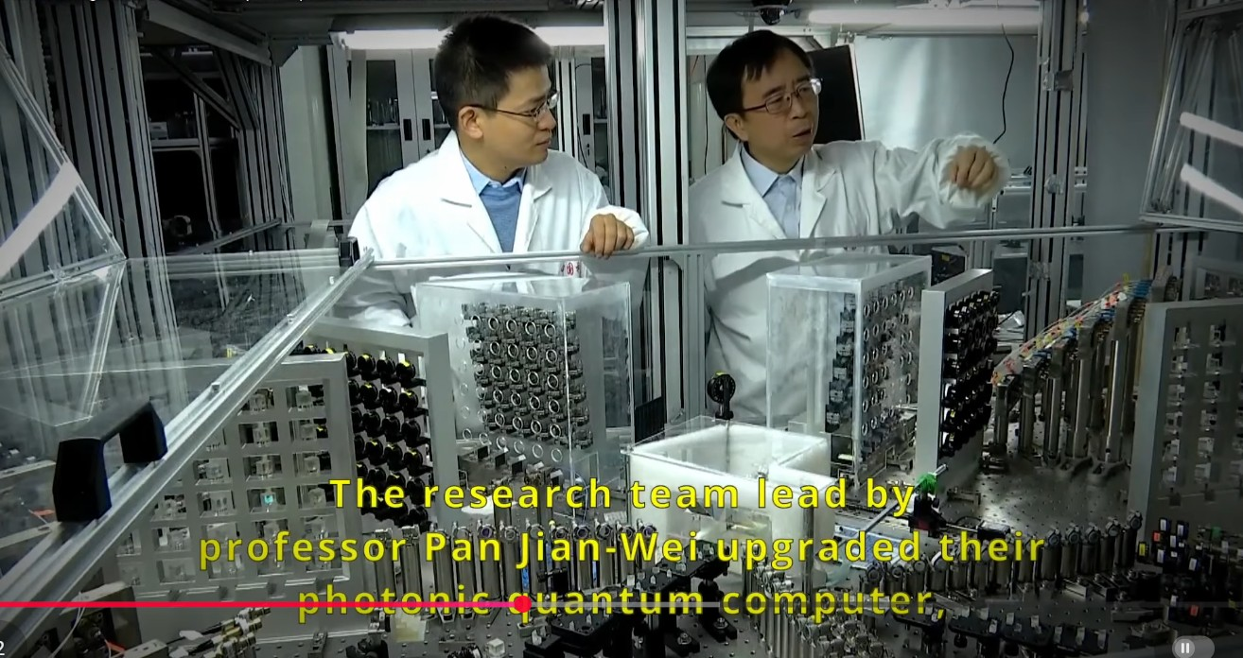

Slide 34
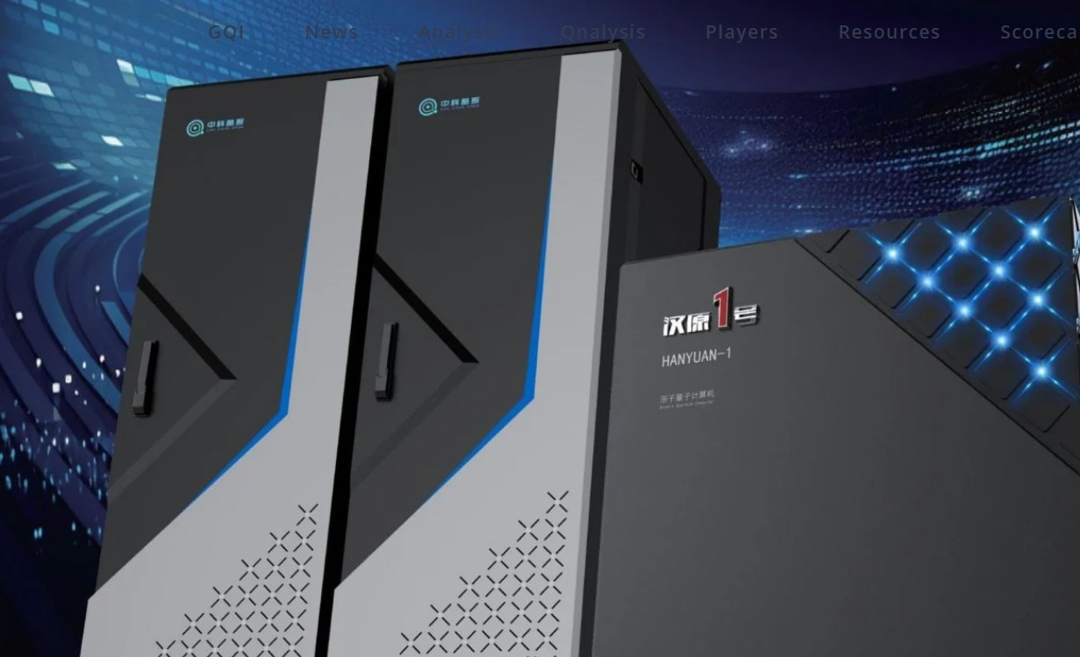
The Hanyuan-1 Quantum System
late 2025, China secured export order for a commercial-grade quantum computer, which was sold to Pakistan.
The Hanyuan-1 Quantum System, a neutral-atom (cold atom) quantum computing system, 100 qubits

Slide 35
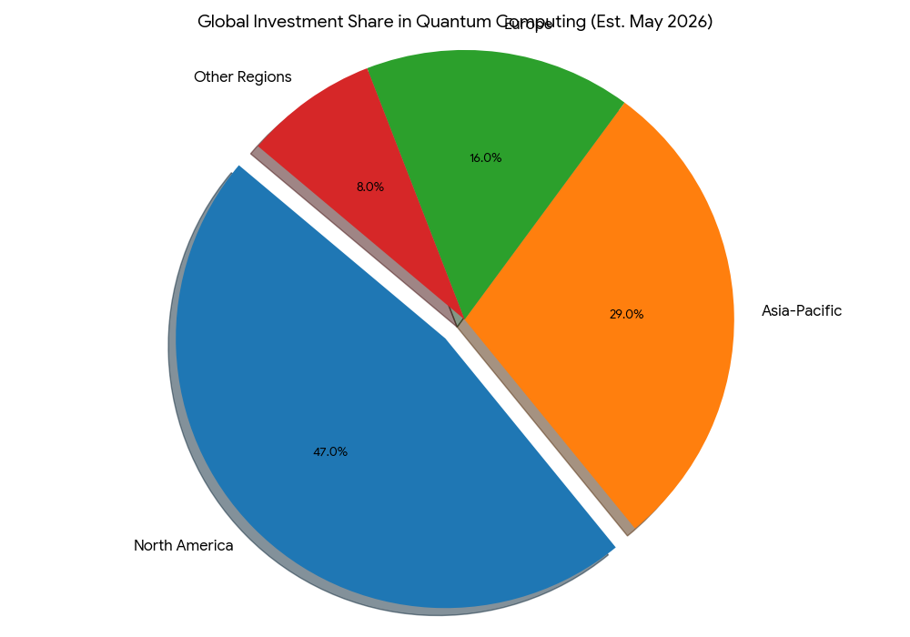
Global landscape: Global investment
Cumulative global investment from 2012 through early 2026 has exceeded $60 billion
https://www.futuremarketsinc.com/quantum-2-market-report-2026-2036/

Slide 36
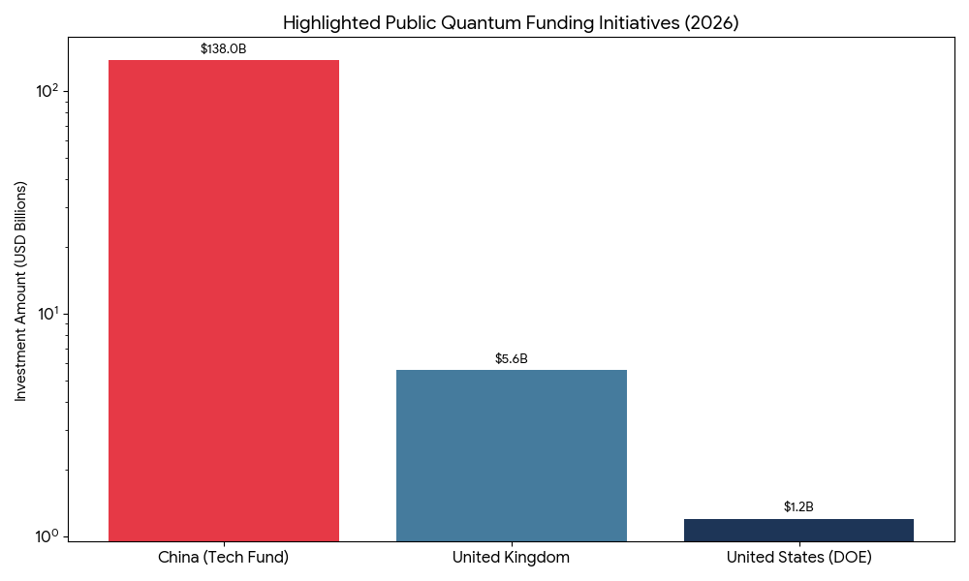
Public funding initiatives
Qubit Capital. (2026, January 24). Government & International Quantum Grants: Funding for R&D 2026. Qubit Capital Blog. https://qubit.capital/blog/government-defense-grants-quantum-rd

Slide 37
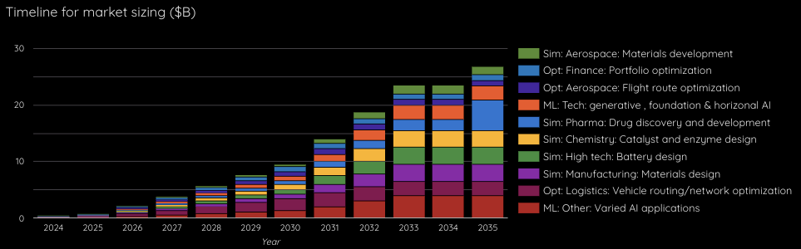
Global View
Quantum computing addressable market 2024-2035
Source: Quantum computing report 2024

Slide 38
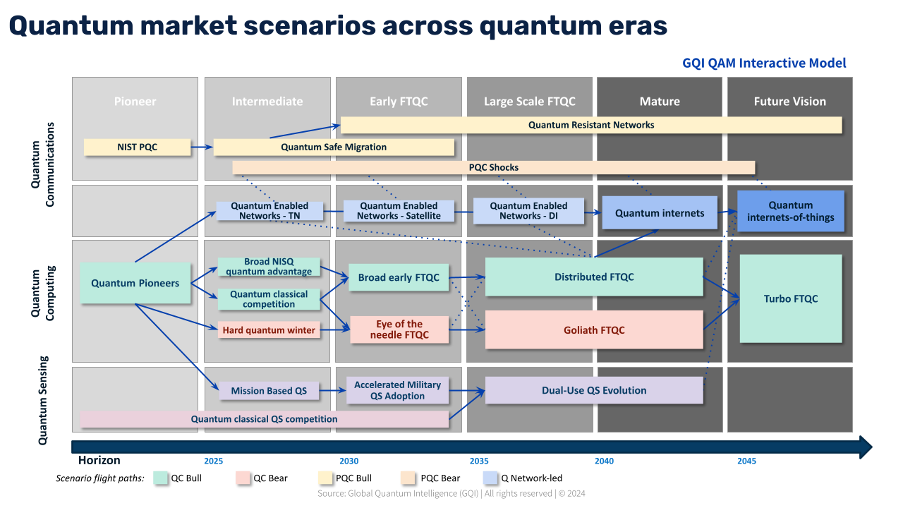

Slide 39
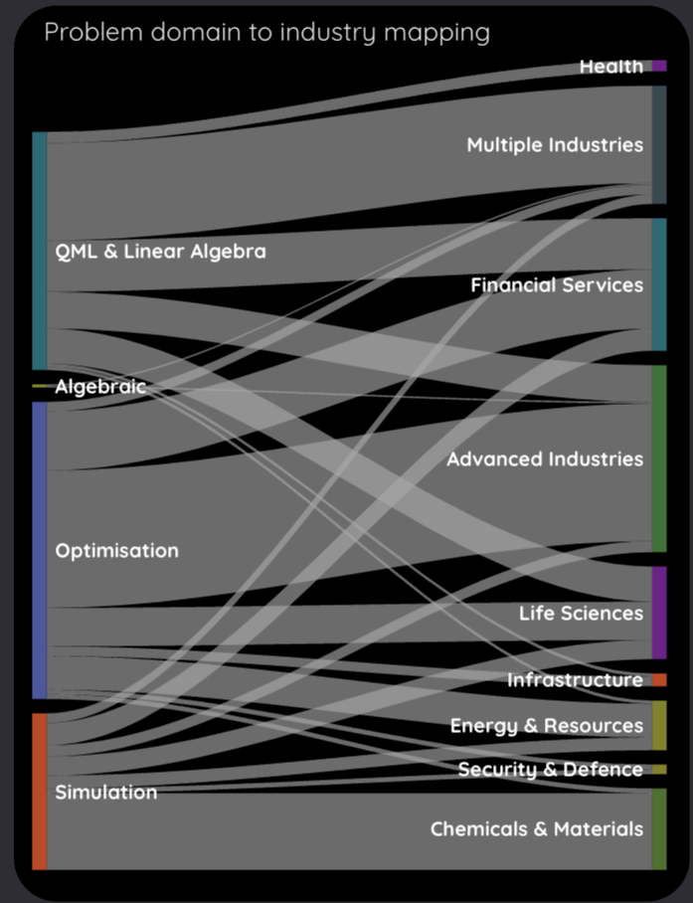

Slide 40
US Quantum Policy
Quantum Information Science (QIS) encompass:
Quantum sensing and metrology
Quantum computing
Quantum networking
QIS for advancing fundamental science
Quantum technology

Slide 41
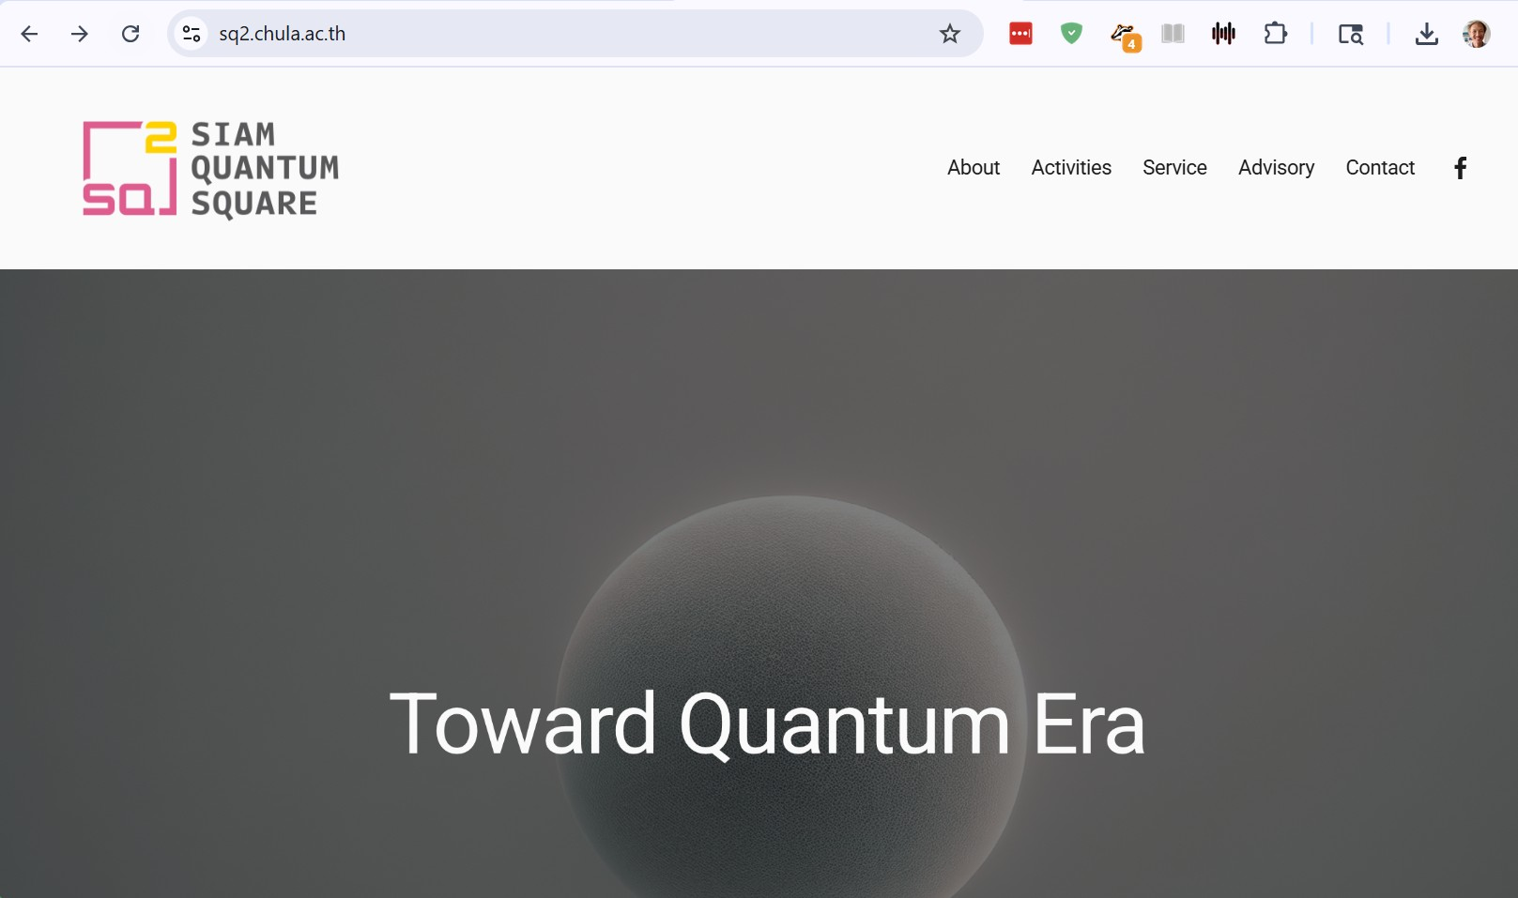
sq2.chula.ac.th

Slide 42
Future
Better qubits (live long, less error)
quantum annealing computers
scaling up

Slide 43
References
S. Yingchareonthawornchai, C. Aporntewan, and P. Chongstitvatana, "An Implementation of Compact Genetic Algorithm on a Quantum Computer," Int. Joint Conf. on Computer Science and Software Engineering (JCSSE), 30 May - 1 June 2012, pp.131-135.
http://www.cp.eng.chula.ac.th/~piak/paper/2012/jcsse-quantum-cga.pdf
K. Suksen, N. Benchasattabuse and P. Chongstitvatana, "Experiments on Quantum Circuits for Compact Genetic Algorithm," 2021 25th International Computer Science and Engineering Conference (ICSEC), Chiang Rai, Thailand, 2021, pp. 185-190, doi: 10.1109/ICSEC53205.2021.9684643.

Slide 44
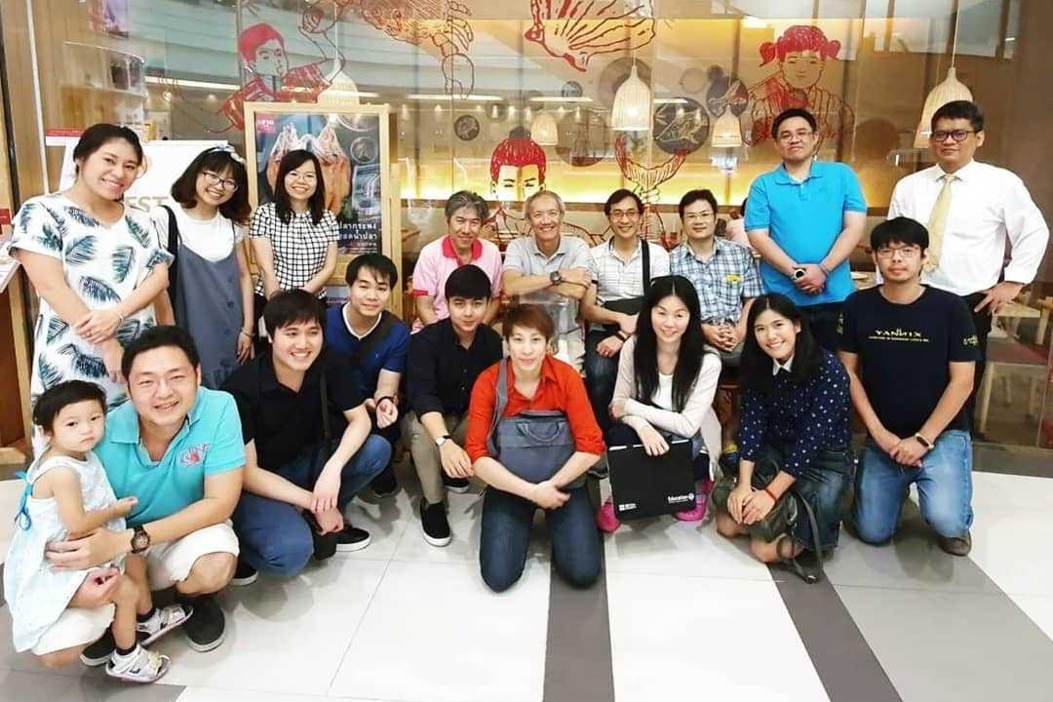
Contributors (student team 2019)

Slide 45
More Information
Search “Prabhas Chongstitvatana”
Get to me homepage

