Slide 1
Can Machines Think ?
Lecture series: Artificial Intelligence Perspective
Prabhas Chongstitvatana
Faculty of Engineering
Chulalongkorn University

Slide 2
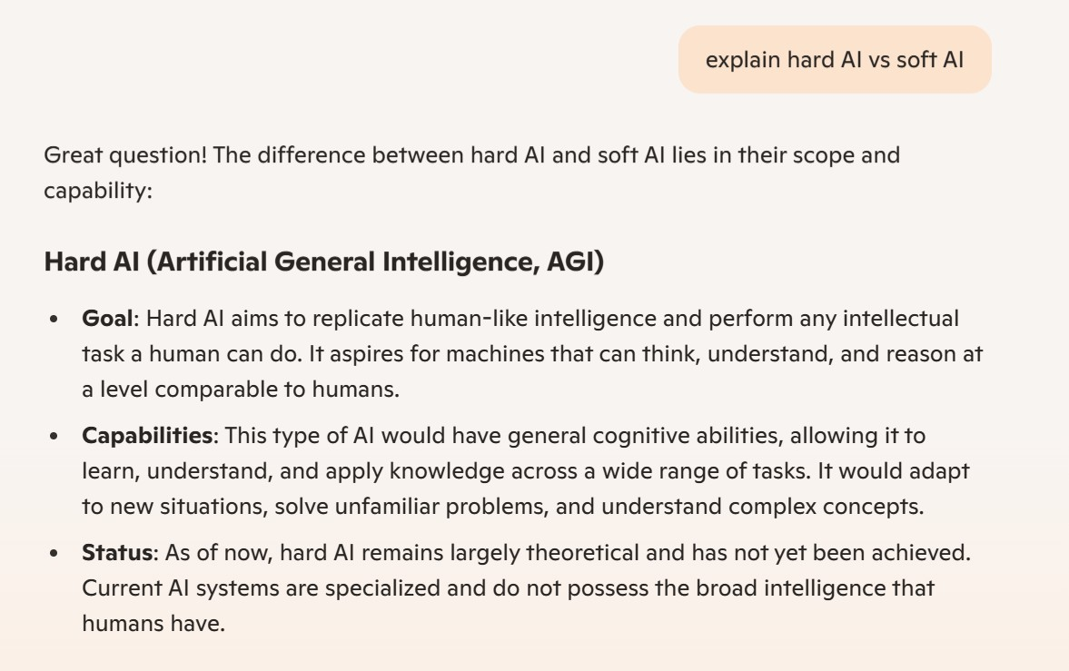
Hard AI vs Soft AI

Slide 3
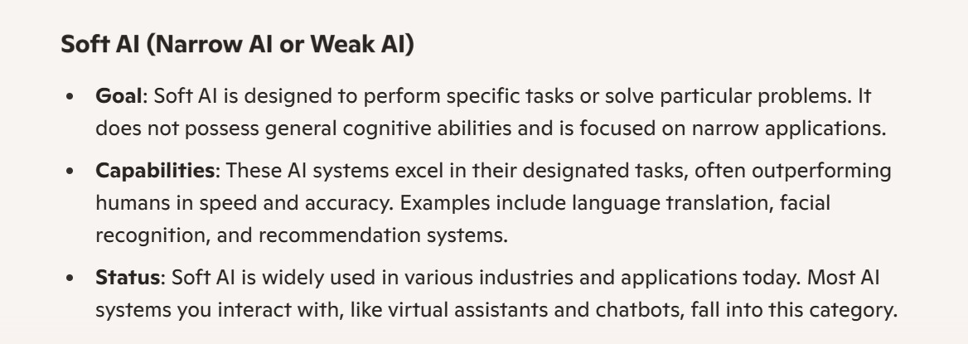
Soft AI

Slide 4
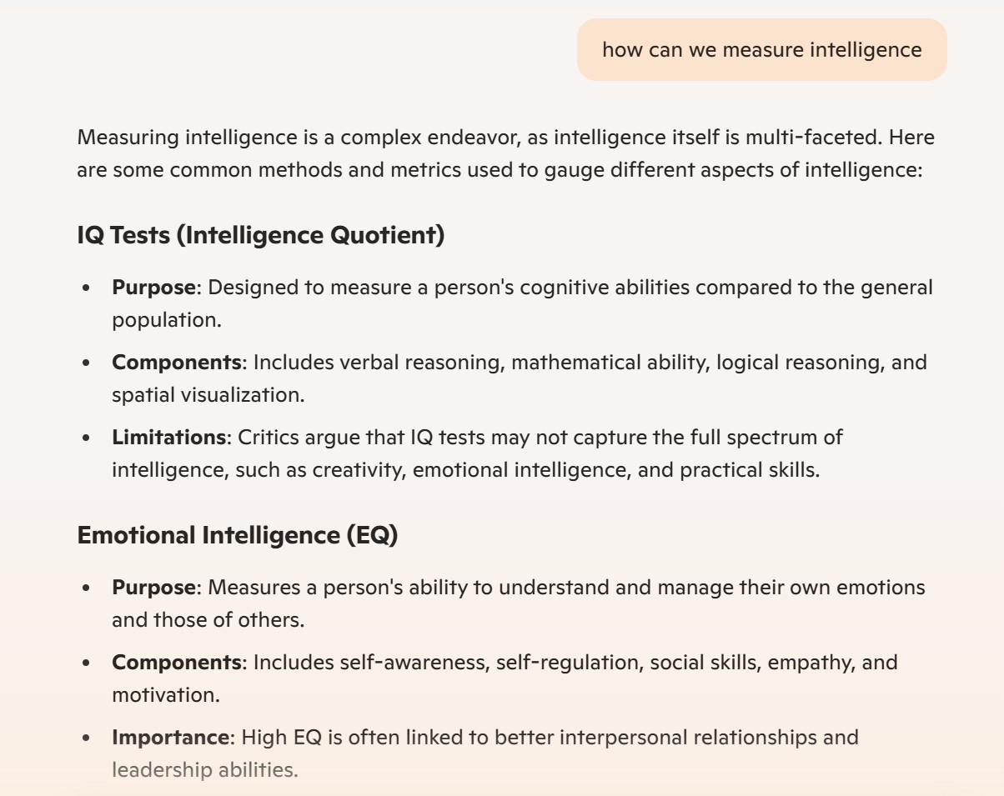
How to measure Intelligence

Slide 5
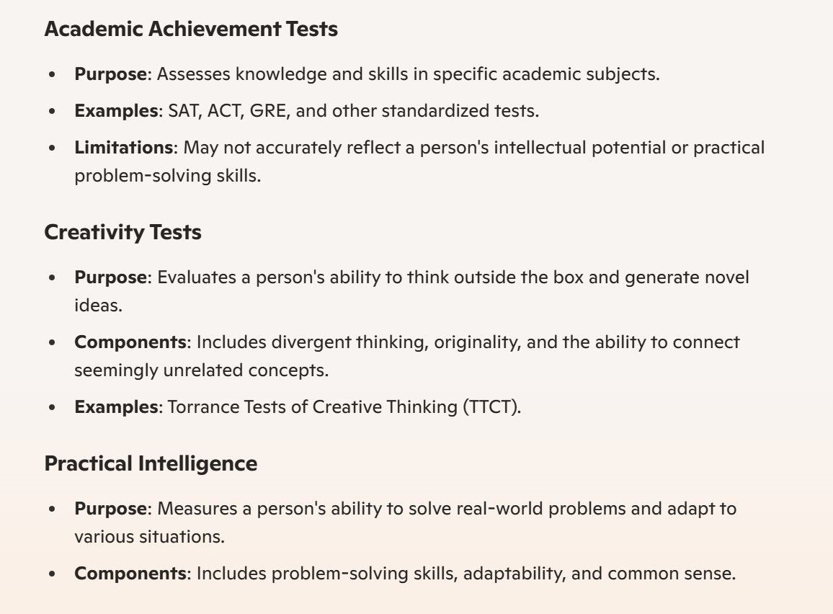

Slide 6
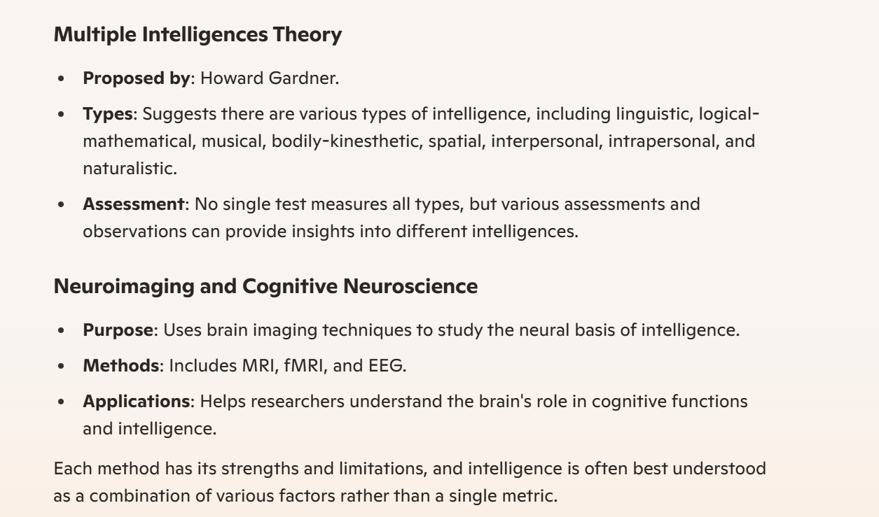

Slide 7
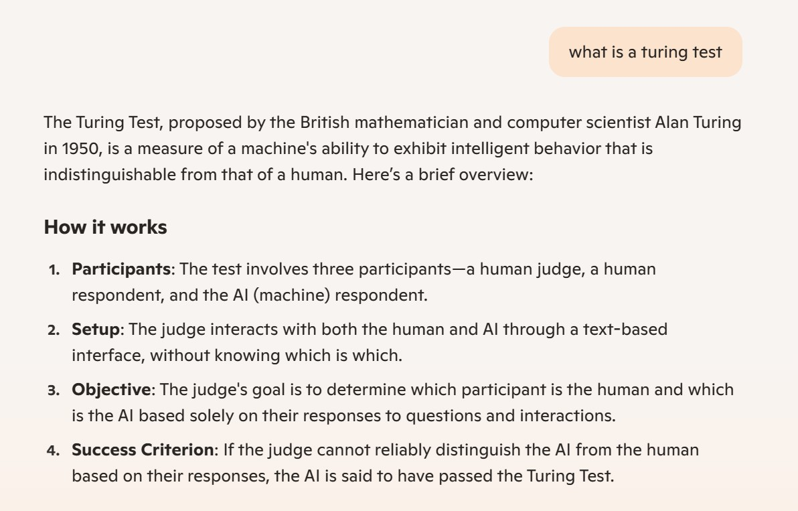
Turing Test

Slide 8
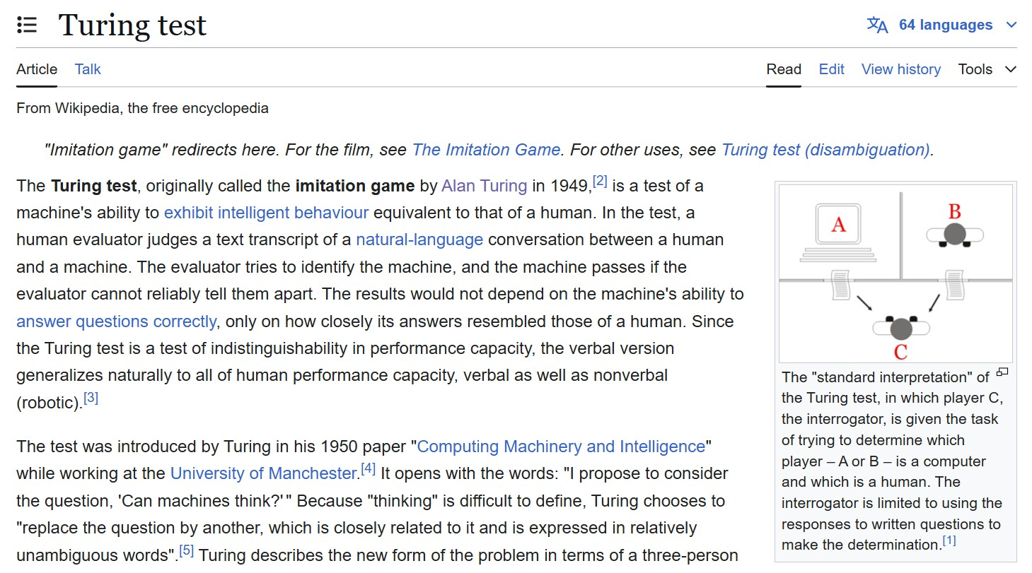

Slide 9
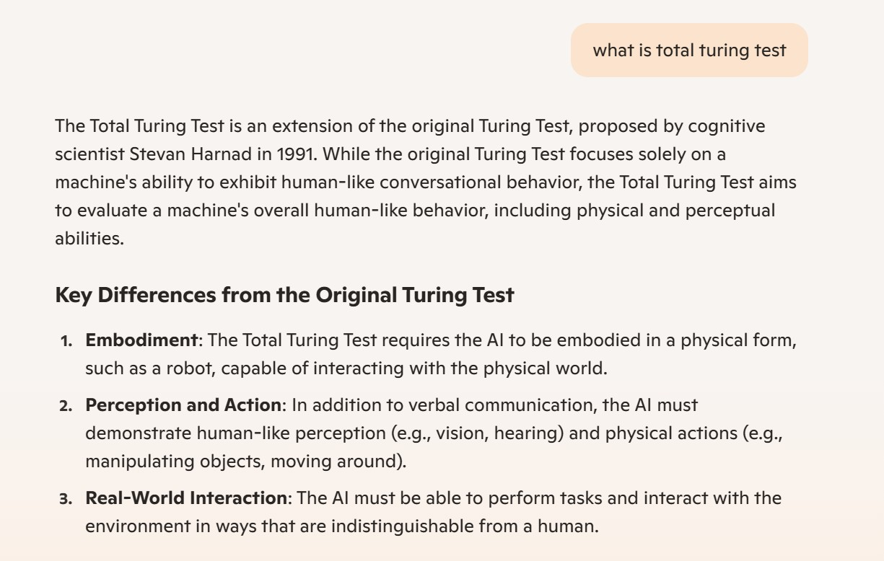
Total Turing Test

Slide 10
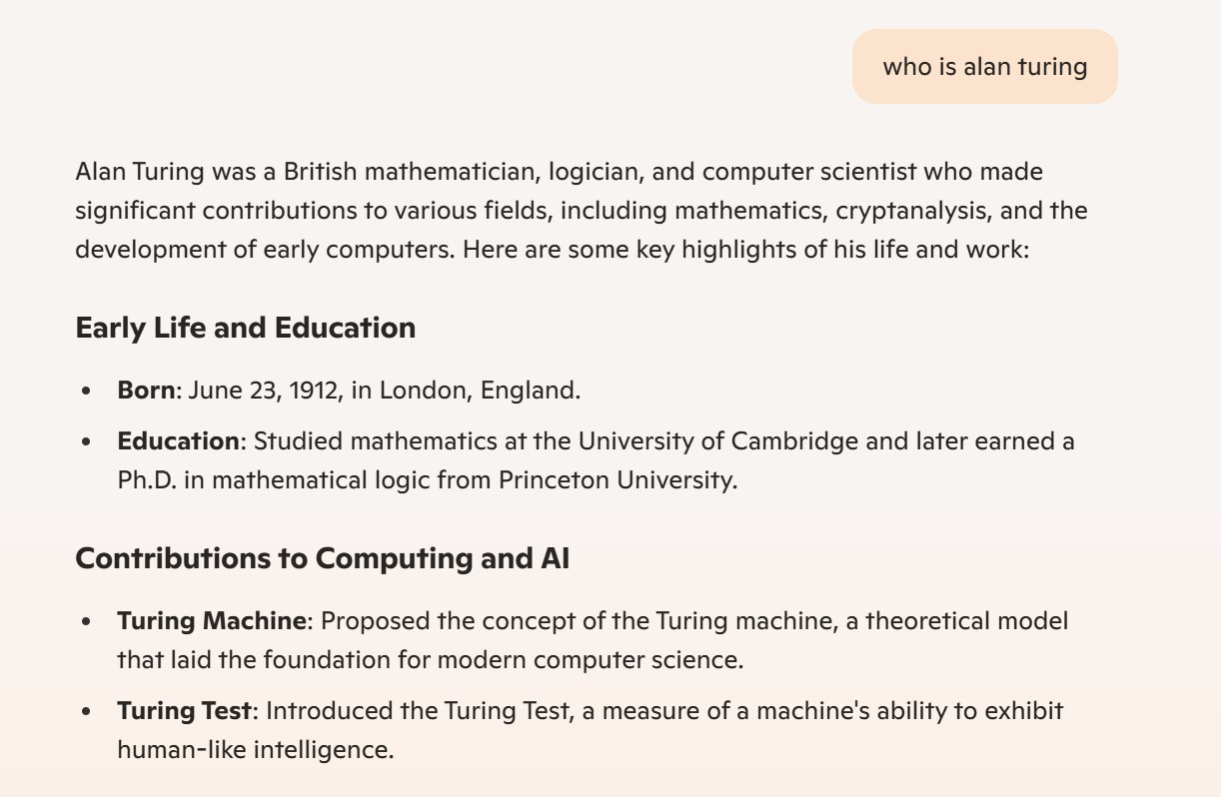
Who is Alan Turing

Slide 11
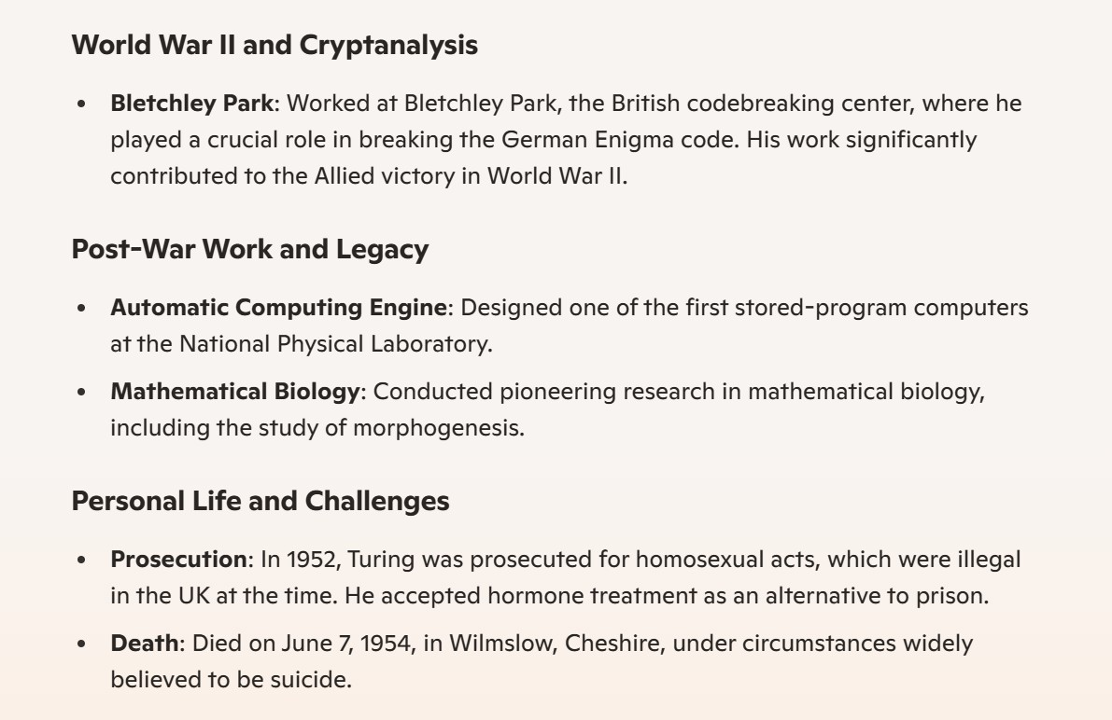

Slide 12
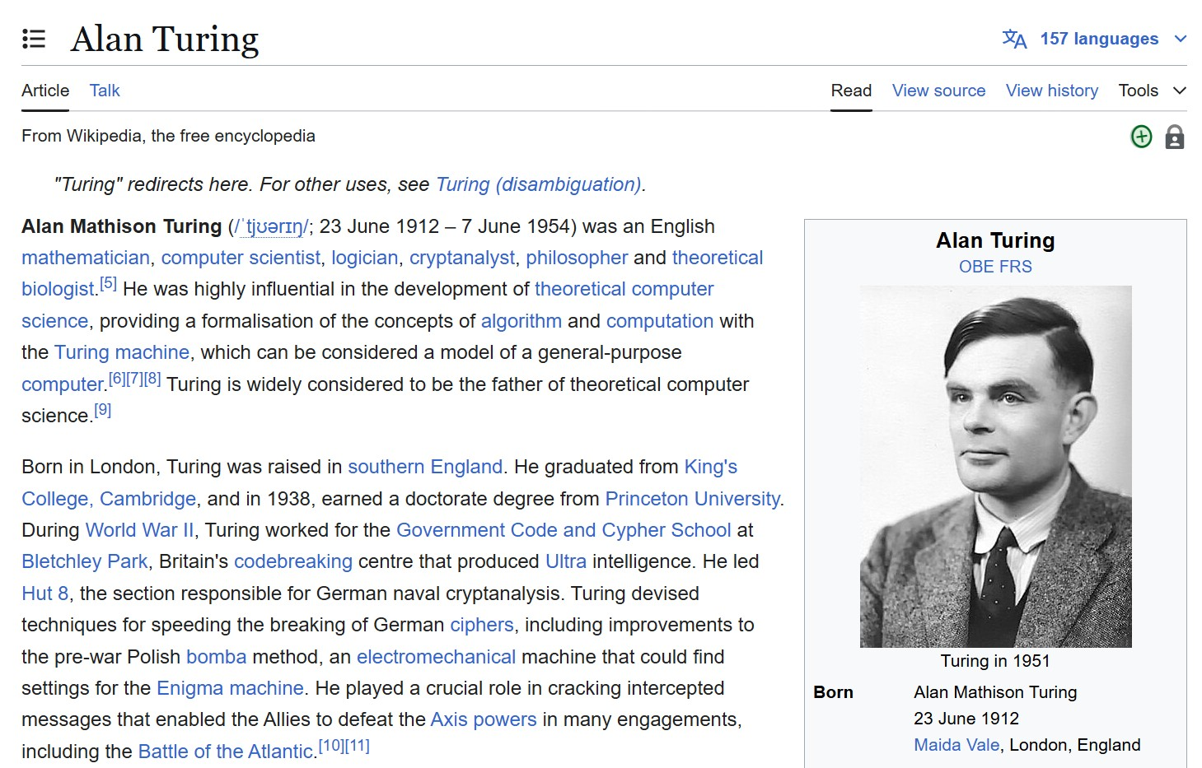

Slide 13
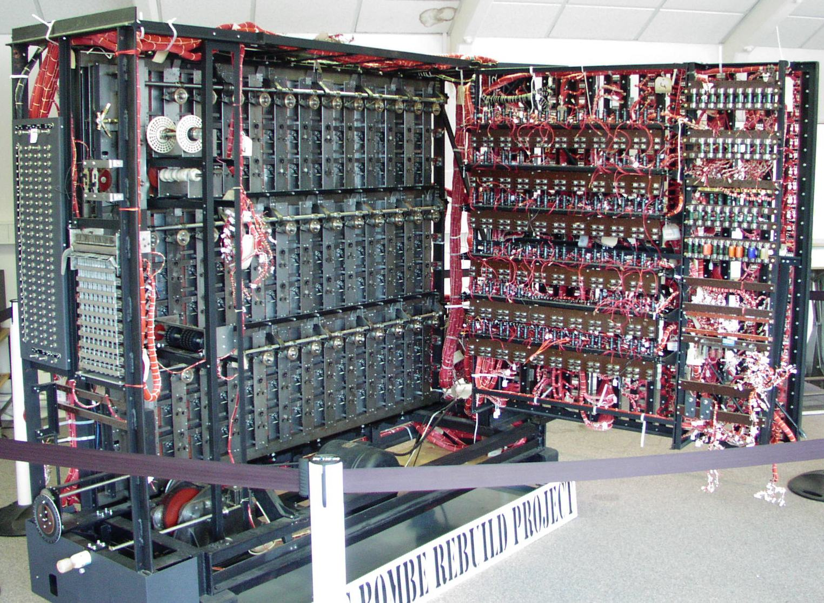
A working replica of a bombe now at The National Museum of Computing on Bletchley Park
https://en.wikipedia.org/wiki/Alan_Turing

Slide 14
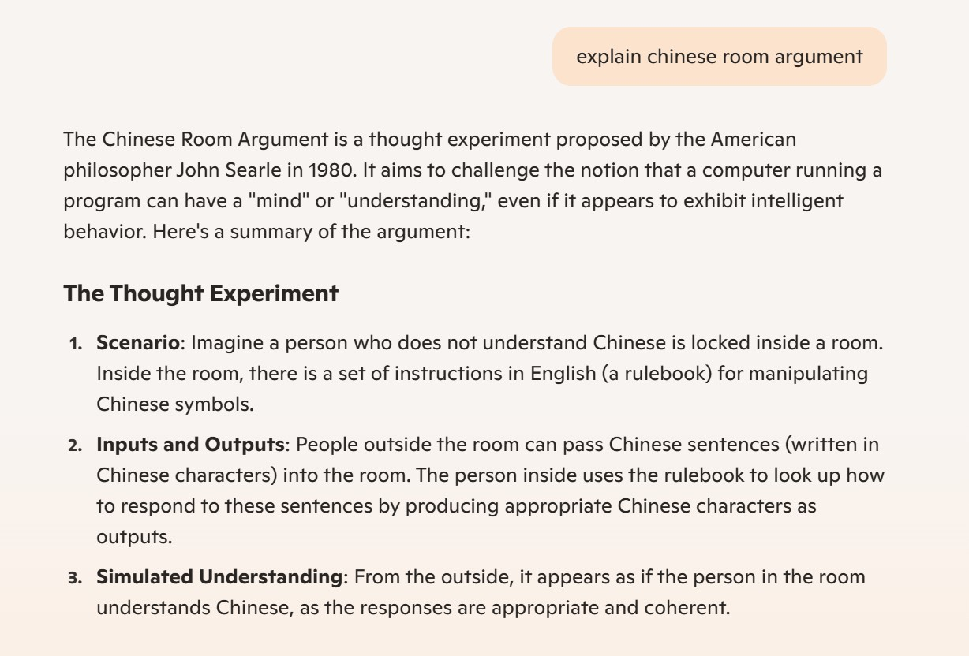
Chinese Room Argument

Slide 15
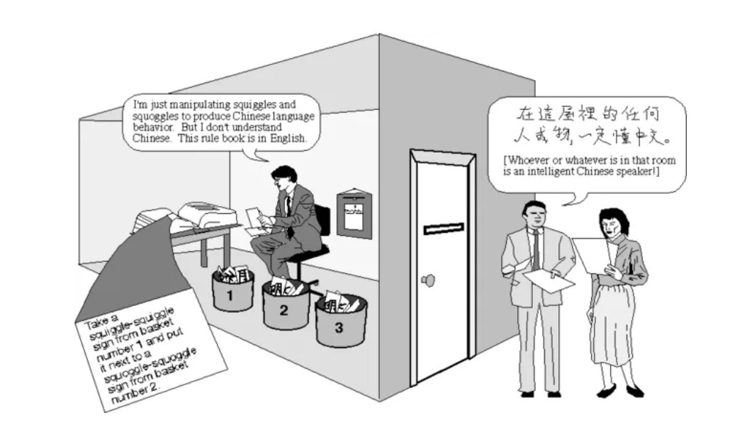
https://medium.com/devansh-mittal/chinese-room-argument-a-robot-cannot-feel-pain-b9fed973aba0

Slide 16
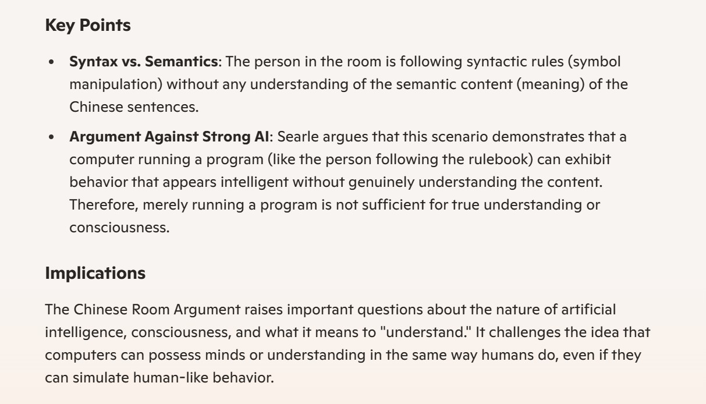

Slide 17
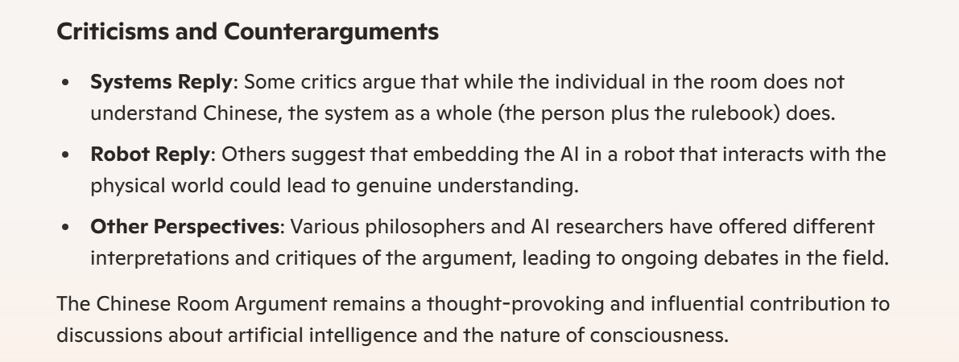
Original article
"Minds, Brains, and Programs," by John R. Searle, from The Behavioral and Brain Sciences, vol. 3. Copyright 1980 Cambridge University Press.
https://web.archive.org/web/20071210043312/http://members.aol.com/NeoNoetics/MindsBrainsPrograms.html

Slide 18
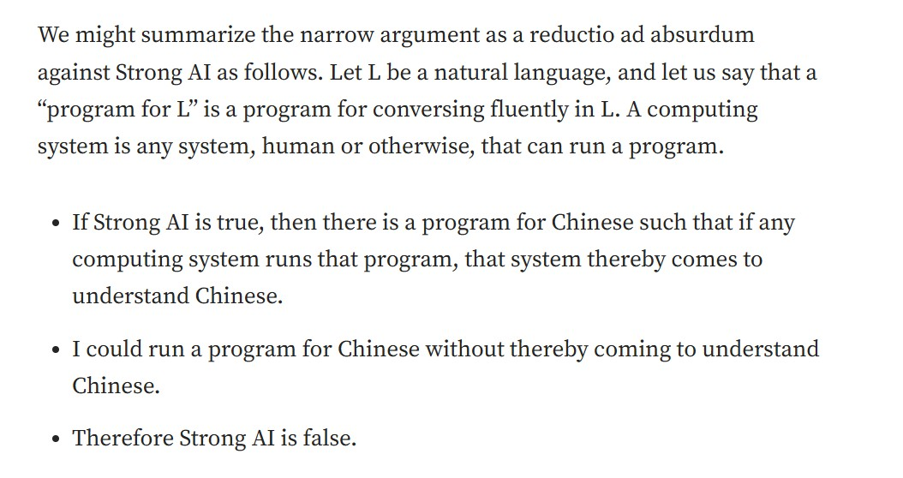
Argument: Hard AI is False
https://medium.com/devansh-mittal/chinese-room-argument-a-robot-cannot-feel-pain-b9fed973aba0

Slide 19
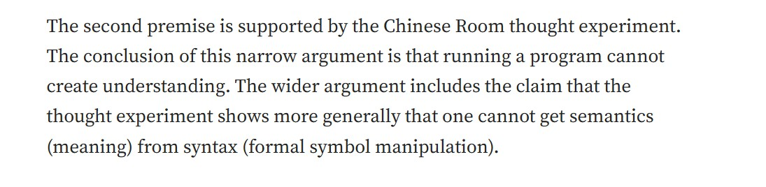
Semantics vs Syntax
https://medium.com/devansh-mittal/chinese-room-argument-a-robot-cannot-feel-pain-b9fed973aba0
For more detailed explanation about Chinese Room Argument and Strong AI: wiki https://en.wikipedia.org/wiki/Chinese_room

Slide 20
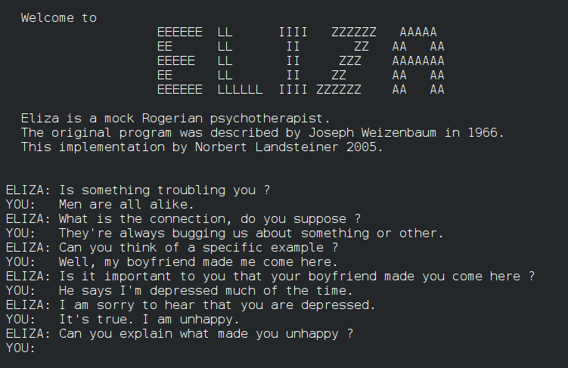
First Chat Bot: Eliza
https://en.wikipedia.org/wiki/ELIZA

Slide 21
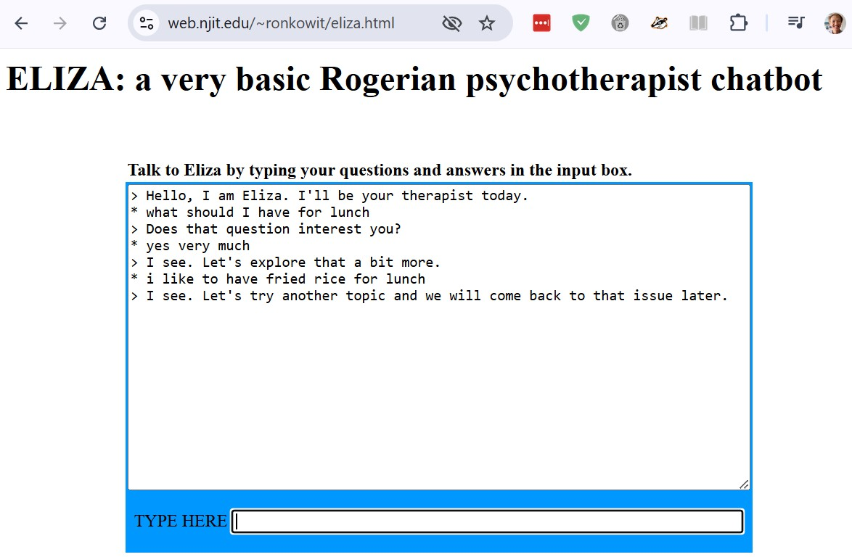

Slide 22
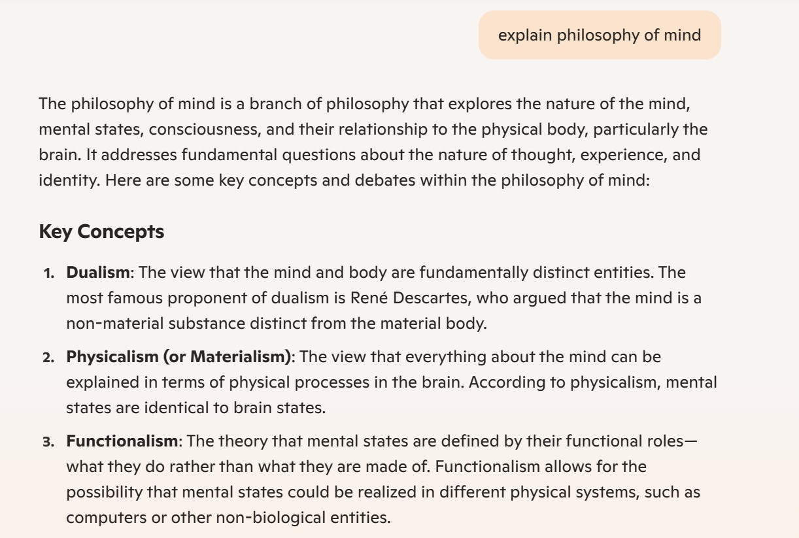
Wider View: Philosophy of Mind

Slide 23
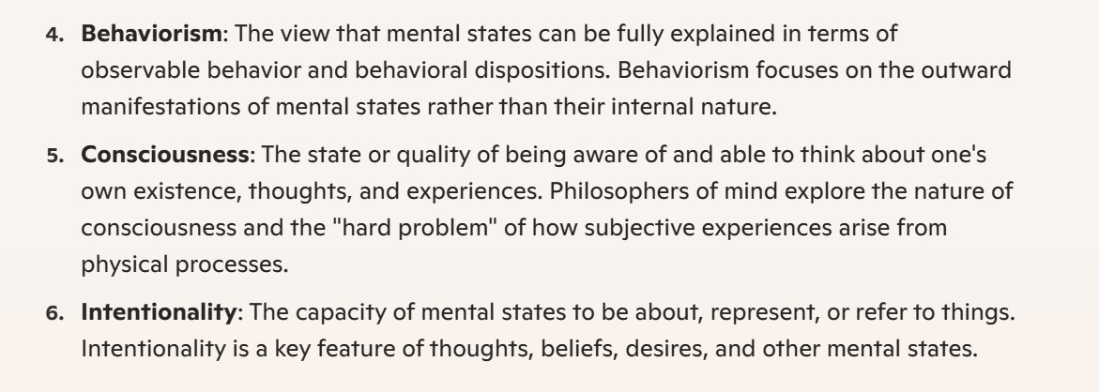

Slide 24
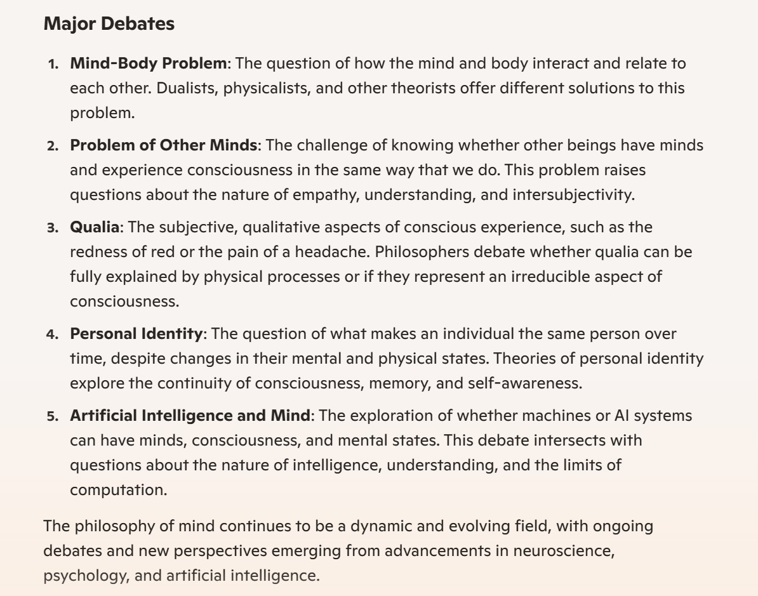
Debates

Slide 25
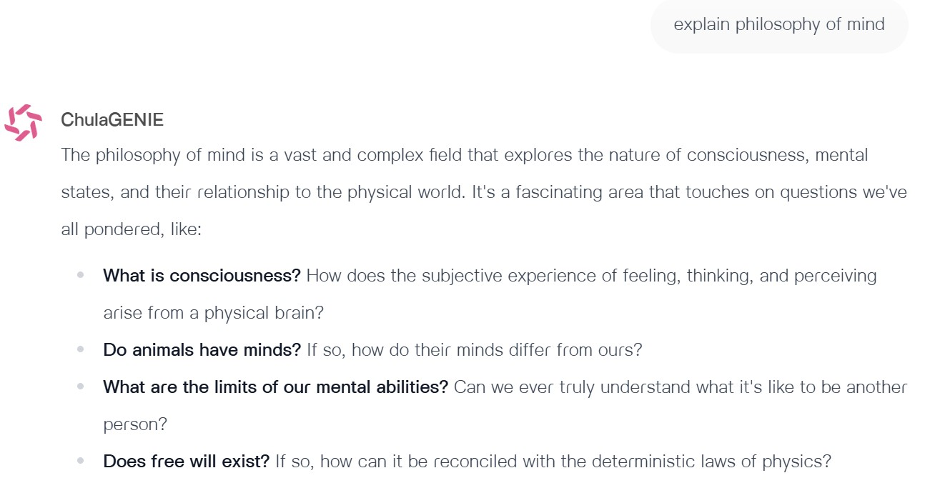
Alternative explanation

