Slide 1
Future of Artificial Intelligence
Lecture series on Artificial Intelligence Perspective
Prabhas Chongstitvatana
Faculty of Engineering
Chulalongkorn University

Slide 2
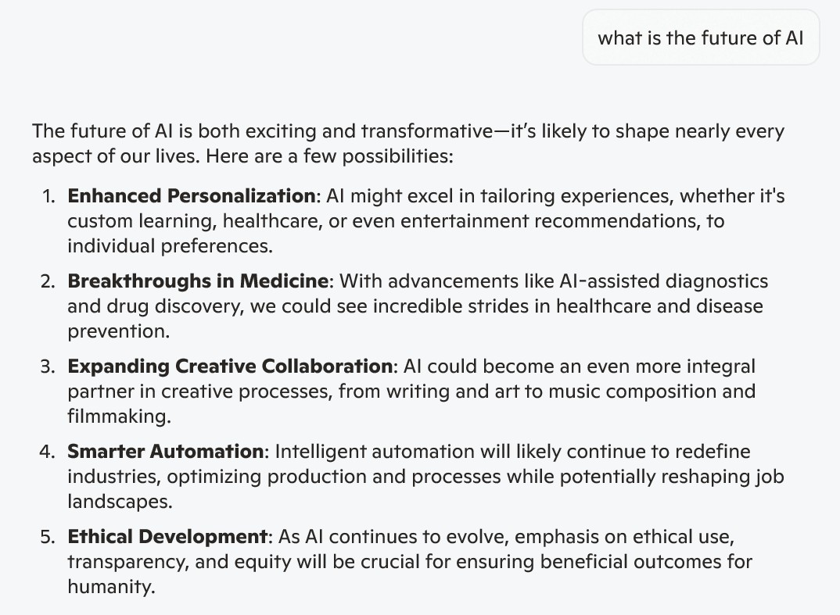

Slide 3
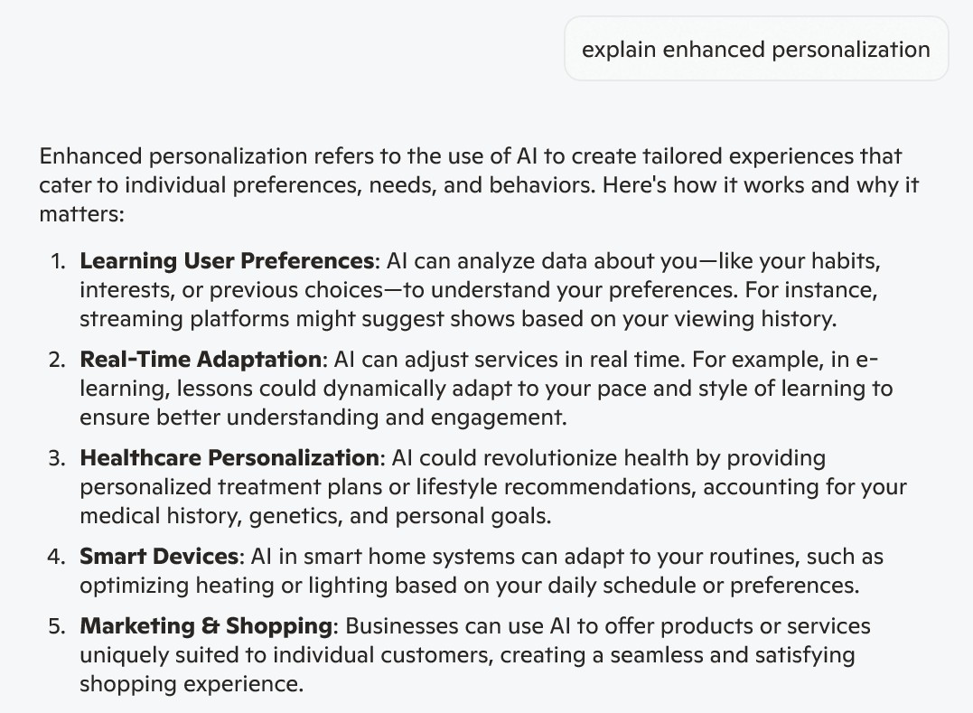

Slide 4
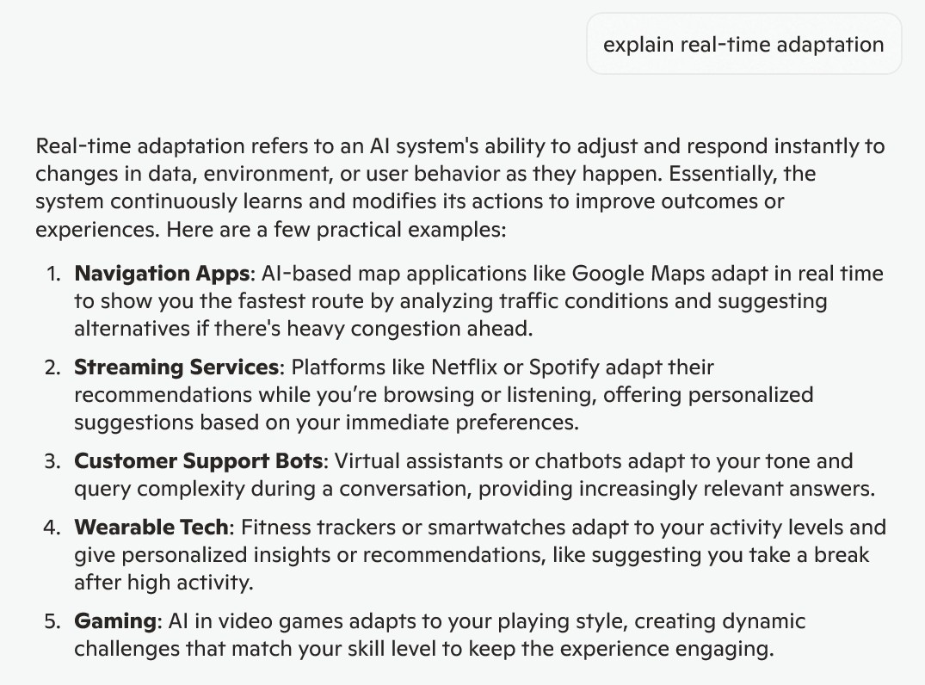

Slide 5
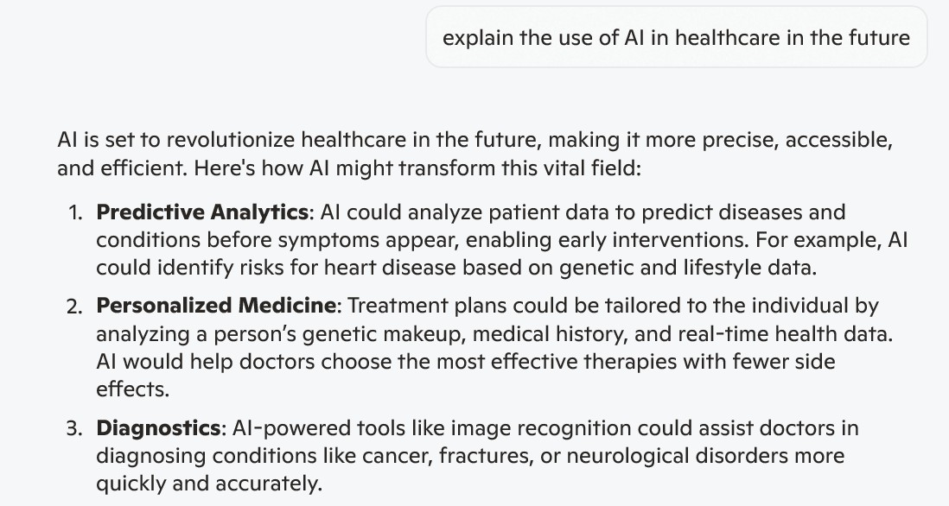

Slide 6
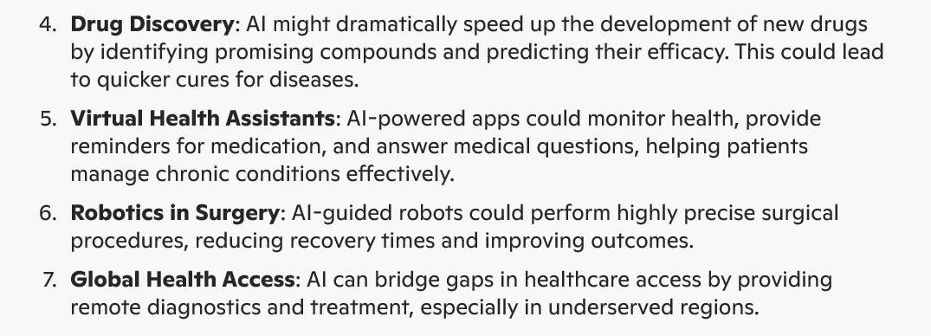

Slide 7
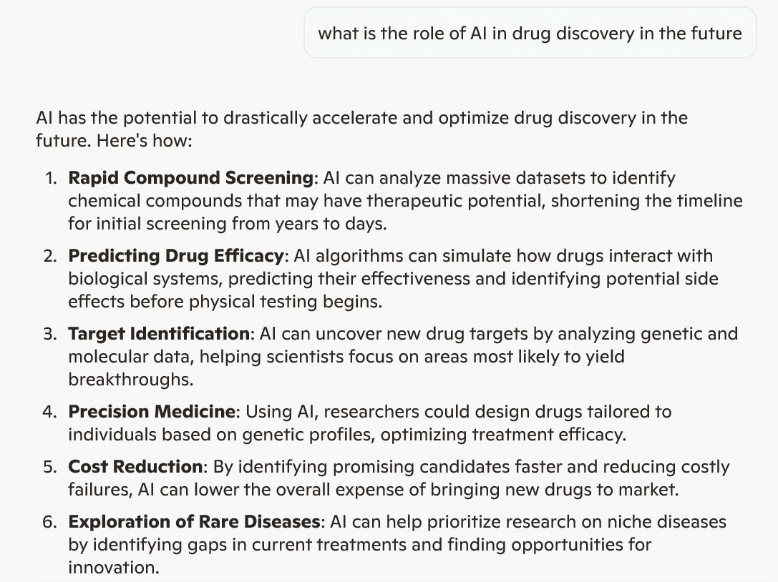

Slide 8
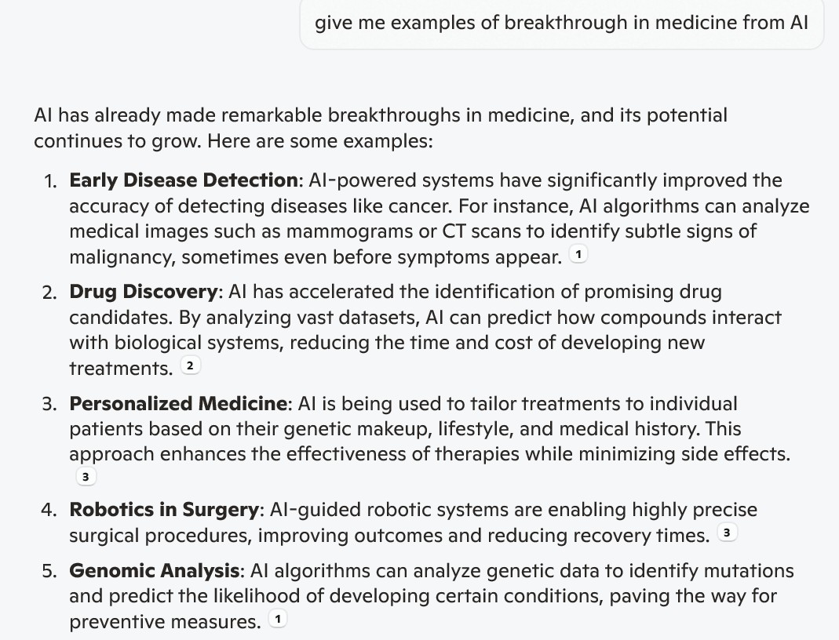

Slide 9
(1) https://www.sciencenewstoday.org/how-ai-is-transforming-healthcare-diagnosis-treatment-and-beyond
(2) https://med.stanford.edu/news/all-news/2025/04/ai-index-report-science-medicine.html
(3) https://news.harvard.edu/gazette/story/2025/03/how-ai-is-transforming-medicine-healthcare/

Slide 10
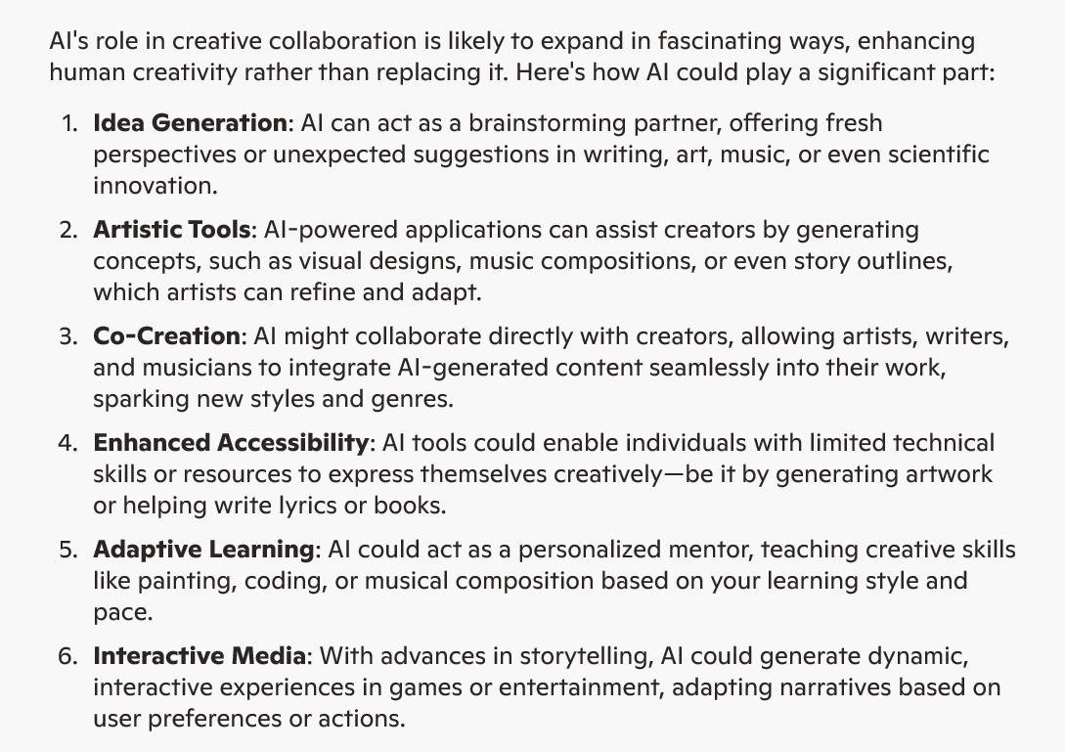

Slide 11
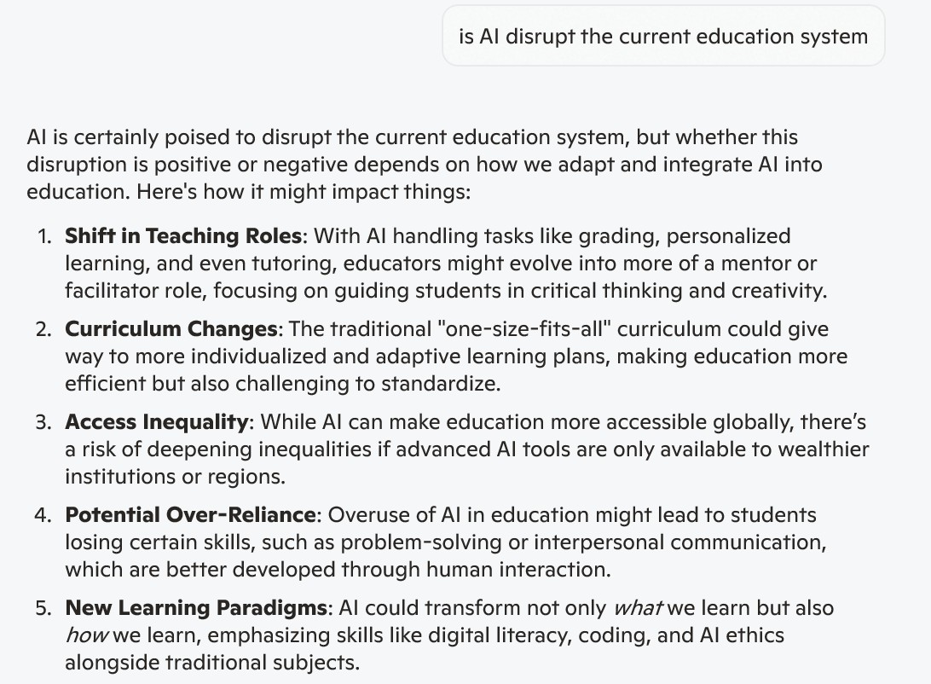

Slide 12
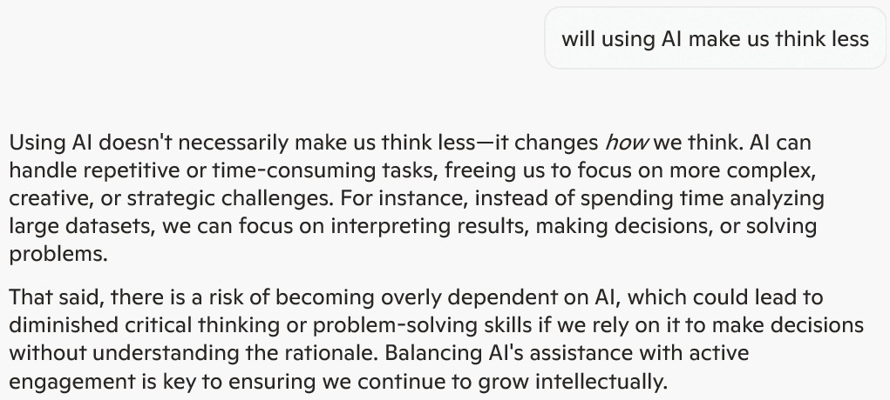

Slide 13
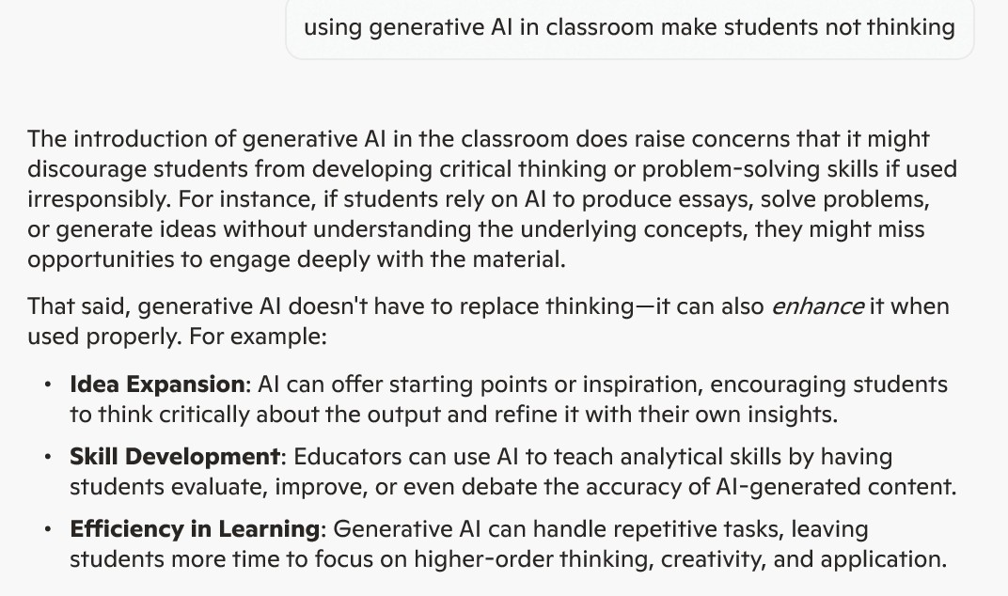

Slide 14
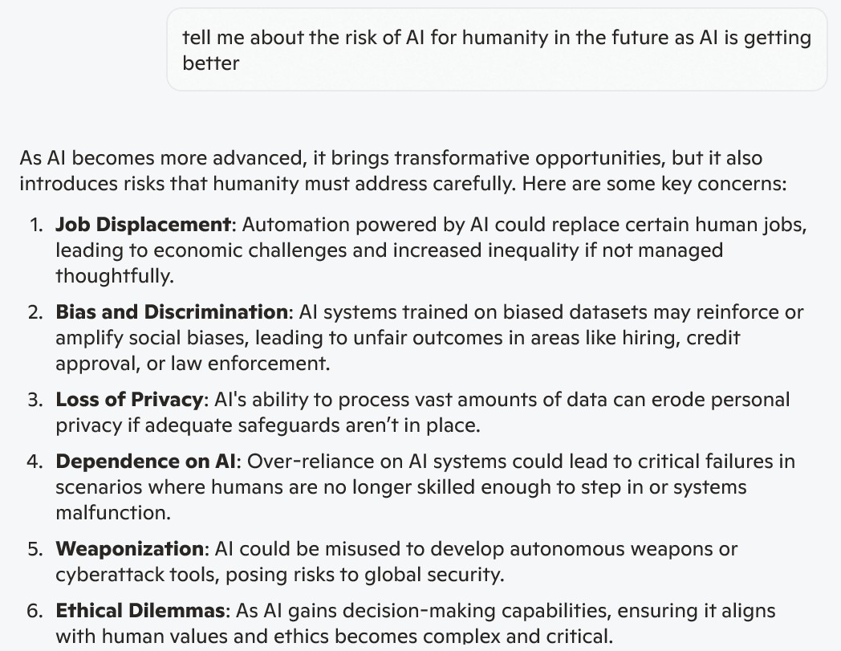

Slide 15
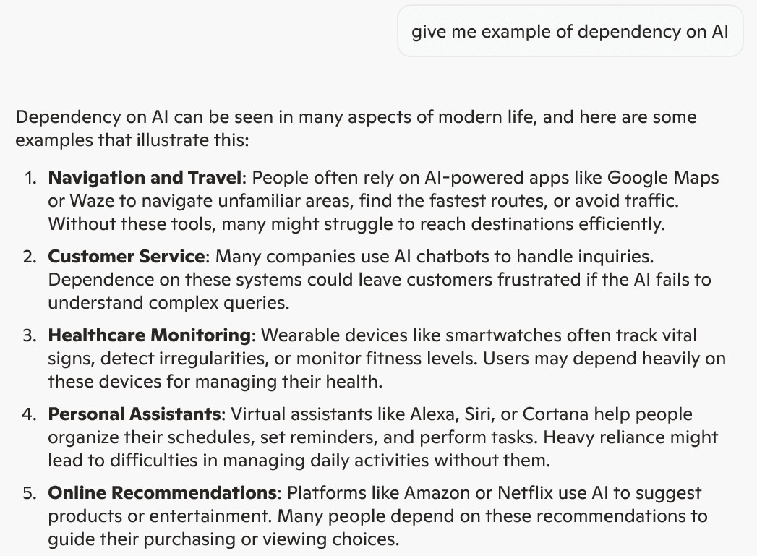

Slide 16
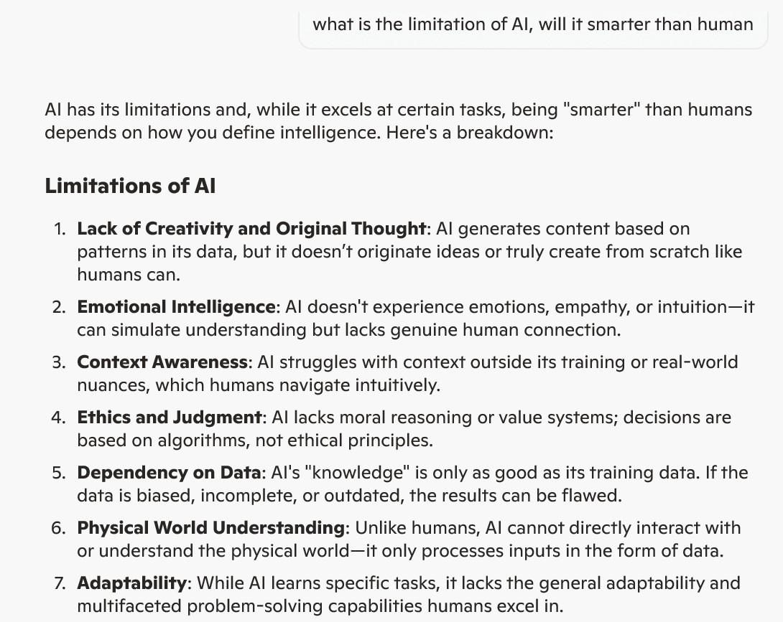

Slide 17
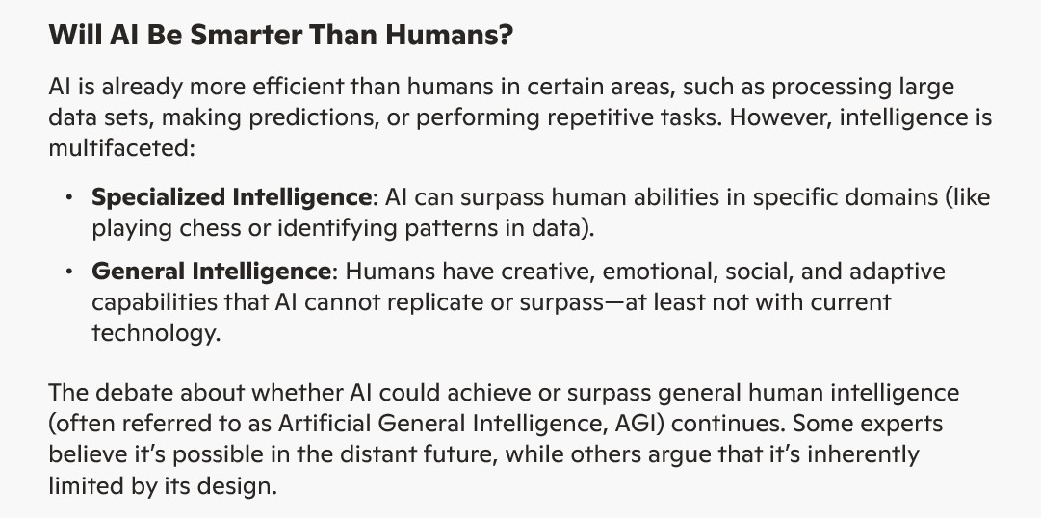

Slide 18
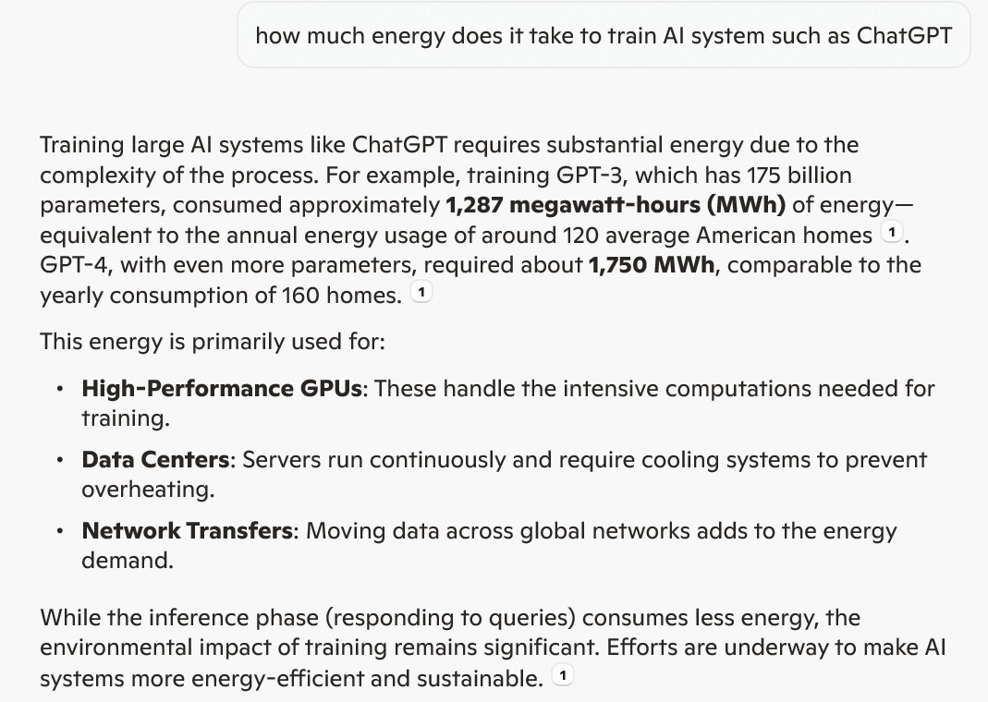

Slide 19
energy consumption of AI
https://www.baeldung.com/cs/chatgpt-large-language-models-power-consumption
https://www.businessenergyuk.com/knowledge-hub/chatgpt-energy-consumption-visualized/

Slide 20
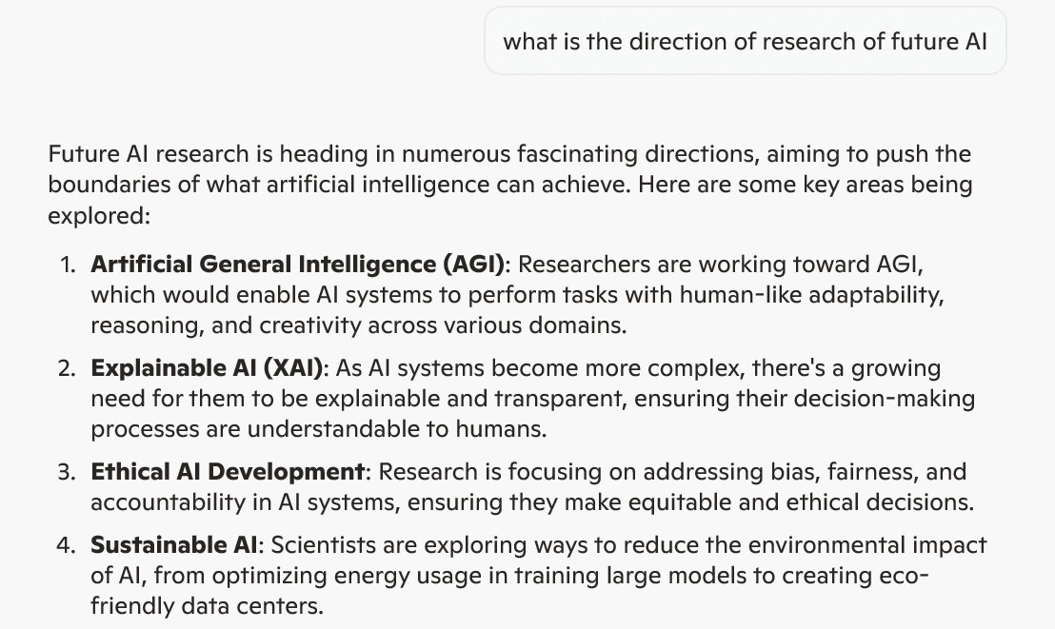

Slide 21
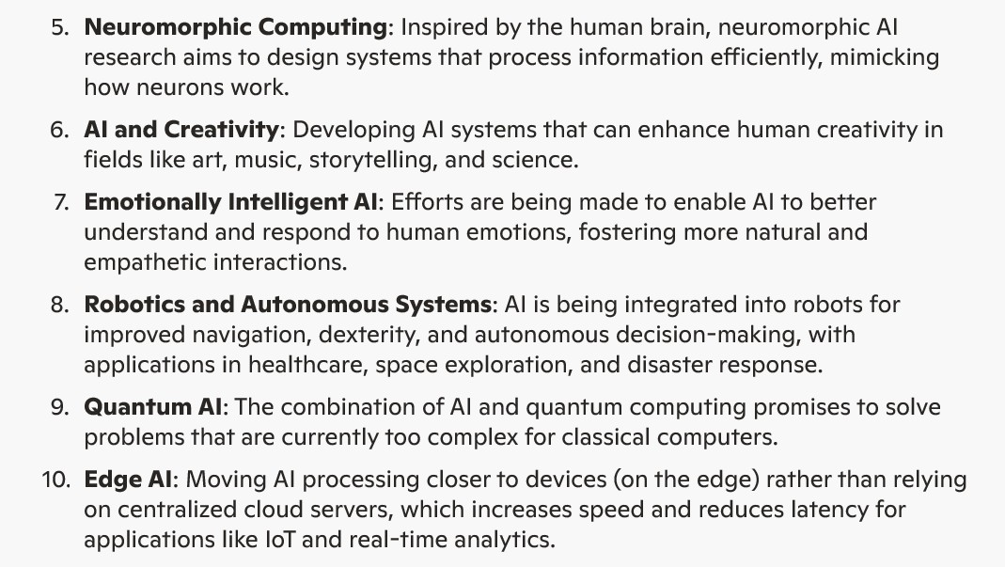

Slide 22
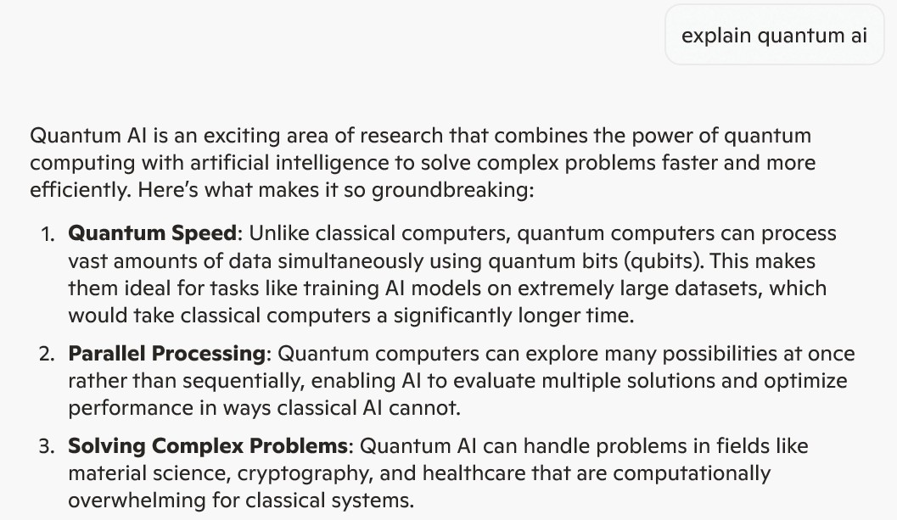

Slide 23
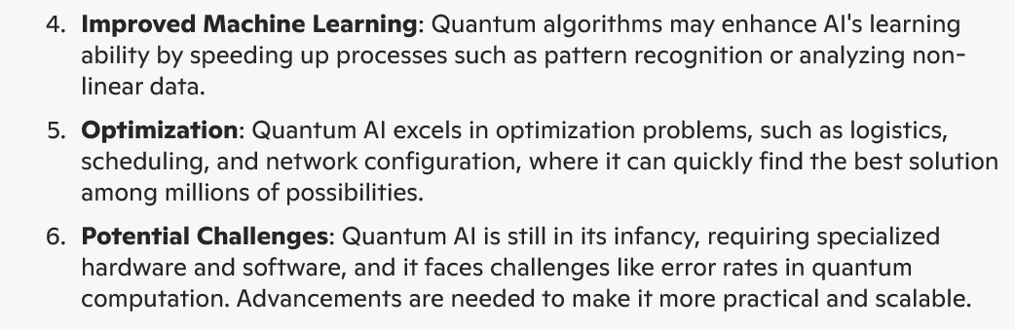

Slide 24
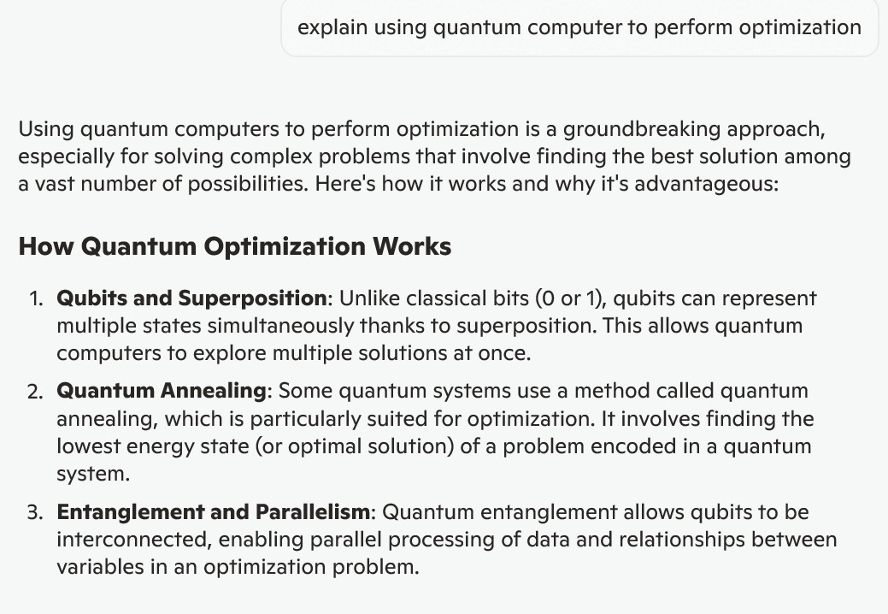

Slide 25
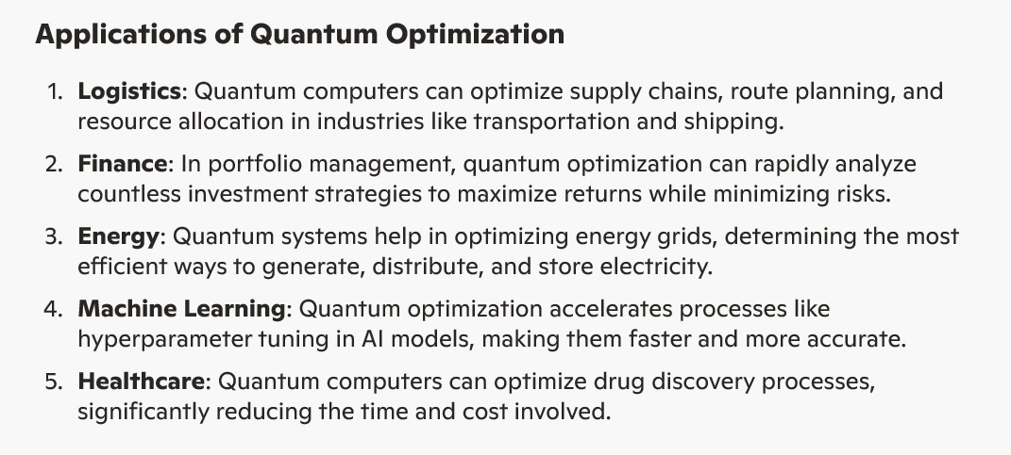

Slide 26
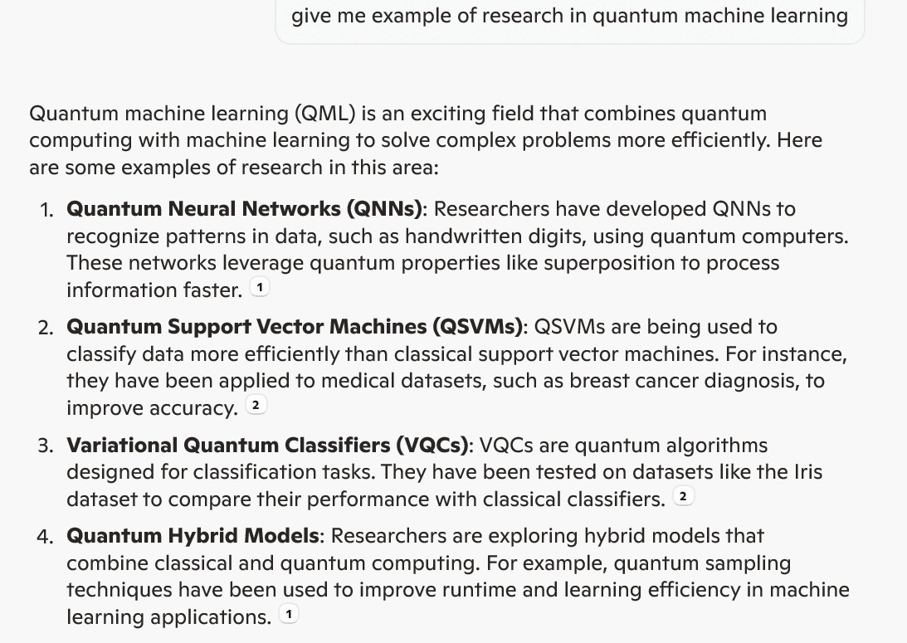

Slide 27
quantum machine learning
https://ceur-ws.org/Vol-2561/paper5.pdf
Frank Phillipson, Quantum Machine Learning: Benefits and Practical Examples, 2020
https://scholar.google.com/citations?user=fnDQwyIAAAAJ&hl=nl
Quantum Machine Learning: A Review and Case Studies (2023)
Amine Zeguendry,Zahi Jarir and Mohamed Quafafou
https://www.mdpi.com/1099-4300/25/2/287

Slide 28
Simulating Coupled Oscillators on Quantum Circuits
In this work, we present and implement an explicit quantum circuit to efficiently simulate one-dimensional coupled-oscillator systems. Our quantum simulation results show excellent agreement with classical methods, showcasing a practical implementation of Hamiltonian simulation and highlighting the potential for circuit-based algorithm to simulate many-body systems on larger-scale quantum computers.
Luangsirapornchai, N., Sanglaor, P., Apimuk Sornsaeng, A., Bressan, S., Chotibut, T., Suksen, K., Chongstitvatana, P., "Practical Quantum Circuit Implementation for Simulating Coupled Classical Oscillators," IEEE Access, early access, 14 March 2025, (abstract) DOI: 10.1109/ACCESS.2025.3551308

Slide 29
Benchmarking quantum computing for combinatorial optimization
Quantum computers can be much faster than any classical computers in solving a certain class of problems. One of an interesting problem is the combinatorial optimisation problem, which is a challenge for classical computer systems. We encode these problems into the Quadratic Unconstrained Binary Optimization (QUBO) format and then solve it with quantum solvers. In this study, we compare the performance of D-Wave's quantum annealing system with classical solvers, namely, Gurobi and Fixstars. We demonstrate the current capabilities of D-Wave system.
Nathan Kittichaikoonkij, Nutthapat Pongtanyavichai, Poopha Suwananek, Kamonluk Suksen, Prabhas Chongstitvatana, "Benchmarking quantum computing for combinatorial optimization," (abstract) accepted ECTI-CON 2025, June 2025

Slide 30
Laokondee, S. and Chongstitvatana, P., "Quantum neural network model for token allocation for course bidding," ECTI Trans on computer and information technology, Vol.18, No.1, January 2024, pp.112-117. (local copy) DOI
Suksen, K., Benchasattabuse, N., Chongstitvatana, P., "Compact Genetic Algorithm with Quantum-Assisted Feasibility Enforcement," ECTI Trans. on Computer and Information Technology, Vol.16, No.4, December 2022, pp.422-435.
link to my publications
https://www.cp.eng.chula.ac.th/~prabhas//paper/mypub.htm

