Slide 1
Robotics
Prabhas Chongstitvatana
Faculty of Engineering
Chulalongkorn
Lecture series in Artificial Intelligence Perspective

Slide 2
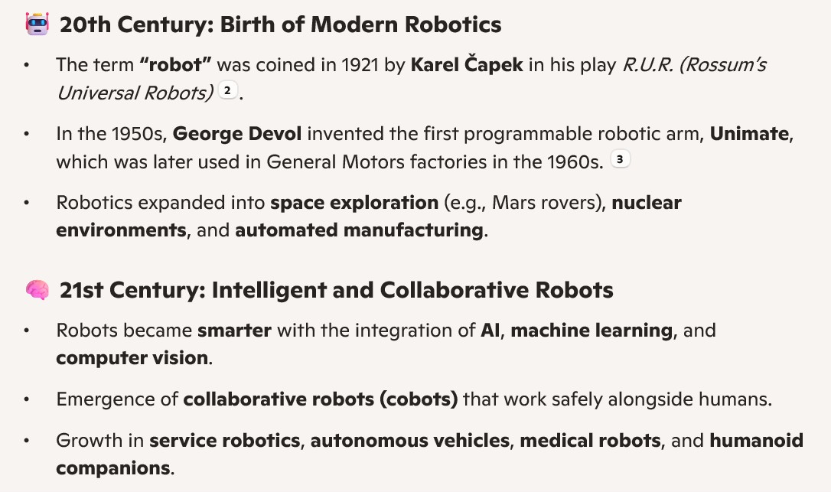
Robots Evolution

Slide 3
What is Robotics
- Definition of robotics
- Distinction between robots and automation
- Brief history and evolution of robotics

Slide 4
Core Components of a Robot
- 🤖 Mechanical structure (chassis, joints, actuators)
- 🧠 Control system (microcontrollers, processors)
- 👁️ Sensors (vision, touch, proximity, etc.)
- ⚙️ Actuators (motors, servos, hydraulic systems)
- 🔋 Power supply (batteries, wired sources)

Slide 5
Types of Robots
- Industrial robots (e.g., robotic arms in manufacturing)
- Service robots (e.g., cleaning, delivery)
- Medical robots (e.g., surgical assistants)
- Humanoid robots
- Autonomous vehicles and drones
- Swarm robots and collaborative systems

Slide 6
Key Technologies in Robotics
- Artificial Intelligence and Machine Learning
- Computer Vision
- Natural Language Processing
- Motion Planning and Control
- Sensor Fusion
- Human-Robot Interaction

Slide 7
Applications of Robotics
- 🏭 Manufacturing and automation
- 🏥 Healthcare and surgery
- 🚗 Transportation and autonomous driving
- 🧹 Domestic tasks (e.g., vacuuming, lawn mowing)
- 🌍 Exploration (space, underwater, hazardous environments)
- 🎮 Entertainment and education

Slide 8
Challenges in Robotics
- Technical limitations (e.g., battery life, sensor accuracy)
- Ethical concerns (e.g., job displacement, surveillance)
- Safety and reliability
- Cost and scalability
- Legal and regulatory issues

Slide 9
Future Trends in Robotics
- Soft robotics and bio-inspired designs
- Collaborative robots (cobots)
- Edge AI and real-time decision-making
- Robotics in agriculture and sustainability
- Integration with IoT and smart environments

Slide 10
History of robotics
https://en.wikipedia.org/wiki/History_of_robots
picture of Unimate
spotwelding robots (automotive industry) video
https://www.youtube.com/watch?v=N5AYZxsnDuM

Slide 11
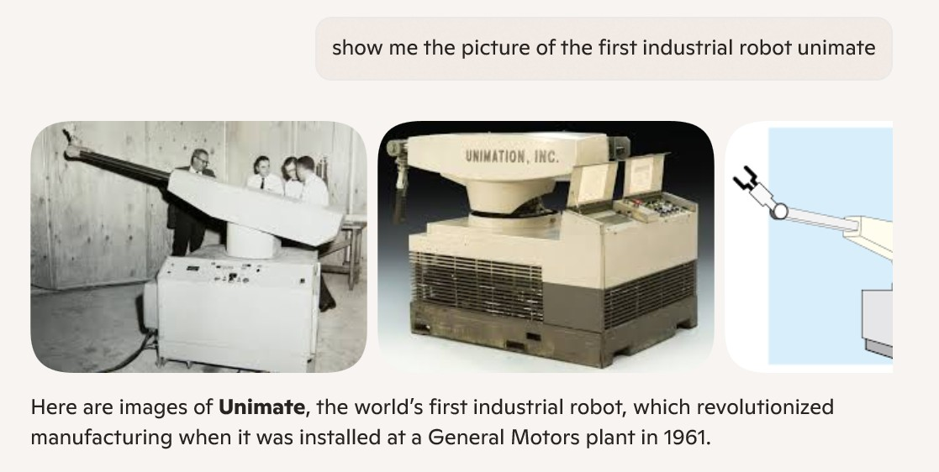
Unimate

Slide 12
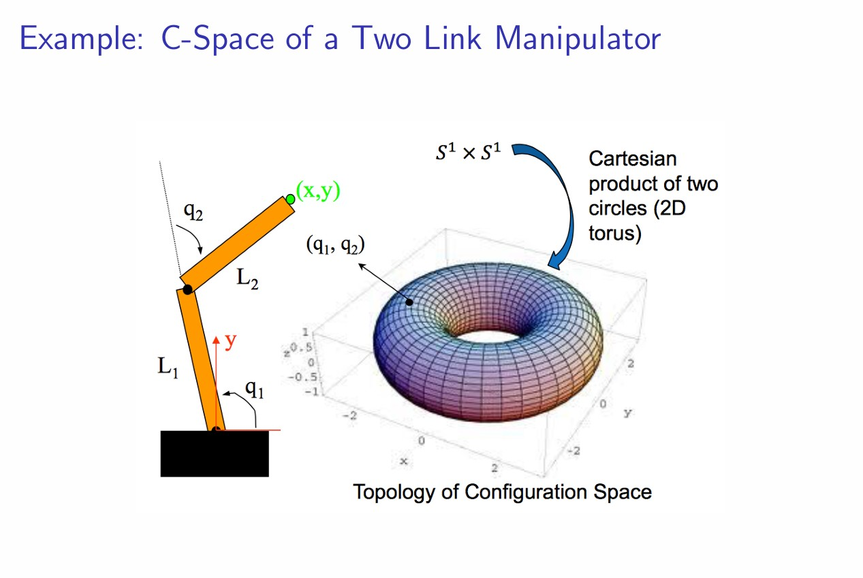
Configuration Space (C-space)
configuration space (CMU lecture)
Chap3-Config-Space_Howie.pdf

Slide 13
MIT leg lab video (Mark Raibert)
MIT leg lab video (Mark Raibert)
https://www.youtube.com/watch?v=XFXj81mvInc
spherical jumping robot (research paper)
minimalist_jumping_robot.pdf
Joel Burdick and Paolo Fiorini, Minimalist Jumping Robots for Celestial Exploration, The International Journal of Robotics Research 2003; 22; 653
DOI: 10.1177/02783649030227013

Slide 14
collaborative robots
collaborative robots
https://www.autostoresystem.com/insights/the-true-value-of-collaborative-robots-cobots

Slide 15
Robot Control
visual servo (my paper 1990)
Conkie, A., Chongstitvatana, P., "An uncalibrated stereo visual servo system", Proc. of the British Machine Vision Conference, Oxford, 1990, pp.277-280.
https://www.cp.eng.chula.ac.th/~prabhas//paper/early/bmvc1990.pdf

Slide 16
Robot Control (walking)
robot control (walking)
Waisusri, K., Chongstitvatana, P., "A Study of ZMP Control for a Walking Biped Robot by the Sinc-function Fuzzy Controller," Proc. of TRS Conf. of Robotics and Industrial Technology, Thailand, 16-17 May 2005.
https://www.cp.eng.chula.ac.th/~prabhas//paper/2005/CRIT2005.pdf

Slide 17
Robot + AI
Chongstitvatana, P., Polvichai, J., "Learning a visual task by genetic programming", Proc. of IEEE/RSJ Inter. Conf. on Intelligent Robots and Systems, Osaka, Japan, 1996.
https://www.cp.eng.chula.ac.th/~prabhas//paper/early/iros96.pdf

Slide 18
Robot walking (AI)
robot walking (AI)
Chaisukkosol, C. and Chongstitvatana, P., "Evolving control programs for a biped static walker", IEEE Inter. Conf. on Humanoid Robots, (poster paper), Waseda, Tokyo, November 22-24, 2001.
https://www.cp.eng.chula.ac.th/~prabhas//biped.avi

Slide 19
Robot Sensing
corner filter
Chongstitvatana, P., "Finding corner points in an image", in Proc. of 3rd Asian Regional Seminar on Microelectronics and Information Technology , Bangkok, Thailand, 1994.
https://www.cp.eng.chula.ac.th/~prabhas//paper/early/corner94.pdf

Slide 20
Summary
Robotics is an evolving field
Automation is already a de facto in industry
We dream about Humanoid robot
But we get ChatBot instead
There is a fear that Generative AI will replace office work
There is a fear that Robot will replace blue collar work (labor, manual)
The fact is somewhere in between, How robots collaborate with Human

