Slide 1
Weakness of Neuron-based AI
Lecture series in Artificial Intelligence Perspective
Faculty of Engineering
Chulalongkorn University
Prabhas Chongstitvatana

Slide 2
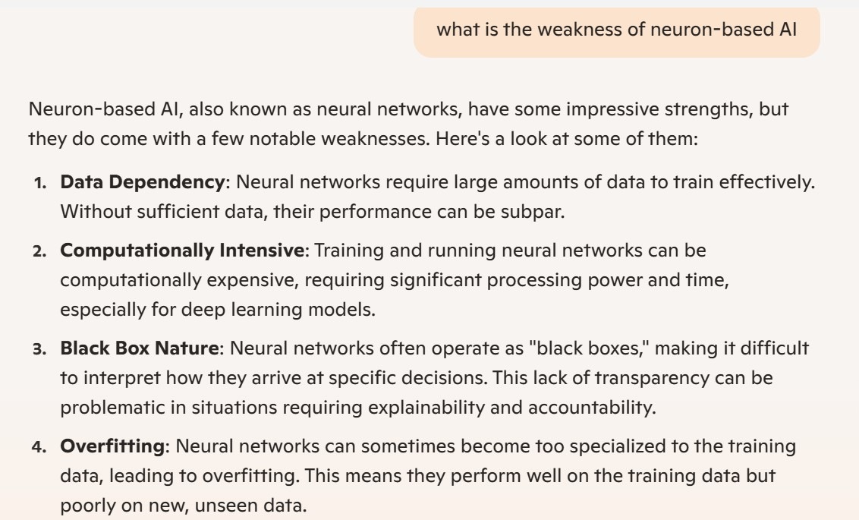

Slide 3


Slide 4
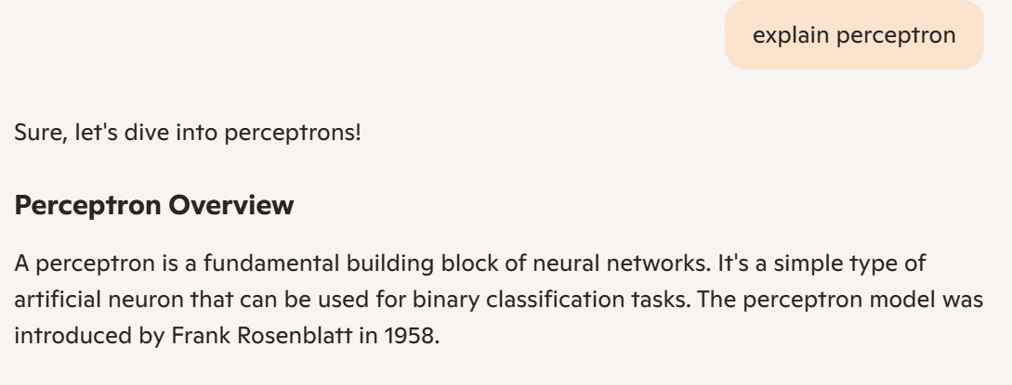

Slide 5
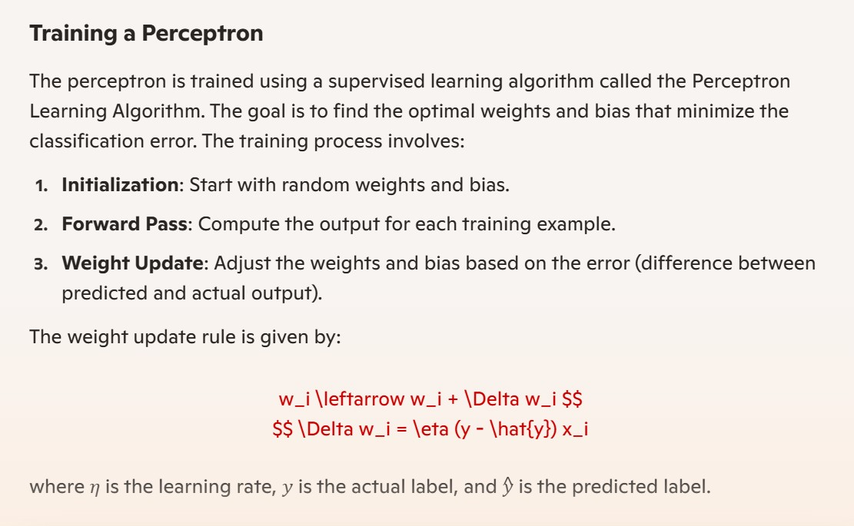

Slide 6


Slide 7
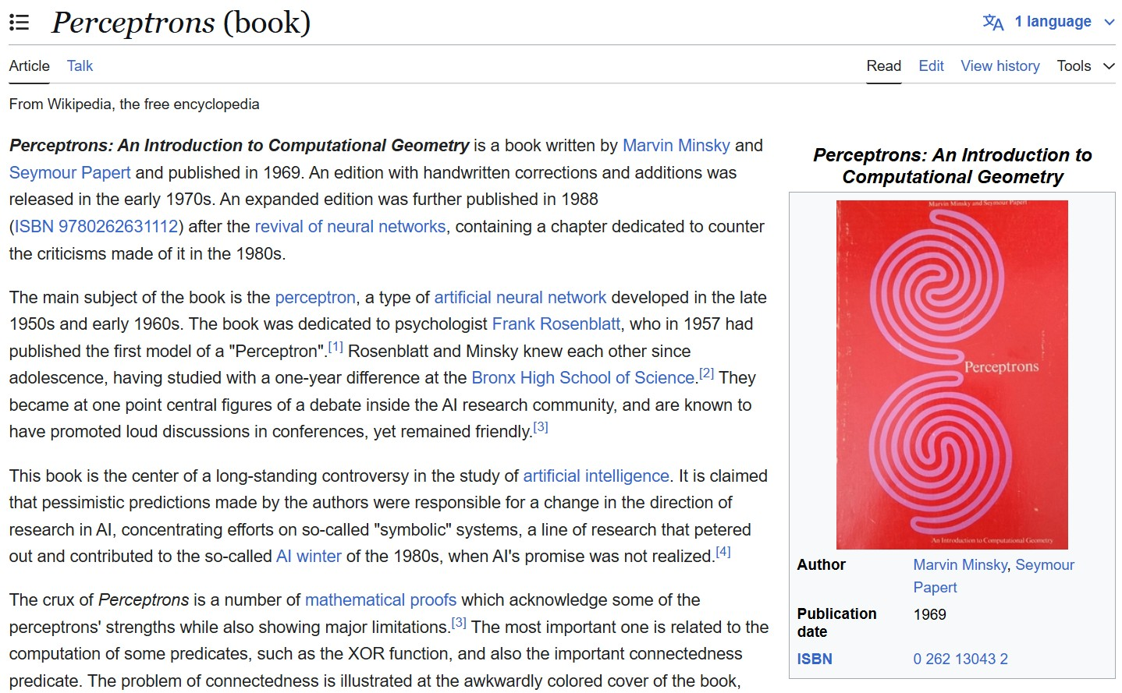
https://en.wikipedia.org/wiki/Perceptrons_(book)

Slide 8
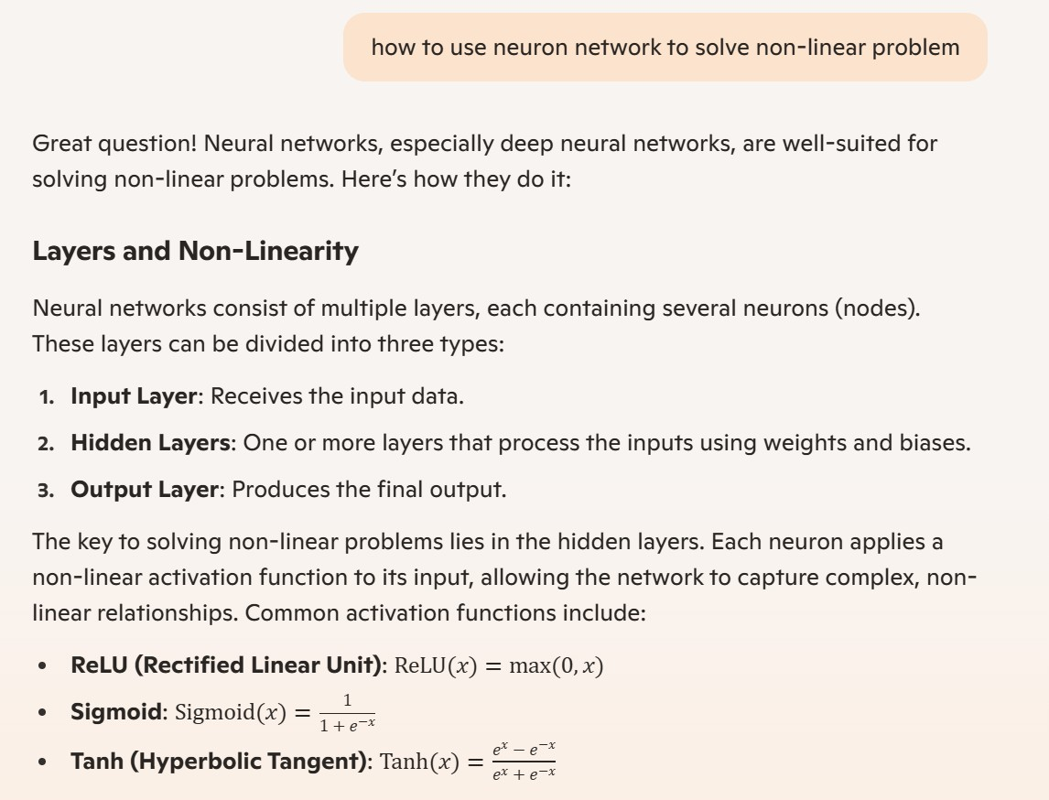

Slide 9
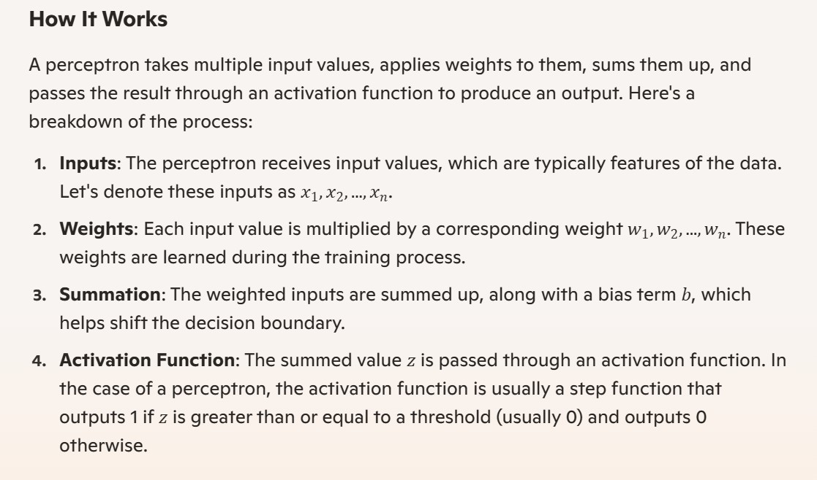

Slide 10
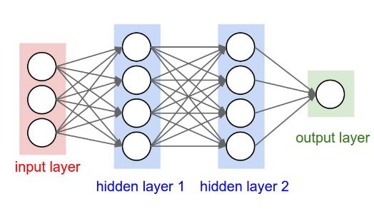
Artificial Neural Network 3-layer

Slide 11
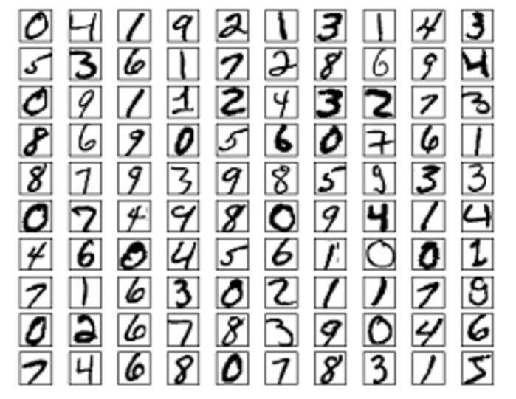
Article explain NIST
http://neuralnetworksanddeeplearning.com/chap1.html
Paper explains implementation of NIST https://arxiv.org/pdf/1909.08490

Slide 12
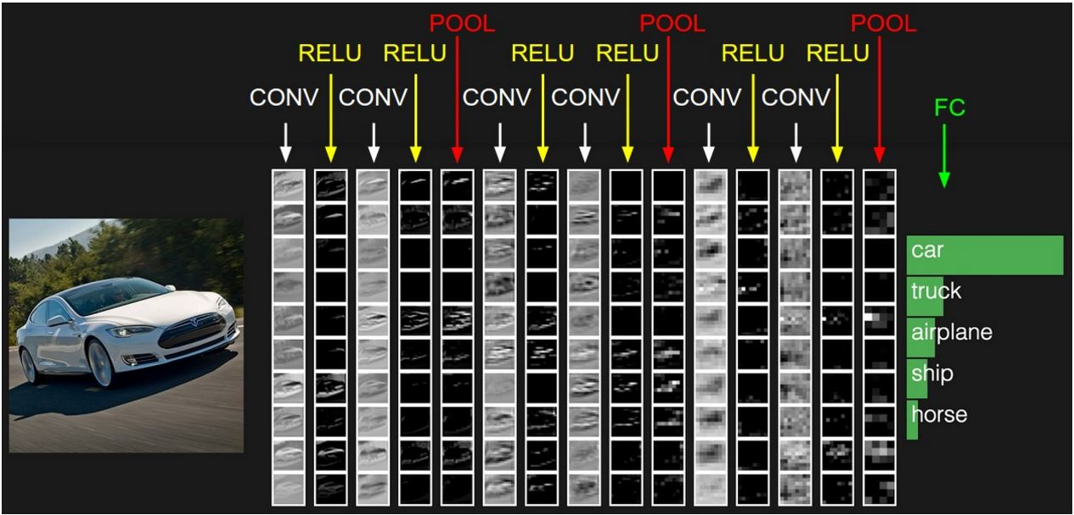
Example of NN layer
https://cs231n.stanford.edu/

Slide 13
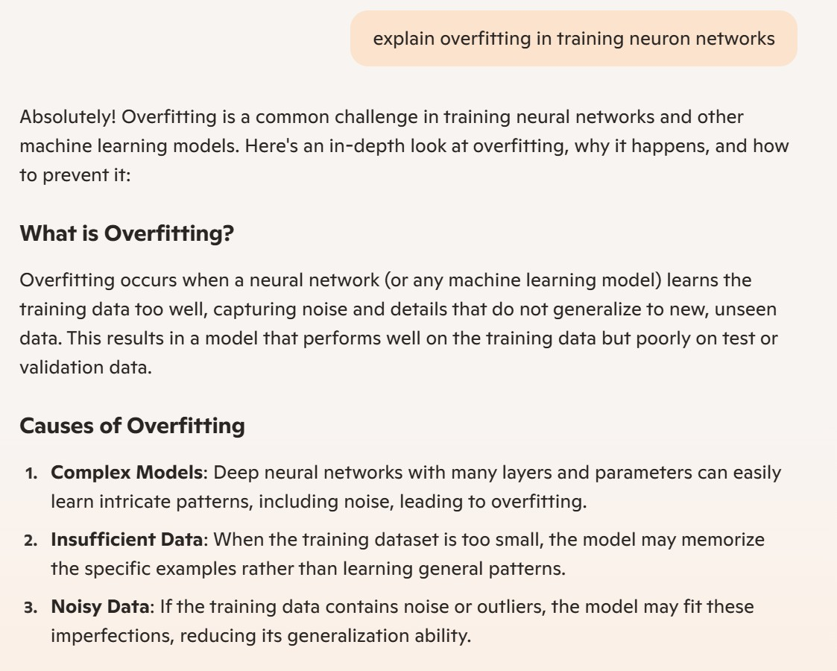

Slide 14
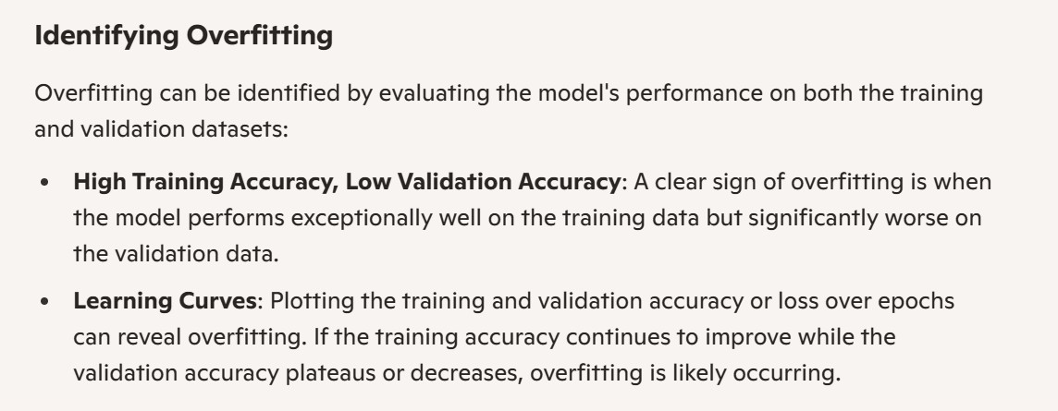

Slide 15
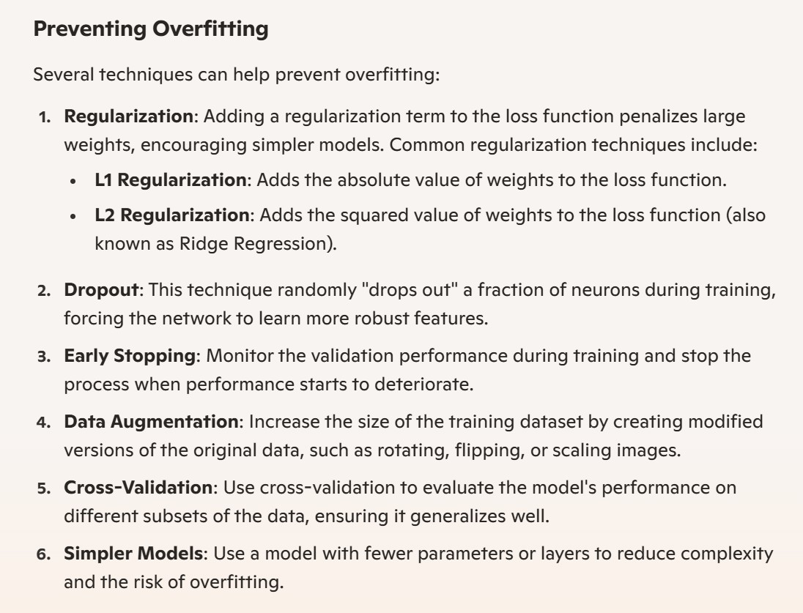

Slide 16
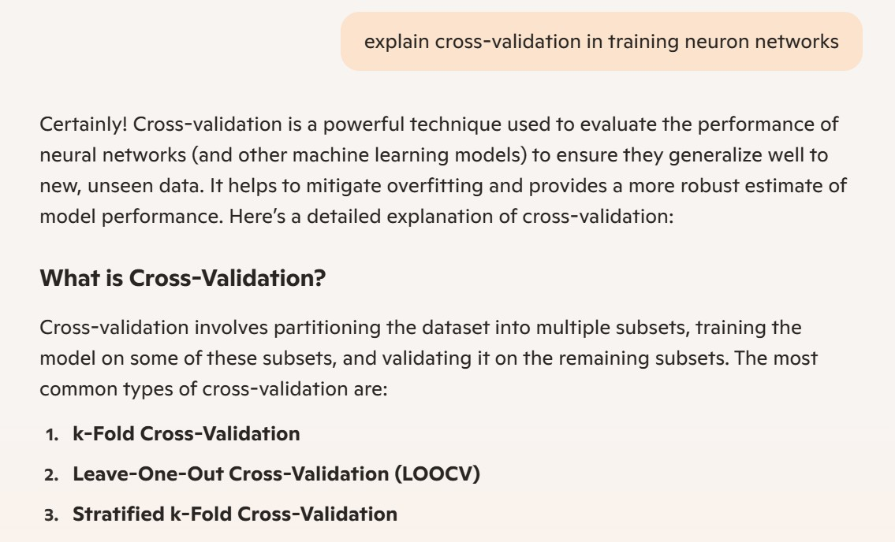

Slide 17
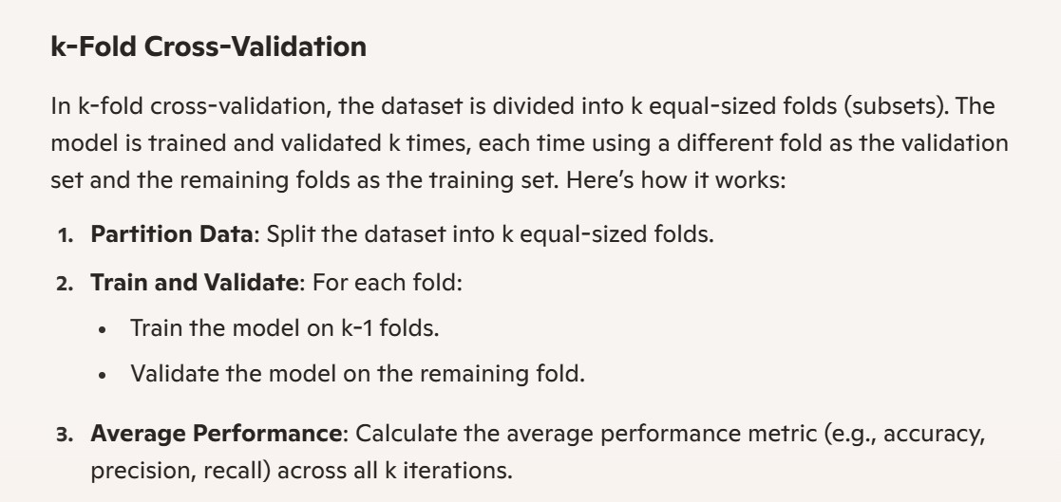

Slide 18
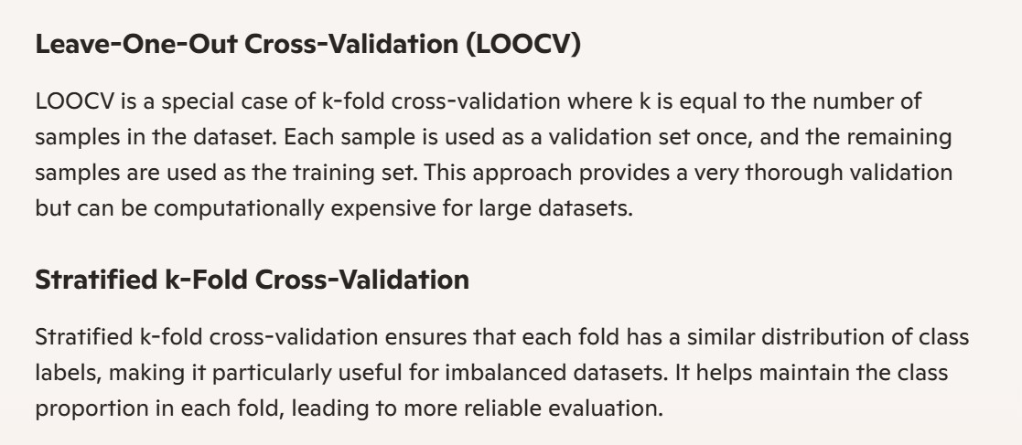

Slide 19
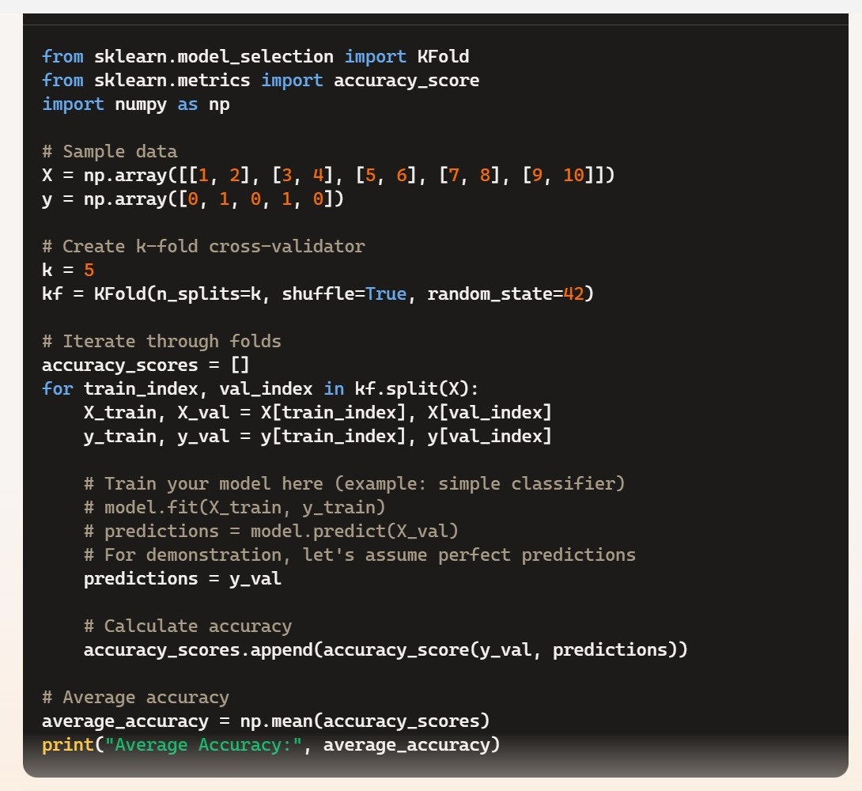

Slide 20
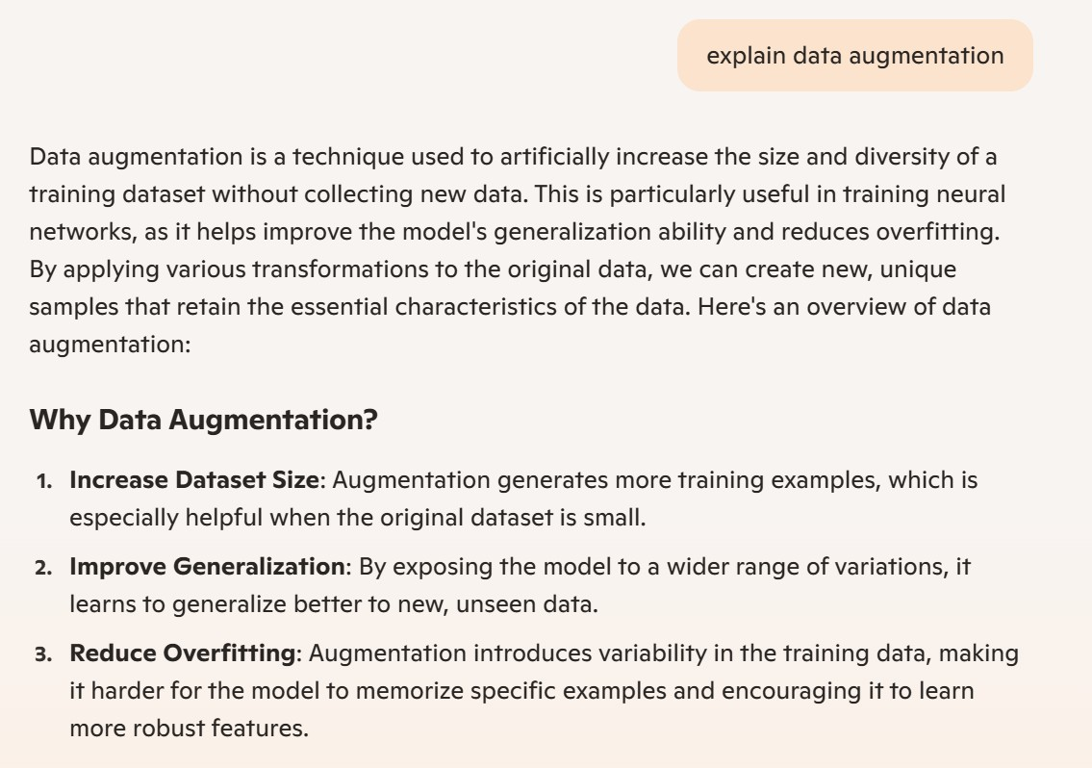

Slide 21
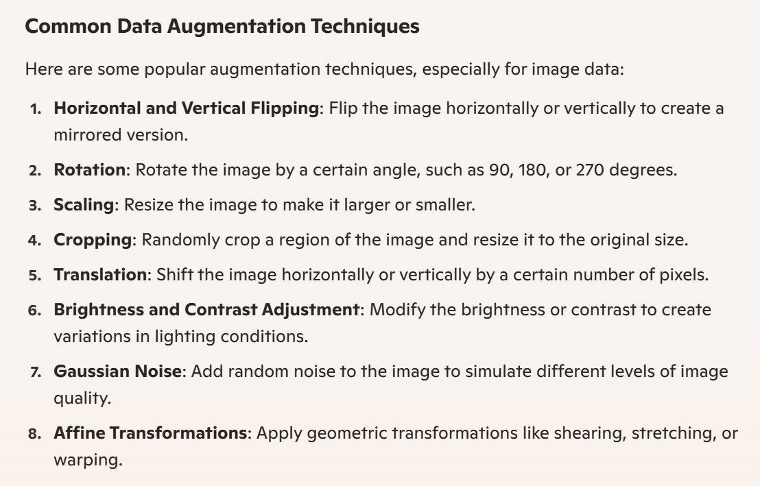

Slide 22
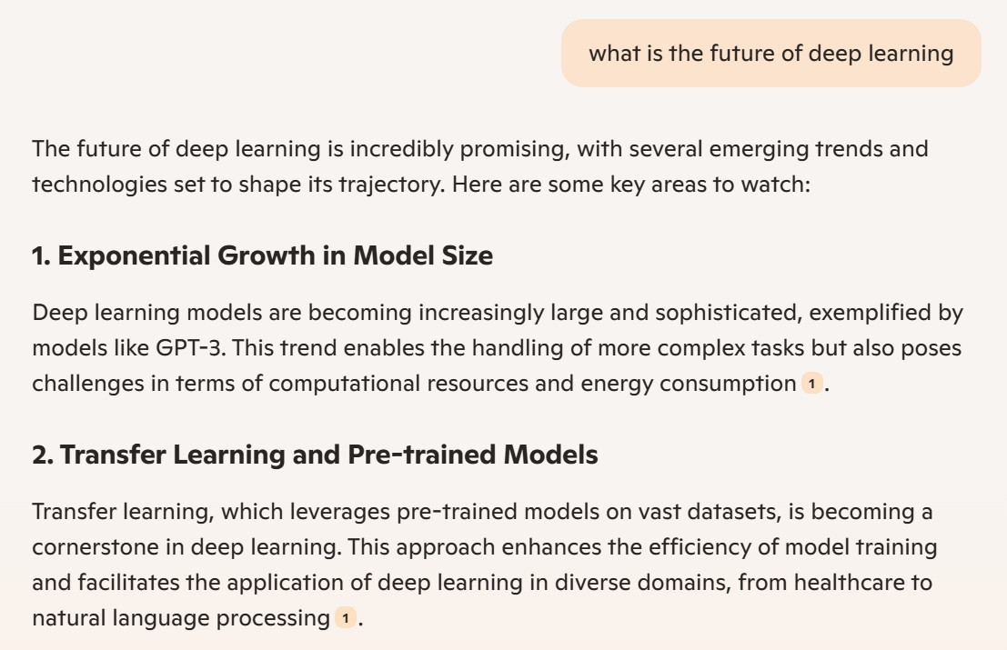

Slide 23
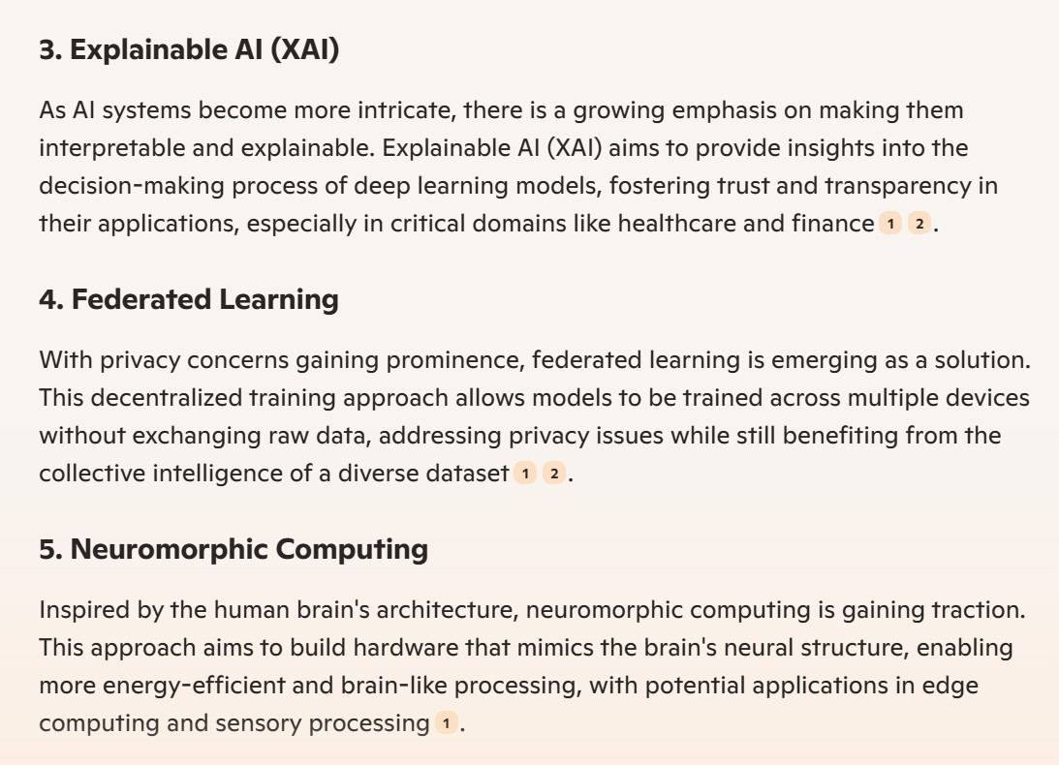

Slide 24
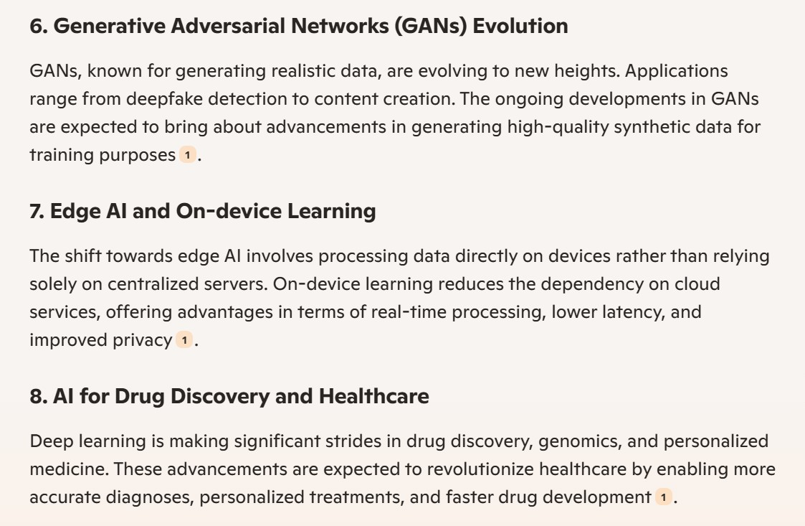

Slide 25
