Slide 1
Introduction to Programming for Quantum Computer
Prabhas Chongstitvatana
Faculty of Engineering
Chulalongkorn University
Workshop for Joint Conference of Computer Science and Engineering
Bangkok, Thailand
22 June 2022

Slide 2
Outline
What is Quantum Computer
How does it work
Try your hands on programming

Slide 3

More Information
Search “Prabhas Chongstitvatana”
Go to me homepage

Slide 4
What is a quantum computer?
a computer that relies on special memory, "quantum bit", to perform massively parallel computing.

Slide 5
What is a quantum bit?
a basic unit of memory that uses superposition of "quantum" effect (entanglement) to store information.
a "qubit" stores the probability of information. It represents both "1" and "0" at the same time.

Slide 6
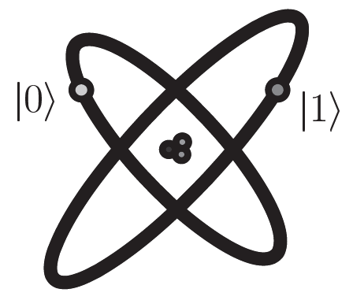


Quantum Bits (Qubits)
Classical bits vs. Quantum bits
Qubits are mathematical objects (similarly to 0/1 in classical bits)
Prob.
Prob.

Slide 7
What is the advantage?
It is very very fast compared to conventional computers
It has very large memory

Slide 8
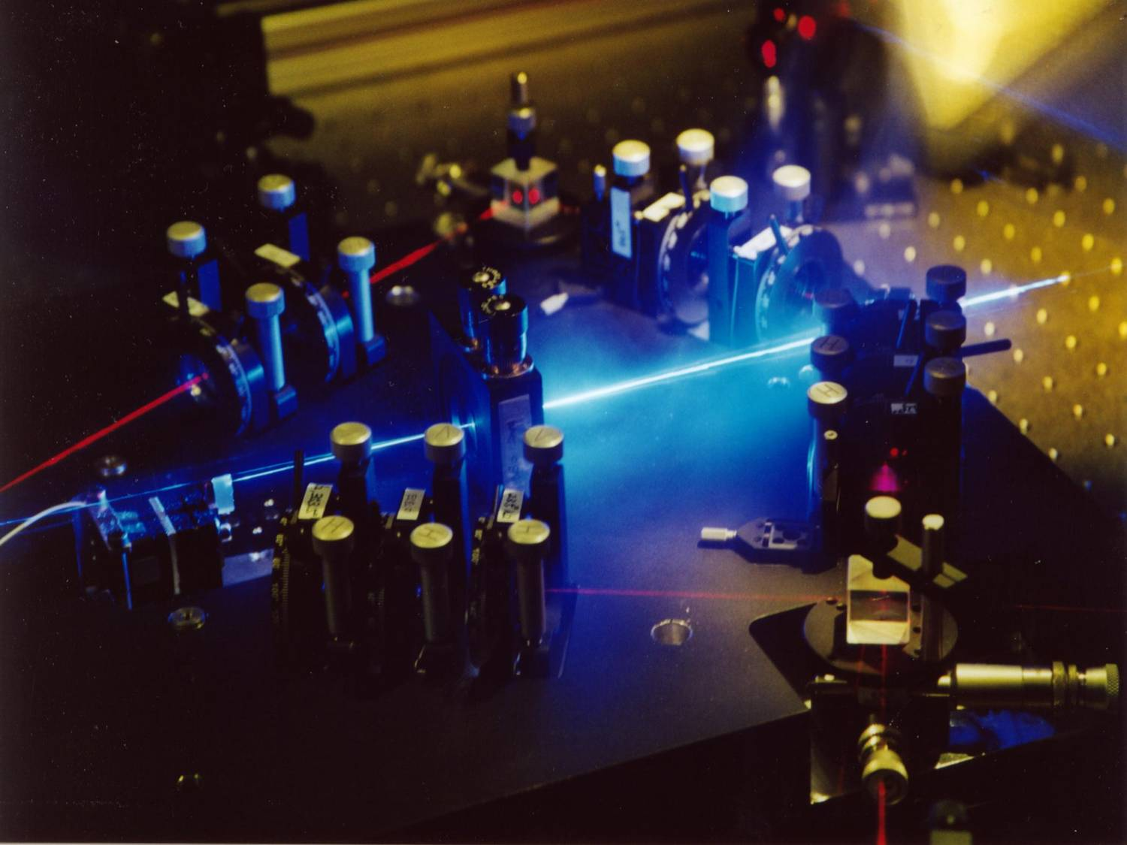
Linear optics quantum computing (LOQC)
Experimental setup to generate up to four entangled photons. These photons are typically entangled in polarization and can be further manipulated by simple optical devices. Recently a four-photon cluster state was realized with this setup. http://homepage.univie.ac.at/robert.prevedel/test_research_LOQC.html

Slide 9
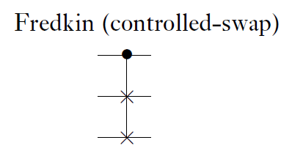
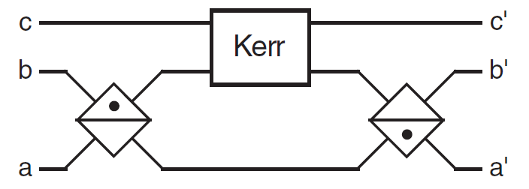
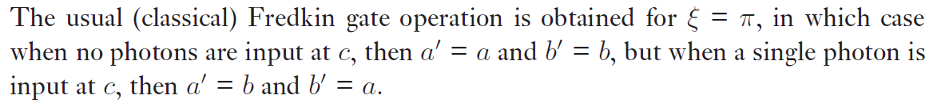
Quantum Optical Fredkin Gate

Slide 10
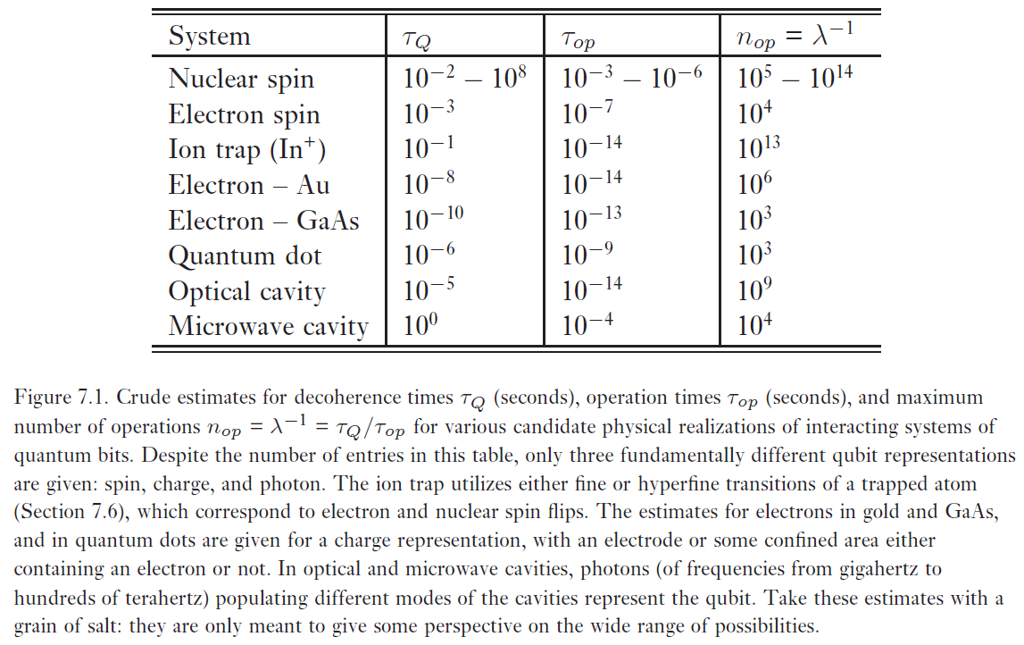
Quantum computers: physical realization

Slide 11
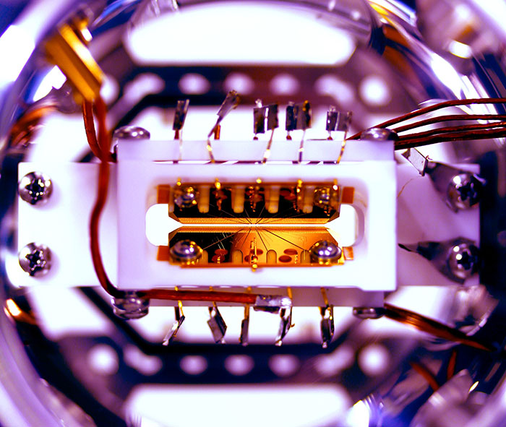

Slide 12
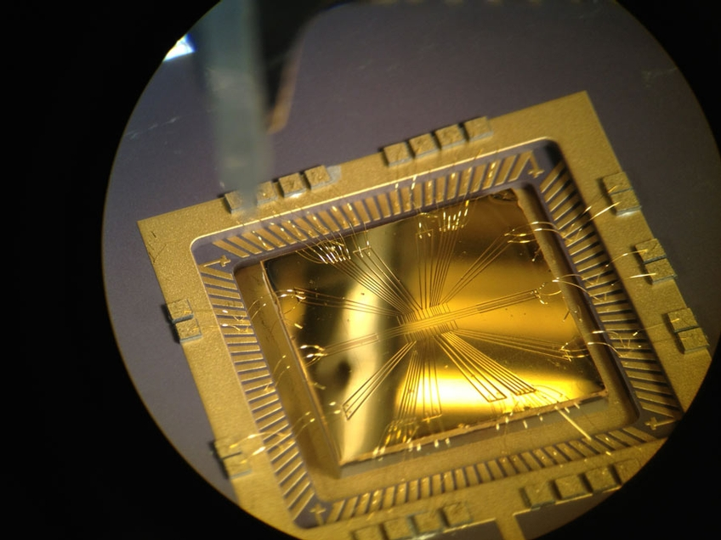

Slide 13
Example of quantum computers
IBM 5 and 50 qubits
D-wave two, quantum annealing

Slide 14
Recent work
google quantum lab's paper
claim of 100,000,000x speed up

Slide 15
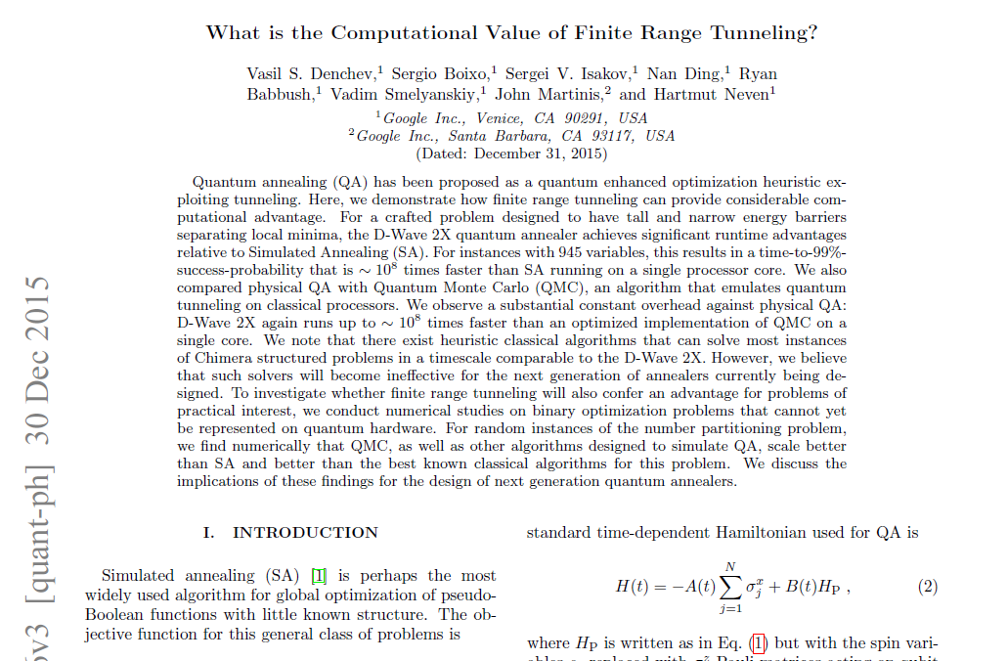

Slide 16
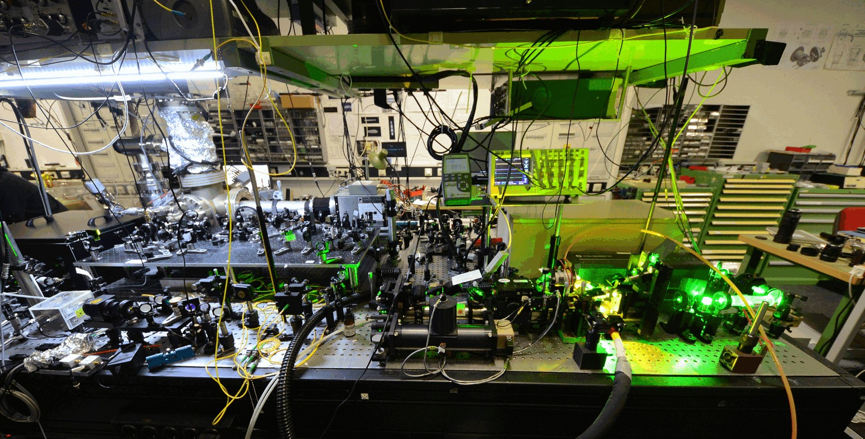

Slide 17
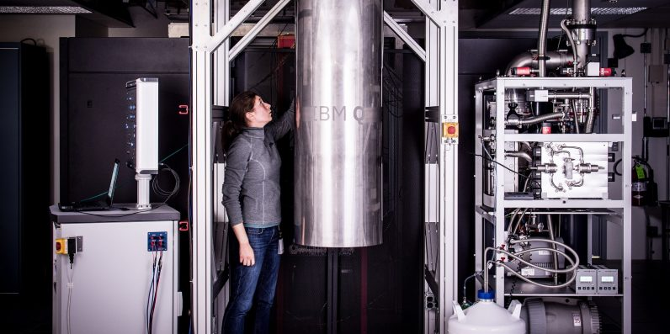
IBM 50 qubits quantum computer

Slide 18
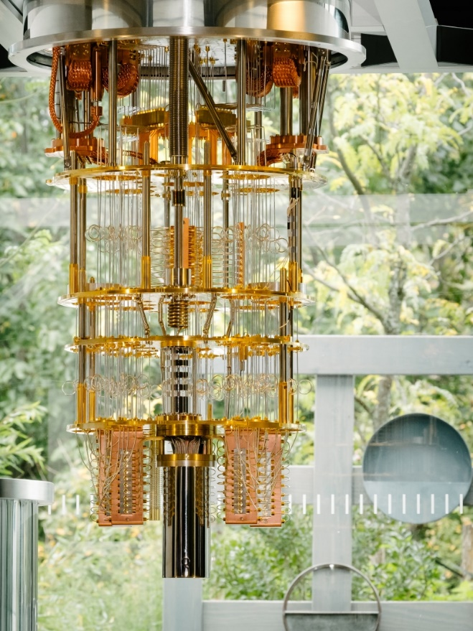

Slide 19
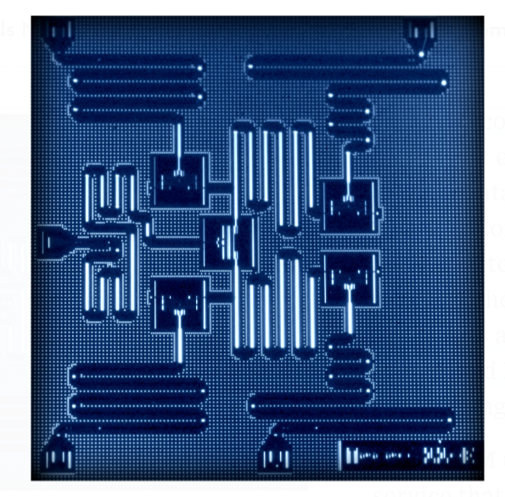
IBM 5 qubits processor

Slide 20
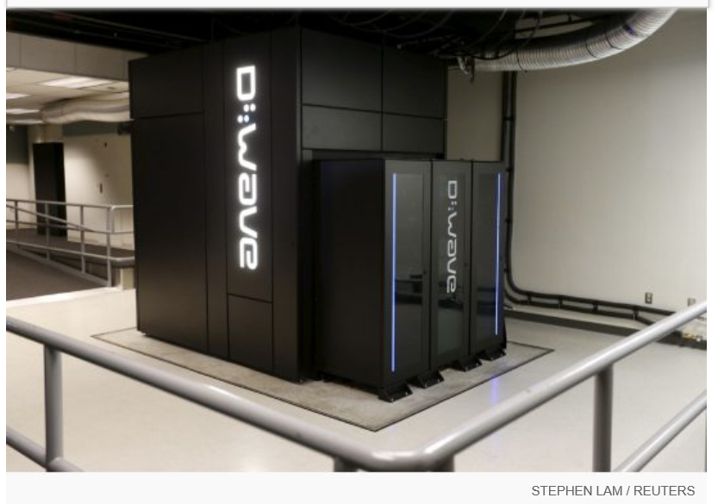
Google Nasa, D-Wave 2x machine

Slide 21
Programming Quantum Computers

Slide 22
Quantum algorithms
computer programs that work on quantum computers

Slide 23
Famous algorithms
Shor's integer factorization
Given an integer N, find its prime factors

Slide 24
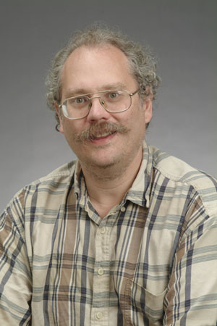
Quantum Algorithms
Peter Shor
a quantum algorithm for integer factorization formulated .

Slide 25
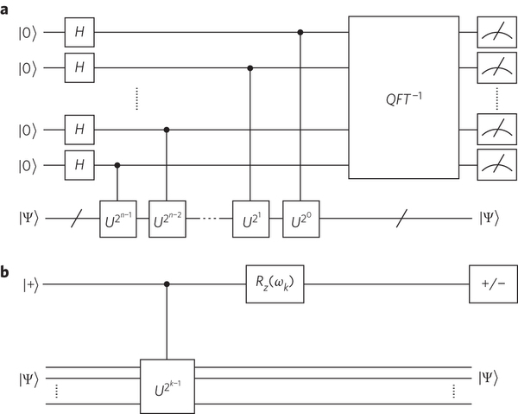
Quantum circuits

Slide 26
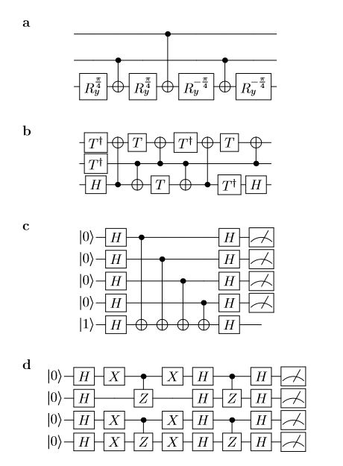

Slide 27
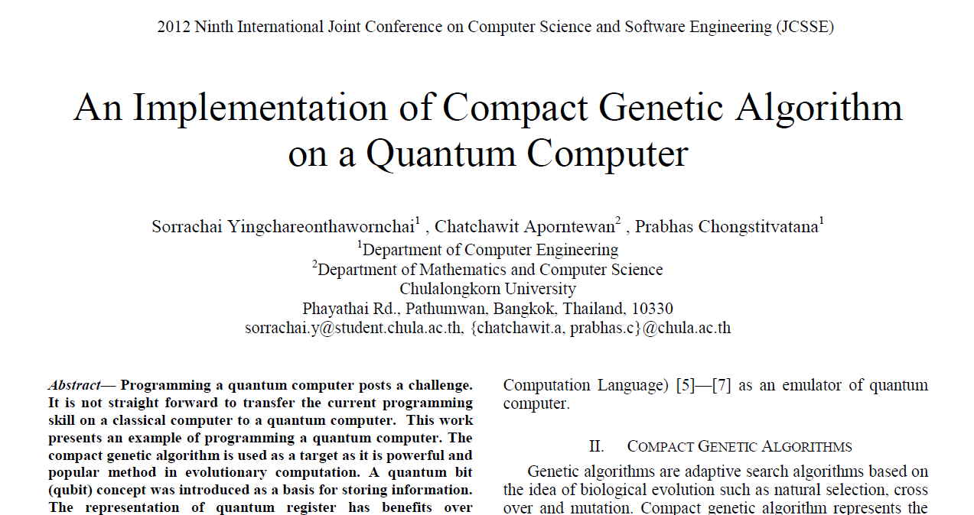

Slide 28
Normal
1) initialze qureg x
2) generate two individuals from qureg
3) let them compete
4) update qureg x with the winner
5) repeat step 2..4 for k times
6) measure the final result

Slide 29
quantum speedup
1) initialze qureg x
2) generate the first individual from qureg x
3) generate the second individual with condition that fitness is greater than the first
4) let them compete
5) update qureg x with the winner
6) repeat step 2..5 for k times
7) generate the final result

Slide 30
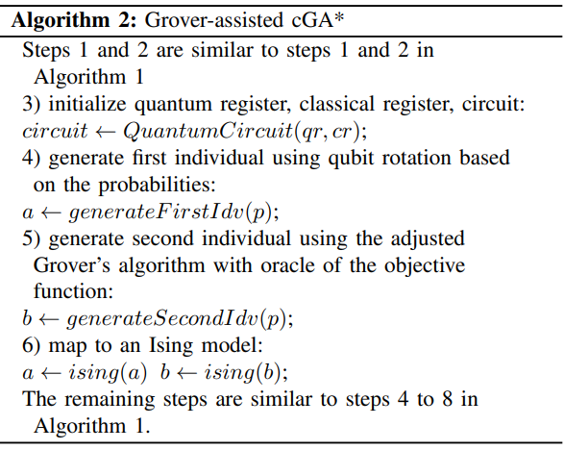



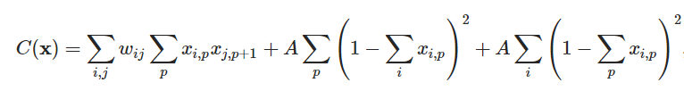
SECTION 5 Proposed Method
Grover-assisted Compact Genetic Algorithm
An arbitrary single-qubit state is defined:
The qubit rotation for angle(θ) is defined:
Mapping to Ising model for TSP:
System energy for TSP:
Total distance
The constraints to check a feasible path

Slide 31
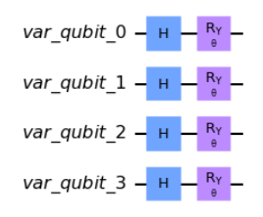
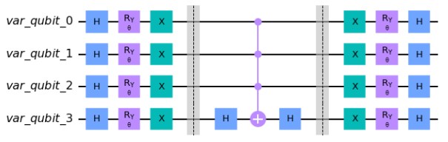
SECTION 5 Proposed Method
Grover-assisted Compact Genetic Algorithm
An arbitrary single-qubit state is defined:
The qubit rotation for angle(θ) is defined:
A circuit to initial the state based on the probability which encoding problem with 4 qubits.
A diffuser circuit which encoding problem with 4 qubits.

Slide 32
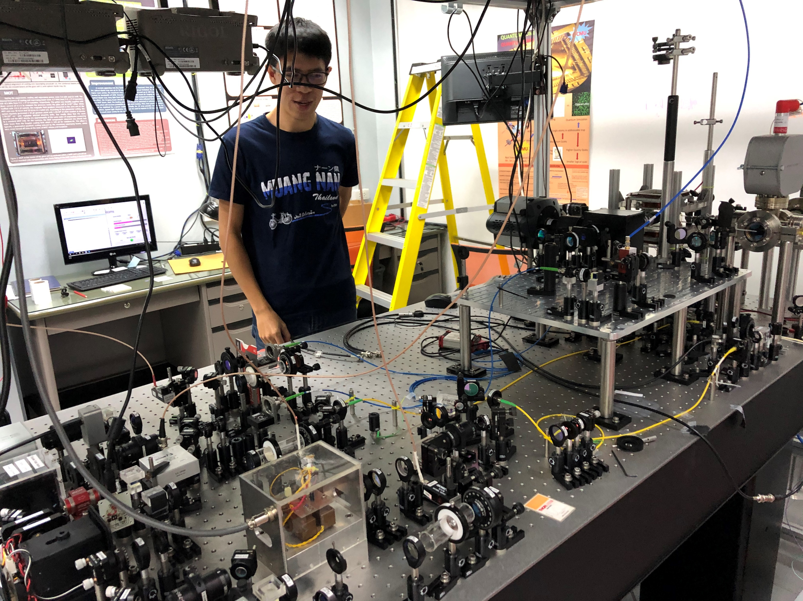
Capture an atom at Chiengmai U, Physics

Slide 33
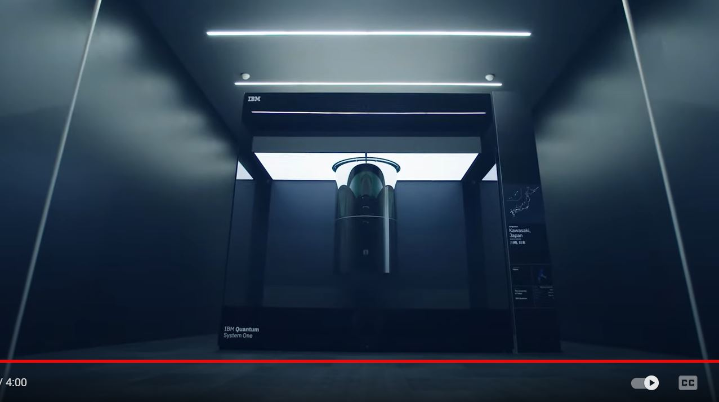
IBM quantum computer system one
https://www.youtube.com/watch?v=tPMY4oP3Qgk

Slide 34
References
Yingchareonthawornchai, S., Aporntewan, C., and Chongstitvatana, P., "An Implementation of Compact Genetic Algorithm on a Quantum Computer," Int. Joint Conf. on Computer Science and Software Engineering (JCSSE), 30 May - 1 June 2012, pp.131-135.
http://www.cp.eng.chula.ac.th/~piak/paper/2012/jcsse-quantum-cga.pdf
Suksen, K. and Chongstitvatana, P., "Experiments on Quantum Circuits for Compact Genetic Algorithm," Int. Computer Science and Engineering Conference, 18-20 Nov, 2021, Thailand.
McKinsey & Company, Quantum computing: an emerging ecosystem and industry use cases, December 2021

Slide 35
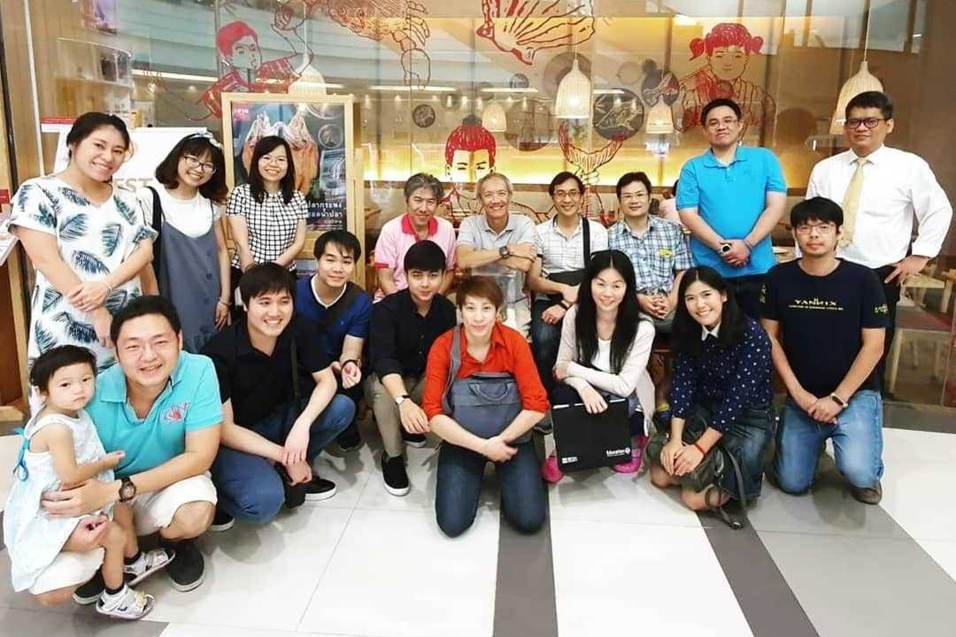
Contributors (student team 2019)

Slide 36
More Information
Search “Prabhas Chongstitvatana”
Go to me homepage

