Slide 1
GPU history
Prabhas Chongstitvatana
Chulalongkorn University

Slide 2
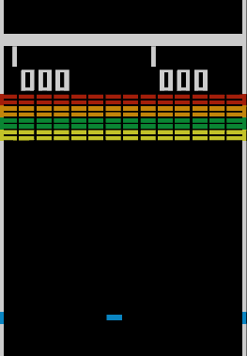
Early Arcade machines
1976 Breakout (Atari), a discrete logic (non-microprocessor) game, was designed by Nolan Bushnell, Steve Wozniak, and Steve Bristow
discrete devices around 100 chips
By Source (WP:NFCC#4), Fair use, https://en.wikipedia.org/w/index.php?curid=62975606

Slide 3
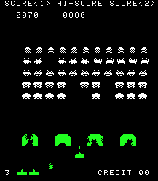
space invader
1979 Namco Galaxian arcade system used specialized graphics hardware supporting RGB color, multi-colored sprites and tilemap backgrounds.
Space Invader

Slide 4
Graphics Card
1940 Saga computer system as the flight simulator, US military, 256 colors
1981 IBM introduced Monochrome Display Adapter
1983 Intel released iSBX 275 video graphics card, 8 colors, 256 x 256

Slide 5
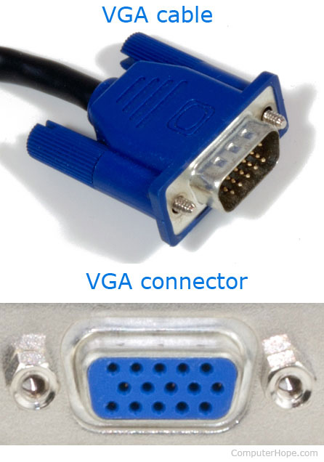
1987 VGA, IBM
VGA provides 640 x 480, 60 Hz, 16 colors
A Video Graphics Array connector, three-row 15-pin DE-15 connector.
Pin 15: ID3/SCL
Pin 3: BLUE
Pin 1: RED
Pin 6: RED_RTN
Pin 2: GREEN
Pin 5: GND
Pin 4: ID2/RES

Slide 6
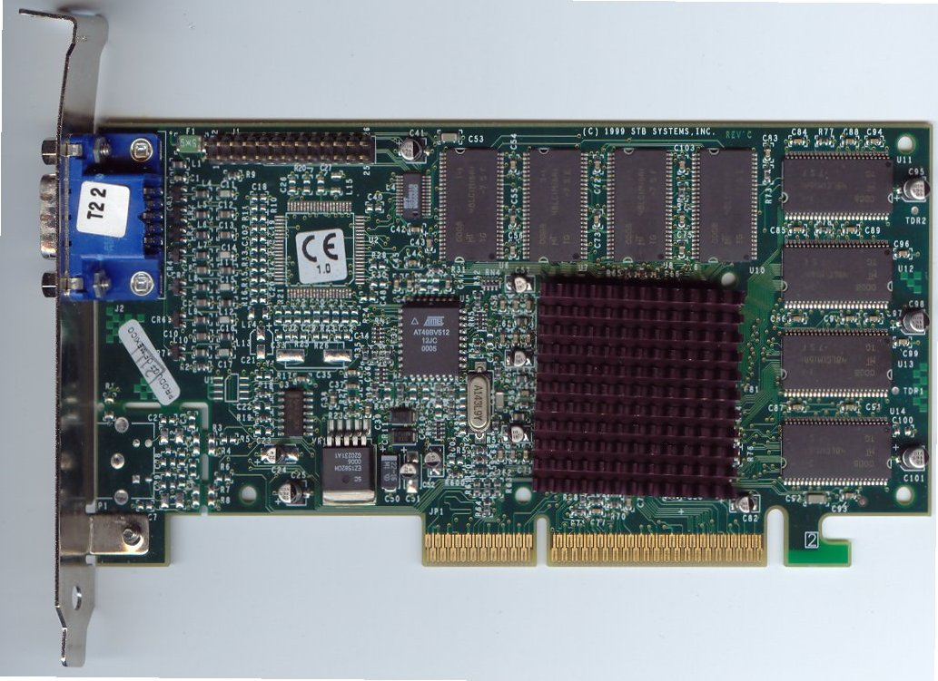
GPU
1992 Silicon Graphics Inc (SGI) released OpenGL 1.0, (API) for 2D and 3D
The term "GPU" was coined by Sony in reference to the PlayStation console's Toshiba-designed Sony GPU in 1994
1998 Voodoo2, 1024 x 768
By Swaaye at the English language Wikipedia, CC BY-SA 3.0, https://commons.wikimedia.org/w/index.php?curid=6037820

Slide 7
GPU (external)
1999 GeForce, Nvidia video card, being called a GPU
a "single-chip processor with integrated transform, lighting, triangle setup/clipping, and rendering engines"
2004 Nvidia GeForce 6 Series 6600 and 6800
2006 GeForce GTX 8800, 129 streaming processors, 575MHz core speed, 768MB of DDR3 memory
2009 AMD took over ATI and released Radeon HD 5970. The dual GPU card

Slide 8
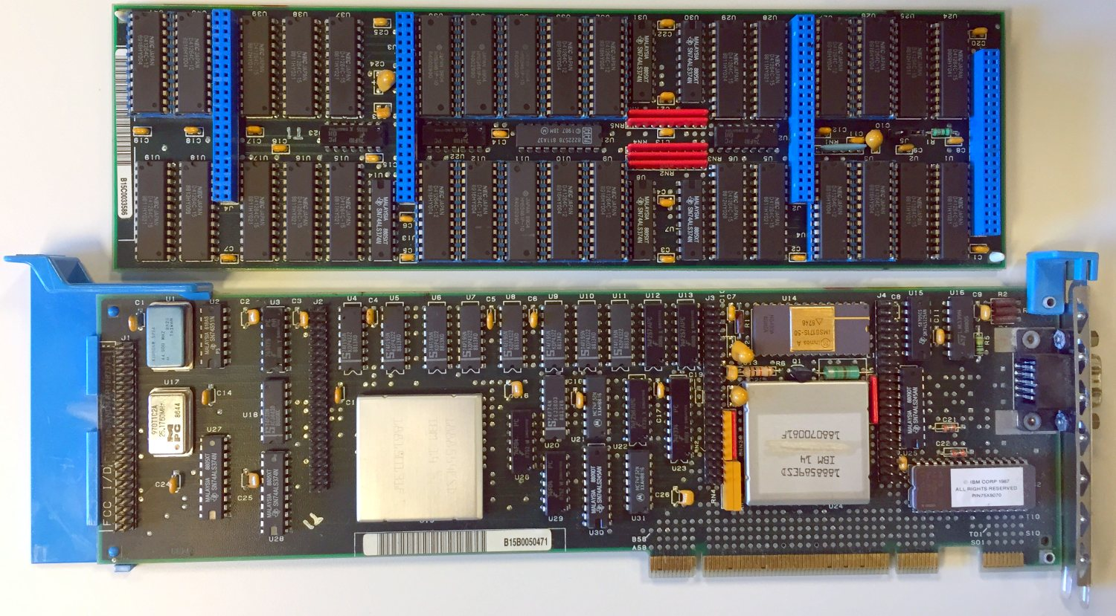
IBM 8514
By Raymangold22 - Own work, CC0, https://commons.wikimedia.org/w/index.php?curid=34790200

Slide 9
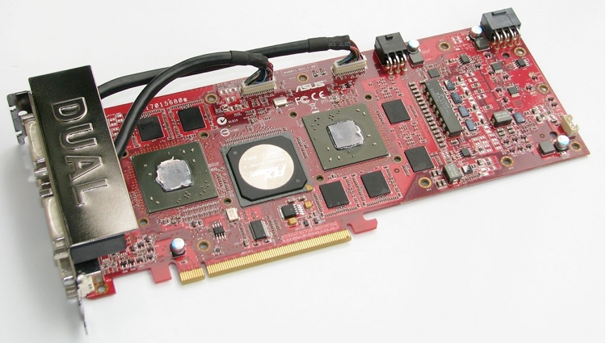
AMD RADEON 4870 x2

Slide 10
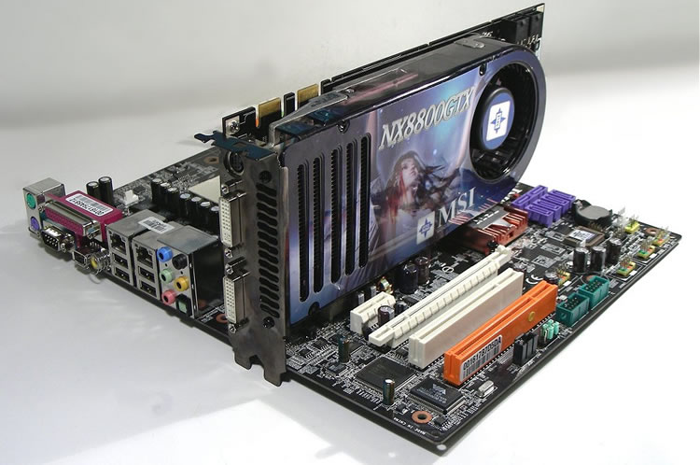
NVIDIA 8800 GTX

Slide 11
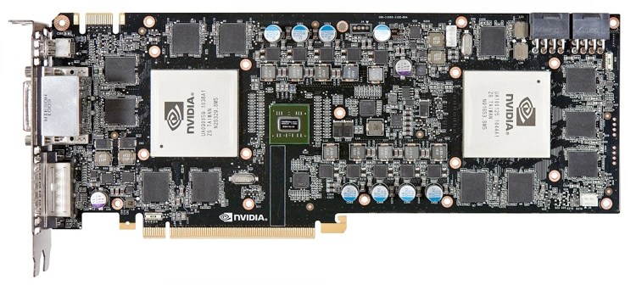
NVIDIA GTX 590

Slide 12
GPU
A graphics processing unit (GPU) is designed to accelerate the creation of images in a frame buffer intended for output to a display device
Highly parallel structure makes them more efficient than general-purpose central processing units (CPUs) for algorithms that process large blocks of data in parallel

Slide 13
GPU evolution
GPUs were initially used to accelerate the memory-intensive work of texture mapping and rendering polygons
later adding units to accelerate geometric calculations such as the rotation and translation of vertices into different coordinate systems.

Slide 14
GPU API extension to C
OpenCL and OpenMP.
Each GPU vendor introduced its own API which only works with their cards:
AMD APP SDK from AMD
CUDA from Nvidia

Slide 15
GPGPU (general purpose GPU)
Graphic Processing Unit (GPU) is a processor that was specialized forprocessing graphics.
The GPU has recently evolved towards a more flexible architecture
We can implement *any algorithm*, not only graphic

Slide 16
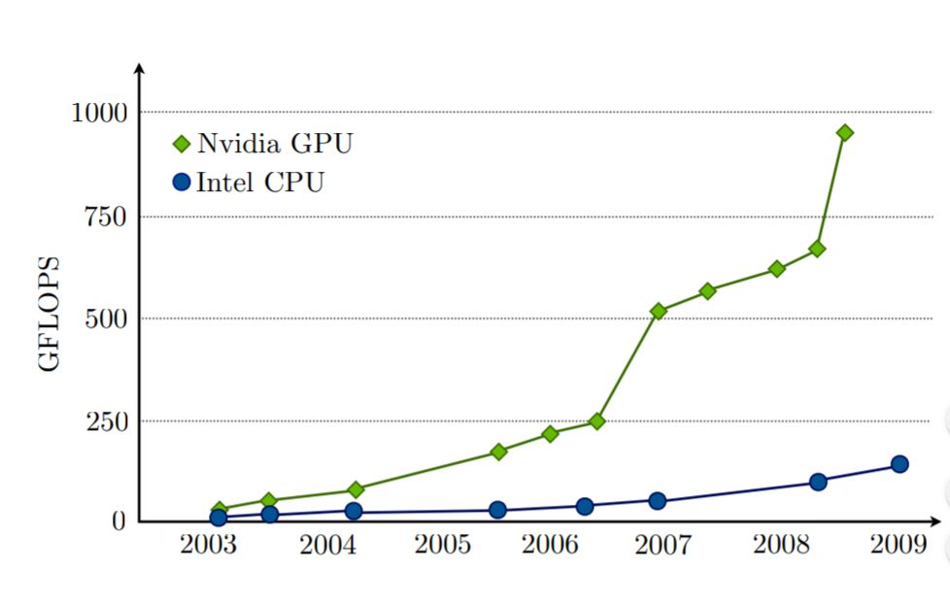
GPU vs CPU

Slide 17
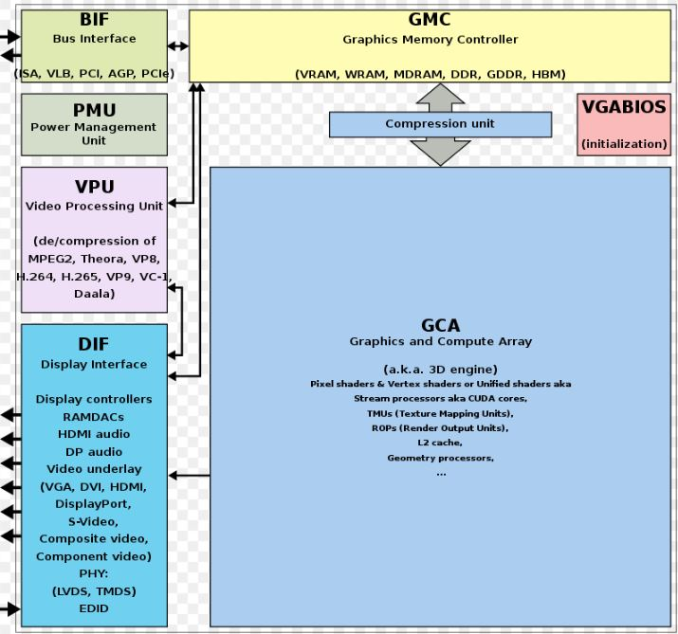
GPU components
By ScotXW - Own work, CC0, https://commons.wikimedia.org/w/index.php?curid=61055349

Slide 18
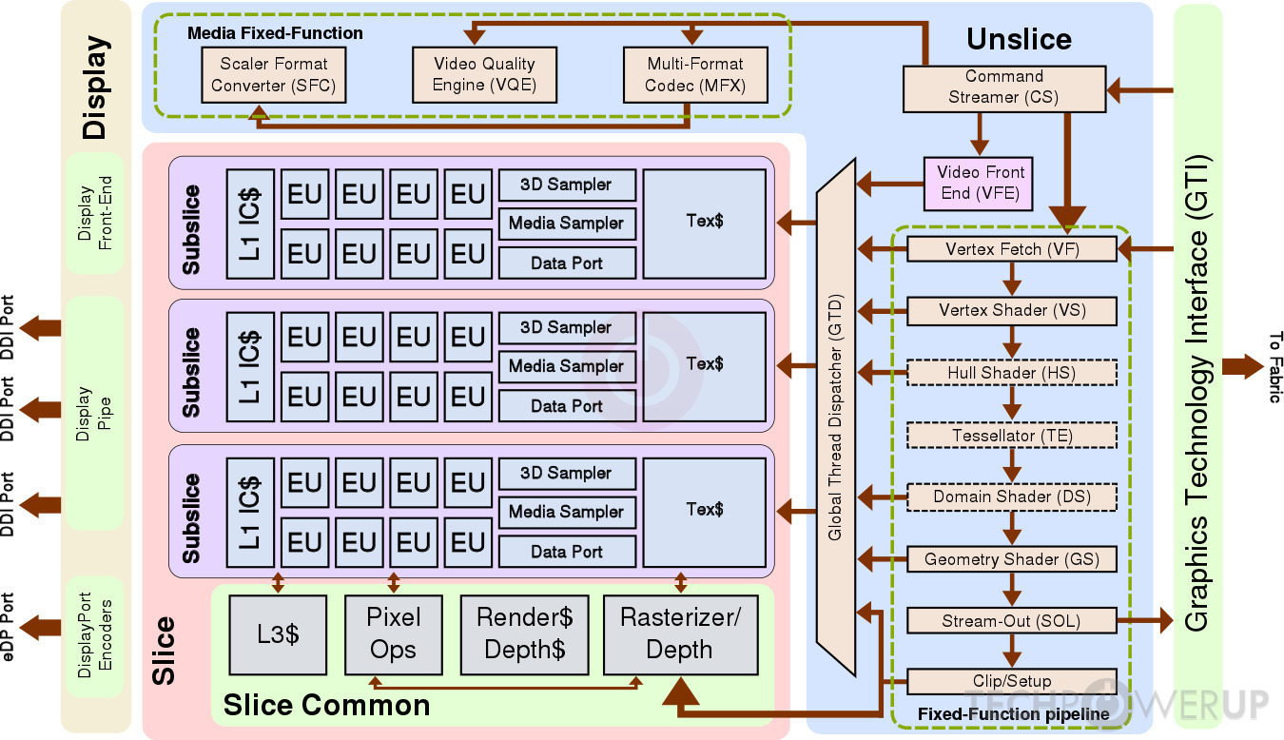
Intel Kaby Lake GT2 GPU

Slide 19
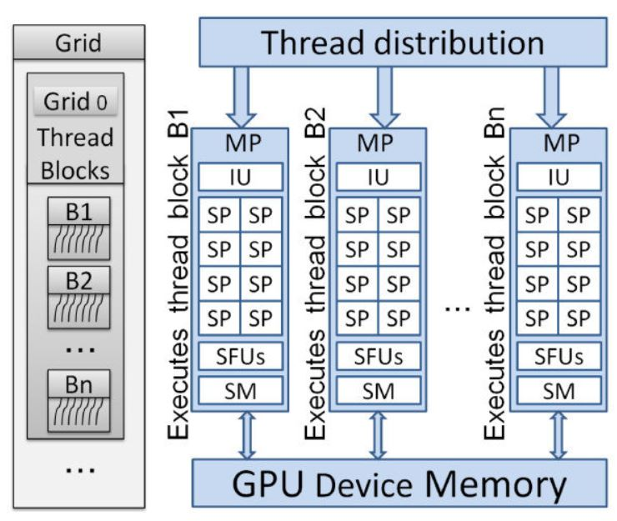
NVIDIA GPU generic

Slide 20
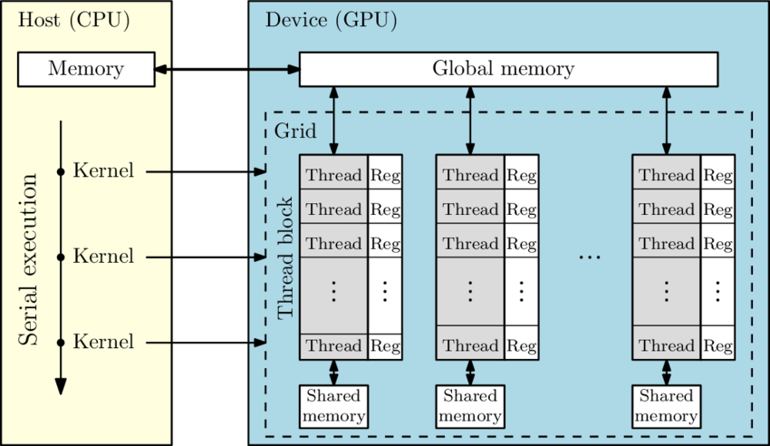
Generic GPU (software model)

