Slide 1

Introduction to CUDA

Slide 2
CUDA
Programing system for machines with GPUs
Programming Language
Compilers
Runtime Environments
Drivers
Hardware

Slide 3
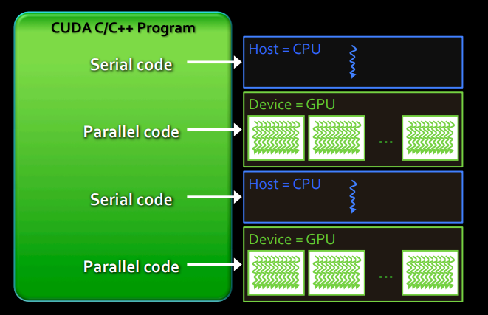
Behavior of CUDA program
Serial code executes in Host (CPU) thread
Parallel code executes in many concurrent Device (GPU) threads across multiple parallel processing elements

Slide 4
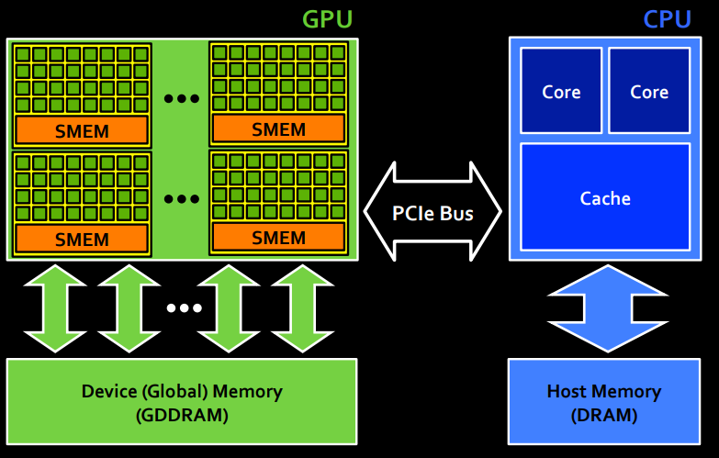
Execution flow

Slide 5
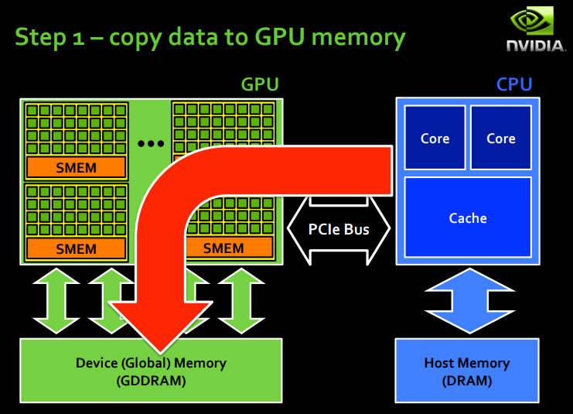

Slide 6
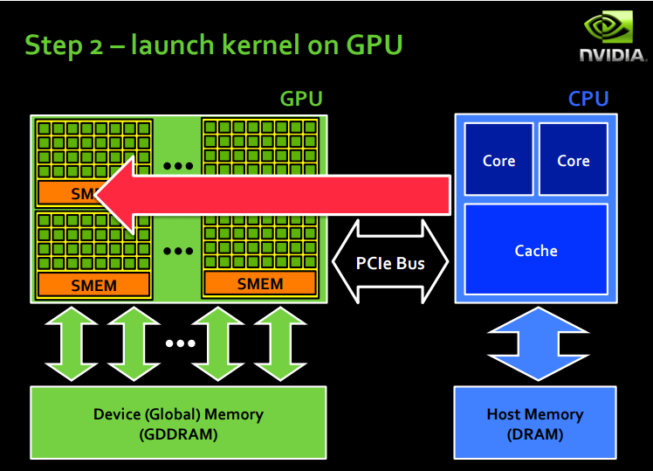

Slide 7
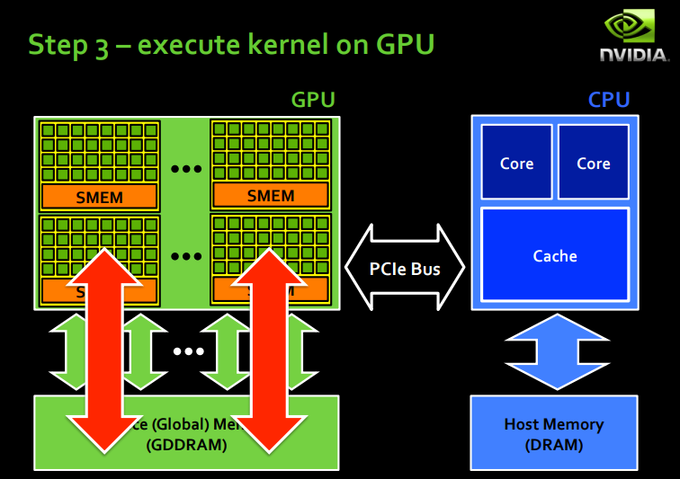

Slide 8
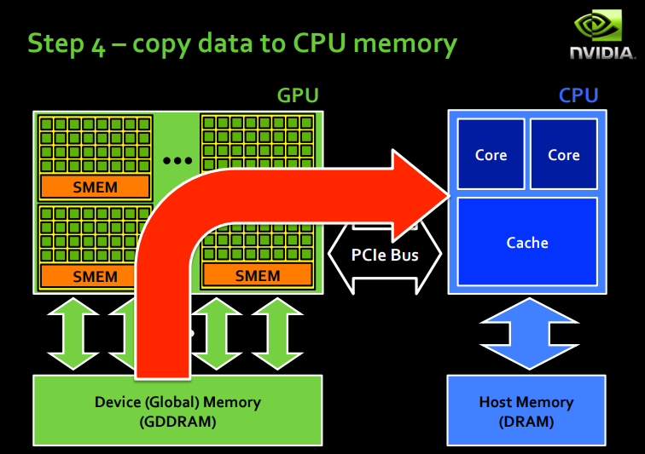

Slide 9
CUDA ARCHITECTURE

Slide 10
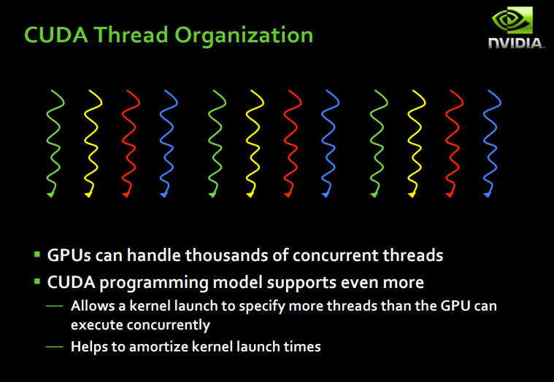

Slide 11
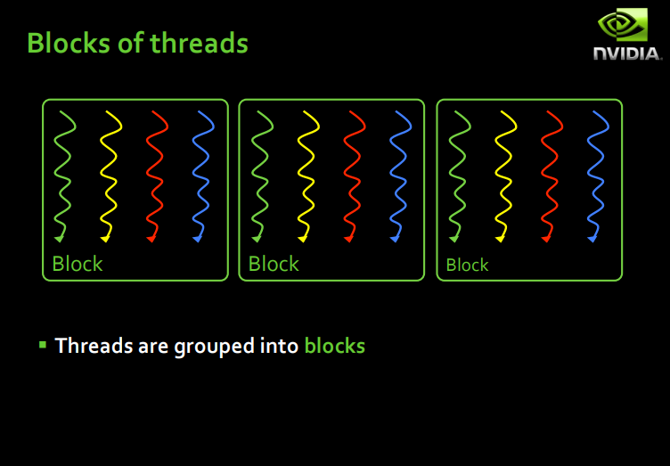

Slide 12
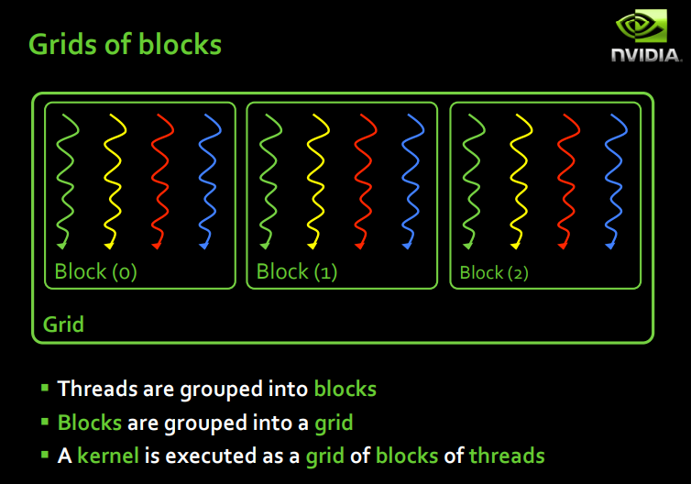

Slide 13
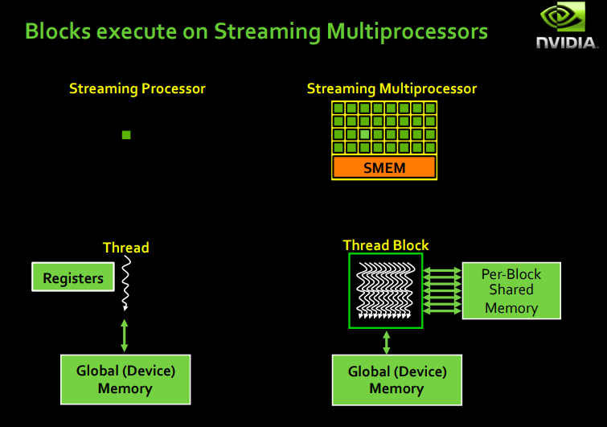

Slide 14
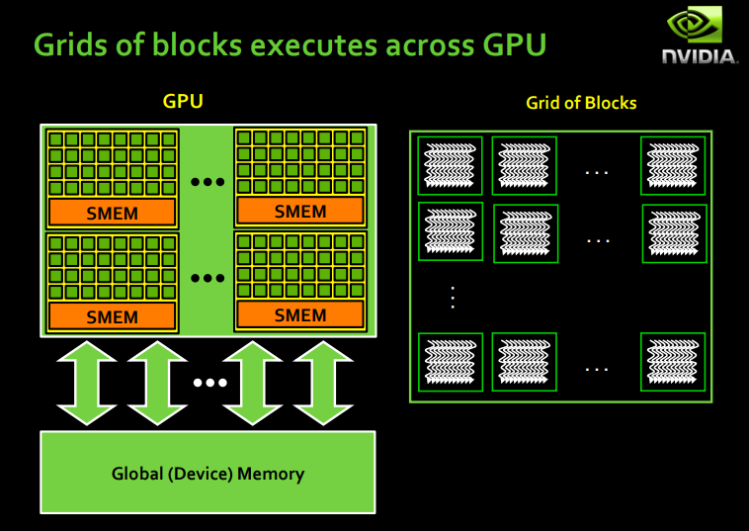

Slide 15
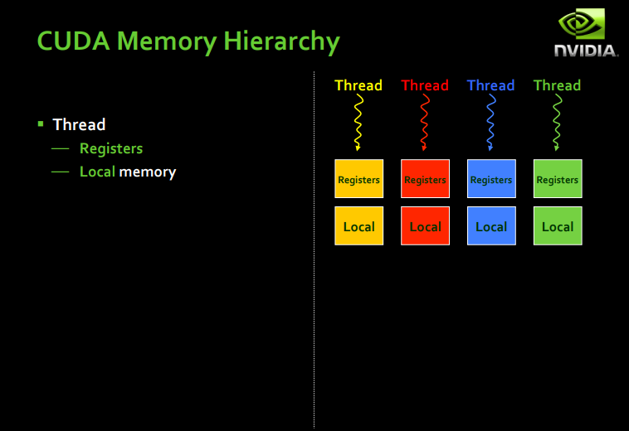

Slide 16
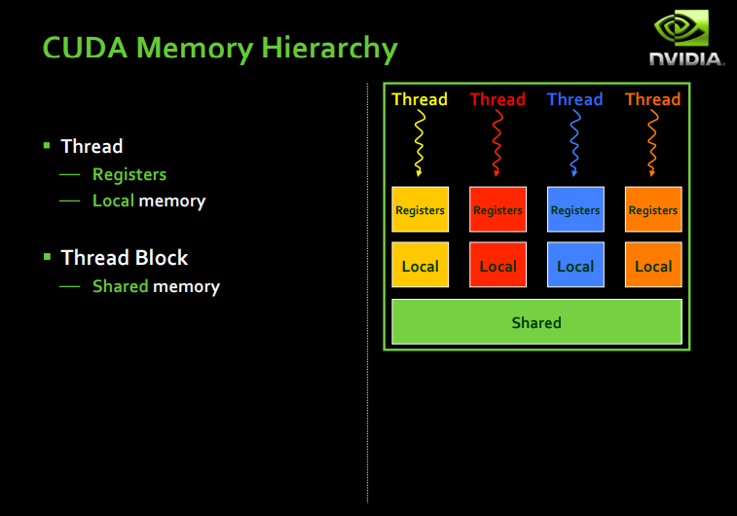

Slide 18
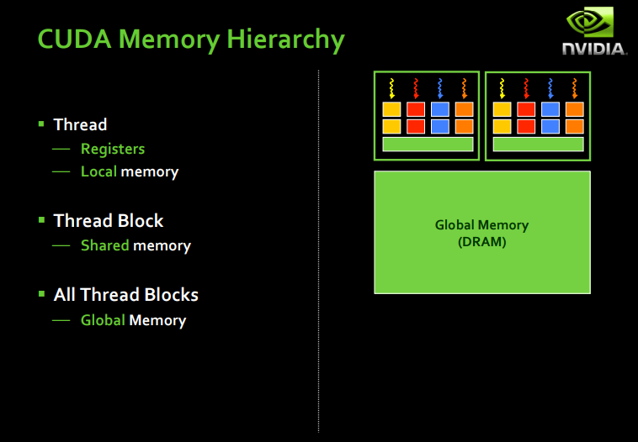

Slide 19
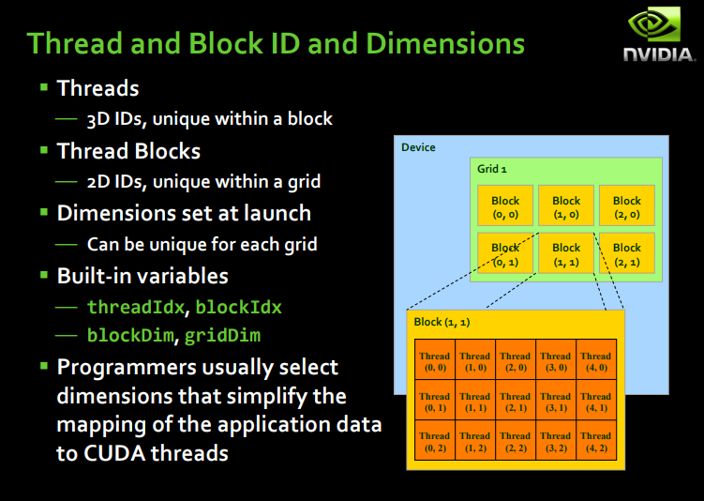

Slide 20
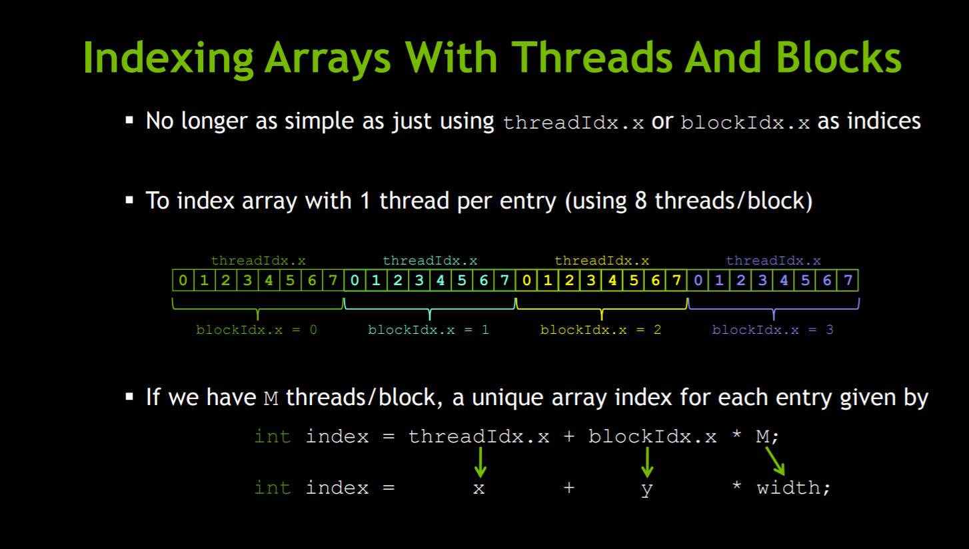

Slide 21
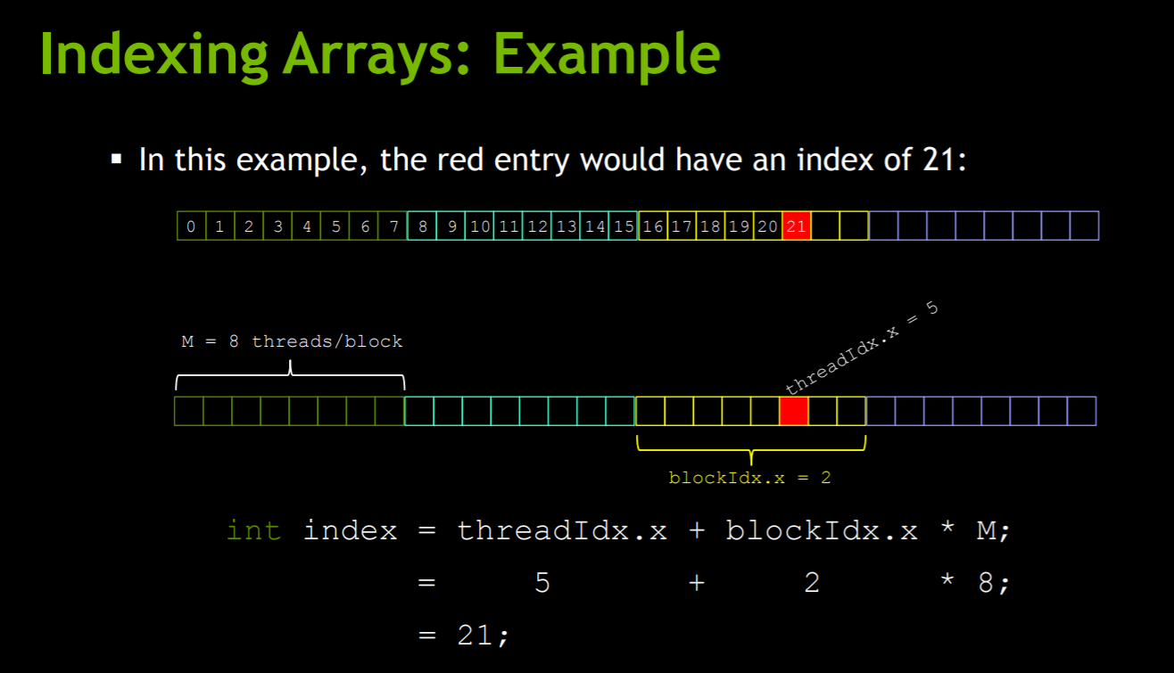

Slide 22

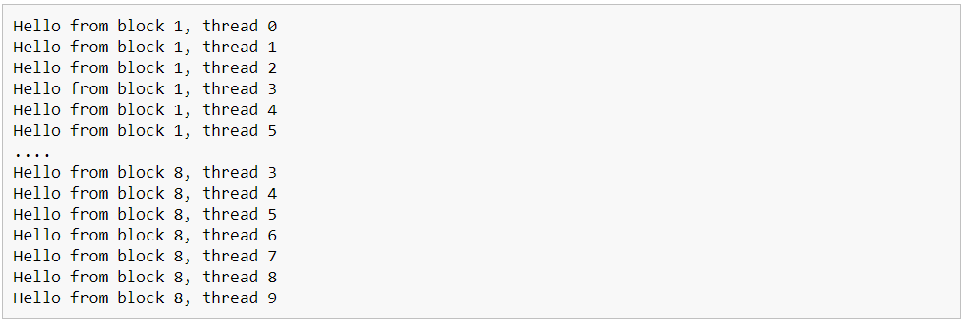
CUDA C

Slide 23
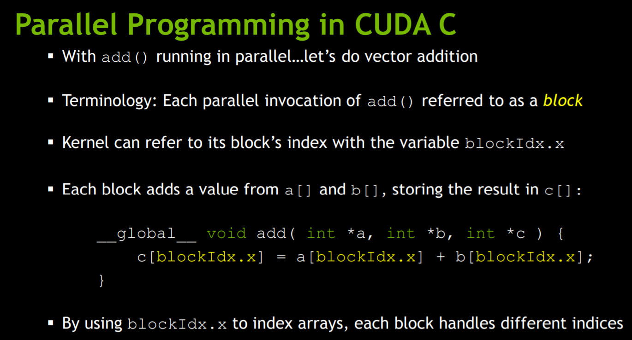

Slide 24
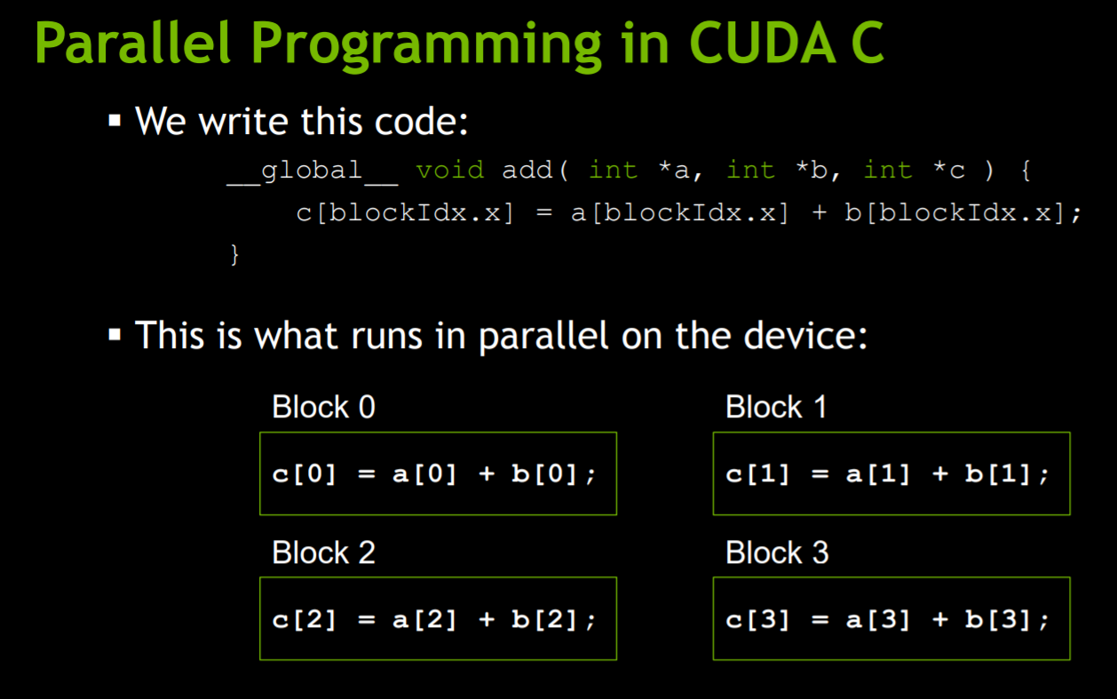

Slide 25
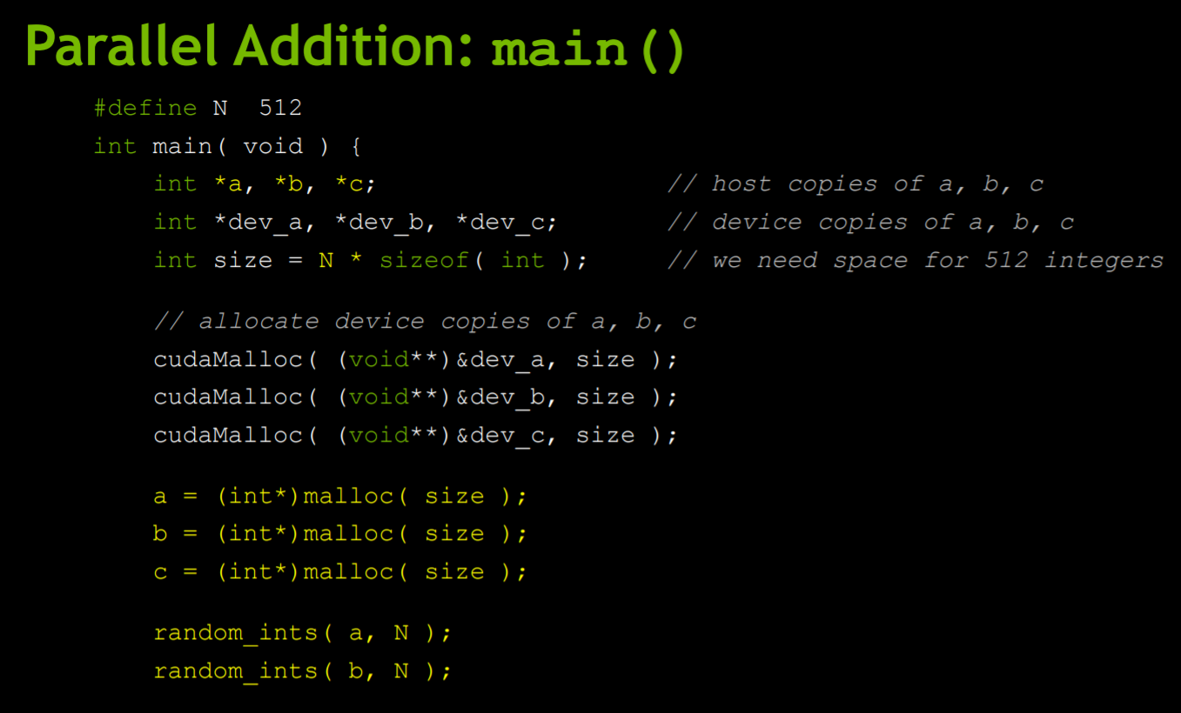

Slide 26
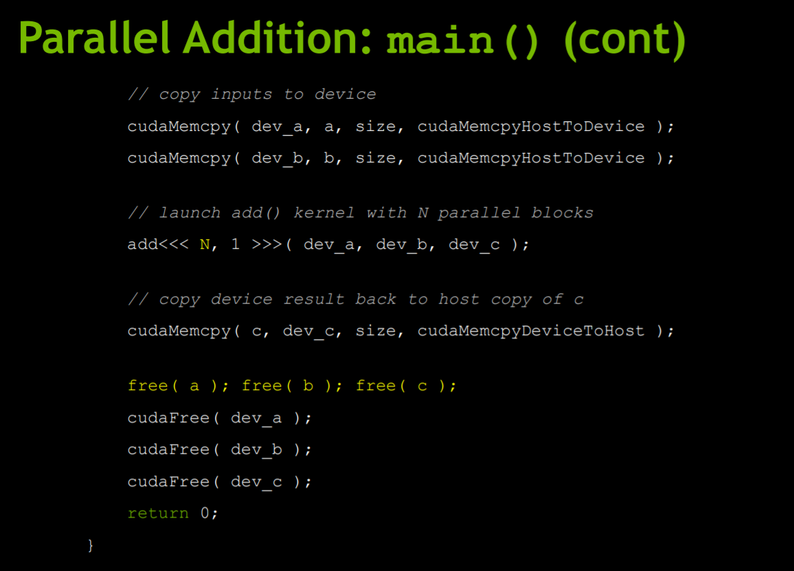

Slide 27
CUDA using Python
Anaconda/Python 3.6.1/Jupyter notebook
CUDA Toolkit
Numba package

Slide 28

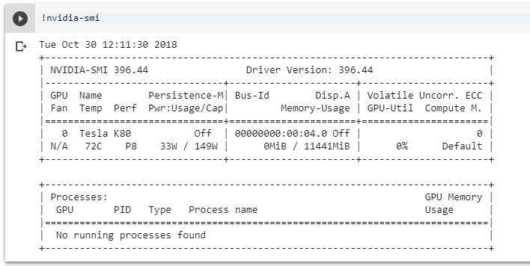
CUDA using Python

Slide 29



CUDA using Python

Slide 30
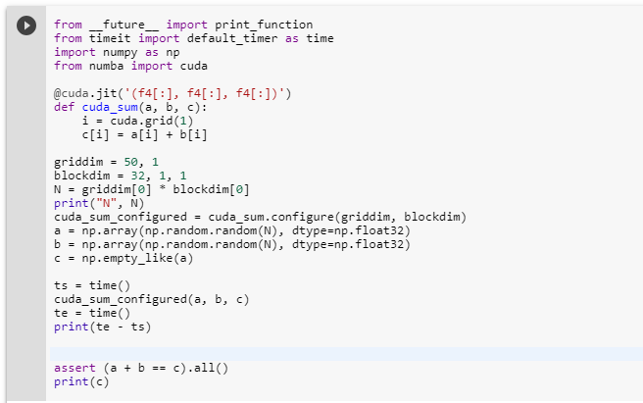
Vector add GPU
http://numba.pydata.org/numba-doc/0.13/CUDAJit.html

Slide 31
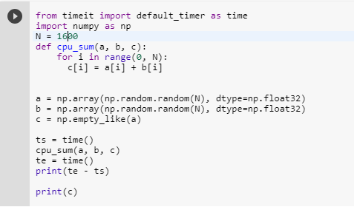
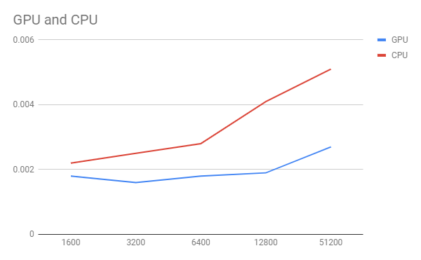
Vector add CPU

