Slide 1
Pipeline
Prabhas Chongstitvatana
20 Feb 2023

Slide 2
Instruction cycle
1. instruction fetch
2. instruction decode/register fetch
3. execution/effective address/ALU op
4. memory access
write-back

Slide 3
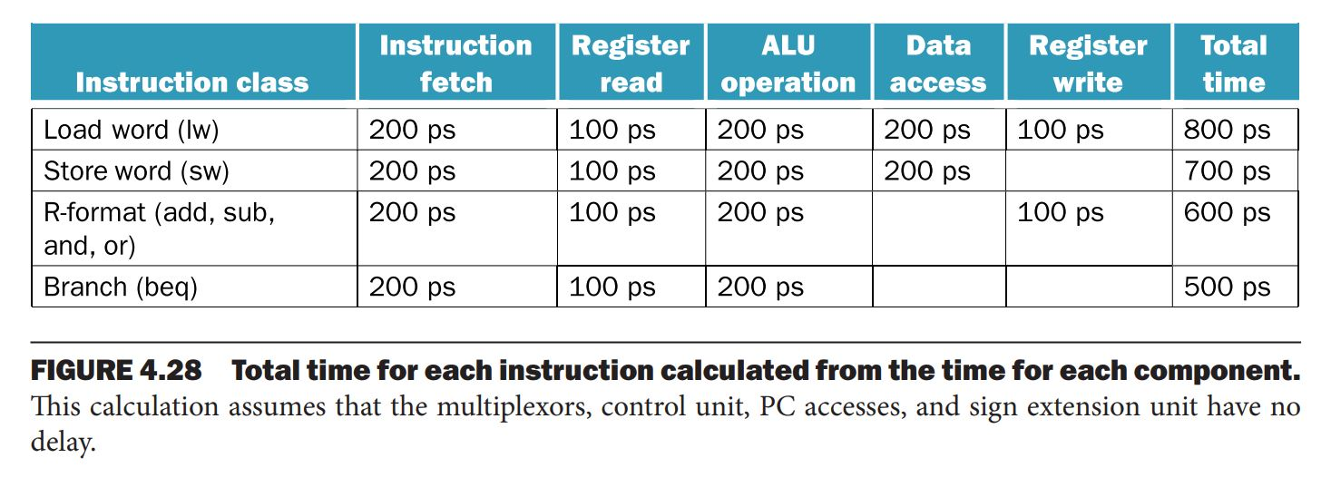
Total time for each instruction

Slide 4
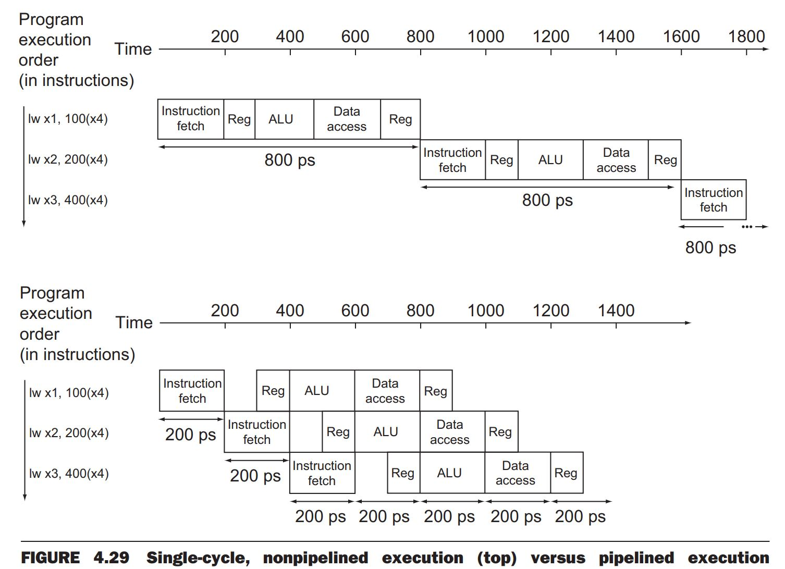
Non-pipe vs pipelined

Slide 5
Performance in pipeline
Time per instruction in a pipelined processor,
Assume ideal condition (no stall)
Time per instruction on non-pipeline / no. of stages of pipeline
Pipeline improves performance by increases instruction throughput

Slide 6
Pipeline harzards
Structural harzard
Not enough hardware unit
Data harzard
One stage waits on data from another stage
Control harzard
Stall on branch

Slide 7
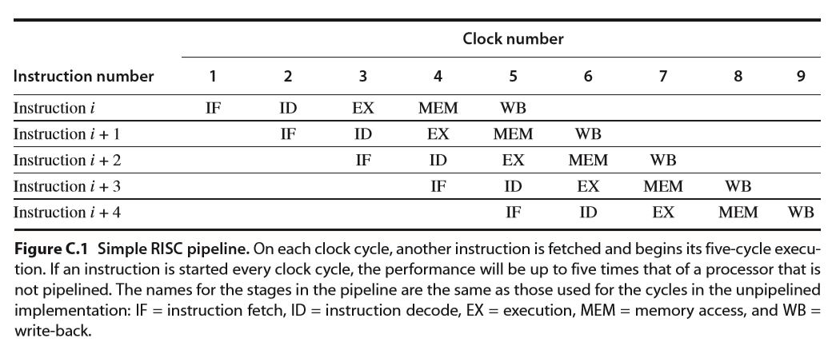
RISC pipeline

Slide 8
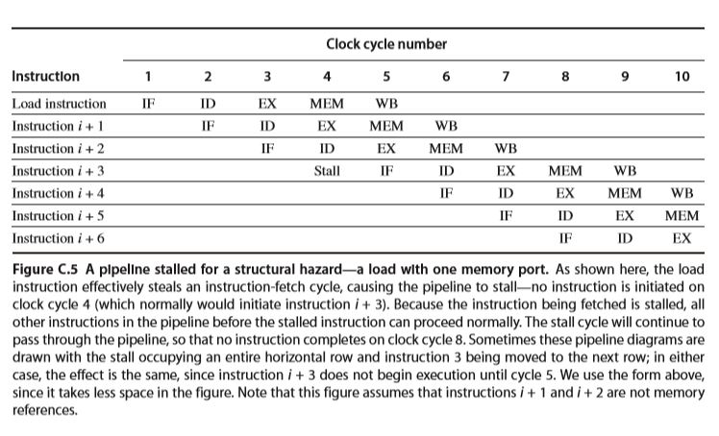
Structural hazard

Slide 9
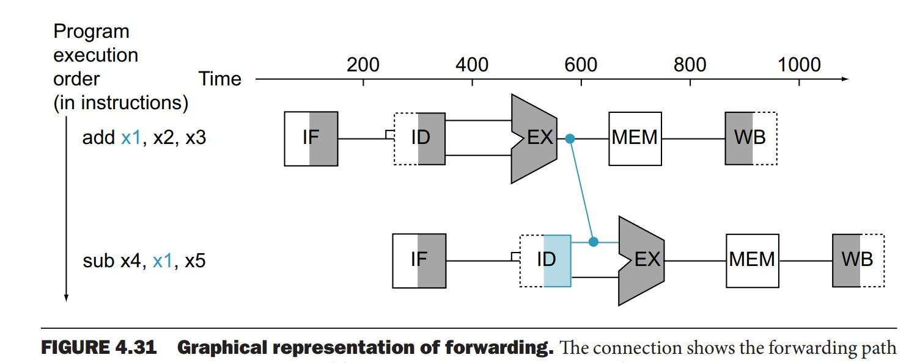
Data harzard
add x1, x2, x3
sub x4, x1, x5
Data forwarding

Slide 10
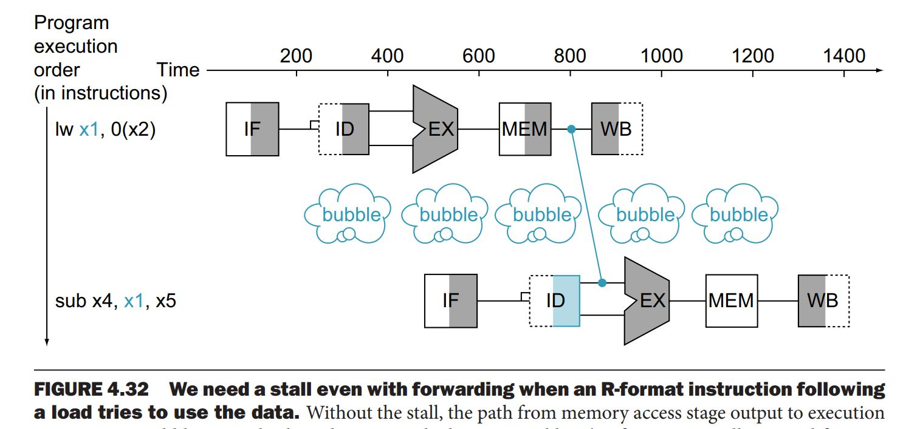
But still stall in some cases

Slide 11
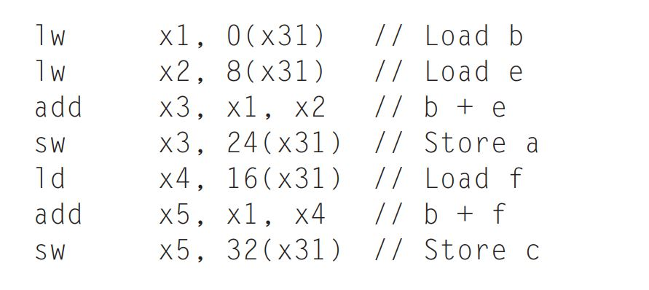
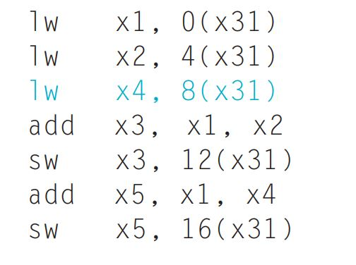
Reorder code to avoid stalls
a = b + e;
c = b + f;

Slide 12
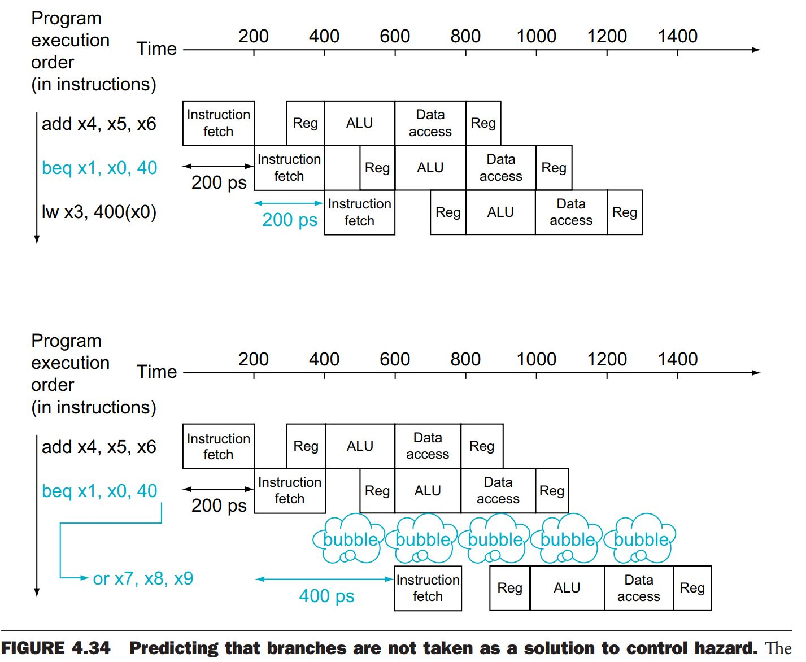
Control harzard

Slide 13
branch-prediction-buffer
memory stores prediction bit (taken/not taken)
index by lower portion of the address of branch instruction

Slide 14
one-bit predictor
one-bit predictor
if a branch is always taken, predict incorrectly twice

Slide 15
One-bit-predictor
1 0000 mov
2 0001 add
3 0010 jmp taken
4 0000 mov
5 0001 add
6 0010 jmp not-taken
7 0011 ld
8 0100 st
9 0101 jmp taken
10 0000 mov
11 0001 add
12 0010 jmp taken
branch prediction buffer
0010 [1] @3 hit,
[1] @6 miss flip,
[0] @12 miss flip -> [1]
0101 [1] @9 hit

Slide 16
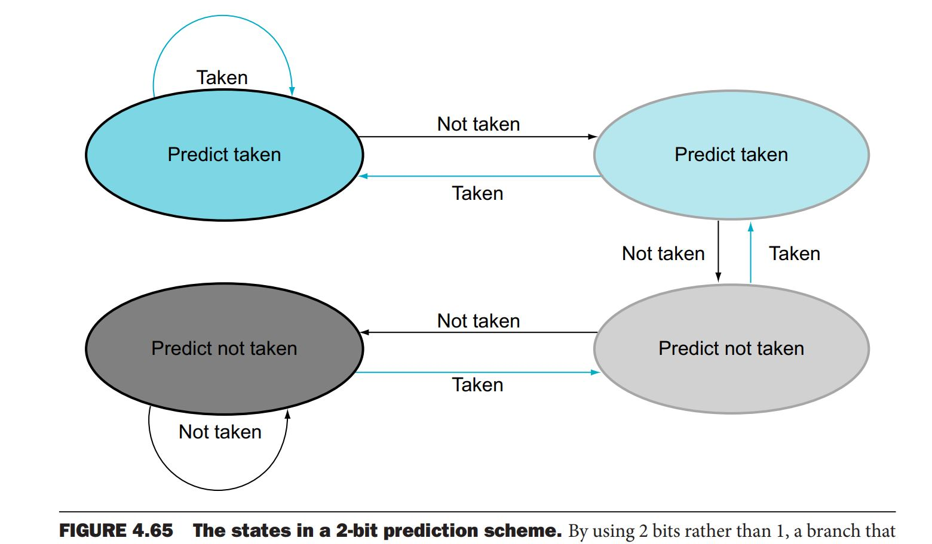
Two-bit-predictor

Slide 17
Quiz 1
Calculate average execution time (CPI)
a processor has 1 ns clock cycle non-pipeline. it uses 5 cycles for ALU ops, 4 cycles for branch,6 cycles MEM.
frequency of ops: ALU 50%, BR 20%, MEM 30%
What is it average instruction execution time?
average instruction execution time = clock cycle x average CPI
Answer
Assume 1 ns clock
1 ns x [(50%x5) + (20%x4) + (30%x6)]
2.5 + .8 + 1.8 = 5.1

Slide 18
Quiz 2
1 0000 add
2 0001 add
3 0010 ld
4 0011 jmp taken
5 0000 add
6 0001 add
7 0010 ld
8 0011 jmp not-taken
9 0100 sub
10 0101 st
11 0110 jmp taken
12 0000 add
13 0001 add
14 0010 ld
15 0011 jmp taken
16 0000 add
17 0001 add
18 0010 ld
19 0011 jmp not-taken
20 0100 sub
This is a trace of instruction execution. using one-bit branch prediction, how many miss?
branch prediction buffer
0011 [1] @4 hit
[1] @8 miss flip
[0] @15 miss flip
[1] @19 miss flip -> [1]
0110 [1] @11 hit
Answer 3 misses

Slide 19
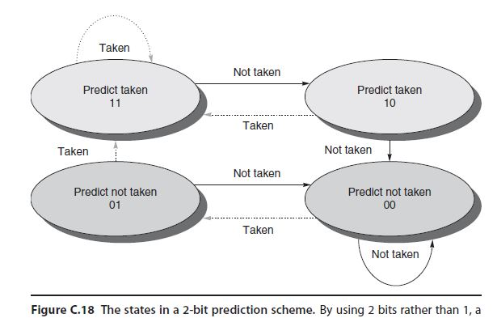
Quiz 3
1 0000 add
2 0001 add
3 0010 ld
4 0011 jmp taken
5 0000 add
6 0001 add
7 0010 ld
8 0011 jmp not-taken
9 0100 sub
10 0101 st
11 0110 jmp taken
12 0000 add
13 0001 add
14 0010 ld
15 0011 jmp taken
16 0000 add
17 0001 add
18 0010 ld
19 0011 jmp not-taken
20 0100 sub
This is a trace of instruction execution. using two-bit branch prediction, how many miss?
Branch prediction buffer
0011 [11] @4 hit
[11] @8 miss -> [10]
[10] @15 hit -> [11]
[11] @19 miss -> [10]
0110 [11] @11 hit
Answer 2 misses

Slide 20
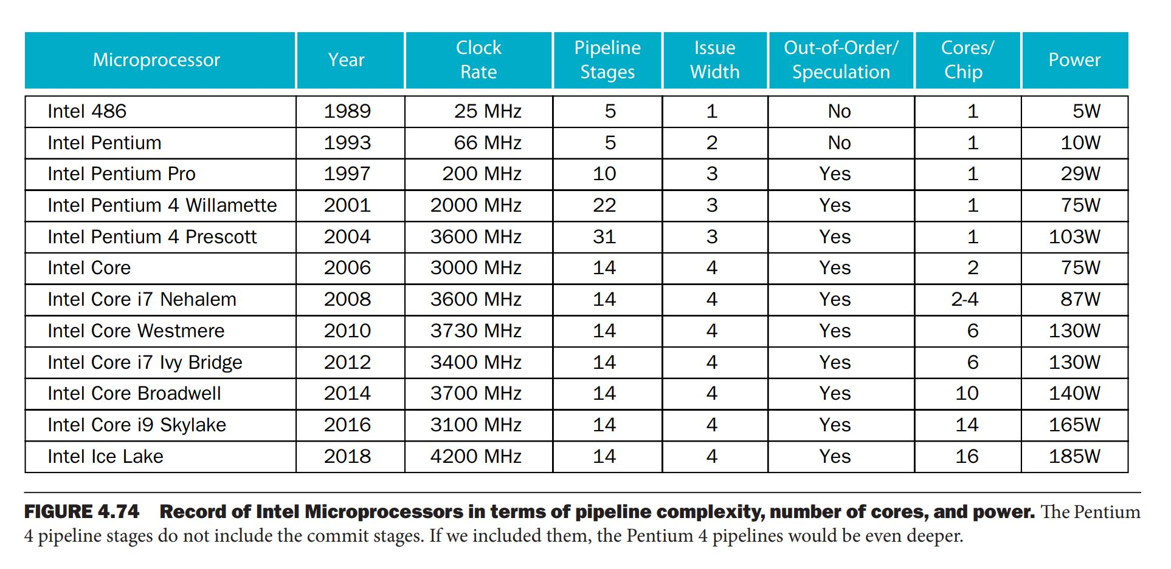
History of Intel family pipeline

Slide 21
Example of pipeline in real processor
core i7 branch predictor
uses a two-level predictor that has a smaller first-level predictor, and a larger second-level predictor as a backup.
Each predictor combines three different predictors:
(1) the simple two-bit predictor,
(2) a global history predictor,
(3) a loop exit predictor.

Slide 22
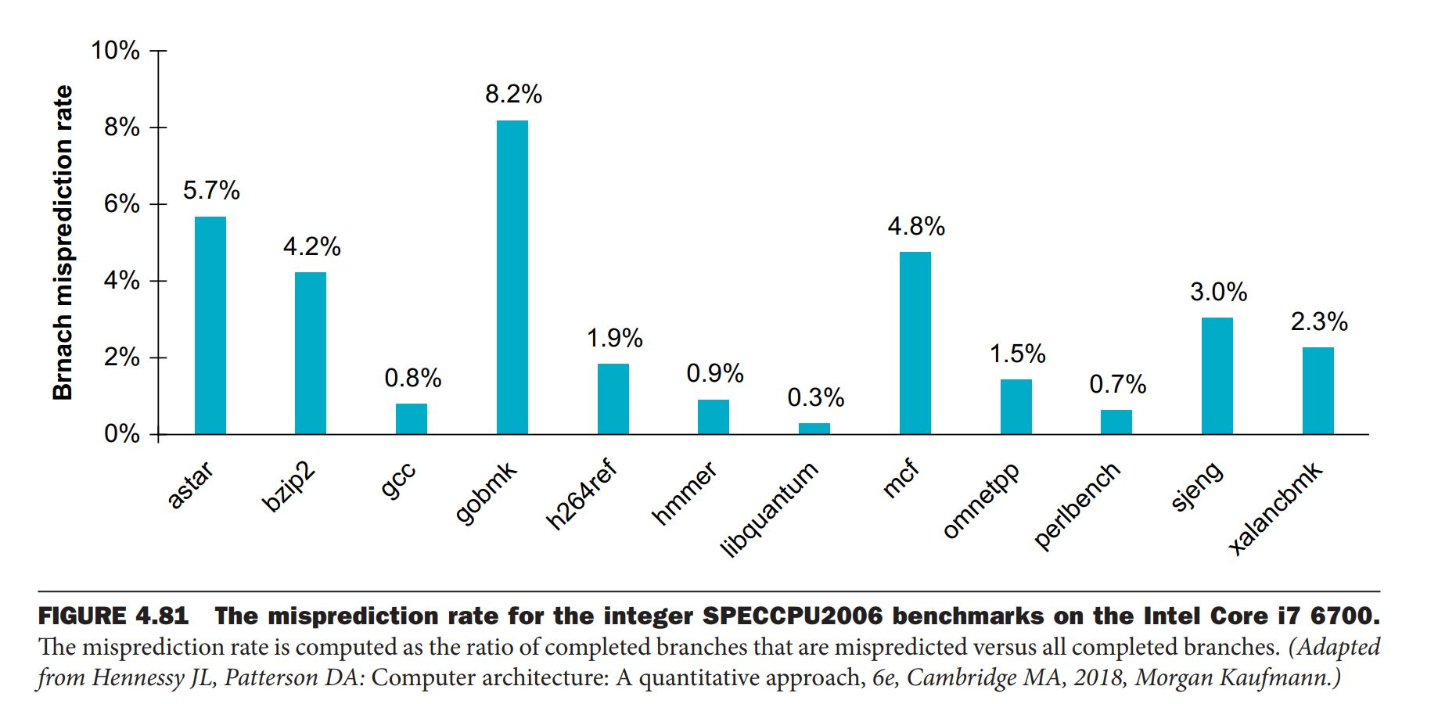
Misprediction rate of intel i7 6700

