Slide 1
RISC-V pipeline implementation
Prabhas Chongstitvatana
Faculty of Engineering
Chulalongkorn University
2023

Slide 2
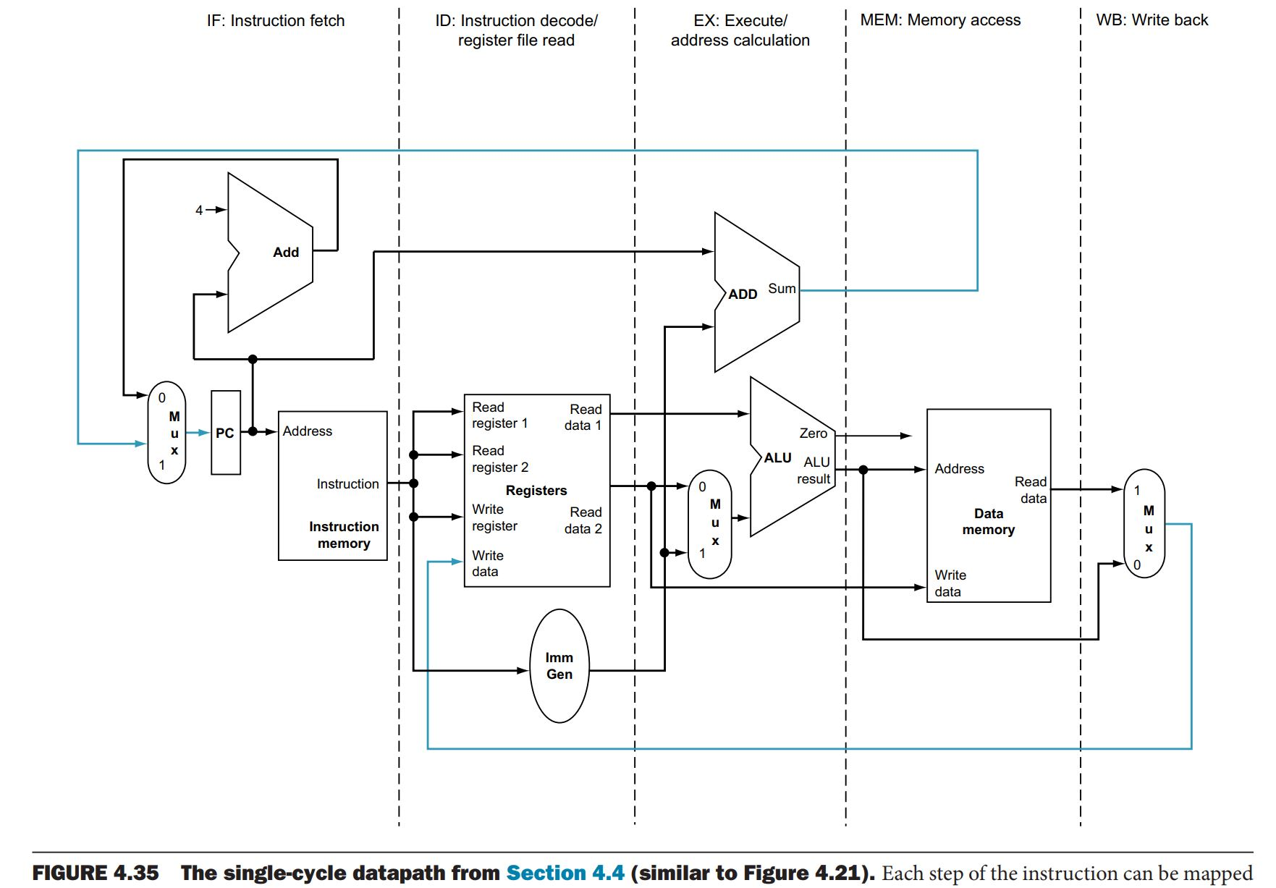
Single cycle data path, 5 steps

Slide 3
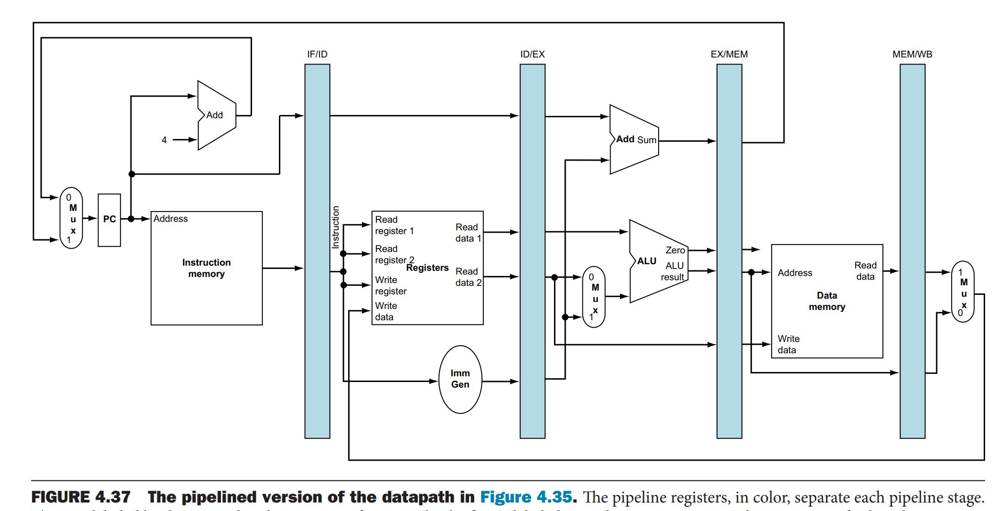
Pipelined version

Slide 4
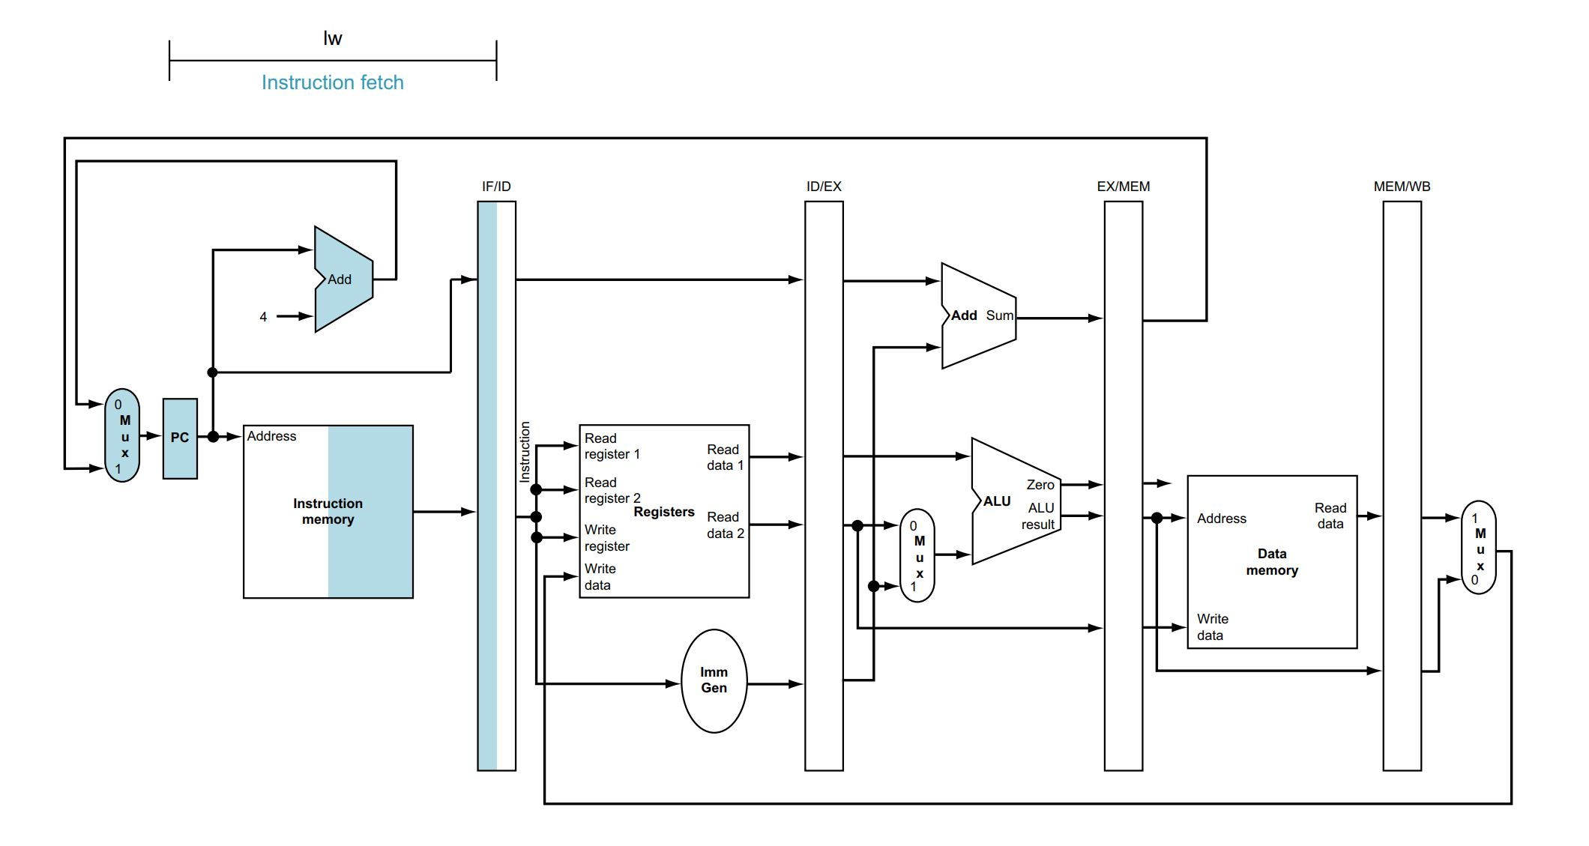
Execution of lw: instruction fetch

Slide 5
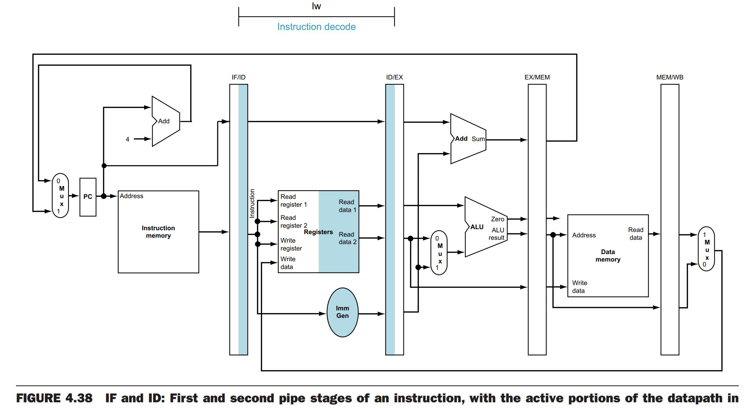
lw: instruction decode

Slide 6
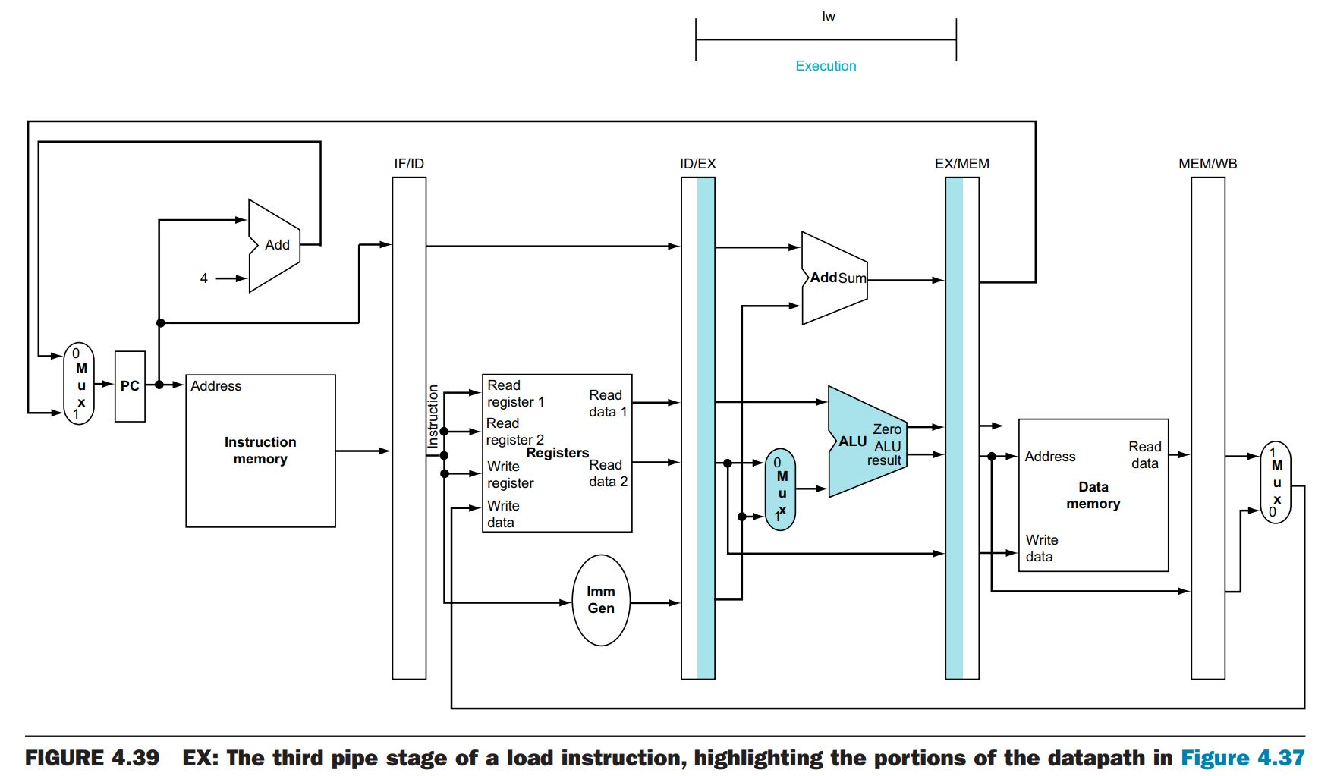
lw: execute

Slide 7
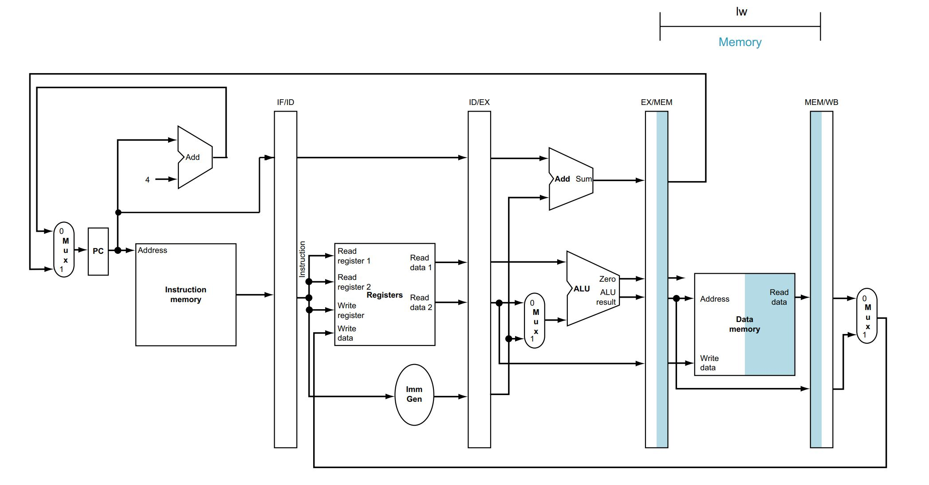
lw: memory

Slide 8
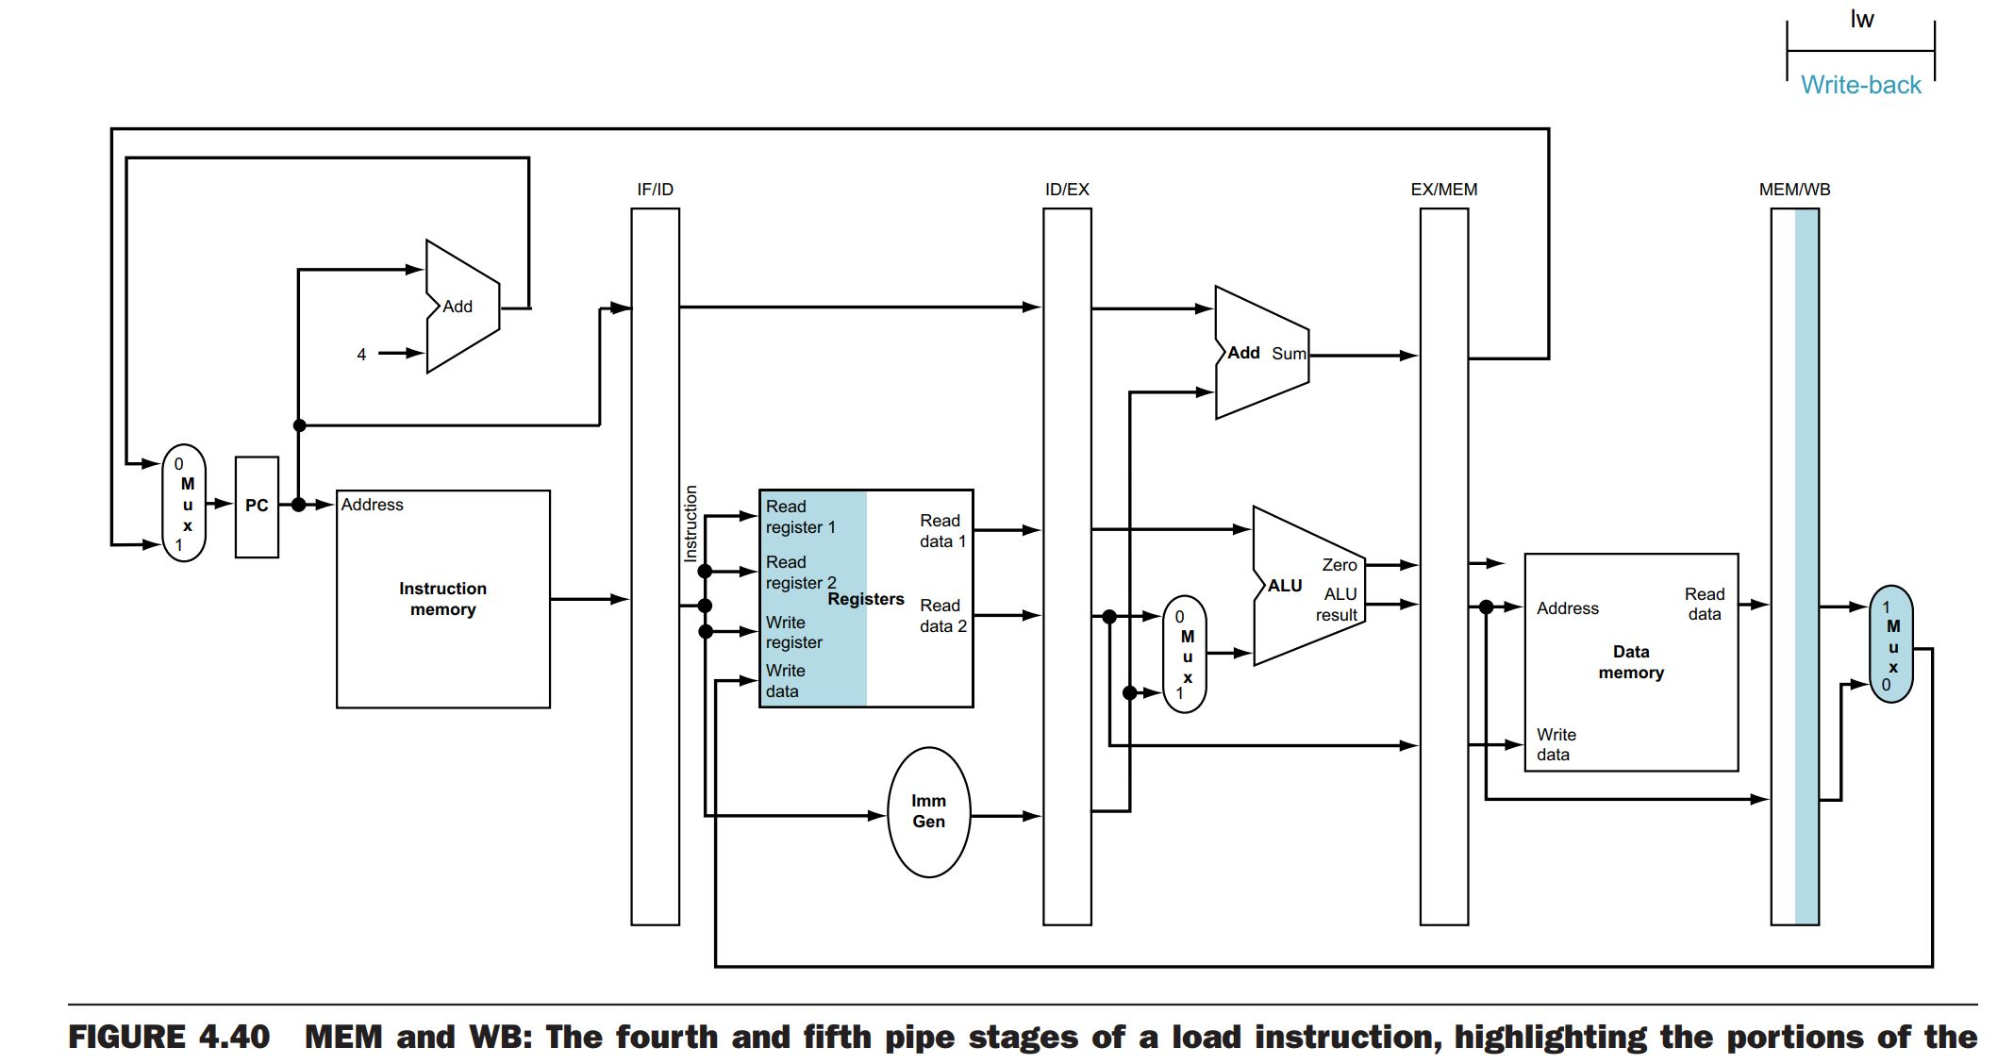
lw: write back

Slide 9
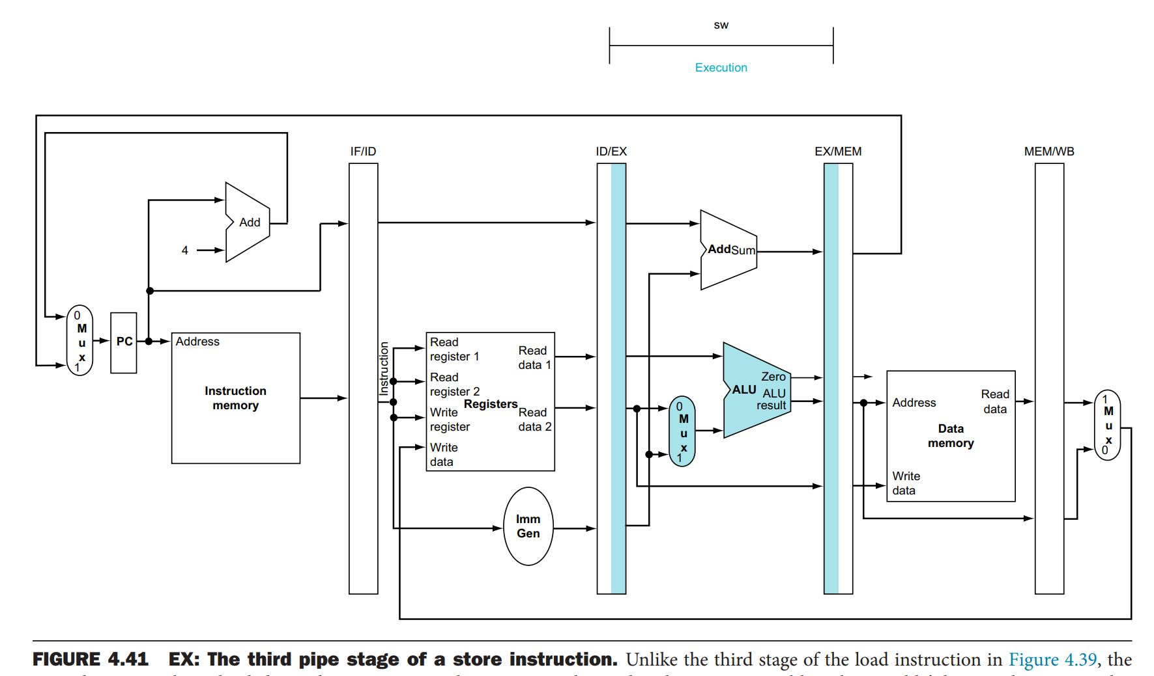
sw: execute

Slide 10
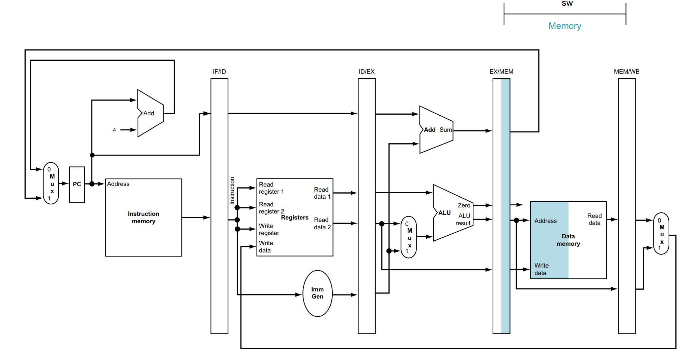
sw: memory

Slide 11
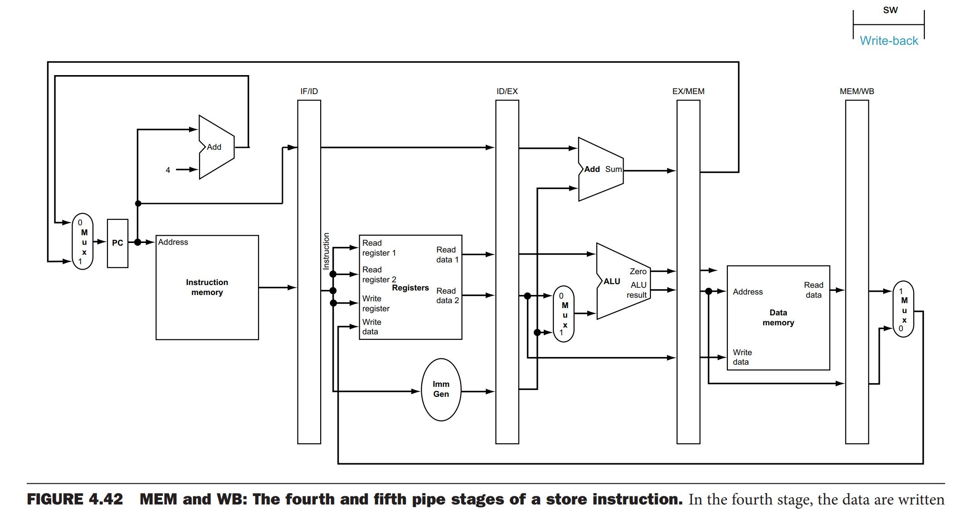
sw: write back

Slide 12
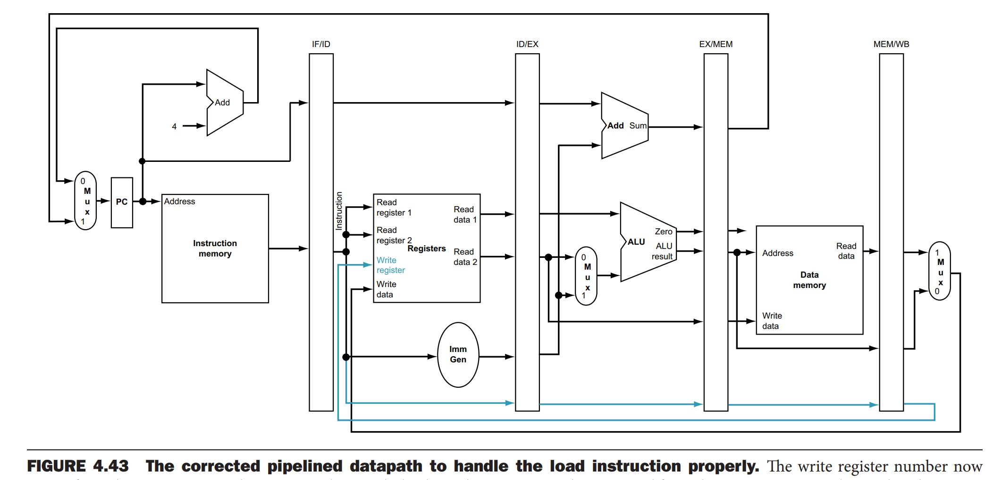
Additional path for “lw”: register number

Slide 13
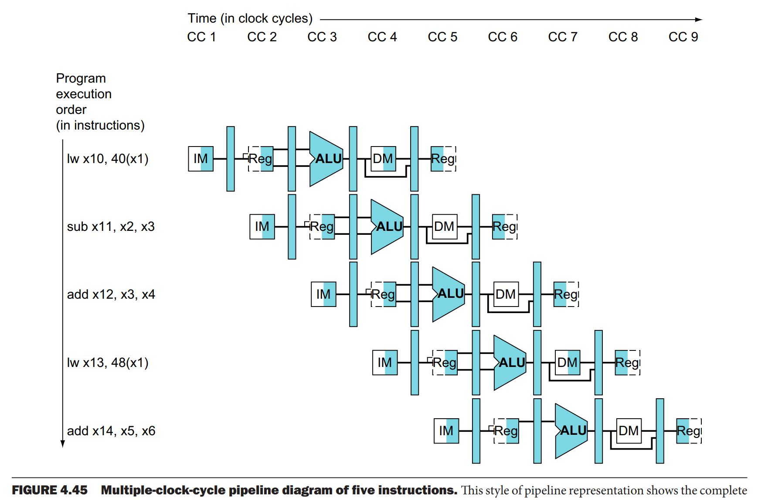
Five instructions in the pipeline

Slide 14
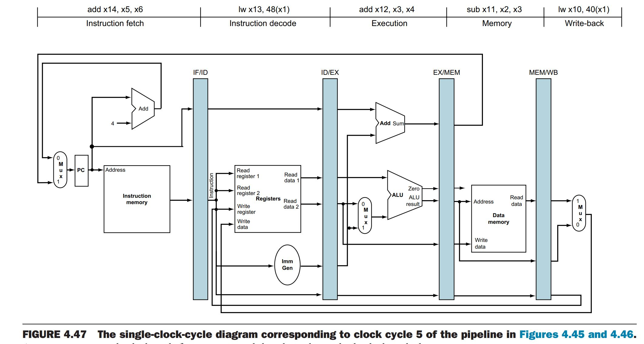
Five instructions, in each stage of pipeline

Slide 15
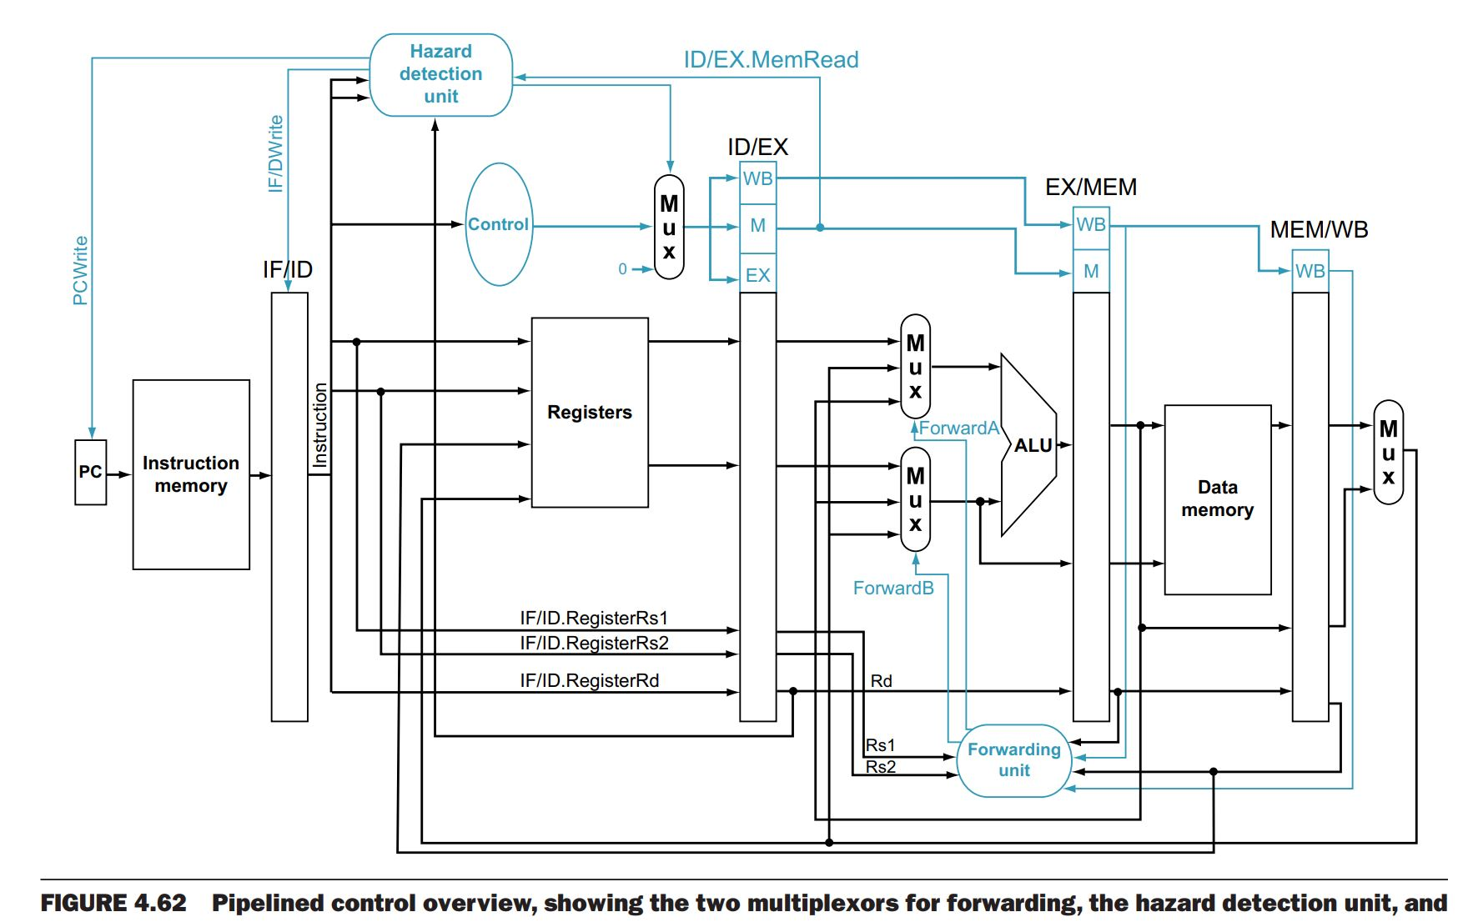
Full view of data path with control: harzard detection and forwarding

Slide 16
End

