Slide 1
Embedded Systems Design

Slide 2
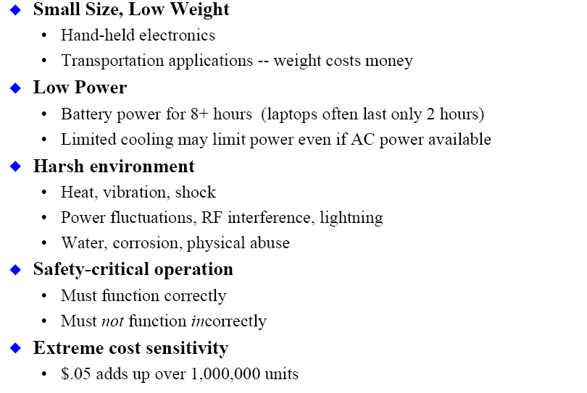
Design Constraints
Slide credit – P Koopman, CMU
Introduction to Embedded Systems Setha Pan-ngum

Slide 3
Design Challenges
Does it really work?
  Is the specification correct?
  Does the implementation meet the spec?
  How do we test for real-time characteristics?
  How do we test on real data?
How do we work on the system?
  Observability, controllability?
  What is our development platform?
Slide credit – P Koopman, CMU
More importantly – optimising design metrics!!
Introduction to Embedded Systems Setha Pan-ngum

Slide 4
Design Metrics
Common metrics
  Unit cost: the monetary cost of manufacturing each copy of the system, excluding NRE cost
  NRE cost (Non-Recurring Engineering cost): The one-time monetary cost of designing the system
  Size: the physical space required by the system
  Performance: the execution time or throughput of the system
  Power: the amount of power consumed by the system
  Flexibility: the ability to change the functionality of the system without incurring heavy NRE cost
Slide credit Vahid/Givargis, Embedded Systems Design: A Unified Hardware/Software Introduction
Introduction to Embedded Systems Setha Pan-ngum

Slide 5
Design Metrics
Common metrics (continued)
  Time-to-prototype: the time needed to build a working version of the system
  Time-to-market: the time required to develop a system to the point that it can be released and sold to customers
  Maintainability: the ability to modify the system after its initial release
  Correctness, safety, many more
Slide credit Vahid/Givargis, Embedded Systems Design: A Unified Hardware/Software Introduction
Introduction to Embedded Systems Setha Pan-ngum

Slide 6
Trade-off in Design Metrics
Expertise with both software and hardware is needed to optimize design metrics
  Not just a hardware or software expert, as is common
  A designer must be comfortable with various technologies in order to choose the best for a given application and constraints
Slide credit Vahid/Givargis, Embedded Systems Design: A Unified Hardware/Software Introduction
Power
Performance
Size
NRE cost
Introduction to Embedded Systems Setha Pan-ngum

Slide 7
Time-to-market: a demanding design metric
Time required to develop a product to the point it can be sold to customers
Market window
  Period during which the product would have highest sales
Average time-to-market constraint is about 8 months
Delays can be costly
Slide credit Vahid/Givargis, Embedded Systems Design: A Unified Hardware/Software Introduction
Revenues ($)
Time (months)
Introduction to Embedded Systems Setha Pan-ngum

Slide 8
Losses due to delayed market entry
Simplified revenue model
  Product life = 2W, peak at W
  Time of market entry defines a triangle, representing market penetration
  Triangle area equals revenue
Loss
  The difference between the on-time and delayed triangle areas
Slide credit Vahid/Givargis, Embedded Systems Design: A Unified Hardware/Software Introduction
Peak revenue
Peak revenue from delayed entry
Revenues ($)
On-time
Market rise
Market fall
Delayed
D
W
2W
On-time Delayed
entry entry
Time
Introduction to Embedded Systems Setha Pan-ngum

Slide 9
Other Design Considerations
Dependability
  Reliability: probability of system working correctly provided that it worked at time t=0
  Maintainability: probability of system working correctly d time units after error occurred. [Some systems require no maintenance throughout their operating lives (e.g. electric kettles, computer keyboards), while some may need it such as mobile phones and airplane flight control (software upgrade)]
Introduction to Embedded Systems Setha Pan-ngum

Slide 10
Other Design Considerations
Dependability
  Availability: probability of system working at time t
  Safety
  Security: in communication
Basically, critical applications have to operate correctly at all time e.g. airplane flight control computer. This includes both hardware and software aspects.
Introduction to Embedded Systems Setha Pan-ngum

Slide 11
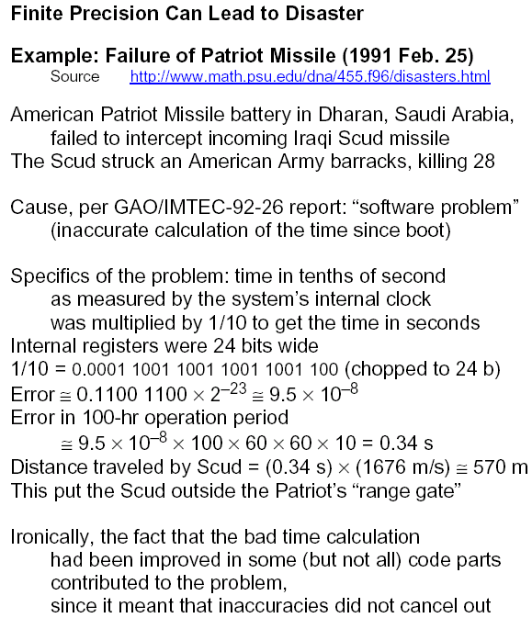
Example of System Fault
Slide credit B. Pahami

Slide 12
Other Design Considerations
Operating environment
  Some engine Electronic Control Units (ECUs) in cars are located under the bonnets. So they have to work at high temperature, as well as dusty and wet environment.
EMI (Electromagnetic Interference)
Introduction to Embedded Systems Setha Pan-ngum

Slide 13
Real-Time Consideration
Correct operation of real-time systems means:
  Working correctly (functionally correct)
  Producing outputs in time!
i.e. correct result at the right time
Introduction to Embedded Systems Setha Pan-ngum

Slide 14
Hard Real-time
System designed to meet all deadlines
A missed deadline is a design flaw
For examples: ABS brake, nuclear reactor monitoring system
System hardware (over) designed for worst-case performance
System software rigorously tested
Formal proofs used to guarantee timing correctness
Slide credit – T Givargis
Introduction to Embedded Systems Setha Pan-ngum

Slide 15
Firm Real-time
System designed to meet all deadlines, but occasional missed deadline is allowed
  Sometimes statistically quantified (e.g. 5% misses)
For examples: multimedia systems
System hardware designed for average case performance
System software tested under average (ideal) conditions
Slide credit – T Givargis
Introduction to Embedded Systems Setha Pan-ngum

Slide 16
Soft Real-time
System designed to meet as many deadlines as possible
  Best effort to complete within specified time, but may be late
For examples: network switch or router
System hardware designed for average case performance
System software tested under averaged (ideal) conditions
Slide credit – T Givargis
Introduction to Embedded Systems Setha Pan-ngum

Slide 17
Deadlines
•
Deadline
: maximum time before
a task must complete
task
time
d
•
The
profit
associated with execution of a task
is after the deadline:
–
Hard
deadline: negative
soft
–
Firm
deadline: 0 (either make
d
profit
time
it or just don’t do it)
firm
–
Soft
deadline: decreasing
with time
hard
Slide taken from J.J Lukkien
Introduction to Embedded Systems Setha Pan-ngum

Slide 18
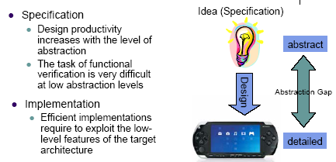
Levels of Embedded System Design
Slide credit – Ingo Sander
Introduction to Embedded Systems Setha Pan-ngum

Slide 19
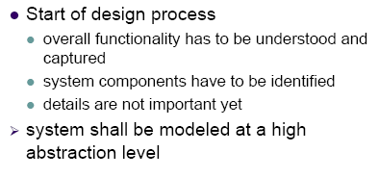
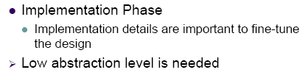
Design Abstraction
Slide credit – Ingo Sander
Introduction to Embedded Systems Setha Pan-ngum

Slide 20
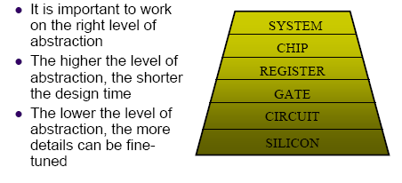
Abstraction Levels
Slide credit – Ingo Sander
Introduction to Embedded Systems Setha Pan-ngum

Slide 21
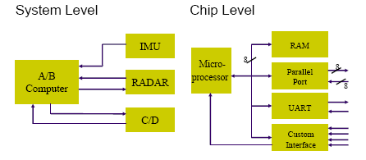
Abstraction Levels
Slide credit – Ingo Sander
Introduction to Embedded Systems Setha Pan-ngum

Slide 22
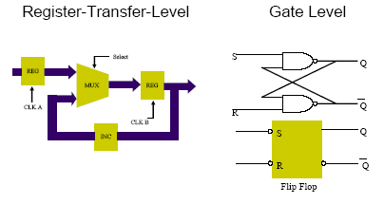
Abstraction Levels
Slide credit – Ingo Sander
Introduction to Embedded Systems Setha Pan-ngum

Slide 23
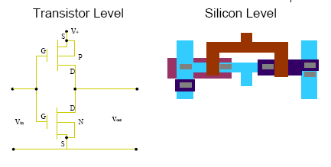
Abstraction Level
Slide credit – Ingo Sander
Introduction to Embedded Systems Setha Pan-ngum

Slide 24
Hardware vs Software
Many functions can be done by software on a general purpose microprocessor OR by hardware on an application specific ICs (ASICs)
For examples: game console graphic, PWM, PID control
Leads to Hardware/Software Co-design concept
Introduction to Embedded Systems Setha Pan-ngum

Slide 25
Hardware or Software?
Where to place functionality?
  ex: A Sort algorithm
    Faster in hardware, but more expensive.
    More flexible in software but slower.
    Other examples?
Must be able to explore these various trade-offs:
  Cost.
  Speed.
  Reliability.
  Form (size, weight, and power constraints.)
Slide credit - W. McUmber, MSU
Introduction to Embedded Systems Setha Pan-ngum

Slide 26
Hardware vs Software
Workstations
Personal Computers
Graphics Processors
DSP Processors
Network Processors
Power/Performance
FFT Processors
MPEG Processors
FIR Processors
General-Purpose
Processors
Embedded
Domain-Specific
Processors
Embedded
Application-Specific
Processors
Programmability and Flexibility
Slide credit - Mike Schulte
Introduction to Embedded Systems Setha Pan-ngum

Slide 27
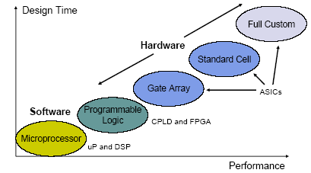
Hardware vs Software
Slide credit – Ingo Sander
Introduction to Embedded Systems Setha Pan-ngum

Slide 28
General-purpose processors
Programmable device used in a variety of applications
  Also known as “microprocessor”
Features
  Program memory
  General datapath with large register file and general ALU
User benefits
  Low time-to-market and NRE costs
  High flexibility
“Pentium” the most well-known, but there are hundreds of others
Controller
Datapath
Control
logic and State register
Register
file
General
ALU
IR
PC
Program memory
Data
memory
Assembly code for:
total = 0
for i =1 to …
Slide credit Vahid/Givargis, Embedded Systems Design: A Unified Hardware/Software Introduction, 2000
Introduction to Embedded Systems Setha Pan-ngum

Slide 29
Single-purpose processors
Digital circuit designed to execute exactly one program
  a.k.a. coprocessor, accelerator or peripheral
Features
  Contains only the components needed to execute a single program
  No program memory
Benefits
  Fast
  Low power
  Small size
Controller
Datapath
Control logic
index
total
State register
+
Data
memory
Slide credit Vahid/Givargis, Embedded Systems Design: A Unified Hardware/Software Introduction, 2000
Introduction to Embedded Systems Setha Pan-ngum

Slide 30
Application-specific processors
Programmable processor optimized for a particular class of applications having common characteristics
  Compromise between general-purpose and single-purpose processors
Features
  Program memory
  Optimized datapath
  Special functional units
Benefits
  Some flexibility, good performance, size and power
DSP จัดอยู่ในประเภทนี้ด้วย
Controller
Datapath
Control
logic and State register
Registers
Custom
ALU
IR
PC
Data
memory
Program memory
Assembly code for:
total = 0
for i =1 to …
Slide credit Vahid/Givargis, Embedded Systems Design: A Unified Hardware/Software Introduction, 2000
Introduction to Embedded Systems Setha Pan-ngum

Slide 31
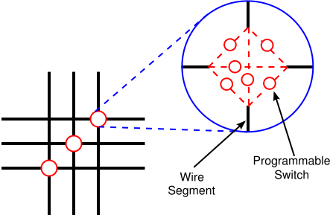
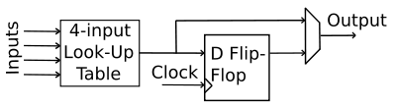
FPGA Architecture
Programmable switch at wiring intersection
(credit: www.wikipedia.com)
FPGA layout with Configurable Logic Blocks (CLB) and I/O Blocks (IOB) (credit: Katz’s Contemporary Logic Design)
Typical CLB (credit: www.wikipedia.com)
Introduction to Embedded Systems Setha Pan-ngum

Slide 32
Highly constrained products tend to use application specific processors
  Many mobile phones (power&size constrained) contain ARM chips
  Hi-Fi (high performance&time constrained) contain DSP chips
Introduction to Embedded Systems Setha Pan-ngum

Slide 33
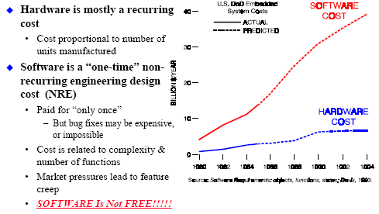
Software Costs
Slide credit – P Koopman, CMU
Introduction to Embedded Systems Setha Pan-ngum

Slide 34
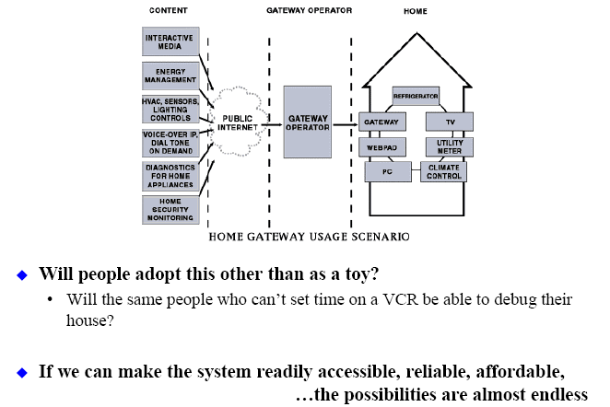
Future Embedded Systems
Slide credit – P Koopman, CMU
Introduction to Embedded Systems Setha Pan-ngum

