Slide 1
Single Purpose Processors:
Peripherals
Prabhas Chongstitvatana
Krek Piromsopa

Slide 2
Introduction
Single-purpose processors
  Performs specific computation task
  Custom single-purpose processors
    Designed by us for a unique task
  Standard single-purpose processors
    “Off-the-shelf” -- pre-designed for a common task
    a.k.a., peripherals
    serial transmission
    analog/digital conversions

Slide 3
Timers, counters, watchdog timers
Timer: measures time intervals
  To generate timed output events
    e.g., hold traffic light green for 10 s
  To measure input events
    e.g., measure a car’s speed
Based on counting clock pulses
    E.g., let Clk period be 10 ns
    And we count 20,000 Clk pulses
    Then 200 microseconds have passed
    16-bit counter would count up to 65,535*10 ns = 655.35 microsec., resolution = 10 ns
    Top: indicates top count reached, wrap-around
Basic timer
Clk
16-bit up counter
16
Cnt
Top
Reset

Slide 4
Counters
Counter: like a timer, but counts pulses on a general input signal rather than clock
  e.g., count cars passing over a sensor
  Can often configure device as either a timer or counter
Timer/counter
Clk
2x1 mux
16-bit up counter
Cnt
16
Cnt_in
Top
Reset
Mode

Slide 5
Other timer structures
Interval timer
  Indicates when desired time interval has passed
  We set terminal count to desired interval
    Number of clock cycles = Desired time interval / Clock period
Cascaded counters
Prescaler
  Divides clock
  Increases range, decreases resolution
16/32-bit timer
Clk
16-bit up counter
Cnt1
Timer with a terminal count
16
Top1
Clk
16-bit up counter
Cnt
16
16-bit up counter
16
Cnt2
Reset
Top2
=
Top
Time with prescaler
Clk
Prescaler
16-bit up counter
Terminal count
Mode

Slide 6
Example: Reaction Timer
indicator light
reaction button
/* main.c */
#define MS_INIT 63535
void main(void){
int count_milliseconds = 0;
configure timer mode
set Cnt to MS_INIT
wait a random amount of time
turn on indicator light
start timer
while (user has not pushed reaction button){
if(Top) {
stop timer
set Cnt to MS_INIT
start timer
reset Top
count_milliseconds++;
}
}
turn light off
printf(“time: %i ms“, count_milliseconds);
}
LCD
time: 100 ms
Measure time between turning light on and user pushing button
  16-bit timer, clk period is 83.33 ns, counter increments every 6 cycles
  Resolution = 6*83.33=0.5 microsec.
  Range = 65535*0.5 microseconds = 32.77 milliseconds
  Want program to count millisec., so initialize counter to 65535 – 1000/0.5 = 63535

Slide 7
Watchdog timer
Must reset timer every X time unit, else timer generates a signal
Common use: detect failure, self-reset
Another use: timeouts
  e.g., ATM machine
  16-bit timer, 2 microsec. resolution
  timereg value = 2*(2¹⁶-1)–X = 131070–X
  For 2 min., X = 120,000 microsec.
osc
clk
overflow
overflow
to system reset
or
interrupt
prescaler
scalereg
timereg
checkreg
/* main.c */
main(){
wait until card inserted
call watchdog_reset_routine
while(transaction in progress){
if(button pressed){
perform corresponding action
call watchdog_reset_routine
}
/* if watchdog_reset_routine not called every < 2 minutes, interrupt_service_routine is called */
}
watchdog_reset_routine(){
/* checkreg is set so we can load value into timereg. Zero is loaded into scalereg and 11070 is loaded into timereg */
checkreg = 1
scalereg = 0
timereg = 11070
}
void interrupt_service_routine(){
eject card
reset screen
}

Slide 8
Serial Transmission Using UARTs
UART: Universal Asynchronous Receiver Transmitter
  Takes parallel data and transmits serially
  Receives serial data and converts to parallel
Parity: extra bit for simple error checking
Start bit, stop bit
Baud rate
  signal changes per second
  bit rate usually higher
embedded device
1
0
1
0
1
0
1
1
1
0
0
1
1
0
1
1
1
0
0
1
1
0
1
1
Sending UART
Receiving UART
start bit
end bit
data

Slide 9
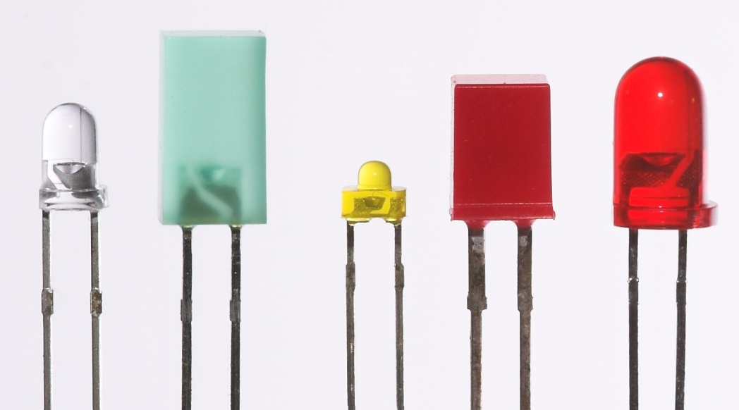
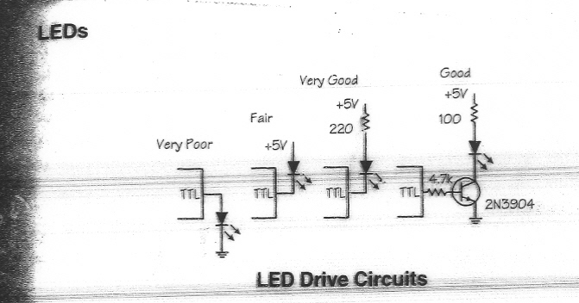
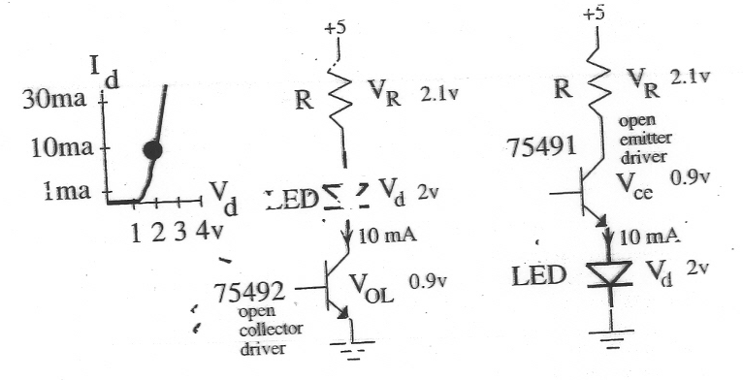
LEDs

Slide 10
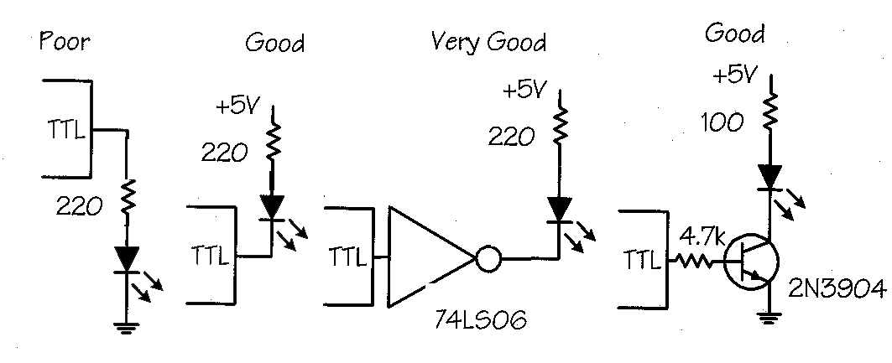
BJT for LED TTL connection
Slide credits: Dr.Krerk Piromsopa

Slide 11
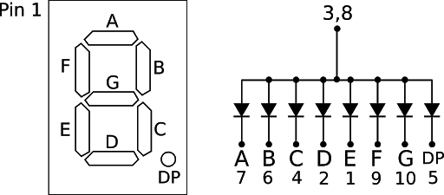
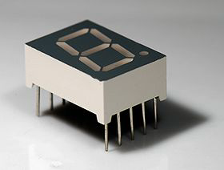
7-Segment LEDs

Slide 12
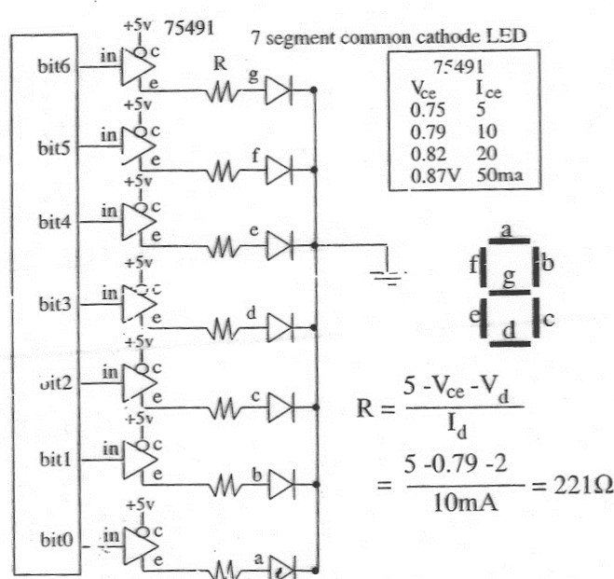
75491 : 7 segments driver

Slide 13
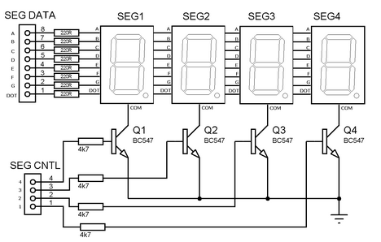
4 digits multiplexed 7 segment display

Slide 14
Pulse width modulator
Generates pulses with specific high/low times
Duty cycle: % time high
  Square wave: 50% duty cycle
Common use: control average voltage to electric device
  Simpler than DC-DC converter or digital-analog converter
  DC motor speed, dimmer lights
Another use: encode commands, receiver uses timer to decode
pwm_o
clk
25% duty cycle – average pwm_o is 1.25V
pwm_o
clk
50% duty cycle – average pwm_o is 2.5V.
pwm_o
clk
75% duty cycle – average pwm_o is 3.75V.

Slide 15
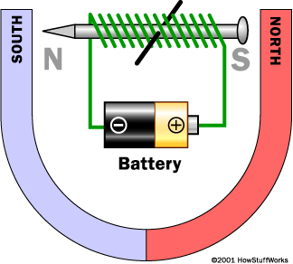
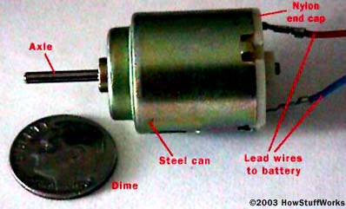
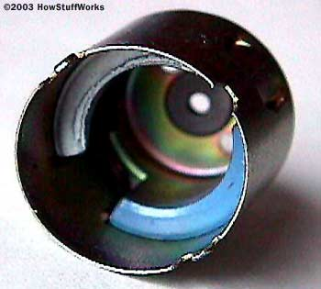
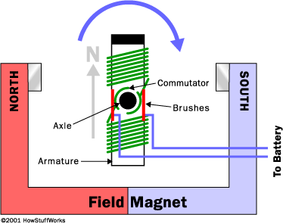
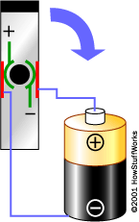
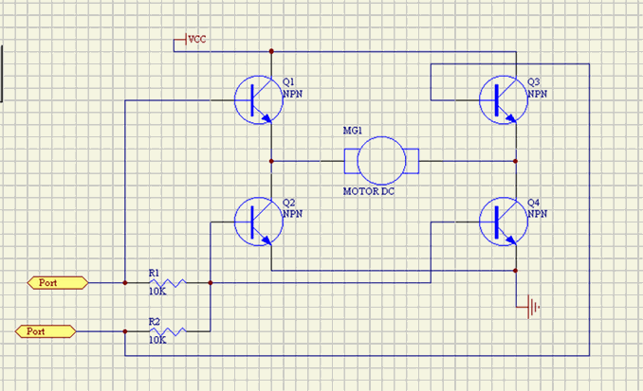
Source www.howstuffworks.com

Slide 16
Controlling a DC motor with a PWM
clk
clk_div
counter
( 0 – 254)
controls how fast the counter increments
8-bit
comparator
counter < cycle_high,
pwm_o = 1
counter >= cycle_high,
pwm_o = 0
pwm_o
cycle_high
Relationship between applied voltage and speed of the DC Motor
Internal Structure of PWM
void main(void){
/* controls period */
PWMP = 0xff;
/* controls duty cycle */
PWM1 = 0x7f;
while(1){};
}
The PWM alone cannot drive the DC motor, a possible way to implement a driver is shown below using an MJE3055T NPN transistor.
5V
DC
MOTOR
From processor

Slide 17
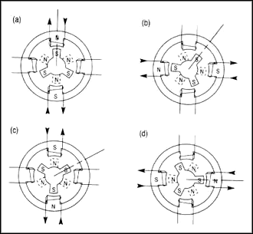
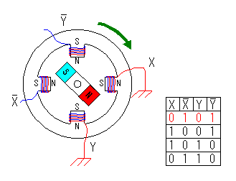
Stepper Motor
From http://hobby_elec.piclist.com/e_step1.htm
From Parker Compumotor Division

Slide 18
Stepper motor controller
Stepper motor: rotates fixed number of degrees when given a “step” signal
  In contrast, DC motor just rotates when power applied, coasts to stop
Rotation achieved by applying specific voltage sequence to coils
Controller greatly simplifies this
Vd
MC3479P
1
16
Vm
A’
2
15
B
A
3
14
B’
GND
4
13
GND
5
12
Bias’/Set
6
11
Phase A’
Clk
7
10
CW’/CCW
O|C
8
9
Full’/Half Step
Red A
White A’
Yellow B
Black B’

Slide 19
Stepper motor with controller (driver)
/* main.c */
sbit clk=P1^1;
sbit cw=P1^0;
void delay(void){
int i, j;
for (i=0; i<1000; i++)
for ( j=0; j<50; j++)
i = i + 0;
}
void main(void){
*/turn the motor forward */
cw=0; /* set direction */
clk=0; /* pulse clock */
delay();
clk=1;
/*turn the motor backwards */
cw=1; /* set direction */
clk=0; /* pulse clock */
delay();
clk=1;
}
MC3479P
Stepper Motor Driver
8051
CW’/CCW
P1.0
P1.1
10
7
B 15
B’ 14
CLK
2 A’
3 A
Stepper
Motor
The output pins on the stepper motor driver do not provide enough current to drive the stepper motor. To amplify the current, a buffer is needed. One possible implementation of the buffers is pictured to the left. Q1 is an MJE3055T NPN transistor and Q2 is an MJE2955T PNP transistor. A is connected to the 8051 microcontroller and B is connected to the stepper motor.

Slide 20
Stepper motor without controller (driver)
8051
/*main.c*/
sbit notA=P2^0;
sbit isA=P2^1;
sbit notB=P2^2;
sbit isB=P2^3;
sbit dir=P2^4;
void delay(){
int a, b;
for(a=0; a<5000; a++)
for(b=0; b<10000; b++)
a=a+0;
}
void move(int dir, int steps) {
int y, z;
/* clockwise movement */
if(dir == 1){
for(y=0; y<=steps; y++){
for(z=0; z<=19; z+4){
isA=lookup[z];
isB=lookup[z+1];
notA=lookup[z+2];
notB=lookup[z+3];
delay();
}
}
}
/* counter clockwise movement */
if(dir==0){
for(y=0; y<=step; y++){
for(z=19; z>=0; z - 4){
isA=lookup[z];
isB=lookup[z-1];
notA=lookup[z -2];
notB=lookup[z-3];
delay( );
}
}
}
}
void main( ){
int z;
int lookup[20] = {
1, 1, 0, 0,
0, 1, 1, 0,
0, 0, 1, 1,
1, 0, 0, 1,
1, 1, 0, 0 };
while(1){
/*move forward, 15 degrees (2 steps) */
move(1, 2);
/* move backwards, 7.5 degrees (1step)*/
move(0, 1);
}
}
P2.4
P2.3
P2.2
P2.1
P2.0
GND/ +V
Stepper
Motor
A possible way to implement the buffers is located below. The 8051 alone cannot drive the stepper motor, so several transistors were added to increase the current going to the stepper motor. Q1 are MJE3055T NPN transistors and Q3 is an MJE2955T PNP transistor. A is connected to the 8051 microcontroller and B is connected to the stepper motor.
1K
+V
Q1
+V
1K
B
A
Q2
330

Slide 21
LCD controller
E
void WriteChar(char c){
RS = 1; /* indicate data being sent */
DATA_BUS = c; /* send data to LCD */
EnableLCD(45); /* toggle the LCD with appropriate delay */
}
communications bus
R/W
RS
DB7–DB0
microcontroller
8
LCD controller

Slide 22
Keypad controller
N1
N2
N3
k_pressed
N4
M1
M2
M3
M4
4
key_code
key_code
keypad controller
N=4, M=4

Slide 23
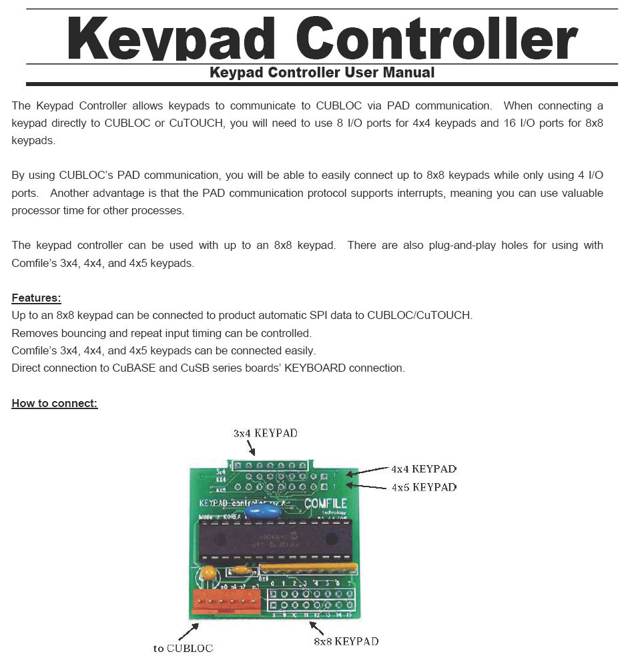

Slide 24
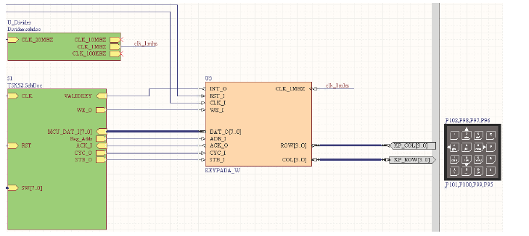

Slide 25
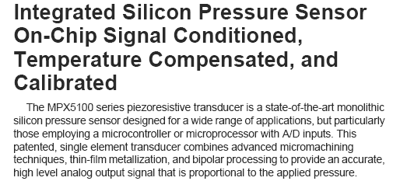
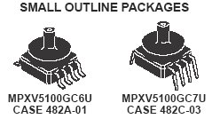
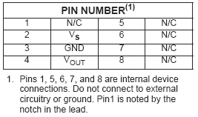
Example Pressure sensor

Slide 26
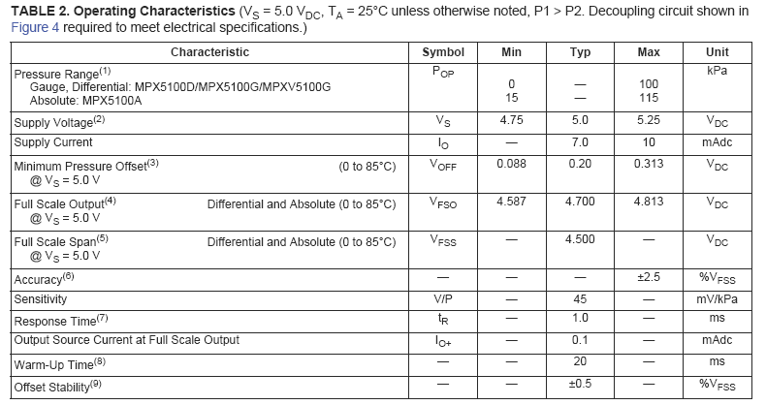

Slide 27
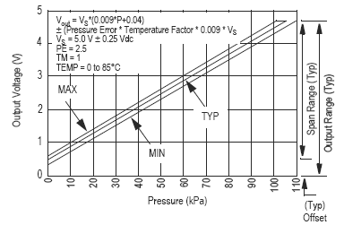

Slide 28
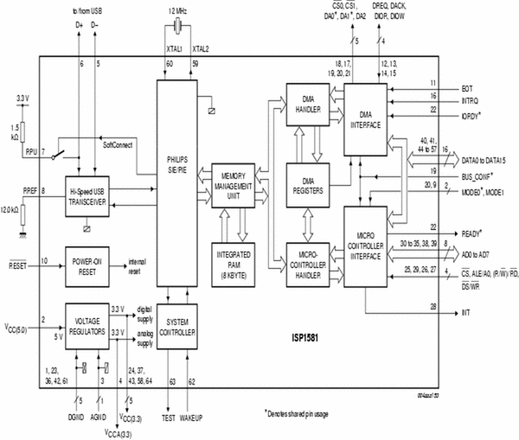
ISP1581 USB Controller

Slide 29
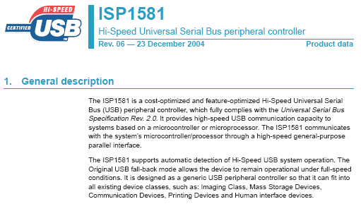
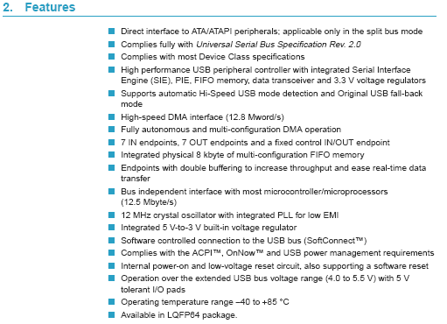

Slide 30
