Slide 1
RTC experiment
Prabhas Chongstitvatana

Slide 2
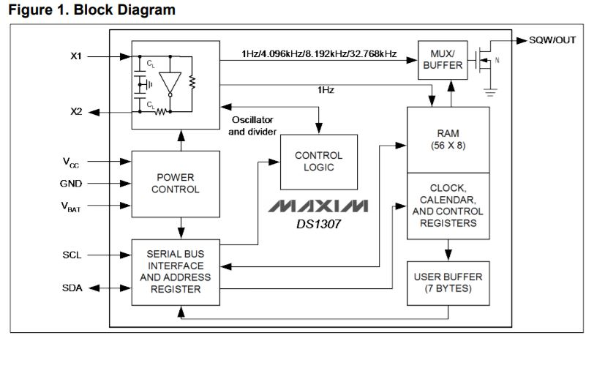
DS1307
The DS1307 serial real-time clock (RTC) is a lowpower, full binary-coded decimal (BCD) clock/calendar

Slide 3
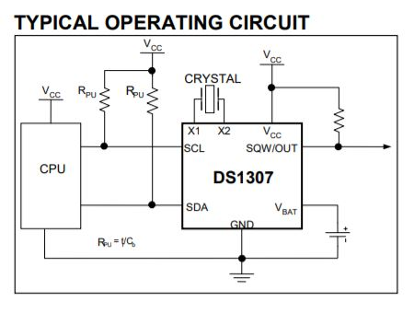

Slide 4
to write to RTC
control byte DS1307
1101000X
1 start condition
2 send control byte write
3 send address
4 send data
5 send another data or stop condition

Slide 5
to read from RTC
1 start condition
2 send control byte read
3 send address
4 start condition
5 send control byte
6 read first byte
7 read another byte or stop condition

Slide 6
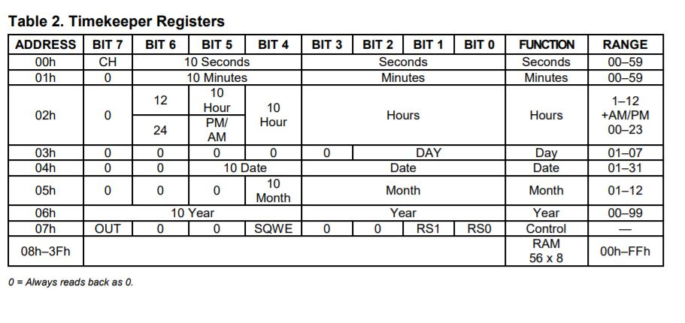
DS1307 registers

Slide 7
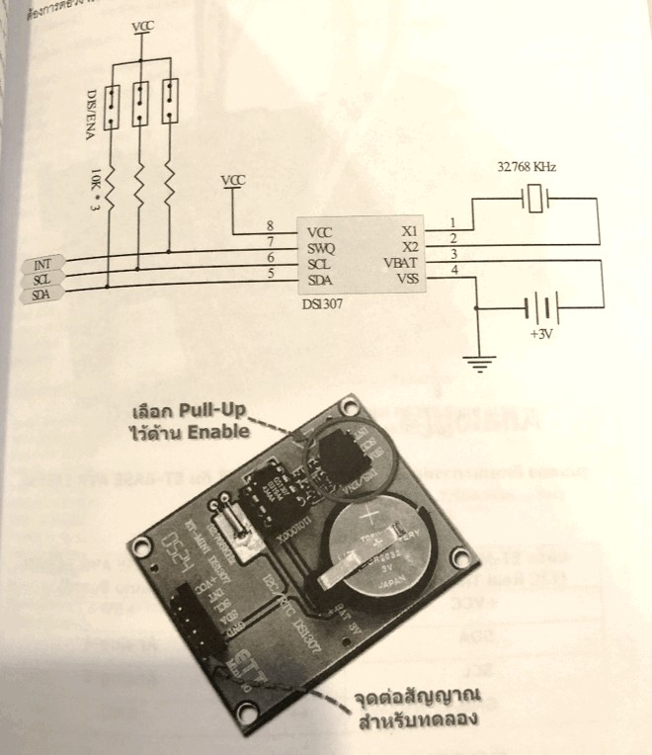
DS1307 experiment

Slide 8
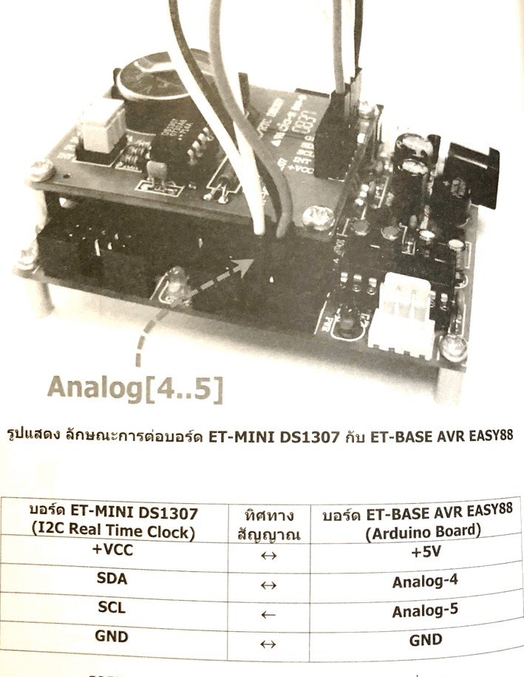
polling
Master (Arduino)
1 setup RTC
2 main loop
2.1 read clock
2.2 print time
2.3 wait 1 second

Slide 9
Read RTC with interrupt
Using interrupt
Master
Setup RTC with square wave out at pin INT (use CTRL = 0x10)
We get interrupt signal from RTC (pin INT) to Arduino pin digital-2
Attach interrupt service routine
4 in ISR if interrupt occurs set int_status
Main loop
5.1 Wait for interrupt by checking int_status
5.2 Then read clock
5.3 Print time
5.4 Reset int_status

Slide 10
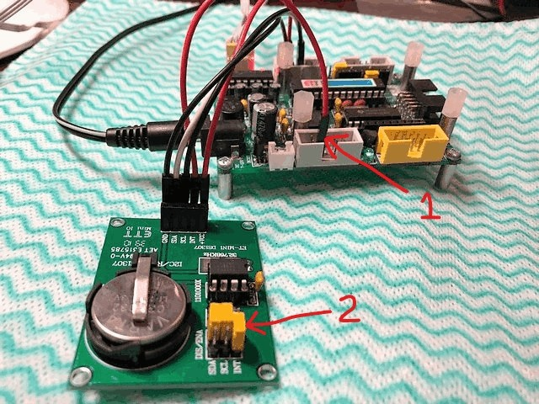
Setting up the board
DS1307 | Atmega
+vcc | +5v
INT | digital-2
SDA | analog-4
SCL | analog-5
GND | GND

Slide 11
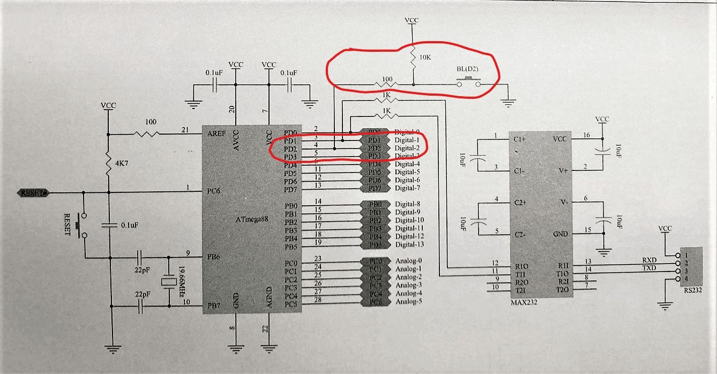
Set Int0 pin
1. The pin PD2, digital-2 on Atmega is connected to Int0 (interrupt 0) and is pull-up by a resistor and connected to a push switch.
2. To connect the output INT of DS1307 to Atmega you must “open” the jumper (2).

Slide 12
Important notice
You have to detach the wire to pin digital-2 before upload program to Atmega and reattach it later.
Otherwise it will interfere with the upload process as the pin PD2 is the actual interrupt pin, the previous state of INT of DS1307 board will affect it.

Slide 13
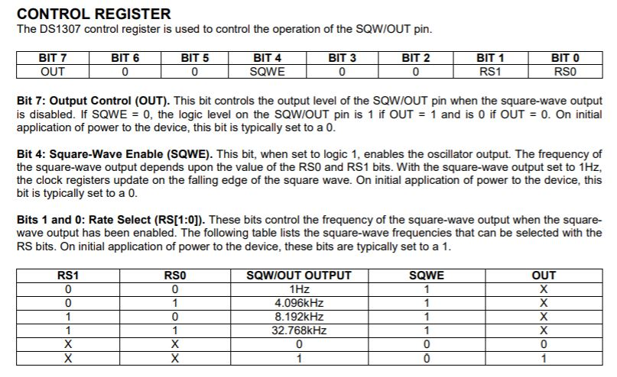
Set control register of DS1307
Set bit 7 (OUT) to 0
Set bit 4 (SQWE) to 1
Set bit 1, bit 0 (RS1,RS0) to 00
= output square wave 1 Hz to pin INT of board DS1307

Slide 14
program
#include <Wire.h>
int ledp = 13;
int intp = 2; // dig port int0:PD2 (dig-2)
volatile boolean ledst = LOW;
volatile boolean intst = LOW;
...
void setup(){
pinMode(ledp,OUTPUT);
pinMode(intp,INPUT);
sec = 0x55;
xmin = 0x59;
hour = 0x23;
...
ctrl = 0x10; <<<<-------------- (1)
SetClock();
attachInterrupt(0,RTCint, CHANGE); <<< ---- (2)
}
void RTCint(){
if(digitalRead(intp) == LOW){
intst = HIGH; // set interrupt status
digitalWrite(ledp,HIGH);
}else
digitalWrite(ledp,LOW);
}
void loop(){
while(intst == 0) // wait for interrupt
GetClock();
printhex(hour);
...
intst = 0; // reset int status
}
1 You need to send the correct control value.
2 To set up interrupt service routine, RTCint is attached to int0 and trigger by change (which is a 1 Hz square wave from DS1307

Slide 15
END

