Slide 1
Data Structure for recursion

Slide 2
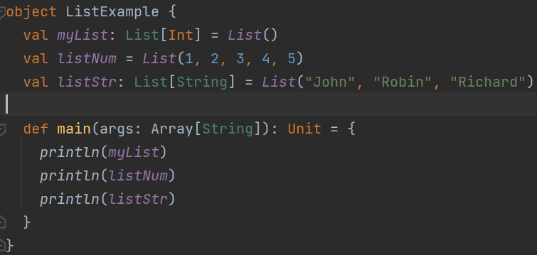
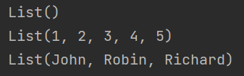
List
Immutable
Linked list
Notes:
object ListExample {
val myList: List[Int] = List()
val listNum = List(1, 2, 3, 4, 5)
val listStr: List[String] = List("John", "Robin", "Richard")
def main(args: Array[String]): Unit = {
println(myList)
println(listNum)
println(listStr)
}
}

Slide 3

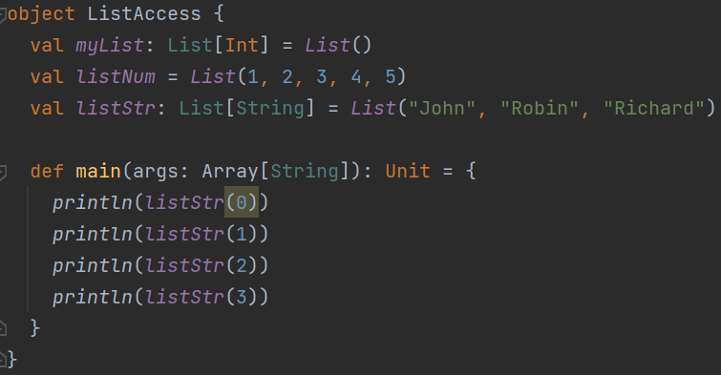
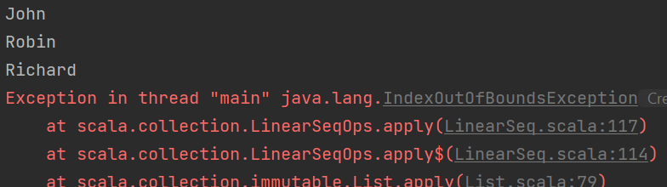



List access
Notes:
object ListAccess {
val myList: List[Int] = List()
val listNum = List(1, 2, 3, 4, 5)
val listStr: List[String] = List("John", "Robin", "Richard")
def main(args: Array[String]): Unit = {
println(listStr(0))
println(listStr(1))
println(listStr(2))
println(listStr(3))
}
}

Slide 4









How to define a list?
Use a cons
List of the rest of data
First data
Anything in front or between it must be a data.
Notes:
object ListAccess {
val myList: List[Int] = List()
val listNum = List(1, 2, 3, 4, 5)
val listNum2 = List(1, 2, 3, 4, 5)
val listStr: List[String] = List("John", "Robin", "Richard")
def main(args: Array[String]): Unit = {
val listStr2 = "Will" :: listStr
println(listStr2)
val listNum2 = 9 :: 6 :: 17 :: Nil
println(listNum2)
println(listNum ++ listNum2)
}
}

Slide 5




Slide 6
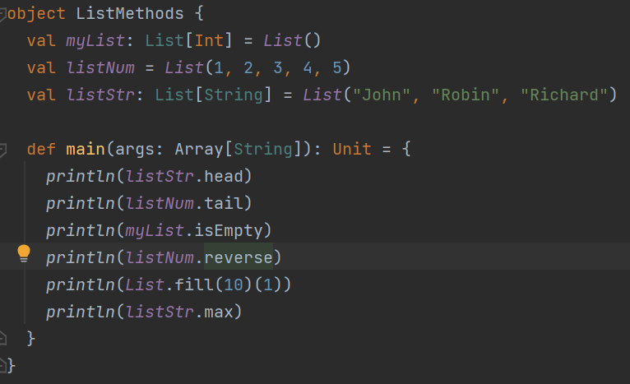
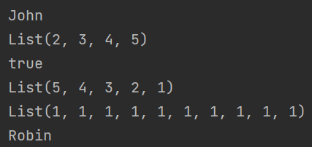
List methods
Notes:
object ListMethods {
val myList: List[Int] = List()
val listNum = List(1, 2, 3, 4, 5)
val listStr: List[String] = List("John", "Robin", "Richard")
def main(args: Array[String]): Unit = {
println(listStr.head)
println(listNum.tail)
println(myList.isEmpty)
println(listNum.reverse)
println(List.fill(10)(1))
println(listStr.max)
}
}

Slide 7

Exercise (only isEmpty, length, head, tail, ::, ++ available)

Slide 8


Exercise - cont

Slide 9
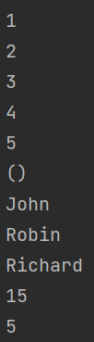
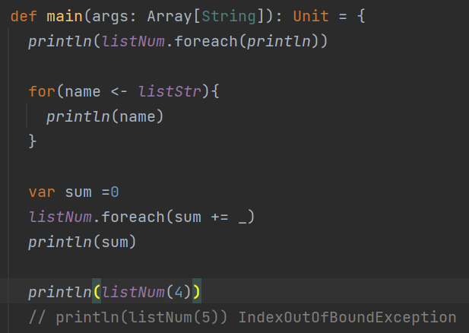
List iteration
Notes:
object ListIterate {
val myList: List[Int] = List()
val listNum = List(1, 2, 3, 4, 5)
val listStr: List[String] = List("John", "Robin", "Richard")
def main(args: Array[String]): Unit = {
println(listNum.foreach(println))
for(name <- listStr){
println(name)
}
var sum =0
listNum.foreach(sum += _)
println(sum)
println(listNum(4))
// println(listNum(5)) IndexOutOfBoundException
}
}

Slide 10
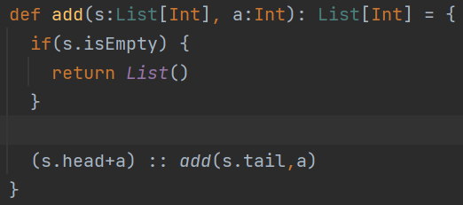


Iterate to modify a list?
Cannot be done because list is immutable.
We have to produce a new list.
Notes:
bject ListIterate {
val myList: List[Int] = List()
val listNum = List(1, 2, 3, 4, 5)
val listStr: List[String] = List("John", "Robin", "Richard")
def add(s:List[Int], a:Int): List[Int] = {
if(s.isEmpty) {
return List()
}
(s.head+a) :: add(s.tail,a)
}
def main(args: Array[String]): Unit = {
println(listNum.foreach(println))
for(name <- listStr){
println(name)
}
var sum =0
listNum.foreach(sum += _)
println(sum)
println(listNum(4))
// println(listNum(5)) IndexOutOfBoundException
println(add(listNum,10))
}
}

Slide 11
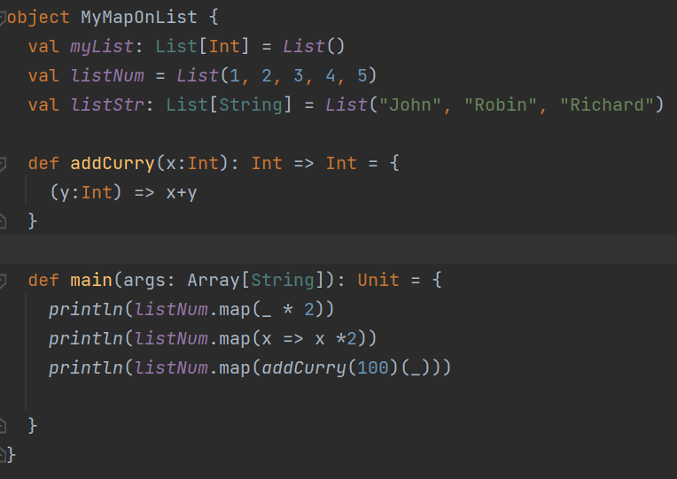
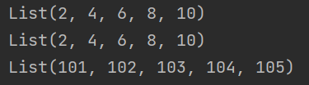
Higher order methods
MAP
Notes:
object MyMapOnList {
val myList: List[Int] = List()
val listNum = List(1, 2, 3, 4, 5)
val listStr: List[String] = List("John", "Robin", "Richard")
def addCurry(x:Int): Int => Int = {
(y:Int) => x+y
}
def main(args: Array[String]): Unit = {
println(listNum.map(_ * 2))
println(listNum.map(x => x *2))
println(listNum.map(addCurry(100)(_)))
}
}

Slide 12
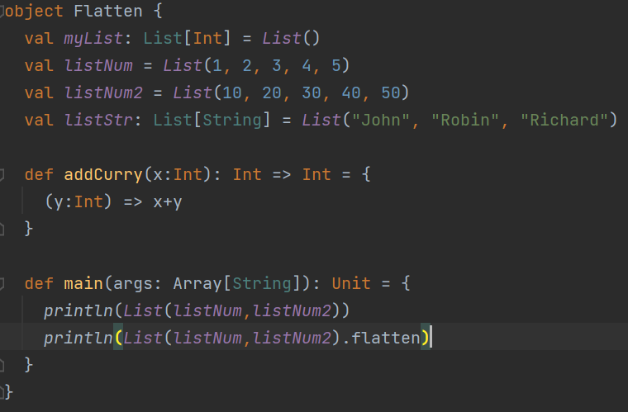

flatten
Notes:
object Flatten {
val myList: List[Int] = List()
val listNum = List(1, 2, 3, 4, 5)
val listNum2 = List(10, 20, 30, 40, 50)
val listStr: List[String] = List("John", "Robin", "Richard")
def addCurry(x:Int): Int => Int = {
(y:Int) => x+y
}
def main(args: Array[String]): Unit = {
println(List(listNum,listNum2))
println(List(listNum,listNum2).flatten)
}
}

Slide 13
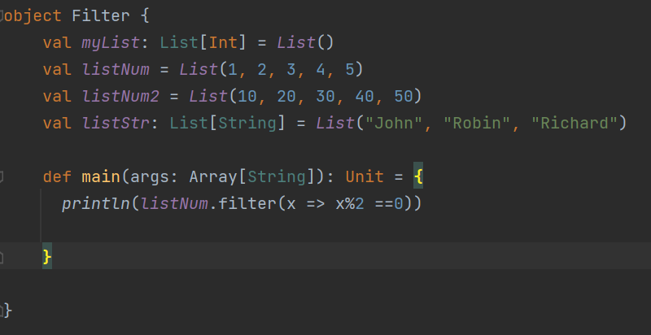

Filter
Notes:
object Filter {
val myList: List[Int] = List()
val listNum = List(1, 2, 3, 4, 5)
val listNum2 = List(10, 20, 30, 40, 50)
val listStr: List[String] = List("John", "Robin", "Richard")
def main(args: Array[String]): Unit = {
println(listNum.filter(x => x%2 ==0))
}
}

