Slide 1
Machine Learning technique to improve performance of cache bypassing
Warisa Sritriratanarak and Prabhas Chongstitvatana
Department of computer engineering
Chulalongkorn University

Slide 2
Last Level Cache bypassing
non-inclusion cache
multimedia applications
multicore processors

Slide 3
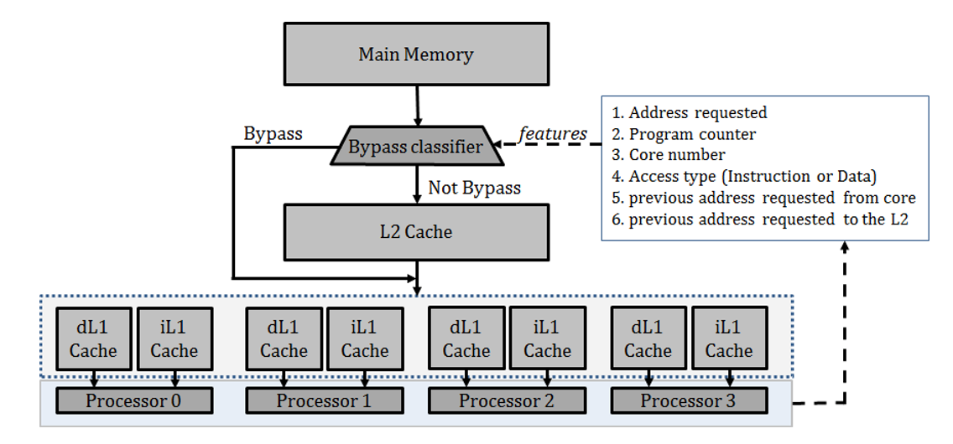

Slide 4
Tools
use machine learning
Support Vector Machine
Running benchmarks
Multi2Sim simulator

Slide 5
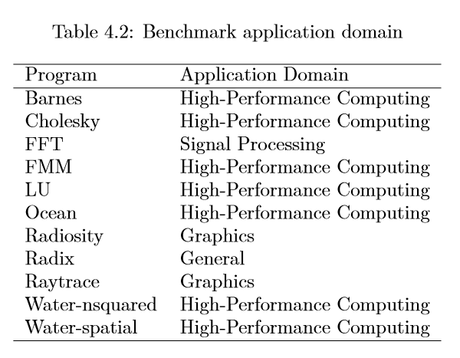

Slide 6
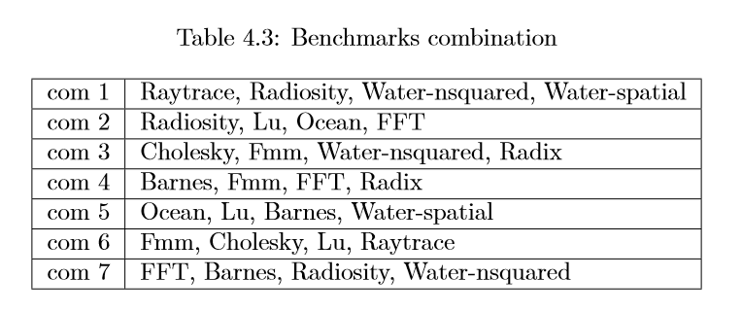

Slide 7
Features
Address requested
Program counter
Address of previously requested data from the core
Address of previously missed from L1
Core number that requested data
Access type: data/instruction
Time of access

Slide 8
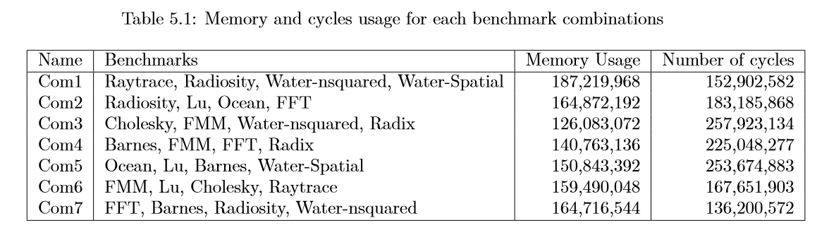

Slide 9
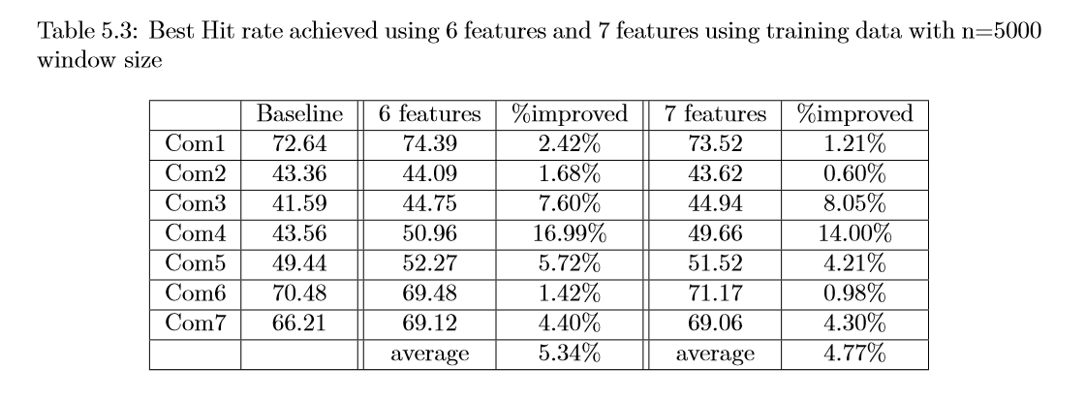

Slide 10
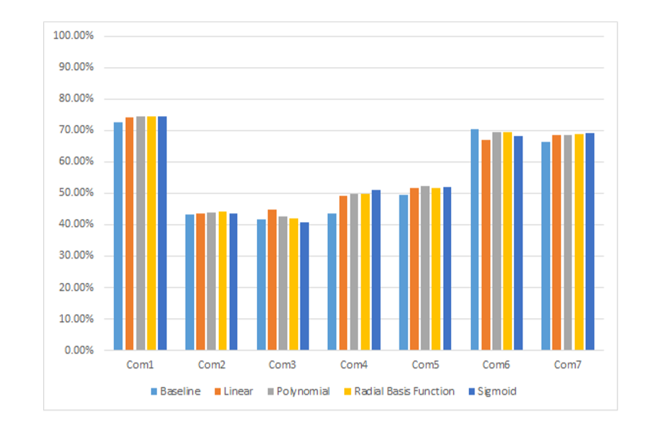

Slide 11
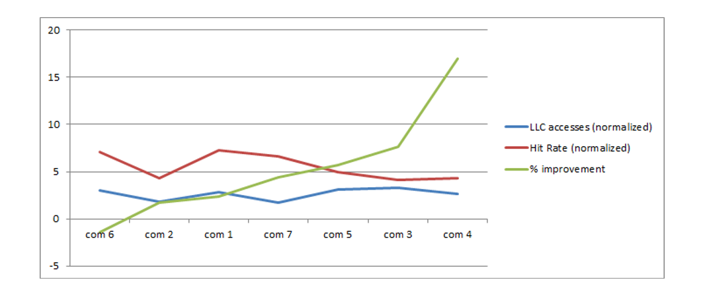

Slide 12
Conclusion
using Machine Learning
for decision to bypass Last Level Cache
on Multi-core processors
5.34% hit rate improvement
across SPLASH2 benchmark combinations

Slide 13
Sritriratanarak, W., Ekpanyapong, M., and Chongstitvatana, P., "Applying SVM to Data Bypass Prediction in Multi Core Last Level Caches," IEICE Electronics Express, Vol.12, No.22, 1-6. (Nov 2015)

Slide 14

More Information
Search “Prabhas Chongstitvatana”
Get to me homepage

