Slide 1
Robots and Emotion
Prabhas Chongstitvatana
CRIT 2012

Slide 2
Future
Robots and autonomous agents will increase in number.
They will serve more roles in human society.

Slide 3
Perceiving human emotion can be one of stimulus in communication between human and robots.

Slide 4
Conclusion
  A robot that can express and perceive human emotion
  Sociable Robot

Slide 5
Need
Robots perceive our need.
We command robots.
Robots adapt their behavior.

Slide 6
Robots situated in human world
Learn by trial and error
Inventing and mixing up its stock behaviours to response to a new situation

Slide 7
Human emotion has been studied in term of arts and design

Slide 8
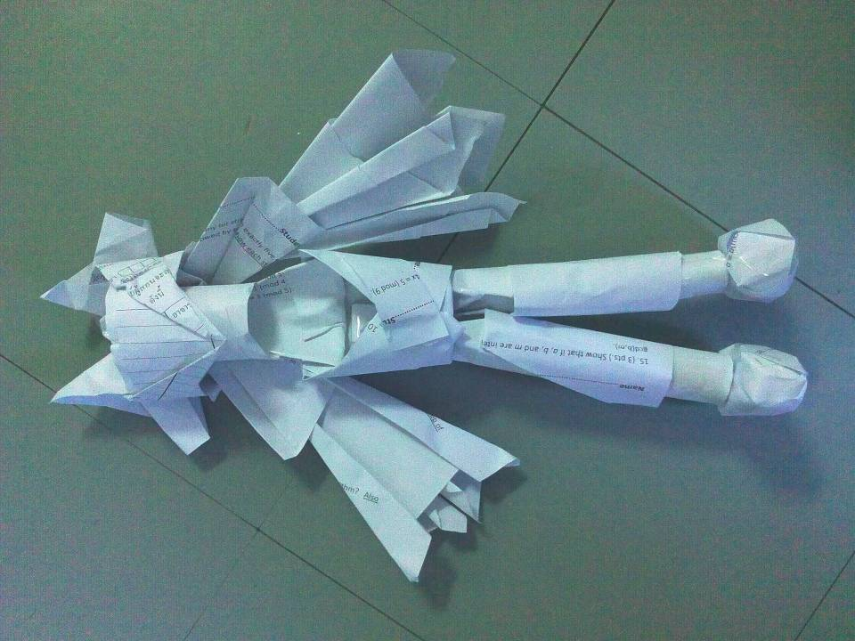

Slide 9
Robot Perception
N. Auttanugune and T. Horprasert, Head Pose Estimation using Motion Matching. in 15th International Workshop on Advanced Image Technology, (Ho Chi Minh City, Vietnam, 2012)

Slide 10
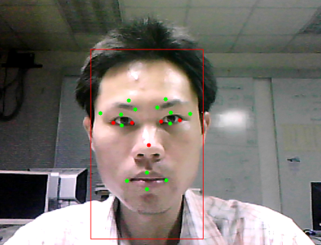
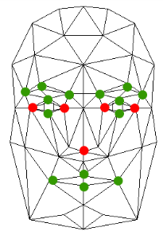
Head post estimation

Slide 11
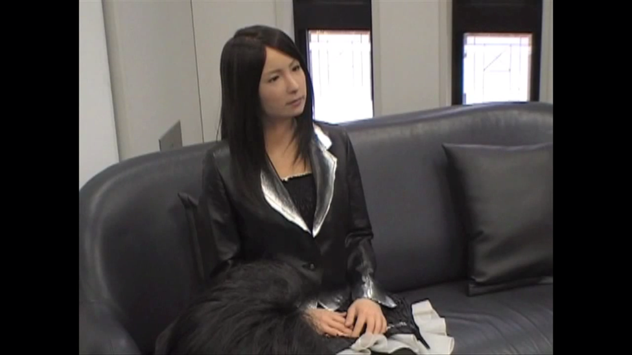
Ishikuro: Female Humanoid

Slide 12
Open-end design achieves with
design by evolution

Slide 13
Evolutionary Algorithm

Slide 14
Genetic Algorithm
Create population
While not terminate
  Evaluate
  Selection, recombination, mutation

Slide 15

1998 Synthesis of Synchronous Sequential Logic Circuits from Partial Input/Output Sequences
.
Two-Horn Chameleon (Bradypodion fischeri ssp.) in the Usambara mountains, Tanzania

Slide 17
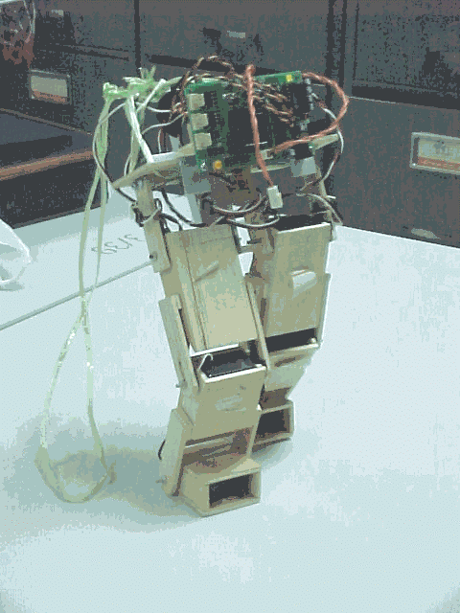
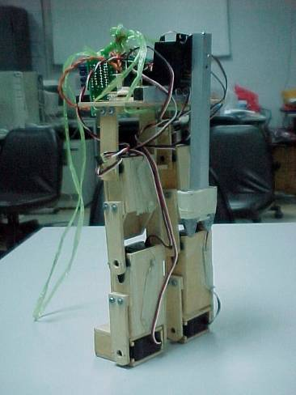
Controller of a 7 DOF Bibed

Slide 18



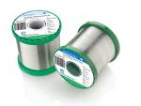

Lead-free Solder Alloys
Lead-based Solder
Low cost and abundant supply
Forms a reliable metallurgical joint
Good manufacturability
Excellent history of reliable use
Toxicity
Lead-free Solder
No toxicity
Meet Government legislations
(WEEE & RoHS)
Marketing Advantage (green product)
Increased Cost of Non-compliant parts
Variation of properties (Bad or Good)

Slide 19
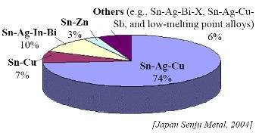
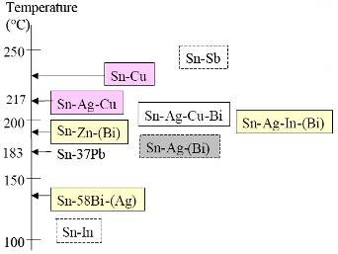
Sn-Ag-Cu (SAC) Solder
Advantage
Sufficient Supply
Good Wetting Characteristics
Good Fatigue Resistance
Good overall joint strength
Limitation
Moderate High Melting Temp
Long Term Reliability Data

Slide 20
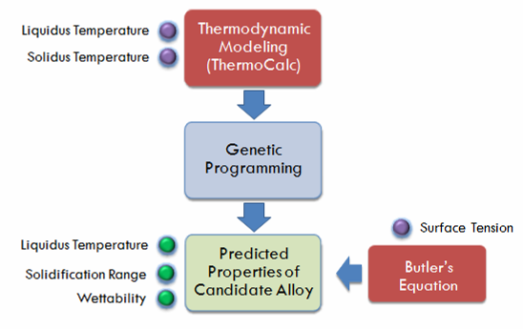

Slide 21
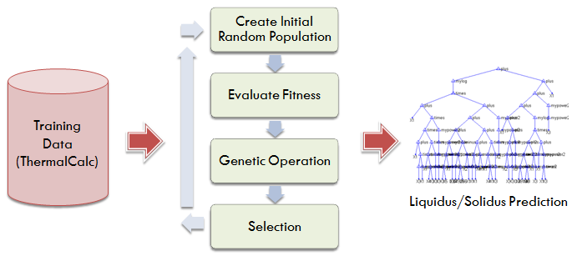
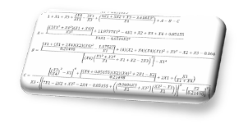
Combine with Genetic Programming

Slide 22
Experiments
10 Solder
Compositions
Thermal Properties Testing (DSC)
Liquidus Temperature
Solidus Temperature
Solidification Range
Wettability Testing
(Wetting Balance;
Globule Method)
Wetting Time
Wetting Force

Slide 23
Human in the evolution loop

Slide 24
Evolution + Emotion Perception
= Sociable Robot

Slide 25
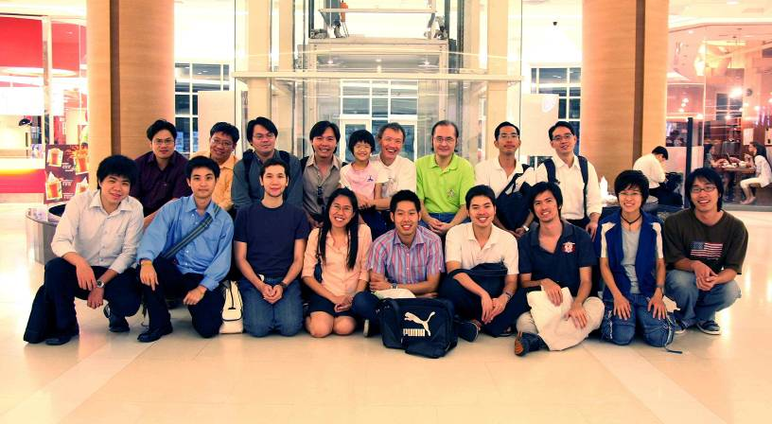
Team Work

Slide 26
prabhas@chula.ac.th
www.cp.eng.chula.ac.th/faculty/pjw/

