Slide 1
Applications of combinatorial optimisation
Prabhas Chongstitvatana
Faculty of Engineering
Chulalongkorn University

Slide 2
Combinatorial optimisation
The domains of feasible solutions are discrete.
Examples
  Traveling salesman problem
  Minimum spanning tree problem
  Set-covering problem
  Knapsack problem

Slide 3
Evolutionary Computation
EC is a probabilistic search procedure to obtain solutions starting from a set of candidate solutions, using improving operators to “evolve” solutions. Improving operators are inspired by natural evolution.

Slide 4
Coincident Algorithm (COIN)
Evolutionary Algorithms that makes use of models to generate solutions.
“Estimation of Distribution Algorithms”
“Competent Genetic Algorithms”

Slide 5
Model in COIN
A joint probability matrix, H.
Markov Chain.
An entry in H_{xy} is a probability of transition from a state x to a state y.
xy a coincidence of the event x and event y.

Slide 6
Steps of the algorithm
Initialise H to a uniform distribution.
Sample a population from H.
Evaluate the population.
Select two groups of candidates: better, and worse.
Use these two groups to update H.
Repeate the steps 2-3-4-5 until satisfactory solutions are found.

Slide 7
Updating of H
k denotes the step size, n the length of a candidate, r_{xy} the number of occurrence of xy in the better-group candidates, p_{xy} the number of occurrence of xy in the worse-group candidates. H_{xx} are always zero.

Slide 8
Coincidence Algorithm
Combinatorial Optimisation with Coincidence
  Coincidences found in the good solution are good
  Coincidences found in the not good solutions are not good
  How about the Coincidences found in both good and not good solutions!
Notes:
If we believe in the building block hypothesis, that the good candidates are composed with the good building blocks,
In contrast the bad candidates must also contain the bad building blocks as well.
So we are going to extract some information from the bad candidates in order to prevent the undesired results
Obviously, Coincidences found in the good solution are good and Coincidences found in the not good solutions are not good
How about the Coincidences found in both good and not good solutions!
We are considering them as the false positive. And keep questioning them to be explored.

Slide 9
Coincidence Algorithm
Next Incidence
Initialize the Generator
 | X₁ | X₂ | X₃ | X₄ | X₅
X₁ | 0 | 0.25 | 0.25 | 0.25 | 0.25
X₂ | 0.25 | 0 | 0.25 | 0.25 | 0.25
X₃ | 0.25 | 0.25 | 0 | 0.25 | 0.25
X₄ | 0.25 | 0.25 | 0.25 | 0 | 0.25
X₅ | 0.25 | 0.25 | 0.25 | 0.25 | 0
Generate the Population
Prior Incidence
Evaluate the Population
The Generator
Selection
Update the Generator
Notes:
Our algorithm use the Markov chain matrix of order 1 in order to construct a generator
This generator represent the joint probability of all the possible search space.
For example the probabilities of the incidence in which x1 can be followed by x2 x3 x4 and x5
Since x1 can not be followed by it self due to the encoding represent the permutation of numbers

Slide 10
Coincidence Algorithm
Initialize the Generator
 | X₁ | X₂ | X₃ | X₄ | X₅
X₁ | 0 | 0.25 | 0.25 | 0.25 | 0.25
X₂ | 0.25 | 0 | 0.25 | 0.25 | 0.25
X₃ | 0.25 | 0.25 | 0 | 0.25 | 0.25
X₄ | 0.25 | 0.25 | 0.25 | 0 | 0.25
X₅ | 0.25 | 0.25 | 0.25 | 0.25 | 0
P(X₁|X₂) = P(X₁|X₃) = P(X₁|X₄) = P(X₁|X₅)
= 1/(n -1)
= 1/(5-1)
= 0.25
Notes:
The algorithm starts by initializing the generator so that all of the joint probabilities are equal
In this case the problem size is 5 so the joint probability for each xi followed by xj is equal to 0.25

Slide 11
Coincidence Algorithm
Initialize the Generator
 | X₁ | X₂ | X₃ | X₄ | X₅
X₁ | 0 | 0.25 | 0.25 | 0.25 | 0.25
X₂ | 0.25 | 0 | 0.25 | 0.25 | 0.25
X₃ | 0.25 | 0.25 | 0 | 0.25 | 0.25
X₄ | 0.25 | 0.25 | 0.25 | 0 | 0.25
X₅ | 0.25 | 0.25 | 0.25 | 0.25 | 0
Generate the Population
Begin at any node X_{i}
For each X_{i}, choose its value according to the empirical probability h(X_{i}|X_{j}).
X2
X3
X1
X4
X5
Notes:
After the generator is initiated, we will start generating the population from the condition probability
Firstly we random a starting point X2, Since the joint probability Xj after x2 are equal so we can select any Xj
Then the conditional probability in which Xk can be follow by X2 and X3 are selected until each of the string is completed.

Slide 12
Coincidence Algorithm
Initialize the Generator
 | X₁ | X₂ | X₃ | X₄ | X₅
X₁ | 0 | 0.25 | 0.25 | 0.25 | 0.25
X₂ | 0.25 | 0 | 0.25 | 0.25 | 0.25
X₃ | 0.25 | 0.25 | 0 | 0.25 | 0.25
X₄ | 0.25 | 0.25 | 0.25 | 0 | 0.25
X₅ | 0.25 | 0.25 | 0.25 | 0.25 | 0
Generate the Population
Evaluate the Population
Population |  |  |  |  | Fit
X₂ | X₃ | X₁ | X₄ | X₅ | 7
X₁ | X₂ | X₃ | X₅ | X₄ | 6
X₄ | X₃ | X₁ | X₂ | X₅ | 3
X₁ | X₃ | X₂ | X₄ | X₅ | 2
Notes:
After we finish generating the population they are evaluated and sorted

Slide 13
Coincidence Algorithm
Uniform Selection :
selects from the top and bottom c percent of the population
Initialize the Generator
 | X₁ | X₂ | X₃ | X₄ | X₅
X₁ | 0 | 0.25 | 0.25 | 0.25 | 0.25
X₂ | 0.25 | 0 | 0.25 | 0.25 | 0.25
X₃ | 0.25 | 0.25 | 0 | 0.25 | 0.25
X₄ | 0.25 | 0.25 | 0.25 | 0 | 0.25
X₅ | 0.25 | 0.25 | 0.25 | 0.25 | 0
Selection
Generate the Population
Evaluate the Population
Population
Top c%
Population |  |  |  |  | Fit
X₂ | X₃ | X₁ | X₄ | X₅ | 7
X₁ | X₂ | X₃ | X₅ | X₄ | 6
X₄ | X₃ | X₁ | X₂ | X₅ | 3
X₁ | X₃ | X₂ | X₄ | X₅ | 2
Selection
Good
Discard
Bottom c%
Not Good
Notes:
Unlike the other evolutionary algorithm that we normally use the good candidate to evolve to the better candidate
In our work we also use the undesired solution as well.
Just to find out why they are not able to survive.
If we can extract the information why they are not good we would be able to generate the better solution
Our selection method can be uniform which select both good and not good equally
And it can also be the adaptive method due to how many candidates appear to be above and below the band of two standard deviations
In order to maintain the diversity

Slide 14
Coincidence Algorithm
Note:
Reward:
If an incidence X_{i},X_{j} is found in the good string, the joint probability P(X_{i},X_{j}) is rewarded by gathering the probability d from other P(X_{i}|X_{else})
d = k/(n-1) = 0.05
 | X₁ | X₂ | X₃ | X₄ | X₅
X₁ | 0 | 0.25 | 0.25 | 0.25 | 0.25
X₂ | 0.25 | 0 | 0.25 | 0.25 | 0.25
X₃ | 0.25 | 0.25 | 0 | 0.25 | 0.25
X₄ | 0.25 | 0.25 | 0.25 | 0 | 0.25
X₅ | 0.25 | 0.25 | 0.25 | 0.25 | 0
 | X₁ | X₂ | X₃ | X₄ | X₅
X₁ | 0 | 0.25 | 0.25 | 0.25 | 0.25
X₂ | 0.20 | 0 | 0.40 | 0.20 | 0.20
X₃ | 0.25 | 0.25 | 0 | 0.25 | 0.25
X₄ | 0.25 | 0.25 | 0.25 | 0 | 0.25
X₅ | 0.25 | 0.25 | 0.25 | 0.25 | 0
 | X₁ | X₂ | X₃ | X₄ | X₅
X₁ | 0 | 0.25 | 0.25 | 0.25 | 0.25
X₂ | 0.20 | 0 | 0.40 | 0.20 | 0.20
X₃ | 0.40 | 0.20 | 0 | 0.20 | 0.20
X₄ | 0.25 | 0.25 | 0.25 | 0 | 0.25
X₅ | 0.25 | 0.25 | 0.25 | 0.25 | 0
 | X₁ | X₂ | X₃ | X₄ | X₅
X₁ | 0 | 0.20 | 0.20 | 0.40 | 0.20
X₂ | 0.20 | 0 | 0.40 | 0.20 | 0.20
X₃ | 0.40 | 0.20 | 0 | 0.20 | 0.20
X₄ | 0.25 | 0.25 | 0.25 | 0 | 0.25
X₅ | 0.25 | 0.25 | 0.25 | 0.25 | 0
Initialize the Generator
 | X₁ | X₂ | X₃ | X₄ | X₅
X₁ | 0 | 0.20 | 0.20 | 0.40 | 0.20
X₂ | 0.20 | 0 | 0.40 | 0.20 | 0.20
X₃ | 0.40 | 0.20 | 0 | 0.20 | 0.20
X₄ | 0.20 | 0.20 | 0.20 | 0 | 0.40
X₅ | 0.25 | 0.25 | 0.25 | 0.25 | 0
Update the Generator
k=0.2
Generate the Population
Evaluate the Population
Population |  |  |  |  | Fit
X₂ | X₃ | X₁ | X₄ | X₅ | 7
X₁ | X₂ | X₃ | X₅ | X₄ | 6
X₄ | X₃ | X₁ | X₂ | X₅ | 3
X₁ | X₃ | X₂ | X₄ | X₅ | 2
Selection
Discard
Update the Generator
Notes:
Our algorithm is different from the mimic algorithm in which we are not generating the whole generator in each generation
But we learn in an incremental or detrimental method
As we can see that the incidence X2 followed by x3 is found in the good candidate
Each of the joint probability then give the reward to the Joint prob by 0.5 according to the equation
The more complex update equation can be seen in the literature
In this presentation we rather show you the effect of the equation in animation
And we are going to train the generator this way until end of the string is met.
In case the representation of the string can be circulated we also need to give the reward to the the tail followed by the head.

Slide 15
Coincidence Algorithm
Note:
Observation:
The incidence X₄,X₅ is equally found in both good and not good strings,
the joint probability P(X_{i},X_{j}) is one time rewarded and one time punished so that the joint probability P(X_{i},X_{j}) remains the same value.
Note:
Punishment:
If an incidence X_{i},X_{j} is found in the not good string, the joint probability P(X_{i},X_{j}) is punished by scattering the probability d to the other P(X_{i}|X_{else})
d = k/(n-1) = 0.05
 | X₁ | X₂ | X₃ | X₄ | X₅
X₁ | 0 | 0.20 | 0.20 | 0.40 | 0.20
X₂ | 0.20 | 0 | 0.40 | 0.20 | 0.20
X₃ | 0.40 | 0.20 | 0 | 0.20 | 0.20
X₄ | 0.20 | 0.20 | 0.20 | 0 | 0.40
X₅ | 0.25 | 0.25 | 0.25 | 0.25 | 0
 | X₁ | X₂ | X₃ | X₄ | X₅
X₁ | 0 | 0.25 | 0.05 | 0.45 | 0.25
X₂ | 0.20 | 0 | 0.40 | 0.20 | 0.20
X₃ | 0.40 | 0.20 | 0 | 0.20 | 0.20
X₄ | 0.20 | 0.20 | 0.20 | 0 | 0.40
X₅ | 0.25 | 0.25 | 0.25 | 0.25 | 0
 | X₁ | X₂ | X₃ | X₄ | X₅
X₁ | 0 | 0.25 | 0.05 | 0.45 | 0.25
X₂ | 0.20 | 0 | 0.40 | 0.20 | 0.20
X₃ | 0.45 | 0.05 | 0 | 0.25 | 0.25
X₄ | 0.20 | 0.20 | 0.20 | 0 | 0.40
X₅ | 0.25 | 0.25 | 0.25 | 0.25 | 0
 | X₁ | X₂ | X₃ | X₄ | X₅
X₁ | 0 | 0.25 | 0.05 | 0.45 | 0.25
X₂ | 0.25 | 0 | 0.45 | 0.05 | 0.25
X₃ | 0.45 | 0.05 | 0 | 0.25 | 0.25
X₄ | 0.20 | 0.20 | 0.20 | 0 | 0.40
X₅ | 0.25 | 0.25 | 0.25 | 0.25 | 0
Initialize the Generator
 | X₁ | X₂ | X₃ | X₄ | X₅
X₁ | 0 | 0.25 | 0.05 | 0.45 | 0.25
X₂ | 0.25 | 0 | 0.45 | 0.05 | 0.25
X₃ | 0.45 | 0.05 | 0 | 0.25 | 0.25
X₄ | 0.25 | 0.25 | 0.25 | 0 | 0.25
X₅ | 0.25 | 0.25 | 0.25 | 0.25 | 0
Update the Generator
Update the Generator
k=0.2
Generate the Population
Evaluate the Population
Population |  |  |  |  | Fit
X₂ | X₃ | X₁ | X₄ | X₅ | 7
X₁ | X₂ | X₃ | X₅ | X₄ | 6
X₄ | X₃ | X₁ | X₂ | X₅ | 3
X₁ | X₃ | X₂ | X₄ | X₅ | 2
Selection
Discard
Update the Generator
Notes:
The reward are given to the good incidence
Then the punishments should be given to the bad
When an incidence if found bad it probability must be scatter to the other joint
In order to give the other joint more of the chance to be searched
You can see in this case that the incidence x4 followed by x5 can be found in both good and not good solutions
So it is considered to be the false positive building block and needed to be once punished then the probability remain the same

Slide 16
Coincidence Algorithm
Initialize the Generator
 | X₁ | X₂ | X₃ | X₄ | X₅
X₁ | 0 | 0.25 | 0.05 | 0.45 | 0.25
X₂ | 0.25 | 0 | 0.45 | 0.05 | 0.25
X₃ | 0.45 | 0.05 | 0 | 0.25 | 0.25
X₄ | 0.25 | 0.25 | 0.25 | 0 | 0.25
X₅ | 0.25 | 0.25 | 0.25 | 0.25 | 0
Generate the Population
Evaluate the Population
Selection
X1
X4
X3
X5
X2
Update the Generator
Notes:
Finally we continue to repeat the process until the terminate conditions are met
You can see that if we perform greedy search according to the joint probability
The candidate would rather look like this

Slide 17
Computational Cost and Space
Generating the population requires time O(mn²) and space O(mn)
Sorting the population requires time O(m log m)
The generator require space O(n²)
Updating the joint probability matrix requires time O(mn²)

Slide 18
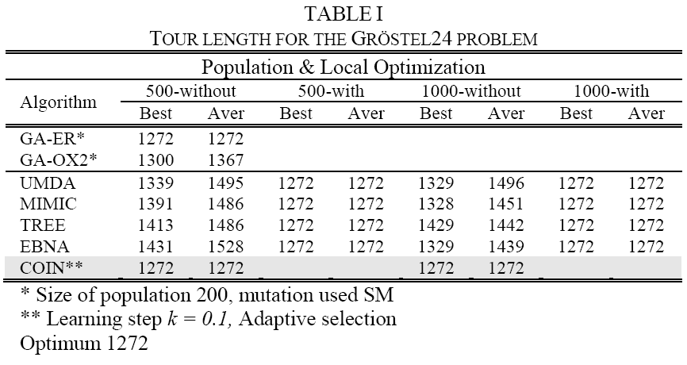
TSP

Slide 19
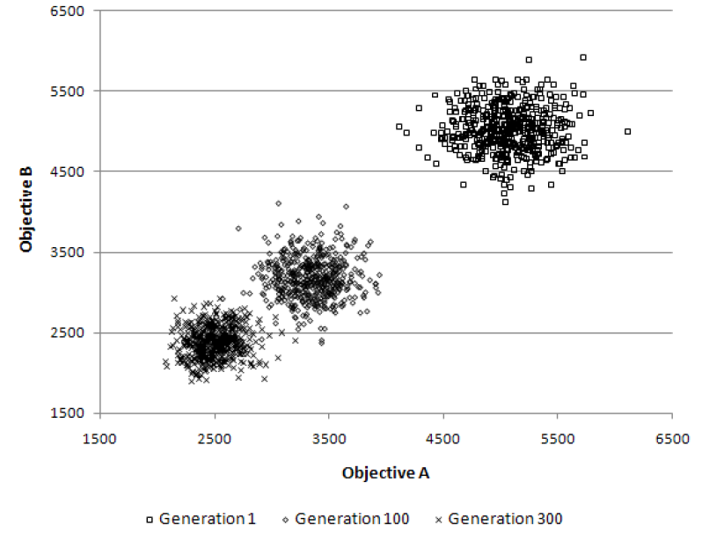
Multi-objective TSP
The population clouds in a random 100-city 2-obj TSP

Slide 20
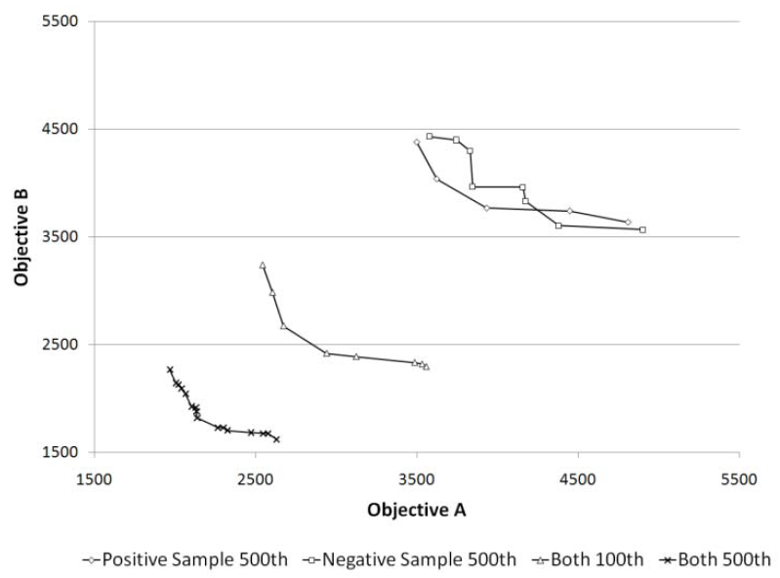
Role of Negative Correlation

Slide 21
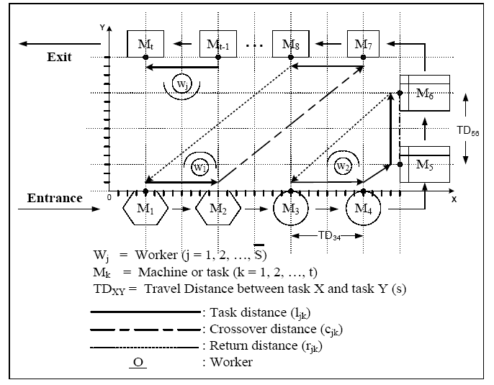
U-shaped assembly line for j workers and k machines

Slide 22
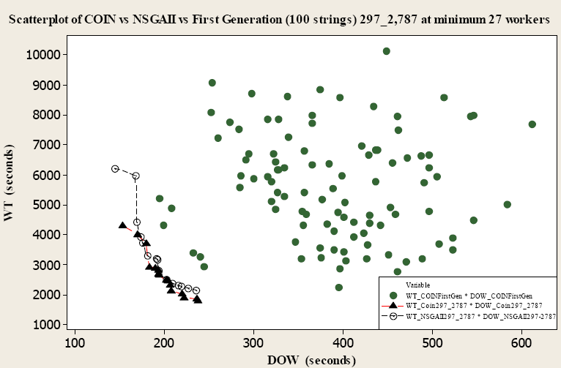
Comparison for Scholl and Klein’s 297 tasks at the cycle time of 2,787 time units

Slide 23
More Information
COIN homepage
http://www.cp.eng.chula.ac.th/faculty/pjw/project/coin/index-coin.htm
My homepage
http://www.cp.eng.chula.ac.th/faculty/pjw

