Slide 1

Applied Evolutionary Optimization
Prabhas Chongstitvatana
Chulalongkorn University

Slide 2
What is Evolutionary Optimization
A method in the class of Evolutionary Computation
Best known member: Genetic Algorithms

Slide 3
What is Evolutionary Computation
EC is a probabilistic search procedure to obtain solutions starting from a set of candidate solutions, using improving operators to “evolve” solutions.
Improving operators are inspired by natural evolution.

Slide 4
Evolutionary Computation
Survival of the fittest.
The objective function depends on the problem.
EC is not a random search.

Slide 5
Genetic Algorithm Pseudo Code
initialise population P
while not terminate
  evaluate P by fitness function
  P’ = selection.recombination.mutation of P
  P = P’
terminating conditions:
  found satisfactory solutions
  waiting too long

Slide 6
Simple Genetic Algorithm
Represent a solution by a binary string {0,1}*
Selection: chance to be selected is proportional to its fitness
Recombination: single point crossover
Mutation: single bit flip

Slide 7
Recombination
Select a cut point, cut two parents, exchange parts
AAAAAA 111111
cut at bit 2
AA AAAA 11 1111
exchange parts
AA1111 11AAAA

Slide 8
Mutation
single bit flip
111111 --> 111011
flip at bit 4

Slide 9
Other EC
Evolution Strategy -- represents solutions with real numbers
Genetic Programming -- represents solutions with tree-data-structures
Differential Evolution – vectors space

Slide 10
Building Block Hypothesis
BBs are sampled, recombined, form higher fitness individual.
“construct better individual from the best partial solution of past samples.”
Goldberg 1989

Slide 11
Estimation of Distribution Algorithms
GA + Machine learning
current population -> selection ->
model-building -> next generation
replace crossover + mutation with learning and sampling
probabilistic model

Slide 12
x = 11100 f(x) = 28
x = 11011 f(x) = 27
x = 10111 f(x) = 23
x = 10100 f(x) = 20
---------------------------
x = 01011 f(x) = 11
x = 01010 f(x) = 10
x = 00111 f(x) = 7
x = 00000 f(x) = 0
Induction
1 * * * *
(Building Block)

Slide 13
x = 11111 f(x) = 31
x = 11110 f(x) = 30
x = 11101 f(x) = 29
x = 10110 f(x) = 22
---------------------------
x = 10101 f(x) = 21
x = 10100 f(x) = 20
x = 10010 f(x) = 18
x = 01101 f(x) = 13
Reproduction
1 * * * *
(Building Block)

Slide 14
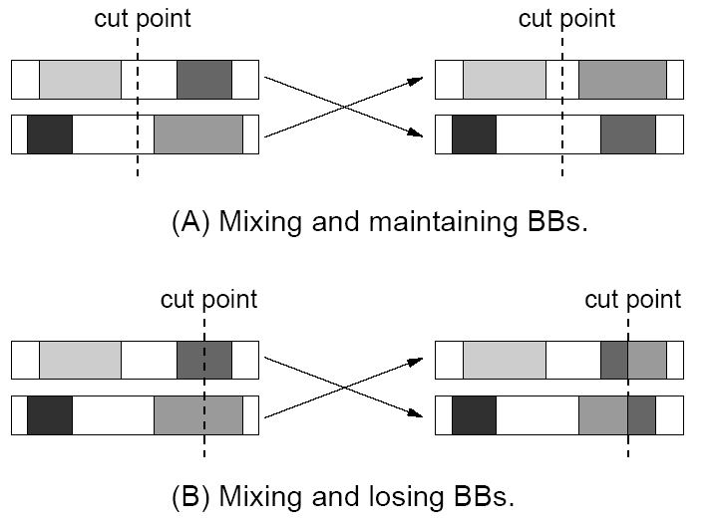

Slide 15
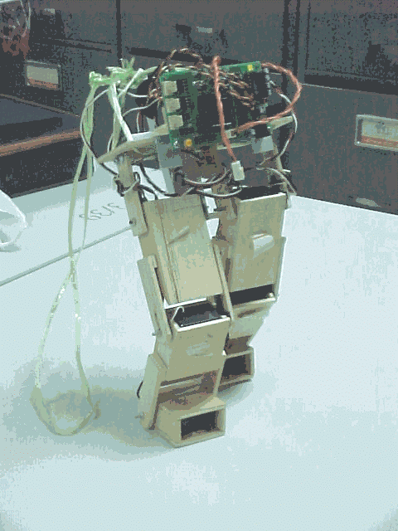
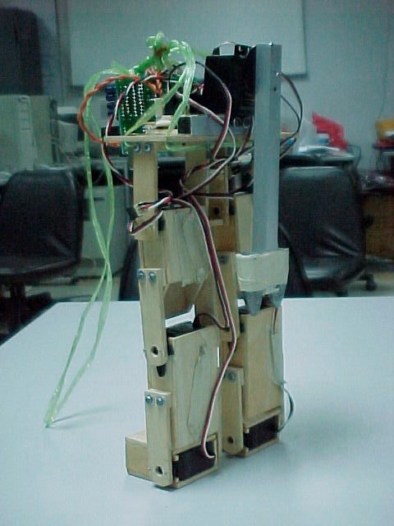
Evolve robot programs: Biped walking

Slide 16
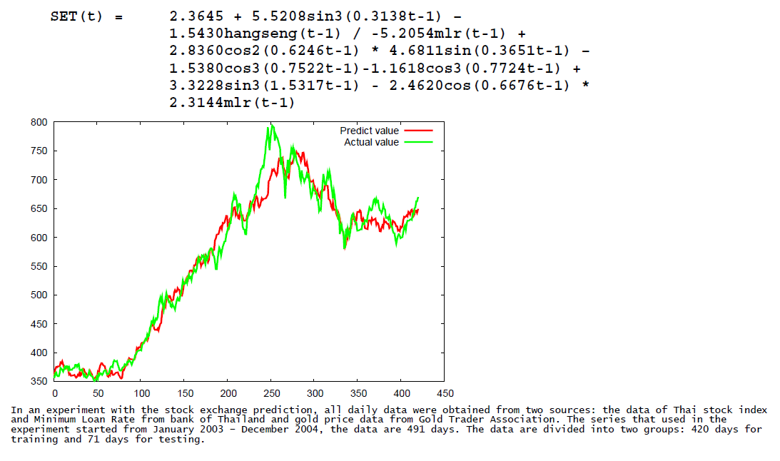

Slide 17
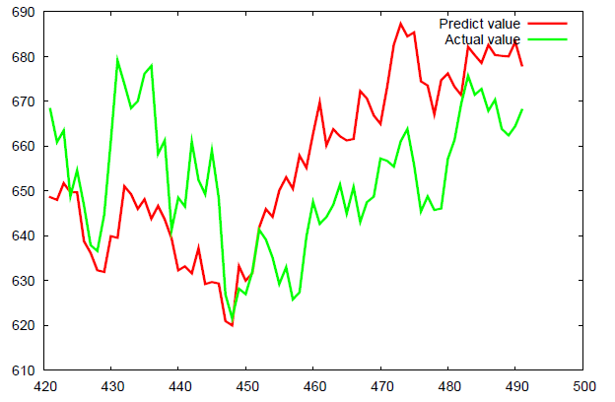

Slide 18



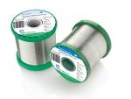
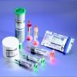
Lead-free Solder Alloys
Lead-based Solder
Low cost and abundant supply
Forms a reliable metallurgical joint
Good manufacturability
Excellent history of reliable use
Toxicity
Lead-free Solder
No toxicity
Meet Government legislations
(WEEE & RoHS)
Marketing Advantage (green product)
Increased Cost of Non-compliant parts
Variation of properties (Bad or Good)

Slide 19
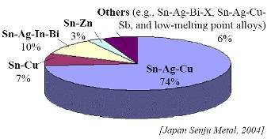
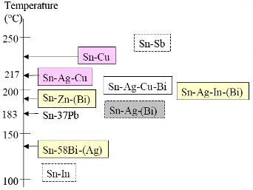
Sn-Ag-Cu (SAC) Solder
Advantage
Sufficient Supply
Good Wetting Characteristics
Good Fatigue Resistance
Good overall joint strength
Limitation
Moderate High Melting Temp
Long Term Reliability Data

Slide 20
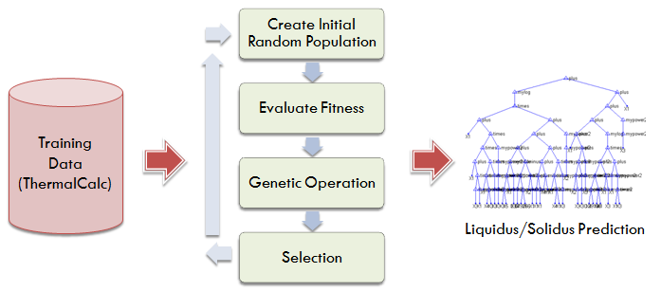

Slide 21
EC summary
GA has been used successfully in many real world applications
GA theory is well developed
Research community continue to develop more powerful GA
EDA is a recent development

Slide 22
Coincidence Algorithm COIN
A modern Genetic Algorithm or Estimation of Distribution Algorithm
Design to solve Combinatorial optimization

Slide 23
Combinatorial optimisation
The domains of feasible solutions are discrete.
Examples
  Traveling salesman problem
  Minimum spanning tree problem
  Set-covering problem
  Knapsack problem

Slide 24
Model in COIN
A joint probability matrix, H.
Markov Chain.
An entry in H_{xy} is a probability of transition from a state x to a state y.
xy a coincidence of the event x and event y.

Slide 25
Coincidence Algorithm steps
Initialize the Generator
 | X₁ | X₂ | X₃ | X₄ | X₅
X₁ | 0 | 0.25 | 0.25 | 0.25 | 0.25
X₂ | 0.25 | 0 | 0.25 | 0.25 | 0.25
X₃ | 0.25 | 0.25 | 0 | 0.25 | 0.25
X₄ | 0.25 | 0.25 | 0.25 | 0 | 0.25
X₅ | 0.25 | 0.25 | 0.25 | 0.25 | 0
Generate the Population
Evaluate the Population
The Generator
Selection
Update the Generator
Notes:
Our algorithm use the Markov chain matrix of order 1 in order to construct a generator
This generator represent the joint probability of all the possible search space.
For example the probabilities of the incidence in which x1 can be followed by x2 x3 x4 and x5
Since x1 can not be followed by it self due to the encoding represent the permutation of numbers

Slide 26
Steps of the algorithm
Initialise H to a uniform distribution.
Sample a population from H.
Evaluate the population.
Select two groups of candidates: better, and worse.
Use these two groups to update H.
Repeate the steps 2-3-4-5 until satisfactory solutions are found.

Slide 27
Updating of H
k denotes the step size, n the length of a candidate, r_{xy} the number of occurrence of xy in the better-group candidates, p_{xy} the number of occurrence of xy in the worse-group candidates. H_{xx} are always zero.

Slide 28
Computational Cost and Space
Generating the population requires time O(mn²) and space O(mn)
Sorting the population requires time O(m log m)
The generator require space O(n²)
Updating the joint probability matrix requires time O(mn²)

Slide 29
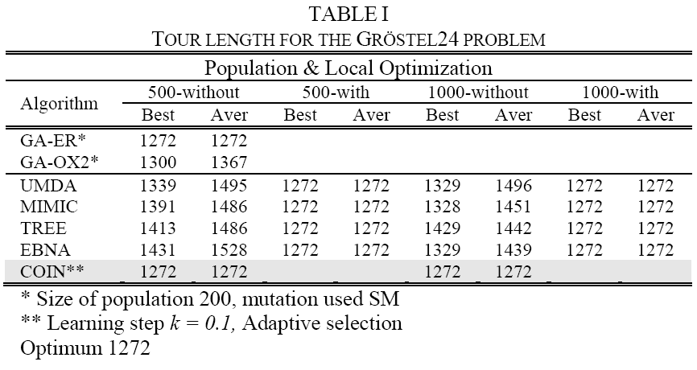
TSP

Slide 30
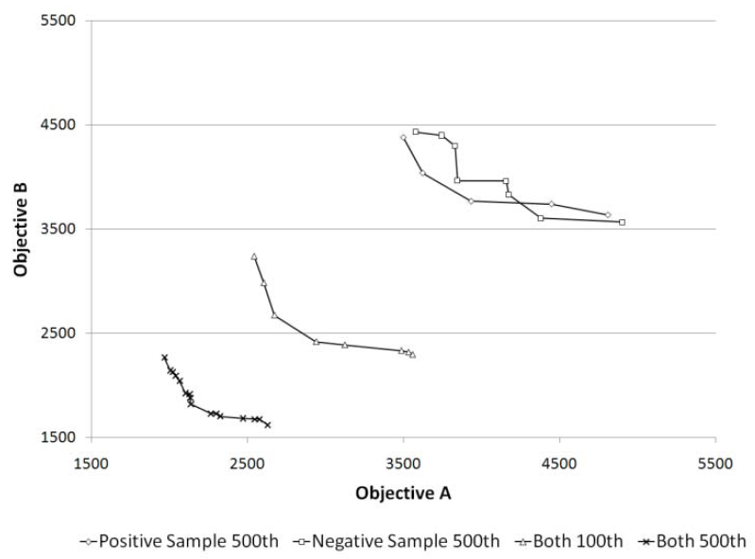
Role of Negative Correlation

Slide 31
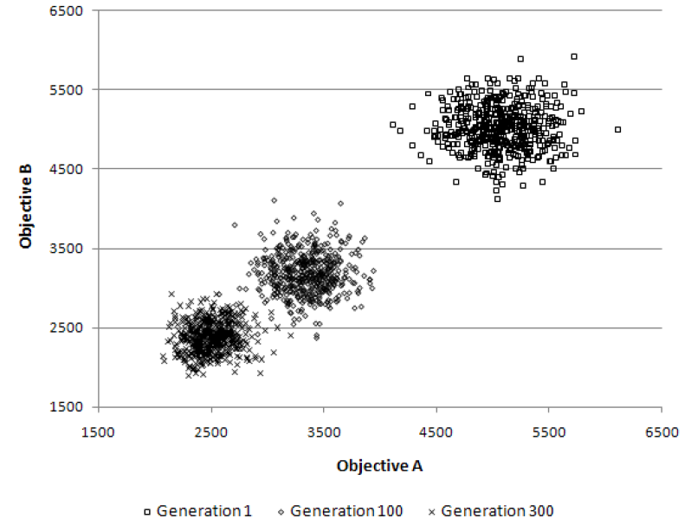
Multi-objective TSP
The population clouds in a random 100-city 2-obj TSP

Slide 32
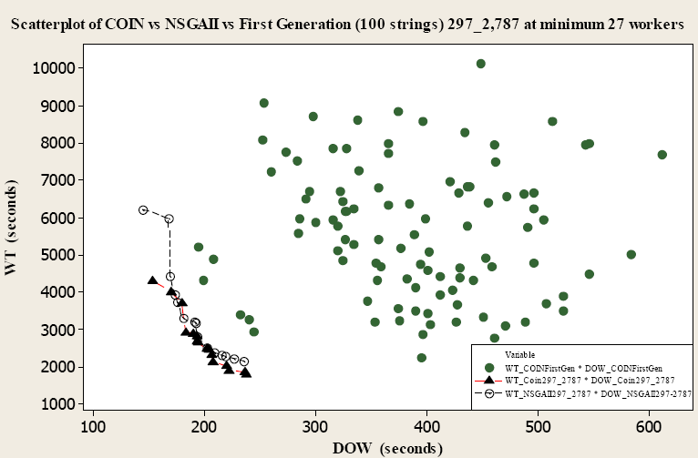
Comparison for Scholl and Klein’s 297 tasks at the cycle time of 2,787 time units

Slide 33
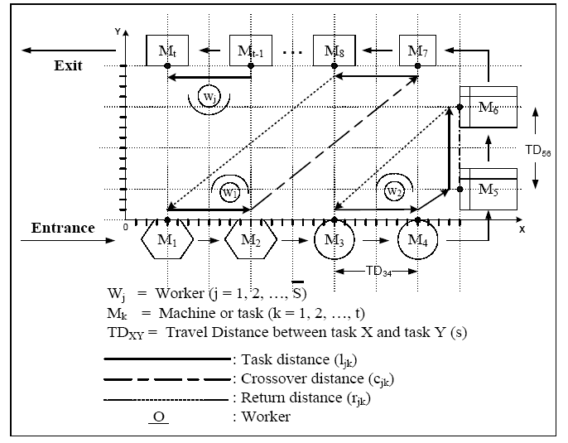
U-shaped assembly line for j workers and k machines

Slide 34
n-queens (b) n-rooks (c) n-bishops
(d) n-knights
Available moves and sample solutions
to combination problems on a 4x4 board

Slide 36


Slide 37
More Information
COIN homepage
http://www.cp.eng.chula.ac.th/faculty/pjw/project/coin/index-coin.htm
My homepage
http://www.cp.eng.chula.ac.th/faculty/pjw

Slide 38
More Information
COIN homepage
http://www.cp.eng.chula.ac.th/~piak/project
/coin/index-coin.htm

Slide 40
Role of Negative Correlation

Slide 42
Experiments
10 Solder
Compositions
Thermal Properties Testing (DSC)
Liquidus Temperature
Solidus Temperature
Solidification Range
Wettability Testing
(Wetting Balance;
Globule Method)
Wetting Time
Wetting Force

Slide 43
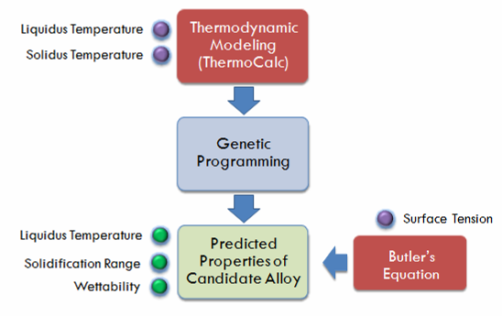

Slide 44
Sn-Ag-Cu (SAC) Solder
Advantage
Sufficient Supply
Good Wetting Characteristics
Good Fatigue Resistance
Good overall joint strength
Limitation
Moderate High Melting Temp
Long Term Reliability Data

Slide 45
Lead-free Solder Alloys
Lead-based Solder
Low cost and abundant supply
Forms a reliable metallurgical joint
Good manufacturability
Excellent history of reliable use
Toxicity
Lead-free Solder
No toxicity
Meet Government legislations
(WEEE & RoHS)
Marketing Advantage (green product)
Increased Cost of Non-compliant parts
Variation of properties (Bad or Good)

Slide 47


