Slide 1
Programming Quantum Computers
Prabhas Chongstitvatana
Chulalongkorn University

Slide 2
Google Nasa, D-Wave 2x machine

Slide 3
Quantum bit in D-wave machine

Slide 4
Recent work
google quantum lab's paper
claim of 100,000,000x speed up

Slide 7
My own example of quantum computation
compact genetic algorithm by quantum computers
exponential speedup

Slide 9
Example of Quantum Algorithm
Yingchareonthawornchai, S., Aporntewan, C., and Chongstitvatana, P., "An Implementation of Compact Genetic Algorithm on a Quantum Computer," Int. Joint Conf. on Computer Science and Software Engineering (JCSSE), 30 May - 1 June 2012, pp.131-135. http://www.cp.eng.chula.ac.th/~piak/paper/2012/jcsse-quantum-cga.pdf

Slide 10
Normal
1) initialze qureg x
2) generate two individuals from qureg
3) let them compete
4) update qureg x with the winner
5) repeat step 2..4 for k times
6) generate the final result

Slide 11
quantum speedup
1) initialze qureg x
2) generate the first individual from qureg x
3) generate the second individual with condition that fitness is greater than the first
4) let them compete
5) update qureg x with the winner
6) repeat step 2..5 for k times
7) generate the final result

Slide 12
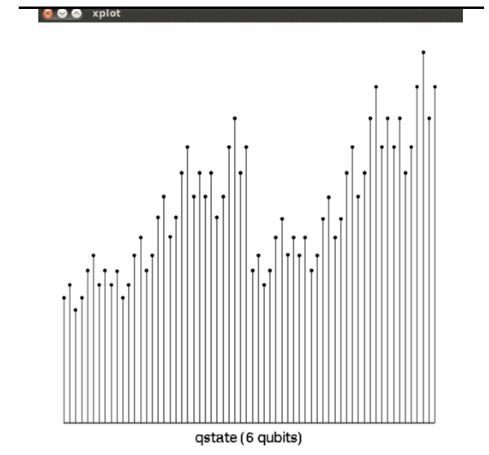
output

Slide 13
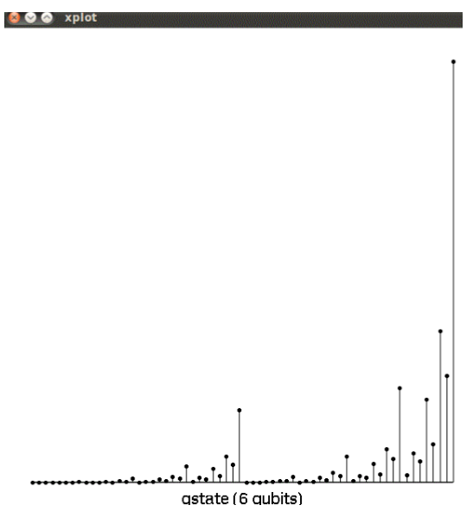
output

Slide 14
Future
qubits
quantum annealing computers
scaling up

Slide 15
Predicting future
uncertain of success
special purpose quantum computers
quantum style will motivate a new class of computation

Slide 16
More Information
Search “Prabhas Chongstitvatana”
Get to me homepage

