Slide 1
Promises of Artificial Intelligence
Prabhas Chongstitvatana
Chulalongkorn University
prabhas.c@chula.ac.th

Slide 2

More Information
Search “Prabhas Chongstitvatana”
Get to me homepage

Slide 3
Why AI is popular today?

Slide 4
Performance in "human task"
Tagging Faces
Search Music
Personal assistance
Play Go

Slide 5
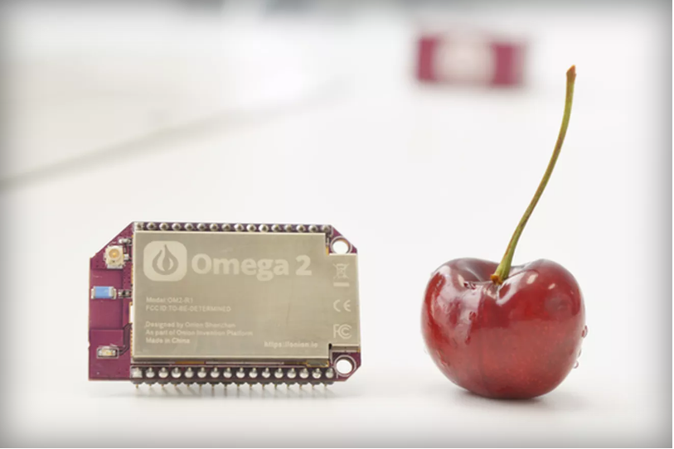
Tiny computer for 5 dollars
Notes:
For 5 bucks, you get a 580 MHz CPU, 64MB of memory, and 16MB of storage. built-in Wi-Fi. Onion has a cloud-based feature called Onion Cloud that allows you to control the Omega2 via the web browser

Slide 6
Part 1
Symbolic AI
based on Predicate logic
Physical Symbol Hypothesis

Slide 7
Physical Symbol Hypothesis
"A physical symbol system has the necessary and sufficient means for general intelligent action."
— Allen Newell and Herbert A. Simon
General Problem Solver

Slide 8
Example of logic system
Cyc
started in 1984 by Dough Lenat (ID3)
encyclopedia + everyday knowledge
(such as people will die)
in June 2012 the knowledge base contains 239,000 concepts and 2,039,000 facts
can be browsed on OpenCyc website

Slide 9
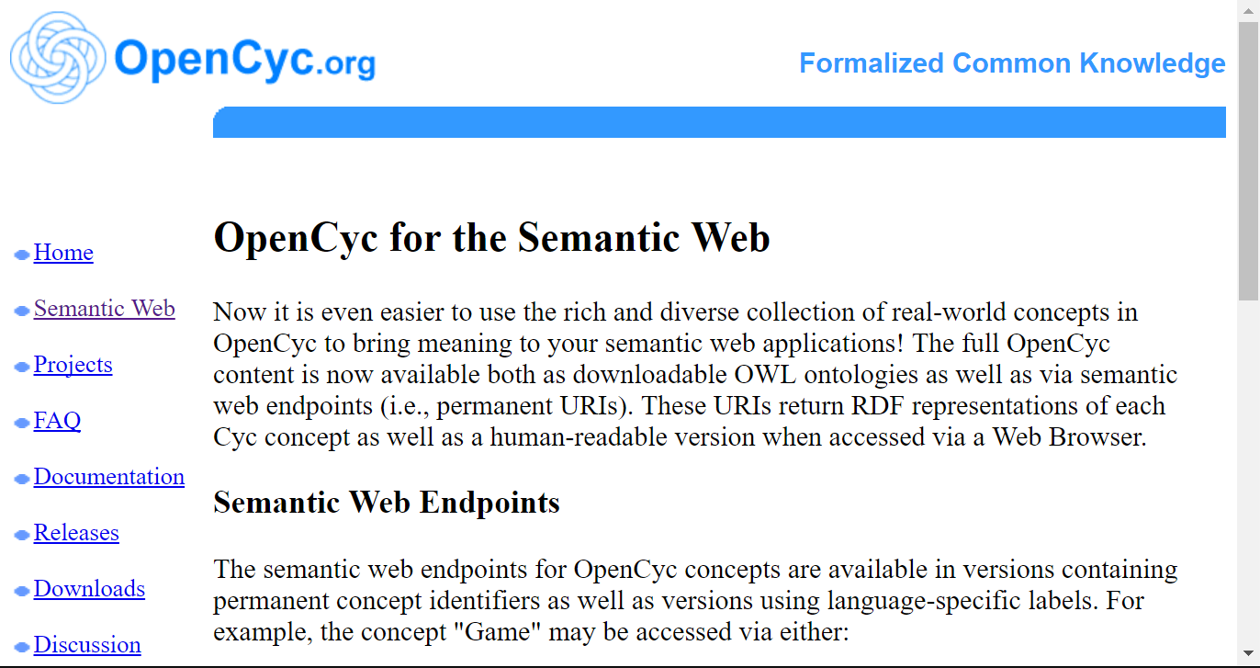
OpenCyc

Slide 10
Part 2
Connectionist

Slide 11
Connectionist
Artificial Neural Networks
Deep learning

Slide 12
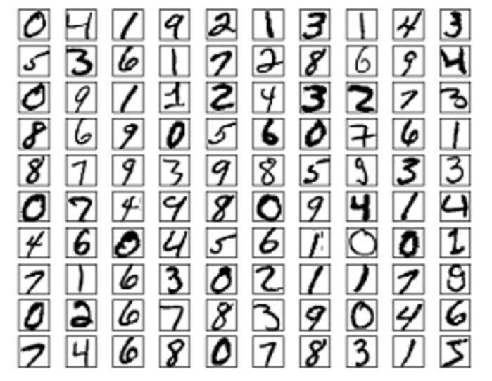

Slide 13
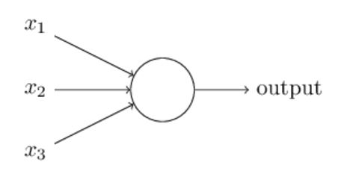
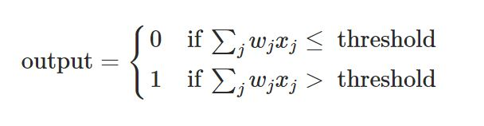
Perceptron
Rosenblatt, 1950

Slide 14
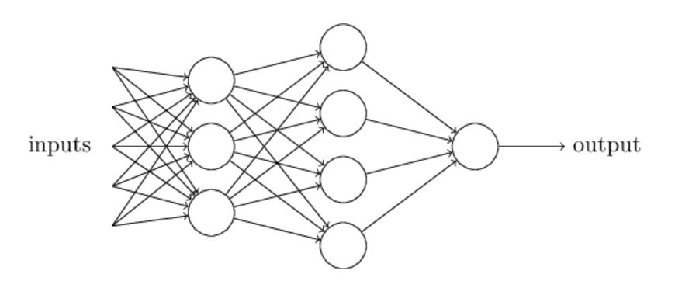
Multi-layer perceptron
Michael Nielsen, 2016

Slide 15
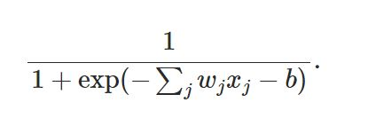
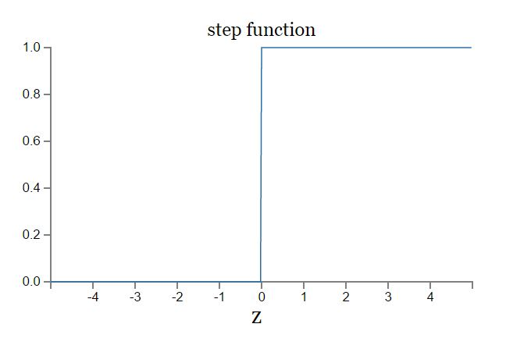
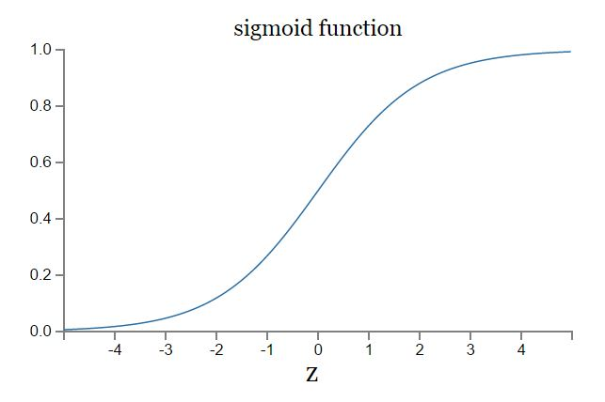
Sigmoid function

Slide 16
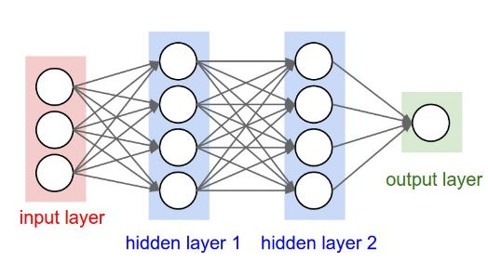
Artificial Neural Network 3-layer

Slide 17
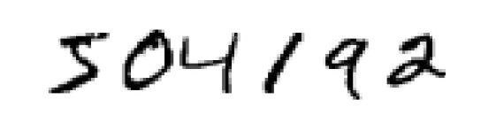
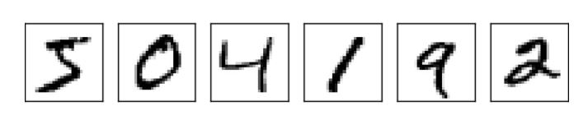

Slide 18
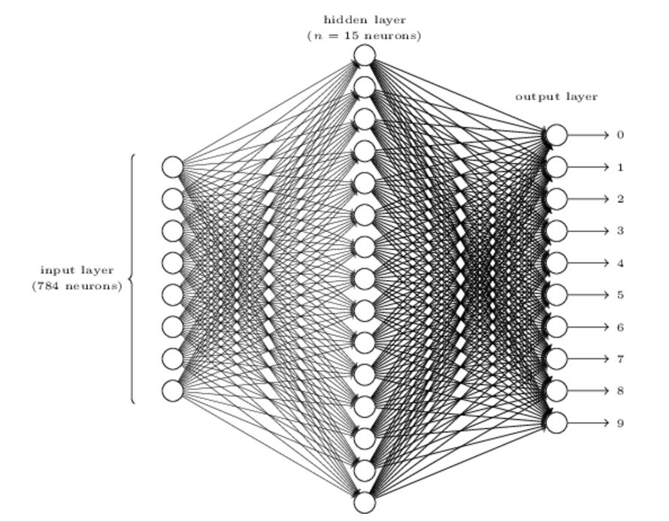
Digit recognition NN
24x24 = 784
0.0 white 1.0 black

Slide 19
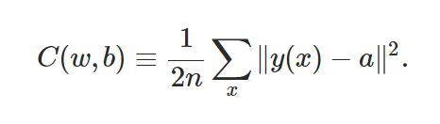
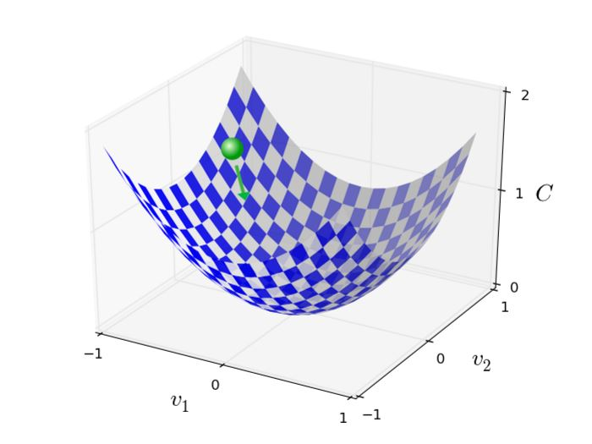
Training NN
Backpropagation is a fast way to compute this, 1986

Slide 20
Convolutional Neural Network
3 main types of layers
Convolutional layer
Pooling layer
Fully Connected layer

Slide 21
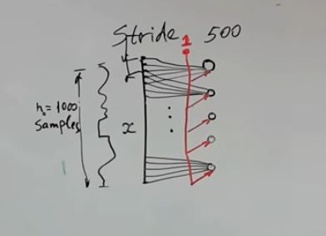
First layer
Drawing by Michael Zibulevsky

Slide 22
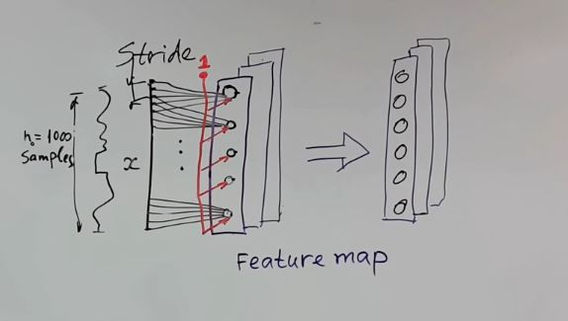
Feature map

Slide 23
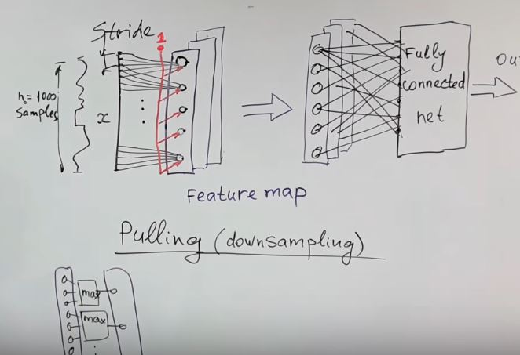
Pooling operation

Slide 24
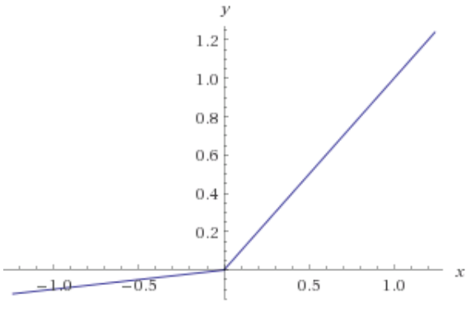
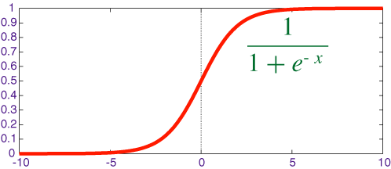
Activation function

Slide 25
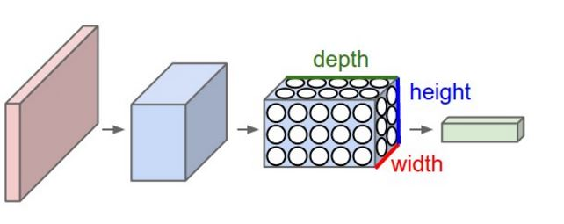
Convolutional Neural Network

Slide 26
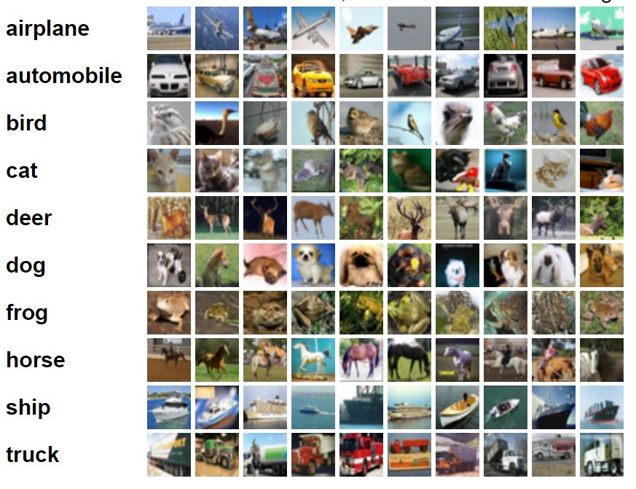
CIFA-10 image dataset

Slide 27
CIFA-10 dataset
CIFAR-10 dataset consists of 60000 32x32 colour images in 10 classes, with 6000 images per class. There are 50000 training images and 10000 test images.

Slide 28
Example (CIFA-10 images)
input 32x32x3 32x32 pixel with 3 color R G B
conv 32x32x12 12 filter
relu max(0,x) same size 32x32x12
pool down sampling 16x16x12
fc compute class score (10 classes for CIFA-10)

Slide 29
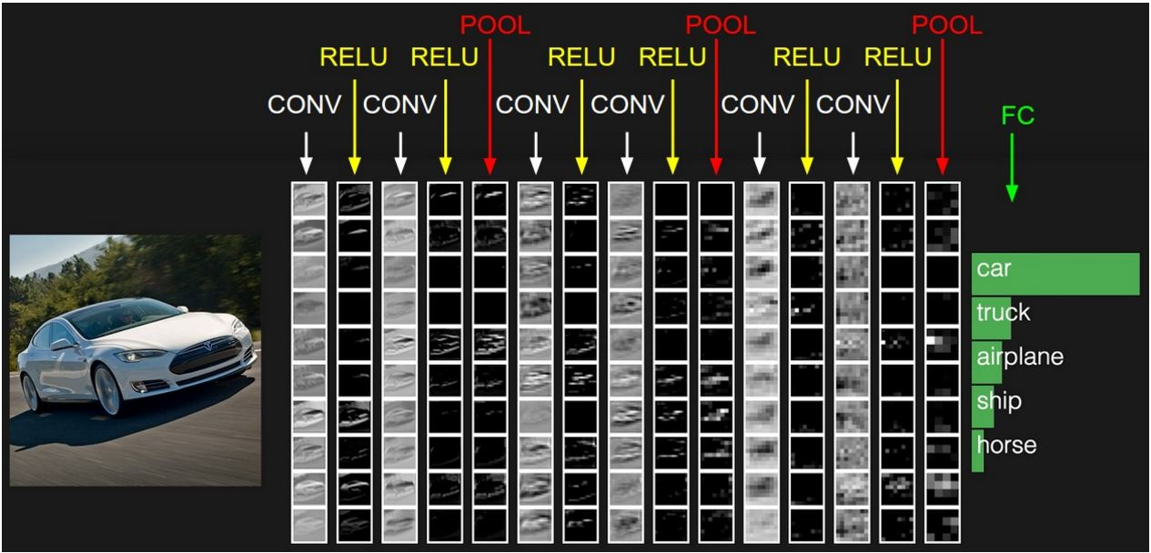
Example of CNN layer

Slide 30
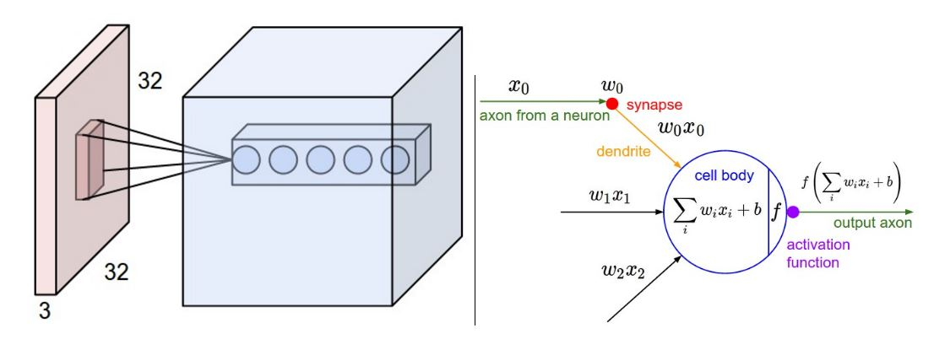
Convolutional layer

Slide 31
Parameters
ImageNet challenge in 2012
images 227x227x3
convolutional layer
receptive field F = 11, S = 4, with 96 filters
55x55x96 = 290,400 neurons
each neuron connects to 11x11x3 = 363+1 bias weights
total 290400*364 = 105,705,600 parameters

Slide 32
Parameter sharing
Volume 55x55x96 has
96 depth slices of size 55x55 each
Each slice uses the same weights
Now
Total 96x11x11x3 = 34,848 + 96 bias

Slide 33
each depth slice be computed as a convolution of the neuron’s weights with the input volume

Slide 34
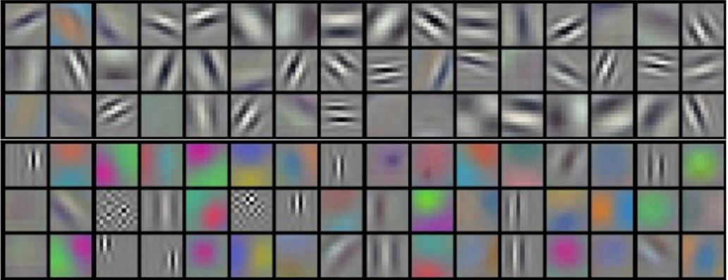
96 filters of 11x11x3 each
Krizhevsky et al. 2012

Slide 35
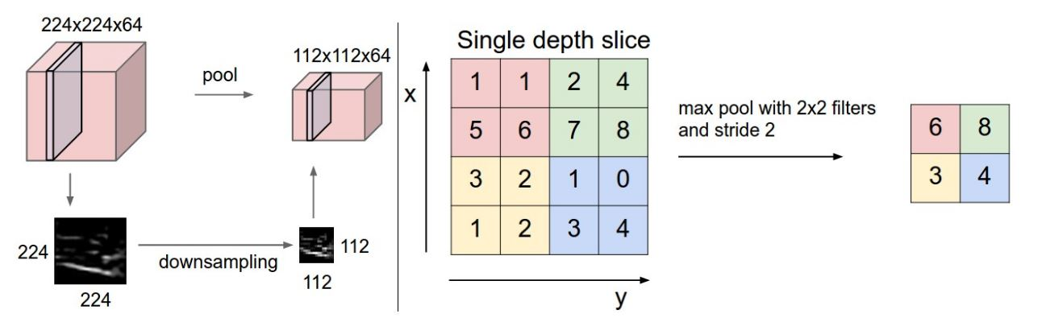
Pooling or downsampling

Slide 36
Sample of work done by Connectionist

Slide 37
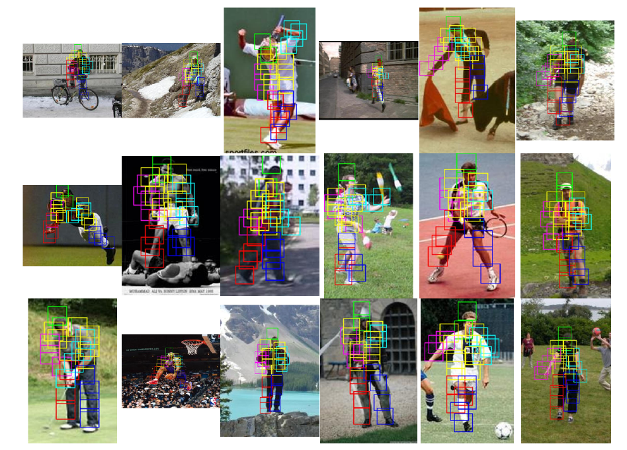
Object Recognition

Slide 38
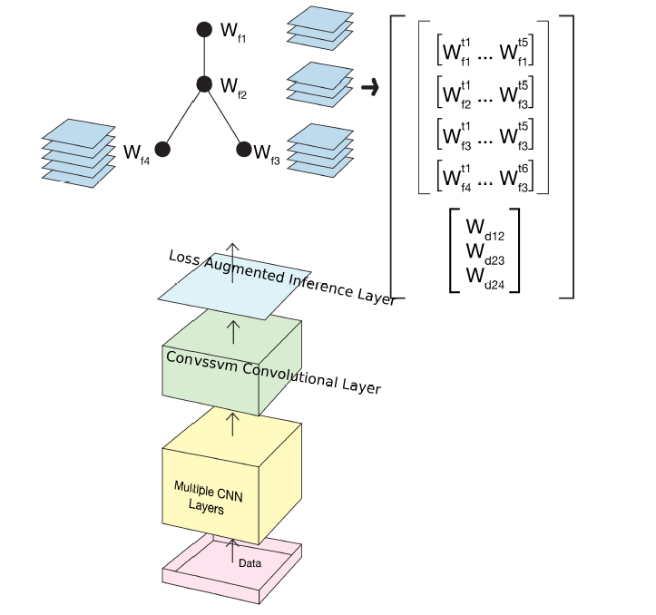

Slide 39
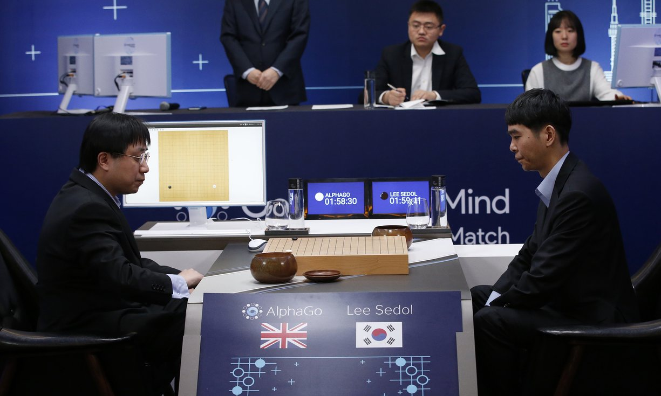
AlphaGo vs Lee Seidol, March 2016

Slide 40
Alpha Go
"Mastering the game of Go with deep neural networks and tree search". Nature. 529 (7587): 484–489.
Deep learning
Monte Carlo Tree search

Slide 41
Part 3
Evolutionist

Slide 42
Probabilistic search
Evolutionary computation

Slide 43
What is Evolutionary Computation
EC is a probabilistic search procedure to obtain solutions starting from a set of candidate solutions, using improving operators to “evolve” solutions.
Improving operators are inspired by natural evolution.

Slide 44
Simple Genetic Algorithm
represent a solution by a binary string {0,1}*
selection:
  chance to be selected is proportional to its fitness
recombination
  single point crossover

Slide 45
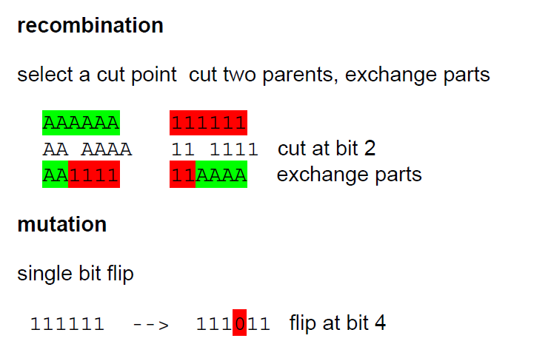
Genetic operator

Slide 46
Other EC
Evolution Strategy -- represents solutions with real numbers
Genetic Programming -- represents solutions with tree-data-structures
Differential Evolution – vectors space

Slide 47
Estimation of Distribution Algorithms
GA + Machine learning
current population -> selection ->
model-building -> next generation
replace crossover + mutation with learning and sampling
probabilistic model

Slide 48
x = 11100 f(x) = 28
x = 11011 f(x) = 27
x = 10111 f(x) = 23
x = 10100 f(x) = 20
---------------------------
x = 01011 f(x) = 11
x = 01010 f(x) = 10
x = 00111 f(x) = 7
x = 00000 f(x) = 0
Induction
1 * * * *
(Building Block)

Slide 49
x = 11111 f(x) = 31
x = 11110 f(x) = 30
x = 11101 f(x) = 29
x = 10110 f(x) = 22
---------------------------
x = 10101 f(x) = 21
x = 10100 f(x) = 20
x = 10010 f(x) = 18
x = 01101 f(x) = 13
Reproduction
1 * * * *
(Building Block)

Slide 50
Coincidence Algorithm COIN
A modern Genetic Algorithm or Estimation of Distribution Algorithm
Design to solve Combinatorial optimization

Slide 51
Model in COIN
A joint probability matrix, H.
Markov Chain.
An entry in H_{xy} is a probability of transition from a state x to a state y.
xy a coincidence of the event x and event y.

Slide 52
Coincidence Algorithm steps
Initialize Matrix
 | X₁ | X₂ | X₃ | X₄ | X₅
X₁ | 0 | 0.25 | 0.25 | 0.25 | 0.25
X₂ | 0.25 | 0 | 0.25 | 0.25 | 0.25
X₃ | 0.25 | 0.25 | 0 | 0.25 | 0.25
X₄ | 0.25 | 0.25 | 0.25 | 0 | 0.25
X₅ | 0.25 | 0.25 | 0.25 | 0.25 | 0
Generate the Population
Evaluate the Population
Joint Probability Matrix
Selection
Update Matrix
Notes:
Our algorithm use the Markov chain matrix of order 1 in order to construct a generator
This generator represent the joint probability of all the possible search space.
For example the probabilities of the incidence in which x1 can be followed by x2 x3 x4 and x5
Since x1 can not be followed by it self due to the encoding represent the permutation of numbers

Slide 53
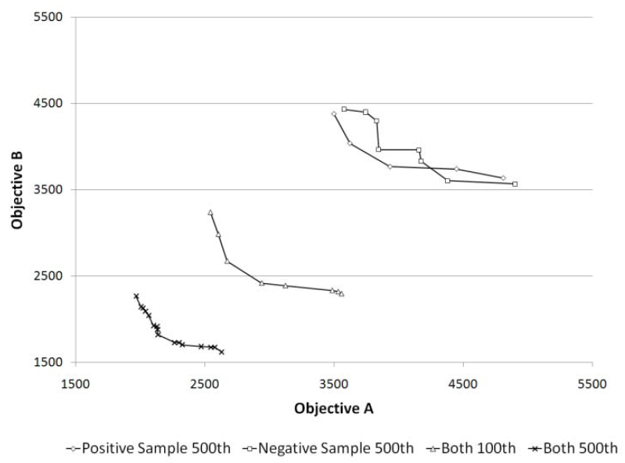
Role of Negative Correlation

Slide 54
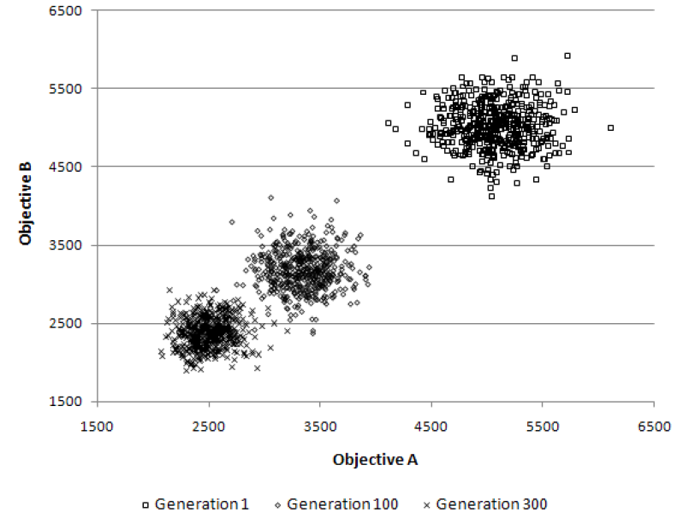
Multi-objective TSP
The population clouds in a random 100-city 2-obj TSP

Slide 55
n-queens (b) n-rooks (c) n-bishops
(d) n-knights
Available moves and sample solutions
to combination problems on a 4x4 board

Slide 57
Evolutionist summary
GA has been used successfully in many real world applications
GA theory is well developed
Research community continue to develop more powerful GA
EDA is a recent development

Slide 58
Examples
robot walking
create a sequential circuit
Invent formula for lead-free solder alloy

Slide 60
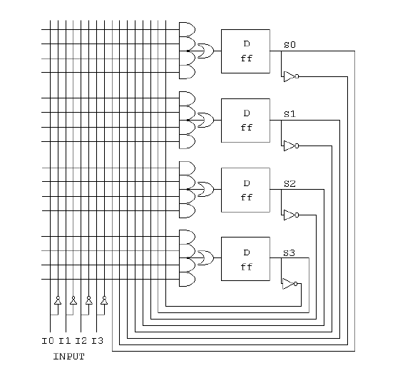

Slide 61



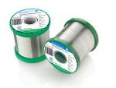

Lead-free Solder Alloys
Lead-based Solder
Low cost and abundant supply
Forms a reliable metallurgical joint
Good manufacturability
Excellent history of reliable use
Toxicity
Lead-free Solder
No toxicity
Meet Government legislations
(WEEE & RoHS)
Marketing Advantage (green product)
Increased Cost of Non-compliant parts
Variation of properties (Bad or Good)

Slide 62
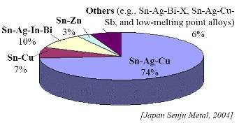
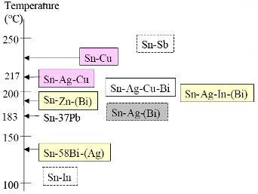
Sn-Ag-Cu (SAC) Solder
Advantage
Sufficient Supply
Good Wetting Characteristics
Good Fatigue Resistance
Good overall joint strength
Limitation
Moderate High Melting Temp
Long Term Reliability Data

Slide 63
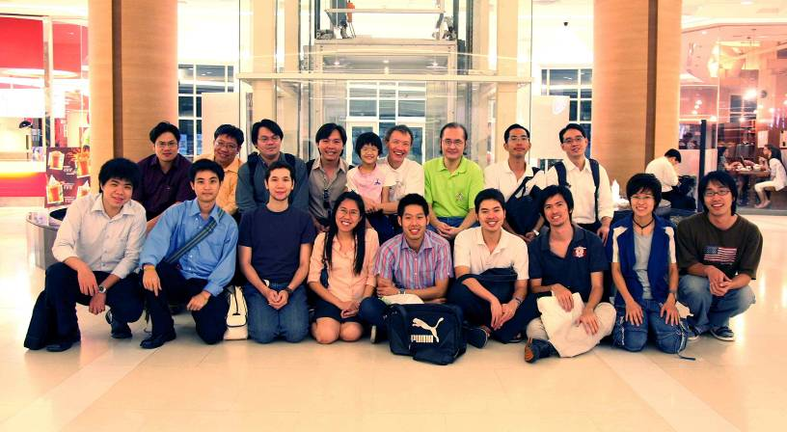
Team work

Slide 64
More Information
Search “Prabhas Chongstitvatana”
Get to me homepage

