Slide 1
Artificial Intelligence:
Past, Present, Future
Prabhas Chongstitvatana
Chulalongkorn University
prabhas.c@chula.ac.th

Slide 2
Why AI is popular today?

Slide 3
Performance in "human task"
Tagging Faces
Search Music
Personal assistance
Play Go

Slide 4
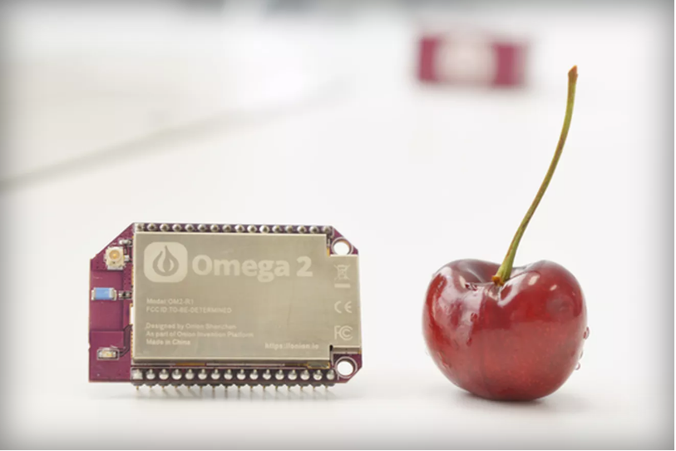
Tiny computer for 5 dollars
Notes:
For 5 bucks, you get a 580 MHz CPU, 64MB of memory, and 16MB of storage. built-in Wi-Fi. Onion has a cloud-based feature called Onion Cloud that allows you to control the Omega2 via the web browser

Slide 5
Past
Symbolic AI
based on Predicate logic
Physical Symbol Hypothesis
Connectionist

Slide 6
Physical Symbol Hypothesis
"A physical symbol system has the necessary and sufficient means for general intelligent action."
— Allen Newell and Herbert A. Simon
General Problem Solver

Slide 7
Example of logic system
Cyc
started in 1984 by Dough Lenat (ID3)
encyclopedia + everyday knowledge
(such as people will die)
in June 2012 the knowledge base contains 239,000 concepts and 2,039,000 facts
can be browsed on OpenCyc website

Slide 8
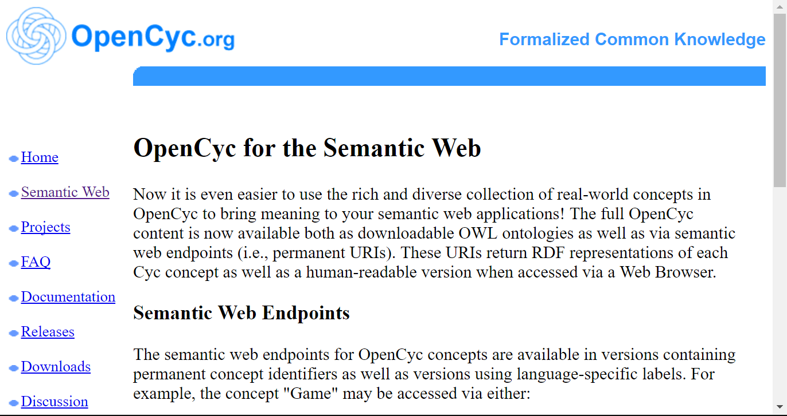
OpenCyc

Slide 9
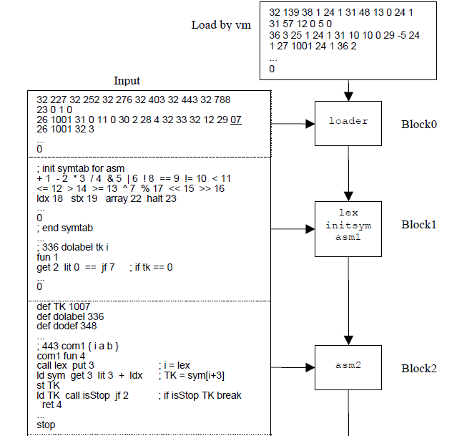
Self Generating Compiler

Slide 10
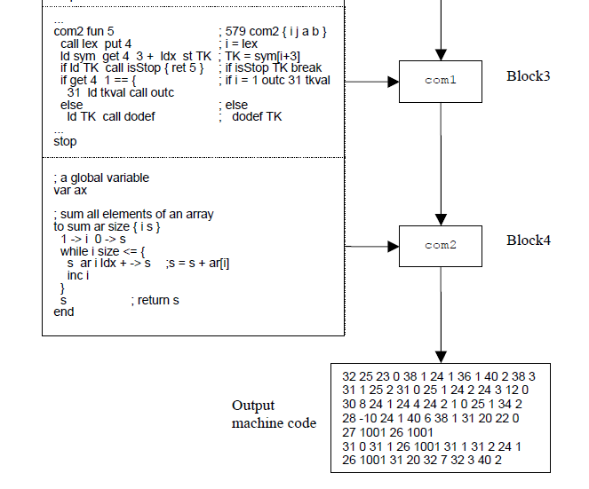
Self Generating Compiler

Slide 11
Connectionist
Artificial Neural Networks
Deep learning

Slide 12
Machine learning
Machines with common sense

Slide 13
Generate Music with GA
GenJam

Slide 14
Present
machine learning in computer vision
Alpha Go

Slide 15
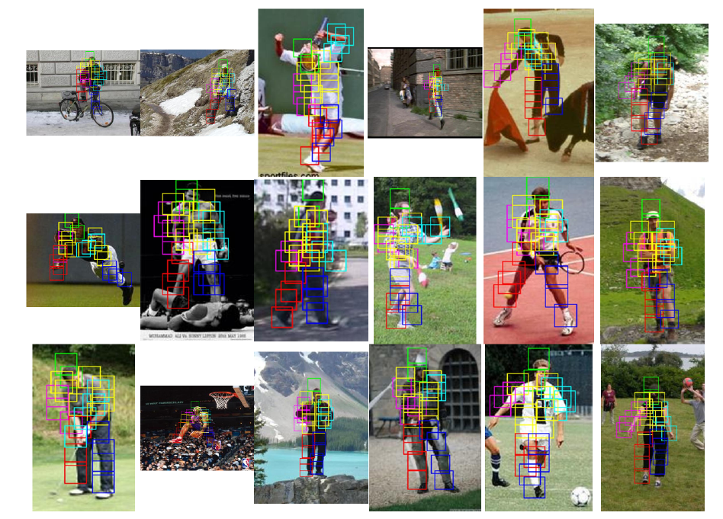
Object Recognition

Slide 16
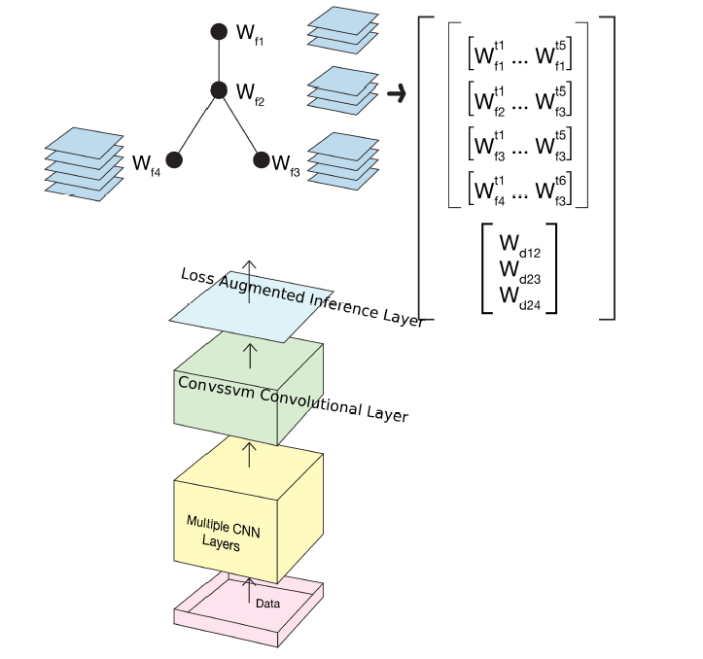

Slide 17
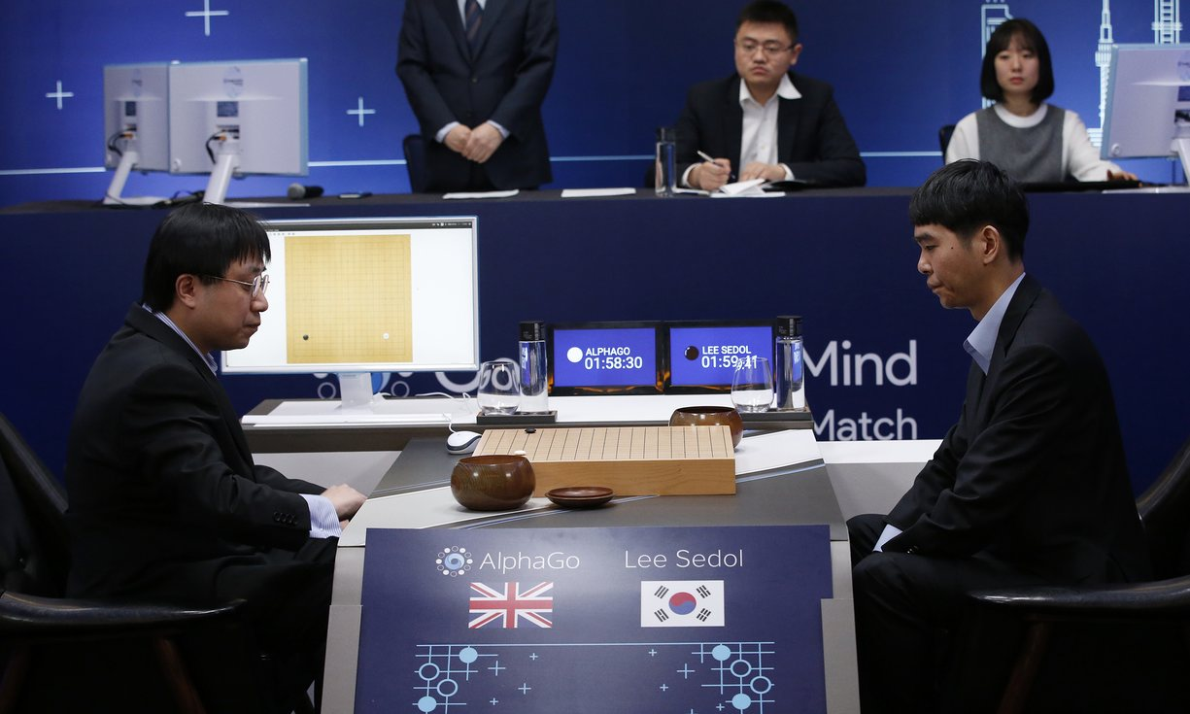
AlphaGo vs Lee Seidol, March 2016

Slide 18
Alpha Go
"Mastering the game of Go with deep neural networks and tree search". Nature. 529 (7587): 484–489.
Deep learning
Monte Carlo Tree search

Slide 19
Quantum computing
Google/Nasa Quantum computer

Slide 20
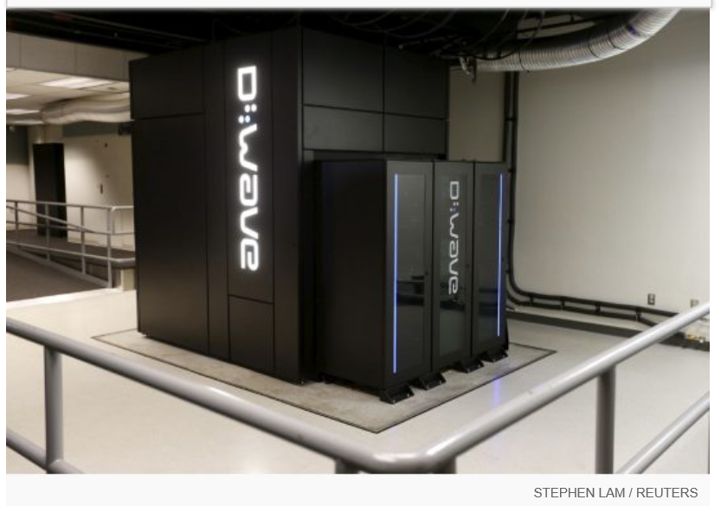
Google Nasa, D-Wave 2x machine

Slide 21
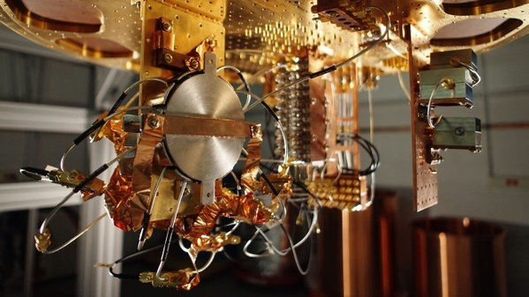
Quantum bit in D-wave machine

Slide 22
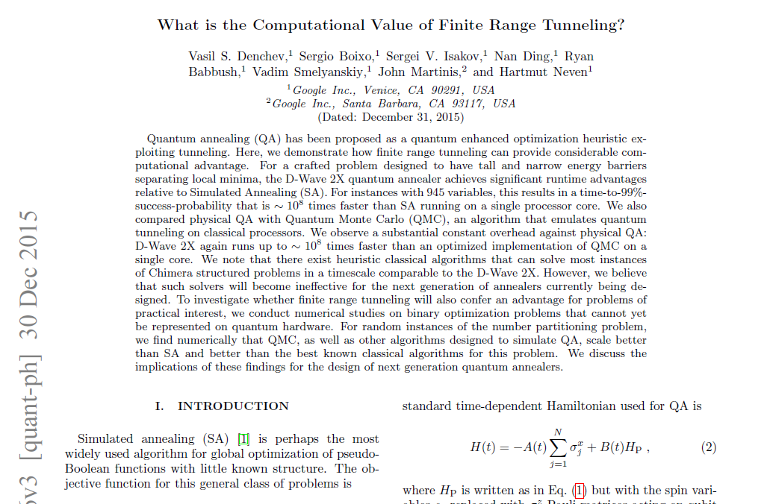

Slide 23
claim of 100,000,000x speed up

Slide 24
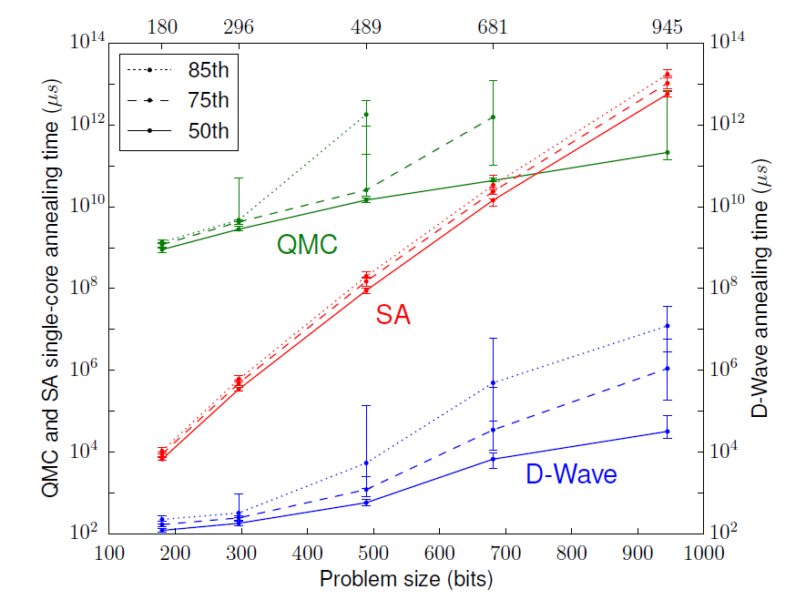

Slide 25
Future
AI lacks of "creativity"

Slide 26
AI and Music
GenJam
AI and art
Cohen

Slide 27
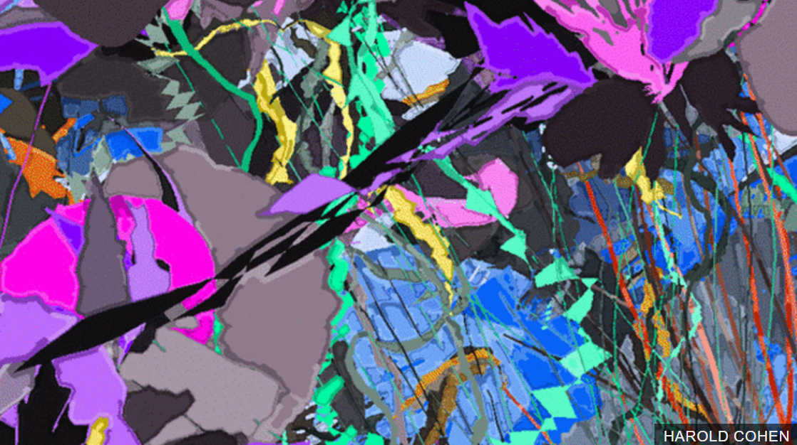

Slide 28
Probabilistic search
Evolutionary algorithms

Slide 29
Simple Genetic Algorithm
represent a solution by a binary string {0,1}*
selection:
  chance to be selected is proportional to its fitness
recombination
  single point crossover

Slide 30
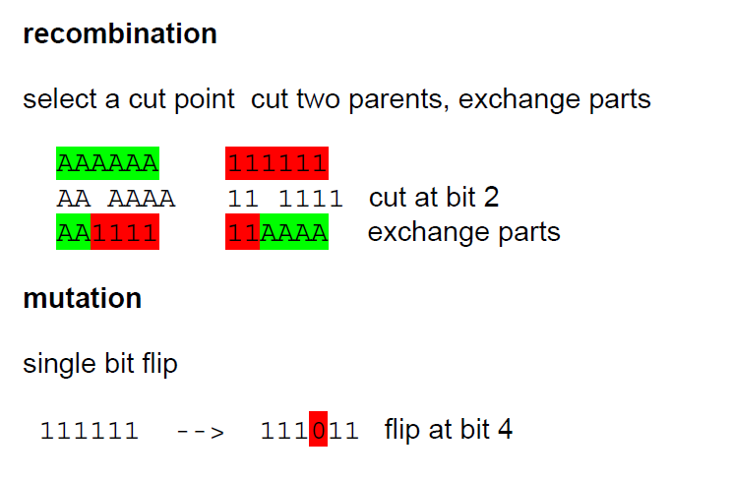

Slide 31
Examples
robot walking
create a sequential circuit

Slide 33
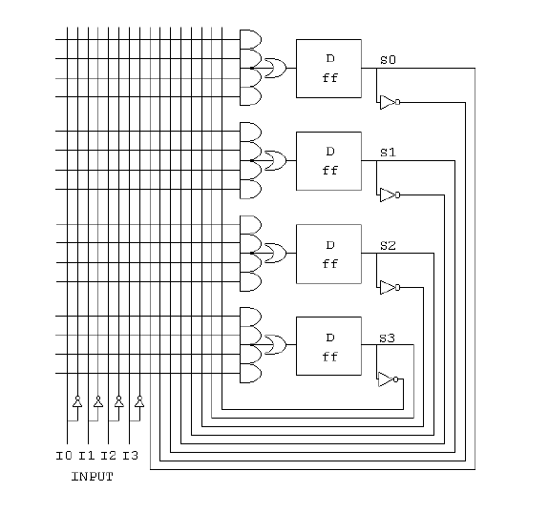

Slide 34
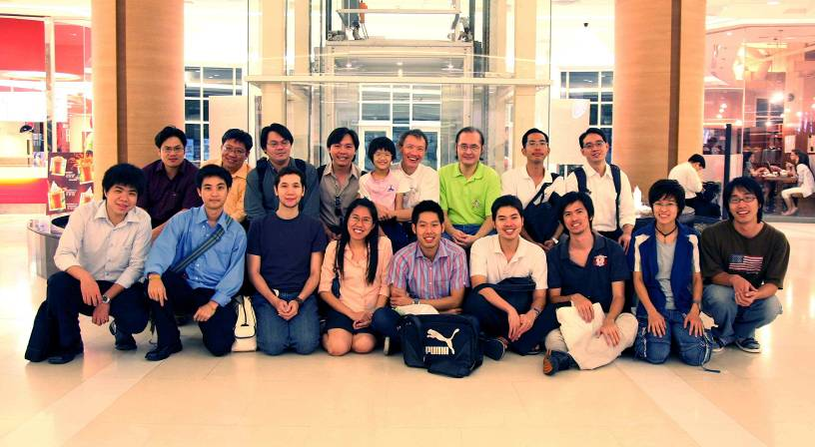
Team work

Slide 35

More Information
Search “Prabhas Chongstitvatana”
Get to me homepage

