Slide 1
Part 2
Evolutionist approach

Slide 2
Probabilistic search
Evolutionary computation

Slide 3
What is Evolutionary Computation
EC is a probabilistic search procedure to obtain solutions starting from a set of candidate solutions, using improving operators to “evolve” solutions.
Improving operators are inspired by natural evolution.

Slide 4
Evolutionary Computation
Survival of the fittest.
The objective function depends on the problem.
EC is not a random search.

Slide 5
Simple Genetic Algorithm
represent a solution by a binary string {0,1}*
selection:
chance to be selected is proportional to its fitness
recombination
single point crossover

Slide 6
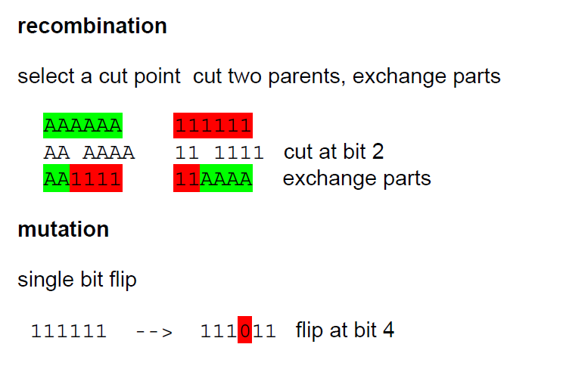
Genetic operator

Slide 7
Other EC
Evolution Strategy -- represents solutions with real numbers
Genetic Programming -- represents solutions with tree-data-structures
Differential Evolution – vectors space

Slide 8
Estimation of Distribution Algorithms
GA + Machine learning
current population -> selection ->
model-building -> next generation
replace crossover + mutation with learning and sampling
probabilistic model

Slide 9
x = 11100 f(x) = 28 x = 11011 f(x) = 27 x = 10111 f(x) = 23 x = 10100 f(x) = 20 --------------------------- x = 01011 f(x) = 11 x = 01010 f(x) = 10 x = 00111 f(x) = 7 x = 00000 f(x) = 0
Induction
1 * * * *
(Building Block)

Slide 10
x = 11111 f(x) = 31 x = 11110 f(x) = 30 x = 11101 f(x) = 29 x = 10110 f(x) = 22 --------------------------- x = 10101 f(x) = 21 x = 10100 f(x) = 20 x = 10010 f(x) = 18 x = 01101 f(x) = 13
Reproduction
1 * * * *
(Building Block)

Slide 11
Coincidence Algorithm COIN
A modern Genetic Algorithm or Estimation of Distribution Algorithm
Design to solve Combinatorial optimization

Slide 12
Model in COIN
A joint probability matrix, H.
Markov Chain.
An entry in H_{xy} is a probability of transition from a state x to a state y.
xy a coincidence of the event x and event y.

Slide 13
Coincidence Algorithm steps
Initialize Matrix
 | X₁ | X₂ | X₃ | X₄ | X₅
X₁ | 0 | 0.25 | 0.25 | 0.25 | 0.25
X₂ | 0.25 | 0 | 0.25 | 0.25 | 0.25
X₃ | 0.25 | 0.25 | 0 | 0.25 | 0.25
X₄ | 0.25 | 0.25 | 0.25 | 0 | 0.25
X₅ | 0.25 | 0.25 | 0.25 | 0.25 | 0
Generate the Population
Evaluate the Population
Joint Probability Matrix
Selection
Update Matrix
Notes:
Our algorithm use the Markov chain matrix of order 1 in order to construct a generator
This generator represent the joint probability of all the possible search space.
For example the probabilities of the incidence in which x1 can be followed by x2 x3 x4 and x5
Since x1 can not be followed by it self due to the encoding represent the permutation of numbers

Slide 14
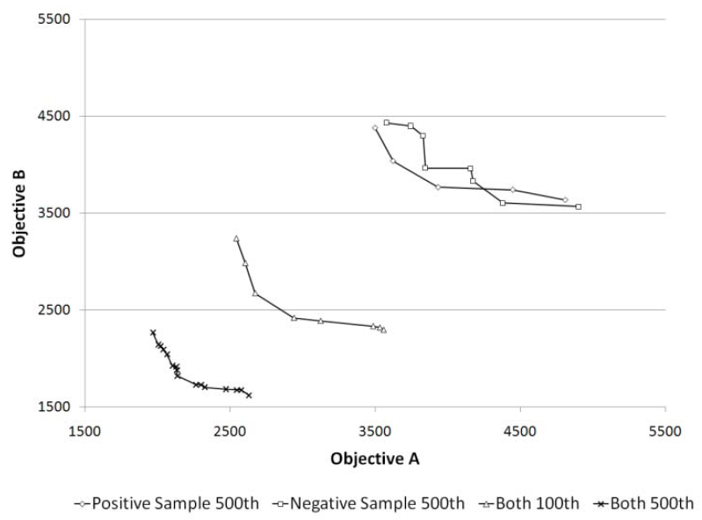
Role of Negative Correlation

Slide 15
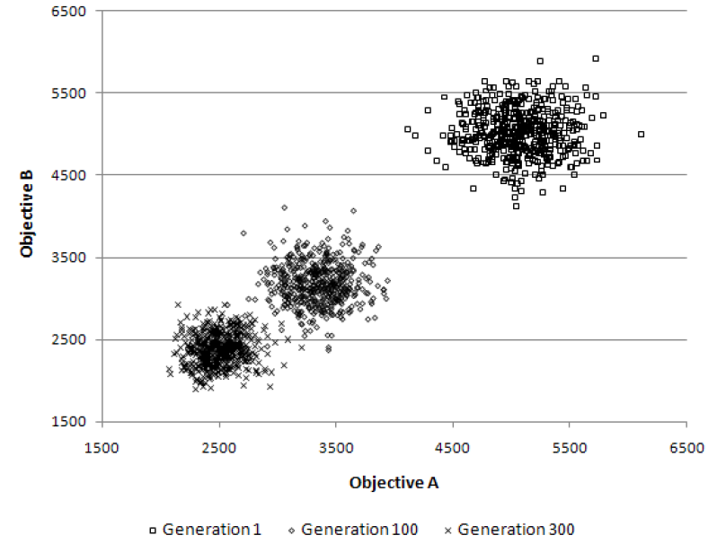
Multi-objective TSP
The population clouds in a random 100-city 2-obj TSP

Slide 16
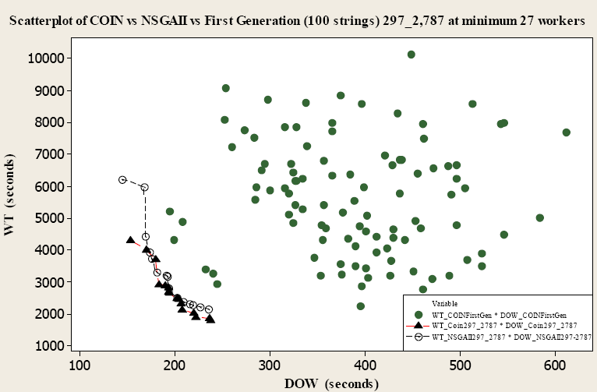
Comparison for Scholl and Klein’s 297 tasks at the cycle time of 2,787 time units

Slide 17
n-queens (b) n-rooks (c) n-bishops
(d) n-knights
Available moves and sample solutions to combination problems on a 4x4 board

Slide 19
Evolutionist summary
GA has been used successfully in many real world applications
GA theory is well developed
Research community continue to develop more powerful GA
EDA is a recent development

Slide 20
Examples
robot walking
create a sequential circuit
Invent formula for lead-free solder alloy

Slide 22
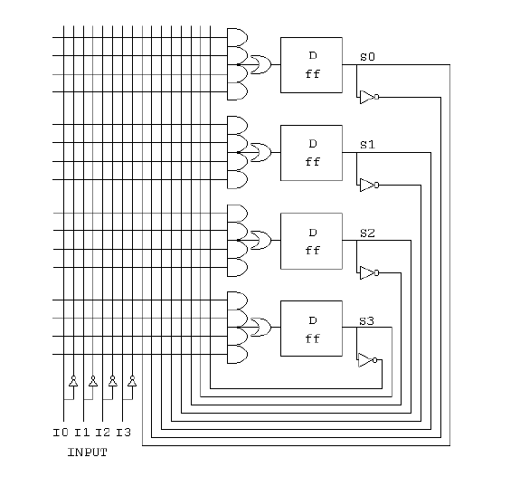

Slide 23





Lead-free Solder Alloys
Lead-based Solder
Low cost and abundant supply
Forms a reliable metallurgical joint
Good manufacturability
Excellent history of reliable use
Toxicity
Lead-free Solder
No toxicity
Meet Government legislations (WEEE & RoHS)
Marketing Advantage (green product)
Increased Cost of Non-compliant parts
Variation of properties (Bad or Good)

Slide 24
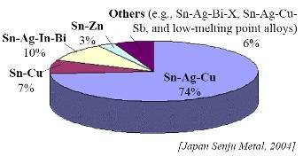
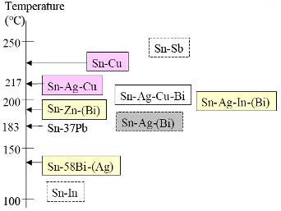
Sn-Ag-Cu (SAC) Solder
Advantage
Sufficient Supply
Good Wetting Characteristics
Good Fatigue Resistance
Good overall joint strength
Limitation
Moderate High Melting Temp
Long Term Reliability Data

Slide 25

Team work

Slide 26

More Information
Search “Prabhas Chongstitvatana”
Get to me homepage

